Slide 1
Trigger system WG status report
ICARUS Collaboration Meeting 12/09/2019
Notes:
1

Slide 2
Trigger WG
The Trigger system deployment involves different technical aspects of the programming of electronic boards as well as dedicated studies/analysis of MC events finalized to extract $ν$ signals from cosmogenic background.
People from PMT, TPC, DAQ and Software WGs are involved.
In the following a overview on the ongoing activities is presented starting from the previous two presentations at last 15th June Technical WG meeting (D. Gibin, D. Torretta).
Analysis refers to Booster events: similar studies on-going for NUMI-OA.
A note on technical status report on the ICARUS-T600 trigger system will be released soon.
Trigger WG people:
M. Diwan, BNL
M. Babicz, CERN
R. Wilson, CSU
M. Betancourt, A. Fava, W. Ketchum, D. Torretta, FermiLab
A. Falcone, Milano Bicocca
S. Centro, D. Gibin, A. Guglielmi, G. Meng, F. Pietropaolo*, S. Ventura, Padova
A. Menegolli, G.L. Raselli, A. Rappoldi, M. Rossella, Pavia
A. Cocco, Napoli
G. Petrillo, Y.-T. Tsai, SLAC
A. Chatterjee, UTA
* Now at CERN

Slide 3
Trigger system overview
ICARUS Trigger will be initially based on the recognition of PMT signals within the gate of BNB/NuMI beam extraction, with T600 vs beam-clock synchro guaranteed at ~50 ps level by White Rabbit system. CRT signals and bunched beam structure will be added at a later stage to improve cosmics rejection.
~0.27 Hz rate of in-spill physical events dominated by cosmics:
BNB - 5 10¹² pot/spill in ~1.6 μs, 5 Hz rate: ~1 ν/180 spill (0.03 Hz)
NuMI - 6 10¹³ pot/spill in ~9.5 μs, 0.75 Hz rate: ~1 ν/53 spill (0.01 Hz).
The trigger system would select genuine ν interactions while rejecting backgr. & noise. A staged level trigger system has been adopted aiming at progressively reducing the data amount from front-end buffers to offline storage.
The choice of a trigger architecture based on programmable FPGA logics gives the flexibility to adopt a staged logic, initially set according to MC events, then tuned on real events to match the actual experimental conditions.
Furthermore this would allow to test directly different trigger configurations to gradually reduce the recorded event rate from 5 Hz of BNB spills to < 1 Hz.

Slide 4
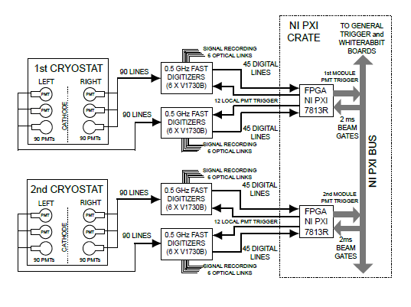
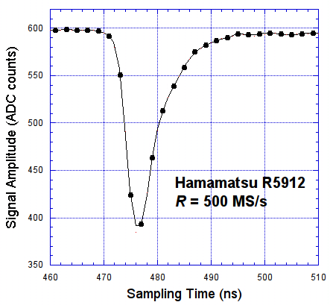
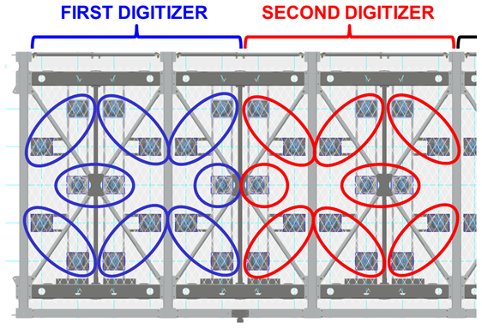
ICARUS Trigger system
In the present trigger layout a set of discriminated output LVDS (Low Voltage Differential Signaling) signals in terms of OR/AND of pairs of adjacent PMTs is available in each TPC for majority trigger logics;
LVDS signal processed by Ni-PXIe 7820R FPGA programmable logics which allow implementing step by step complex trigger logics tuned to real events to match actual experimental conditions.
THRESHOLD
Basic PMT Trigger signal processing scheme
L
V
D
S
PMT 1
PMT 2
PMT …
MAJORITY
SPILL GATE
1.6 μs for BNB
PMT TRIGGER

Slide 5
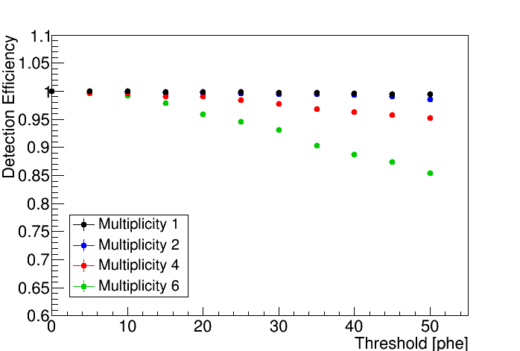
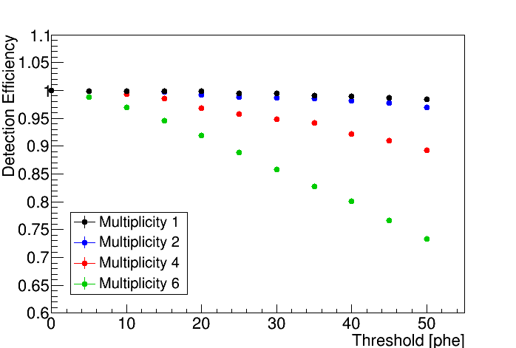
ICARUS Trigger system: triggering efficiency
According to MC studies different combination of PMT discrimination threshold and multiplicity of fired PMTs would allow to select physical events in spill with an almost full efficiency for both νeCC and νμCC events
νeCC
νμCC
~99 % and 97% triggering efficiency for νeCC &νμCC events is expected with negligible PMT noise by requiring the majority of 12 PMTs (6 couples of adjacent PMTs) in a TPC wall with a signal >10 phe discrimination threshold

Slide 6
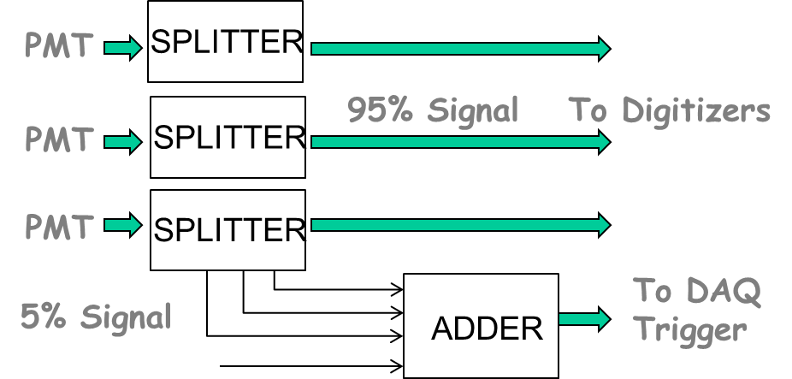
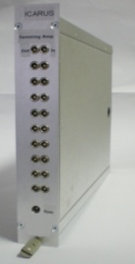
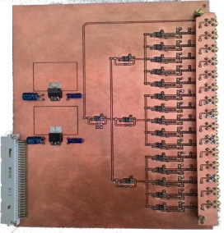
ICARUS Trigger system: 15 PMT analog sum signals
Neutrino events are expected to occupy only a small fraction of detector volume because the low energy of BNB/NuMI beams:
On average 90% of fired PMTs, >10 phe is contained within ~2 m from PMT barycenter;
Furthermore the analogue sum signal of 15 adjacent PMTs in ~3 m detector slice will be used to identify in spill events.
P.MTs
2018
Final VME 15 inputs prototype; 6 boards under production to equip a TPC chamber (90 PMTs);
24 board in total are required.
2019
NIM prototype with 10 inputs realized /tested at CERN with the 10 PMTs LAr facility.
According to ICARUS at LNGS this would increase the Trigger capability rejecting at same time detector noise, possibly identifying the interested detector region.
A combined multiplicity/analog sum signal is under study with MC events: the resulting Trigger logic will be successively implemented in FPGA programmable logic tables in the Trigger layout and tested with first data.

Slide 7
ICARUS trigger system layout
Based on NI PXIe instrumentation: PXIe-8135 RT(Real Time) controller, SPEXI board by INCAA Computers and 3 NI boards (PXIe-7820R) for the PMT Trigger and the General Trigger:
RT controller: implements all features for communication with DAQ, monitoring of available buffer/veto generation;
SPEXI : VHDL programmed - synchronizes timing of whole detector, generates TT-Link signal for TPC readout Clock & Reset to PMT readout, handles beam extraction messages;
2 PMT trigger 7820 boards: LabView programmed - generate a PMT Trigger & start pulse to digitizers for PMT activity recording in correspondence of interactions in LAr as detected by PMTs in each T300;
General Trigger 7820 board: combines PMT Trigger with SPEXI signal to generate a Global Trigger in coincidence with beam extraction from BNB/NuMI (early warning).
ICARUS Trigger NI crate configuration
PXIe-
8
1
3
5
RT
Controller
SPEXI
7
8
2
0
R
General
Trigger
7
8
2
0
R
PMT
Trigger
7
8
2
0
R
PMT
Trigger
All modules already tested in Padova, Pavia labs and CERN with the 10 PMT LAr facility: now installed at FNAL ICARUS site.

Slide 8
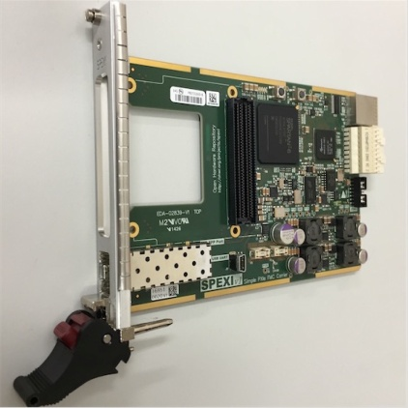
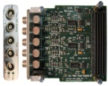
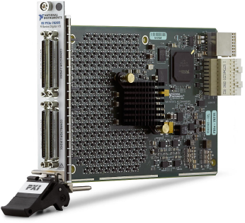
SPEXI board and NI PXIe-7820 Programming
Firmware for programming FPGA of SPEXI board has been already implemented:
VHDL codes for generating TT-Link and Clock;
VHDL codes for reception of beam Early Warning and generate Beam Gate signals to be combined with PMT trigger.
LabVIEW driver for SPEXI/FMC-DIO hardware to access to registers in SPEXI FPGA has been prepared.
Each 7820 board features 128 configurable I/O channels available for
PMT LVDS output signals, PMT local trigger and Laser/CRT triggers;
Backplane to communicate signals, i.e. beam gate and General Trigger, among the different trigger modules (SPEXI, CPU, other 7820s).
Programmable logics of I/O channels/backplane already configured to:
Define logics to produce output pulses for PMT coincidence/majority;
Monitoring the rates of PMT and resulting logics;
Handling of the backplane signals.
I/O channel mapping according to the PMT deployment geometry has been defined
Tests of electronics/programming logics performed with 10-PMT CERN facility.

Slide 9
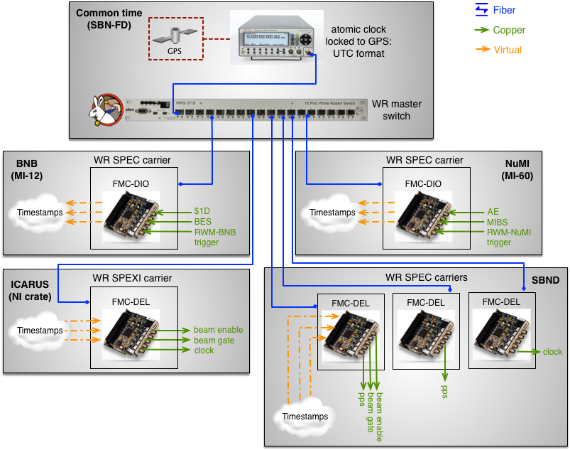
Timing and beam extraction for SBN
At Fermilab an “absolute” GPS timing in form of pps (pulse per second) signal will be provided to all SBN detectors and to the beams extraction locations;
Timestamps of several signals related to beam extraction are available:
‘’early warning” for BNB/NuMI, 35/730 ms in advance of proton on target;
Booster/Main Injector extraction, 0.3/1.75 ms in advance;
Booster off target extraction;
2GHz recording of Resistive Wall Monitor detectors for both beams (BNB RWM/NuMI RWM).
Beam signal distribution occurs by a fully deployed White Rabbit (WR): Ethernet based network for synchronization of distributed systems with sub-ns accuracy, 50 ps precision.

Slide 10
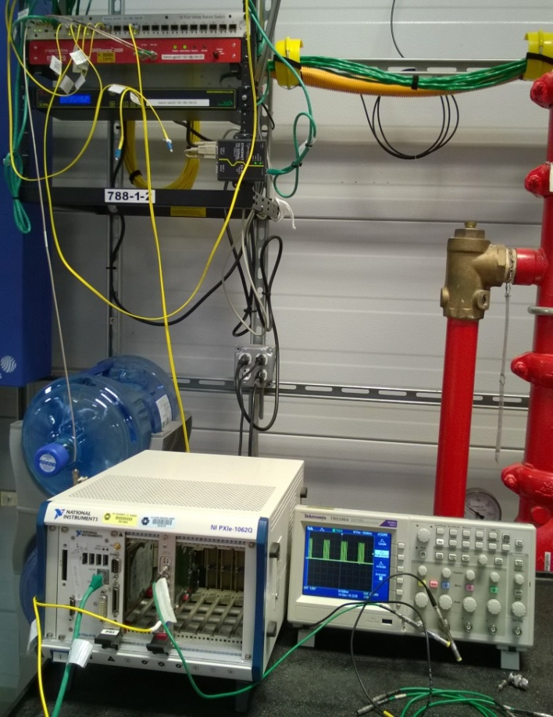
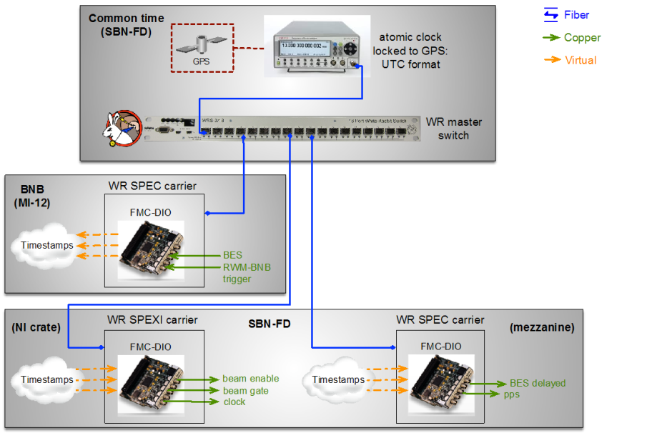
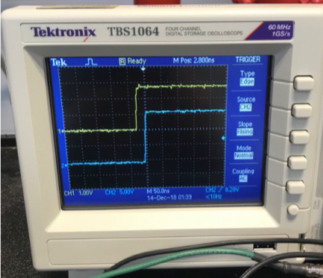
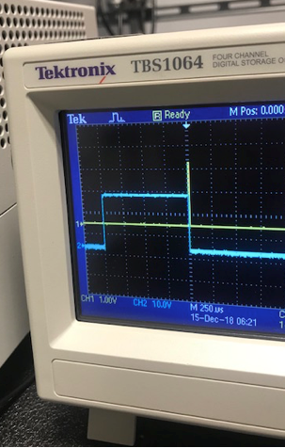
SPEXI Test at FNAL ICARUS site: installed setup & results
A NI-PXIe 1062Q crate installed at ICARUS site close to WR master switch:
A NI-PXIe 8130 RT controller;
A SPEXI board with DIO FMC.
BNB beam signals broadcasted on WR network via WR_NIC software on DIO;
A SPEC card with DIO FMC installed in a server on the ICARUS site as a slave node, used to cross check the SPEXI signals.
Extensive successful test in progress @FNAL
Phase locking of clocks generated by SPEXI with common time has been validated (Δ<1 ns);
Correctness of decoding of beam extraction signals has been assessed;
Appropriate gate opening further confirmed.

Slide 11
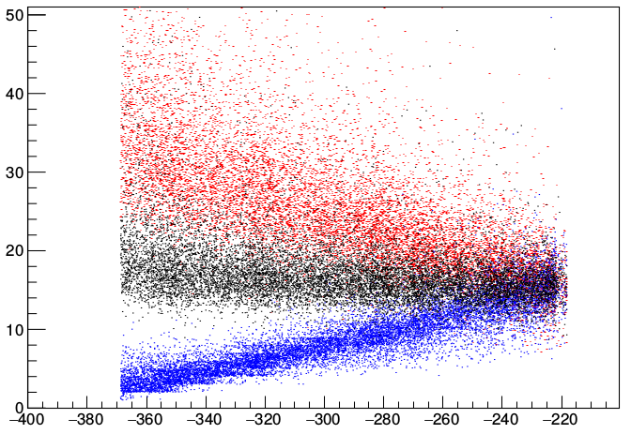
A 2nd level Trigger: Event Filtering by PMT timing - 1
In order to select genuine ν interactions the acquired events can be filtered out by reconstructing quasi-online the PMT signals, determining signal pulse height and timing at ns level: a precise PMT calibration will laser is mandatory !
The precise timing of neutrino interaction will depend on position of the vertex interaction along the transversal (drift) x and longitudinal z directions.
Light propagation from track to PMTs introduces a delay between t₀ time of ν interaction and the first hit PMT in Left, Right TPCs t_{L}, t_{R} which increases with track distance from PMTs:
distance to Right TPC decreases
Left
Right
t (ns)
MC νeCC
t_{L}
t_{R}
t_{R}
t₀
ν int
TPC wires
cathode
cathode
½(t_{L}+t_{R})
~ t₀+16 ns
PMT
x
PMT
ν interaction in Left TPC
t_{L}
→ (t_{L}+t_{R})/2 provides a 1st evaluation of t₀ ν interaction independent from ν vertex position with σ ~2.4 ns
distance to Left TPC decreases
ν interaction vertex x (cm)
Scint. light propagation delay
Slide# : 11

Slide 12
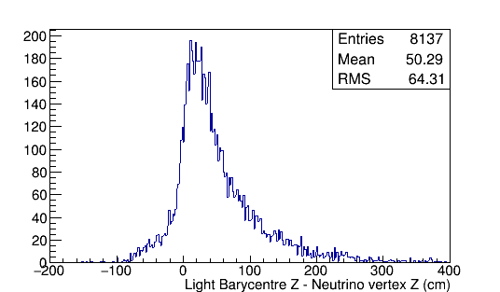
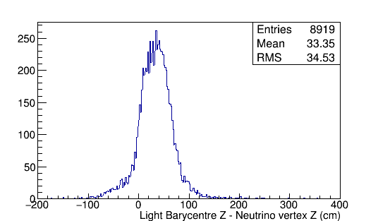
A 2nd level Trigger: Event Filtering by PMT timing - 2
As a first attempt the longitudinal position of ν interaction along the beam direction can be determined by the barycenter of hit PMT with a RMS resolution of ~30 , 60 cm for νeCC, νμCC corresponding to ~1, 2 ns time resolution:
ν‘s
ν int
z
MC ν CC events: difference between barycenter of hit PMTs and ν vertex along the beam direction z
νμCC
νeCC
50 cm bias
30 cm bias
→ Combining the transverse and the longitudinal contributions, the t₀ time of ν interaction could be roughly determined within σ₀ ~ 2.7- 3.1 ns resolution.
A starting point: more studies are required by software WG to improve it!
Slide# : 12

Slide 13
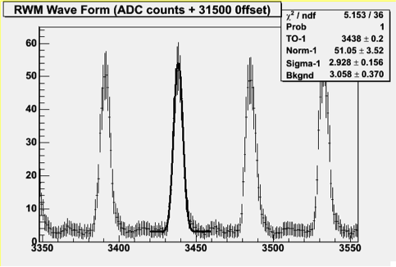
A 2nd Trigger level: Event Filtering by timing - 3
The 2ns FWHM vs 19 ns separation of bunched beam structure could be exploited for rejecting in spill cosmics:
Accounting for σ_{BEAM} ∼1 ns width of p-buckets and σ₀ ~2.7-3 ns resolution in t₀ time of ν interactions in ICARUS a global resolution σ ~ 3.1 ns for the in spill c-rays rejection is envisaged (i.e. a factor ~ 2 rejection for at 90% C.L., ~ 5 ns) .
19 ns
13 ns
In spill ν event timing by MiniBooNE:
to be carefully measured in ICARUS!
Combining the pattern of hit PMTs and the detailed (ns scale) time evolution of the light flash on PMTs would provide some discrimination between cosmic μs and ν, as indicated from first neural networks studies.
Reconstructing CRT signal would provide an additional handle to reject cosmics. The absence of a CRT hit would select νe events with only a few percent of auto-veto probability. In addition the time of CRT hits will provide additional handle to measure the particle direction and reject incoming cosmics.
→ more MC event studies are required asap to improve measurement of t₀ time of ν interaction /prepare algorithms for cosmic rejection!

Slide 14
Trigger system: next steps
Besides the on going MC event studies focused on the trigger logic and the t₀ event timing measurement, the main activities will be addressed to:
Complete development/tests of SPEXI board finalizing gate opening and TT-Link signal generation based on input of 7820 board (Sept. 2019);
Implement PMT trigger programming of LabVIEW interface for the 7820 module to the full 180 PMTs in each cryostat (by Sept. 2019);
Implement the communication between the trigger board and the DAQ in order to handle the trigger distribution to the TPC readout boards according to the occupancy level of their buffers (by Oct. 2019).
An initial trigger logic based on PMT majority in both the Left and Right TPCs will be implemented in the FPGA according to the outcome on the MC studies. Tuning will done during commissioning phase on real events to match the actual experimental conditions (starting by Dec. 2019, depending on time schedule).
Furthermore the test of the analog sum signal of 15 PMT in a 3 m detector slice in one TPC chamber will be performed (by Dec. 2019).
Finally a quasi-online event filter with an initial event classification will be studied, prepared/optimized on the actual data in order to efficiently select the event sample for offline analysis and storage.

Slide 15
Backup

Slide 16
Recalling the expected event rates in ICARUS-T600
BNB facts - 5 10¹² pot/spill extracted in ~1.6 μs, 5 Hz repetition rate: ~1 event over 35 spills is expected in ICARUS:
~1 neutrino interaction in T600 LAr-TPC per 180 spills;
~1 beam-associated event every 210 spills, mainly from muon beam halo/ interactions in the material surrounding T600;
~1 in-spill cosmic event every 55 spills.
NuMI Off-Axis facts now: - 6 10¹³ pot/spill in ~9.5 μs, 0.75 Hz repetition rate: ~ 1 event/10 spills is expected in ICARUS mainly due to in-spill cosmics, ~ 1 neutrino interaction/53 spill;
Additional ~0.03 Hz signal from the decay of cosmic μs crossing ICARUS few μs before the p beam extraction, entering the spill time windows;
Globally a ~0.27 Hz physical event rate in the proton pulse time windows is roughly expected, corresponding to ~5 PB of data for three years - 6.6 10²⁰ pot exposure if the full ICARUS-T600 detector is read-out (~70 MB/event);

