Slide 1
TPC electronics WG
ICARUS TPC Read-out System Overview
TPC electronics installation
Vertical slice tests
Future activities
C. Farnese for the TPC WG
ICARUS Collaboration Meeting September 12nd 2019
Notes:
1

Slide 2
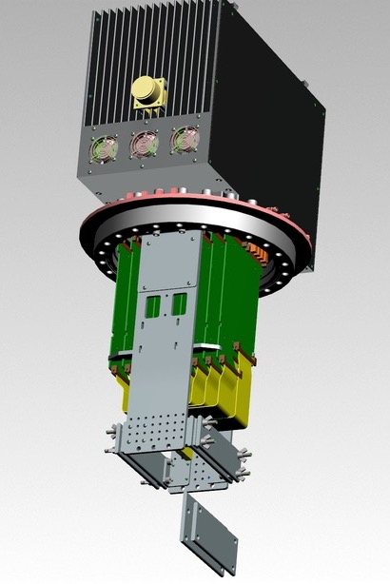
1. ICARUS TPC Read-out System Overview
The new ‘’warm’’ ICARUS TPC electronics includes:
  A front-end based on analogue low noise/charge sensitive pre-amplifier - same for Induction/Collection wires;
  A serial 12 bit ADC system, one per channel with 400 ns sync. sampling;
    A serial bus architecture with optical links for Gigabit/s transmission.
Both analogue/digital electronics hosted in a single board directly mounted on a signal feedthrough flange. External side of flange acts as backplane for a custom mini-crate where 9 boards (576 ch) are housed:
64 pre-Amps/ADC per board, 0-3.3V rail to rail, FPGA, optical link
Backplanes of mini-crates distribute power supply/local control signals
Wire signals decoupled from HV bias by DBB boards installed in the internal side of flanges.
H.V. (<±500 V)
Backplane connector
Liquid argon
Gas
REG
REG
Trigger
Sense wires
(4-9m, 20pF/m)
Twisted pair cables
(~1.8-6.2 m, 50pF/m)
TT-link
ADC
…
…
FPGA
optical
link
Fibers
Induction (32ch)
ADC
Collection (32ch)
RAM
Test IN
JINST 13 (2018) P12007
Decoupling board
UHV
Feed-through
(18x32ch)
12bit serial ADC
400ns sampling
Front-end ampl
(64/board)

Slide 3
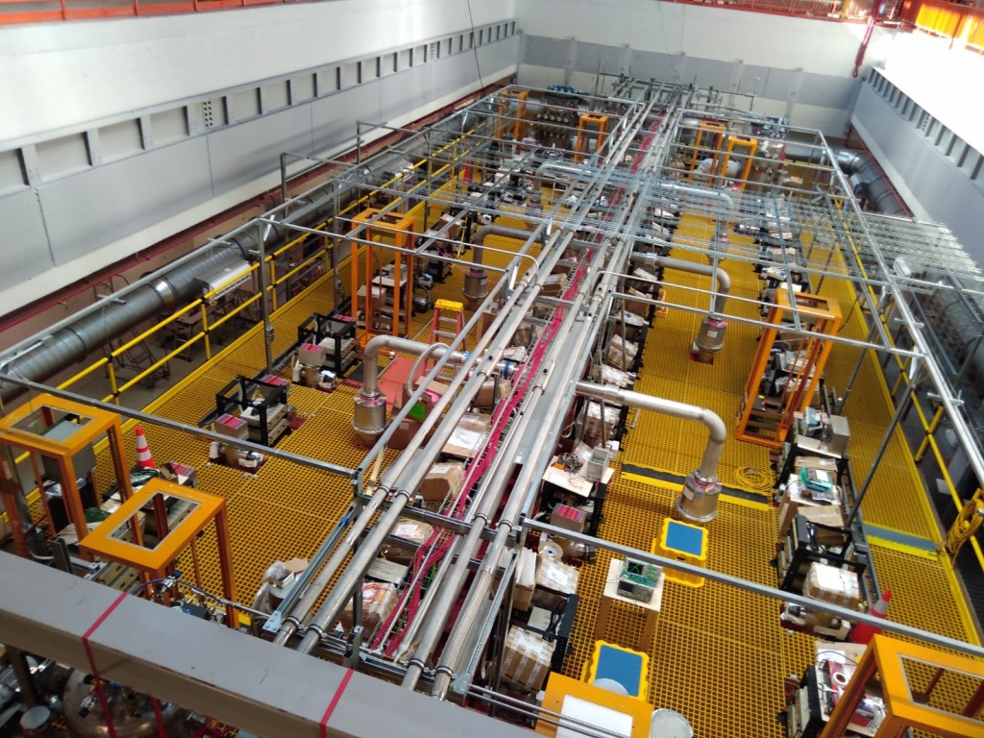
Status and planning for DAQ electronics delivery
All the 96 flanges with DBBs, Mini-crates, 838 over 856 required A2795 CAEN boards equipped with their pre-Amps, power supplies already installed
DAQ read-out based on CAEN A3818 optical links:
  TPC + PMT signals read by 24 + 3 PCs, each hosting 2 CAEN A3818 boards.
  3 PCs more are reserved for CRT data reading.
  All required 54 + 6 spare A3818 boards delivered by CAEN already at FNAL.
  All 30 + 5 spare PCI-express HP Proliant DL 380 delivered at CERN: first 6 PCIs already at FNAL, the remaining 29 on their road.
  Procurement of the associated connecting fibers is ongoing
TT-Link (LVDS signals), originated by SPEXI from central trigger crate, will be distributed to all 96 Mini-crates by some 6+2 spare fan-out units (1 input, 26 outputs) prepared by CSU team
Slide# : 3

Slide 4
2. TPC electronics installation -1
Four TPC chambers are served by 96 flanges each one supporting a mini-crate:
  Induction 2 and Collection planes are served by one row of 18 standard flanges on top of each TPC chamber (72 flanges in total);
  Induction1 and shortest wires in the corners are served by 4 special chimneys that support 3 flanges each at corners of each T300 (24 flanges in total).
EE 1-20 raw
Standard flange
Standard flanges
T300 – 2 EAST
EW 1-20 raw
WE 1-20 raw
Standard flanges
Standard flange
T300 – 1 WEST
Triple flange corner chimneys
WW 1-20 raw
Triple flange corner chimneys
Slide# : 4

Slide 5
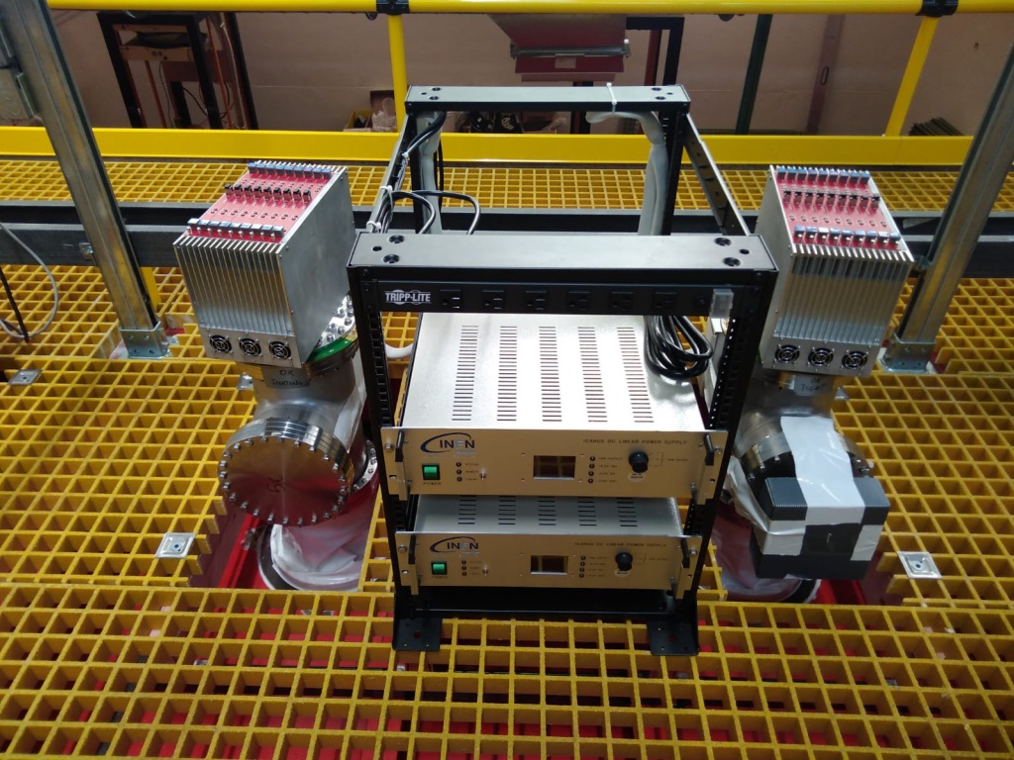
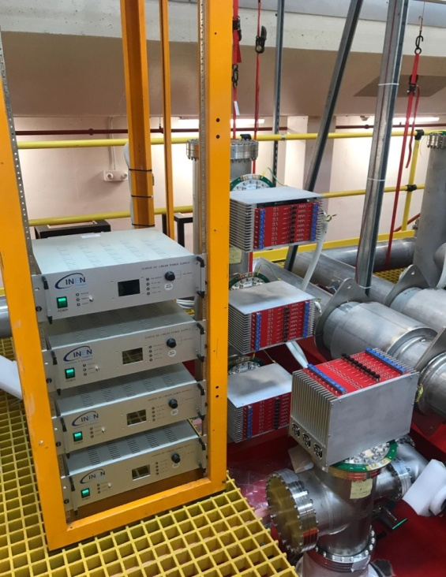
TPC electronics installation - 2
Two mini-crates with 9 A2795 boards on two chimneys for Induction 2 and Collection wires connected to power supplies
Three mini-crates with 9 A2795 boards on one corner chimney: 3 vertical flanges for horizontal (Induction 1) and short wires on TPC corner, connected to power supplies.
TOP
MIDDLE
BOTTOM
HV distributor
2 power supplies
All power supplies have been tested with 9 boards load
Slide# : 5

Slide 6
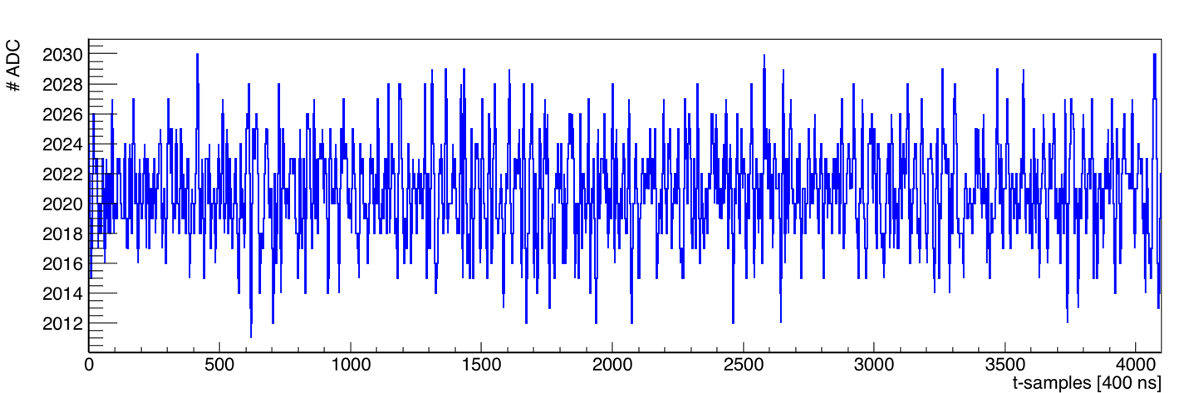
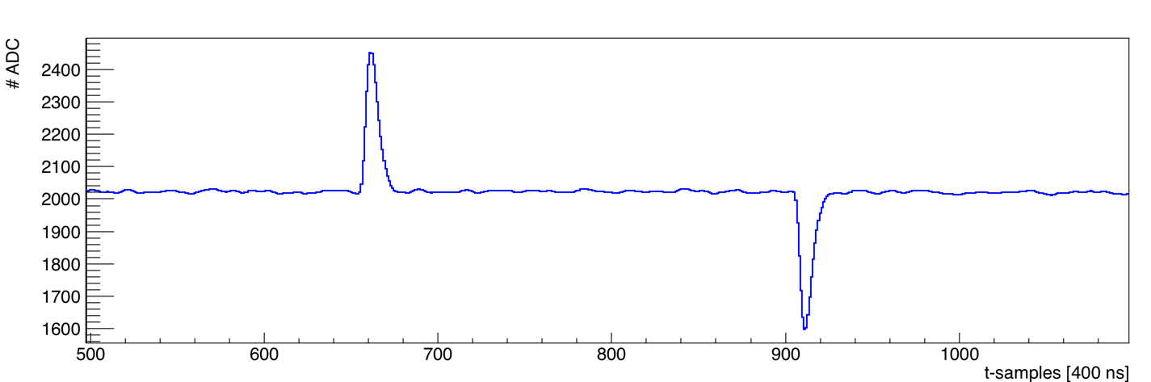
3. Vertical Slice test: 72 standard chimneys
A full TPC vertical slice has been performed on all the 72 (18 x 4) standard chimneys injecting test pulse at the far end of chamber wires and reading out the signals by A2795 on the other end to evaluate overall performance:
  72 mini-crates, fully populated with 9 A2795 boards each were tested, the power supply modules properly connected;
  A server with one A3818 board used to receive data through optical links.
Typical baseline noise and test pulse shape
Wire signal (board 1, channel 37, EE16): RMS: 3.1 #ADC
Slide# : 6

Slide 7
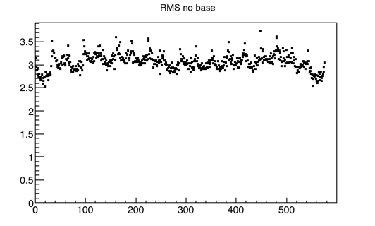
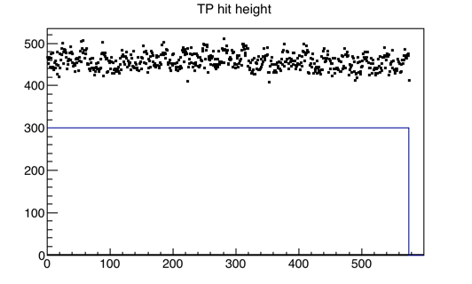
Results for the 72 standard flanges
RMS (#ADC)
TP height (#ADC)
Typical results from WE10 standard crate
TP pulse-height
WE10
WE10
Number of events with identified TP
channel
channel
Some problematic boards/crates/channels were identified during the tests:
  1 crate (EE18) and 2 boards result to have RMS values clearly anomalous;
  Problems related to low frequency noise on one crate (WW18);
  14 channels with low RMS in crate EE02 (possible disconnected cable);
  Few boards with a slightly high RMS.
Slide# : 7

Slide 8
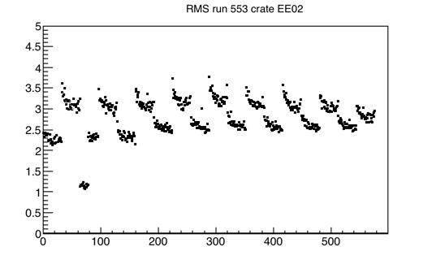
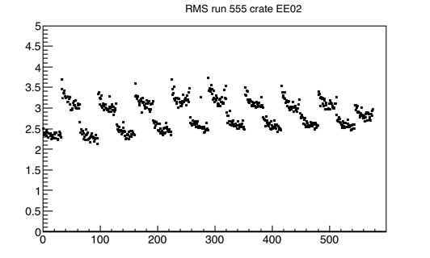
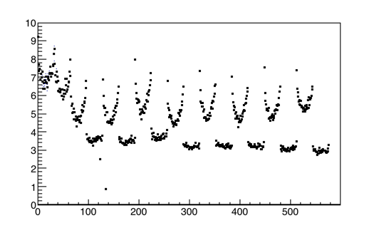
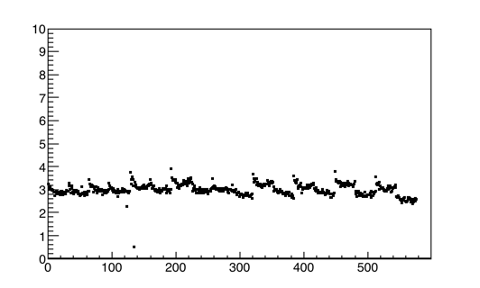
Recent interventions on the standard chimneys
Interventions on 18 crates have been performed in June/July in order to solve the previously identified problems and to improve the noise condition
RMS (#ADC)
Crate EE02
RMS (#ADC)
Crate EE02, after intervention
Possible disconnected cable
replacing the board, all channels are working properly
channel
channel
Crate EE18, after the re-installation of the 9 boards
RMS (#ADC)
Crate EE18
RMS (#ADC)
strange noise behavior in the whole crate
channel
channel
Slide# : 8

Slide 9
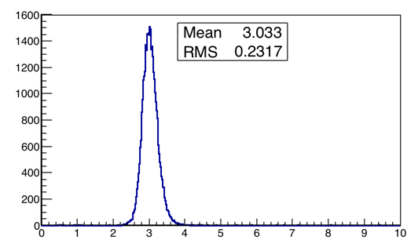
Summary of noise after the interventions: 72 standard chimneys
Globally 41472 channels (648 boards) have been studied: all the channels behave as expected with a noise level ~ 3 ADC counts (~1640 e- );
Only ~ 0.2 % of channels requires additional checks:
  25 channels with a low RMS (below 2 #ADC);
  46 channels with a high RMS (above 4 #ADC);
All the anomalous behavior is due to the external electronics and will be cured either changing pre-Amplifier(s) or repairing boards if required.
Global distribution of the RMS noise for all the channels in standard crates associated to Collection/Induction2 wires with standard ~3.8 m length
RMS (#ADC)
Slide# : 9

Slide 10

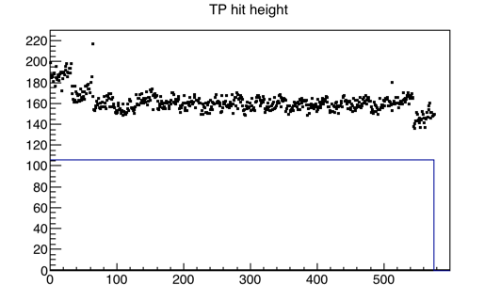
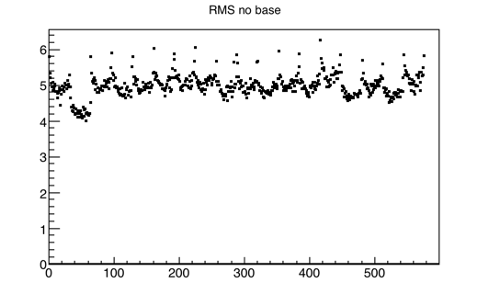
Vertical Slice test: 24 flanges on 8 corner chimneys
Similar TPC vertical slice tests were performed on the 24 corner flanges which refer to horizontal Induction1 wires, shortest Induction 2 and Collection wires;
TP height (#ADC)
RMS (#ADC)
channel
channel
During June/July, interventions had been performed to improve noise conditions on 5 mini-crates where an increased noise level up to 10-16 #ADC was observed;
  An improved noise condition was reached in all 5 mini-crates;
  However in the end of the process, an higher noise level on these crates (~ 4.5 - 5 #ADC) comparing with the standard crates is still present, due also to the different wire length (9 m long wires of Induction 1) and cable length;
Slide# : 10

Slide 11
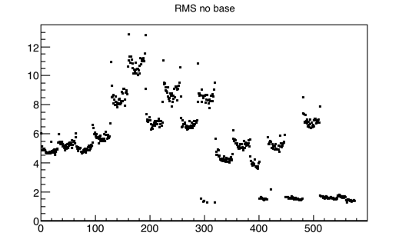
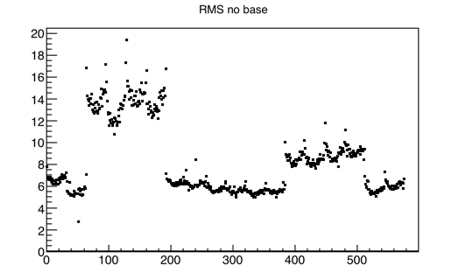
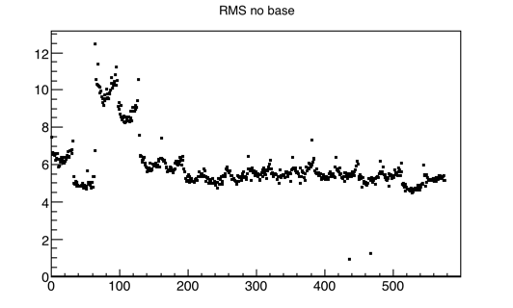
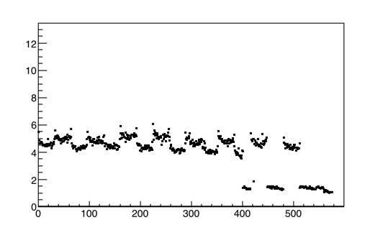
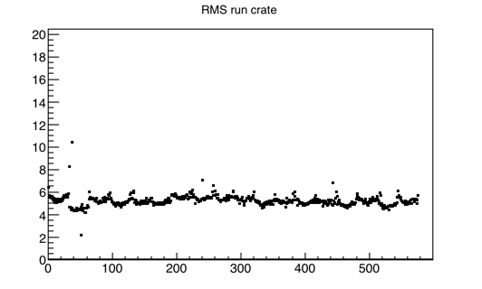
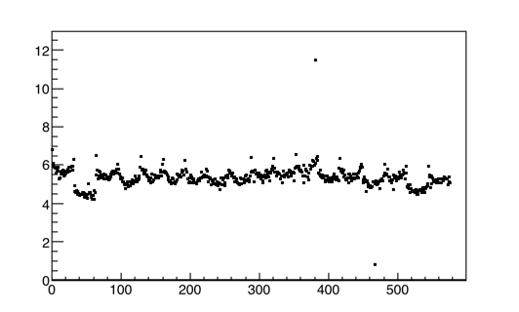
Examples of interventions in 3 corner chimneys
EW20Top
EW20Middle
EE20Middle
RMS (#ADC)
RMS (#ADC)
RMS (#ADC)
not used channels +15 chs flat cable cut
channel
channel
channel
EW20Top,
after intervention
RMS (#ADC)
EW20Middle,
after intervention
RMS (#ADC)
RMS (#ADC)
EE20Middle,
after intervention
not used channels +15 chs flat cable cut
channel
channel
channel
Slide# : 11

Slide 12
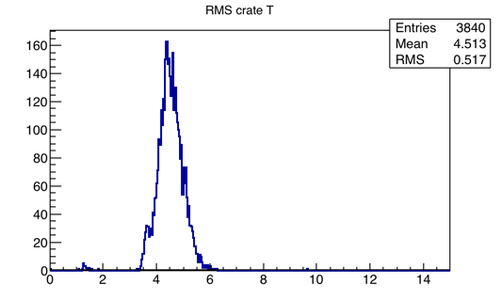
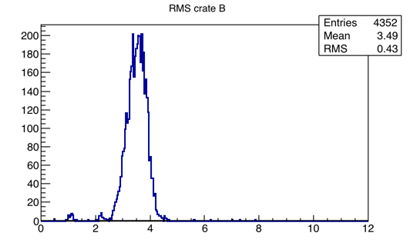
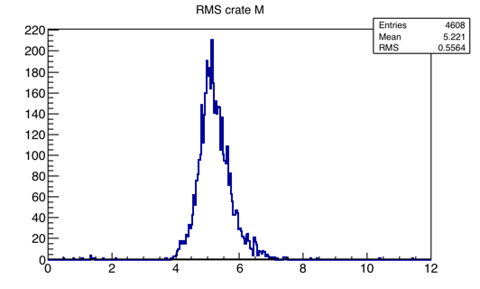
Summary of noise after the interventions: 24 corner chimneys
Globally 12800 channels (208 boards) studied: identified 53 single channels that should be cured changing pre-Amplifier(s) or repairing boards:
  23 channels with RMS < 2 #ADC;
  30 channels with RMS > 7 #ADC;
The average noise level, in particular on the Middle and Top crates, is ~ 5#ADC still higher w.r.t. the expectations
Top crates, Induction1 wires, channels RMS distribution
RMS (#ADC)
Bottom crates, Induction2/Collection wires, channels RMS distribution
Middle crates, Induction1 wires, channels RMS distribution
RMS (#ADC)
RMS (#ADC)

Slide 13


Correlated noise
In all flanges is also present evident correlated noise that is enhanced in the corner flanges. This problem is still under investigation.
This correlated noise is not present in the channels where no internal cables from the wires are connected to the flanges
Corner chimney crate: RMS~5.3#ADC
Not used channels without cables
channels
channels
ticks
ticks
Middle
Top
Slide# : 13

Slide 14
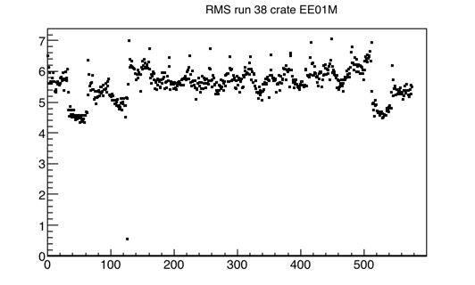
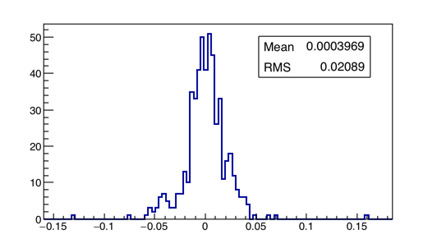
Test to identify possible sources of correlated noise
A dedicated test has been performed to identify possible source of the correlated noise external to the detector:
  The signals of 4 different crates (one per TPC, in different positions along the longitudinal direction of the detector)
  All the considered external sources (Wifi, Air conditioning, Lights, Control system for the cryogenics, cranes, vacuum pumps) have been switched off and then one by one turned on
No visible differences on the noise when all the elements are switched off and then turned on: the measured noise level is not related to external sources
RMS (#ADC)
EE01M
Difference between all switched on all switched off
EE01M: average RMS ~6 #ADC
channel
Variation of the RMS (#ADC)
Slide# : 14

Slide 15
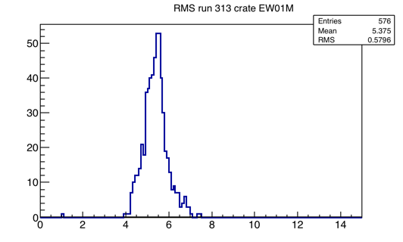
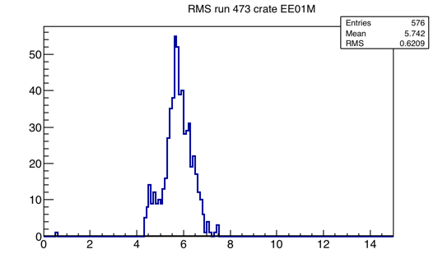
Rough evaluation of the S/N ratio in Induction 1
Induction1 horizontal wires will play at FNAL an important role in the event selection, identification/reconstruction of crossing cosmic muons: > 10 cosmic μs in each event are expected, making the full event reconstruction more challenging.
In Gran Sasso run a signal to noise (S/N) ratio ~4 allowed an efficient reconstruction of the single cosmic muon track in the event even if with some small hit detection inefficiencies.
A preliminary study on MC cosmic muons shows 17 #ADC minimum hit pulse-height in Induction 1 horizontal wires for vertical cosmic μs orthogonal to wires, resulting in a ~ 3.4 S/N ratio for a 5 #ADC noise.
  A reduction of the noise level in Induction 1 horizontal wires is mandatory for the corner flanges at least for EW01M and EE01M in the East cryostat with the worse actual noise!*
EW01M
RMS (#ADC)
EE01M
*A small increase of noise in LAr is expected, due to the increase of the 9 m long wire capacitance.
RMS (#ADC)
Slide# : 15

Slide 16
4. Future activities for investigation/corrections
A complete survey of the noise condition in all the mini-crates has been done with the vertical slice tests;
An average noise level of ~3 #ADC have been found in the standard chimneys associated to the Collection/Induction2 wires.
In the corner chimneys, corresponding to the Induction1 horizontal wire, an average noise of ~5 #ADC has been observed;
The corner chimneys have a surplus of flat cable that obliged to roll up the flat cables spoiling likely its characteristics. This could be the reason of the observed higher level of noise. We have brand new connectors that might allow for shortening cables to the right length, resulting in a better layout of the flat cables inside the chimneys.
This operation requires the vacuum breaking on at least one cryostat and the opening of the corner chimney flanges, in particular EW01M and EE01M in the East cryostat
Slide# : 16

