Slide 1
Beam Line Tuner for the FAST linac
Lea Richtmann (Leibniz University Hannover)
Supervisor: Dan Broemmelsiek (and Jinhao Ruan and Chip Edstrom)
Helen Edwards Internship, Final Presentation, 8/8/2019

Slide 2
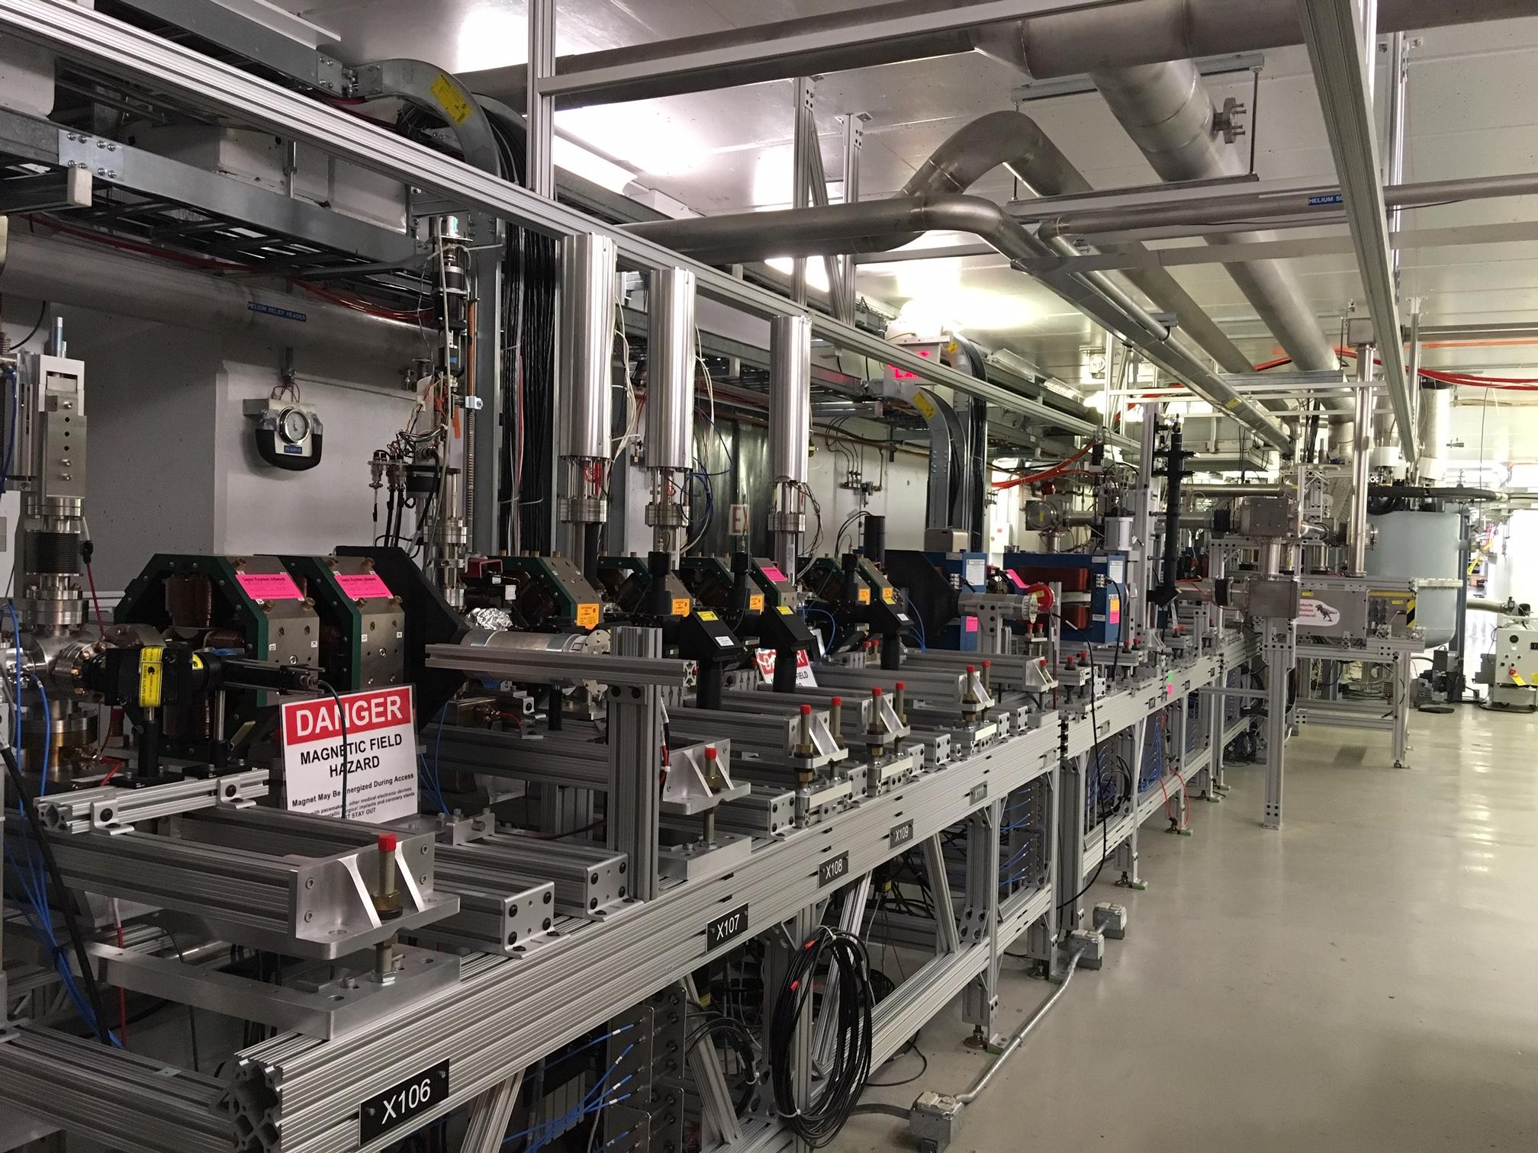
Outline
Motivation
Studies
Results & Future Work
Additional Learnings
Conclusion

Slide 3
Motivation
Importance to keep beam on design trajectory
Track beam through linac
Create beam bumps
Correct and create simulated beam trajectories
Steer beam to have it on desired trajectory
These elements participate in steering process:
Corrector
Quadrupole (should only focus but steers if beam is off center)
Beam Position Monitor (BPM)
Picture credit: USPAS

Slide 4
Studies I: Orbit Correction Algorithm
Orbit Correction Algorithm: Singular Value Decomposition
#BPM #Correctors
Find pseudoinverse of Response matrix
Know which corrector angles we need to achieve certain position offsets
Beam Position (BPM) change (m)
Corrector kick angle (mrad)
Response matrix
With angles: Calculate new current for correctors
Corrector
BPM

Slide 5
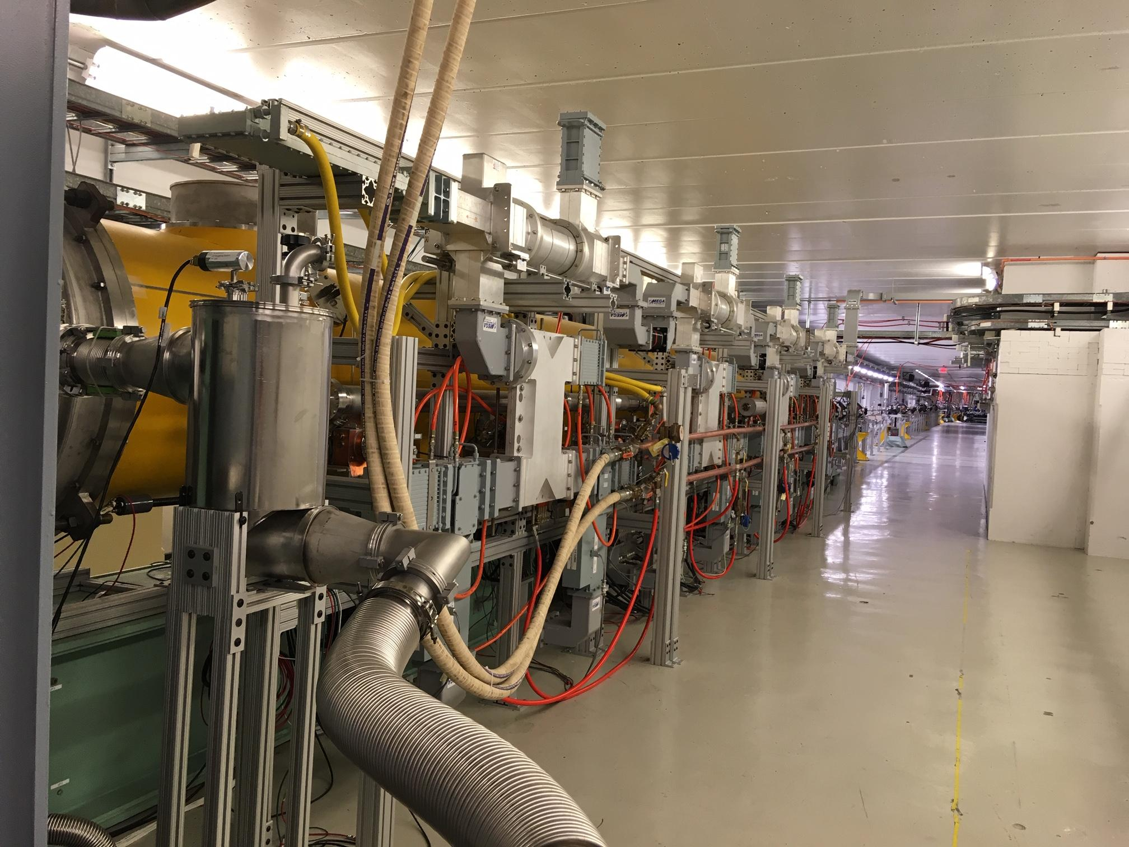
Studies I: Orbit Correction Algorithm
What to do with that?
Beam bump
Correct beam to a specific setting of BPM readings
Elegant simulations
Feed in desired positions, try to adjust beam trajectory as good as possible to that
Cryomodule (CM) in linac

Slide 6
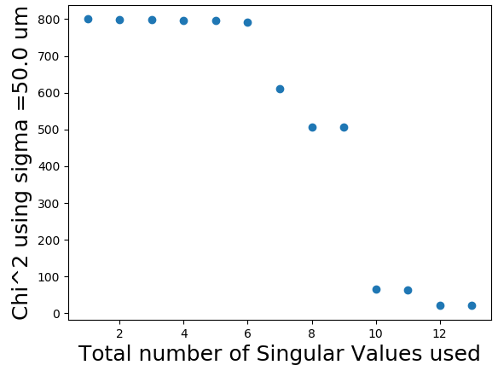
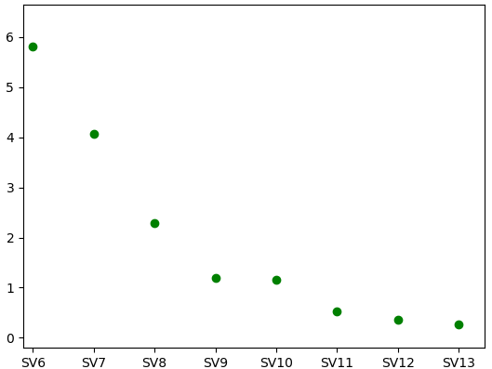
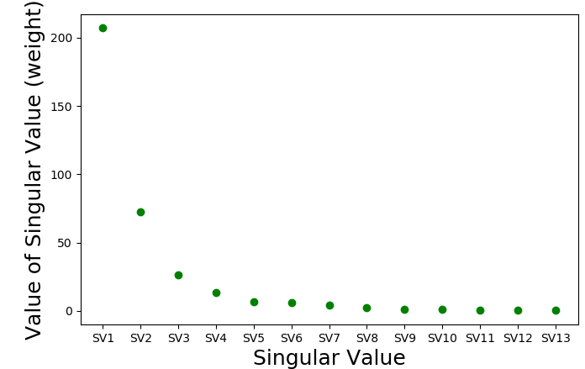
Studies II: Analysis of Singular Values (SV):
Example: Beam Bump (location: Before Cryomodule (CM), using 90 m of beamline including 13 correctors and 21 BPM, quads set to zero)
Goodness of fit increases with amount of SV (if #BPM>#correctors)
Using BPM resolution for

Slide 7
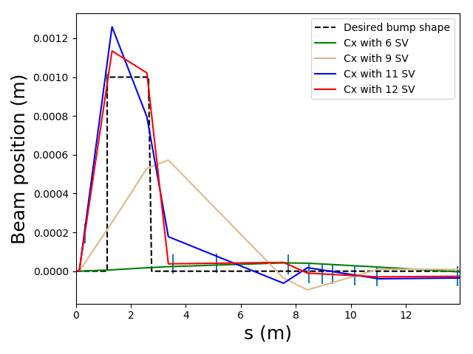
Studies II: Analysis of Singular Values (SV):
Example: Beam Bump (location: Before Cryomodule (CM), using 90 m of beamline including 13 correctors and 21 BPM, quads set to zero)
90 m of linac (until H480)
Quads are off
If #BPM>#correctors:
Result gets better while increasing amount of SV with no upper limit
plot is a zoom in bump region

Slide 8
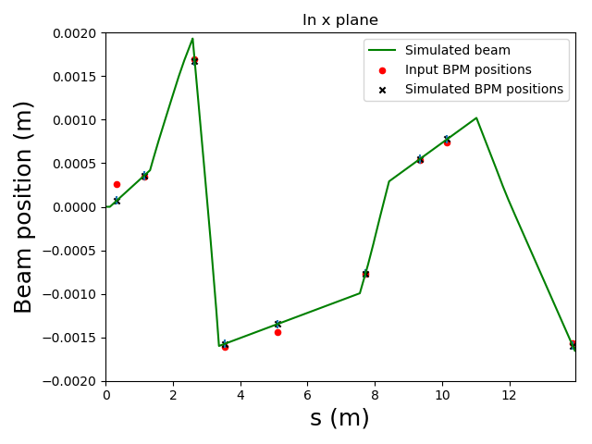
Studies III: Simulate beam trajectory with steering
in Injector (before CM)
Using realistic, simulated lattice containing focussing for injector to CM beamline
Use BPM measurements from 03/13/2019
Correct beam to these values
Output corrector strengths
Correction not always within
error bars

Slide 9
Results & Future Work
Results
Corrector Strengths
Injector beam bump
Realistic beam trajectory
Future Work
Improve Elegant lattice files
Correspondence with actual linac (model for CM not clear)
Turn corrector strengths into magnet current settings
Controls interface

Slide 10
Additional Learning
Learn to work with linux cluster and elegant
Understand behavior of components in a beam line
Understand what are the limits and possibilities of steering in a beam line
Understanding of quad steering
Understanding of beam based alignment

Slide 11
Conclusion
Learning about beam simulation and tracking
Outcome: Usable routines
Thank you for your attention!
(...and for your help and for organising!)

Slide 12
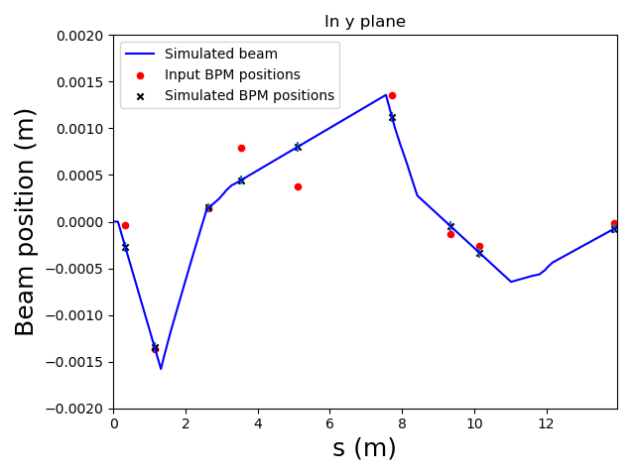
Backup - Steering in y plane
Steering in y plane and x plane works simultaneously

Slide 13
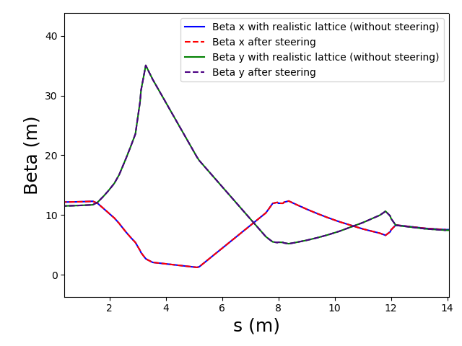
Backup - Steering: beta functions
Still more detailed analysis needed but it seems that the steering preserves the beam size.

Slide 14
Backup - Steering after CM
Model for the Cryomodule not clear, problems with steering through the CM
No correctors directly after the CM, difficult to adjust to first BPMs directly after CM
Correction further downstream works

Slide 15
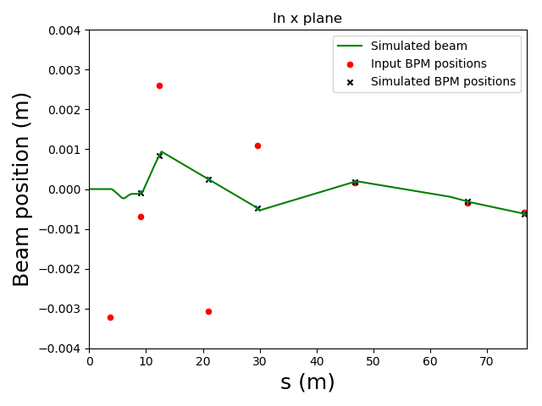
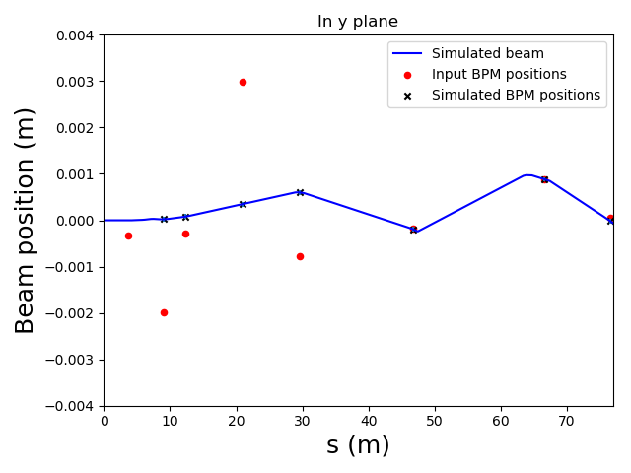
Backup - Steering after CM
s=0 means here 0 meters after the CM

Slide 16
Backup
More Details to Singular Value Decomposition (SVD)
Not square matrix:
Columns have eigenvectors of
Has Singular Values on diagonal, are square root of the eigenvalues of both and
Rows have eigenvectors of
Pseudoinverse:

Slide 17
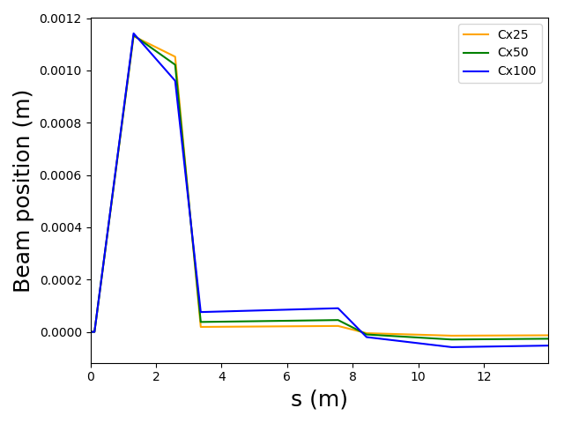
Comparison using different BPM noise levels
Difference of the simulation when using BPM resolution of 25 um, 50 um and 100um

Slide 18
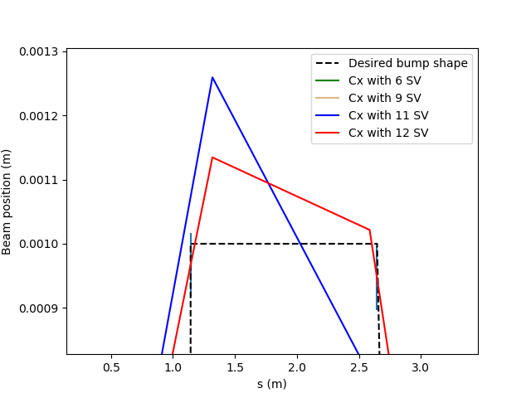
Backup - Zoom of bump
Zoom of bump to show error bars

Slide 19
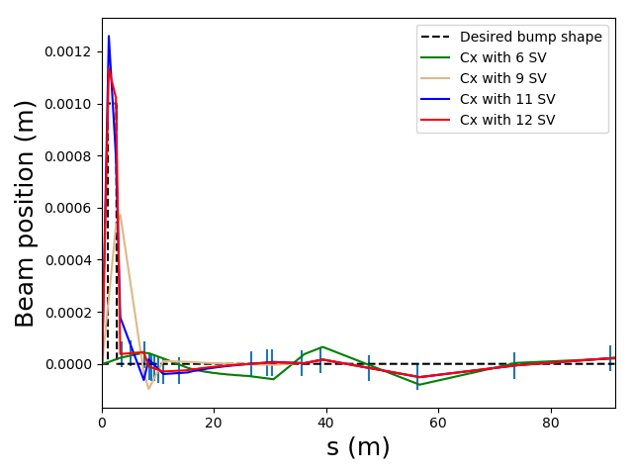
Backup - Bump with full used beamline
This bump was constructed using 90 m of the linac (until H480).
This part of the beamline has 13 horizontal correctors, hence we get 13 SV.

Slide 20
Backup - Zoom of Chi Squared
Zoom for the Chi Squared Values for the use of 10 to 13 singular values

