Slide 1
MQXFS1d - acoustics
Stoyan Stoynev /FNAL/
-
-

Slide 2
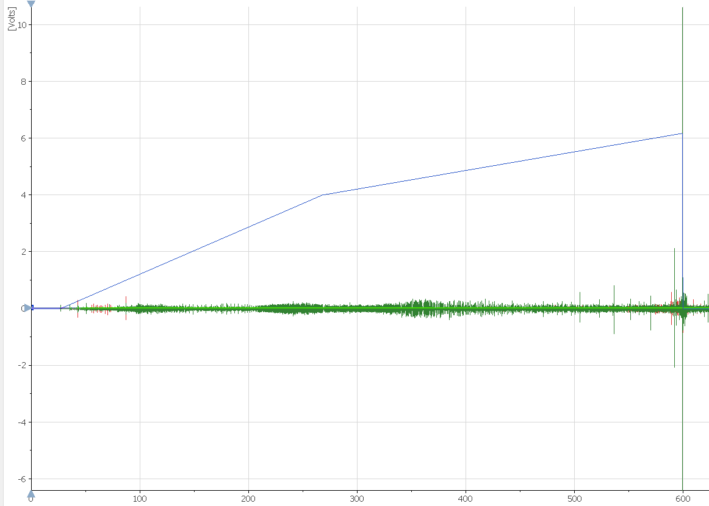
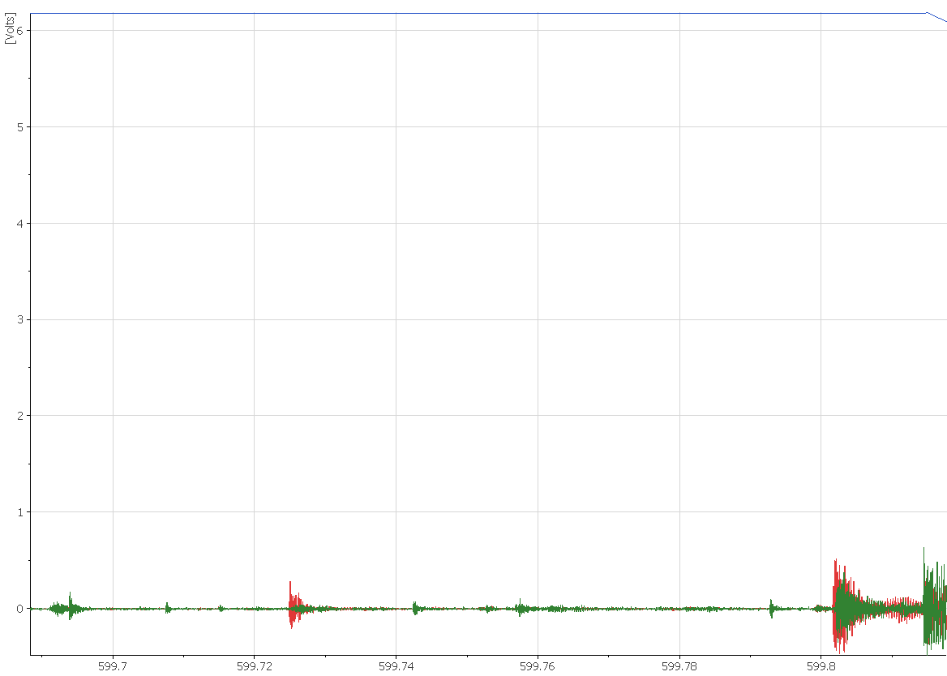
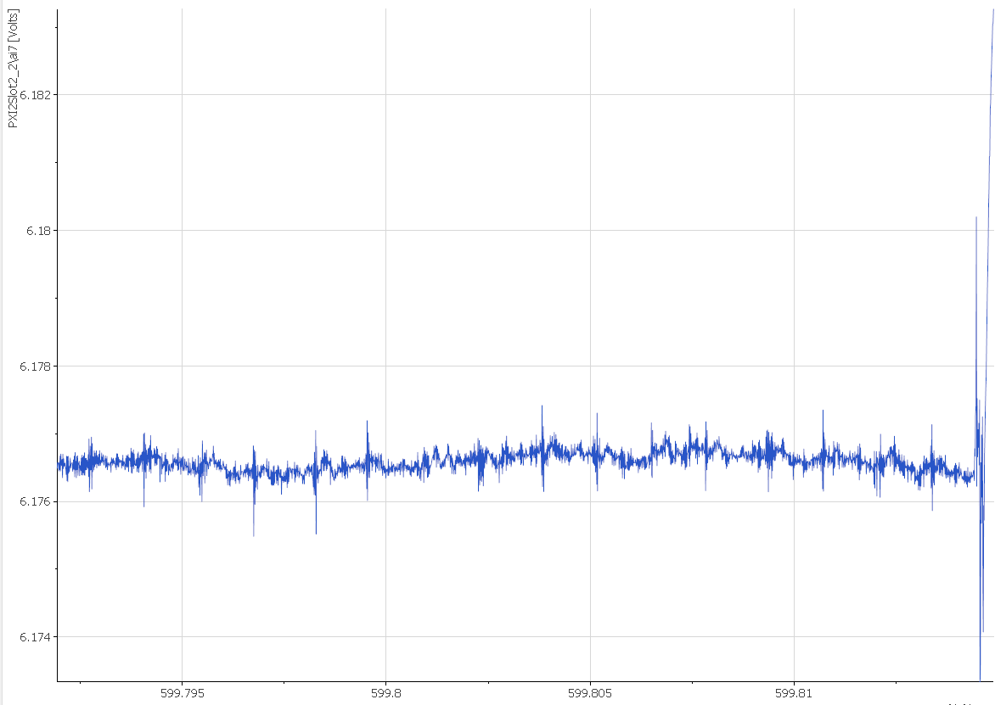
Ramp #30

Slide 3
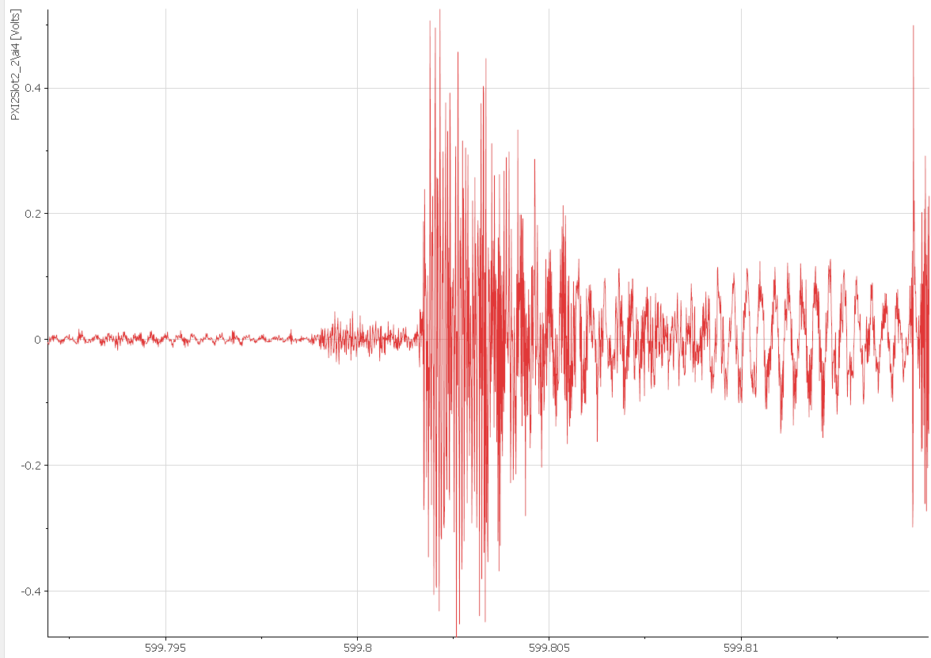
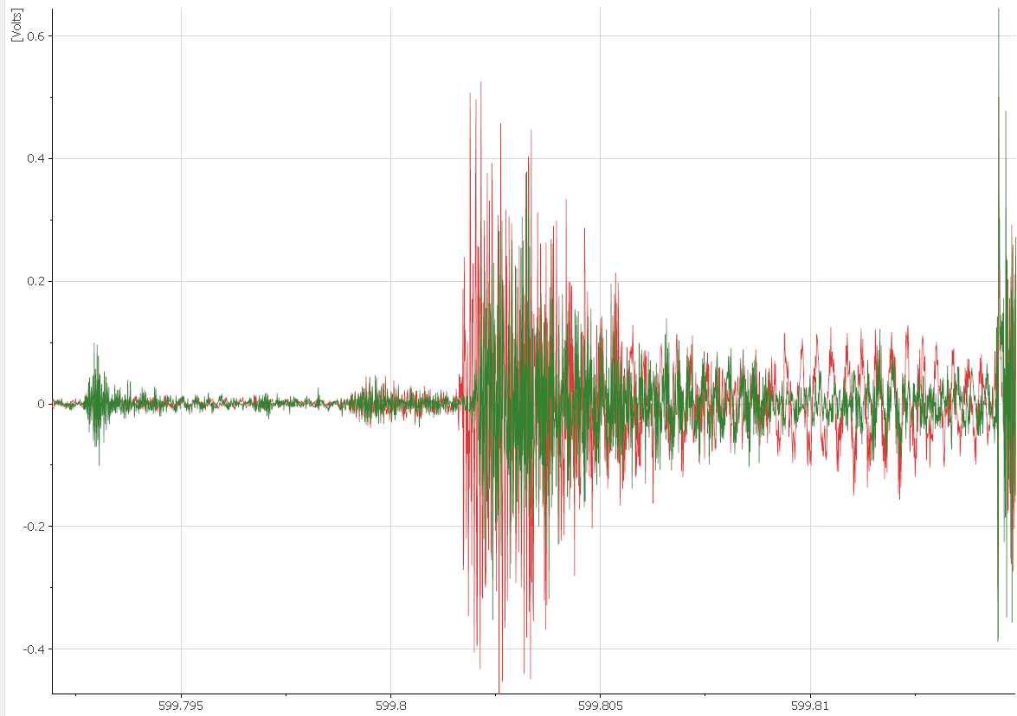
Ramp #30
5 ms
Independent QA
quench detection
(VTs are 1 ms later)

Slide 4
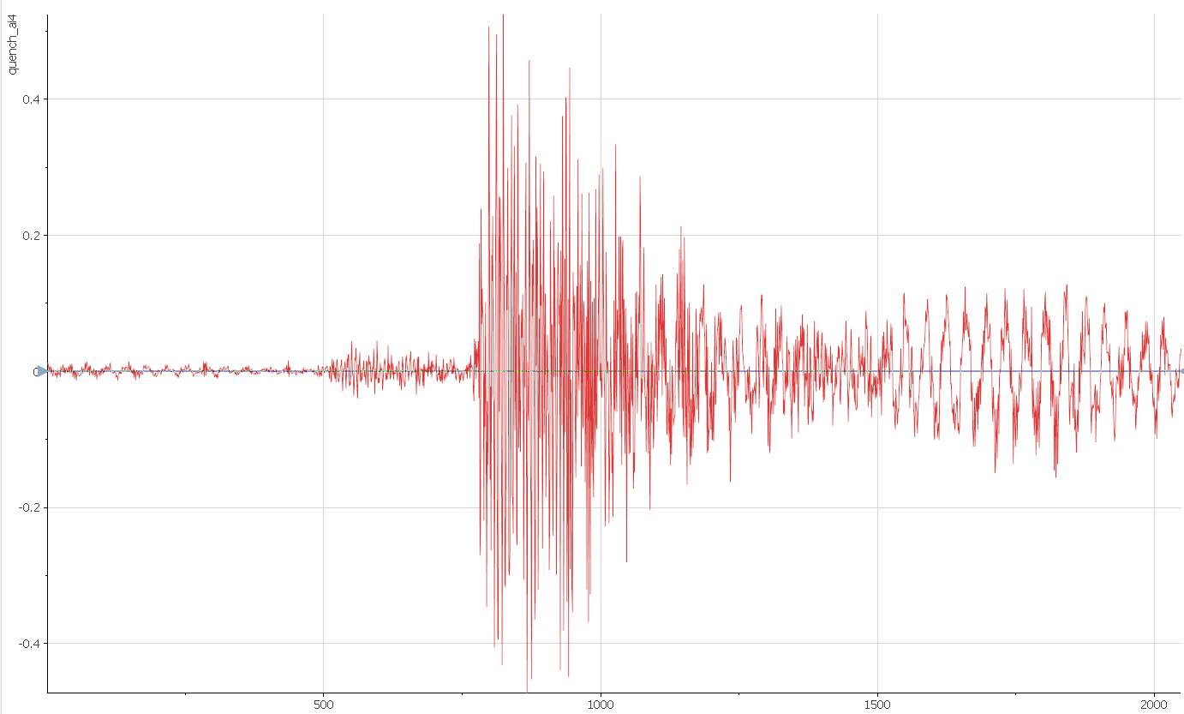
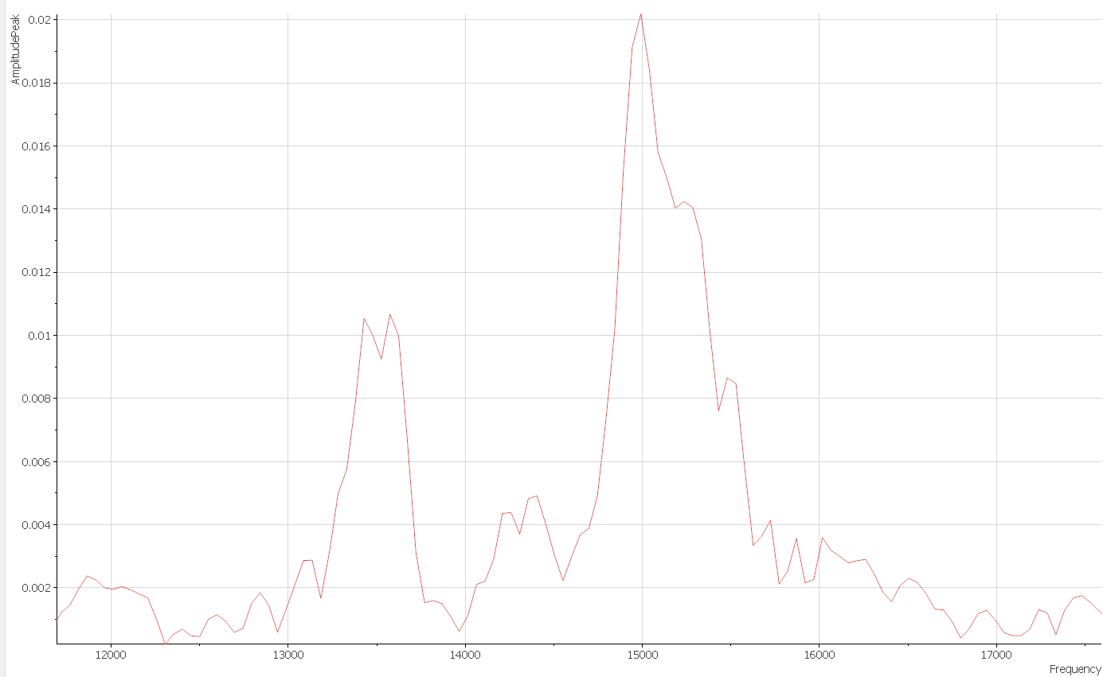
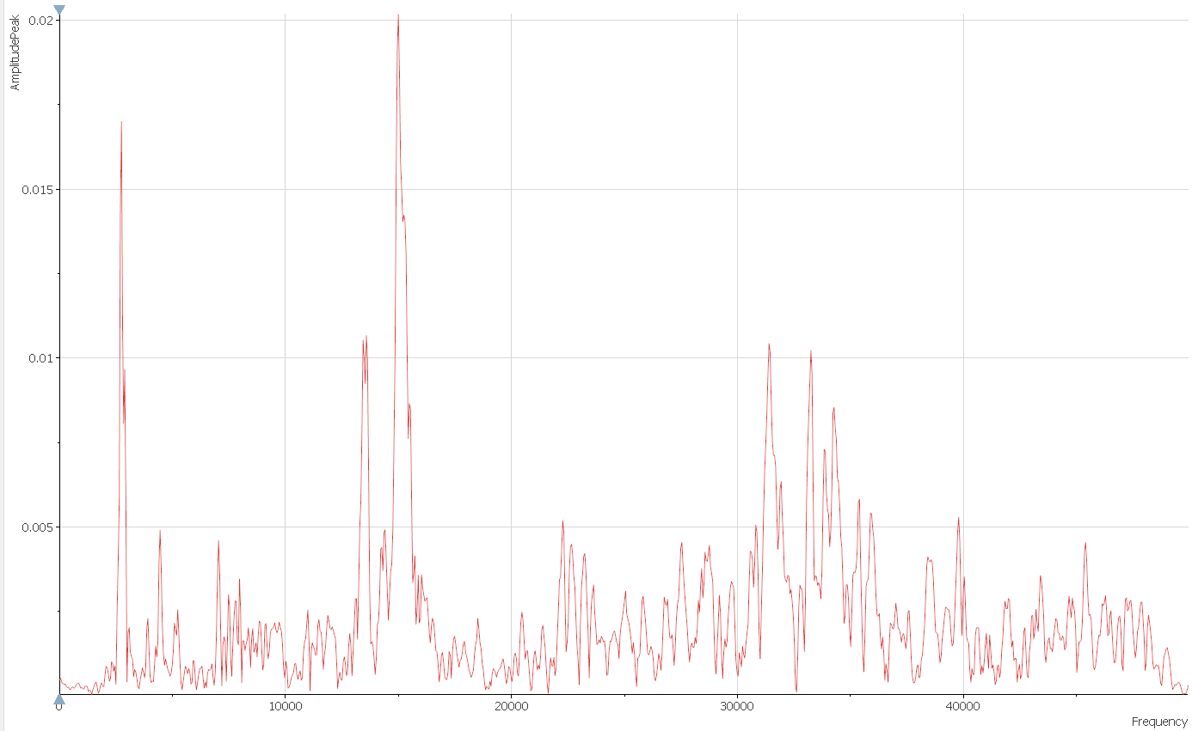
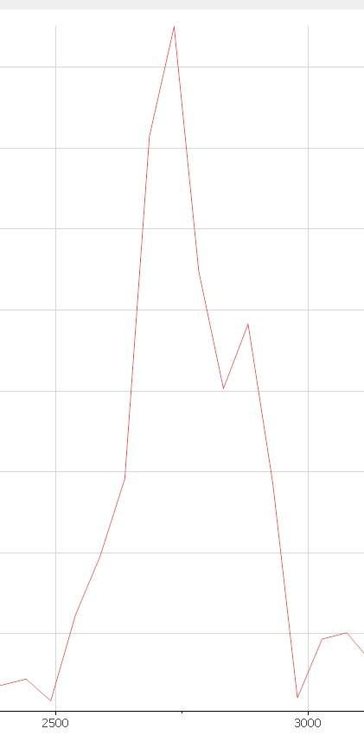
FFT (with Hanning window)
Frequency
spectrum
13 kHz
15 kHz
20 kHz
40 kHz
2.5 kHz
3 kHz

Slide 5
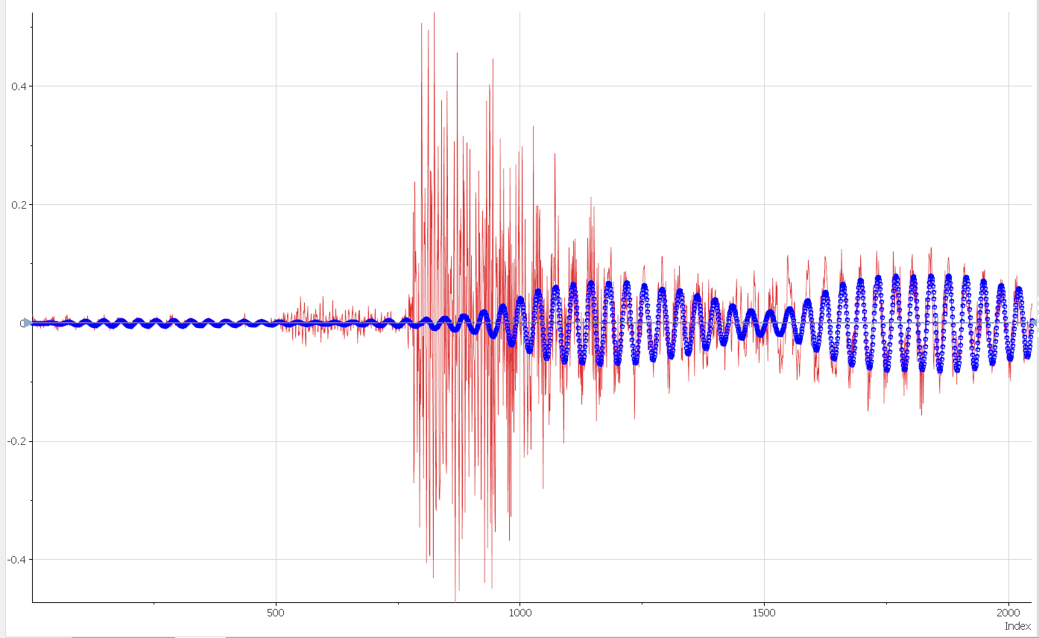
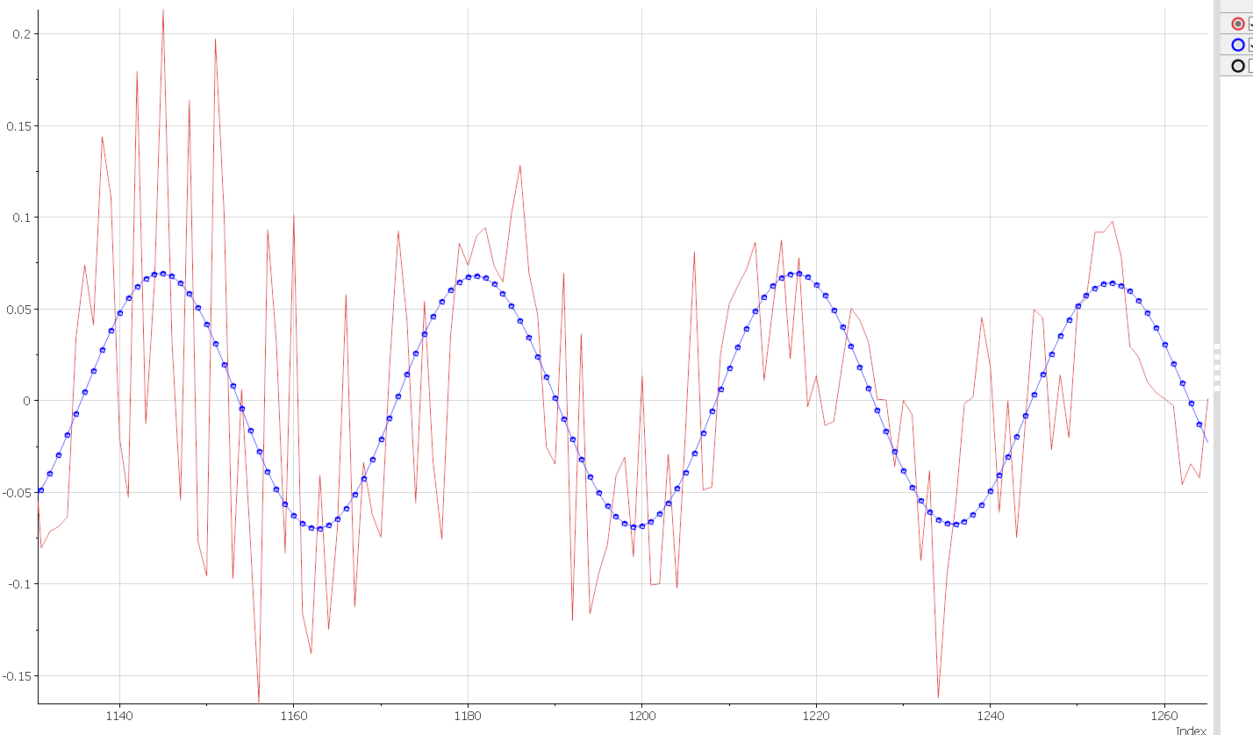
Frequency filtering
5 ms
Filtered (2.5-3 kHz allowed)
2f_{B} ~ 200 Hz
f’ ~ 2860 Hz
f_{B} = (f₁-f₂)/2
f’ = (f₁+f₂)/2
f₁ ~ 2960 Hz
f₂ ~ 2760 Hz

Slide 6
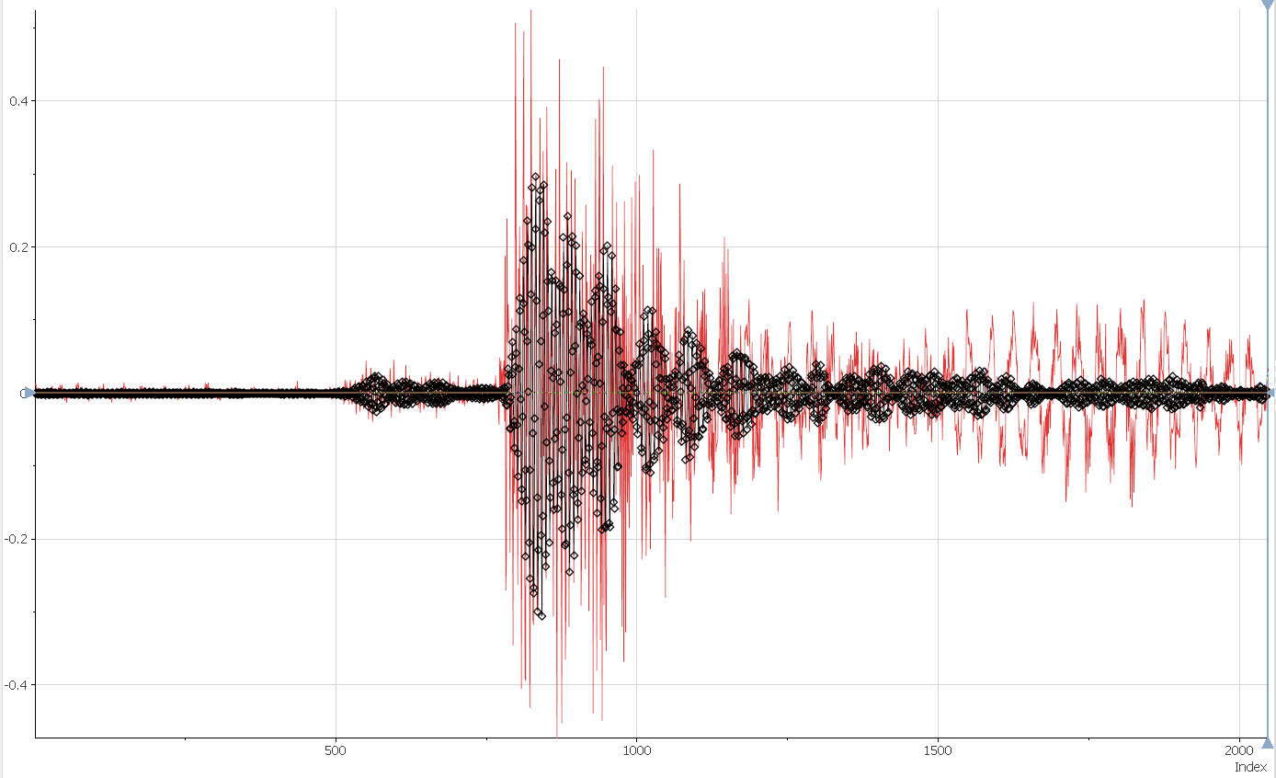
Frequency filtering
Filtered (13-16 kHz allowed)

Slide 7
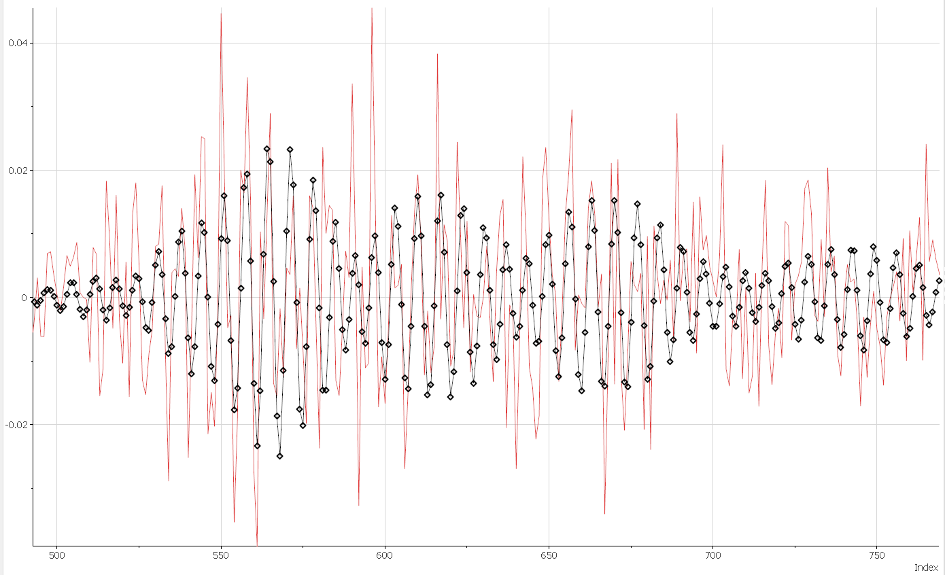
Frequency filtering
Filtered (13-16 kHz
allowed)
2f_{B} ~ 1.8 kHz
f₁ ~ 15.4 Hz
f₂ ~ 13.6 Hz
f’ ~ 14.5 kHz

Slide 8
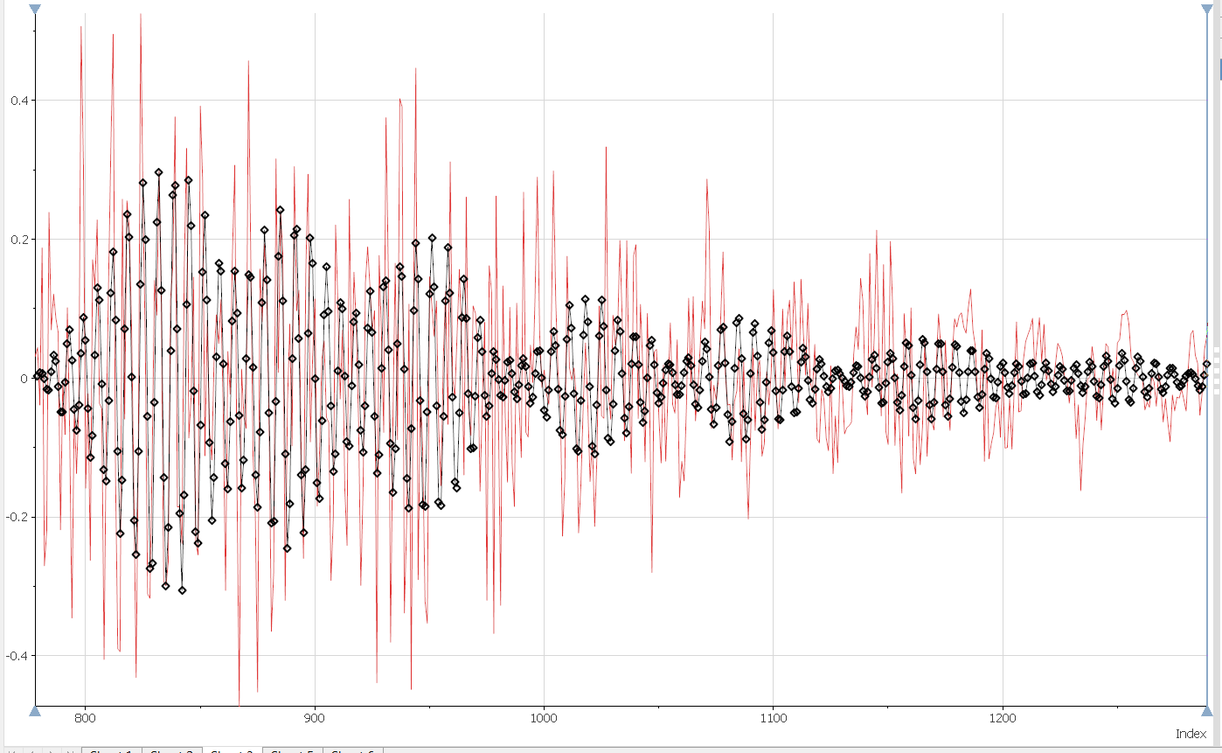
Frequency filtering
Filtered (13-16 kHz
allowed)
2f_{B} ~ 1.5 kHz
f₁ ~ 15.2 Hz
f₂ ~ 13.8 Hz
f’ ~ 14.5 kHz

Slide 9
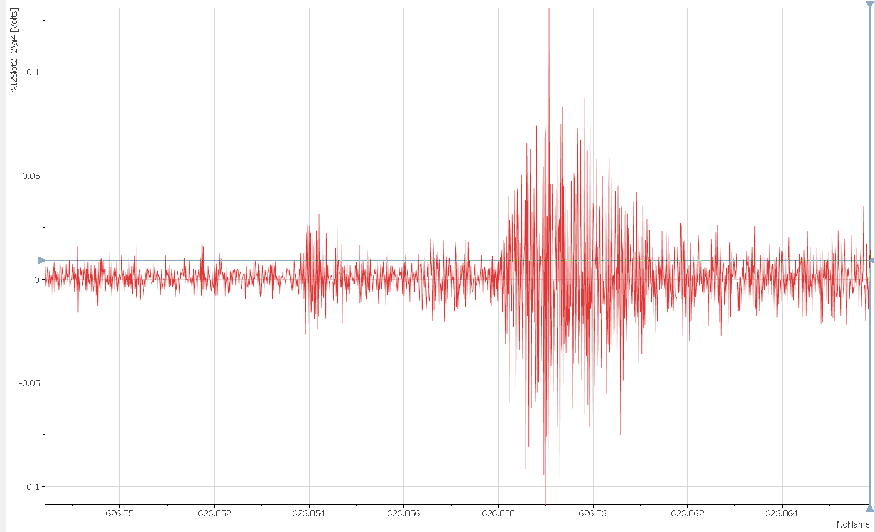
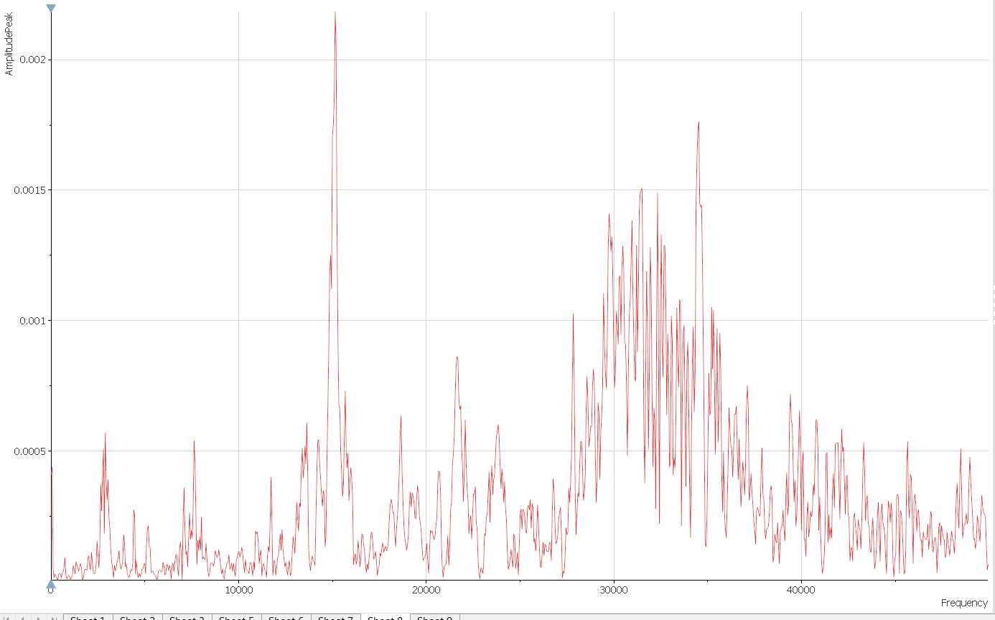
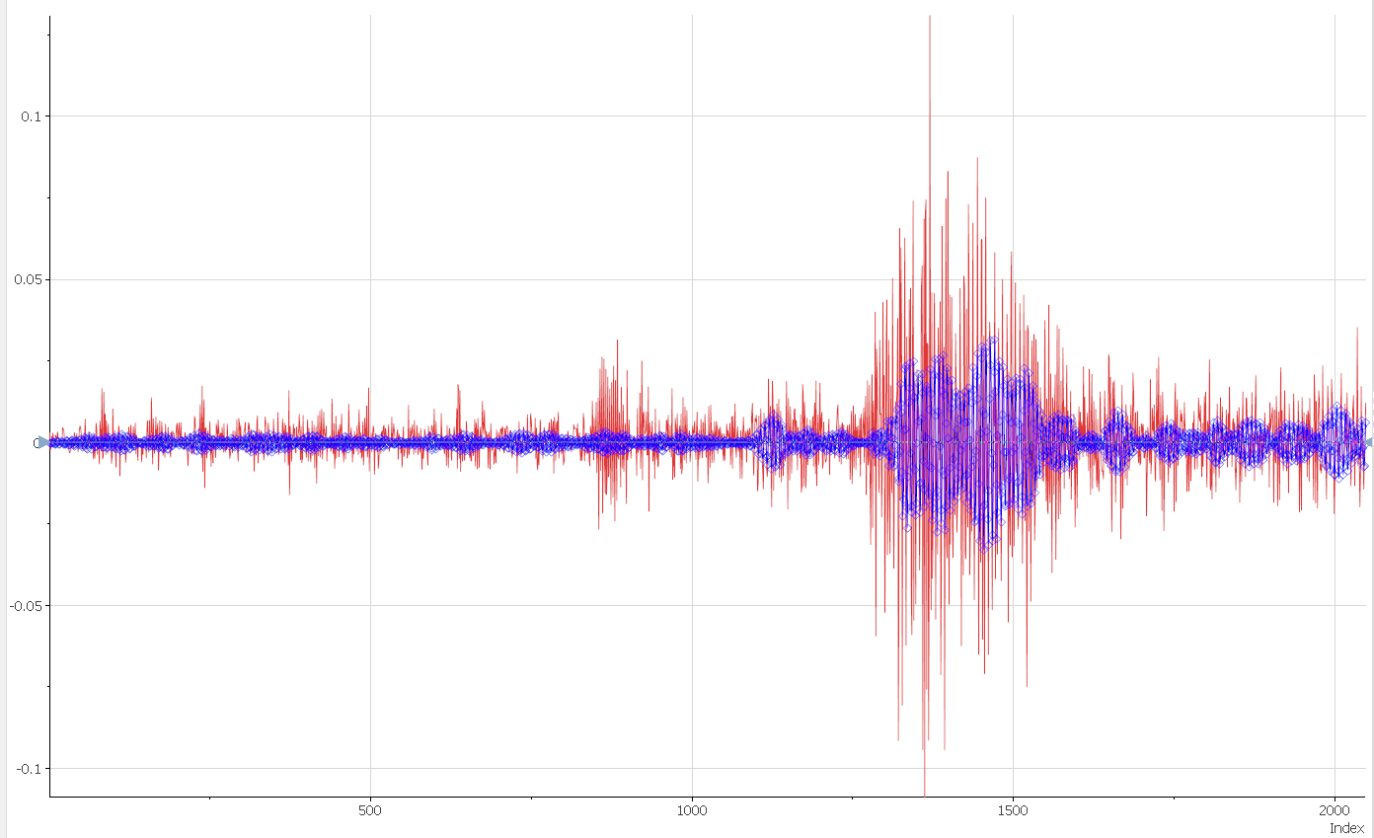
Ramp 29
FFT
Filtered (13-16 kHz)
Independent QA
quench detection
(VTs are 2 ms later)

