Slide 1
Fiber optics and future accelerator magnets
M. Baldini
8th August 2019

Slide 2
LDRD: optical fiber sensors
Project Summary (goals, novelty, relation to mission)
Goal: Developing a novel instrumentation tools and analysis technique to enable a deep understanding of magnet training process and to design free of quench magnets in future accelerators.
Focus: to use the fibers to characterize external disturbances in order to drive and give feedback for designing free of quench magnets. A novel approach to investigate the disturbance spectrum: energy and localization.
Strategic relevance:
  Match the Laboratory distinctive capability on accelerator magnets and bring enduring benefit in magnet diagnostic.
  Lab mission: significant impact on cost and schedule of future High Energy Hadron Colliders; possibly enabling them.

Slide 3
LDRD Project focus
Use fiber optic sensors for bridging the technology gap on superconductive magnet diagnostic
FBG fibers: discrete sensors
Rayleigh fibers: continuous sensors

Slide 4
Project work plan
PHASE 1 (1 year): develop a novel magnet diagnostic using bonded FBG fiber sensor to measure strain and temperature during magnet fabrication and training.
Short term goals:
  Handling and bonding
  Fiber coating
  Fiber calibration
PHASE 2 (2-3 year): use Rayleigh fibers
Embed and wind fibers along a coil
Consult with vendor for measurements and data analysis/interpretation
Fabricate a coil and test a short mirror magnet/short model
Disturbance spectrum analysis

Slide 5
Fiber optics and future accelerator magnets
FBG (Bragg grating) fibers to measure strain and temperature on shell and coil
Goal: bring a novel and advantageous diagnostic probe at FNAL
Monitor strain and temperature during magnet service life:
Coil fabrication
Assembly
Cold down
Training
Heat treatment/
impregnation
Pre-stress effects
Temperature and strain
distribution

Slide 6
FBG fibers: costs and needs
5-6 gratings per fibers + 2 accesses: 1500$ per fiber
Spectrometer with 1kHz acquisition rate: Si255 Hyperion from Micron optics. Price is 35000$ (multiplexing capability)
Resplice fiber instrumentation: 4000$
R&D goals:
fiber handling and bonding
Fiber coating for T estimation
Calibrations of the fiber: cryostat down to 4.2 K
Testing: short model (Synergy with MDP/HFM)

Slide 7
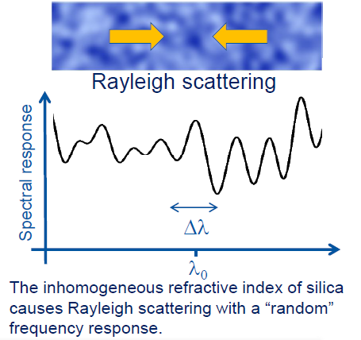
Fiber optics and future accelerator magnets
Goal: bridging the technology gap on superconductive magnet diagnostic
Quench detections for HTS magnets
Mechanical perturbation spectrum for superconducting magnets:
  Localization of quench in the pole turn: tip of the cable/distributed?
  Determination of energy releases
New coil design and novel diagnostic

Slide 8
Rayleigh fibers cost and needs
Fiber embedded in the coil
Determine spatial and temporal resolution required
Someone from the vendor Lupine visit and help set up the system and acquire data: 40-50k. They bring the instrumentations and test it with you
Interrogators 75000 $ to > 100000 $
Fibers itself are 500$

Slide 9
Rayleigh fibers cost and needs
R&D effort:
fiber handling and bonding
Fiber coating for T estimation
Calibrations of the fiber: cryostat down to 1.9 K
Understand how to wind multiple fibers around the pole
Fabricate and test at least one short coil with fibers embedded and wound around the pole.
Test of a short magnet with new instrumentation
Disturbance spectrum analysis

