Slide 1

Strand PRR Intro & Charges
Giorgio Ambrosio
Magnets L2
U.S. HL-LHC Accelerator Upgrade Project
Production Readiness Review of the HL-LHC AUP MQXF Strand Procurement Task 302.2.02
August 22, 2019

Slide 2


Introduction
The HL-LHC AUP 302.2.02 scope covers strand procurement, vendor QC supervision, QC validation, and preparation and test of extracted strands and witness samples. The HL-LHC AUP project received CD-3a approval for conductor procurement in October 2017, and the remaining scope of 302.2.02 was approved under CD-3b in February 2019. This PRR covers the remaining scope approved under CD-3b: QC validation, and preparation and test of extracted strands and witness samples.
The 302.2.02 L3 Manager (Lance Cooley) is presently with FSU and the NHMFL, where strand QC validation is being performed. The 302.2.02 L3 Manager Deputy (Vito Lombardo) is at FNAL where extracted strands and witness samples are prepared and tested.

Slide 3
Introduction
Production Readiness Review (PRR) is a major review step in the HL-LHC Accelerator Upgrade Project (AUP). It is held prior to the start of series production, and is intended to be a largely technical review, but include assessment of the planned cost, schedule, and personnel needs to complete the production.
Scope of this PRR:
  - Parts and materials for testing virgin strands, extracted strands and witness samples.
  - Procurements, sample preparation and test procedures.
  - Interfaces. (ICDs to be reviewed after this PRR)
Goal of this PRR:
  - Approval of plans and procedures for remaining scope of 302.2.02

Slide 4
CHARGE I
The committee is requested to answer the following questions:
Scope and interfaces: is the L3 task scope clearly defined and are interfaces with other tasks sufficiently well-defined for execution during QC validation, and preparation & test of extracted strands & witness samples?
Procurement and Manufacturing: are the procurement and manufacturing work flow documents and travelers - including scheduling, personnel needs, floor space, and facilities requirement - appropriate to execute these activities during series production?
QA/QC: is the QA/QC plan adequate? Are there appropriate documentation for quality control procedures, manufacturing and inspection plan, and data reporting?
Cost and Schedule: are the cost and schedule estimates sufficiently well-defined and of adequate maturity to support the series production?

Slide 5
CHARGE II
ES&H: Have all hazards been identified and addressed? Are ES&H policy and documentation sufficient for the series production?
Risk: are risks understood and appropriately managed for the series production?
Reviews: are all closeout recommendations for this L3 task from Final Design Review addressed?
  - No recommendations for this L3 task
Is this L3 task ready for series production?

Slide 6
Backup Slides

Slide 7
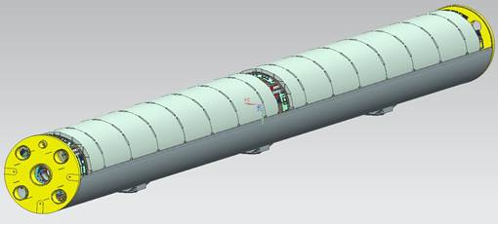
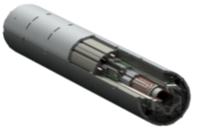
AUP MQXFA Magnet Deliverables
20 Magnets
  16 magnets for Q1/Q3 to be installed in LHC tunnel
  4 magnets for 2 Q1/Q3 commissioning spares
  (assuming: 4 re-assemblies = post test re-work)
  (assuming: 1 damaged during handling or shipment)
Magnet
(MQXFA)
Cold Mass
(LMQXFA)
Cryo-assembly
(LQXFA)

Slide 8

MQXFA Performance Requirements
Listed in Magnets FRS
Approved by CERN
Accepted by AUP
  approved July 2017
US-HiLumi-doc-36
Electronic signature on DocDB
Engineering & Equipment Data Management Service (EDMS)

Slide 9
Performance Requirements (FRS)
Requirements are classified into two groups:
  Threshold requirements (23) are requirements that the project must achieve.
  Objective requirements (6) are challenging requirements that the project should achieve and will strive to achieve.
All requirements are traceable
ID | Description
R-T-01 | The MQXFA coil aperture requirement is 150 mm. This aperture is the coil inner diameter at room temperature, excluding ground insulation, inner layer quench heaters, cold bore, and beam screens. (…)
R-T-02 | The MQXFA physical outer diameter must not exceed 614 mm.
R-T-03 | The MQXFA magnet must be capable of operate at steady state providing a gradient of 143.2 T/m in superfluid helium at 1.9 K and for the magnetic length specified in R-T-04, when powered with current of 17.9 kA.
R-T-04 | The MQXFA magnetic length requirement is 4200 ± 5 mm at 1.9 K.
R-T-05 | MQXFA magnets must be capable of operation in pressurized static superfluid helium (HeII) bath at 1.3 bar and at a temperature of 1.9 K.
R-T-06 | The MQXFA cooling channels must be capable of accommodating two (2) heat exchanger tubes running along the length of the magnet in the yoke cooling channels. The minimum diameter of the MQXFA yoke cooling channels that will provide an adequate gap around the heat exchanger tubes is 77 mm.
R-T-07 | At least 40% of the coil inner surface must be free of polyimide.

Slide 10
Acceptance Criteria for MQXFA Magnets
Acceptance Plan for Cryo-assembly has 3 parts with Acceptance Criteria:
Acceptance Criteria Part A for MQXFA magnets approved by CERN
  EDMS# 2031083
Accepted by AUP
US-HiLumi-doc-1103

Slide 11
Acceptance Criteria (with examples)
Based on Acceptance Plan for MQXB magnets (present IT quads at LHC)
Content: Verification Method, Procedure summary and References,

Slide 12
MQXFA Final Design Report
Final Design Report was reviewed by external team
  Details will be presented by L3s
FDR and Drawings are available on Review website
US-HiLumi-doc-948
Electronic signature on DocDB

Slide 13
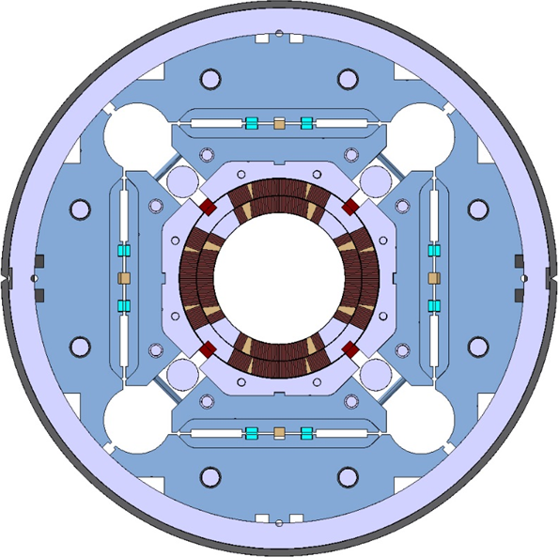
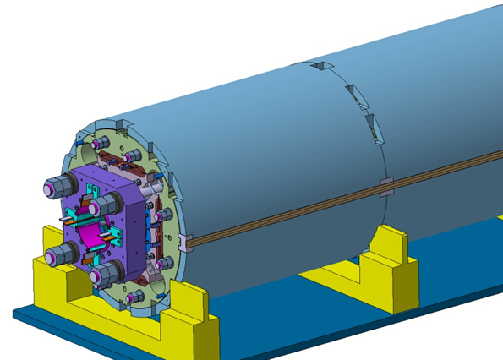
MQXFA/B Main Parameters
Parameter | Unit | MQXFA/B
Coil aperture | mm | 150
Magnetic length | m | 4.2/7.15
N. of layers |  | 2
N. of turns Inner-Outer layer |  | 22-28
Operation temperature | K | 1.9
Nominal gradient | T/m | 132.6
Nominal current | kA | 16.5
Peak field at nom. current | T | 11.4
Stored energy at nom. curr. | MJ/m | 1.2
Diff. inductance | mH/m | 8.2
Strand diameter | mm | 0.85
Strand number |  | 40
Cable width | mm | 18.15
Cable mid thickness | mm | 1.525
Keystone angle |  | 0.4
P. Ferracin et al., “Development of MQXF, the Nb₃Sn Low-β Quadrupole for the HiLumi LHC ” IEEE Trans App. Supercond. Vol. 26, no. 4, 4000207
G. Ambrosio et al., “MQXFS1 Quadrupole Design Report” LARP DocDB 1074

