Slide 1
Strand verification testing at the NHMFL
Jun Lu and Jeremy Levitan
Magnet Science and Technology Division, NHMFL
Strand Production Readiness Review, 22 Aug 2019

Slide 2
About our team
Team members
Jun Lu, PhD physics,1999, Nb₃Sn testing since 2006
Jeremy Levitan, B.Sc. Mech. Eng. 2015, Nb₃Sn since 2016
Relevant project experiences
RRP Nb₃Sn quality assurance tests for NHMFL series-connected hybrid magnet.
Heat treatment, Ic, RRR, hysteresis loss, etc.
The only ITER Nb₃Sn verification lab in the US
Heat treatment, Ic, RRR, hysteresis loss, etc.
Tested total of over 1600 samples.
Completed in time under budget.
Strand Production Readiness Review, 22 Aug 2019

Slide 3
Outline of this talk
Project management
The test facility
Heat treatment
Critical current test
RRR test
Test results
Summary
Strand Production Readiness Review, 22 Aug 2019

Slide 4
Flow chart of each verification test cycle
Verification samples are taken by supplier at the same time, and adjacent to, QC samples. Samples are shipped to NHMFL → Cooley
Samples and test requests from Lance Cooley
Receiving inspection/ Labeling if necessary
Heat treatment and tests
Report I_{c} and RRR to Vito Lombardo (CAM) by email; copied to Cooley
Send remaining wire to LBNL archive
Archive the raw data
Strand Production Readiness Review, 22 Aug 2019

Slide 5
Project management
Procedures are well developed.
Benchmarking with OST during NHMFL SCH project.
ITER world-wide benchmarking; ITER annual x-checks.
Benchmarking within LARP.
Data reporting and security
Data are reported in a timely manner to Vito, copied to Lance.
Vito is CAM; Work at NHMFL is a sub-contract to FNAL
Raw data are secured in NHMFL network and can be accessed only by the team members.
ES&H: in compliance with the safety practice of the NHMFL which implemented an integrated safety management system.
Risks:
Magnet failure. Another magnet at the NHMFL may be used temporarily to mitigate this risk.
Hurricane: Tallahassee has no major flooding threat, therefore delay should be no more than 2 months.
Strand Production Readiness Review, 22 Aug 2019

Slide 6
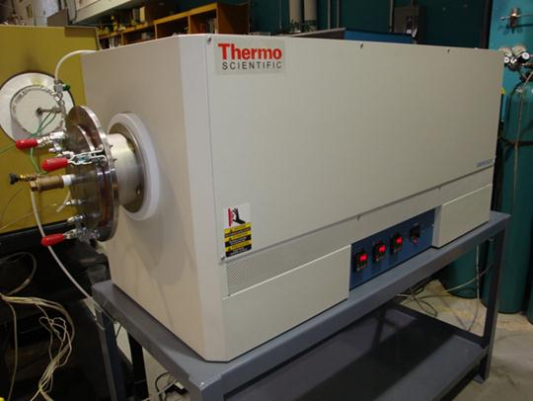
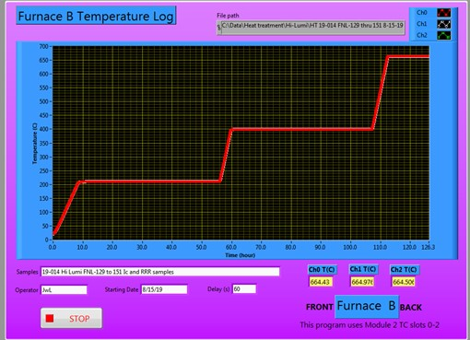
Heat treatment facility
4 furnaces: 6” diameter, 36” long 3 zone furnaces. Each can take 30 I_{c} and RRR samples.
Inconel retort, Ar purge and flow (100 SCCM). 4 psi positive Ar pressure.
I_{c} and RRR samples heat treated at the same time.
LabVIEW data monitoring. 3 thermocouples over 12” central zone.
Furnace
Temperature Trending Program
Strand Production Readiness Review, 22 Aug 2019

Slide 7
A typical T trend during heat treatment
Three K-type thermocouples reading within 5 deg.
Thermocouples are replaced annually.
Strand Production Readiness Review, 22 Aug 2019

Slide 8
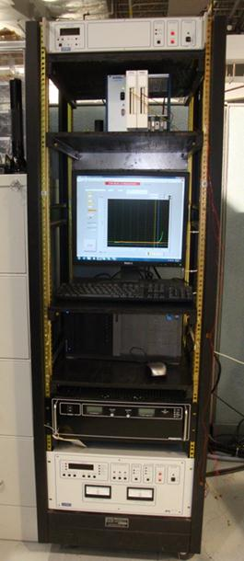
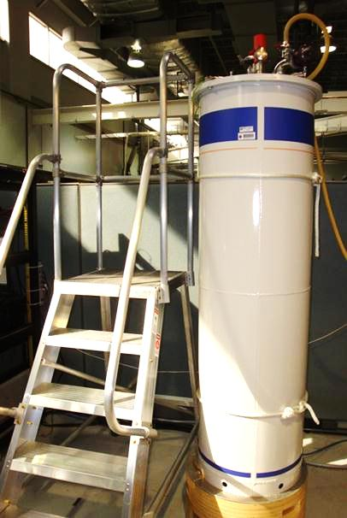
I_{c} testing facility
Oxford 52 mm bore 15/17 T magnet, 0.1% field homogeneity.
Ametek 0-1000 A PS, NI SCXI-1000 DAQ, LabVIEW programs.
I_{c} probes capable of up to 1000 A at 4.2 K.
NI SCXI
Oxford 15/17 T
I source
Magnet power
Strand Production Readiness Review, 22 Aug 2019

Slide 9
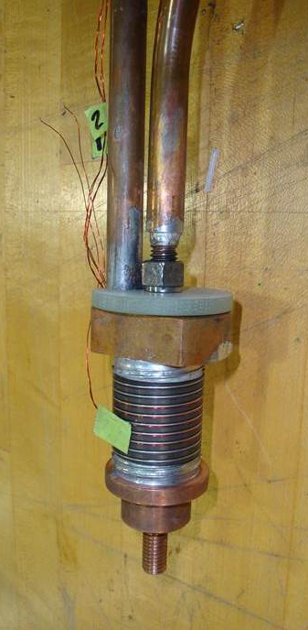
I_{c} test probe and sample mandrel
Standard ITER Ti-6V-4Al barrel. 4 slotted roll pins to connect to each Cu terminal ring.
Pressure contact between sample and the probe,
Both 25 and 50 cm (reported) V-taps.
Strand Production Readiness Review, 22 Aug 2019

Slide 10
I_{c} sample prep
Heat treat on the test mandrel. No wire transfer after HT.
1 kg winding tension before heat treatment.
After HT, wire is loose. retighten carefully by pressing the wire onto the mandrel while moving along the helical groove. It’s a delicate operation and critical.
Retightening is necessary to a reliable and accurate I_{c} results.
Strand Production Readiness Review, 22 Aug 2019

Slide 11
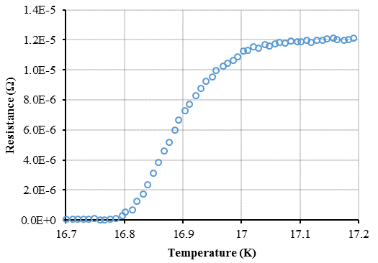
Residual Resistance Ratio (RRR)
Four probe R vs. T measurement with +/- 1A current input.
Cool down to 4.2 K, take measurements while samples naturally warming up.
Eight 150 mm straight sample in contact with a horizontal G-10 plate.
A Cernox temperature sensor glued on the G-10 plate. Warm up rate < 20 mK/s.
R vs. T data are analyzed to obtain R_{273K}/R_{20K} or R_{295K}/R_{IEC} (Hi-Lumi)
RRR probe
Samples
Cernox
Strand Production Readiness Review, 22 Aug 2019
Notes:
Z:\MS&T\Materials Development and Characterization\Physical Properties\Other projects\Other data\Resistance measurements\RRR\ACE 2mm 11-14-05
Z:\MS&T\Materials Development and Characterization\Physical Properties\Other projects\Other data\Resistance measurements\ITER Copper Perer Bauer

Slide 12
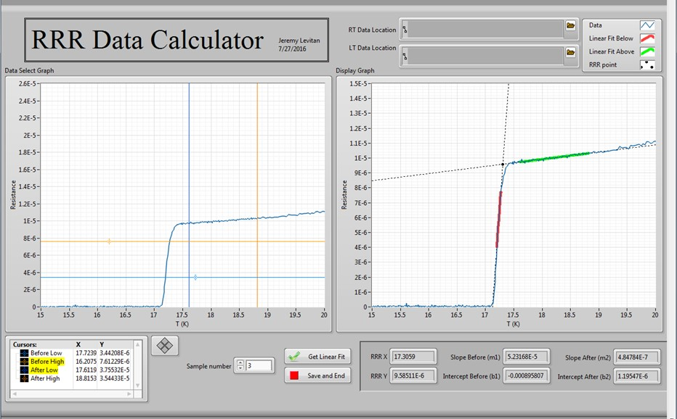
IEC RRR data analysis program
Allows efficiently analyze large number of data sets.
Strand Production Readiness Review, 22 Aug 2019

Slide 13
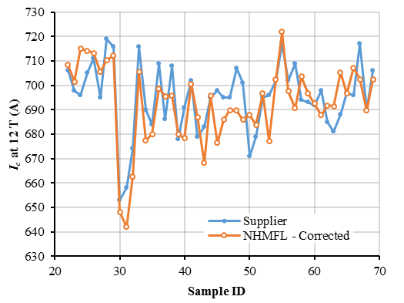
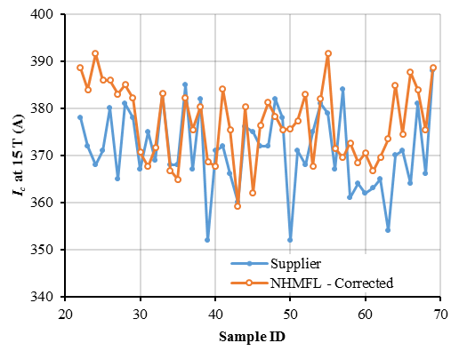
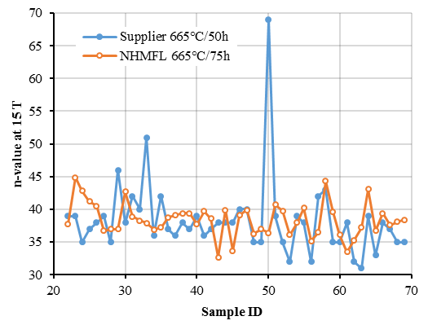
I_{c} results
FNAL did not convey the change of HT time from 75 h to 50 h. So our I_{c} data were systematic difference from those of the supplier.
After 4.7% and 2.8% corrections for 15 T and 12 T data*, the results are in agreement with the supplier’s.
* J. Levitan, et al., IEEE Tran. Appl. Supercond. (2019) 6000904
Strand Production Readiness Review, 22 Aug 2019

Slide 14
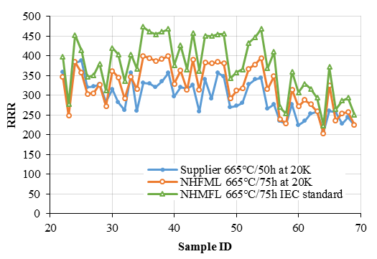
RRR results
Systematic differences are due to the difference in heat treatment and RRR definitions,
Strand Production Readiness Review, 22 Aug 2019

Slide 15
Summary
NHMFL has ample experiences of testing large volumes of Nb₃Sn strands for quality assurance.
The existing facilities and personnel are well prepared and meet the requirement of the quality plan.
Data security, personnel safety and project risks are evaluated.
We have successfully tested 107 samples for LARP. So far, our results track those of supplier’s well.
A testing work flow path has been established. Tests and reports have been timely.
Strand Production Readiness Review, 22 Aug 2019

Slide 16
Outlook
Average of 100 tests per year is well within the capability of our facility and personnel
A batch of 20-50 samples will take about a month to complete.
Helium price has doubled since our last contract.
Cost per test remains below that at FNAL (Opportunity RO-302-2-02-003)
Acknowledgement
NHMFL is supported by NSF through NSF-DMR-1157490 and 1644779, and the State of Florida.
Strand Production Readiness Review, 22 Aug 2019

