Slide 1
302.2.02 Strand Procurement Production Readiness Review Cost and Schedule
Vito Lombardo – L3 Deputy Manager and CAM for 302.2.02

Slide 2
Organization
US HL-LHC Accelerator Upgrade Project: 302.2 MQXFA Magnets Fabrication
Control Account
MQXFA Magnets
Fabrication
302.2
L2: G. Ambrosio
(M. Baldini)
Magnet Design, Integration and Coordination
302.2.01
L3/CAM: G. Ambrosio
(M. Baldini)
Strand Procurement and Testing
302.2.02
L3: L. Cooley
(V. Lombardo)
CAM: V. Lombardo
Cable Fabrication
302.2.03
L3/CAM: I. Pong
(C. Sanabria)
Coil Parts, Materials, and
Tooling Procurement
302.2.04
L3/CAM: M. Yu
(A. Nobrega)
Coil Fabrication at FNAL
302.2.05
L3/CAM: A. Nobrega
(M. Yu)
Coil Fabrication at BNL
302.2.06
L3/CAM: J. Schmalzle
(M. Anerella)
Structure Fabrication and
Magnets Assembly
302.2.07
L3/CAM: S. Prestemon
(D. Cheng)
US-HiLumi Document 104

Slide 3
Dollarized RAM
Budget covers scope approved under CD3a and CD3b
Account is mostly driven by M&S for large procurements
Includes budget approved via BCR to reflect changes in cable HT verification and witness samples

Slide 4
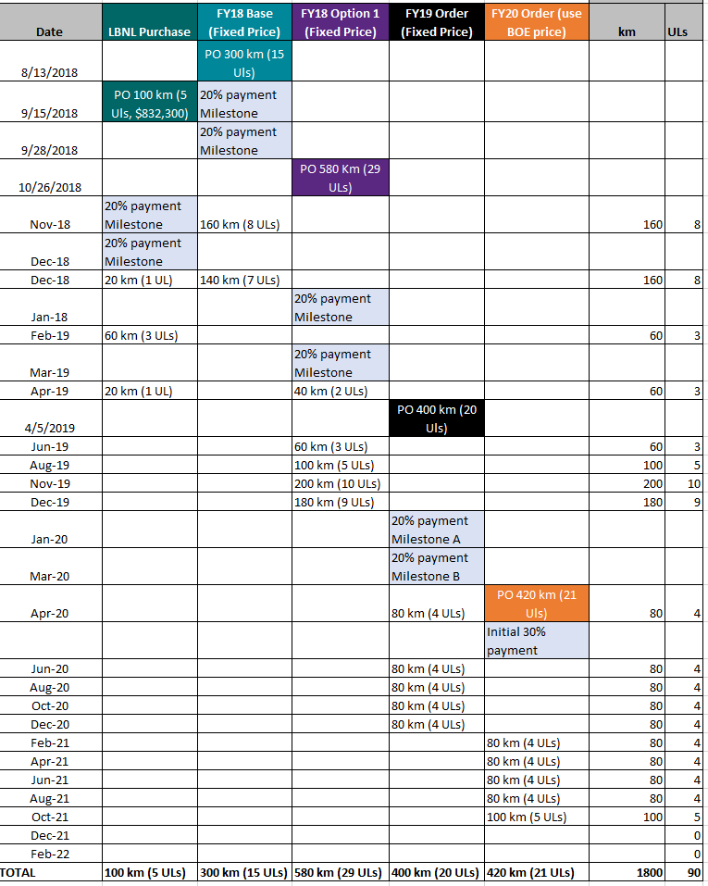
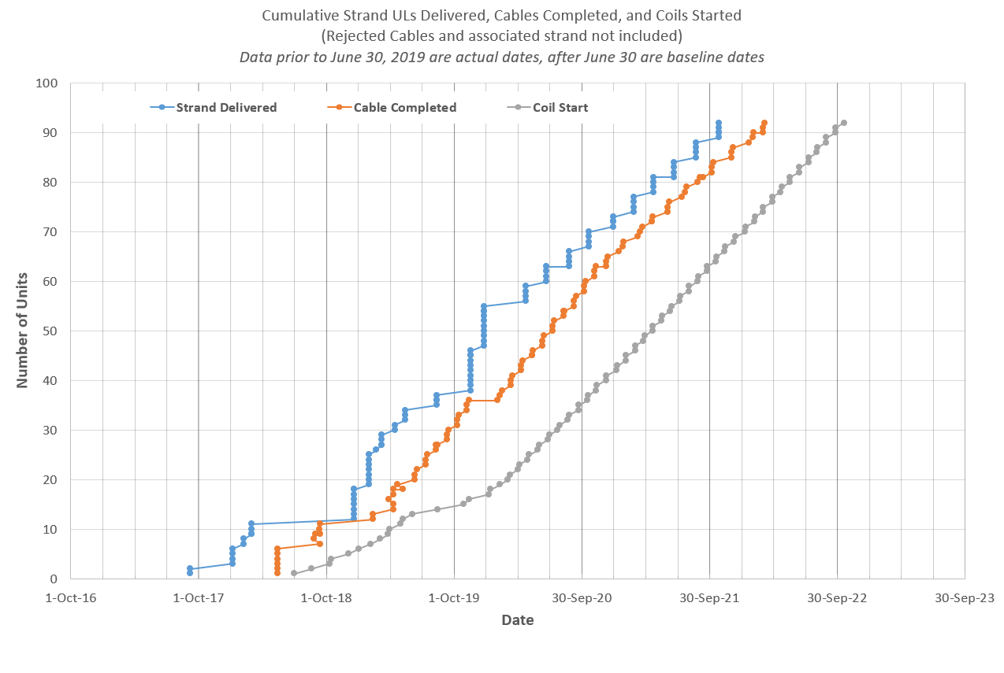
Schedule and float at glance
TODAY
Plot updated on 8/20/19

Slide 5
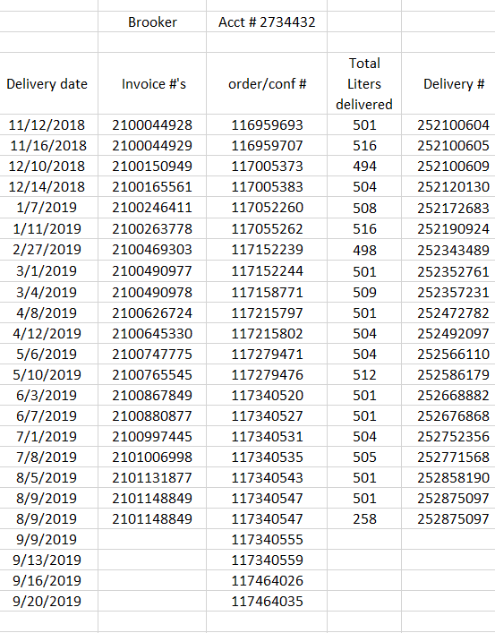
LHe cap at vendor
LHe cap at the vendor could have severely delayed QC and strand deliveries.
To avoid schedule slippage, Fermilab has been providing LHe dewars directly to the vendor
This seems to be a viable solution for the rest of the AUP strand procurements.
Deliveries are logged and costs associated with LHe procurement is credited back to the project at the end of each PO.

Slide 6
302.2.02 at a glance
The account is healthy both from a cost and schedule stand-point

Slide 7
Charge Questions
Cost and Schedule: Are the cost and schedule estimates sufficiently well-defined and of adequate maturity to support these activities during series production?
Lead time for AUP strands is understood and fully captured in P6.
Vendor is extremely responsive and has demonstrated to be able to meet and sometimes exceed project’s needs.
P6 delivery schedule is actively maintained via BCR every time a procurement is placed.
Fermilab’s RFP logistics and timing are understood.
Current P6 schedule allows comfortable float to all tasks in the account.
Only one large procurement left to place (420km out of 1800km).
FY18 and FY19 RFPs came in at budgeted levels (1380km out of 1800km).
Risk of price increase is now pretty low, but still captured in risk register.
Budget to execute quality plan is available. People and facilities are assigned to the project.
June BCR fully approved and implemented in P6 to fund the execution of testing recommendations from cable PRR.
Adequate contingency is available in the form of risks captured in risk register.
This is a very large account. Any deviation from the baseline has meaningful impact to project’s metrics.
EVMS numbers tracked since Jan 2019 show the account has been delivering on its scope on schedule and on budget. We expect to keep this up to completion.
The account is ready for series production.

