Slide 1
MooD Summary
Attempt at a brief summary
Necessarily biased and incomplete
No vetting yet for political correctness (Criticisms accepted)
Nevertheless…

Slide 2
My impression of this workshop…
Many very interesting and exciting ideas
Good discussion and good company
I believe that we can make a compelling case for further development of noble liquid TPCs
A good start to generating enthusiasm and planning for the Module of Opportunity for DUNE
…to borrow a phrase
Faster, Better, Cheaper
Stefan’s introduction of the Module of Opportunity

Slide 3
My comments towards the Module of Opportunity
DUNE needs to keep its eye on the ball building the first two modules and the LBNF infrastructure (this is in the US CD-2 plan).
The LBNF project will have built an outstanding underground facility in a powerful beam…
…there is space for additional detectors: A compelling case can be made (It is obvious) to develop the collaborations/teams to advance detector development towards the Module of Opportunity
We have opportunities to push within the US system to invest in Basic Research Needs for LArTPCs
Let us make sure this R&D advances in parallel with the Project.
My crystal ball is cloudy, but I think we want to be ready to build or deploy this in ~a decade.

Slide 4
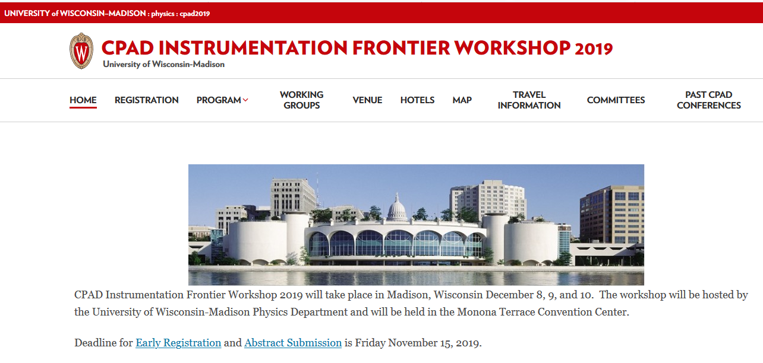
CPAD (Coordinating Panel for Advanced Detectors)
https://wp.physics.wisc.edu/cpad2019/

Slide 5
Basic Research Needs (BRN) Study on HEP Detector Research and Development (R&D)
DOE has launched a BRN study to inform future directions of instrumentation
Website: http://doe-brn-hep-detectorrandd.physics.ox.ac.uk

Slide 6
Goals
The Detector R&D BRN Study will:
  Survey the present state of the HEP technology landscape.
  Identify key capabilities and associated performance requirements to enable HEP science drivers.
  Identify technologies to provide or enhance such capabilities.
  Articulate long-term Priority Research Directions to push well beyond the current state of the art, potentially leading to transformative technological advances with broad-ranging applicability; flesh out the required R&D efforts with deliverables with notional timelines and key technical milestones along the way; and elucidate the technical infrastructure required to support these efforts.
  Formulate a small set of instrumentation Key Challenges that could, if addressed successfully, result in game-changing experimental capabilities.

Slide 7
Input is requested from the community!
Several emails have been sent by different groups to provide inputs (e.g. Noble Liquids, Neutrino Physics, …). The website also has links for confidential input forms. Email the conveners directly. CPAD workshop will also be a good place for inputs.
It’s important that the community’s view points are well represented. You have until 10 December 2019 to provide input!
This workshop is a great opportunity to provide input and conveners will be expecting inputs.

Slide 8
Info on conveners
The Conveners of the BRN Study are:
The Higgs as a tool for discovery: Jim Hirschauer (FNAL) Gabriella Sciolla (Brandeis)
The physics of neutrino mass: Ornella Palamara (FNAL) Kate Scholberg (Duke)
The new physics of dark matter: Jodi Cooley (SMU) Dan McKinsey (Berkeley)
Cosmic Acceleration: inflation and dark energy: Clarence Chang (ANL) Brenna Flaugher (FNAL)
Exploring the unknown: new particles, new interactions and physical principles:
Sarah Demers (Yale) Monica Pepe Altarelli (CERN)
Quantum Sensors: Andy Gercai (Northwestern) Kent Irwin (Stanford)
Noble Liquids: Roxanne Guenette (Harvard) Jocelyn Monroe (RHUL)
Calorimetry: Francesco Lanni (FNAL) Roger Rusack (Minnesota)
Solid State (tracking and vertexing): Marina Artuso (Syracuse) Carl Haber (LBNL)
Photodetectors: Lindley Winslow (MIT) Peter Krizan (Jožef Stefan Institute)
TDAQ: Darin Acosta (Florida) Tulika Bose (Wisconsin)
Readout and ASICs: Gabriella Carini (BNL) Mitch Newcomer (Penn)
Cross Cut: Marcel Demarteau (ORNL) Abe Seiden (UCSC)
The Chairs of the BRN Study are:
Bonnie Fleming (Yale) Ian Shipsey (Oxford)
The DOE BRN Study liaisons are:
Glen Crawford (DOE) and Helmut Marsiske (DOE)

Slide 9
Intro to DUNE
Stefan

Slide 10
Module of Opportunity
Elizabeth
Stefan

Slide 11
Phenomenology perspective
Peter

Slide 12
Gd-water
Pablo

Slide 13
Theia: Wb-LS
Michael

Slide 14
Theia: Wb-LS
Mike

Slide 15
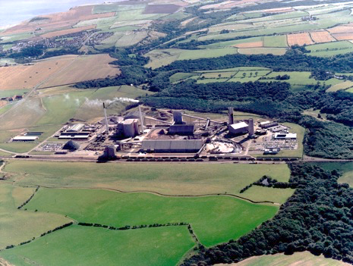
The Advanced Instrumentation Testbed AIT will enable real-world, at-scale testing of antineutrino-based monitoring technologies for nuclear reactors
UK’s Underground Science Facility at Boulby has agreed to host AIT
(AIT) will house the world’s first experiment dedicated to exploring the viability of remote reactor monitoring
Depth is ~3600 feet (2850 mwe) compared to ~4850 ft Homestake depth
AIT will accommodate follow-on experiments for nonproliferation and/or physics
Adam
With advance planning, follow-on experiments could develop technologies for DUNE and other fundamental physics experiments

Slide 16
Coherent Captain-Mills (CCM) Experiment
Maximizing Scintillation Light Detection
Richard

Slide 17
JUNO
Jiajie

Slide 18
Liquid0 (opaque scintillator)
Pedro

Slide 19
ARAPUCA Light Detection
Light Readout
Flavio

Slide 20
Dichroic filters for Cherenkov/scintillation separation
Tanner

Slide 21
Active ganging in LAr ARAPUCA
Gustavo

Slide 22
nEXO
Liang

Slide 23
Xe doping
Denver

Slide 24
Reflective Foils
Andrzej, Marcin

Slide 25
Discussion of LArTPC light readout
Should MooD have a different light/charge ratio?
How much light can we get at 500 V/cm?
Flavio

Slide 26
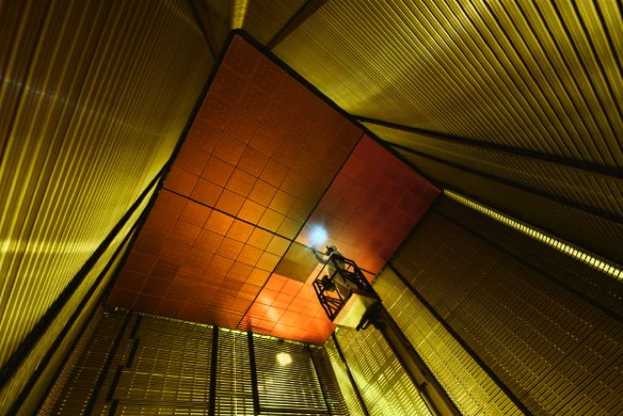
Vertical Drift SP TPC
Projective Charge Readout
First introduced at the CERN mini workshop in June 2019
Based on the easier assembly concept of the DP field cage
6m drift, 300KV technology almost acquired. Could be tested in the NP02 layout
Less requirements on purity as for the case of a DP 12m drift
Easy to install, because very modular
Francesco
Cathode, similar to the DP one, transparent, made of small tubes
Anode structure can be supported in the same way as done for DP, but must be more rigid then a standard wire APA
SP cold electronics similar to the one already planned (top anode cables short, bottom anode cables long, not very different then SP baseline)
Embedded in the same FC concept as the DP
cryostat
Unit = 3m x 3m
anode
Support wires
6m drift
Cathode (300KV)
6m drift
anode

Slide 27
Summary
The proposed Single Phase Vertical drift concept is largely based on the more flexible DP design for the FC and Anode supports
Several Anode Plane choice could be studied: optimization campaign could start soon in existing facilities
Newly proposed concepts for photon detectors could also be implemented
Mechanical design, assembly and installation sequence to be detailed
A dedicated R&D program could start immediately
Francesco

Slide 28
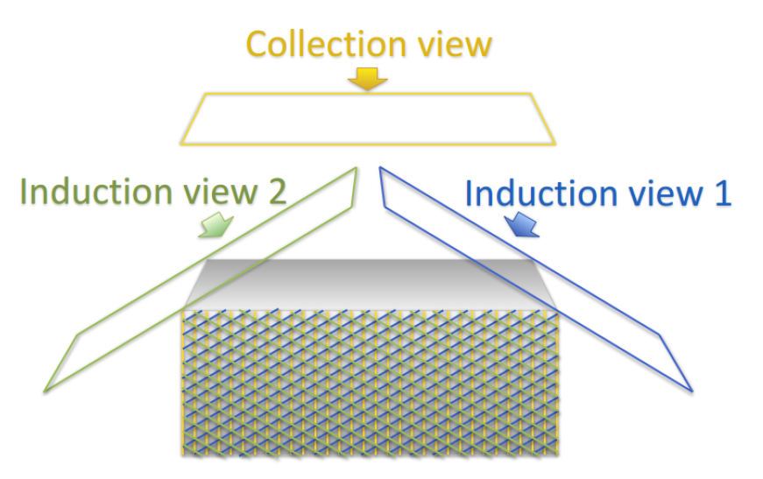
Axial Projective Charge Readout
Xin
Made by Georgia Karagiogi
Advantage:
  Reduce number of electronics readouts → Ensuring fully active tracking calorimeter (homogeneous LAr volume
  + continuous readout satisfying Nyquist sampling theorem)
Disadvantage:
  Ambiguities inside readout-plane directions
How many projective views are necessary?
What is the best detector orientation?
Use multiple 2D projective views to reconstruct 3D images of interaction events
Non-destructive induction view is commonly used to ensure intact clone of the original 3D image

Slide 29
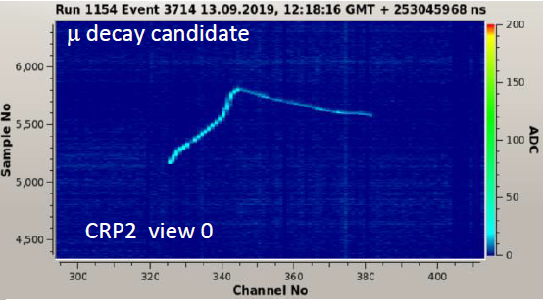
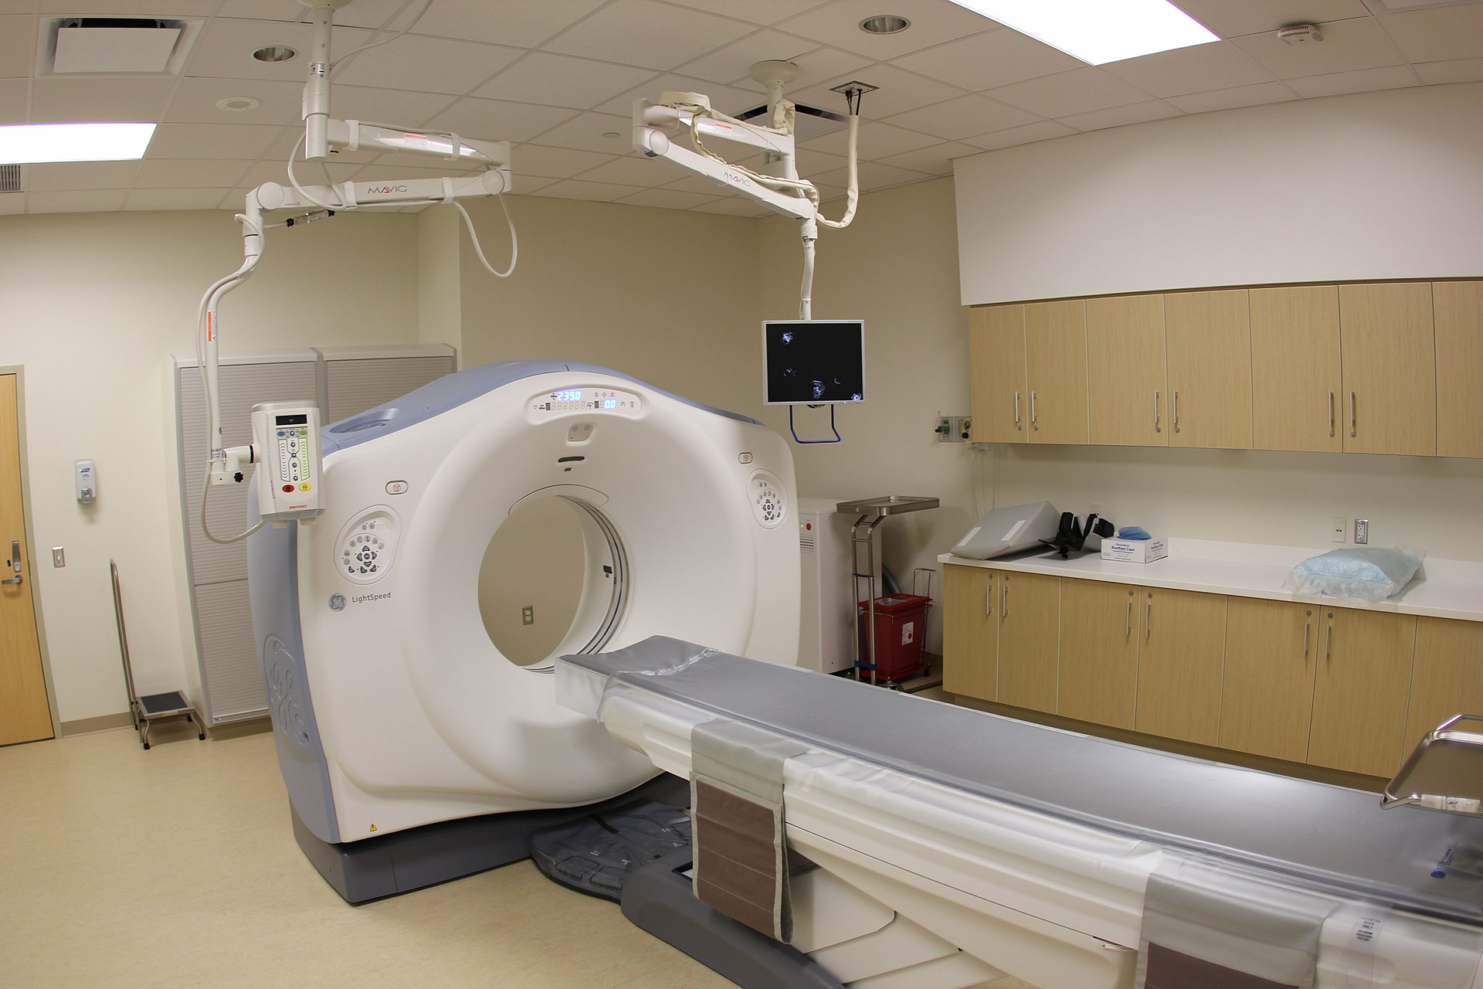
How many projective views are necessary (I)?
Xin
Not an easy question to answer
  Particle detectors typically have at least two
  views, as 3D reconstruction requires
  minimally two views
Answer depends on the complexity of
object, bounds are available
  For non-isochronous simple track(s), two
  views are generally sufficient (see
  Pandora’s cosmic muon reconstruction)
  In a CAT scan in hospital, typically
  more than 1000 views with 2π coverage
  (human body is complex)
ProtoDUNE-DP
Wikipedia

Slide 30

Summary for the “Module of Opportunity”
Xin
Three views are essential for the generic 3D automated event reconstruction on LArTPCs with projective charge readout
  More views are even better for reconstruction
Perpendicular TPC orientation (w.r.t. beam) would significantly reduce ambiguities with projective charge readout for beam interaction events
  New ideas and progress (DL-SP and MP-SP in development) may conquer the challenges in TPC signal processing for the perpendicular TPC orientation option

Slide 31
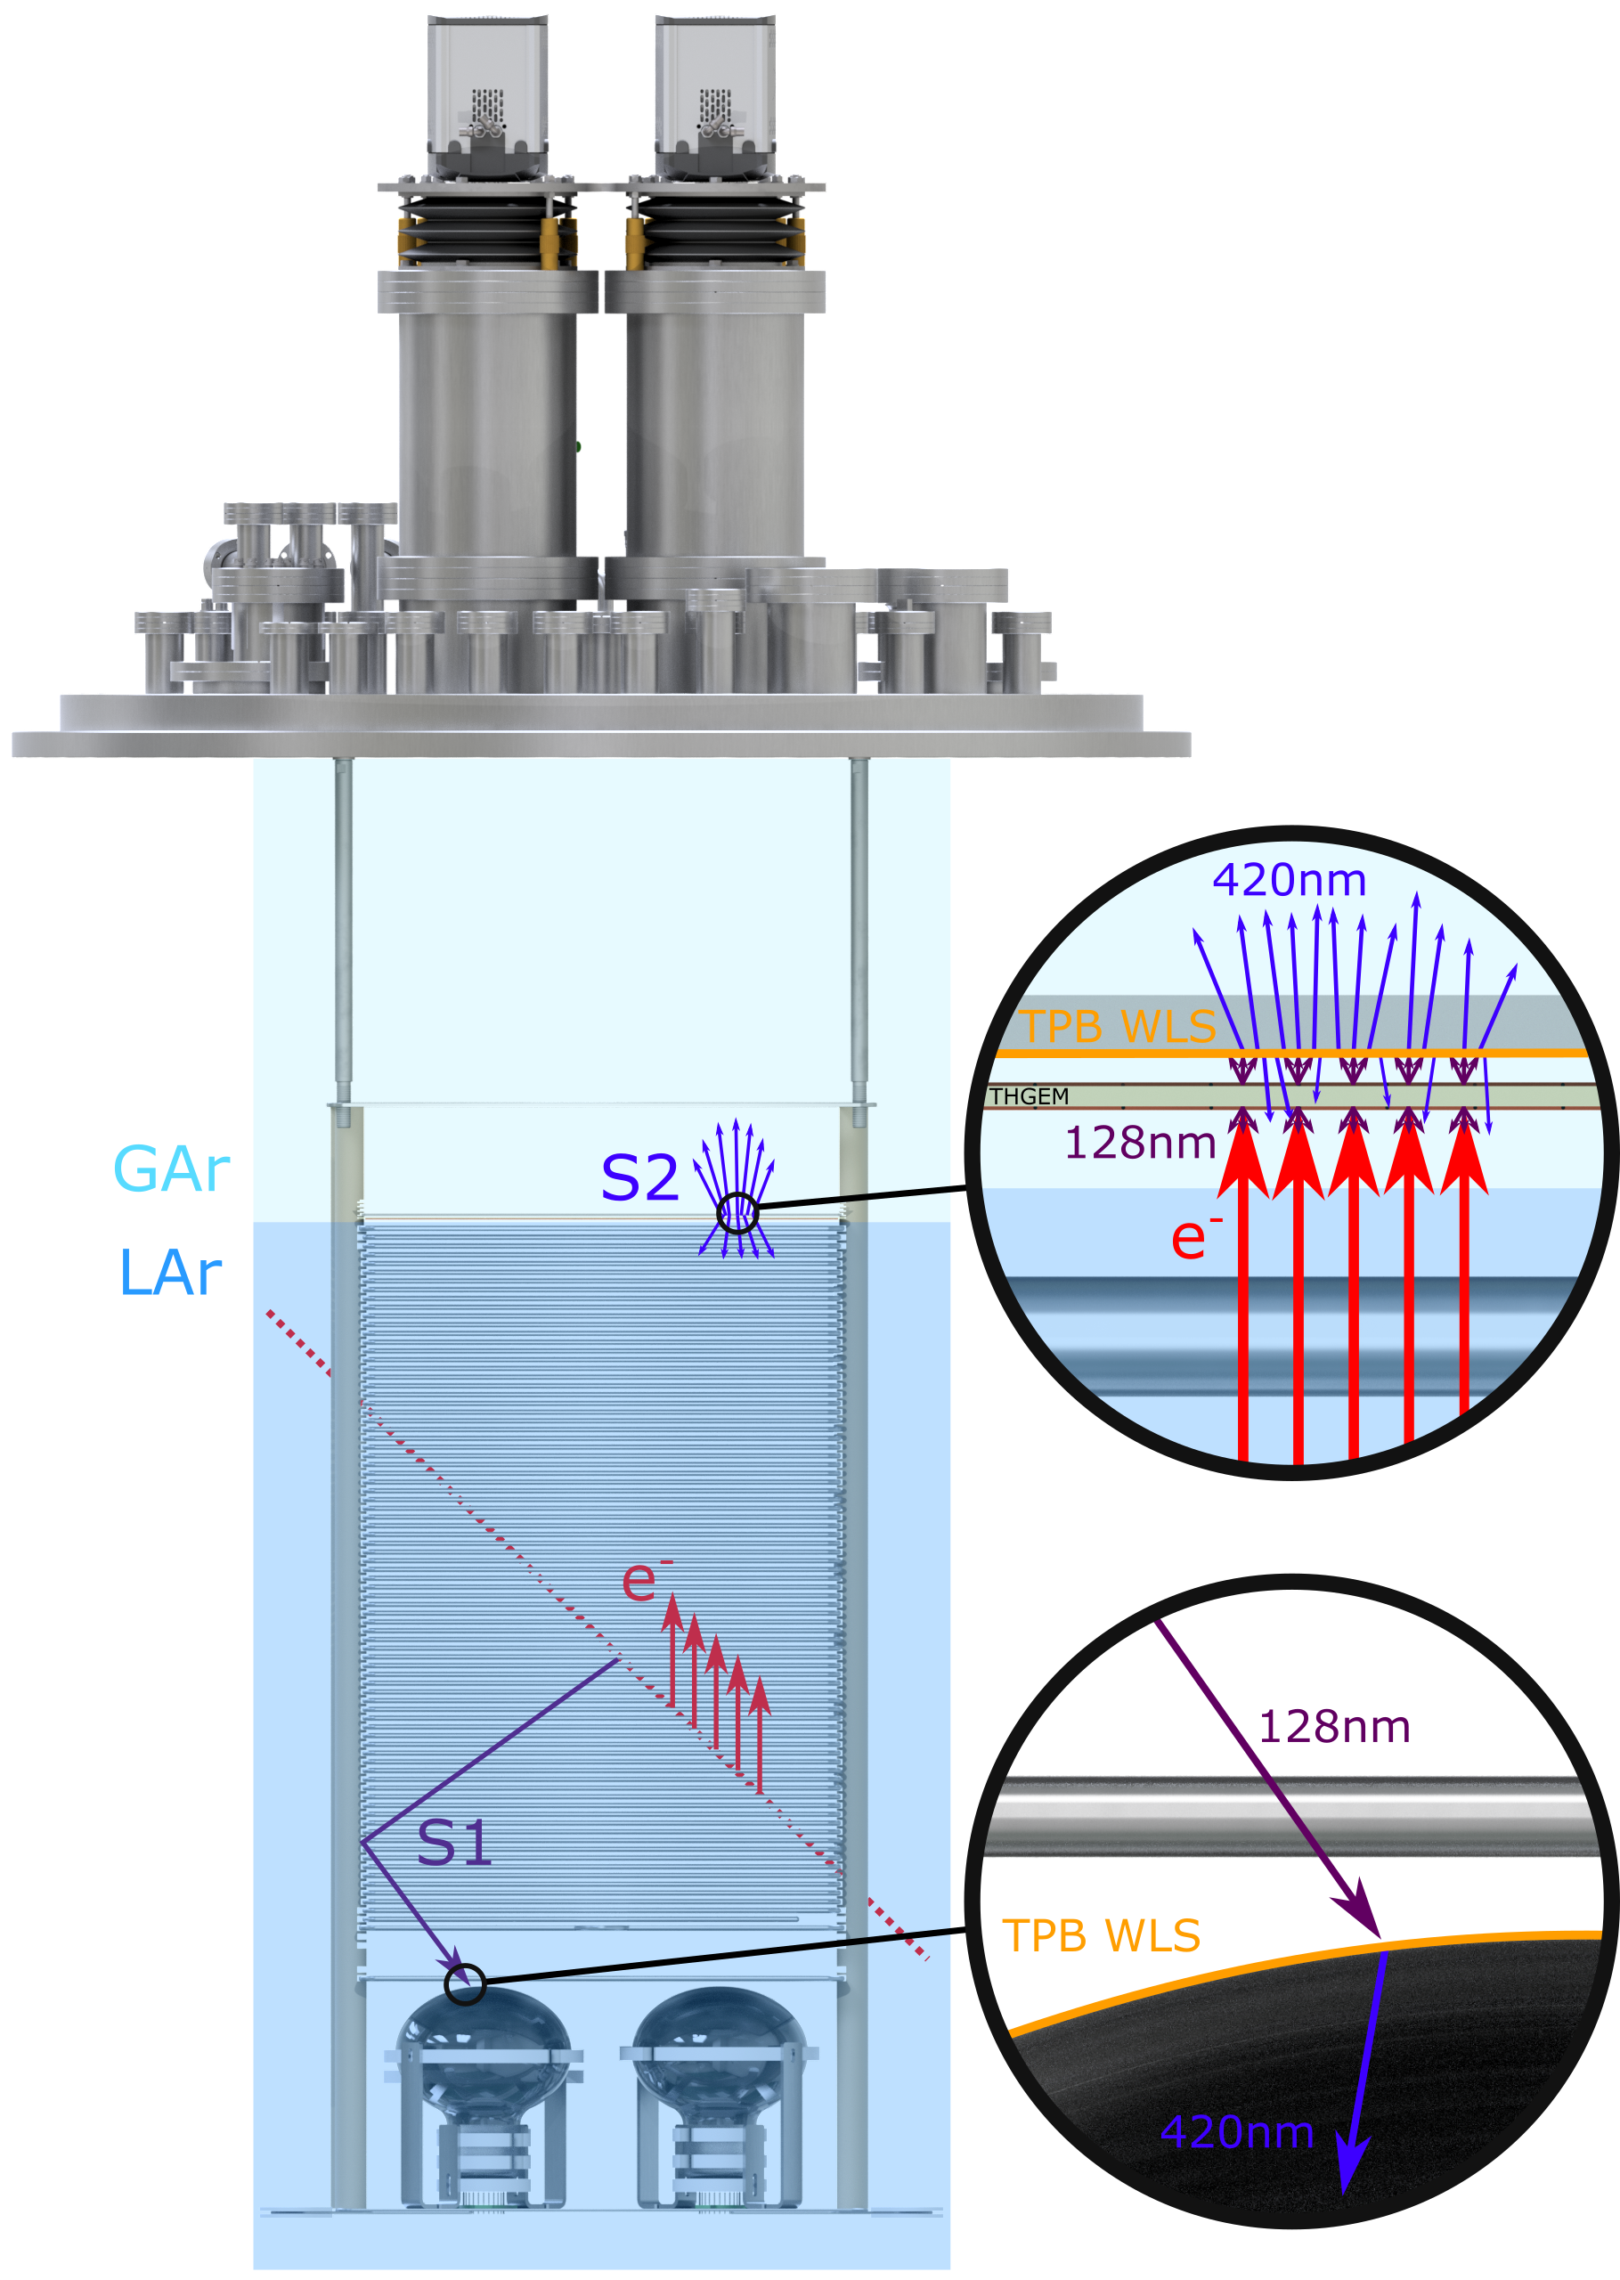
Dual Phase Optical TPC
Operation & Benefits
ARIADNE - developing optical readout, as an alternative to charge.
Kostas
Benefits over previous charge readout techniques:
High resolution — For e.g. an EMCCD sensor is 1024x1024 pixels (run with 4x4 binning ≈ 1mm resolution).
Sensitivity to low energies — gain is generated in the THGEM (~100s of photons per accelerated e⁻); cameras can be sensitive to single photons.
Very low noise — Externally mounted cameras are decoupled from TPC electronic noise sources.
Ease of access — Cameras can easily be replaced or upgraded - particularly useful during long-term cryogenic running.
Cost efficient (No need for thousands charge channels used in previous charge readout technology)

Slide 32

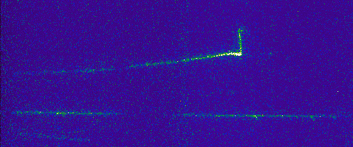
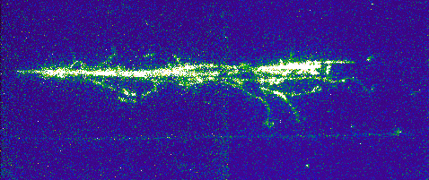
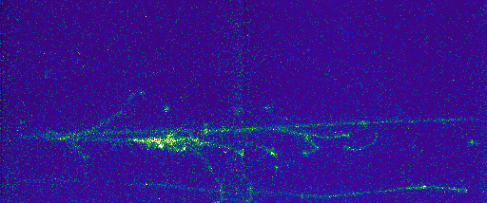
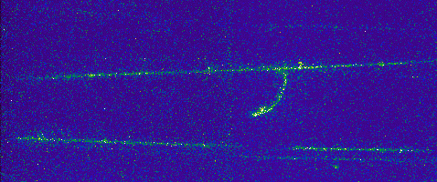
Beamline Events
1.1mm / pixel resolution (4x4 bin)
(@Low THGEM gain 27 kV/cm)
Kostas
0.4m
0.4m

Slide 33
Conclusions –Next steps
Technology is mature and ready to go now. From here on is all about improvements and dedicated optimization for the specific detector
  Plans to test a VUV sensitive intensifier to remove the need of TPB
  Further in the future bring the cost even lower by alternatives to intensifiers
  TPX4 is coming soon
Plan to start commissioning the large scale detector at CERN in spring 2020.
  Please let us know if you would like to get involved (maybe we need to create a working group).
Kostas
Thank you

Slide 34
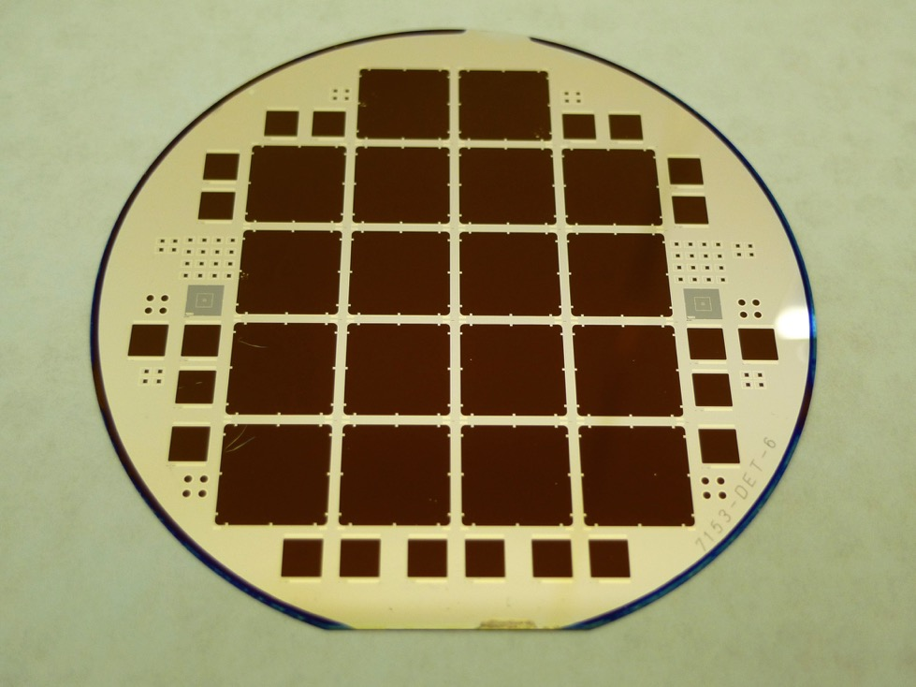
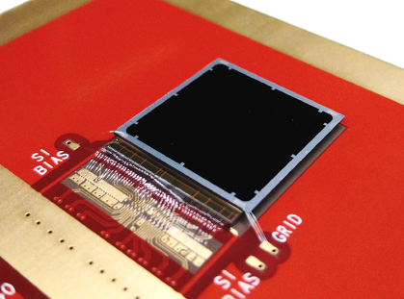
Timepix3
Andrei
Thin window optical sensors
Timepix3 ASIC: spin-out of R&D for LHC, commercialized by CERN
256 x 256 array, 55 x 55 micron pixel
  14 mm x 14 mm active area
1.5 ns timing resolution
Data-driven readout, 80 Mpix/sec, no deadtime
each pixel measures time and flux, ~1us pixel deadtime when hit
Threshold ~ 700 photons so not single photon sensitive
  arxiv: 1707.06253, 1902.01357
Sensor is bump-bonded to chip
Developed at BNL, produced at CNM (Barcelona, Spain)
Surface preparation inspired by astronomical CCDs (LSST)

Slide 35
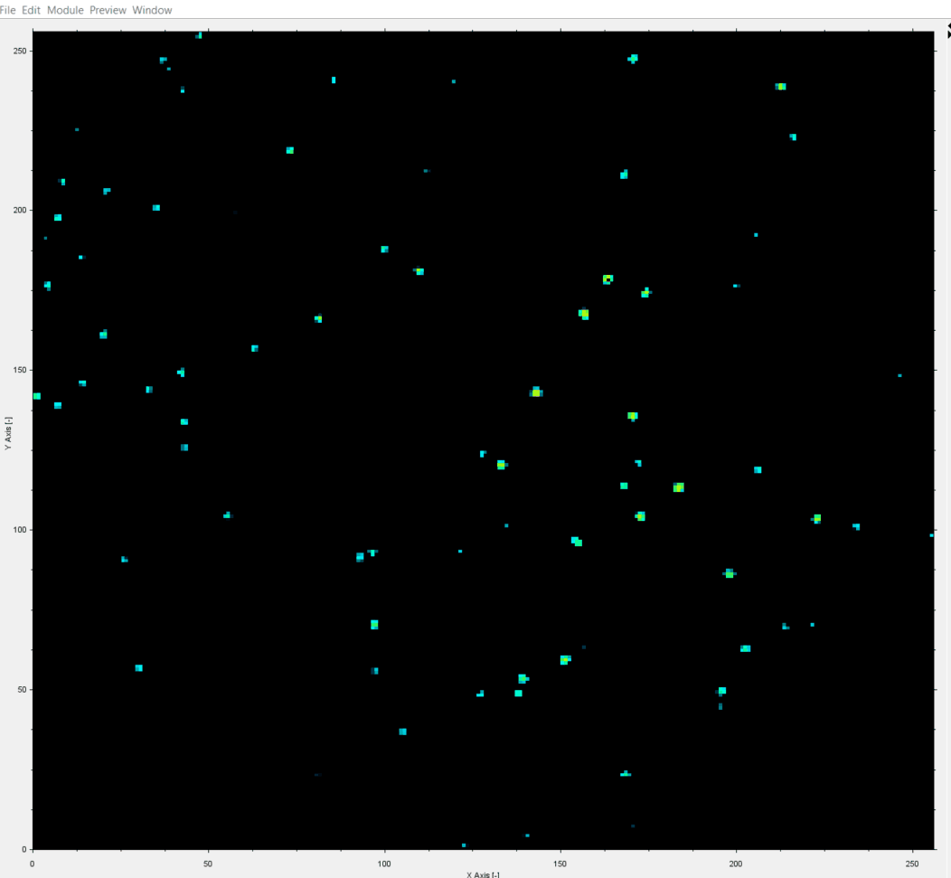
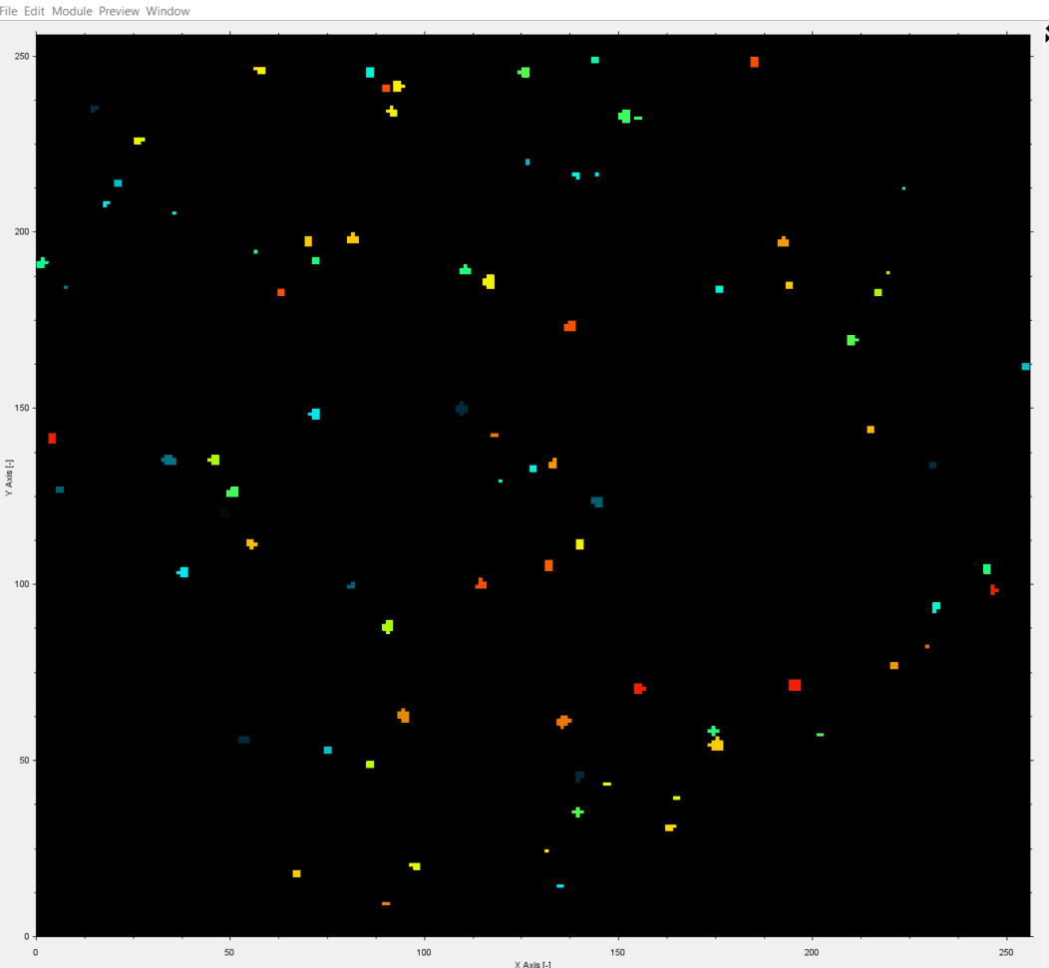
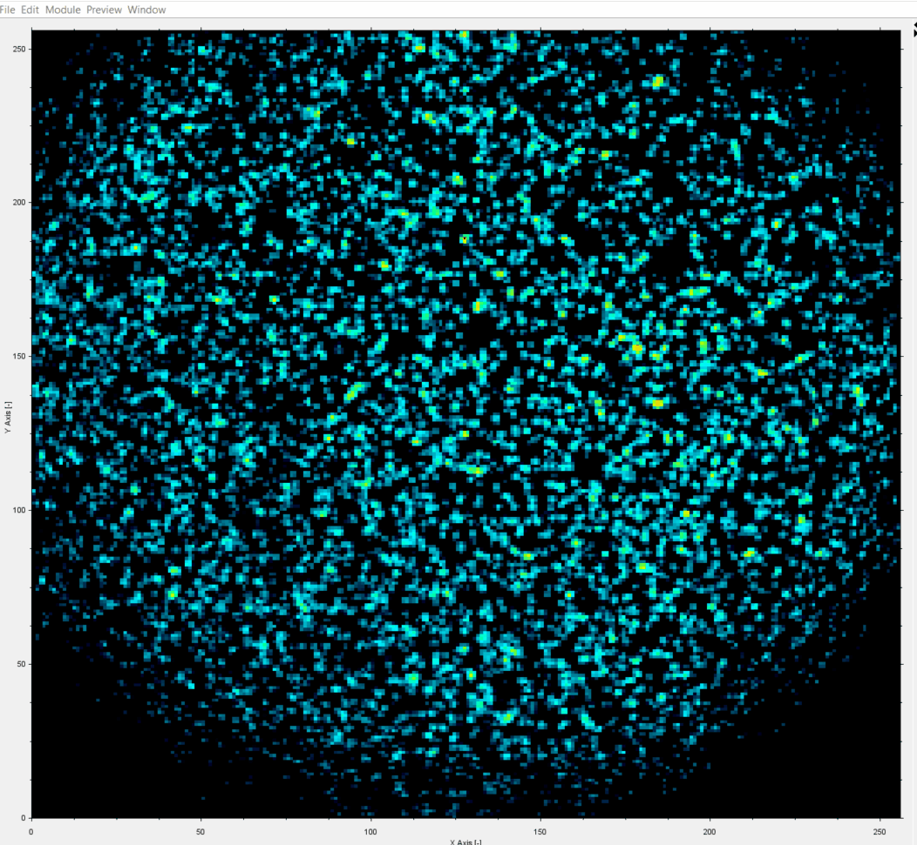
Single Photons in Tpx3Cam
  Time stamping of optical photons with data-driven readout is attractive alternative to frame readout
  Works well for sparse data
  Needs intelligent pixels with complex functionality
  Timing resolution: 10 nsec → 0.1 nsec
  Photon sensitivity: 1000 photons → single photon
  Mature technology for DUNE dual-phase LAr TPC
1 ms slice of data
1.5ns time-stamping
Andrei
TOT
TOA
Tpx3Cam + intensifier by Photonis
data taken by J. Long (ASI)
TOT

Slide 36
New ideas for gain
Shikma

Slide 37
Introduction
Design Concepts for PCB Based APAs
Bo
In the past years a dedicated R&D program was carried out at CERN aiming at replacing the LAr-TPC wire chamber with perforated multilayer printed circuit board (PCB), where fragile wires are replaced by robust copper strips:
Electrons are 2D focused in the PCB holes
Strips in the front and intermediate layers sense induction signal
Strips on last plane collect the ionization electrons.
The idea was driven by several possible improvements wrt wire chambers:
Most components can be mass produced commercially
The anode plane is robust, without risk of broken wires, has simpler support structure
Possibility of integrating the FE electronics on the PCB
Better segmentation / modularity, the possibility to test the full readout before installation
The design took advantage of the technological development of wide area Thick-Gems at CERN.

Slide 38
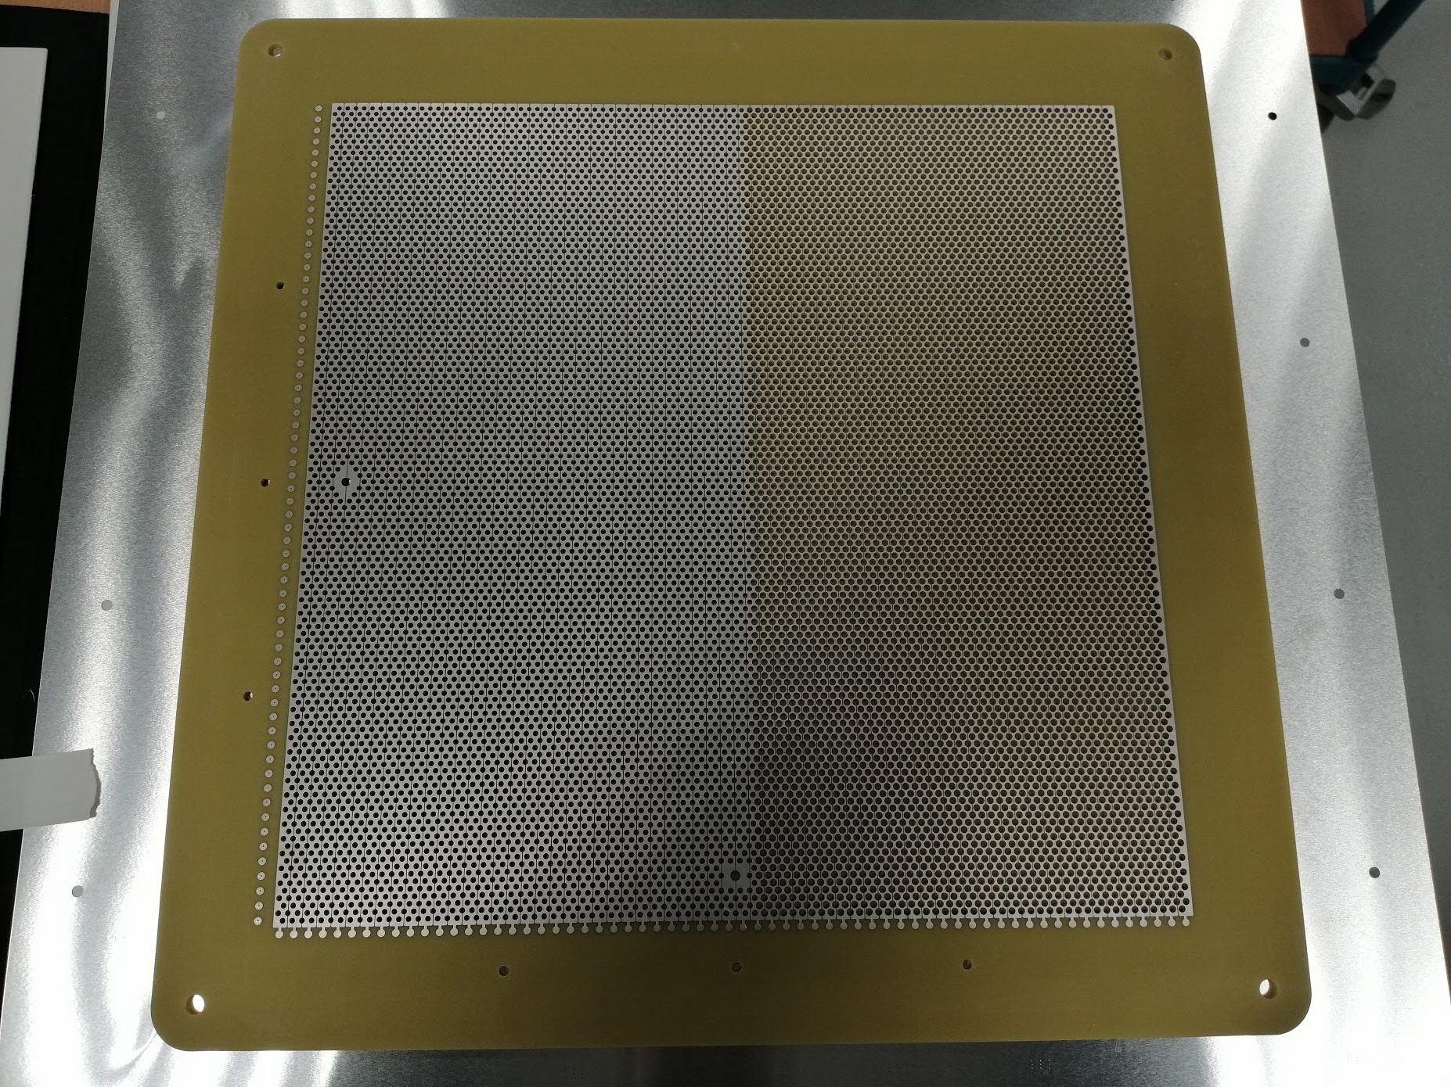
Summary
APAs constructed from PCB anode modules are interesting alternative to the current wire based APAs. They can be mass produced by industry, robust, better uniformity and modularity.
Despite of the large number of holes on the anode PCBs, cost estimate from a PCB vendor projected the cost of the 2 view PCB at ~ $200 /m². The material cost for building a 3mx3m module is about $30k without the readout electronics. The assembly labor is expected to be substantially less than that of the current APAs.
Due to the larger dielectric constant of G10 (x3 from LAr), to have comparable SNR to the wire based APAs, we need at least 3x channel count per unit area. A longer drift and fewer APA arrays will help reduce the CE channel count.
A 2-view demonstrator is under development, which can be scaled to a 3mx3m module taking advantage of the NP02 support frame design.
Due to the high field necessary inside the holes of the PCB, internal induction planes are far less effective due to charge cancellation. Therefore to build a 3-view PCB anode, we plan to use one induction view, and two shared collection views. Small scale samples will be designed and tested to select the best electrode configuration.
For horizontally placed large anode PCBs, perforation is needed to allow liquid argon flow. This may not be a requirement for vertical APA walls.
Bo

Slide 39
Sourcing LRUA for DUNE could be a reality
DarkSide/Underground Ar
Cristiano, Eric
Argon is not generally looked for in underground gas fields
PNNL working with to explore large scale underground argon sources
  Supplier: Major U.S. gas producer/supplier (not disclosed at company request)
  Production rate: ~5,000 tonnes/year
    Can start in about 2 years
  Ballpark cost: x3 regular argon
  NOTE: These are very rough estimates.
  Further refinement require expression of true interest from DUNE
Next steps for physics:
  Reminder: DarkSide source is the only proven source (i.e., extremely low ³⁹Ar)
  Measure ³⁹Ar levels from new potential source
  For ⁴²Ar level, new assay method required – expected to be VERY low

Slide 40
Pixelated Charge Readout
Roxanne

Slide 41
LArPix
Dan

Slide 42
LArPix (2)
James

Slide 43
LArPix (3)
Igor

Slide 44
QPix
Mitch

Slide 45
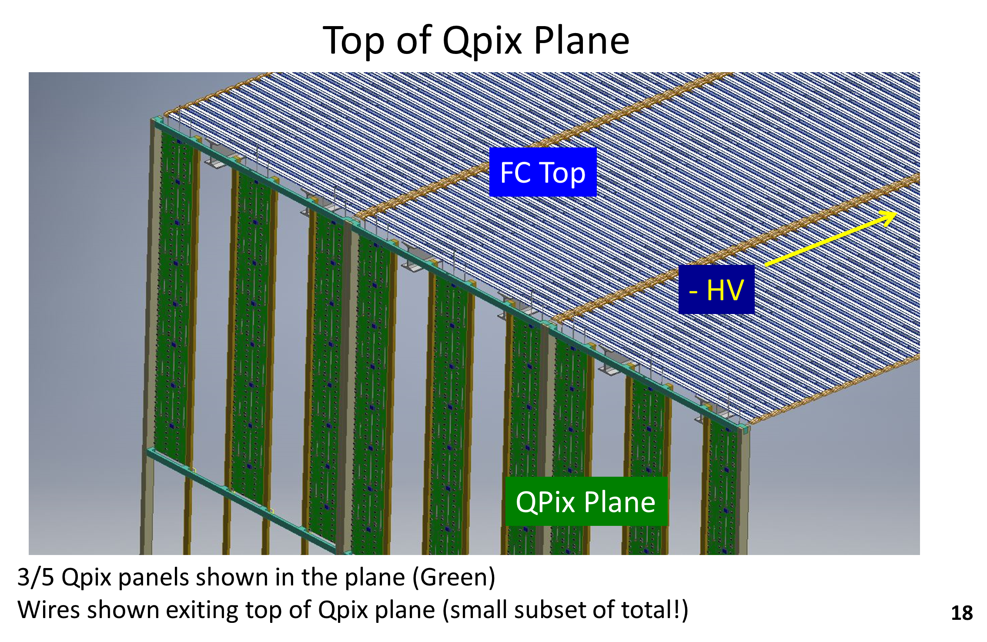
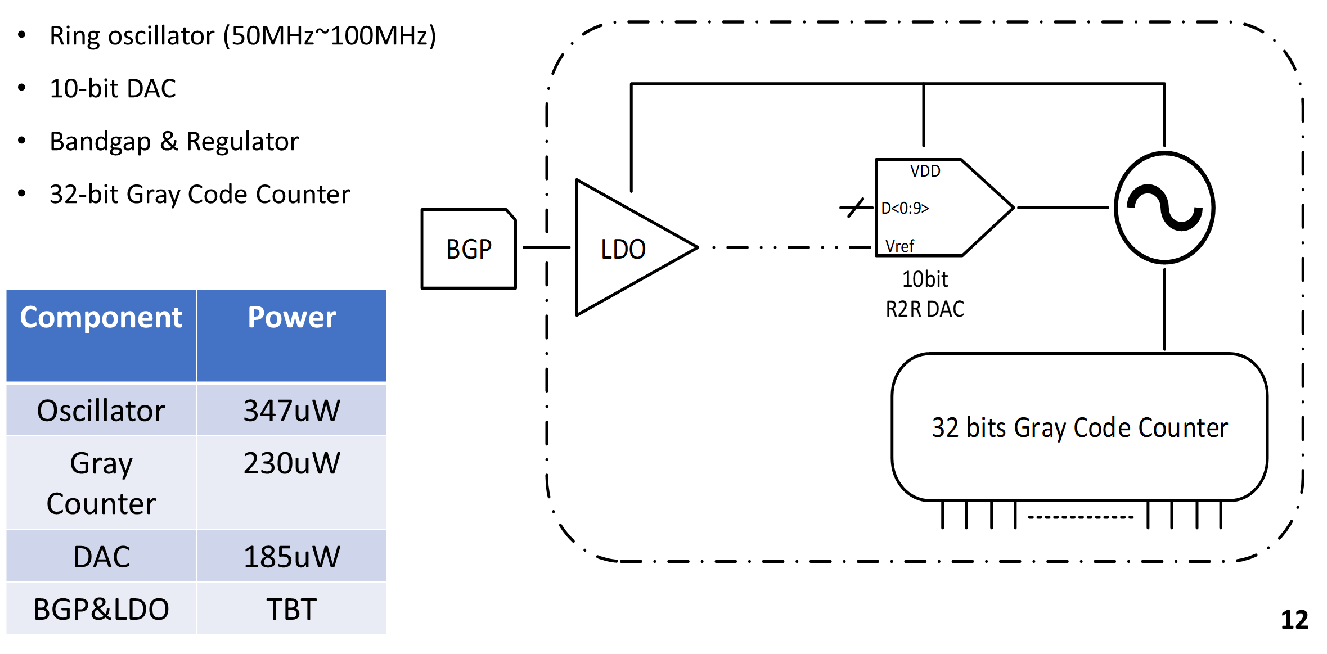
Qpix (2)
Gary

Slide 46
Qpix (3)
Elena

Slide 47
Discussion of LArTPC charge readout

Slide 48
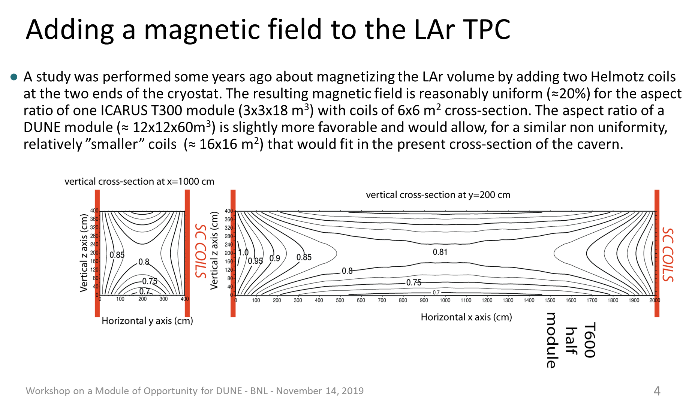
Other ideas?
Claudio

Slide 49
…and now a word from our sponsors
Ed and Stefan will lead the discussion on what the next steps are for DUNE
(and in the US, I hope that we can agree and push the case for LArTPC development as part of BRN)
…
Many thanks to Debbie and Carlene and the local organizing committee
Special thanks to Hanyu Wei and Xiangpan Ji for heroic efforts on the audio/video

