Slide 1
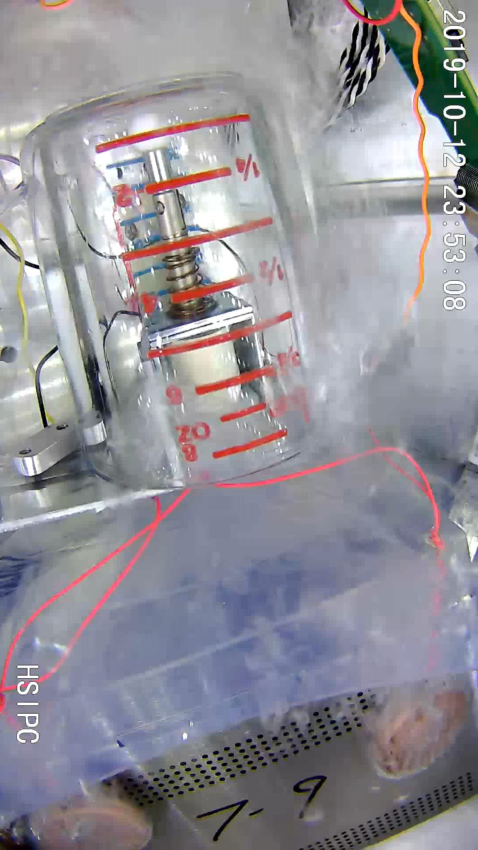
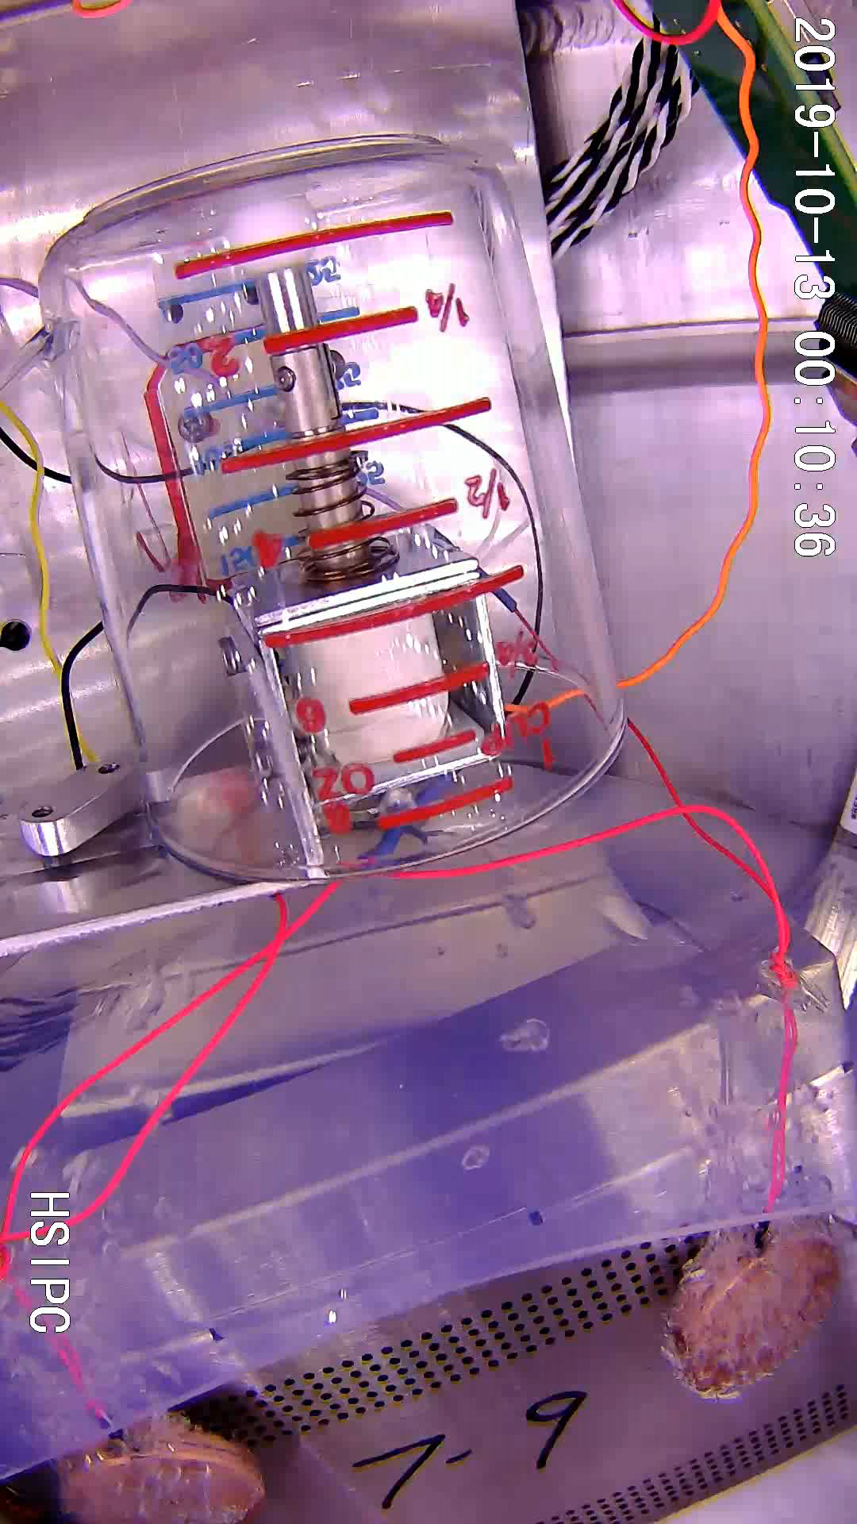
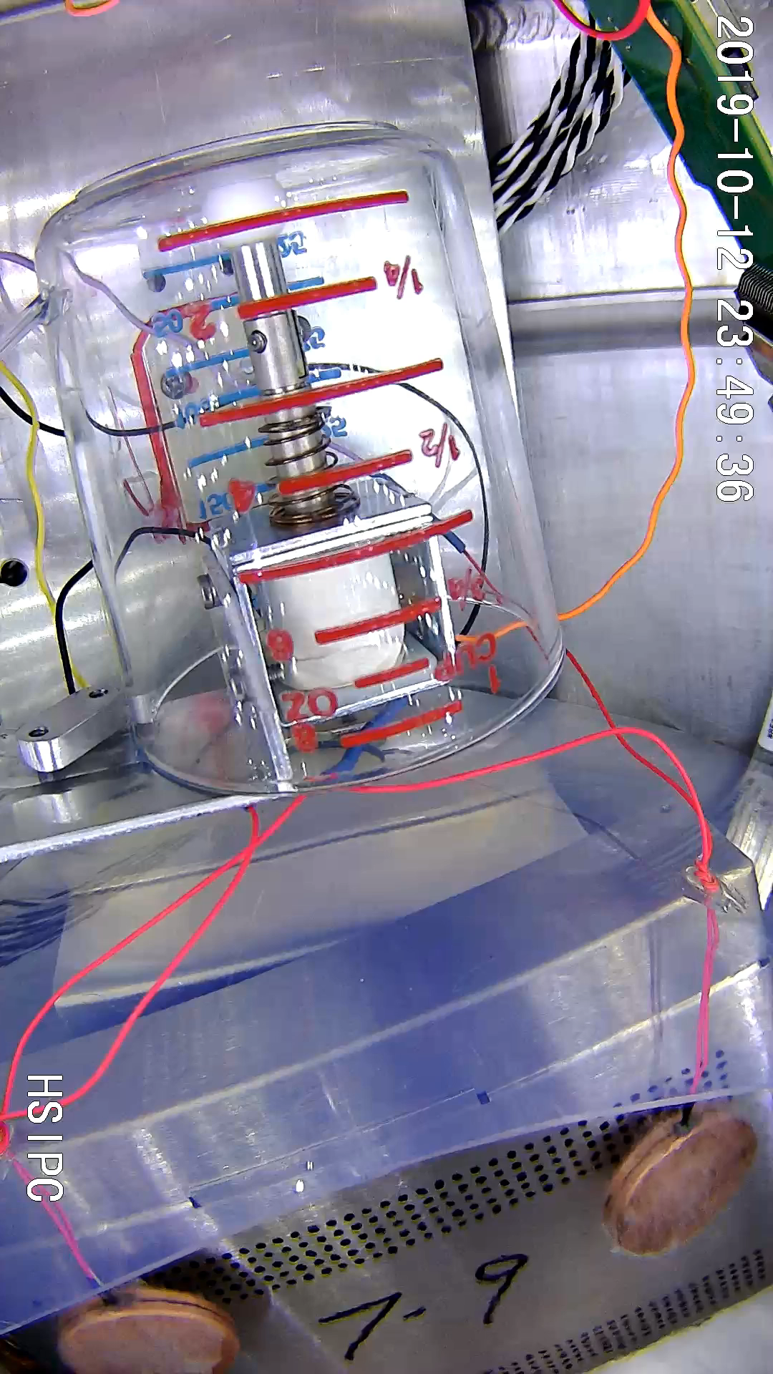
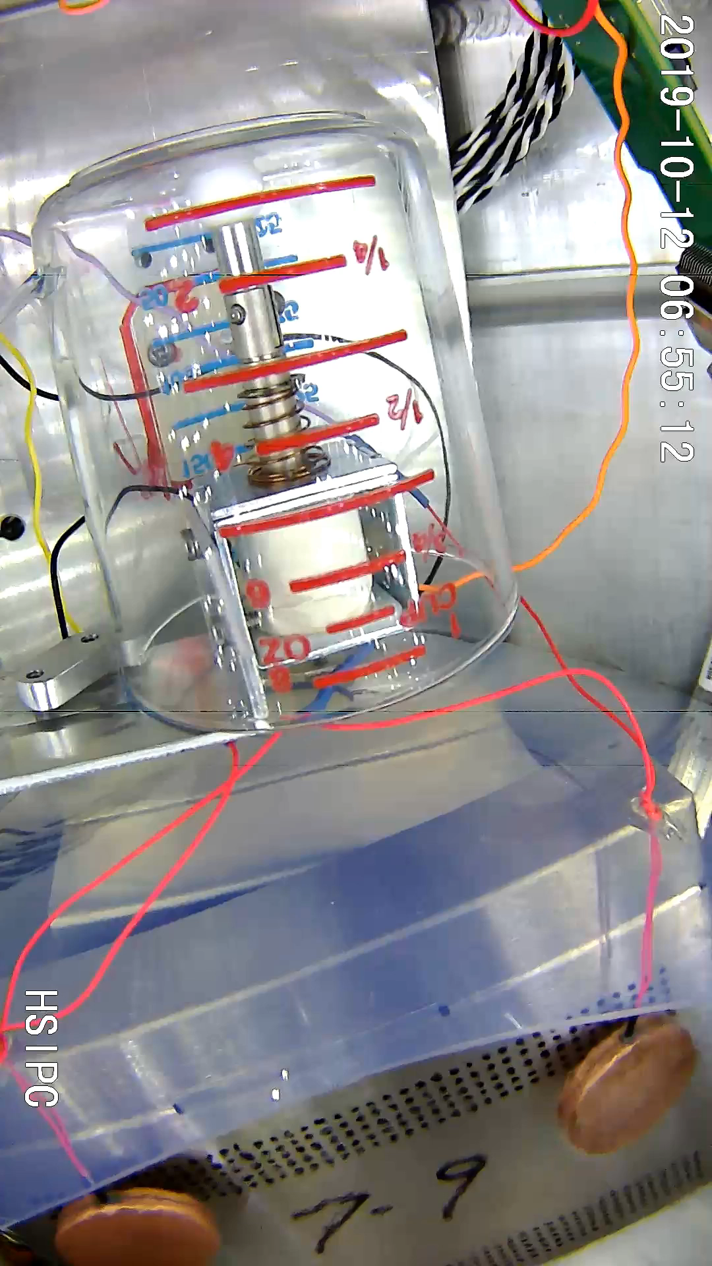
Boiling in LAr at Various Depths
Different boiling behaviors at various depth of LAr at 87K. The heaters were powered at 120W each (40kW/m² power density)
5psi (2.5m depth)
7psi (3.5m depth)
15psi (7.3m depth)
30psi (14.5m depth)
See DUNE docdb 16670 for more details.

