Slide 1


Pixel detector concept with Qpix
Gang Liu, Kurtis Nishimura, Gary Varner
K. Byrum, Z. Djurcic, S, Kuhlmann, S. Magill,
R. Wagner, L. Xie (ANL-HEP)
V. Gurino, S. Spormba (ANL-EOF)

Slide 2
Q-Pix Consortium
Four central ideas being worked on
  Physics Simulations: Quantify the conferred benefit of pixel vs. wire readout and the requirements of the ASIC design
  CIR Input: all extraneous leakage current at the input node needs to be small (aA)
  Clock and robust readout: δf/f ~10⁻⁶ per second, self-assembling network
  Light Detection: Exploring new ideas using photoconductors on the surface of the pixels

Slide 3
How the time stamping works
One free running clock per ASIC (50-100 MHz)
  Required precision for DUNE δf/f ~10⁻⁶ per second
    Expect this to be easily achieved in liquid argon
Time stamping routine has the ASIC asked once per second “what time is it?”
  ASIC captures local time and sends it
  Simple linear transformation to master clock synced to GMT
  RTD’s calculated “off chip”
Has this idea been realized before?
  YES! In ICECUBE (e.g. Nygren)
    Oscillator precision achieved > 10⁻¹⁰ /s (hard to measure)

Slide 4
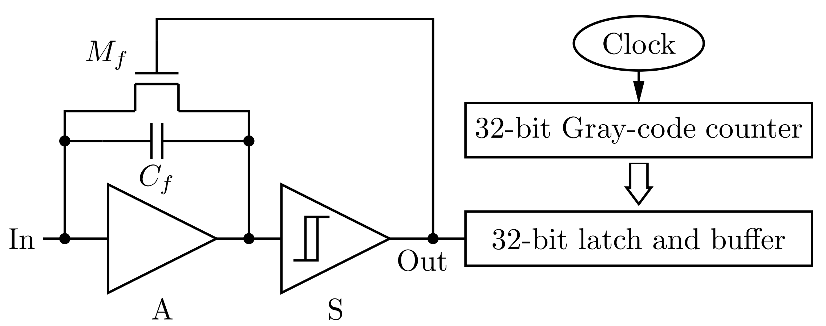
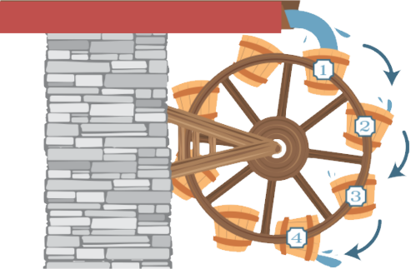
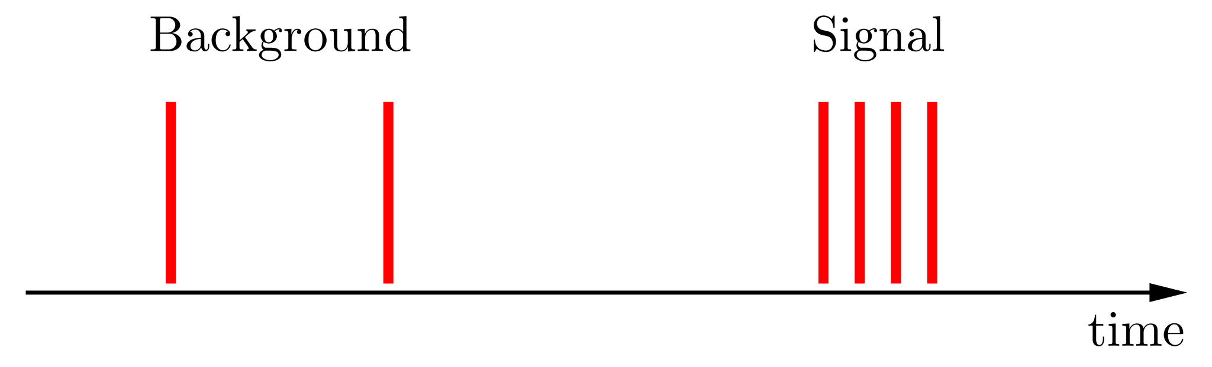
Reset Time Difference
Mitch Newcomer’s talk earlier

Slide 5
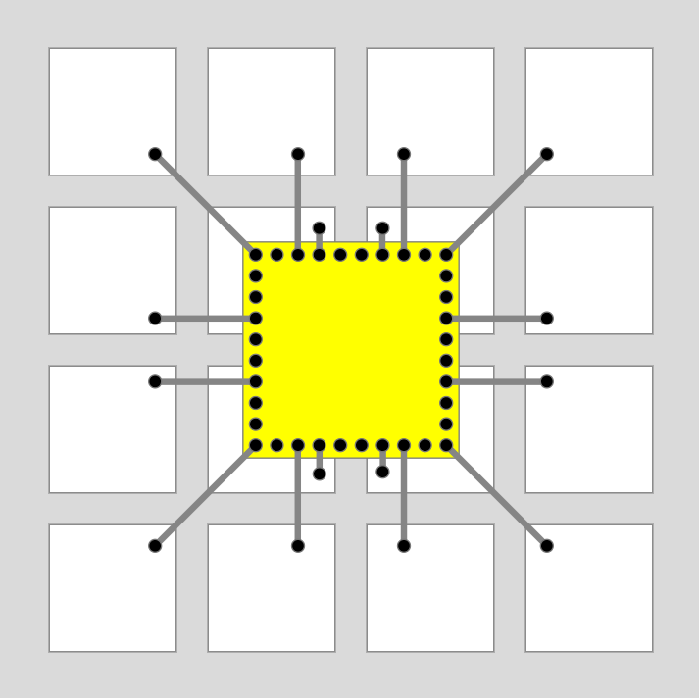

Q-Pix ASIC Concept
16-32 pixels / ASIC
  1 Free-running clock/ASIC
  1 capture register for clock value, ASIC, pixel subset
  Necessary buffer depth for beam/burst events
  State machine to manage dynamic network, token passing, clock domain crossing, data transfer to network (many details to be worked out)
Basic unit would be a “tile” of 16x16 ASICs (4092 4mm x 4mm pixels)
  Tile size 25.6 cm x 25.6 cm

Slide 6
Q-Pix operating principle
Q-Pix ASICs form a self-assembling network through asynchronous communications with their nearest neighbors.
Self-assembling: ASICs discover their neighbors and build up a data transmission network through one another.
  This network should be robust to missing/inoperative ASICs.
  Only one or a few ASICs, probably on the periphery, that talk to DAQ nodes.
Asynchronous: each ASIC runs on its own clock at a given nominal frequency.
  Clock frequencies may differ slightly! This should not be an impediment to operation.
6

Slide 7
Q-Pix Digital Logic
Key Features:
Self-assembling &
fault-tolerant network:
  ASICs discover their neighbors, decide on how to route signals.
  The network should be robust to missing, inoperative, malfunctioning ASICs.
Asynchronous comms:
  Each ASIC runs on its own clock at a given nominal frequency, no “system clock” available for communications.
7

Slide 8

Self-Assembling Network
Timestamp Passing with
One DAQ Connection on Corner
Goals:
Minimize the number of required external connections to DAQ system.
Single point failures should not make the tile or parts of the tile unusable.
A Simple Initial Concept:
ASIC hits queued up until interrogation.
One or more readout nodes initiate interrogation by passing a timestamp.
Every ASIC node:
  Accepts first timestamp it sees.
  (This acceptance defines DAQ pathway.)
  Passes timestamp to its nearest neighbors.
  Sends its hits back down DAQ pathway.
  If no hits, just send back local time.
  Route neighbors’ hits back down DAQ pathway until done/timeout.
Timestamp Passing with
Two DAQ Connections on Sides
8
Notes:
Over ~20 year lifetime of detector, ASICs should not be considered serviceable ➔
We want to minimize the number of connections to the outside world to simplify the overall system design.
ASICs should talk to one another and relay data back to one or more selected “readout nodes”.
No single failure should make tile, or large parts of the tile, unusable.
Over ~20 year lifetime of detector, these ASICs will generally not be serviceable, so if an ASIC fails, the system must be able to work around it without further losses.

Slide 9

Self-Assembling Network
Timestamp Passing with
Two DAQ Connections on Sides
Other Features:
Protocol routes around non-responsive ASICs without user intervention.
ASIC positions can determine their own positions in the tile through the protocol.
Control packets can be routed to specific positions or broadcast.
ASICs can also be manually masked by user through register commands.
Network path is documented, may be useful for calibration purposes (e.g., comparison of local to global timestamps to study event skew).
Timestamp Passing with One Dead ASIC,
Two DAQ Connections on Sides
9
Notes:
Over ~20 year lifetime of detector, ASICs should not be considered serviceable ➔
We want to minimize the number of connections to the outside world to simplify the overall system design.
ASICs should talk to one another and relay data back to one or more selected “readout nodes”.
No single failure should make tile, or large parts of the tile, unusable.
Over ~20 year lifetime of detector, these ASICs will generally not be serviceable, so if an ASIC fails, the system must be able to work around it without further losses.

Slide 10
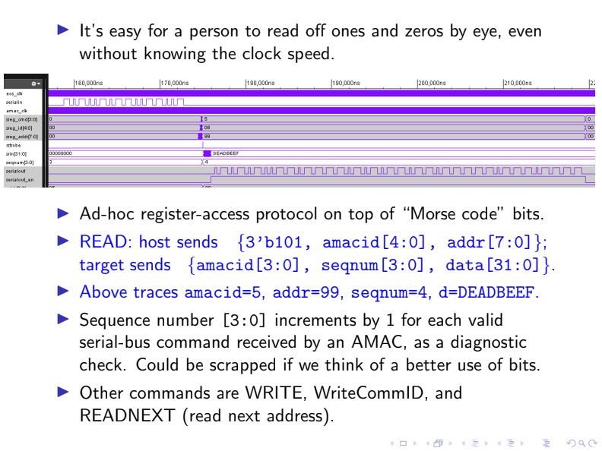
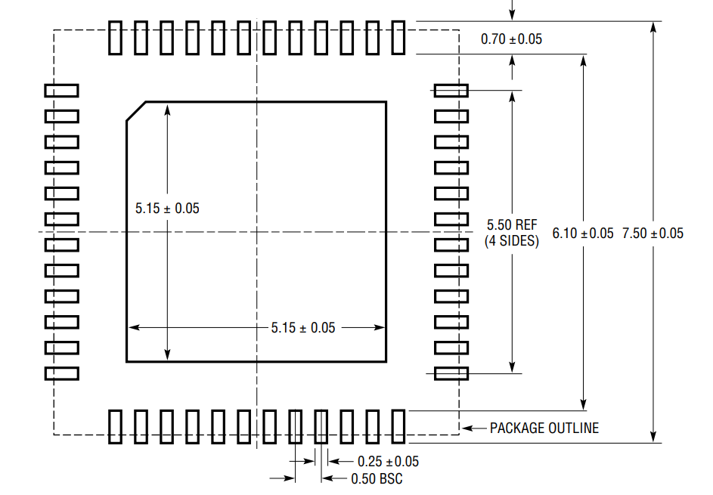
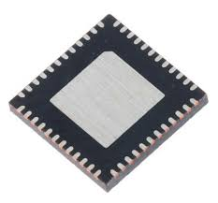
Asynchronous Network
Penn “endeavor” Protocol
Nominal 50 MHz local oscillators.
  Tolerances on oscillators depend on the communications protocol.
  Tradeoffs with overall throughput.
  64-bit UART requires ~1.5% clock matching.
  Other protocols (e.g., Penn “endeavor” protocol in AMAC ASIC) can operate with much looser tolerances.
  Note that overall data rates are low…
  ³⁹Ar background gives ~29 kbit / s of data.
Simple communications scheme also results in light pin count…
  Full-duplex communications with four nearest neighbors (8 pins, 16 pins differential).
  No distributed clock.
  16 (or 32) analog inputs.
  Powers, grounds.
  ➔ No issues expected to accommodate
  16 x 16 mm² pixel footprint.
UART with 64 data bits, 1 parity
Compact Packaging
10

Slide 11
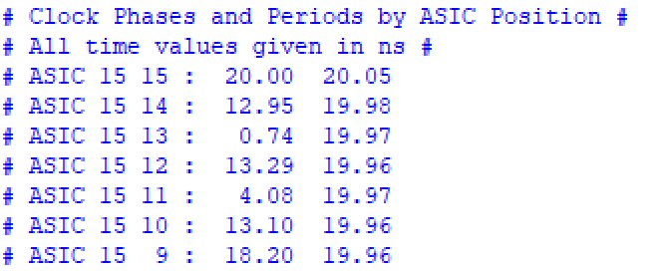
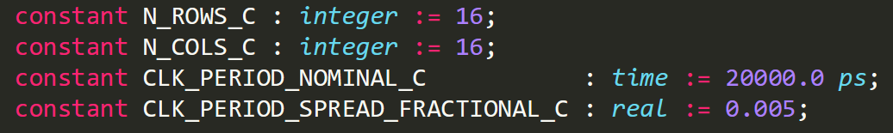
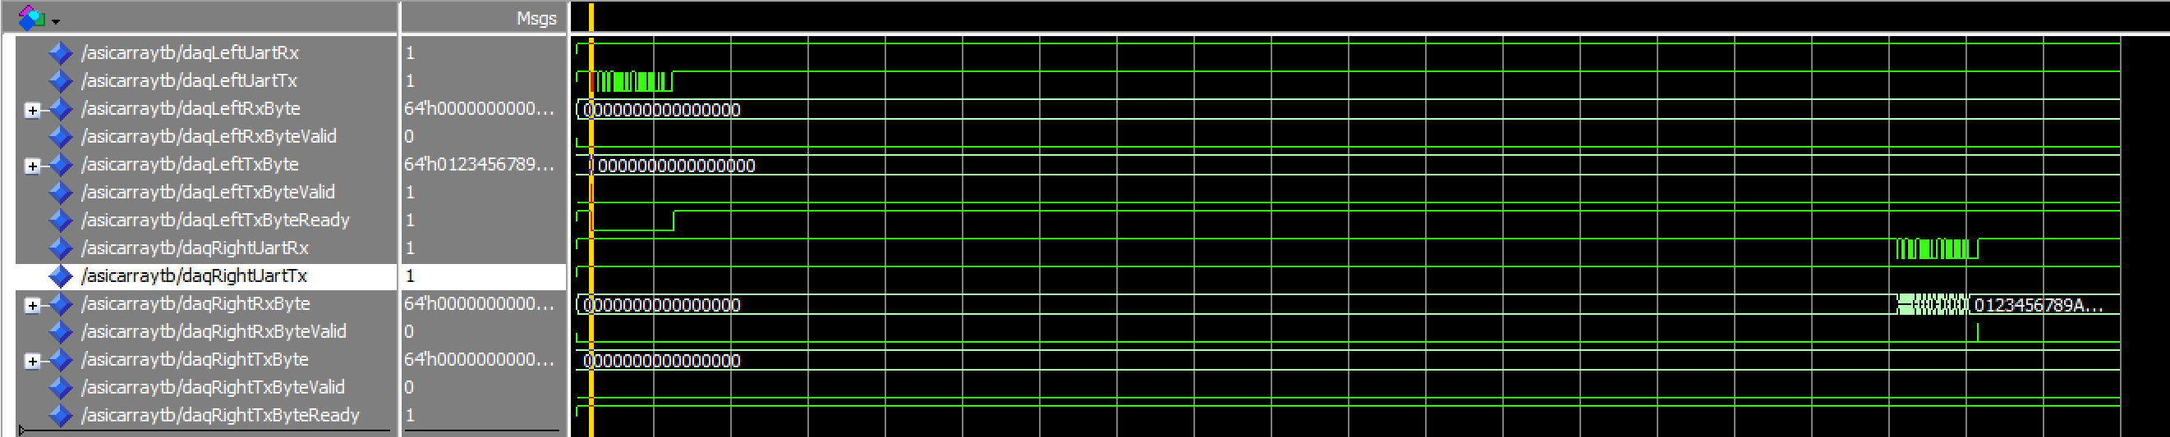
Simulation Frameworks
Dual approach to simulation:
  High-level simulations (for now in Python) to do basic occupancy, throughput studies.
    Inter-chip communication and state machine states have parameterized delays.
  Corresponding HDL implementations.
    Full implementation of all logic from above.
  In both cases:
    Parameterizable & modular implementations… easy to swap, e.g., inter-chip protocols.
    Clock mismatches and variable phases included.
➔ Initial simulations aiming to study varying protocols, tile dimensions, connections to DAQ nodes, etc.
Initial Full-tile HDL Simulation of Timestamp Passing

Slide 12
Oscillator Overview
Ring oscillator (50MHz~100MHz)
10-bit DAC
Bandgap & Regulator
32-bit Gray Code Counter
Component | Power
Oscillator | 347uW
Gray Counter | 230uW
DAC | 185uW
BGP&LDO | TBT

Slide 13
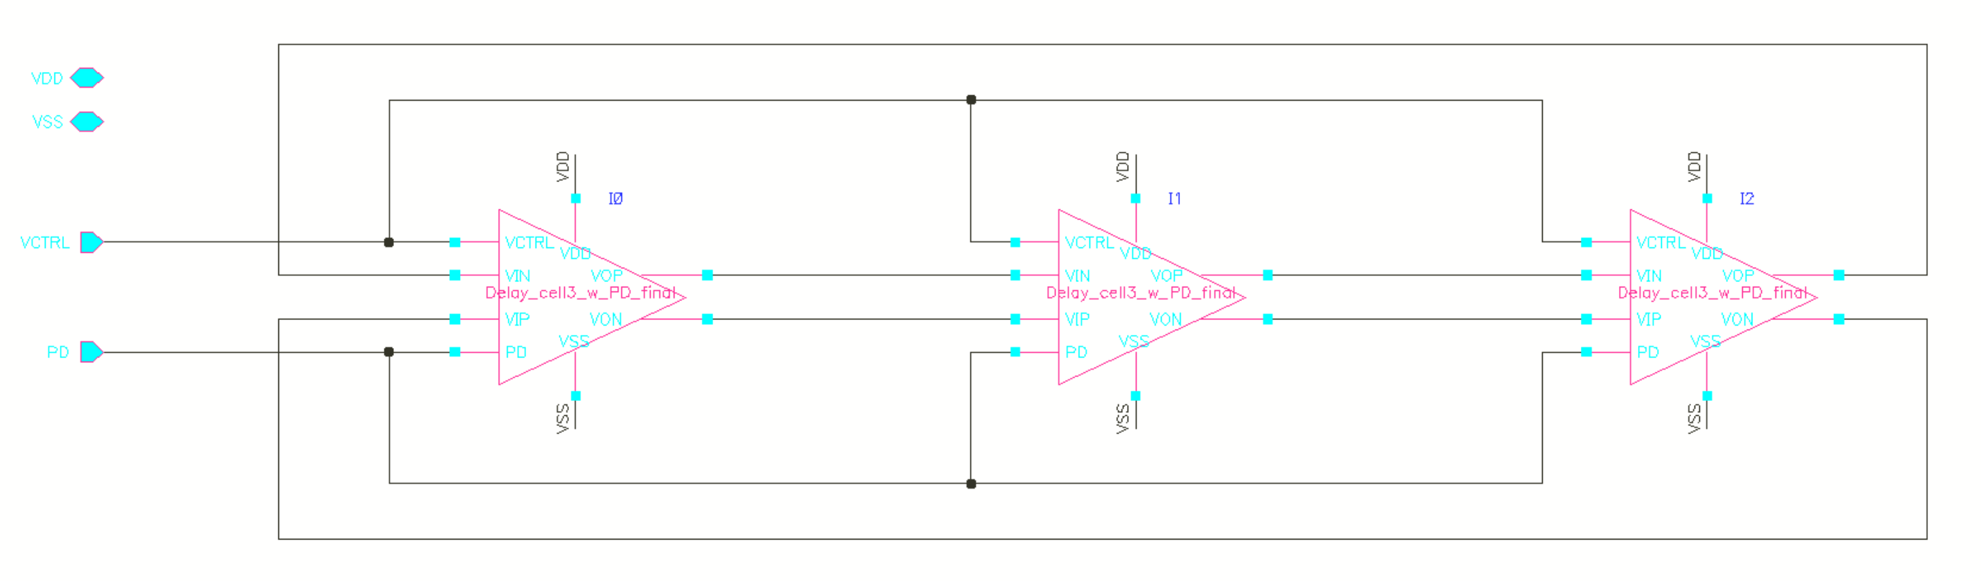
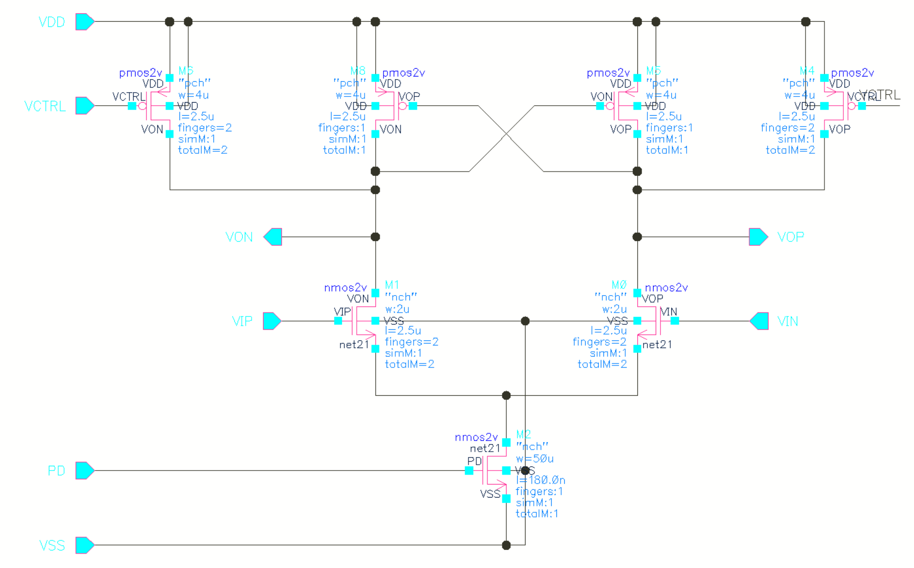
Ring Oscillator
Differential delay cell, good common mode noise rejection
3-stage ring oscillator, optimized for power consumption
Power-down mode through a deep triode region transistor
High output swing, close to rail-to-rail

Slide 14
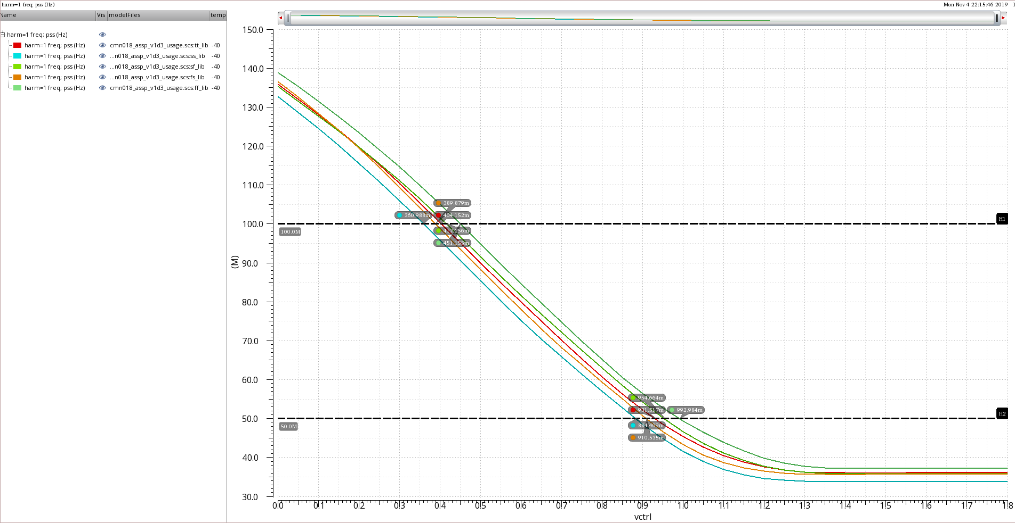
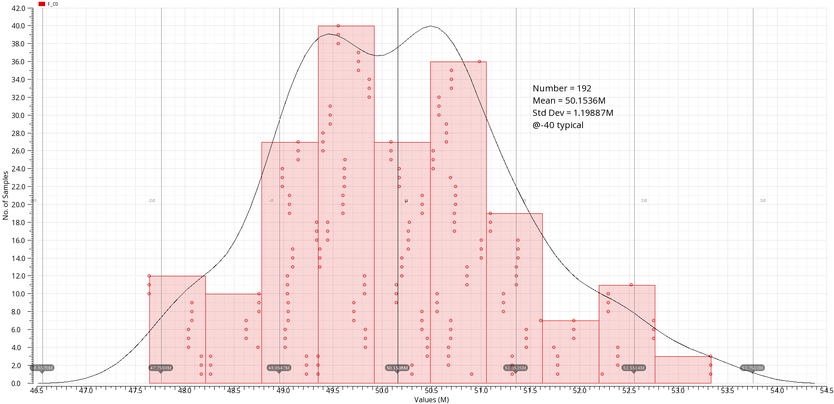
Ring Oscillator
100M
Freq
50M
VCTRL
V-F curve @ -40° (lowest temp for the current model) with all corners
Frequency monte carlo simulation
2σ: 47.76M ~52.56M @-40 typical
Approx +/- 4.5%

Slide 15
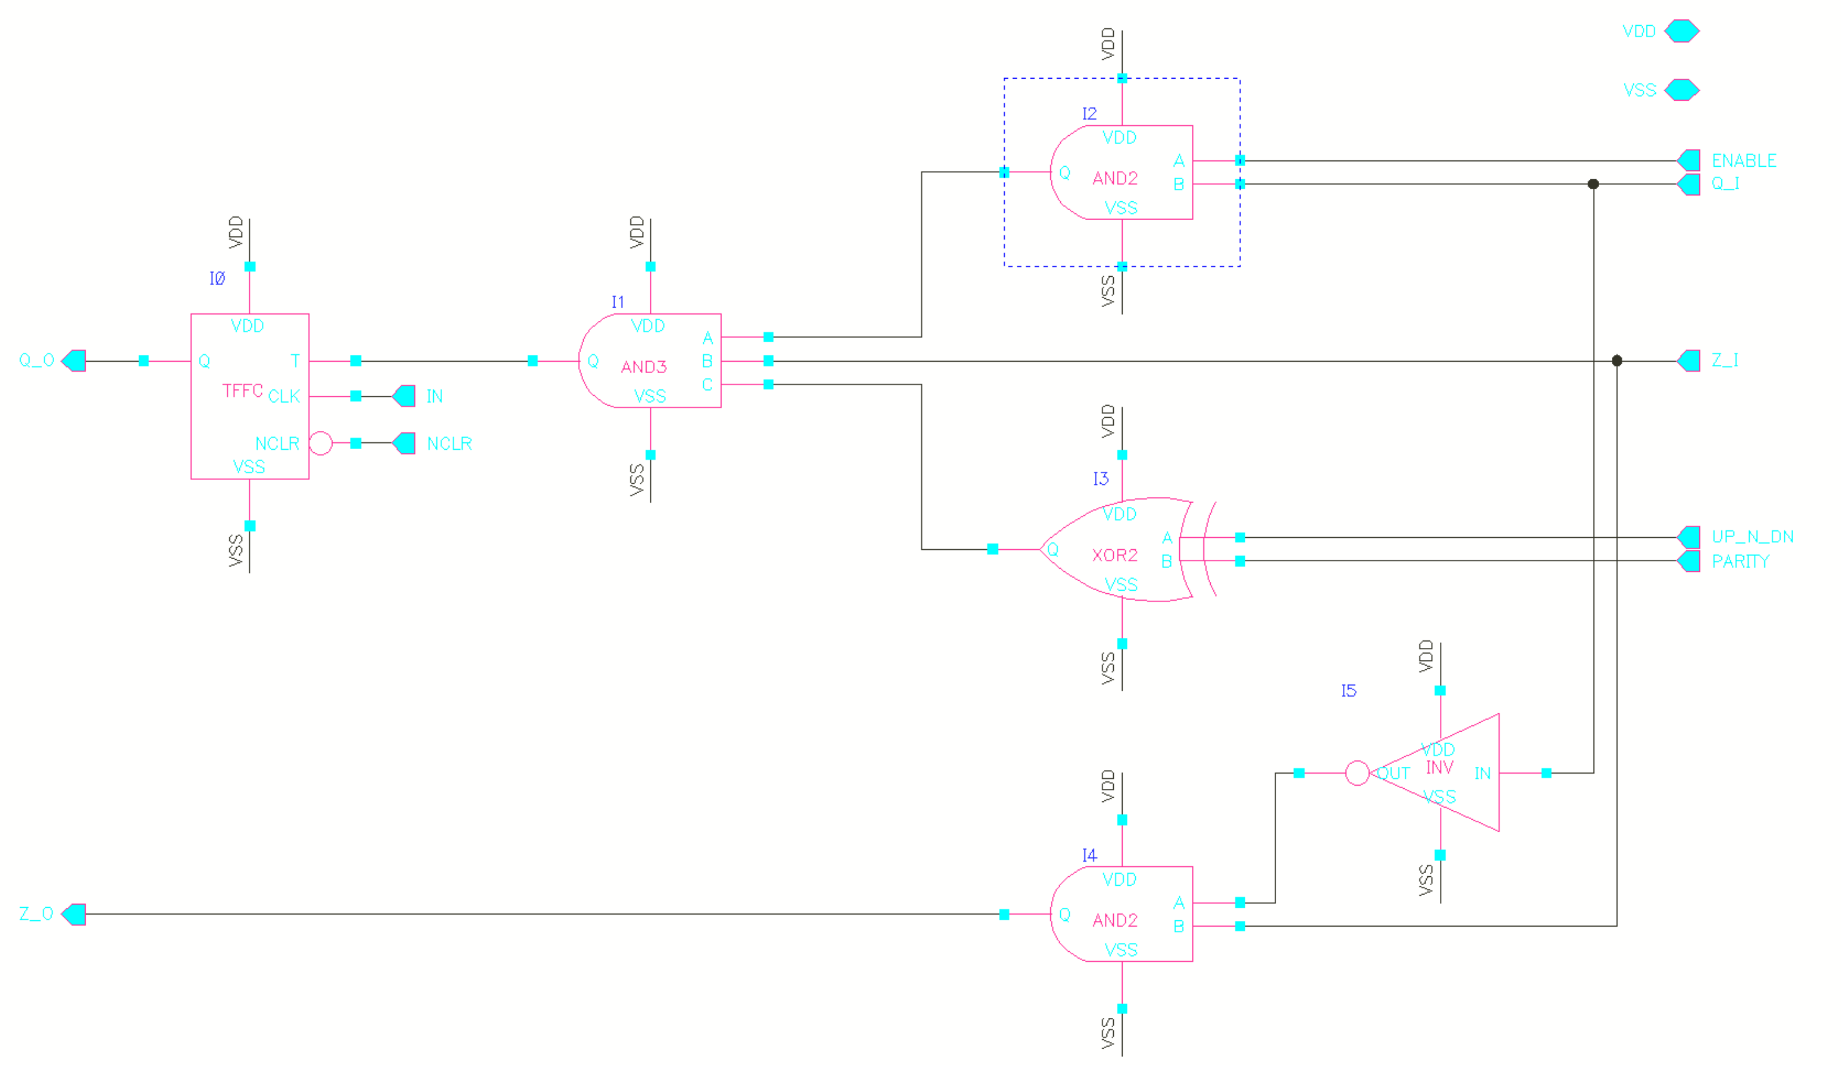
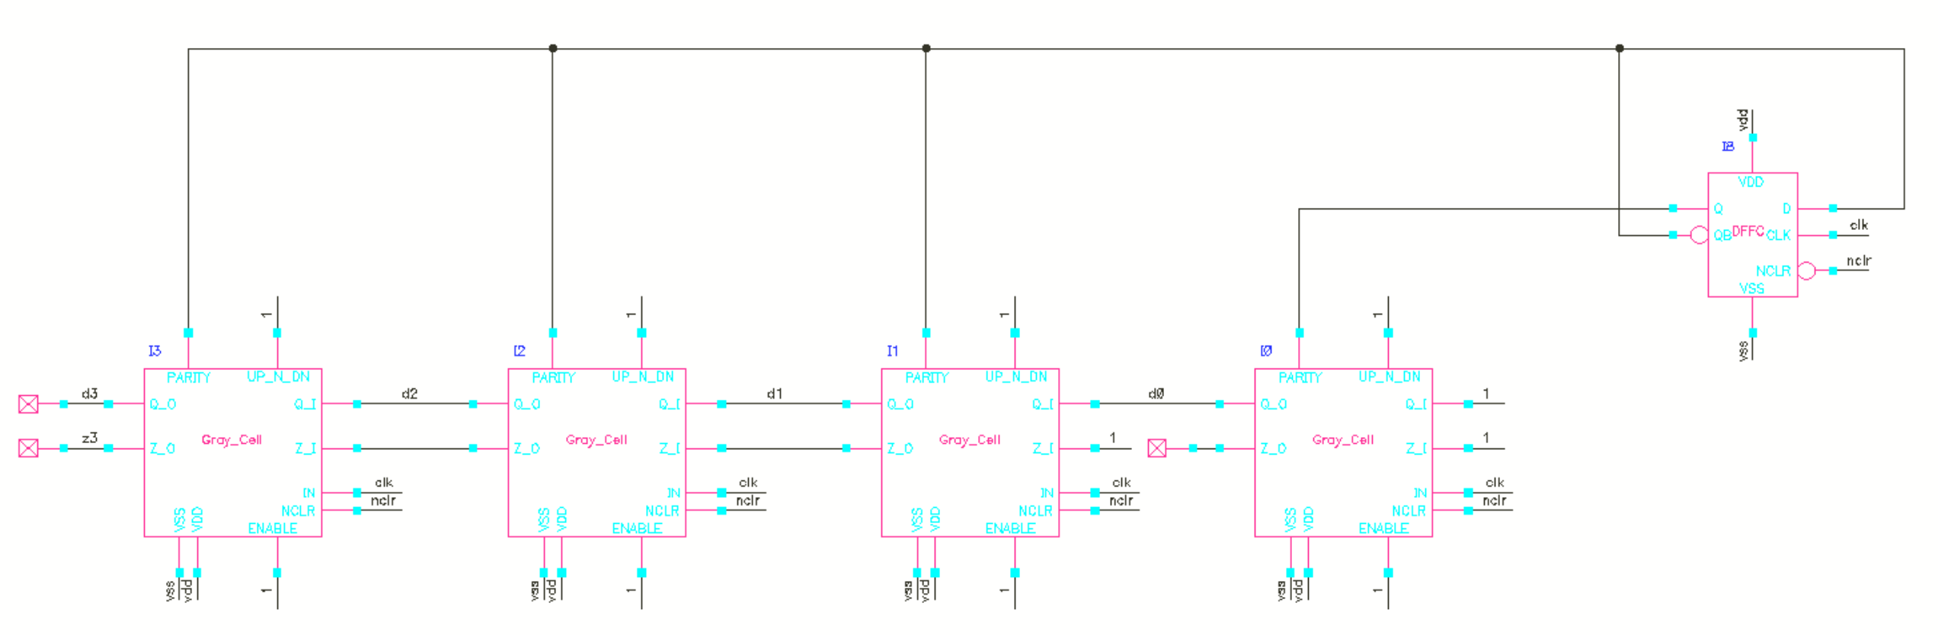
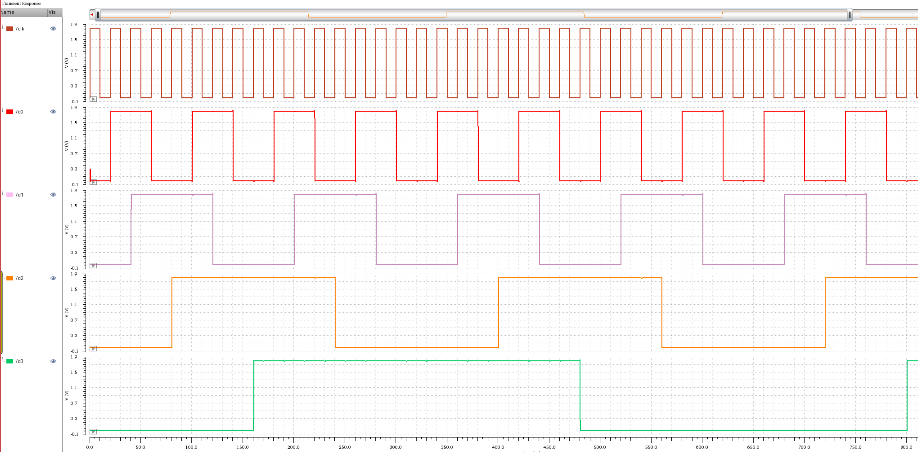
32-bit Gray Code Counter
1-bit Gray Code Cell
4-bit Gray Code Counter for an example
1-bit Gray Code Cell, cascaded to 32 bit
Need a reset signal after one counting cycle
I_{avg}=128uA (230.4uW) for 32 bit @ -40° 50MHz
Customized standard cell, not minimum size
0
1
1
0
0
1
1
0
0
1
1
0
0
1
1
0
0
0
1
1
1
1
0
0
0
0
1
1
1
1
0
0
0
0
0
0
1
1
1
1
1
1
1
1
0
0
0
0
0
0
0
0
0
0
0
0
1
1
1
1
1
1
1
1

Slide 16
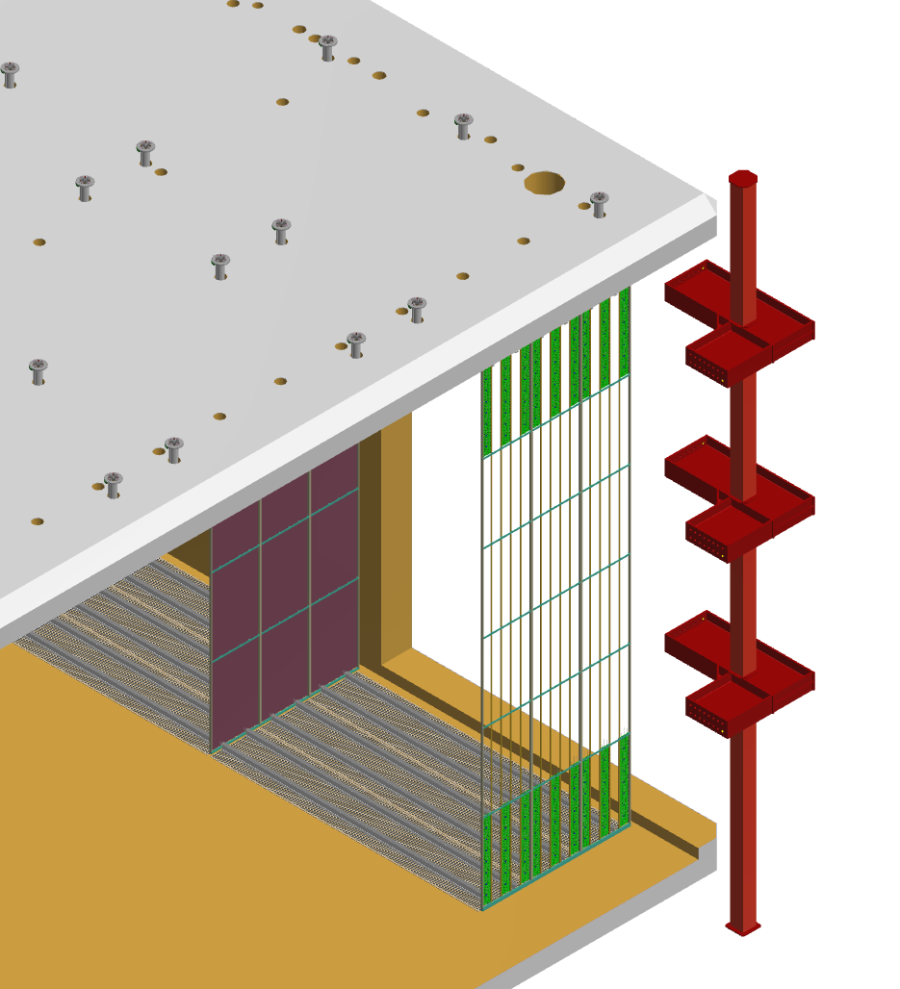
Overall view of 4th Detector with QPix
(HEP, EOF)
Roof of Cryostat - Detector Support Structure (DSS)
Corner of cryostat
Cathode Planes (CPA)
Field Cage (FC) Bottom (EndWall not shown)
Qpix Plane
3.5 m drift region between CPA and Qpix planes; 12 m detector height -> same as DUNE SP APA TPC

Slide 17
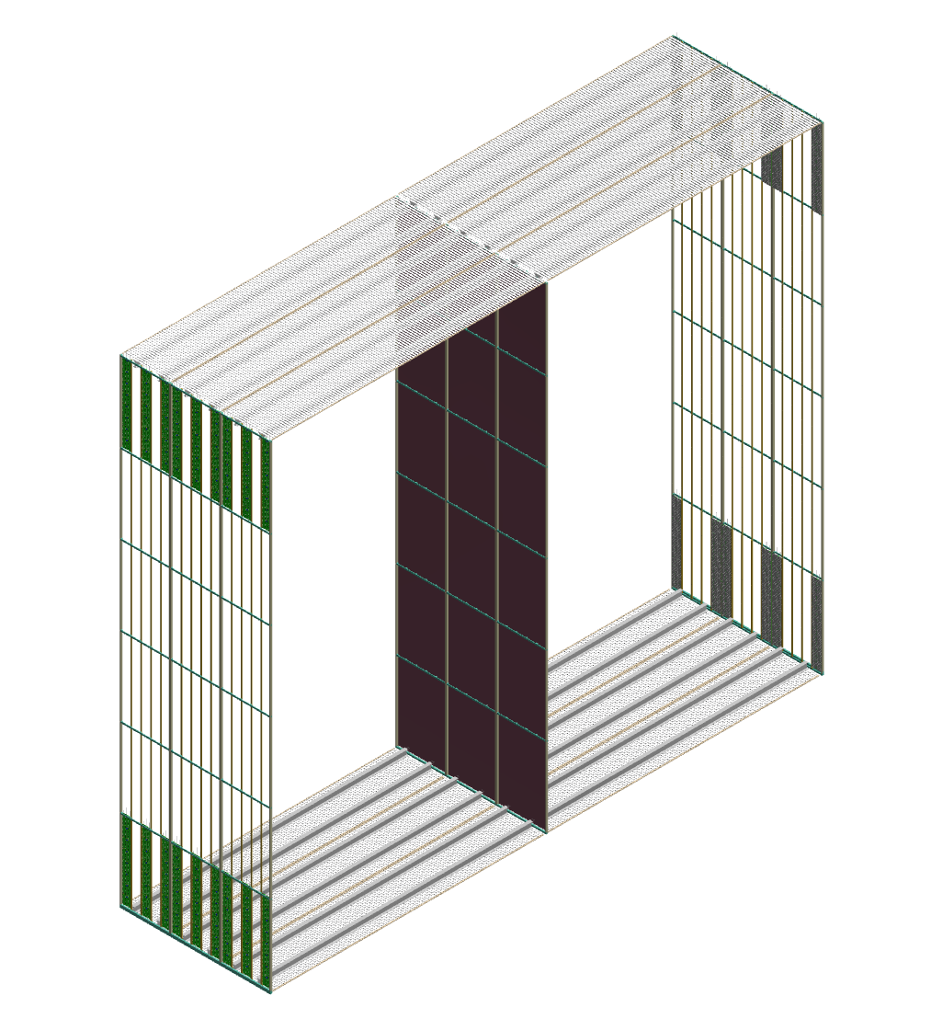
2 Drift volumes showing Top/Bottom Field Cage, CPA in middle and Qpix planes at each end
- HV
- HV
12 m
3.5 m
3.5 m
Notes:
In this conceptual design, each green Qpix PCB column is made up of 48 tiles of roughly 10” x 10” (25cm x 25cm). Each tile contains an array of 32 ASICs or 512 pixels of 4mm x 4mm.

Slide 18
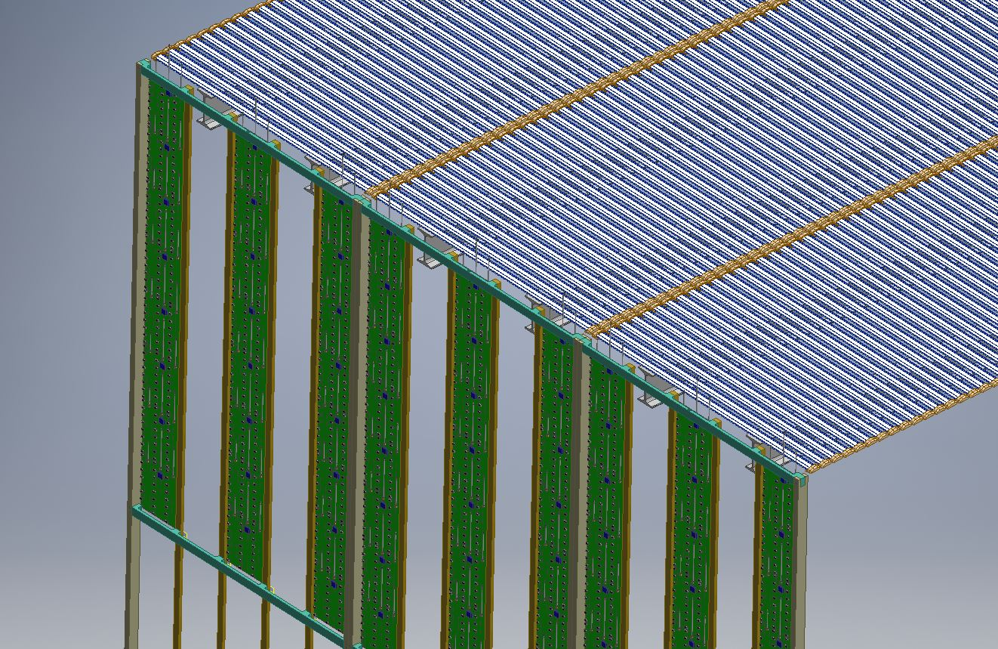
Top of Qpix Plane
FC Top
- HV
QPix Plane
3/5 Qpix panels shown in the plane (Green)
Wires shown exiting top of Qpix plane (small subset of total!)
Notes:
Note: details of Qpix PCB boards are included at this stage; there is just one connector with a pigtail of cable per tile although the conceptual design shows the 3 connectors. Only one of these connectors would be instrumented on each tile, but different tiles would use different connector locations in order to spread out the distribution of cables as they snake to the top of structure.

Slide 19
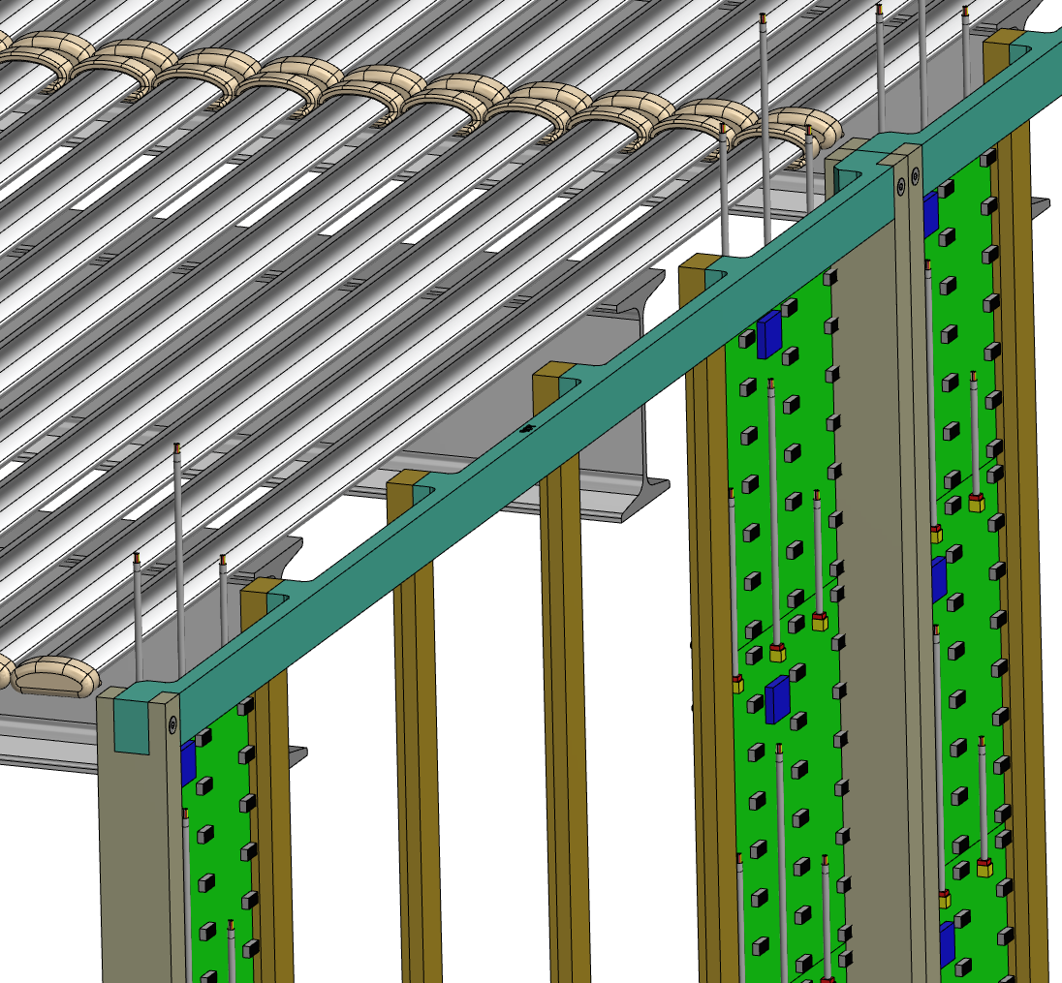
Closeup of Top of Qpix Plane showing cable thruways, ASICs, Data Collector, Connectors and Cables
Data Collector (blue)
ASIC (grey)
Connectors (yellow) - Note: Only one connector is instrumented & connected on each tile.
Cable pigtails
Notes:
Again, we would have only one connector per PCB tile board instrumented, not 3 as shown in this picture. The 3 positions would be used for different (tiles) PCB boards in the column of 48 tiles to spread out the cable bundles. Also, the pigtail cables are not routed, but are shown to give an idea of amount of cables. One pigtail per connector. In principle the routing of the cables would attach to the G10 picture frame structure.

Slide 20
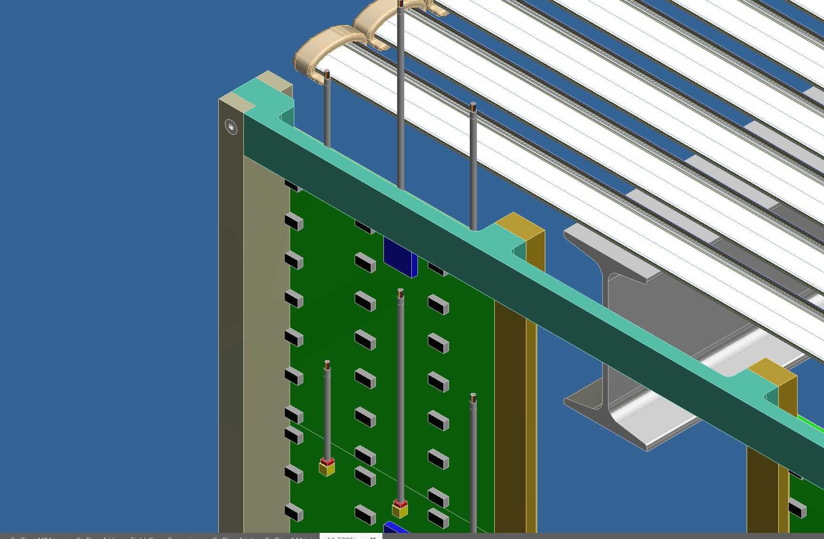
Closeup of Top of Qpix Plane showing cable thruways, ASICs, Data Collector, Connectors and Cables
Notes:
Just another zoom level of closeup of one tile which shows an array of 32 ASICs and data collector chip, connector and pigtail per tile.

Slide 21

Summary/Backup
Q-pix Consortium
A consortium of universities and labs has formed to realize and test the Q-Pix concept
  Being done in close collaboration with LArPix (JINST 13 P10007) readout for the DUNE near detector

Slide 22
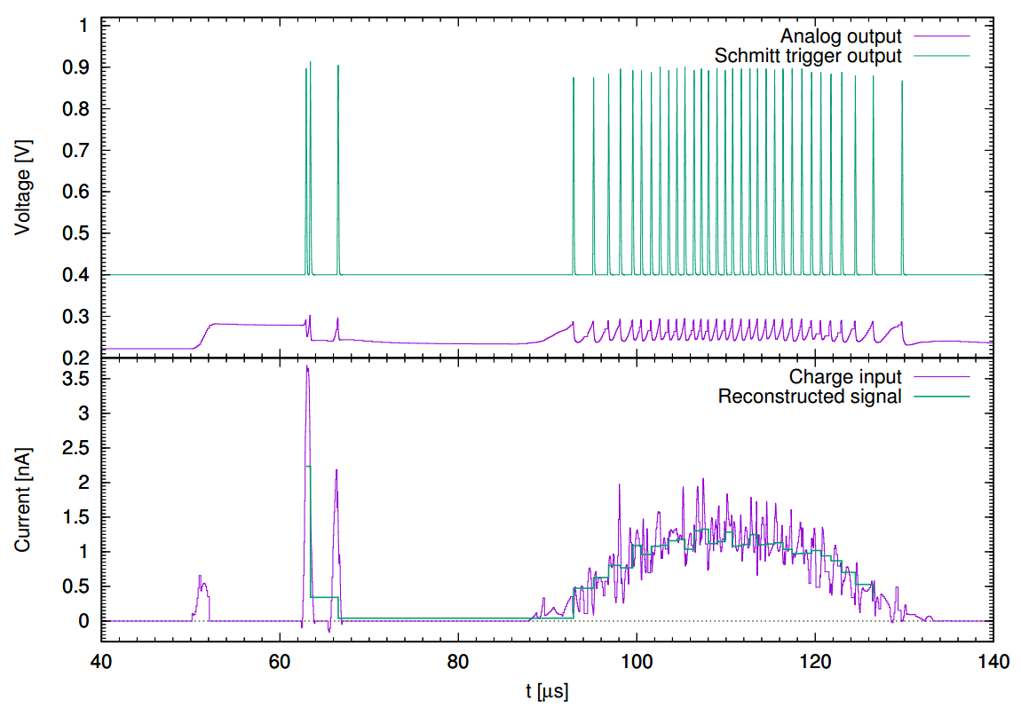
ΔQ~0.3 fC (~1800 e⁻)
Nygren & Mei arXiv:1809.10213

Slide 23
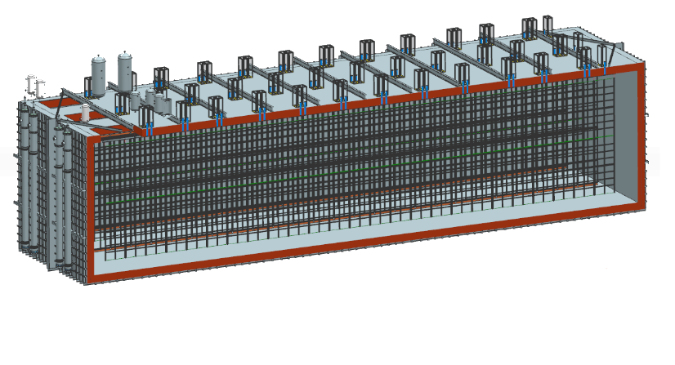
Data Rates for 10 kTon
We imagine each tile is 16x16 ASICs and one readout plane (APA) has 11,136 tiles per APA
We perform the clock calibration 1/second (perhaps less often)
One 10kT DUNE LArTPC Module (18 m x 19 m x 66 m)
¼ the total size of DUNE
-- This gives 16,384 bits / tile
The total data rate is thus set by the number of readout planes
  7 meter drift = 2 APA’s = 16,384 bits/tile x 22,276 tiles ~ 40.5 Mbytes/s
  3.5 meter drift ~ 90.5 Mbytes/s
    The detector can be made more modular!
    Reduce the demands on the HV, purity, diffusion, etc...

Slide 24
Q-Pix ASIC Concept
ASICs will be in one of six states
  Data Acquisition (DAQ)
  Local Time Capture (LTC)
  Wave Propagation (WP)
  Data Transfer (DT)
  Initiate Data Acquisition (IDAQ)
  Control State (CS)
A major feature of Q-Pix is dynamic network generation within a tile.

Slide 25
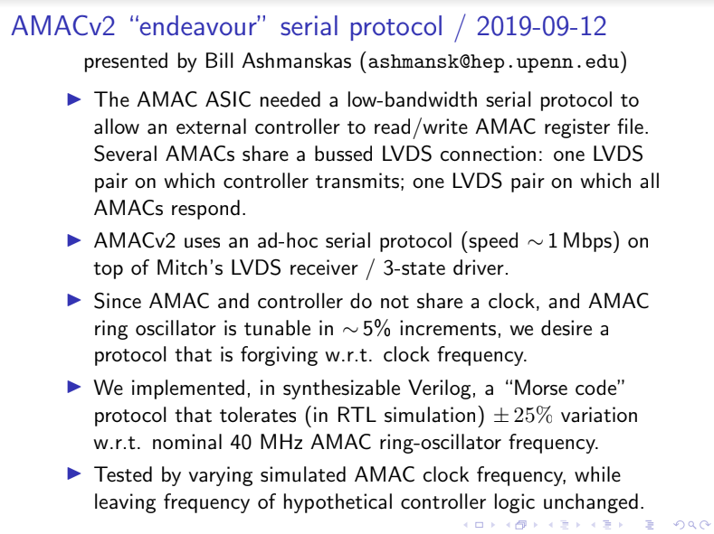
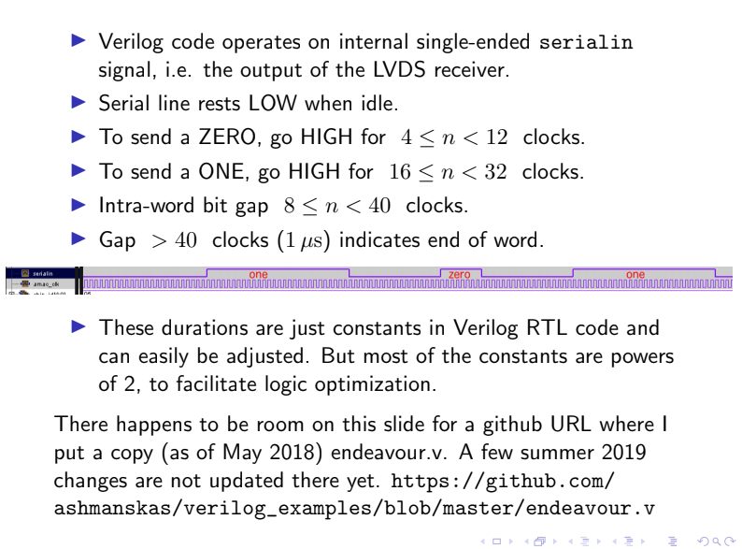
Other Protocols (AMAC)
From our Penn colleagues, all source available.
Slower, but more robust to frequency mismatch.
25

Slide 26
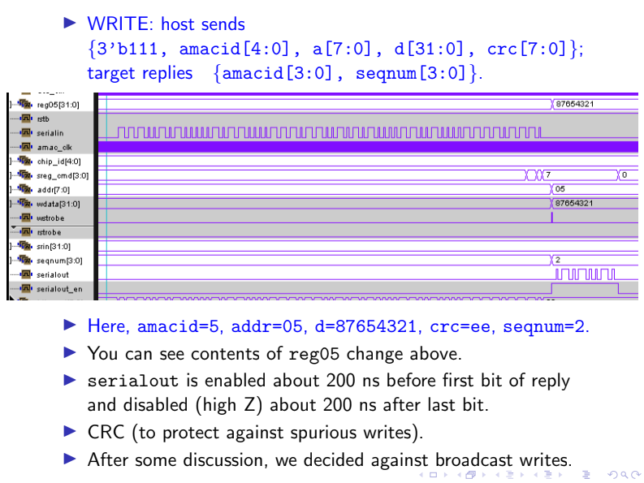
Other Protocols (AMAC)
From our Penn colleagues, all source available.
Slower, but more robust to frequency mismatch.

Slide 27
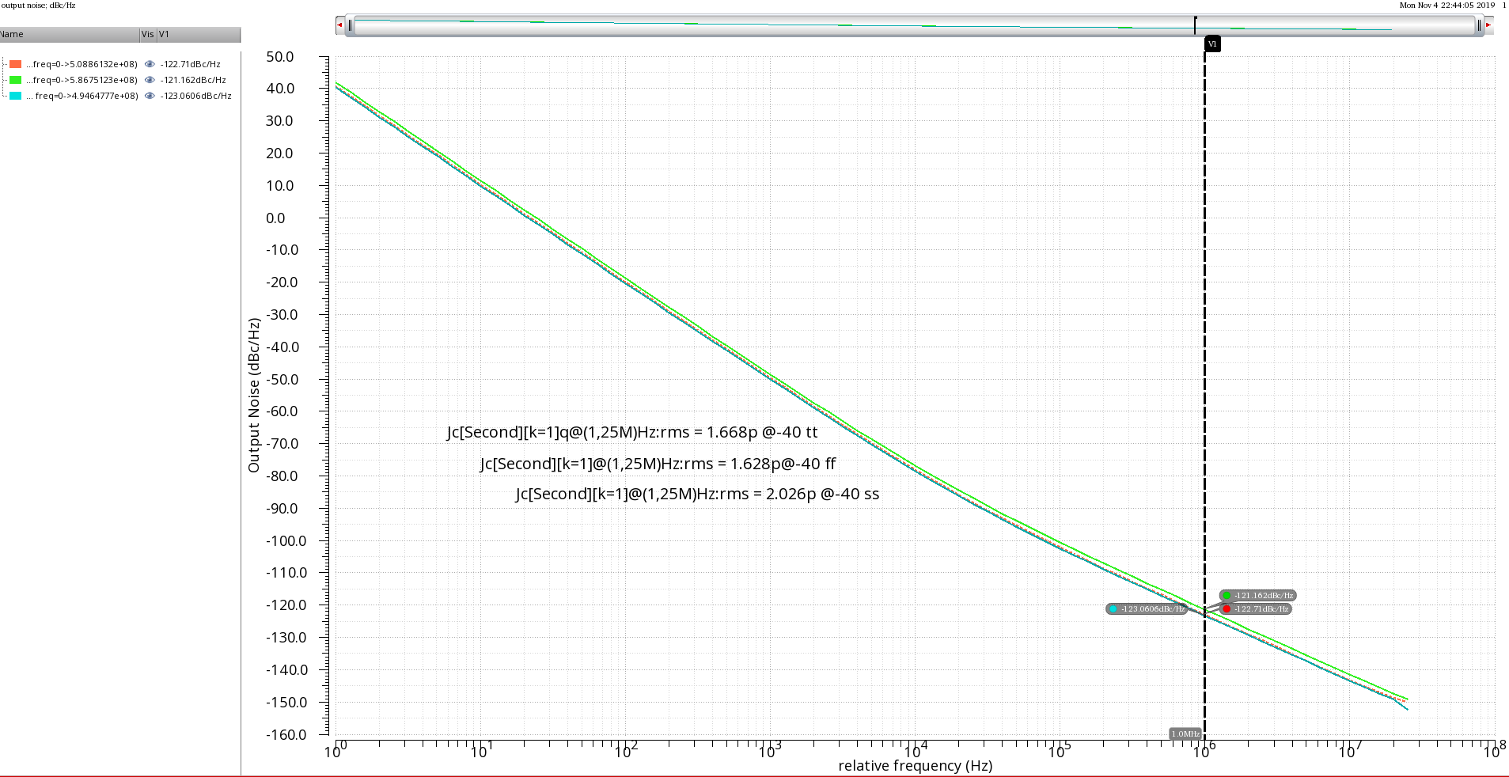
Ring Oscillator
pnoise & period jitter @ -40° with typical, ff and ss corners

Slide 28
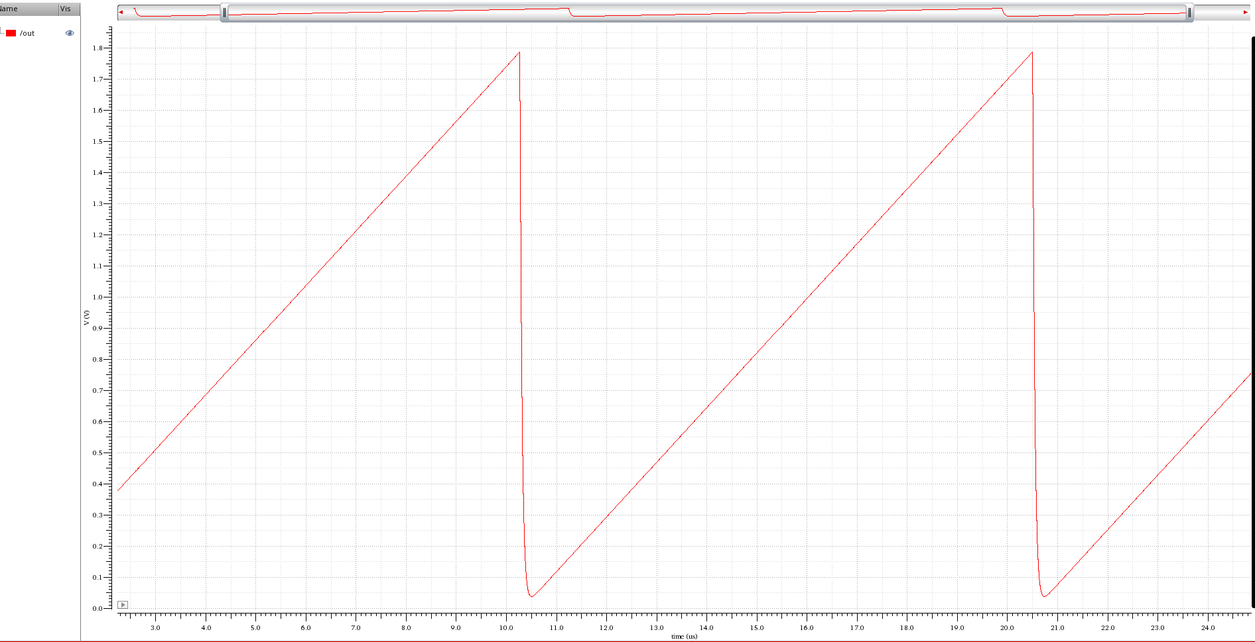
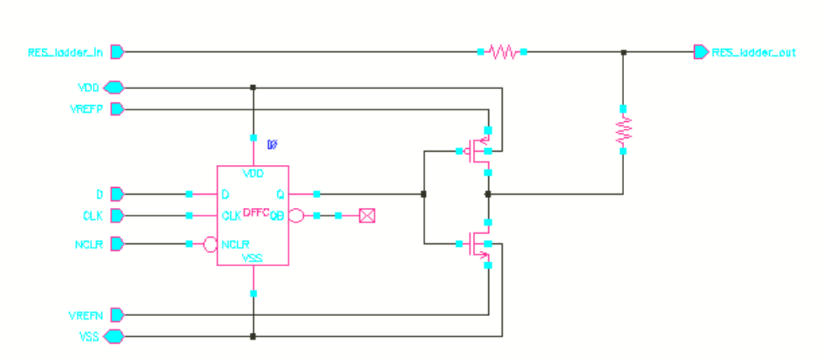
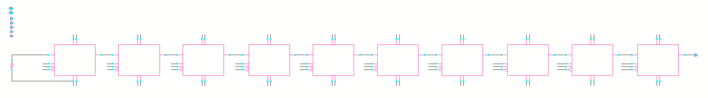
10-bit R2R DAC
R2R DAC
Low power consumption
Iaverage=103uA (185.4uW) @ -40° 50MHz for a full range sweep
No obvious glitch and nonlinearity
Detailed performance needs to be tested
especially the process variation of the R
1-bit DAC
1-bit DAC
1-bit DAC
1-bit DAC
1-bit DAC
1-bit DAC
1-bit DAC
1-bit DAC
1-bit DAC
1-bit DAC

