Slide 1

Hybrid Quantum-Classical Computing Architectures
QIS Workshop, Argonne, IL
September 23, 2019
erhtjhtyhy
Martin Suchara
Yuri Alexeev*, Jeffrey Larson*, François-Marie Le-Régent†, James Osborn*
Argonne National Laboratory
msuchara@anl.gov
* Argonne National Laboratory
† École Polytechnique
Notes:
Hello everyone. I will talk about an architecture that combines the power of quantum computing and traditional supercomputing with the goal to solve practically-sized computational problems.

Slide 2
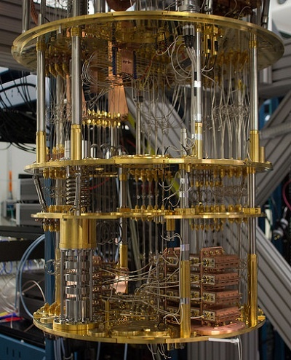
Building Quantum Computers is
Really Hard!
Remarkable technological advances in qubit manufacturing in the past few years but:
  The cost to build quantum processors is extremely high
  It is difficult to add qubits
  Qubit coherence is improving but will always be a fundamental challenge
How can we use multiple unreliable quantum processors of intermediate size to reliably solve large computational problems?
IBM Q superconducting quantum computer
Notes:
Remarkable progress in the past few years, systems with 50 qubits or more are available
However, building quantum computers is really hard and quantum chips are likely to have limited number of qubits and be prone to noise
Fundamental engineering limitations, such as radiation leakage in the Josephson junction in superconducting computers or laser frequency fluctuations for ion traps, and the fragile nature of quantum information make the presence of errors inevitable
This talk will try to answer the question how can we use these noisy intermediate scale quantum processors to solve interesting problems.

Slide 3
Combining The Power of Quantum Computers and Supercomputers
Notes:
This picture shows an architecture that combines a traditional supercomputer and quantum computers accessible in the cloud
Step 1: Compile quantum algorithm into circuit – e.g. Scaffold programming language + ScaffCC compiler; circuit not yet fault tolerant
Step 2: Partitioning of circuit into sub-circuit: difficult task – minimize number of cuts while producing small enough sub-circuits; identify which sub-circuits should be mapped to what hardware
Step 3: Copying circuit descriptions and inputs – classical
Step 4A: Computing on quantum processors – must be compiled and made fault tolerant
Step 4B: Classical computing – use e.g. Intel-QS or Atos simulator
Step 5: Combine the results
Benefits: Classical computers are efficient at evaluating certain sub-circuits, e.g. consisting of Clifford or mostly Clifford gates. Classical simulations are also noise free, but due to exponential scaling quantum chips are believed to soon surpass the ability of classical simulators for some problems.

Slide 4
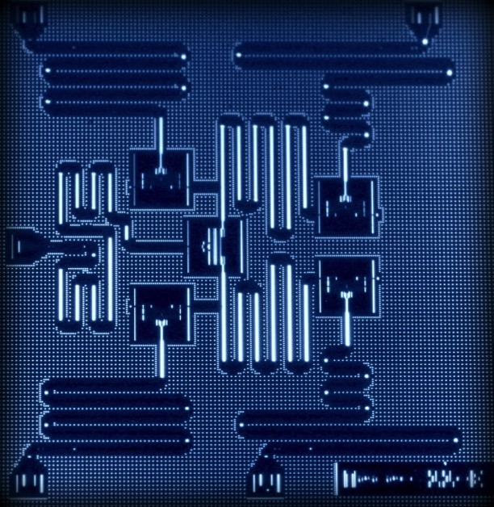
Idea: Cut a Large Quantum Circuit Into Multiple sub-Circuits
6-qubit quantum circuit:
Evaluate this circuit on a device with 5 qubits?
|0⟩
Z
|0⟩
Z
|0⟩
H
Z
|0⟩
Z
|0⟩
Z
|0⟩
Z
4
Notes:
What we want to do is obtain the probability distribution of the measurement outcomes for the quantum circuit on the left. This can be in fact done even if our chip has fewer qubits than the circuit.

Slide 5
Idea: Cut a Large Quantum Circuit Into Multiple sub-Circuits
Processor A
Cost scales exponentially with number of wire and gate cuts
Need to find a clean cut
|0⟩
Z
|0⟩
Z
|0⟩
H
Z
|0⟩
Z
Bravyi, Smith, Smolin, Phys. Rev. X, June 2016
Peng, Harrow, Ozols, Wu, arXiv, April 2019
|0⟩
Z
|0⟩
Z
Processor B
5
Notes:
The main idea is to cut the circuit into multiple sub-circuits that are small enough to fit onto the quantum processors
This idea was first introduced in papers by Sergey Bravyi and Aram Harrow
Using this approach we perform many repeated evaluations of the sub-circuits and measure the qubits in different bases to obtain probability distributions for the sub-circuits; these sub-circuit probability distributions will be later used to reconstruct the probability distribution for the whole circuit
Superconducting chips are well suited for repeated evaluation of sub-circuits due to their fast clock cycle

Slide 6
Idea: Cut a Large Quantum Circuit Into Multiple sub-Circuits
Original circuit
6
Notes:
The first step in cutting a circuit is deciding where we want to cut it.

Slide 7
Idea: Cut a Large Quantum Circuit Into Multiple sub-Circuits
Original circuit
7
Notes:
Next we represent the circuit by a tensor network—graph with vertices carrying small-order tensors of quantum gates and edges referring to qubit wires.

Slide 8
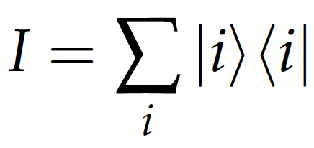
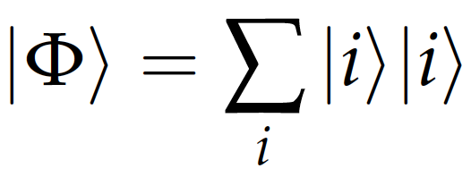
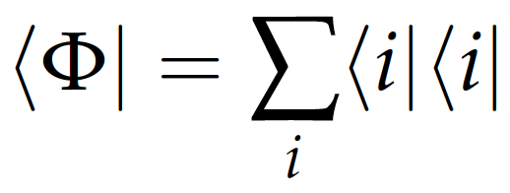
Idea: Cut a Large Quantum Circuit Into Multiple sub-Circuits
Original circuit
8
Notes:
Tensor contraction generalizes matrix multiplication. Tensor network is evaluated by contracting indices, and this can be done in many different ways. Our goal is to perform certain manipulations that transform the tensor network into two equivalent smaller tensor networks whose contraction represents the original tensor network. Here are a few of the rules we can use in this process.

Slide 9
Idea: Cut a Large Quantum Circuit Into Multiple sub-Circuits
Original circuit
Fragment A
Fragment B
9
Notes:
As you can see the tensor network can be cut, resulting in creation of two smaller tensor networks that can be represented as circuits.

Slide 10
Evaluating the Sub-Circuits on a Quantum Simulator
Repeatedly evaluate each sub-circuit, perform measurements in the X, Y and Z bases, and record the outcomes
Fragment B
Fragment A
X
Y
Z
Results with a quantum simulator:
Outcome
0 0 0 | 0.25 | 0.27 | 0.5
0 1 0 | 0.26 | 0.25 | 0
1 0 1 | 0.24 | 0.25 | 0
1 1 1 | 0.25 | 0.23 | 0.5
X
Y
Z
Outcome
0 | 0.49 | 0.49 | 0
1 | 0.51 | 0.51 | 1
10
Notes:
We used the Aer simulator in Qiskit to evaluate these sub-circuits by performing 5,000 repetitions, and the measurement outcomes are as you would expect.

Slide 11
Combining the Outputs with Classical Postprocessing
Finally we combine the results using multiplicative factors from Peng et al.:
X
Y
Z
X
Y
Z
Outcome
0 | 0.49 | 0.49 | 0
1 | 0.51 | 0.51 | 1
Outcome
0 0 0 | 0.25 | 0.27 | 0.5
0 1 0 | 0.26 | 0.25 | 0
1 0 1 | 0.24 | 0.25 | 0
1 1 1 | 0.25 | 0.23 | 0.5
Expected circuit output: |11⟩
Outcome | Estimate
0 0 | 0.001
0 1 | 0.000
1 0 | 0.000
1 1 | 0.999
*1 if same, *-1 if different
*-1 if same, *1 if different
*2 if same, *0 if different
11
Notes:
As the last step the output of the original circuit is obtained by combining the probability distributions from the sub-circuits. As you can see the estimated outcome for the original circuit matches what you would expect.

Slide 12
Applications of Circuit Cutting to Variational Quantum Circuits
Are there interesting circuits that can be cut into smaller sub-circuits?
Network community detection problem splits vertices into natural communities
  Applications in biological networks, neural networks, social networks, etc.
Circuit cutting has also deep connections to fault tolerance
12

Slide 13
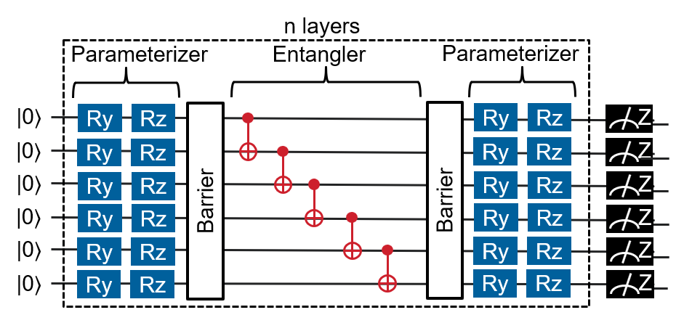
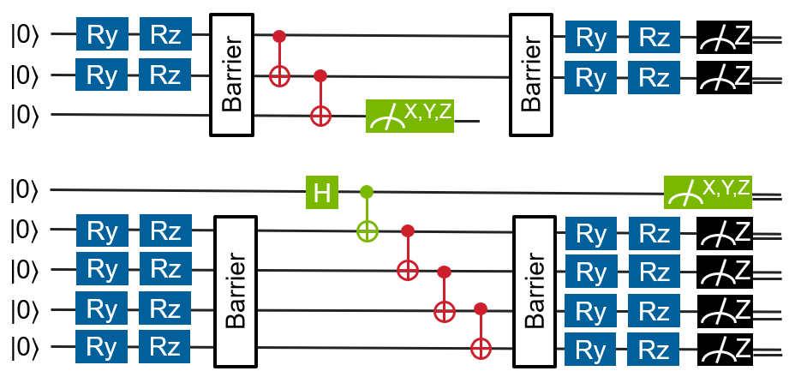
Example – Network Community Detection
Iteratively solve subproblems on 6 vertices:
Circuit cutting allows solving larger subproblems, decreasing number of iterations and improving solution quality
13

Slide 14
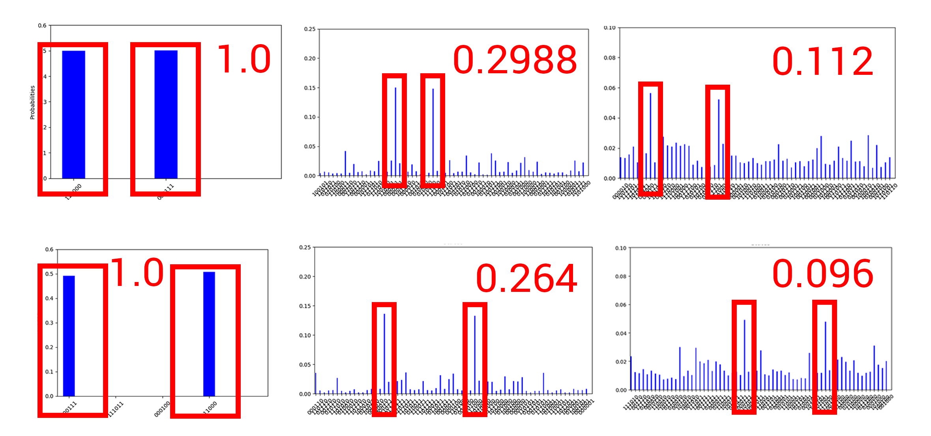
Example – Network Community Detection
Demonstrated evaluations of circuits with up to 36 qubits on the 20-qubit IBM processor and the IBM Aer simulator
No noise
5% depol. noise
10% depol. noise
Original 6-qubit circuit
Two smaller subcircuits
IBM Aer simulation with imported noise model from IBM Q Poughkeepsie chip
  Successfully solves the problem even in the presence of noise
14

Slide 15
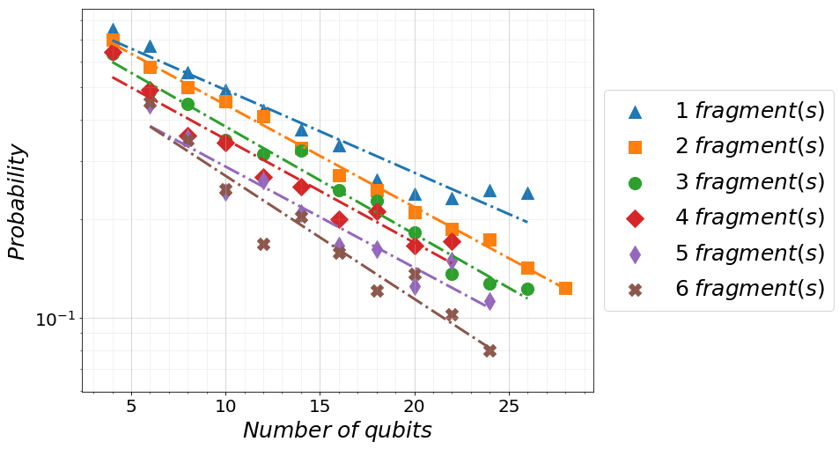
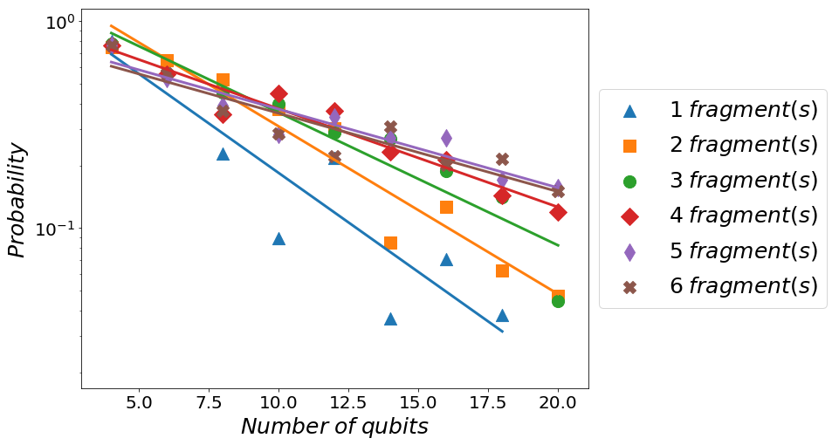
Improving Circuit Fidelity with Circuit Cutting
Vertical cutting of circuits that are too deep to be evaluated faithfully
Horizontal cutting into smaller subcircuits allows mapping logical qubits to the most reliable physical qubits
IBM Aer simulations with a noise model
Evaluations on IBM Q Poughkeepsie chip
Cutting and mapping to the best qubits improves fidelity
15

Slide 16
Summary And Future Directions
Evaluations of 36-qubit circuits on 20-qubit IBM processors
Ongoing work with 100+ qubit circuits
Circuit cutting as a technique for quantum simulations (Intel-QS, ATOS)
Ongoing work on parallelization
Vision of a future architecture that integrates classical and quantum computers and uses circuit cutting and compiling to improve scalability and fidelity
Knowing which circuits cannot be cut is fundamentally important
16
Notes:
In some specific cases circuit cutting allows us to evaluate circuits larger than before
The same technique can be applied to quantum circuit simulations
Future work: scalability of the classical post-processing step that is very expensive – two approaches, sampling or parallelization
In this talk I presented a vision of an architecture that integrates classical and quantum computing, and uses circuit cutting as a technique to allow solving larger problems more reliably
Knowing which circuits cannot be cut is just as important as knowing which circuits can be cut; if quantum computing provides any advantage then general quantum circuits cannot be cut; however, circuit cutting can optimize suboptimal quantum circuits as well as identify inefficient circuits that do not solve interesting problems

Slide 17
QIS Team at Argonne
Co-PIs
Computing interns Spring, Summer ‘19
Quantum Network Simulation Team
PhD students / postdocs
17

Slide 18
Thank You!
Acknowledgements: This material is based upon work supported by Laboratory Directed Research and Development (LDRD) funding from Argonne National Laboratory, provided by the Director, Office of Science, of the U.S. Department of Energy under contract DE-AC02-06CH11357. This work was also funded in part by ATOS. Access to IBM Q was provided by the Oak Ridge Leadership Computing Facility, which is a DOE Office of Science User Facility supported under Contract DE-AC05-00OR22725.

