Slide 1
Quantum Metrology for dark matter wave detection
Aaron S. Chou (Fermilab)
Argonne QIS Workshop
September 23, 2019
Collaborators:
David Schuster, Akash Dixit, Ankur Agrawal (U.Chicago)
Daniel Bowring, Mohamed Hassan, Matt Hollister, Rakshya Khatiwada (Fermilab)
Konrad Lehnert, Dan Palken, Kelly Wurtz (U.Colorado/NIST)
Reina Maruyama, Sid Cahn, Danielle Speller, Sumita Ghosh (Yale)

Slide 2
Low mass dark matter takes the form of coherent bosonic sine waves
For mass < 70 eV, Fermi degeneracy pressure would make the smallest dark matter clumps larger than the observed size of dwarf galaxies. (Randall, Scholtz, Unwin 2017)
→ If lower mass, dark matter must be coherent bosonic sine waves with macroscopic mode occupation number >>1
Not billiard balls.
Need coherent wave detector.

Slide 3
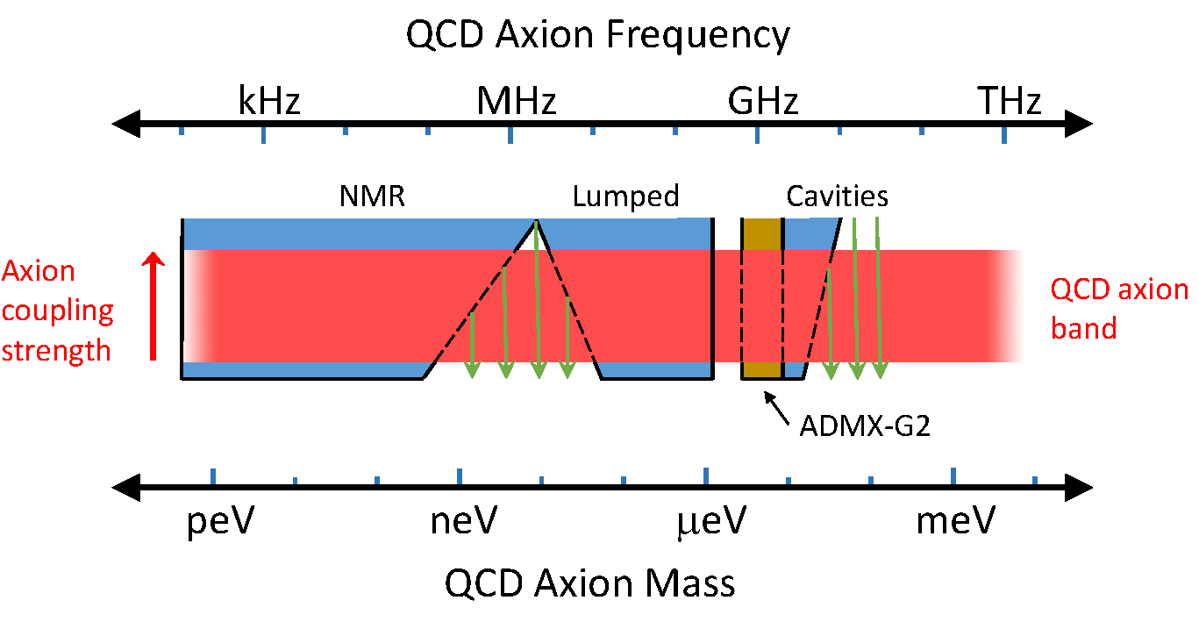
The Dark Matter Wave Landscape
Figure adapted from DOE ”Small Dark Matter” BRN Study, 2018
Atom interferometry
(MAGIS)
PHz
10 eV threshold WIMP sensors
(SENSEI)
ADMX-G2
Transition edge sensors,
Superconducting nanowire,
Quantum capacitance det.
MKID microcalorimeters
BOLD = funded by DOE QuantISED program
Squeezed photon states,
Quantum nondemolition with aluminum qubits
Noiseless photon upconvertors, spin-squeezing
High-Tc qubits/amps
Rydberg atoms
Graphene-JJs

Slide 4
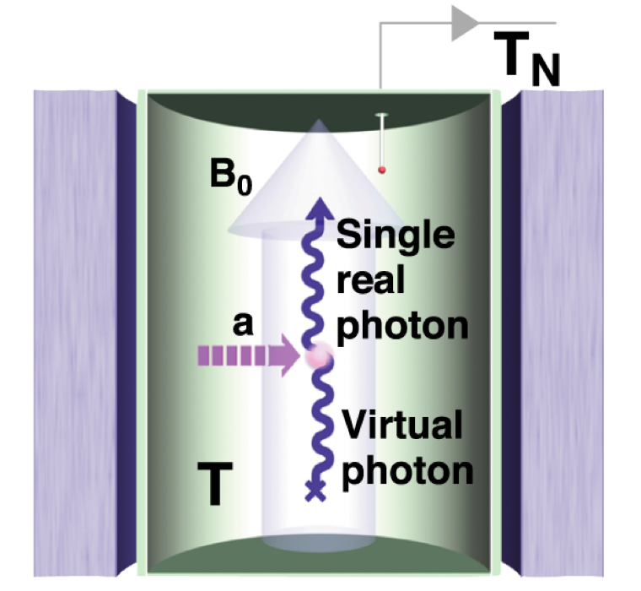
The Dark Matter Haloscope: Classical axion wave drives RF cavity mode
Pierre Sikivie,
Sakurai Prize 2019
In a constant background B₀ field, the oscillating axion field acts as an exotic, space-filling current source
which drives E&M via Faraday’s law:
In the presence of matched cavity boundary conditions to extend the coherent interaction time (cavity size $≈$ 1/m_{a}³), the exotic source current excites standing-wave RF fields.
A spatially-uniform cavity mode can optimally extract power from the dark matter wave

Slide 5
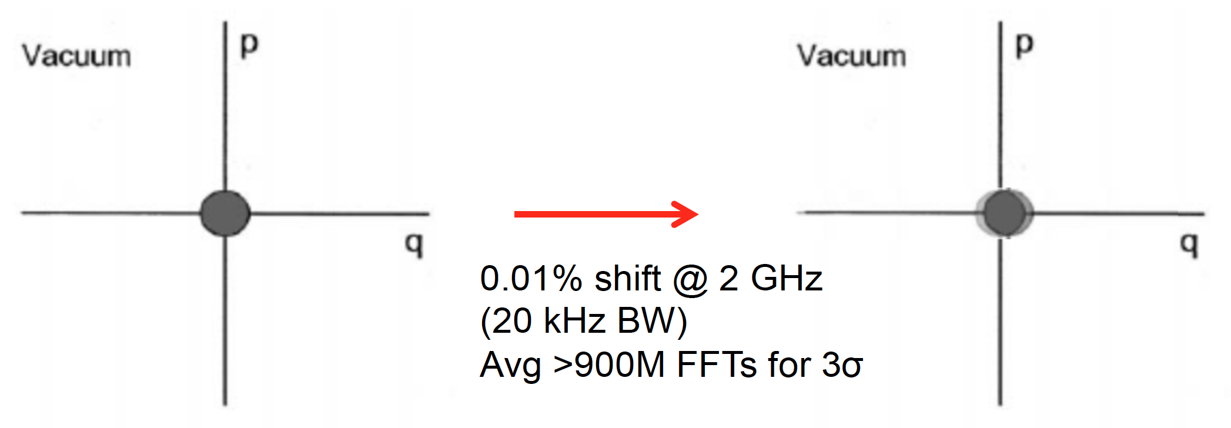
Due to limited coherence time, the axion wave displaces the cavity vacuum state by an amount much smaller than the zero-point vacuum noise
p
Axion-photon mixing induces tiny coherent
state displacement $D\left(gθB_{0}Q_{cav}/m_{a}^{2}\right)|\left.0\right\rangle$
p
x
x
Coherent state
phase space area = ½ħ
𝛼=10⁻²
(Exaggerated) displacement
Cannot easily see the tiny shift when reading out using the coherent state basis,
i.e. measuring power using phase-preserving amplifiers with standard quantum limit noise.
SQL probe resolution = ½ħ → +/-1 photon variance, but avg signal << 1 photon.

Slide 6
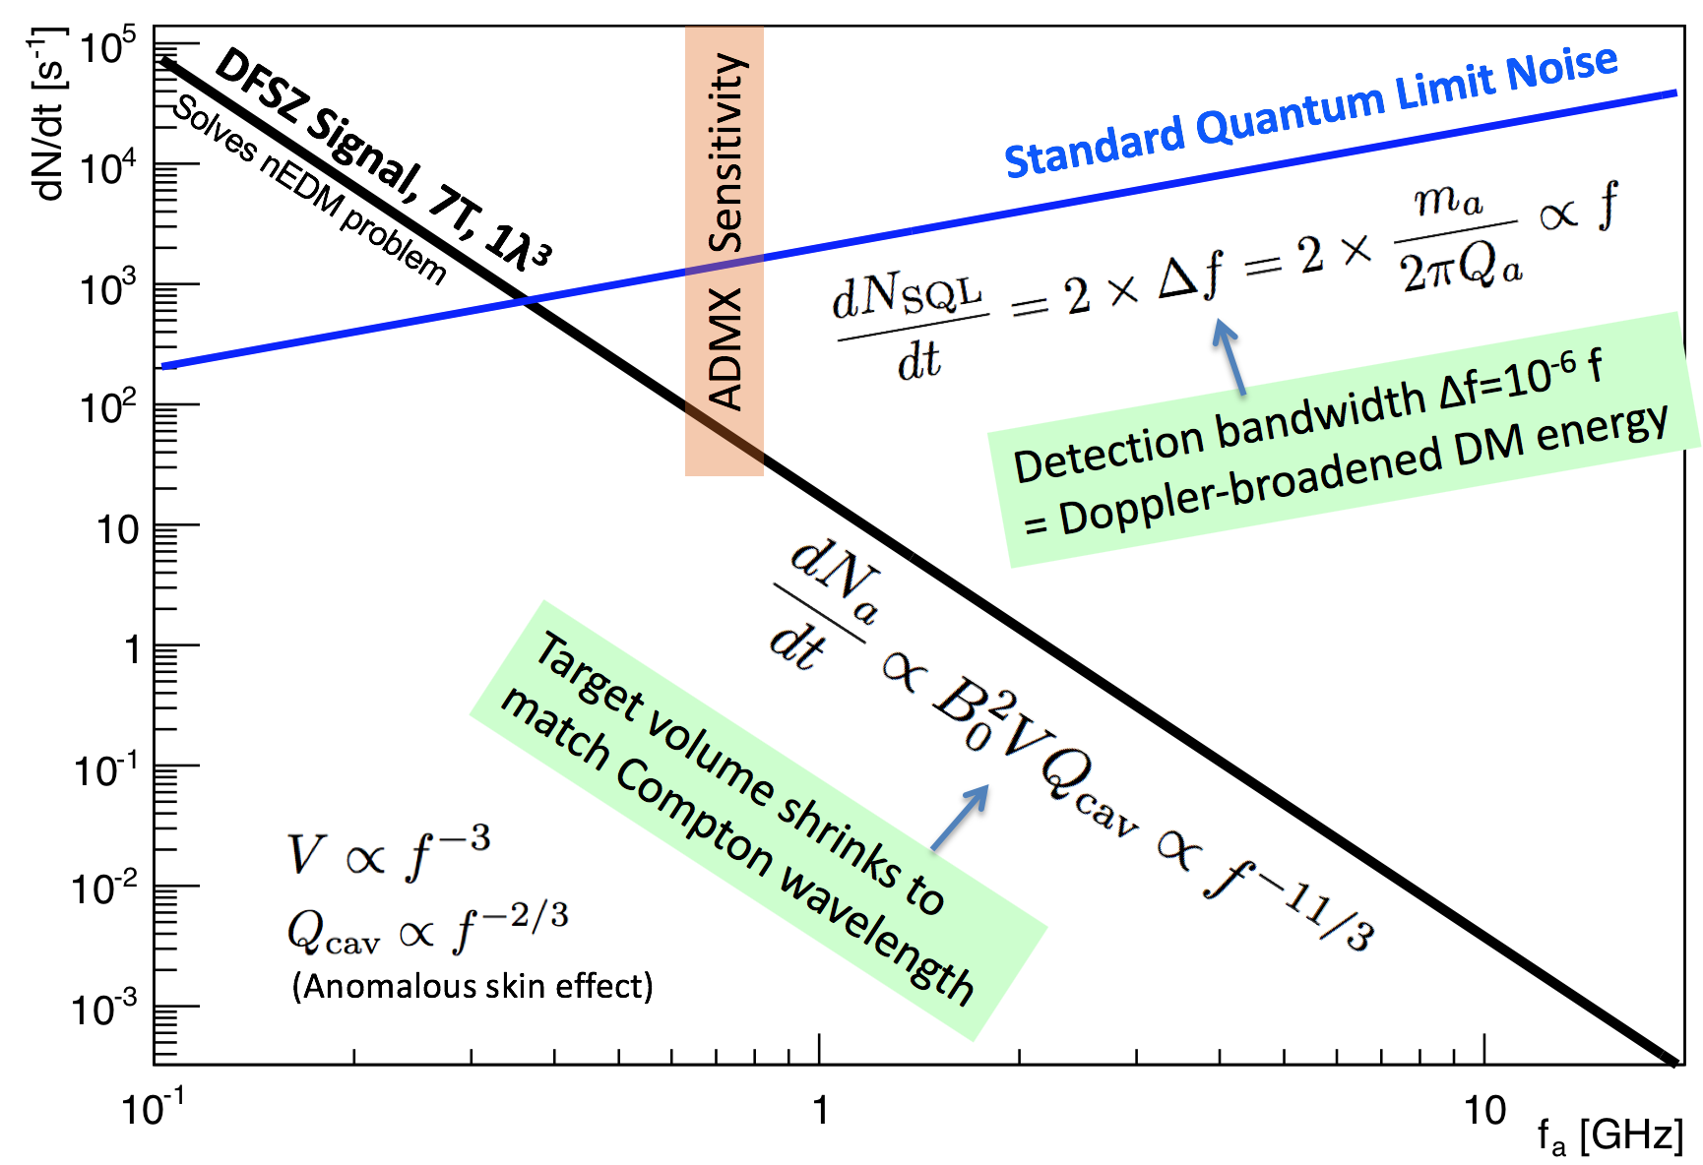
The predicted axion DM signal/noise ratio plummets as the axion mass increases → SQL readout is not scalable.

Slide 7
To reduce readout noise, use photon counting to measure displacement using the Fock basis – number eigenstates
Photon number operator commutes with the Hamiltonian → all back-action is put into the unobserved phase of the photon … which we don’t care about.
Phase space area of each annulus is still ½ħ but is squeezed in radial (amplitude) direction. Phase of photon state is randomized.
Quantum nondemolition measurements demonstrated with Rydberg atoms, (Serge Haroche Nobel Prize 2012)
Implemented using solid state artificial atom qubits,
D.Schuster et.al, 2007
Proposed for axion search:
Lamoreaux, Lehnert, et.al, 2013,
Zheng, Lehnert, et.al, 2016
1
2
3
Displaced vacuum state exponentially leaks into non-zero Fock number.
Detect displacement by counting the occasional single photon.

Slide 8
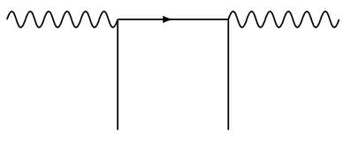
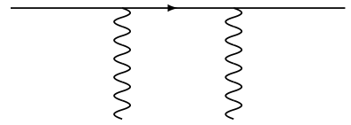
Quantum non-demolition “off-shell” sensors transduce photon occupation numbers into atomic frequency shifts
Index of refraction diagrams:
$$γ$$
$$γ$$
$$ψ$$
$$ψ$$
$ψ$*
$ψ$*
$$ψ$$
$$ψ$$
$$γ$$
$$γ$$
Photon 2-point function measures the density of background fermions.
Fermion 2-point function measures the density of background photons
The photon occupation number of the cavity mode is encoded as a frequency shift of the probe atom.
Being far off-resonance of $ψ$* results in no net absorption of photons.
Quantum non-demolition: indirectly measure the same photon many times to achieve higher measurement fidelity.

Slide 9
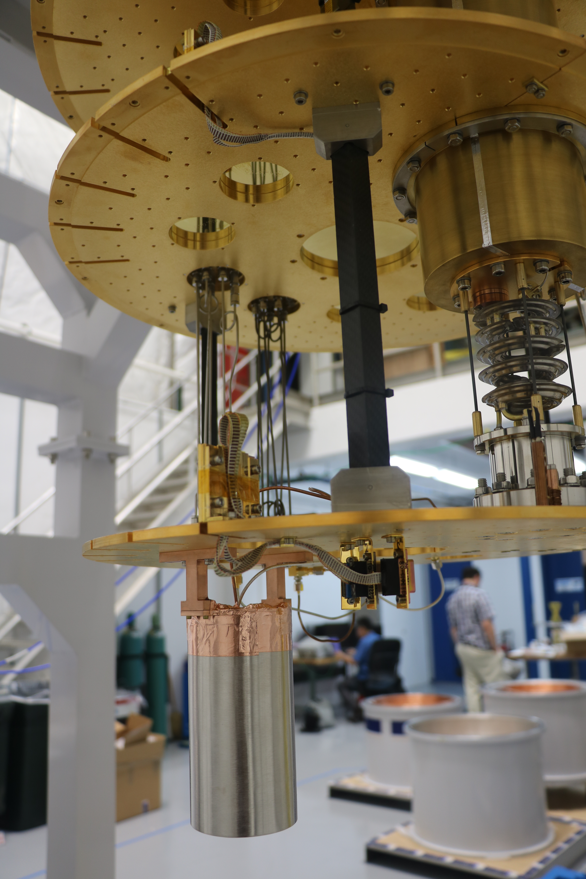
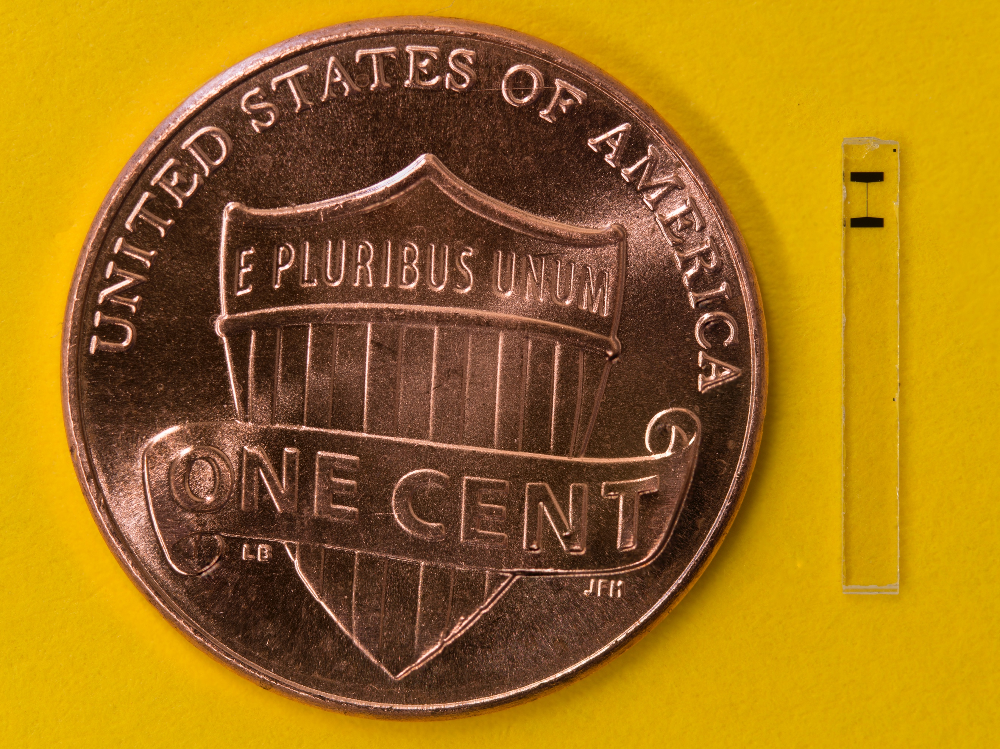
Use artificial atoms made of superconducting “transmon” qubits to nondestructively sense photons
A.S. Chou, David Schuster, Akash Dixit (U.Chicago)
Funded by
1mm
DOE QuantISED
Fermilab LDRD
The electric field of individual photons exercises the nonlinear inductance of the Josephson junction. Photon number is transduced into frequency shifts of the $|\left.g\right\rangle →|\left.e\right\rangle$ transition.

Slide 10
Single photon resolution: Measured $|\left.g\right\rangle →|\left.e\right\rangle$ qubit transition frequencies while weakly driving the cavity into a Glauber state with <n>=1
Measured spectrum exhibit a distribution of resonances which are in 1-1 correspondence with the Poisson distribution of the cavity’s coherent state.
Non-destructively count photons by measuring the quantized frequency shift.

Slide 11
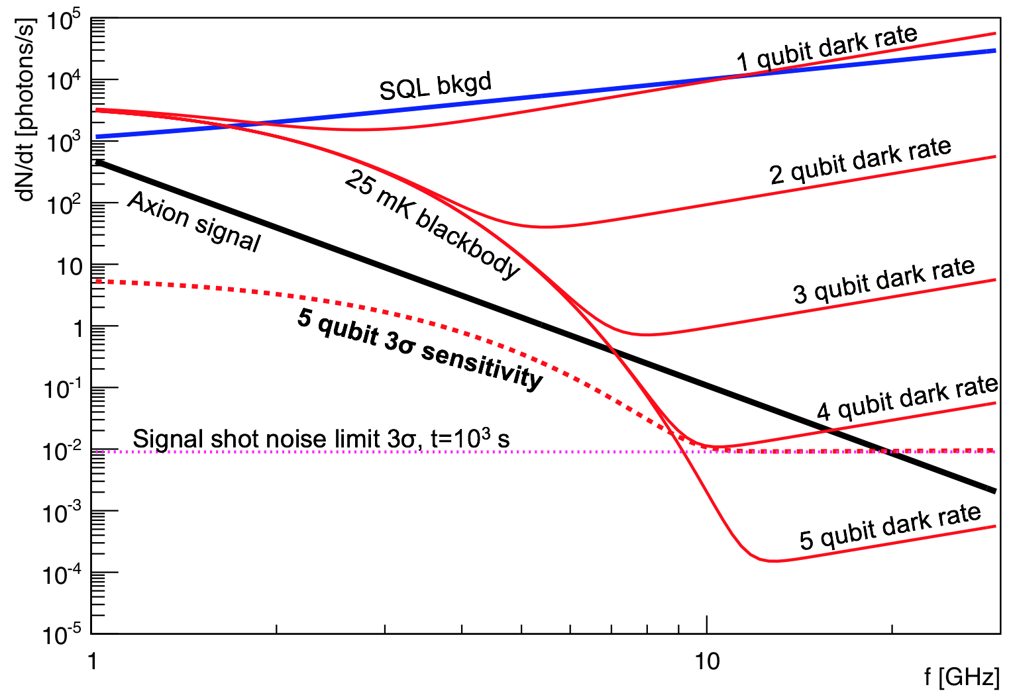
Multiple, redundant readouts of the same signal photon give the noise equivalent of >40 dB of squeezing → enables a background-free experiment
No thermal dark counts, no qubit-error-induced dark counts.
DFSZ, 0.45 GeV/cc, B=14T, C=1/2, Q=5x10⁴@1GHz, V=13𝜆³, crit.coup
Typical single measurement error probability
p=10⁻²
With N QND measurements, dark rate =
(10⁻²)^{N} ∆f
Assumes axion detection bandwidth
∆f ~ MHz
Sensitivity limited only by signal photon shot noise.
Serge Haroche used majority vote out of 8 atoms → Nobel prize 2012.
Here we assume unanimous vote amongst 5 qubits to reduce dark rates by 10 orders of magnitude. Enables future axion DM search up to 20 GHz.

Slide 12
More stupid qubit tricks: Stimulated emission of photons from DM axions
Start the photon wave swinging so it can more easily accept energy from the axions.
Good!
Waiting…
Oops, wrong phase
Power = $\vec{Force}∙\vec{velocity}$
Phase offset determines the direction of energy flow.
But the axion wave is a coherent state of unknown phase which changes every millisecond… How do we prepare the cavity oscillator???

Slide 13
Solution: Prepare the cavity wave in a superposition of all possible oscillation phases – a Fock number eigenstate!
The Fock state is symmetric in phase angle
→ responds equally well to pushes at any time.
It also has definite occupation number N
no Poisson noise!
$H_{I}$ = $g(a^{†}b$+${ab}^{†}$) →
$${\left\langle α,N+1|\right.H}_{I}|α,\left.N\right\rangle =gα\sqrt{N+1}$$
N=1 Fock state
∆N×∆𝜑 = ½
Konrad Lehnert
(Colorado)
Wigner function describing the distribution of the amplitude and phase of the cavity sine wave.

Slide 14
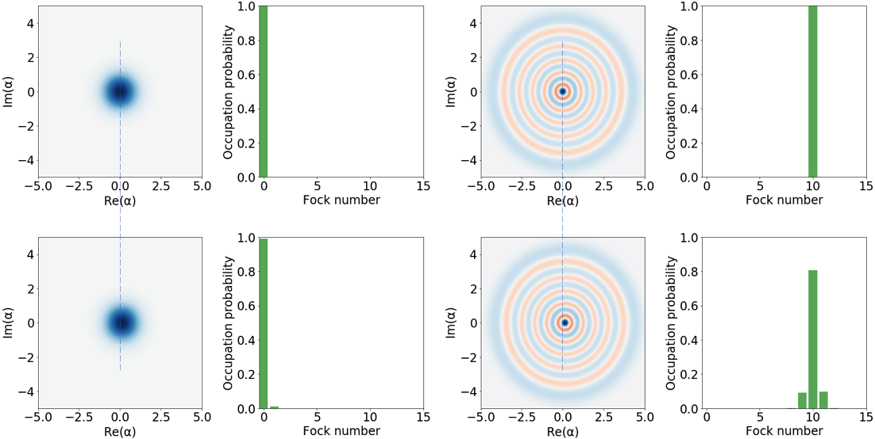
For finite coherence time << mixing time, the transfer of quanta from axions to photons is enhanced by a factor (N+1)
N=1
N=10
Displacement
Displacement
Much larger signal!

Slide 15
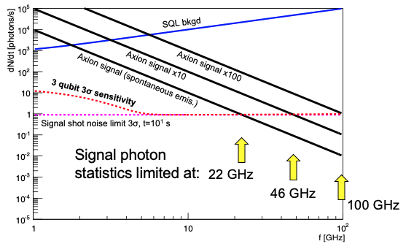
Using Q=10⁸ cavities, stimulated emission boosts axion signal by factors up to 100.
Not only increases SNR at lower masses, but also extends range to higher masses!
The signal rate is sufficiently strong… but just need the technology to create the Fock state.
Al qubits limited <30 GHz → Need higher frequency qubits made of custom superconductor.

Slide 16
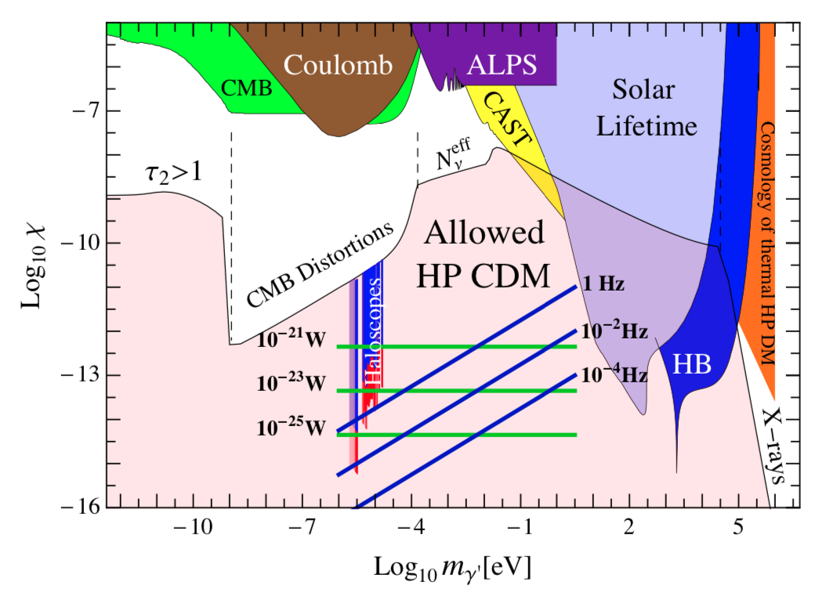
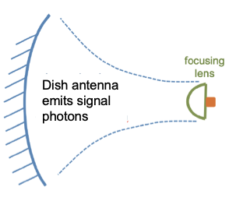
Above 30 GHz, improved sensor technology needed to bridge the gap between wave and particle sensors:
Figure adapted from Horns et.al (2012)
Use dish antenna for broadband response to dark matter waves
Low dark rate single photon detector:
MKID,
SNSPD,
TES,
Quantum capacitance?
10 eV threshold particle detectors (e.g. SENSEI)
R&D consortium: FNAL, ANL, U.Chicago, MIT, NIST
Wave detectors
(e.g. ADMX)
Need better sensors

Slide 17
Summary
A new focus of the dark matter community is on classical waves made of low mass bosonic dark matter
In particular, axions may solve the 70-year old problem of the vanishing neutron electric dipole moment
Axion DM sensitivity is currently limited by the zero-point noise of the quantum vacuum (1 background count per readout)
QND photon counting evades vacuum noise and can achieve arbitrarily low background rates
Cavity state preparation in non-classical states can also improve SNR via stimulated emission
At higher frequencies, use superconductors as microcalorimeters instead of as nonlinear inductors
Now hiring postdocs and students at Fermilab, Univ. of Chicago.

Slide 18
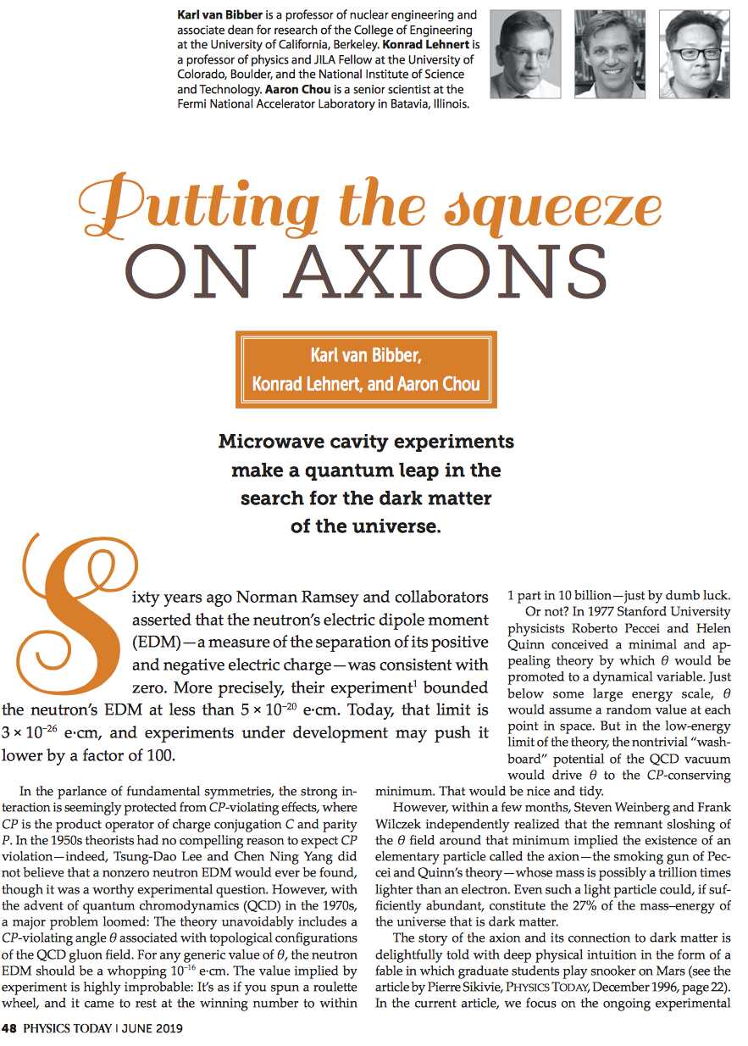
Physics Today, June 2019
Explains how dark matter axion searches are already limited by quantum noise and that new quantum sensing techniques are needed to make further progress towards higher mass axions.
With qubit-QND measurements:
Already demonstrated single measurement noise equivalent of -10dB squeezing.
Goal for dark matter search: average many measurements to get -40 dB below SQL vacuum noise.

Slide 19
Upcoming Aspen Winter Conference:
https://indico.physics.lbl.gov/indico/event/939/overview

