Slide 1
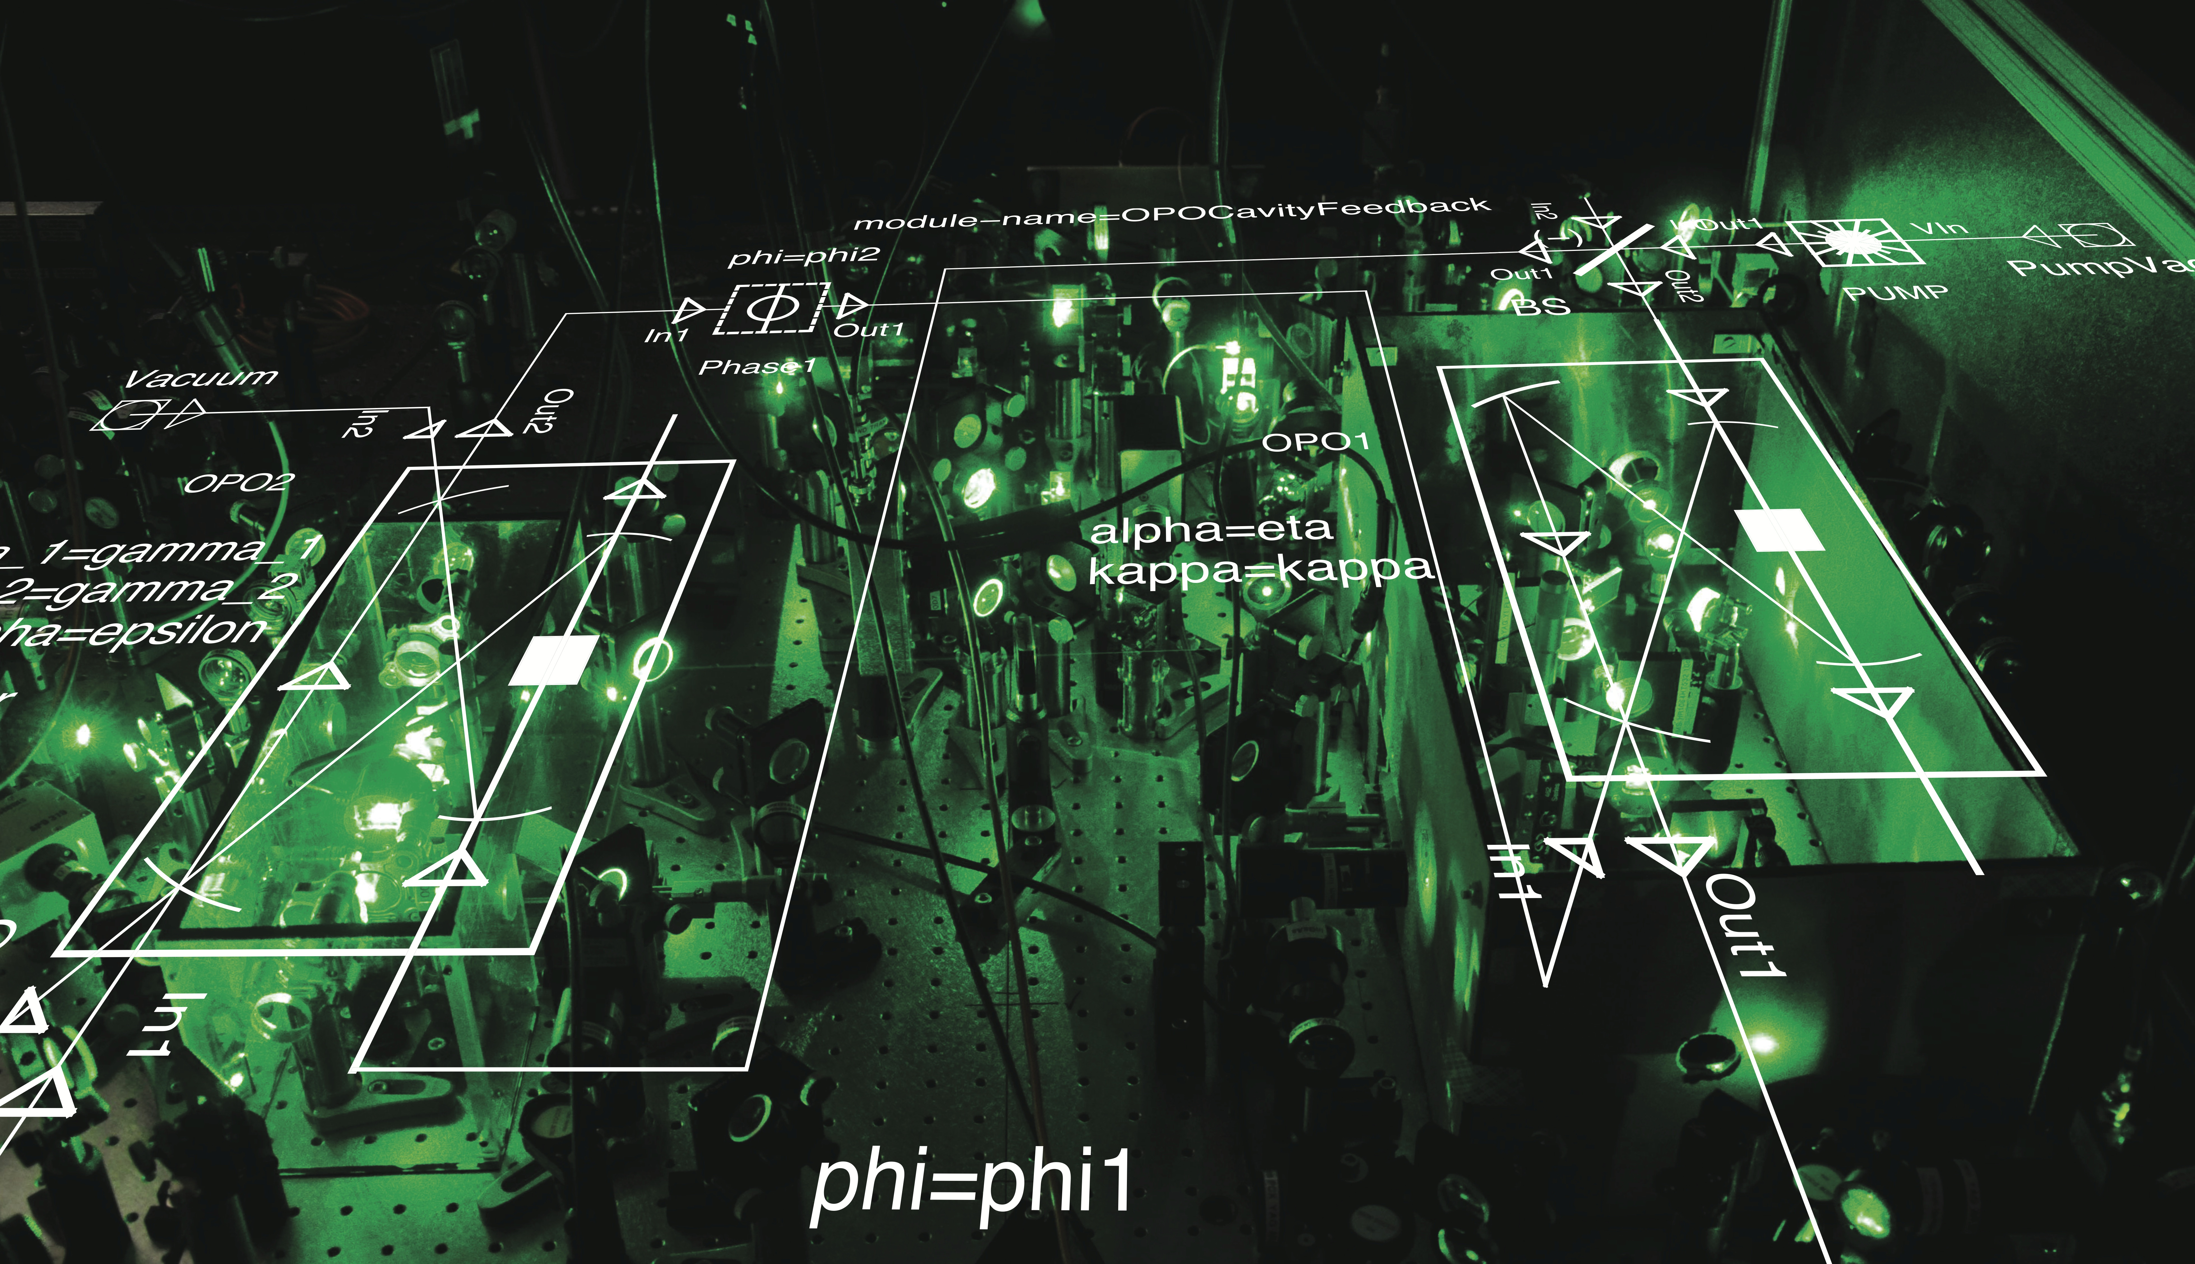
Coherent nonlinear photonics:
From attojoule to quantum
Hideo Mabuchi
Stanford University
DARPA, AFOSR, NSF, ARO
TexPoint fonts used in EMF.
Read the TexPoint manual before you delete this box.: AAAAAAAAAAAAA

Slide 2


Slide 3
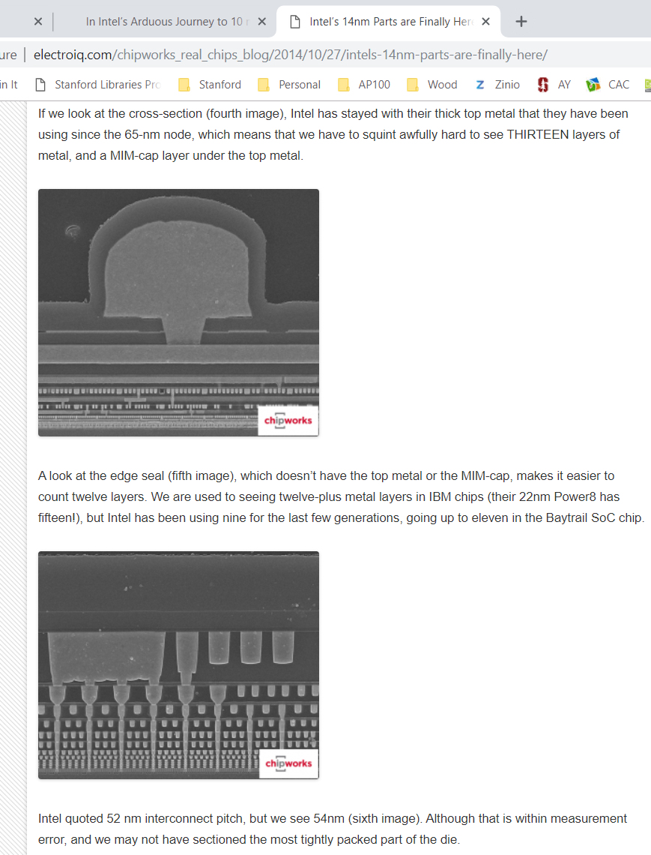



Slide 4



(nano)Photonic integration: on the roadmap?

Slide 5
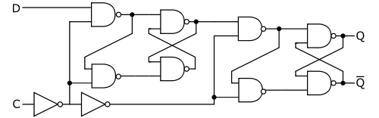
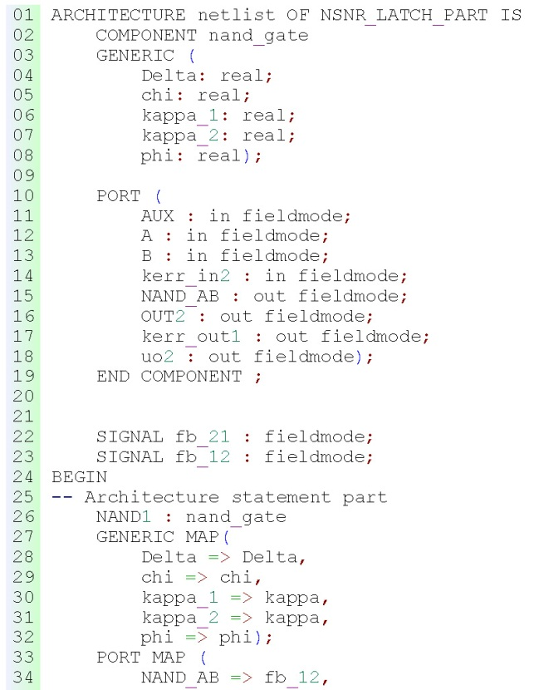
Ultra-low power nanophotonic circuit theory
HM, Appl. Phys. Lett. 98, 193109 & 99, 153103 (2011)
PLINC: Photonic Logic via Interferometry with Nonlinear Components
PLINC exploits cavity-enhanced nonlinearity and circuit-scale optical coherence to implement attojoule photonic logic
PLINC is a natural scheme for near-future integrated nanophotonics, testable today using single-atom cavity QED
PLINC circuit theory = coherent-feedback quantum control
1. Develop QHDL, a subset of industry-standard VHDL for the specification of PLINC circuits
2. Develop software for compiling QHDL into rigorous quantum optical models
3. Use QHDL toolbox + high-performance numerical simulation for analysis and design of functional circuits
4. Validate key coherent feedback concepts in single-atom cavity QED experiments
In2
Out1
Kerr
¼/4
In1
w
x
¯ ’
µ
¯
µ ’
¼/4
Out2
Notes:
Upper panel left presents three bullet points about “PLINC” architecture; upper right is a schematic diagram of a D-type flip-flop built from elementary logic gates (from Wikipedia; image placed by author in public domain). The schematic is shown to emphasize the idea that we want to transition from thinking about individual photonic logic components to thinking about functional circuits.
Lower panel left presents four key elements of our SOW; lower middle is an excerpt of QHDL code for a PLINC NAND latch; lower right is an optical diagram of a PLINC NAND gate for use within a latch.

Slide 6
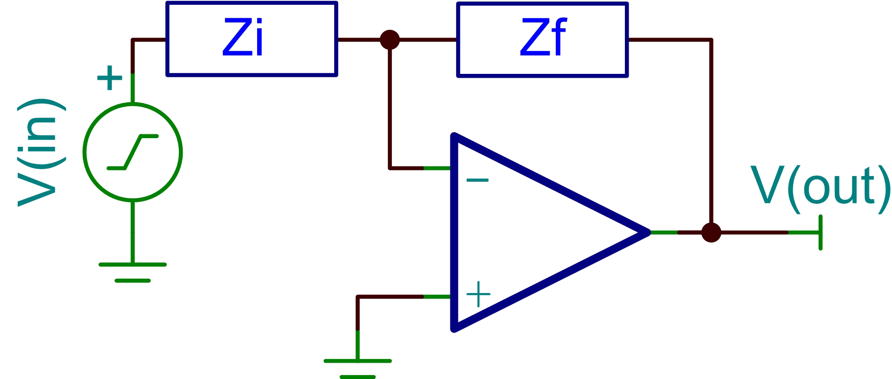
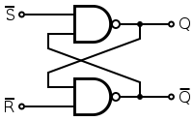
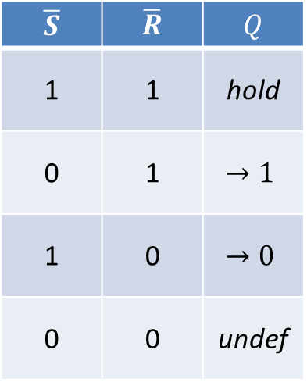
Feedback (control) motifs in circuit design
Stabilization
(robustness)
http://www.rfdesignline.com/howto/209400216
$$\overline{S}$$ | $$\overline{R}$$ | $$Q$$
1 | 1 | hold
0 | 1 | $$→1$$
1 | 0 | $$→0$$
0 | 0 | undef
Synthesis
Steady-state analysis can be intuitive, but need theory for dynamics (transients), noise

Slide 7
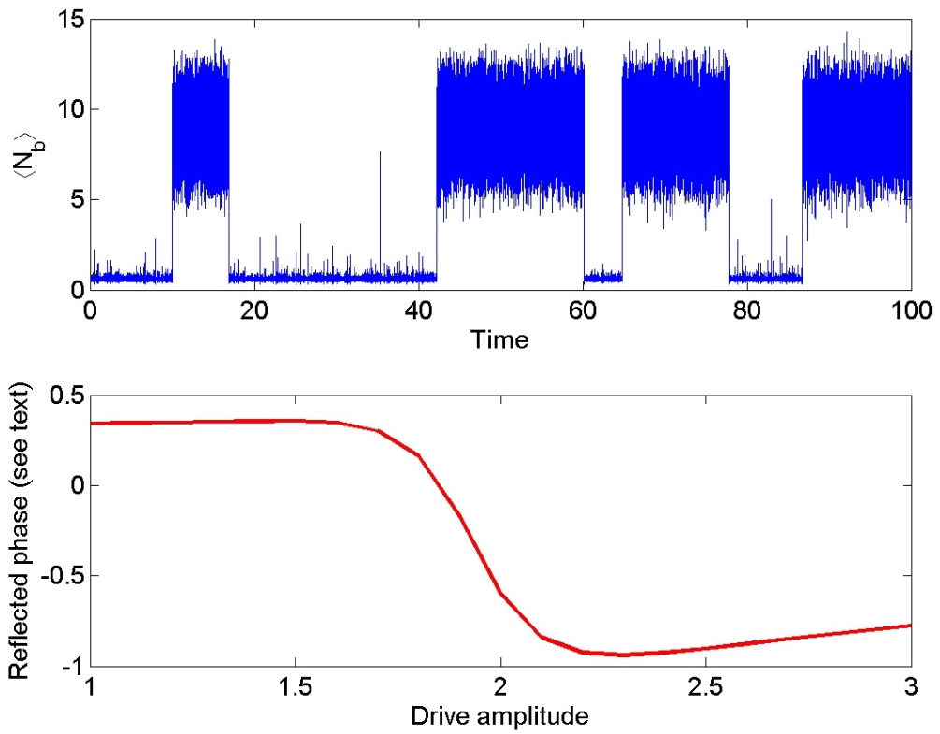
Attojoule nanophotonic switch stabilization
HM, Appl. Phys. Lett. 98, 193109 (2011)
β
β
ϕ₀
P
ϕ(P)
Nonlinear dynamic
controller

Slide 8

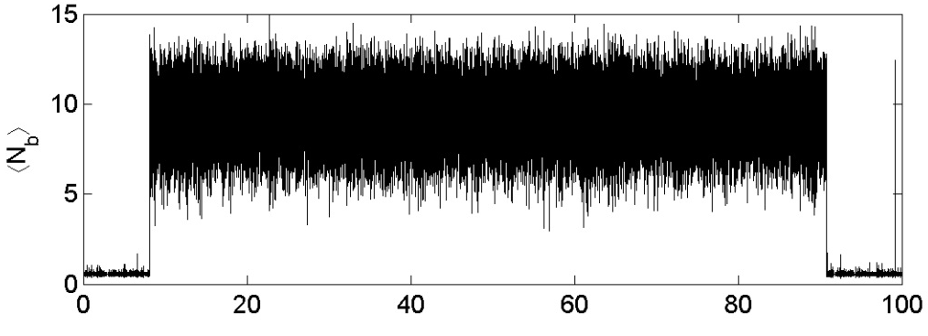
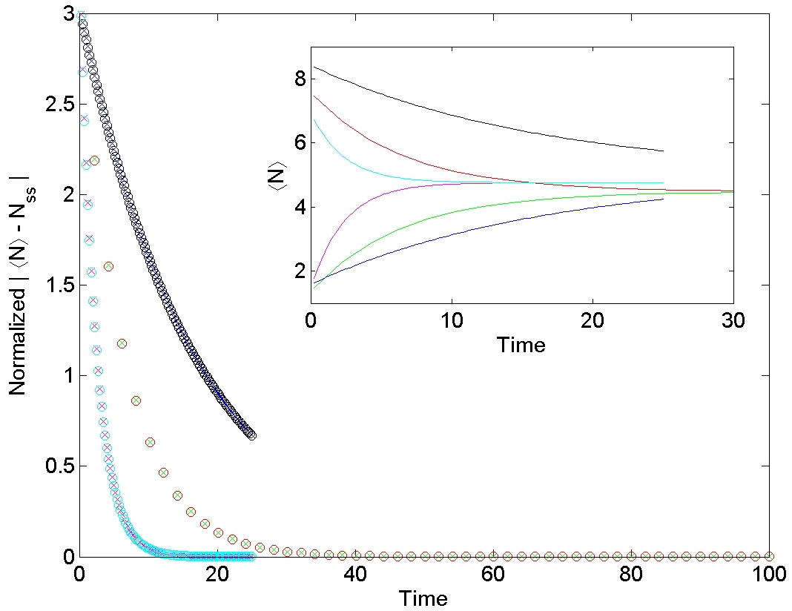
Attojoule nanophotonic switch stabilization
HM, Appl. Phys. Lett. 98, 193109 (2011)
β
ϕ₀
P
ϕ(P)
Nonlinear dynamic
controller

Slide 9
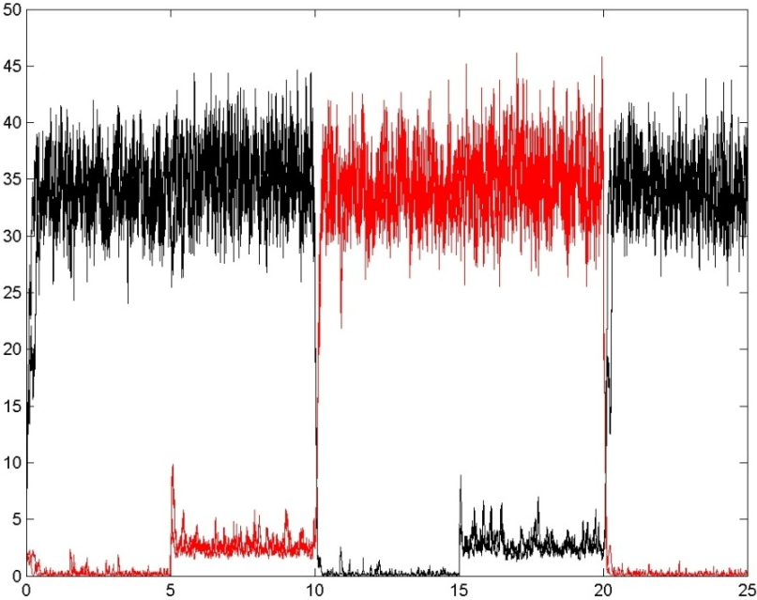
Quantum models for attojoule photonic switching
HM, Appl. Phys. Lett. 99, 153103 (2011)
N. Tezak, A. Niederberger, D. S. Pavlichin, G. Sarma and HM, Phil. Trans. Roy. Soc. A 370, 5270 (2012)
SR NAND latch
Hierarchical Design
NAND gate
http://mabuchilab.github.com/QNET/
Notes:
Can use existing open source tools to visually design our circuits from a custom library of basic components.
Hierarchical design principle allows to work on different levels of hardware abstraction
Circuit schematic can finally be exported to hardware description language

Slide 10
Computer-aided model construction and simulation
N. Tezak, A. Niederberger, D. S. Pavlichin, G. Sarma and HM, Phil. Trans. Roy. Soc. A 370, 5270 (2012)
In2
Out1
¼/4
Kerr
In1
w
x
¯ ’
µ
µ ’
¯
¼/4
Out2

Slide 11

The QNET simulation package (GitHub)
N. Tezak, A. Niederberger, D. S. Pavlichin, G. Sarma and HM, Phil. Trans. Roy. Soc. A 370, 5270 (2012)

Slide 12
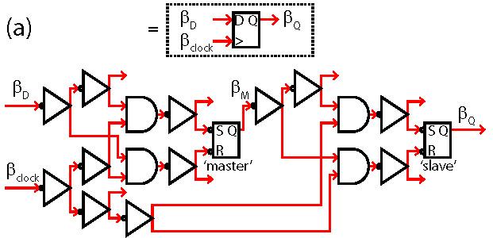
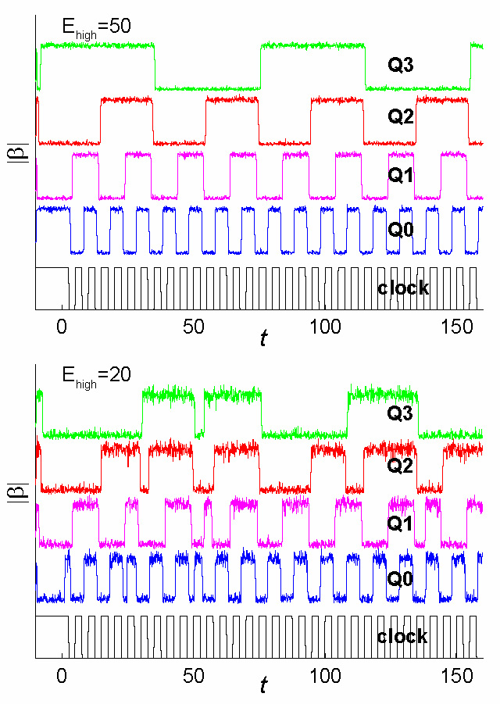
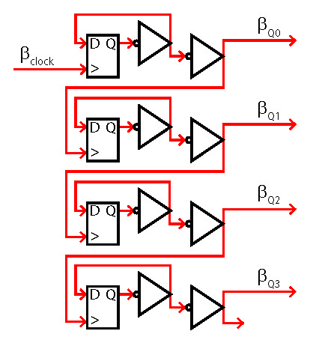
Quantum noise in large-scale coherent circuits
C. Santori et al. (HP Labs + Stanford), Phys. Rev. Appl. 1, 054005 (2014)
4-bit ripple counter
= 4 flip-flops
= 88 resonators

Slide 13
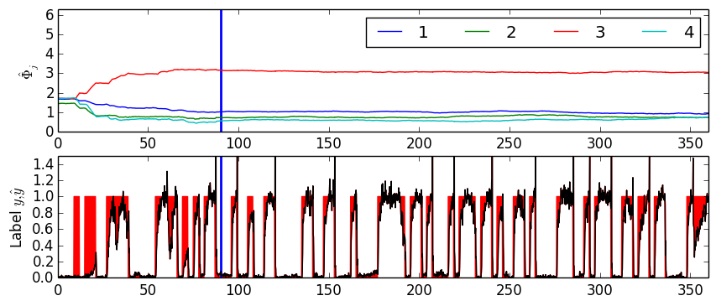
An all-optical Perceptron architecture
Nikolas Tezak and HM, EPJ Quantum Technology 2:10 (2015)
=
Notes:
A perceptron is a machine-learning algorithm that can realize linear binary classification. It does this by learning a separating hyperplane between two differently labeled clusters of training data.
Subsequent unlabeled data is then projected onto the normal vector of the hyperplane. If this inner product is positive, the example is labeled 1, otherwise 0.
Perceptrons can be trained “on-line”, i.e., incrementally using a so-called stochastic gradient technique, where each training sample perturbs the weights w_j of the normal vector a little bit in the direction it needs to be labeled correctly. The feedback rule to the j’th synapse during training is: delta w_j = alpha * (y - y_estimated) * x_j. I.e., if the estimated/predicted label and the training data label agree, apply no feedback. Otherwise, if it should be labeled 1, but was predicted 0, increase the weight proportionally to x_j. If it should be labeled 0, but was predicted 1, decrease the weight proportionally to x_j.
The upper left graphic shows a single synapse with the logic necessary to train it.
The inputs are
T: which is a binary input signaling whether the learning feedback is turned on or not. T=1 → train, T=0 → no feedback
y_est: feedback from the overall perceptron’s output: the estimated class label
y: training class label
x_j: j-th input coordinate
The circuit realizes exactly the above-described feedback rule for a single synaptic weight. The learning rate alpha is determined by four things: The input beamsplitter mixing angle theta, the overall input power, the time that each training sample is presented to the circuit (inputs constant over that time period) and finally the sensitivity of the active oscillator’s internal phase to external input.
The tunable bias for the amplifier now drives two different amplifiers with anti-correlated gain, because they receive inputs \beta_0 +/- \beta_1 e^{i\Phi}. Their output is subtracted and this yields an overall gain, that can swing both positive and negative.
Finally, the lower left circuit shows the full perceptron. Four synaptic weights receive the input data in parallel, while y, T and y_est drive them sequentially (this will change in v. 2 for timing reasons). The amplifier outputs are summed on a 5-port beamsplitter (not shown here is an extra static bias), fed through a quadrature filter to remove the unwanted y-quadrature, and then sent through a two-mode Kerr-modulator as described on previous slide, lower right plot. The estimated output label is then fed back.
The lower right plot shows a simulation of this N=4 problem. Training data was generated as random samples of two gaussians each centered at a different location in R^3 and a sigma that was less than their distance to ensure linear separability. The system was trained on 30 training samples and then classified the remaining 90 samples. The upper subplot shows the internal Phi_j it converged to. The blue vertical bar marks the end of training. After this, feedback is turned off and the phases/weights diffuse slightly but remain fairly stable.
The lower plot shows the predicted label (black) and the area between real and predicted label (colored red). One generally already sees that the circuit performs quite well. If one averages the predicted class label output over each input time interval and sets a threshold of .5, there are zero false predictions in this simulation.
This is a toy model, and the cascade of the feedback should probably be replaced by a faster (but less energy efficient) fanout when scaling up. Or maybe a combination of cascade and fanout.
Simulations take about 10-20 seconds to run. About 200 circuit components (including all passive components), around 70, internal mode degrees of freedom.
Can be built with fewer components (right now there is actually one quadrature filter per weight, not as shown in above diagram).
To make non-linear classifier, do dimensional lifting with input, i.e. prepend circuit by static non-linearity→ all-optical reservoir computer

Slide 14
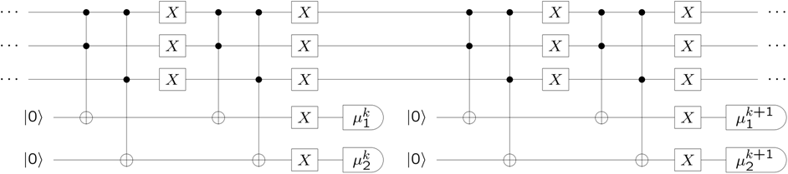
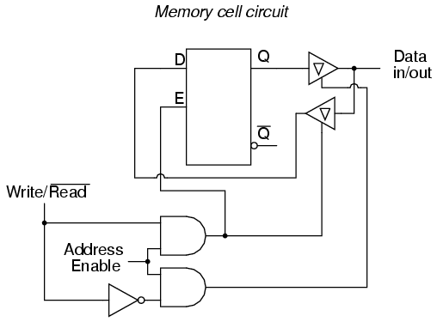
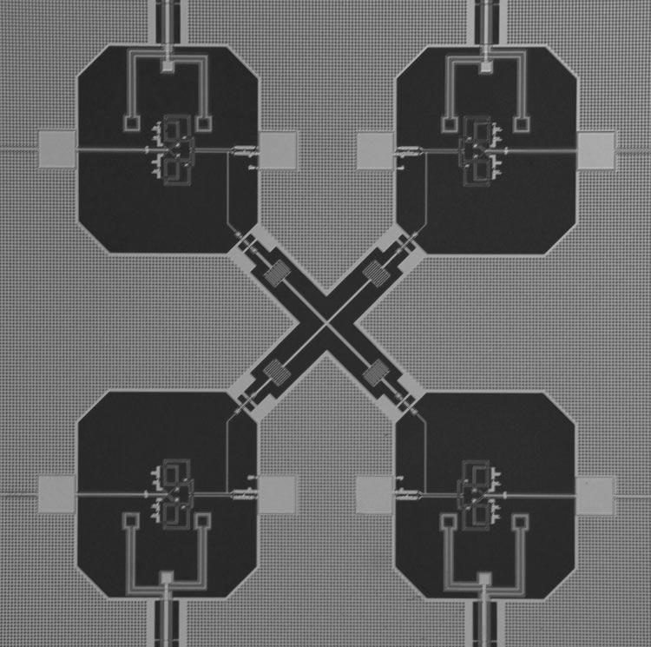
Quantum error correction “circuits”
physicsworld.com (UCSB)
“superconducting trio get entangled”
http://openbookproject.net/electricCircuits/Digital/DIGI_15.html

Slide 15
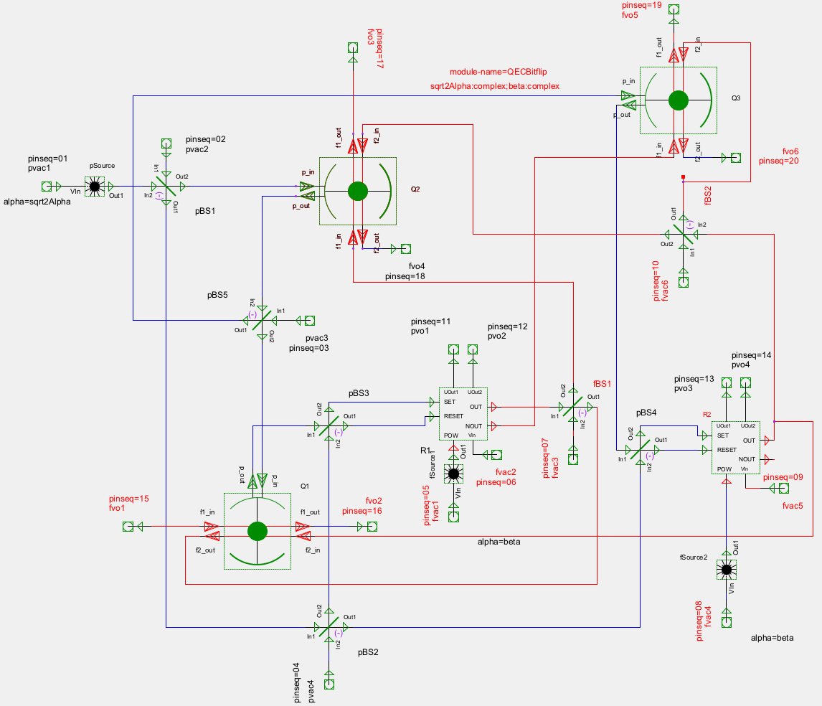
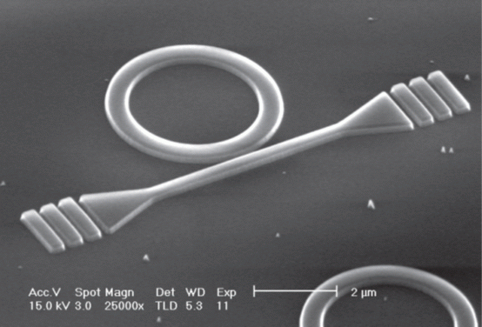
Coherent-feedback autonomous quantum memory
J. Kerckhoff, H. Nurdin, D. Pavlichin and HM, PRL 105, 040502 (2010)
J. Kerckhoff, D. S. Pavlichin, H. Chalabi and HM, New J. Phys.13, 055022 (2011)
A. Faraon et al. New J. Phys. 15 025010 (2013)
SET in
OUT
RESET
in
R
POWER
in
OUT

Slide 16
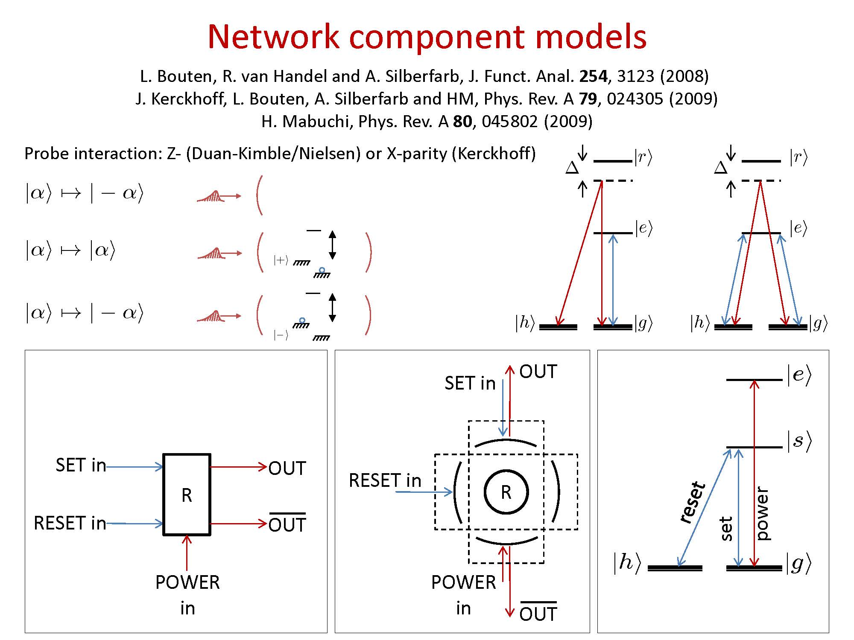

Slide 17
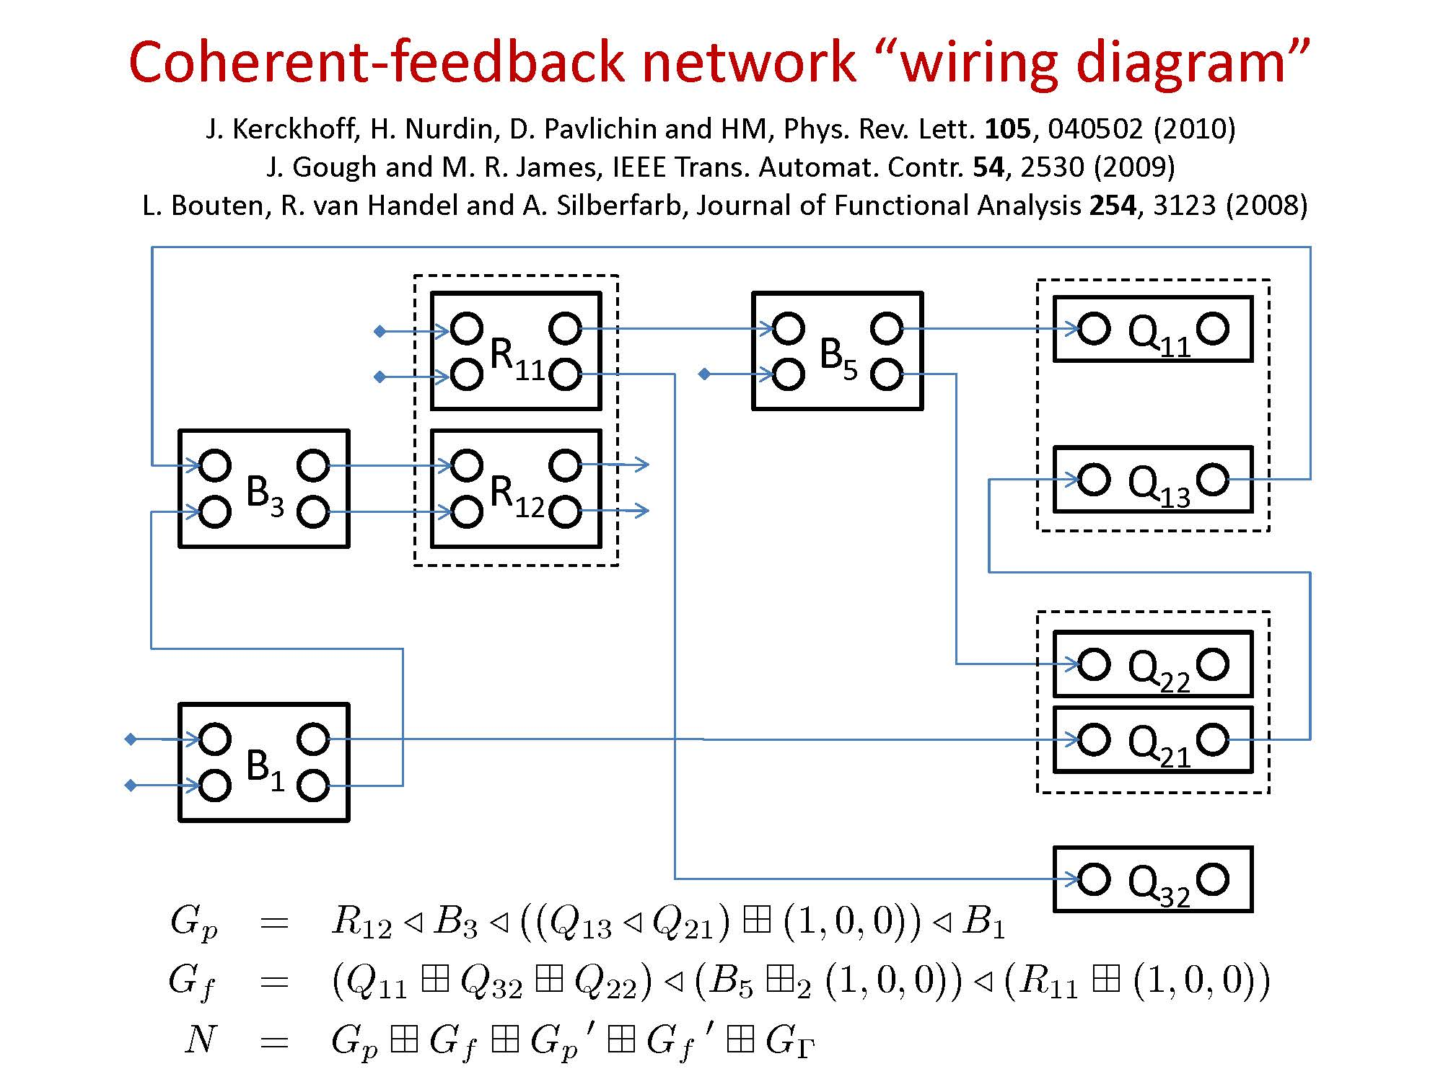

Slide 18
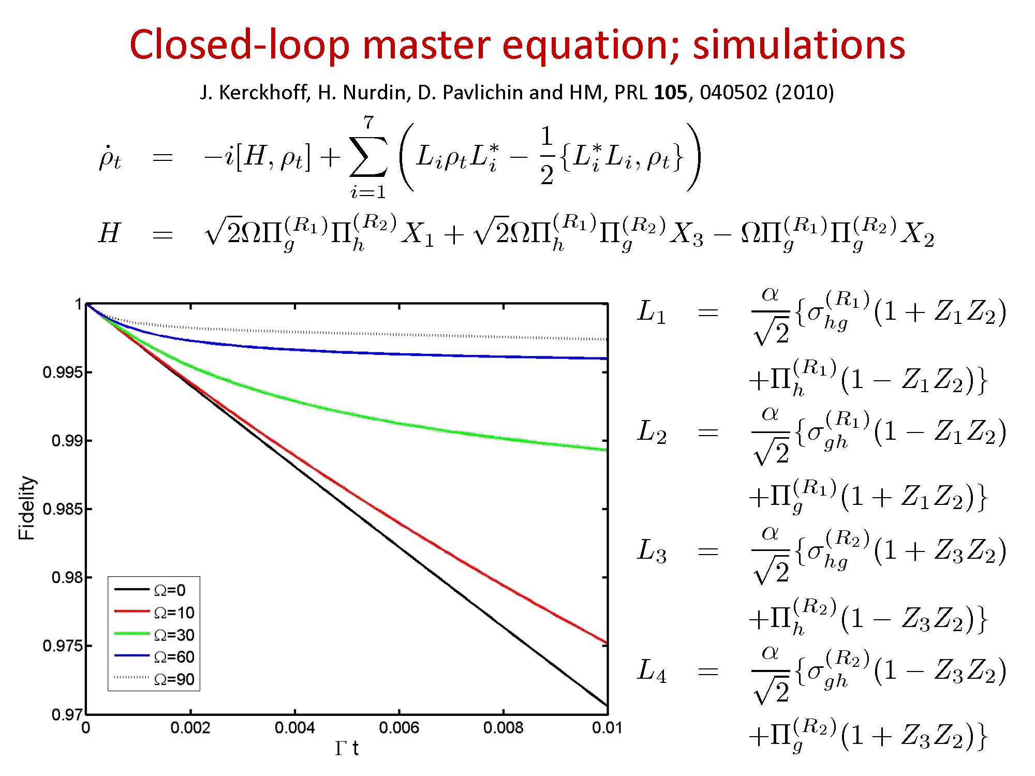

Slide 19
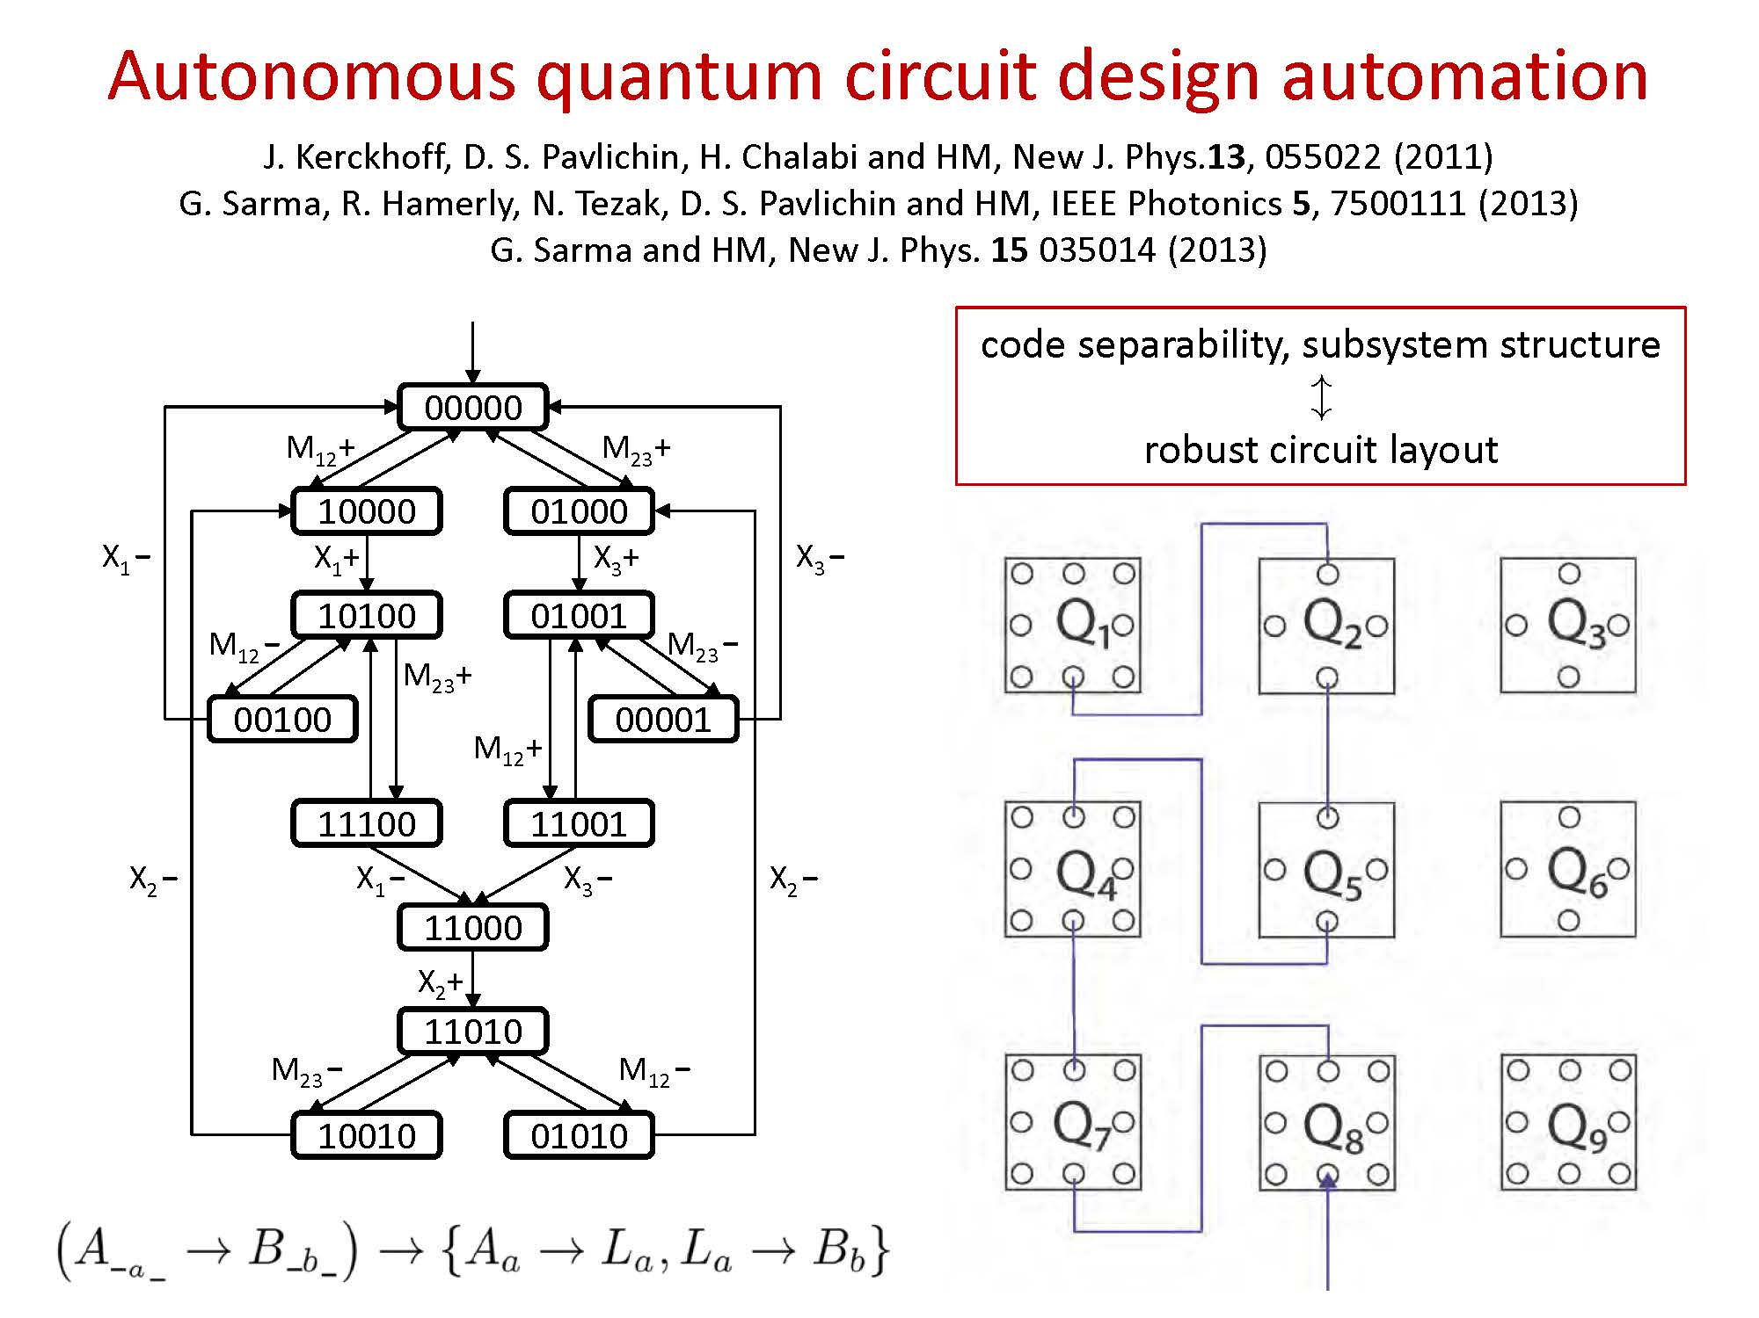

Slide 20
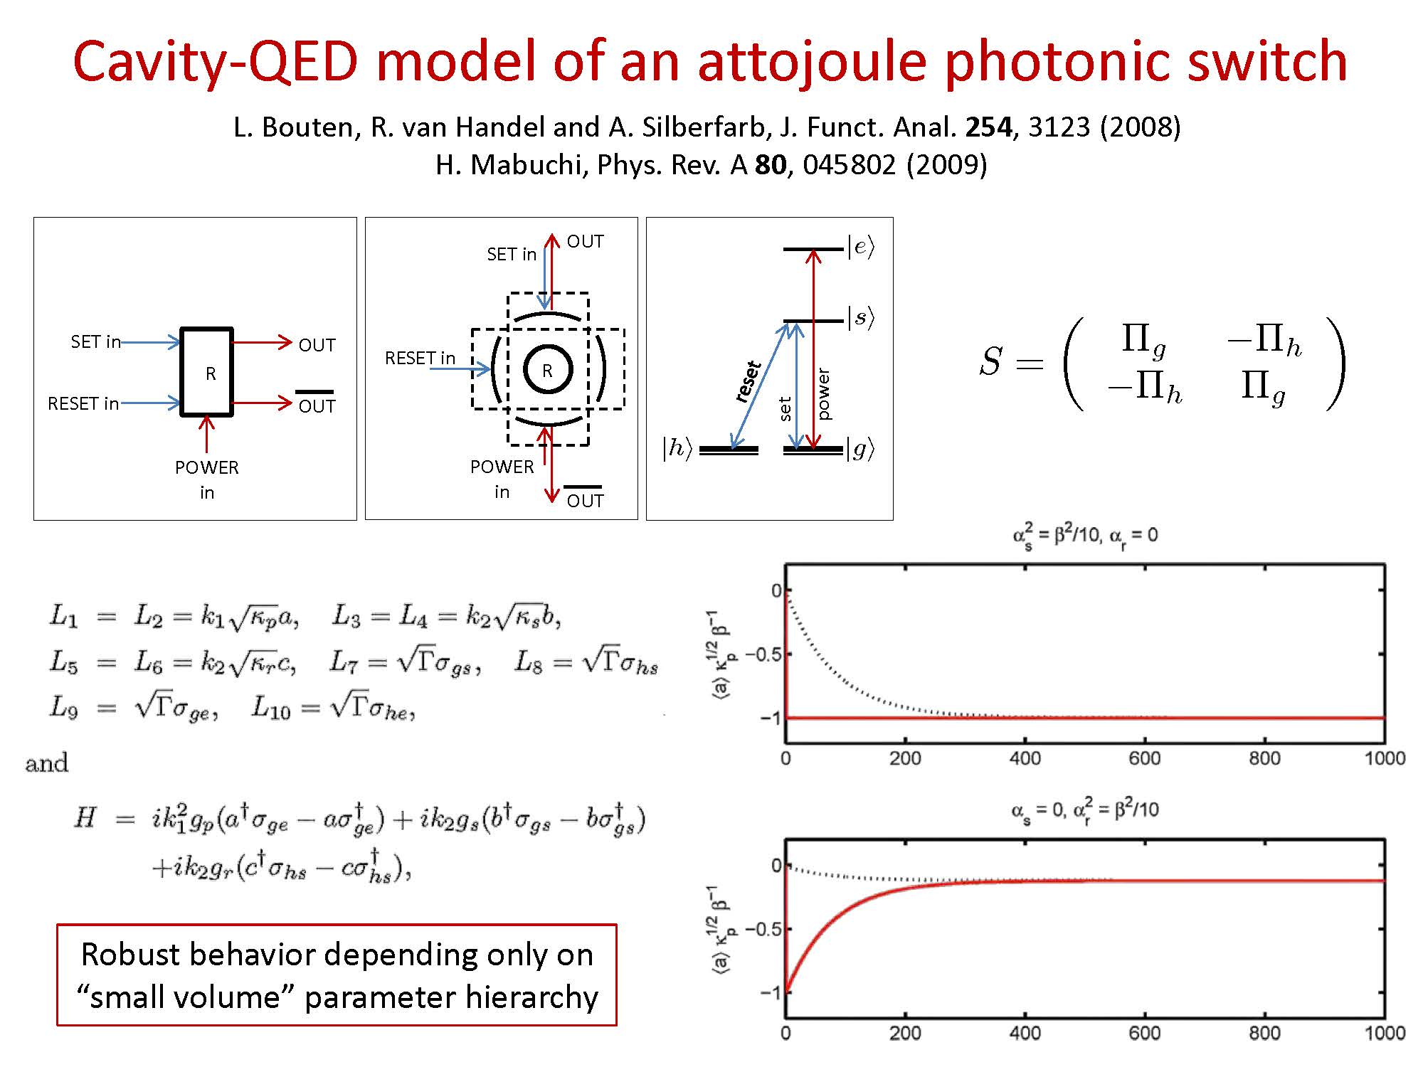

Slide 21
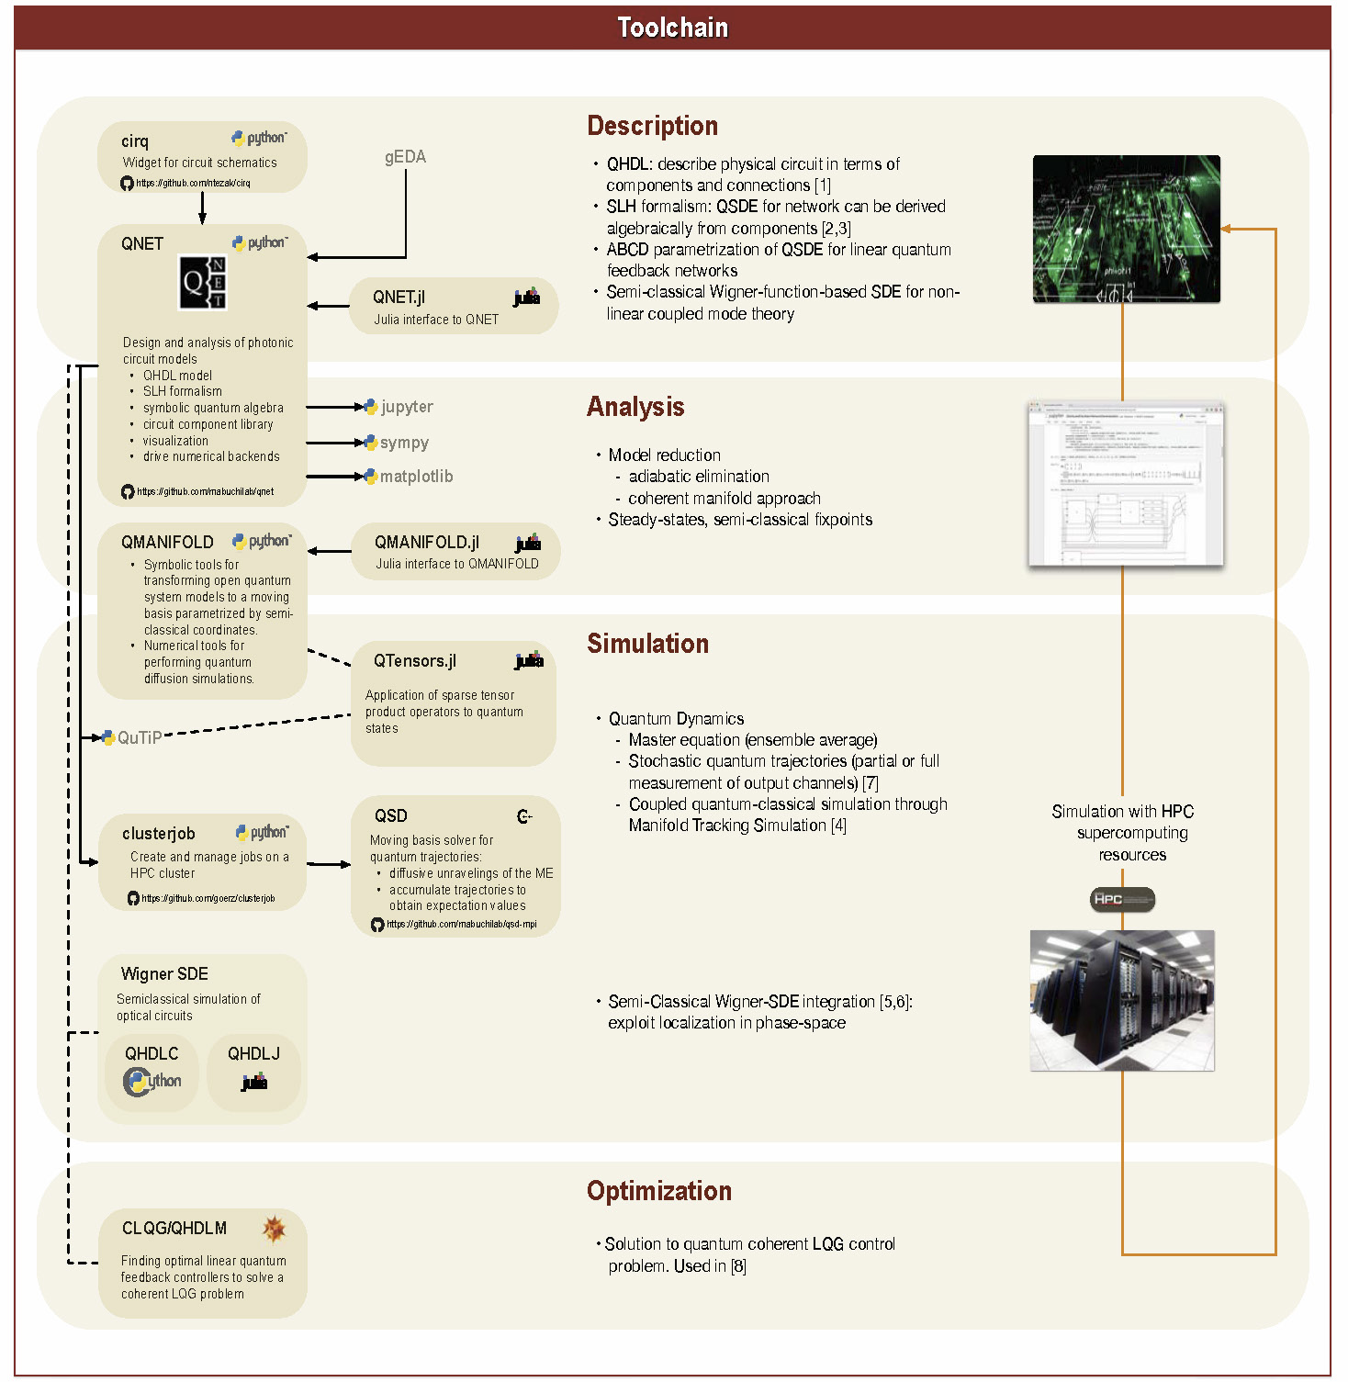

Slide 22
Dimensional reduction of open quantum networks
Classical computation
Fully-quantum computation
?
Computational power of semi-quantum architectures?
Decoherence-dependent complexity of classically simulating quantum models?

Slide 23
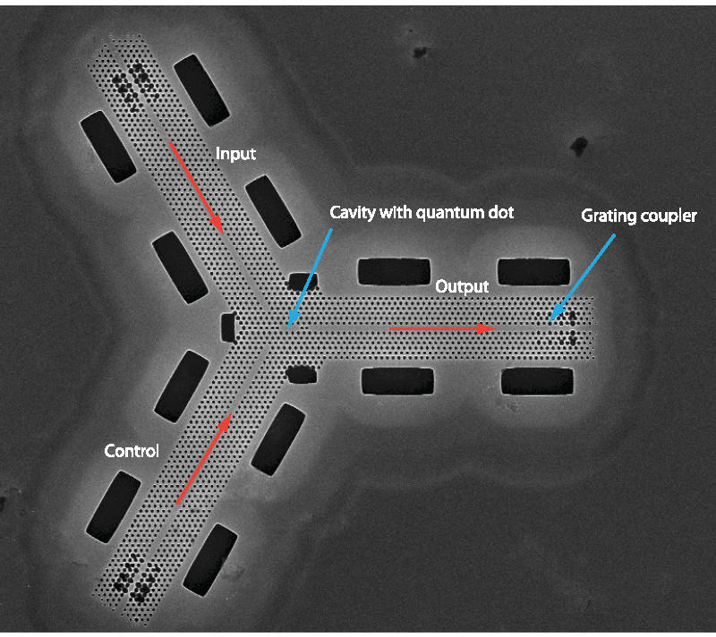
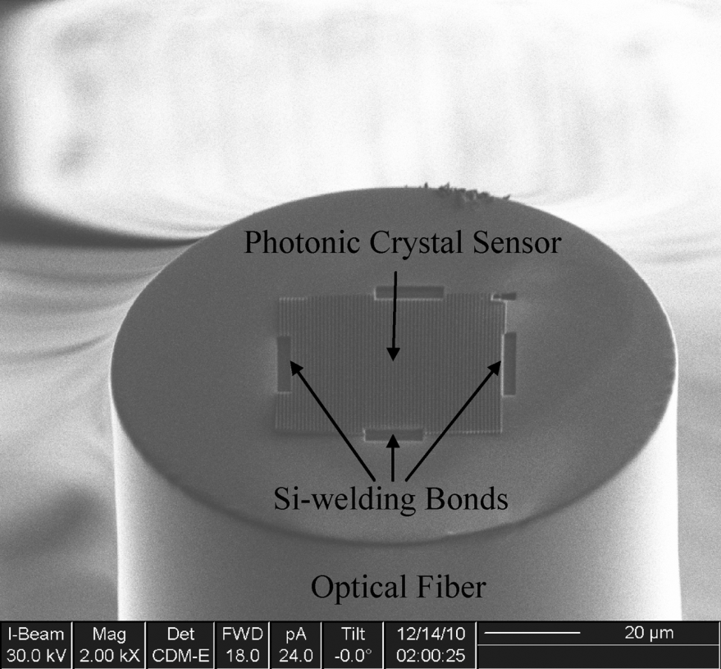
Embedded photonic signal-processing
MHz-GHz natural bandwidths
Coherent ) very low dissipation (power in ¼ power out)
Homogeneous platforms: nano/micro-photonic circuits; fiber sensor networks?
J. Vuckovic et al., 2011 New J. Phys. 13 055025
B. Park et al., 2011 IEEE Sensors J. 11 2643

Slide 24
Star-coupled network of optomechanical sensors
Preliminary work by Nikolas Tezak, Michael Celentano

Slide 25
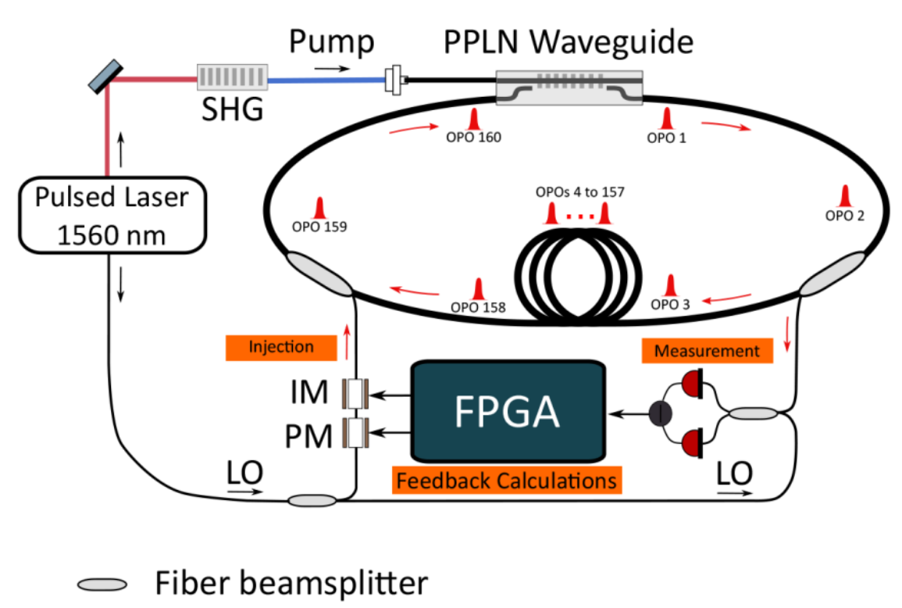
Measurement-based Coherent Ising machine (CIM)
CIM is an optics-based solver of Ising problems
Optical parametric amplifier (OPA)
Classical interaction
(LOCC)
P. L. McMahon, et. al., Science 354, 614-617 (2016)

Slide 26
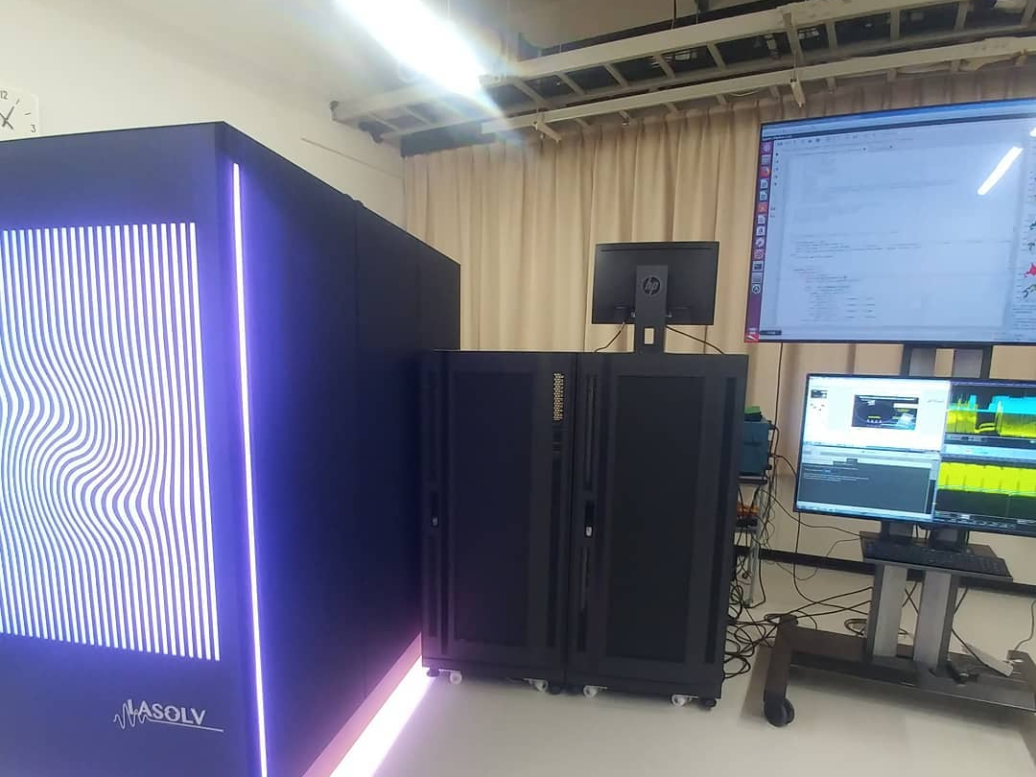
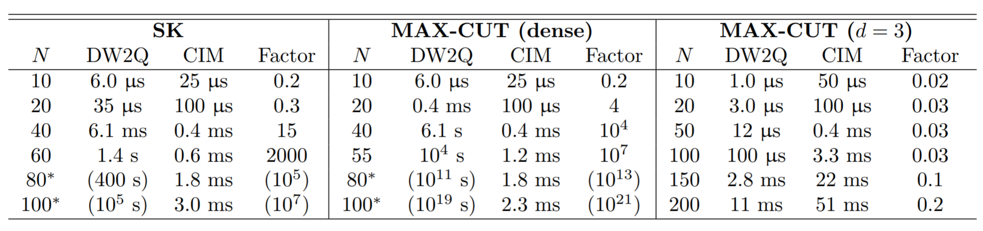
Summary of Benchmarking Results
Time to Solution (running on D-Wave 2000W)
Time to Solution (running on CIM)
Problem Size
Speedup of CIM over D-Wave 2000Q
Projected speedup of 10²¹x
R. Hamerly*, T. Inagaki*, P.L. McMahon*, et al. arXiv:1805.05217 (2018)

Slide 27
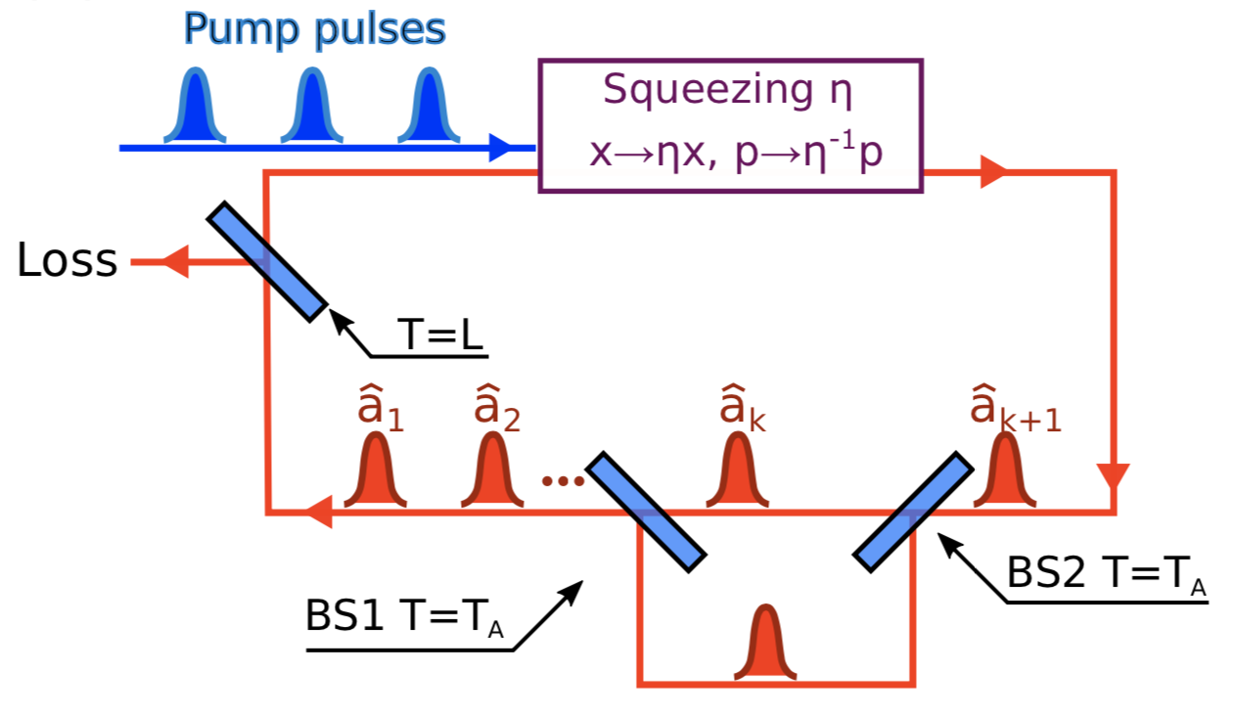
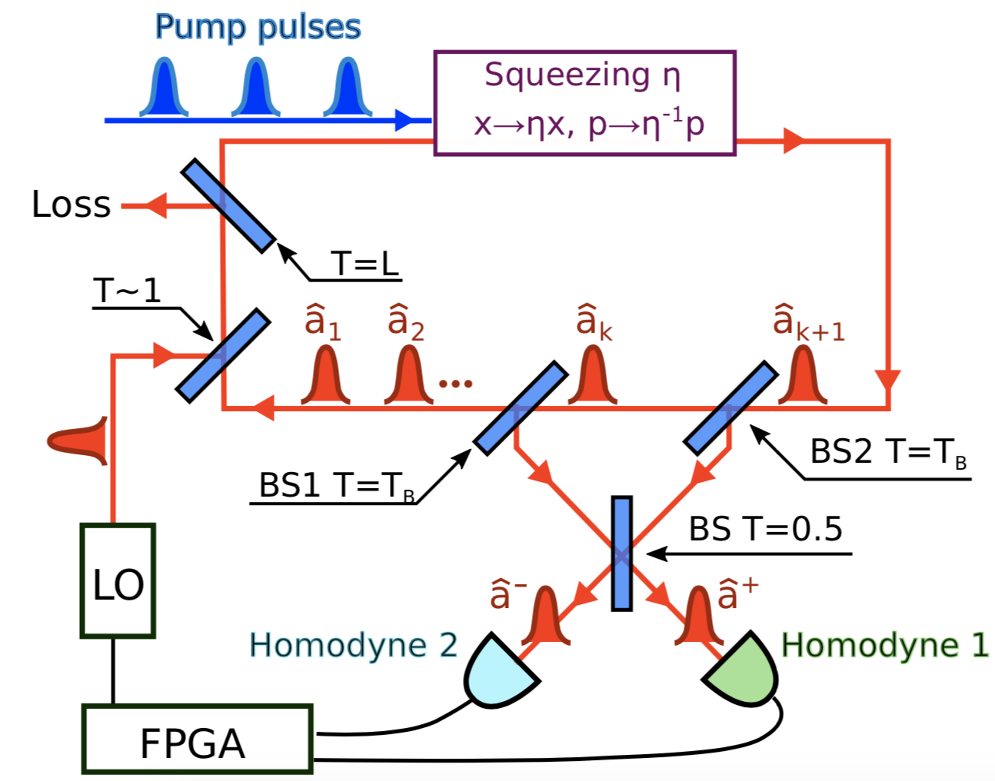
Establishing quantum nearest-neighbor interactions
R. Yanagimoto, P. McMahon, T. Onodera, E. Ng
Delay line
Entanglement swapping
Pulses are directly mixed via delay path
Measurement feedback scheme motivated by cv e-swap/teleport
Also c.f. Gaussian MPS literature
﻿A. Marandi, et al., Nat. Photon 8, 937(2014)
Entanglement swapping refs:
J.-W. Pan, et al., PRL 80, 3891(1998)
X. Jia, et al., PRL 93, 250503(204)

Slide 28
Coherent feedback OPO networks/CIM
Marandi et al.
Takata et al.
Pulsed/SPOPO coherent feedback…

Slide 29
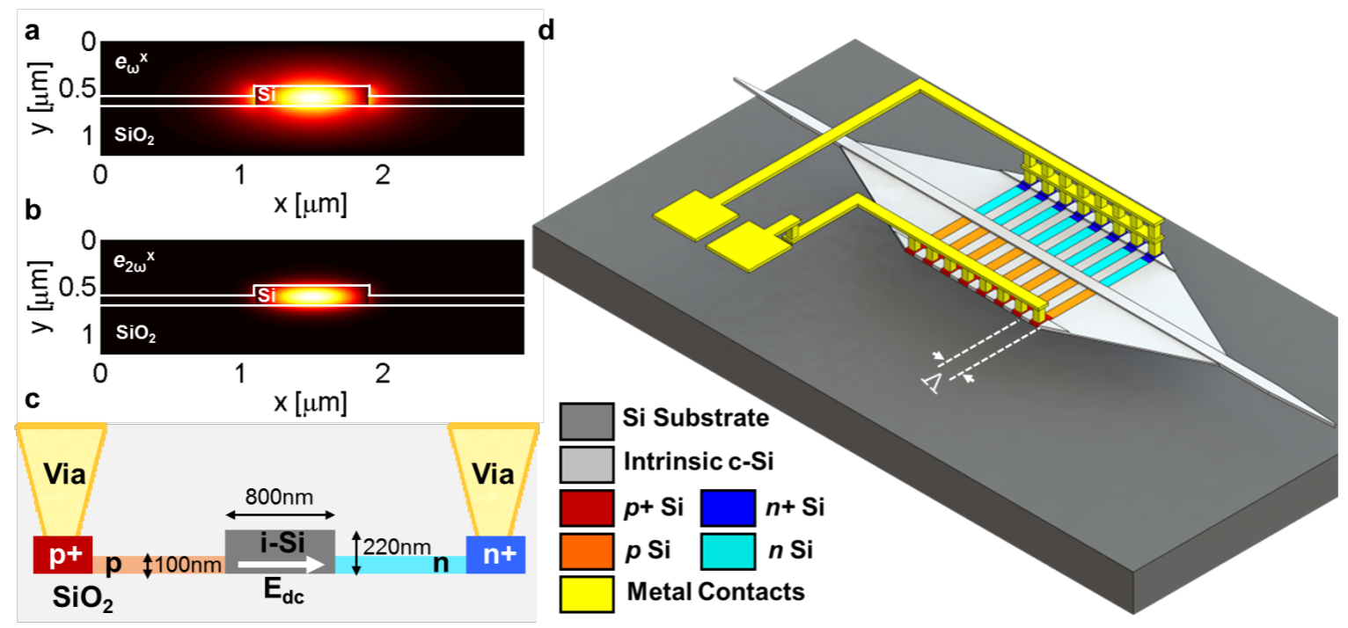
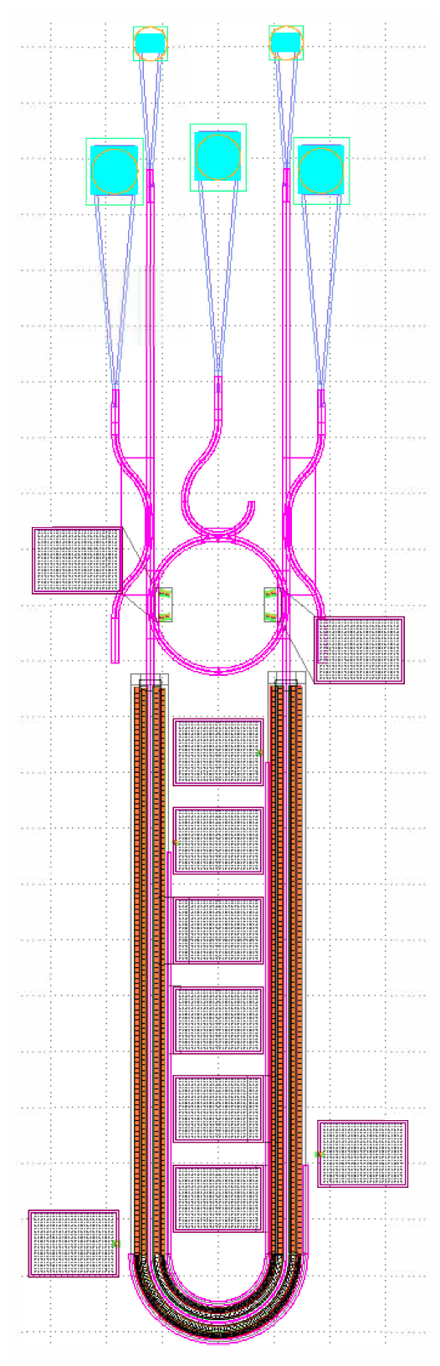
Quantum OPO? 2D waveguides + ultrafast
Nanophotonic LiNbO₃ ; silicon photonics?
Prospects for ~1 photon per pump pulse at threshold
E. Timurdogan, et al., Nature Photonics 11, 200–206 (2017)
R. Hamerly, PhD thesis, Stanford (2016)

Slide 30
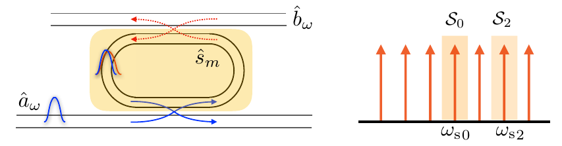
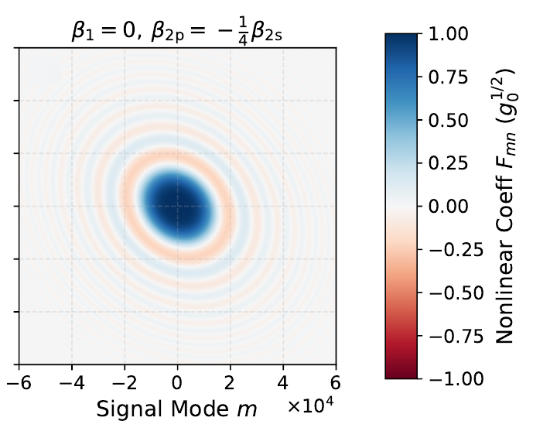
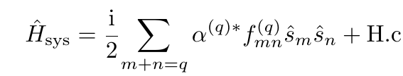




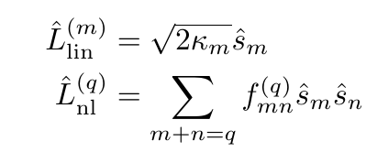
Quantum input-output theory of multimode OPOs
T. Onodera, E. Ng, N. Lörch, A. Yamamura, R. Hamerly, P. McMahon, A. Marandi, HM arXiv:1811.10583

Slide 31
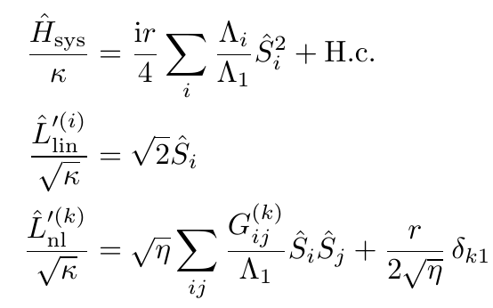
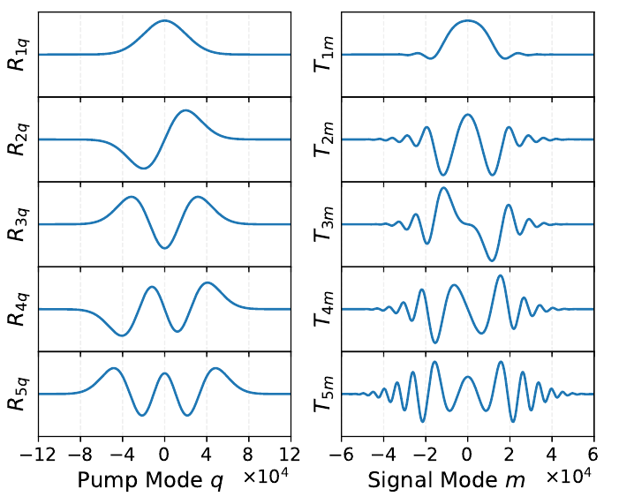
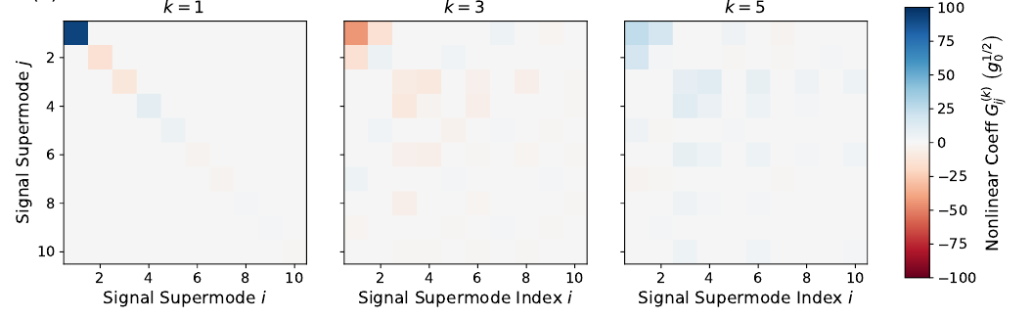

Quantum input-output theory of multimode OPOs
T. Onodera, E. Ng, N. Lörch, A. Yamamura, R. Hamerly, P. McMahon, A. Marandi, HM arXiv:1811.10583
Pump Signal
Supermodes Supermodes
Pump first supermode
Collective signal loss
Dissipative multimode pump interactions

