Slide 1
Circular Quench Antenna – New Assembly Update
H. Song, S. Dimaiuta, P. Joshi, P. Kovach, M. Anerella
For Quench antenna efforts at BNL
In collaboration with M. Marchevsky, LBNL, T. Strauss, FANL
9/6/2019

Slide 2
Status Summary
PCB preparations
The 11th empty PCBs received,
All the 11 PCBs populated – today (9/6).
Drawings – completed, PK, MA
3D prints – all the parts received
Sent to lab machine shop for further cleaning process
Cable preparation for new PCB boards, 32 signals – 60 % completion
Existing 32 signals
To do
Check all the 8 PCB of v2015, 8 PCB of v2017, and 11 PCB of v2019
Quench antenna assembly, tests
In parallel to cable preparation
System integration tests

Slide 3
New assembly

Slide 4
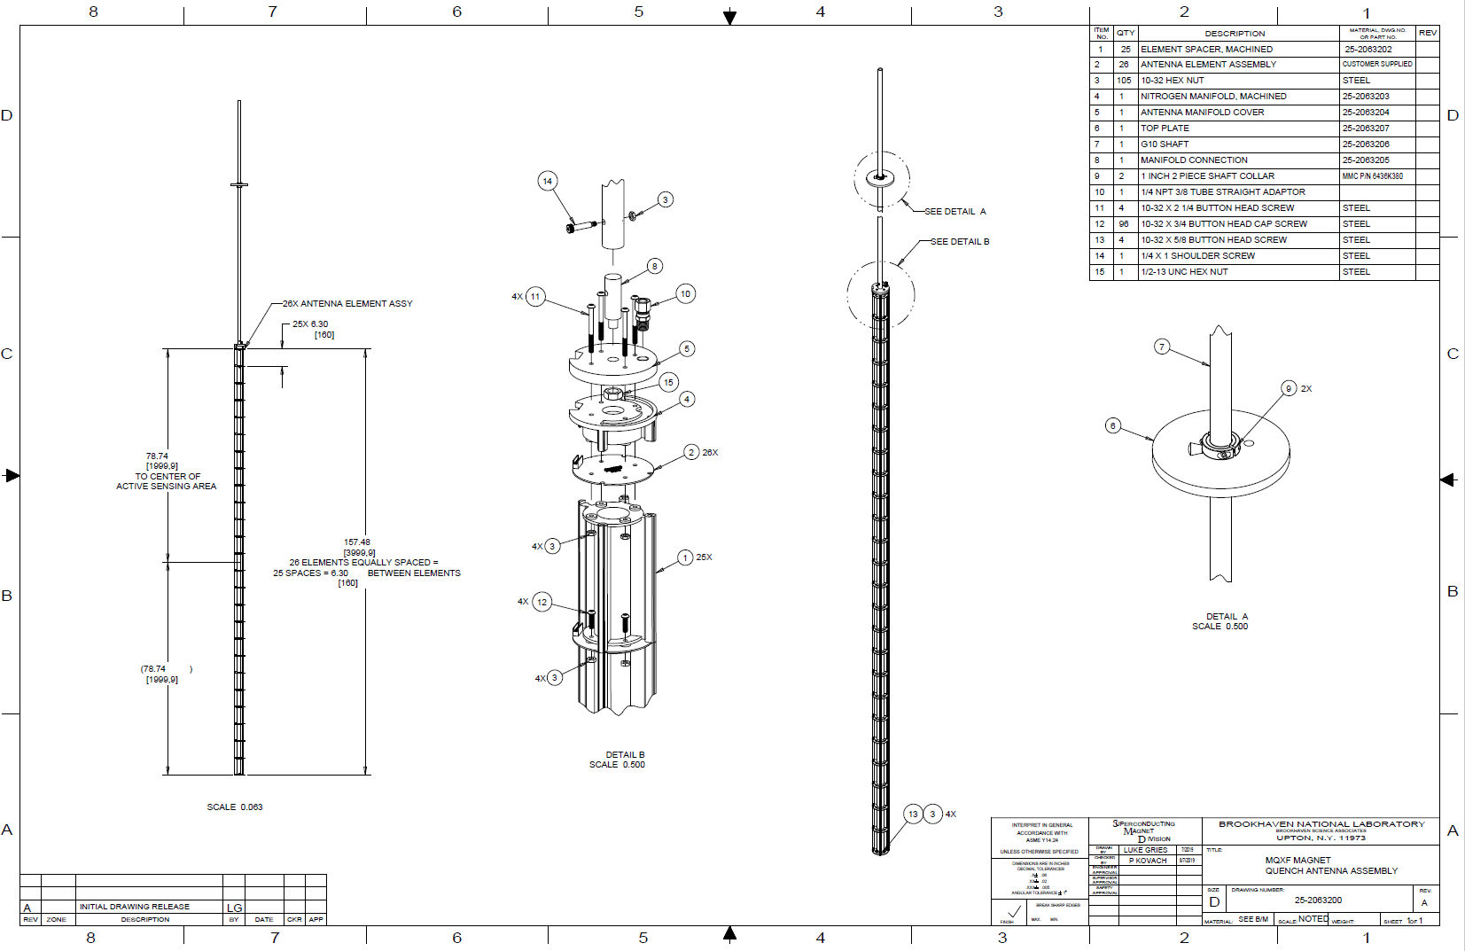

Slide 5
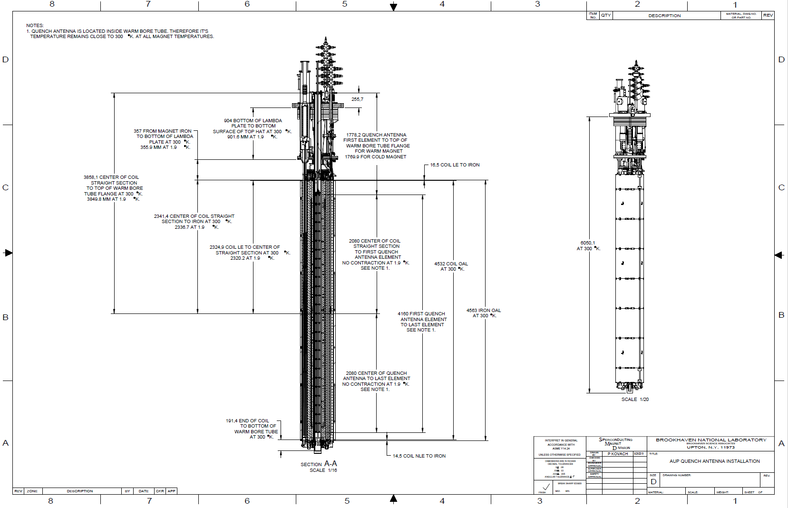

Slide 6
Backup slides

