Slide 1
Fermilab Contributions to the US High Field Magnet Program and Progress on the 15 T Magnet: Q/A
George Velev
Accelerator Advisory Committee Review
November 19-21, 2019

Slide 2
Question
There are many activities on the Fermilab magnet development road map that have no funding secured (activities in green). Please explain the impact on the Fermilab program, if those activities will not receive funding on time. Does Fermilab have set priorities for these activities in case of limited funding?

Slide 3
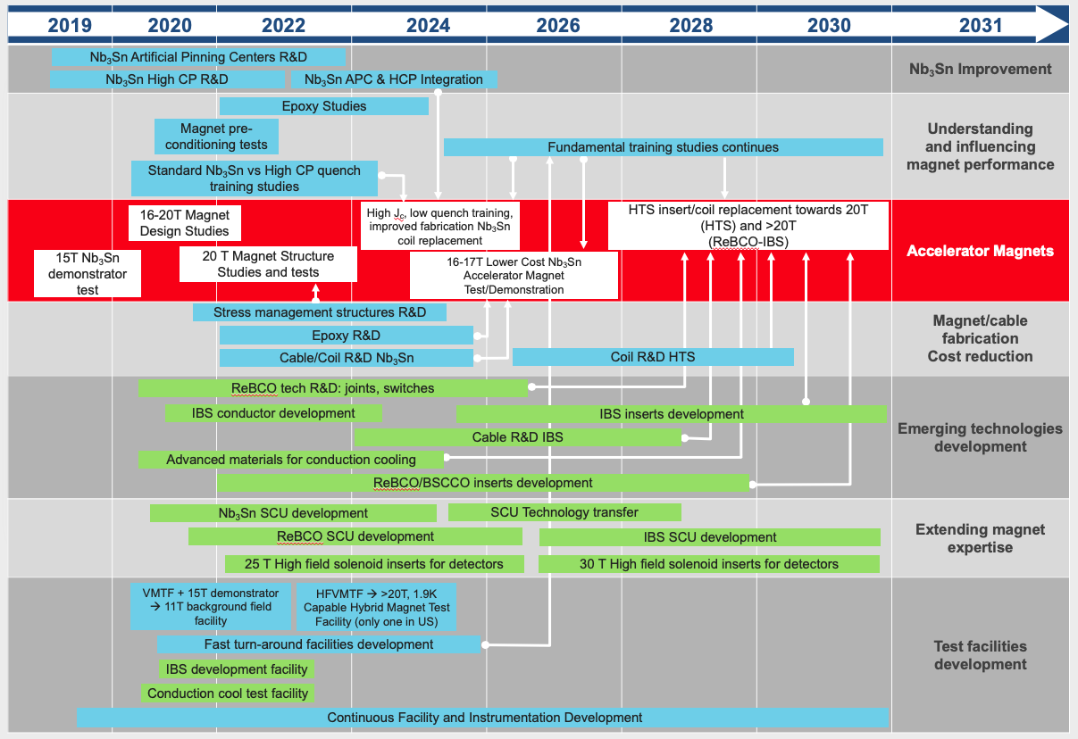
FNAL R&D
Preliminary
MDP
Non- MDP
MDP

Slide 4
FNAL R&D
Preliminary
IBS
SCU
MDP
Non- MDP
MDP

Slide 5
Comments
IBS and SCU are applying for LDRD funds
SCU
SCU are in top of the Nigel’s list
Agreement (MOU) with Argonne (ANL) on SCU
Help with Nb3Sn wire selection and reaction, coil fabrication
Agreement with INFN on SCU
Significant market for SCU
Typical path: LDRD( FNAL funds) -> DOE(Office of Science)
IBS
High risk/high reward R&D
China has a monopoly
There is chance to be funded
Typical path: LDRD(FNAL funds) -> ECA(DOE) -> GARD

