Slide 1
Fermilab Accelerator Status
Mike Lindgren
Fermilab AAC 2019
19 November 2019

Slide 2
Outline
FY19 performance
FY20 plans
Modernization, PIP1+, CAST

Slide 3
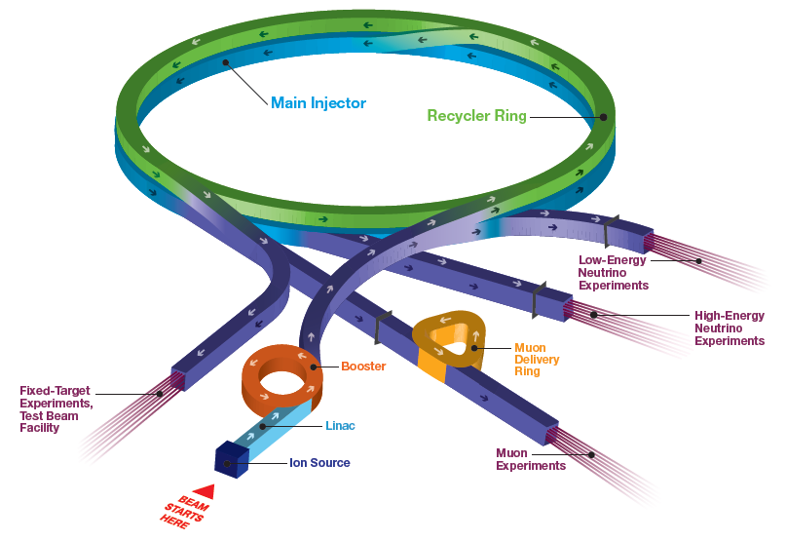
Fermilab Accelerator Complex
Short Baseline Neutrino:
MicroBooNE, ICARUS, SBND
SwitchYard 120:
SpinQuest, test beam (FTBF)
Long Baseline Neutrino:
NOvA, (LBNF/DUNE)
Muon Campus:
(g-2, Mu2e)

Slide 4
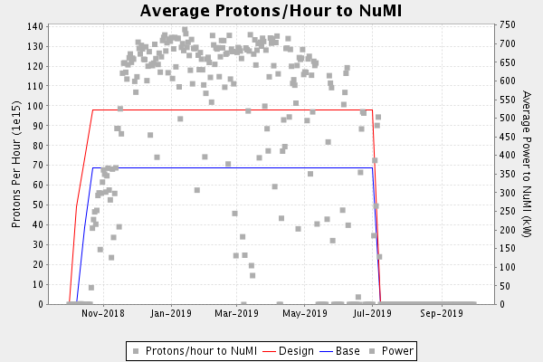
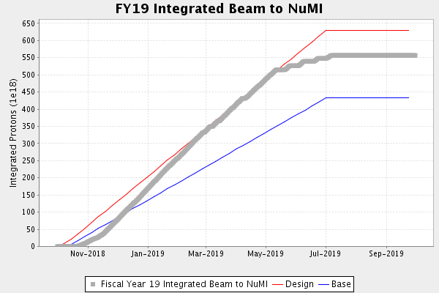
Achieved FY19 Goals for Beam to NuMI
Ran consistently at ~650 kW (w/ SY120).
Post-May ran 5 on/9 off to match work scope to funding

Slide 5
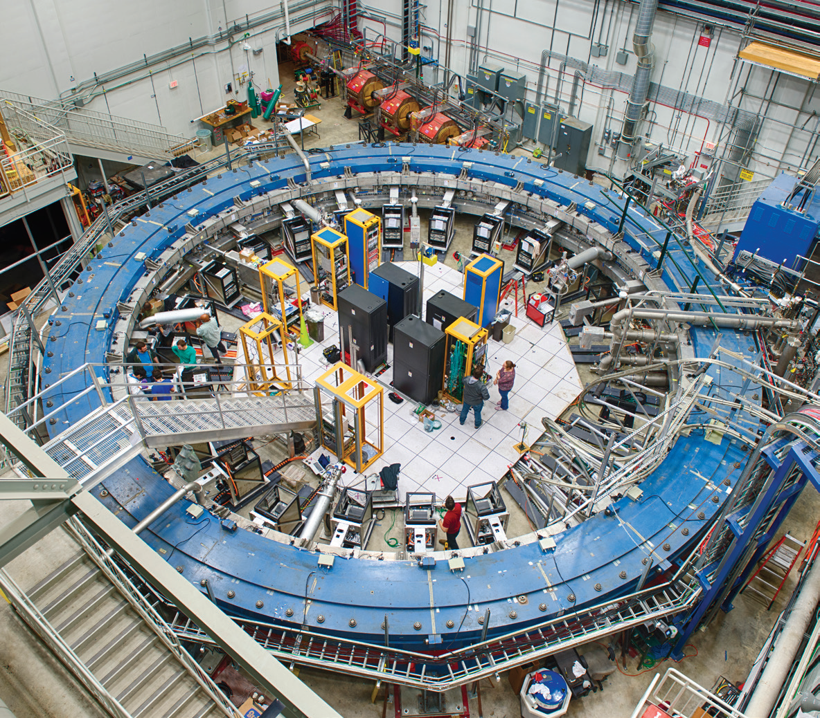
Muon g-2 experiment
Experiment began taking data in May 2017

Slide 6
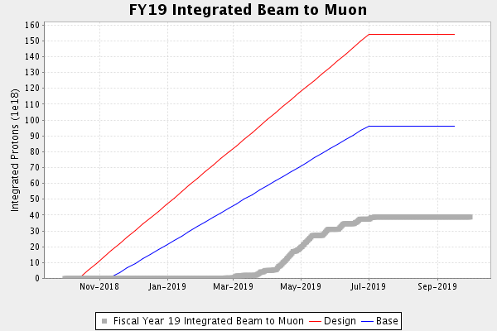
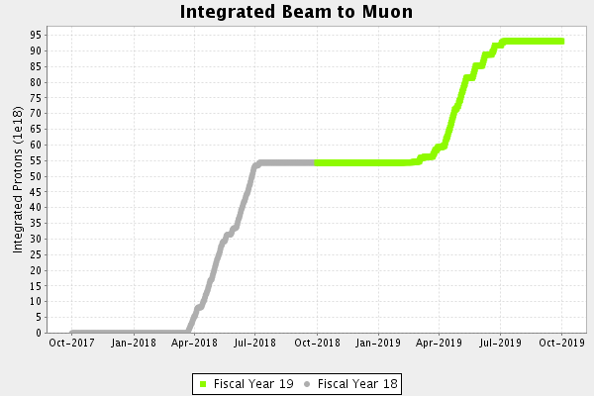
FY19 Muon g-2 performance
2X Brookhaven data set in 2018
2019 start delayed due to experiment, finish impacted by reduced accelerator run time
To collect 20x BNL dataset will likely mean running in FY21for full year

Slide 7
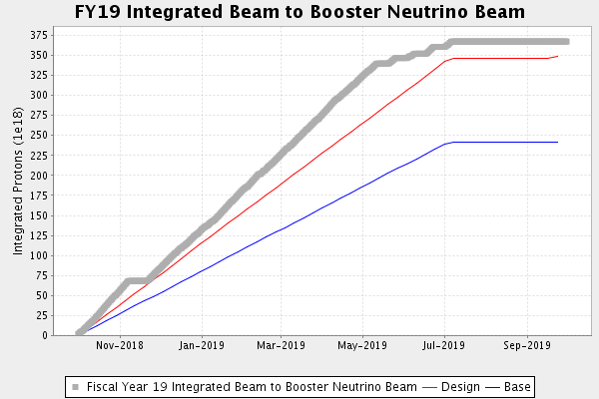
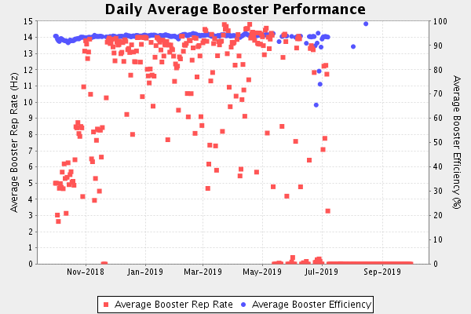
FY19 Booster performance
BNB performance good
MicroBooNE collected full experiment dataset

Slide 8
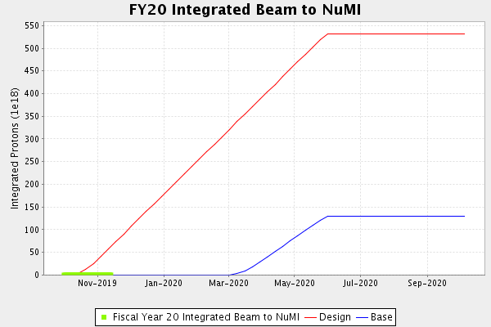
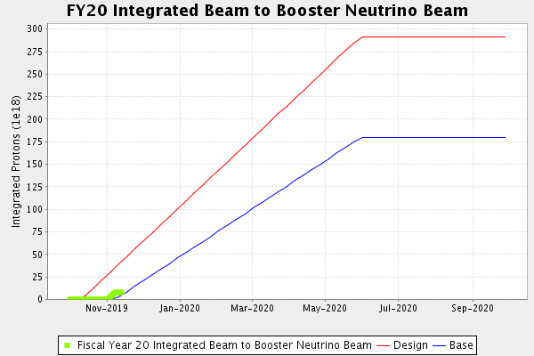
Accelerator Operations Goals for FY20
FY19 Summer shutdown work scope had little contingency
  Start up delayed to complete shutdown scope and to address safety initiative
  Modified 107 large (old) supplies – reduced potential electrical hazard
NuMI base curve assumed FY19 funding level
  Started operations based on initial funding guidance from DOE
  Will terminate NuMI running before June 1 if year long CR
    Starting up now, assuming there will be a budget passed

Slide 9
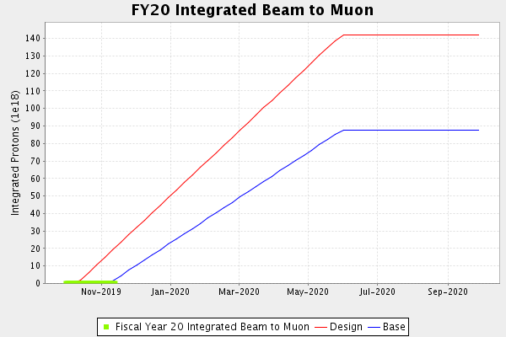
g-2 in FY20
Beam delivery and experiment uptime are less than originally scheduled.
  Aiming for ~8x BNL in FY20
No major accelerator improvements planned for g-2

Slide 10
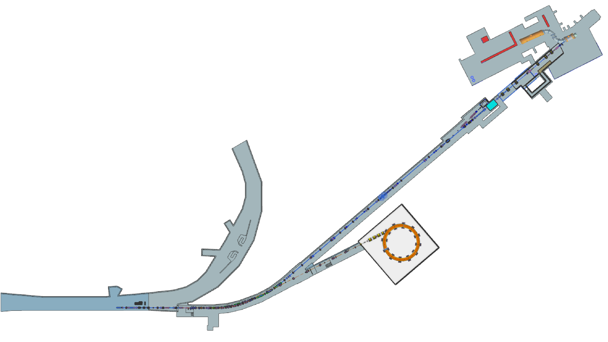
Mu2e beamline
M4 beamline components largely installed
Will start commissioning beam to the diagnostic absorber this year
Mμ2e
Shield Wall
Delivery Ring
M4 Beamline
M4
Enclosure Boundaries
g-2

Slide 11
DOE Modernization Review
DOE/HEP draft charges received in March 2018
  Deliverable is Accelerator Modernization Plans. Charge to develop an Accelerator Modernization Plan covering:
    workforce composition over the next 10 years.
    Analyzes the support effort needed for the current accelerator equipment, looking for one-time investments that will increase operational efficiency and reduce costs.
Report delivered June 2019, review synopsis returned October.
“DOE-HEP has completed its review of the Fermilab Accelerator and Detector Modernization plan. Please find attached a 41-page synopsis of the external review comments which is the combined evaluation and advice of 20 external reviewers.
From our perspective this marks a very significant step forward in strategic planning for two key sectors of Fermilab’s workforce and facilities. The value of this review is already apparent to us—for the first time DOE-HEP is seeing comprehensive, prioritized lists of upgrades, and we are seeing these priorities reflected in the FY 2020 FWPs in a traceable manner. It has also highlighted several areas and aspects of the workforce that need attention. ”

Slide 12
DOE Modernization Review (2)
That said, we call attention to several points:
A complete workforce analysis, including project construction and the transition of project staff to operations, is still needed;
Strategic workforce management will be needed to rebalance the demographic and skill composition of the Fermilab workforce;
Performance record keeping (MTTF, MTTR) for mission-critical systems needs to be significantly strengthened to enable predictive, preventative maintenance and upgrade prioritization on a quantitative basis;
As the lead HEP lab, Fermilab should do much more to reach out and draw in expertise, collaboration, and services in the operations and R&D realms. This was a recurrent theme in the reviewer’s comments, and is a striking contrast to the collaborative nature of Fermilab’s big projects.”
.
.
.

Slide 13
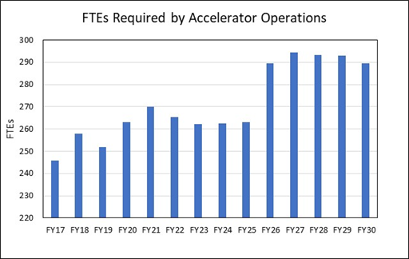
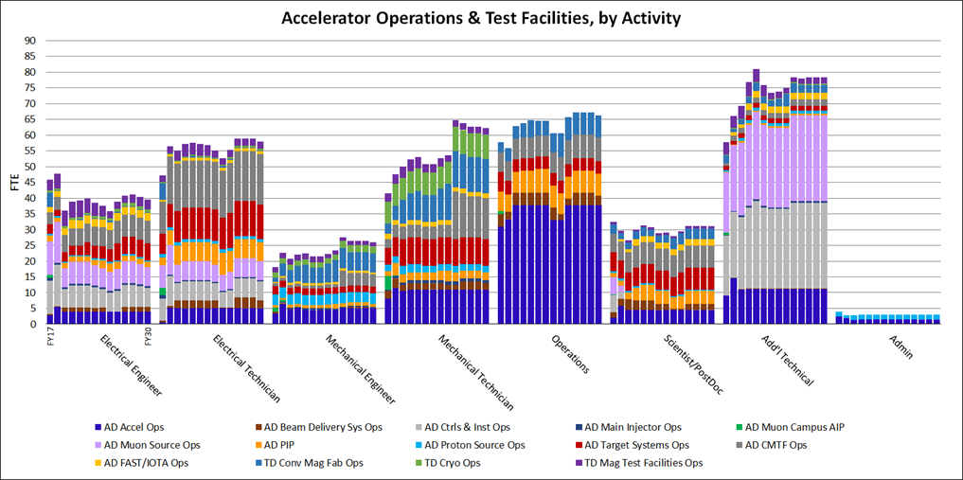
Modernization Review: Workforce
Demand ~stable before PIP-II
Post 2025 increase driven by LBNF and PIP-II operations

Slide 14
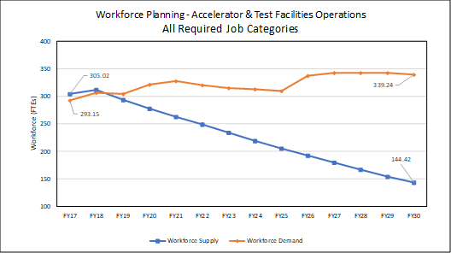
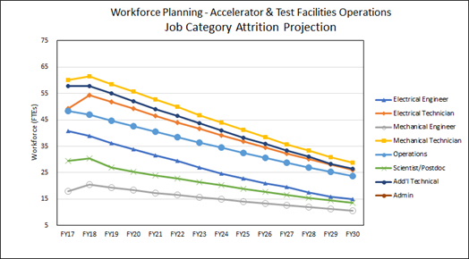
Modernization Review – workforce supply
Workforce supply calculated based on current FTE fractions on Accel ops scaled by actuarial projections
~half of current workforce will have separated by 2030
Consistent across job categories

Slide 15
Modernization Review – Infrastructure
Identified equipment and facility needs to increase capability, reliability, and or system resilience. 54 total within the accelerator complex
  39 proposals support the main injector, 3 proposals support the booster, 1 supports the LINAC, and 11 support the general complex. The five highest priority needs are:
    BNB horn charging supply (general complex)
    Replace obsolete controls hardware (general complex)
    Control power supplies and dipole/quad rectifiers (MI)
    Refurbish Main Injector RF cavities (MI)
    Replace ion pump cables in hot areas (general complex)

Slide 16
Modernization Review – Infrastructure (2)
Equipment funding in initial funding guidance for BNB horn charging PS
DOE HEP supportive of ACNET replacement (Patrick talk)
  Attempting to initiate as 413.3 project
    Mission Validation review held last summer
    looking to get CD-0 this year
  Does not include PIP-II controls work, but systems match
  Plan to include some larger obsolete power supplies
  Implementation schedule will depend on funding and rate of design planning

Slide 17
PIP1+ Status
PIP1+ FY19 AIP scope
  ~$50M to:
    NuMI Target System Upgrade
    Booster Intensity and D-magnets
    Main Injector Gamma-t
    Booster RF Cavities
Some scope moved to PIP-II, some work descoped
  Only AIP ongoing is NuMI Target System Upgrade
  Need Booster Intensity work completed by FY21 to ensure NOvA power goals
NuMI Target System Upgrade funded at $5.6M in FY19
  MW target installed summer 2019
  New horns projected installation Summer 2020

Slide 18
CAST Infrastructure Initiative update
DOE SLI proposal being developed for a new central campus building to support accelerator science
  Described this at last AAC – housed Controls groups as well as new operations center and accelerator science groups
  Effectively on hold at this point. SLI focus shifted to backbone infrastructure - Power, water, site utilities upgrades
  Would like to get CD-0 for this in case priorities change (again)

Slide 19
Fermilab Experiments’ Run Schedule

Slide 20
Summary
FY19 accelerator operations scope adjusted to match funding
  Delay in g-2 startup also reduced beam delivery to them
Execute seven month run plan for 2020 followed by extended shutdown (5 months) to begin LBNF near site prep
  If year long CR, will revisit and likely reduce run time
Modernization review completed
  Labwide workforce planning building on this
  Infrastructure needs awareness better communicated
  Push to stand up controls modernization project

Slide 21
Back up

