Slide 1
Synergia Code for High Intensity Beam Simulations
Eric G. Stern
Fermilab
Nov 19, 2019
Notes:
1

Slide 2
Accelerator Simulation Group (Scientific Computing Division)
Formed in 2000 to develop numerical tools and expertise for beam and accelerator simulations.
Members: E. Stern (head), Q. Lu, T. Zolkin
Former members: P. Spentzouris (founder, now head of the Quantum Science Initiative), J. Amundson (now head of the Scientific Computing Division), D. Dechow, P. Lebrun, A. Macridin (now part of the Quantum Science Initiative), L. Michelotti, C. S. Park
Former students: D. McCarron, O. Ponfilenok
2
11/19/2019
Eric G. Stern | Synergia | AAC Review 2019

Slide 3
Motivation
Synergia project was begun in early 2000s to take advantage of advances in HPC to address accelerator physics questions with detailed simulations.
High intensity proton beams (HEP community plan, 2014 P5 report)
  Need for beam simulation tools capable of addressing the specific challenges of the high intensity proton beams:
    Space-charge, longitudinal dynamics, injection, coherent instabilities, RF optimization, focusing optics, halo control, beam instrumentation, theory and modeling
  Developed and hosted in the Scientific Computing Division to take advantage of HPC expertise
  Synergia can address all these issues
3
11/19/2019
Eric G. Stern | Synergia | AAC Review 2019

Slide 4
Synergia features (1)
Developed at Fermilab in the SCD organization. Modifications can be performed quickly (electron lens element added for SC compensation studies)
Aligned with the needs of the Fermilab accelerator complex.
Particle-in-cell code that combines 6D symplectic particle tracking and collective effects.
All standard magnetic beam elements are modeled, multiple RF frequencies, acceleration.
Self-consistent collective effects:
  Space charge (2.5D, 3D, Rectangular, Bassetti-Erskine, KV) able to efficiently run millions of macro-particles.
    Large statistics required for halo and loss simulations.
    Allows simulations of non-gaussian bunch distributions occurring during phase space painting, slip stacking, 2nd harmonic cavities, and other beam manipulations.
  Impedance (arbitrary pipe geometries, short and long range, Booster laminations)
Eric G. Stern | Synergia | AAC Review 2019
Notes:
Space charge calculation includes details of the distribution at large distances, but slow and complicated

Slide 5
Synergia features (2)
Arbitrary shaped apertures (for simulating losses)
Handles dynamically changing element parameters to simulate operational scenarios (resonant extraction, gamma-t jump)
(Anti) Dampers
Nonlinear normal form analysis to arbitrary order
Collective mode analysis
Multiple bunches
Slip-stacking
Phase space painting injection
Spectator particles
Advanced beam analysis diagnostics.
Simulations are programmed in Python for maximum flexibility, and broad expertise
Runs on laptops, clusters, and supercomputers according to the size of the problem
Many unique capabilities among beam simulation codes!
Eric G. Stern | Synergia | AAC Review 2019
Notes:
Space charge calculation includes details of the distribution at large distances, but slow and complicated

Slide 6
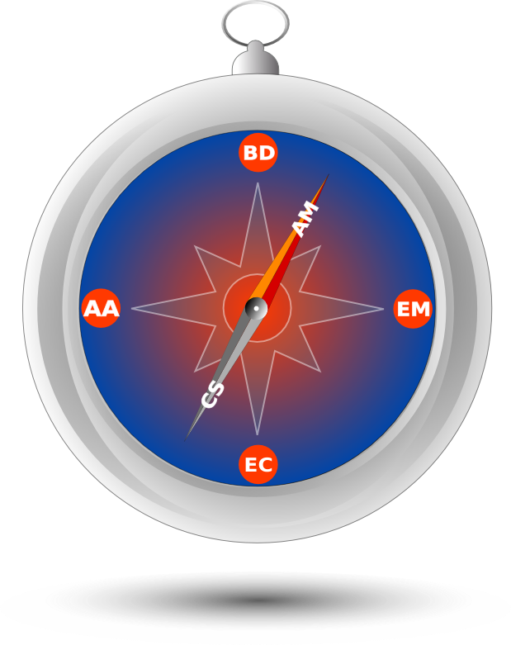

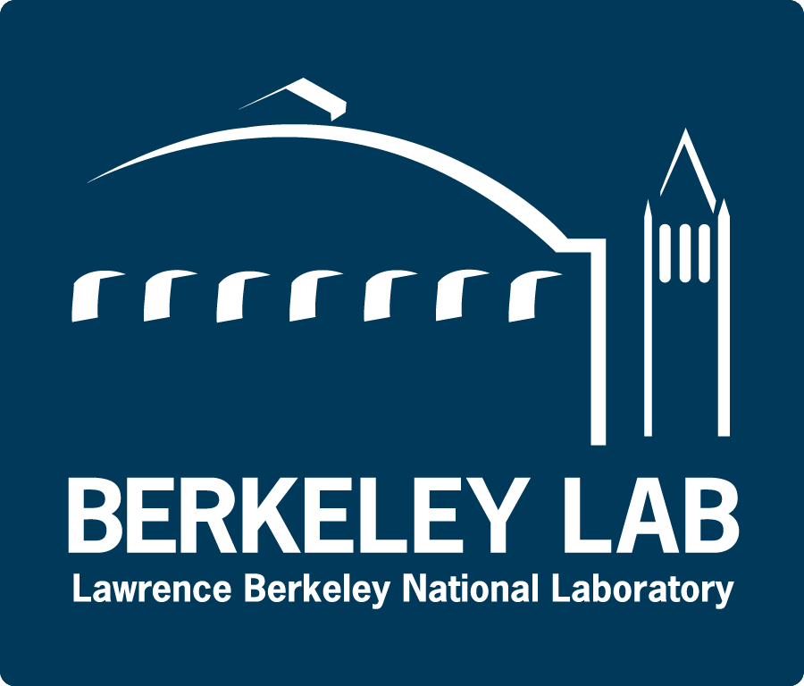


Synergia
Part of the ComPASS (Community Project for Accelerator Science and Simulation) SciDAC (Scientific Discovery through Advanced Computing) project.
ComPASS
        Receives funds through the HEP and ASCR (Advanced Scientific Computing Research) offices.
        Simulation tools for large beam dynamics problems which can only be addressed with large-scale computing resources.
        Currently have a five-year grant to develop optimized simulations for PIP-II and IOTA as well as multi-stage plasma acceleration.
        Collaboration between different laboratories and universities, led by Fermilab.
Synergia is also supported by GARD and Accelerator Operations.
6
11/19/2019
Eric G. Stern | Synergia | AAC Review 2019

Slide 7
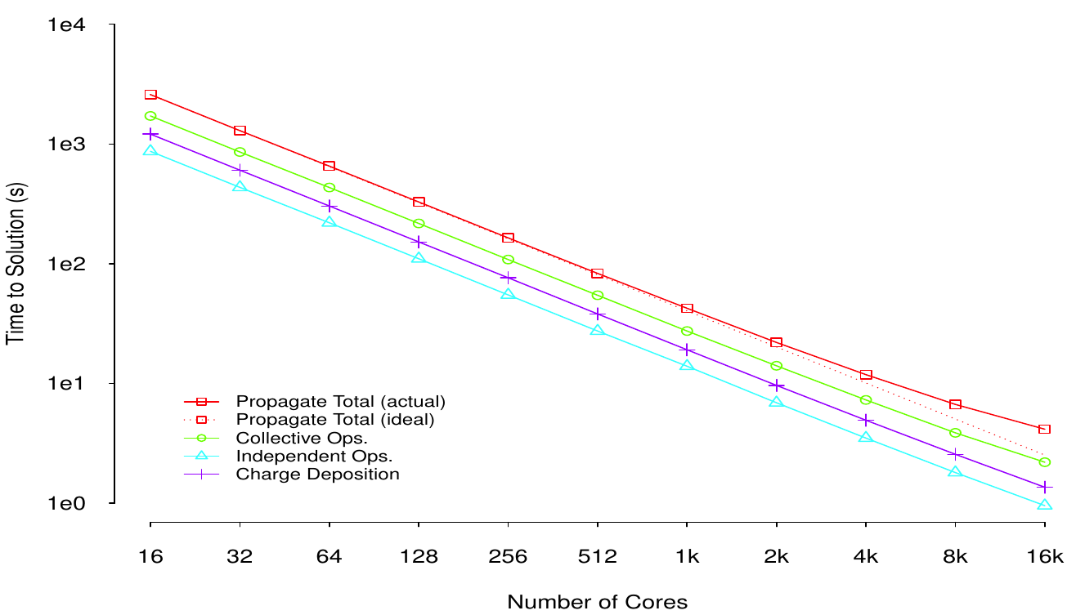
Synergia, large scale parallel simulations
Synergia can run on computing resources ranging from laptops to the largest available supercomputers (Argonne, NERSC).
GPU version arriving soon!
  Single-bunch scaling to 16K processors
  Multi-bunch scaling to >130K processors
  Biggest simulation: >1e10 particles
Single-bunch simulation time versus number of cores
7
11/19/2019
Eric G. Stern | Synergia | AAC Review 2019

Slide 8
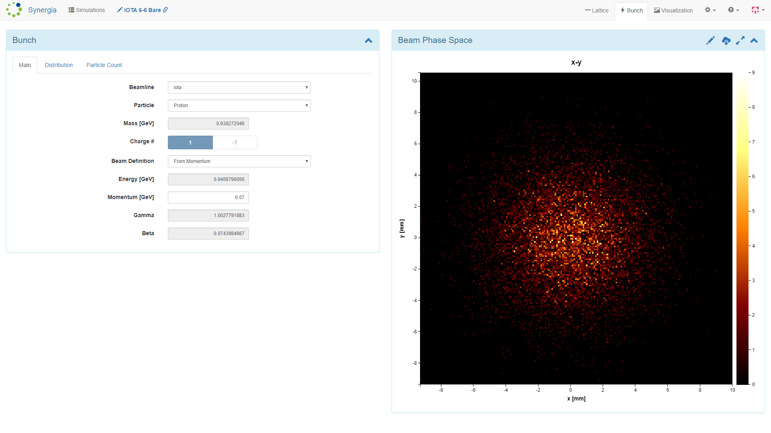
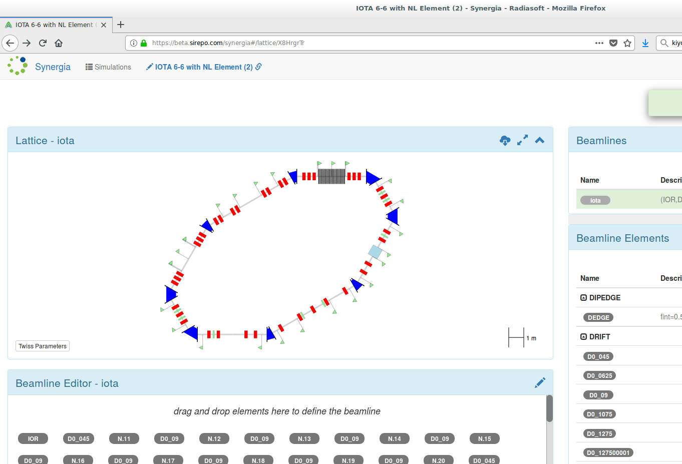
How can one acquire run Synergia?
Open source
  https://synergia.fnal.gov
Synergia core is written in C++, but the users can run simulations employing simple python scripts.
Jupyter notebook or Sirepo portal web interface for Synergia developed by Radiasoft
Radiasoft Sirepo portal
8
11/19/2019
Eric G. Stern | Synergia | AAC Review 2019

Slide 9
Synergia applications
Main Injector magnet multipole errors and space charge induced losses (E. Stern, FNAL, WEP096, PAC11, 2011)
Coupling impedance and wake functions for laminated structures with an application to the Fermilab Booster (A. Macridin, FNAL, Phys. Rev. ST Accel. Beams 14, (2011) 061003)
Mu2e resonant slow extraction optimization with space charge (C.S. Park, FNAL, FERMILAB-PUB-15-042-CD, 2015)
Simulation of Transverse Modes with Their Intrinsic Landau Damping for Bunched Beams in the Presence of Space Charge (A. Macridin, FNAL, Phys.Rev.ST Accel.Beams 18 (2015) no.7, 074401)
Booster beta-beating induced losses study (A. Macridin, FNAL, 2017)
Transition Crossing in the Main Injector for PIP-II (R. Ainsworth, FNAL, FERMILAB-CONF-17-143-AD, 2017)
Post PIP-II RCS design studies (J. Eldred, FNAL, TUPAF073, IPAC 2018)
Suppression of Instabilities Generated by an Anti-Damper with a Nonlinear Magnetic Element in IOTA, (E. Stern, FNAL, FERMILAB-CONF-18-132-APC-CD, 2018)
Studies of integrable optics (N. Cook, C. Hall, Radiasoft, THPAF067 IPAC 2018)
Parametric Landau damping of space charge modes (A. Macridin, FNAL, Phys.Rev.Accel.Beams 21 (2018) no.1, 011004)
High intensity space charge effects on slip stacked beam in the Fermilab Recycler (R. Ainsworth, FNAL, Phys.Rev.Accel.Beams 22 (2019) no.2, 020404)
Simulation of space charge compensation with an electron lens (E. Stern, FNAL, 2019)
9
11/19/2019
Eric G. Stern | Synergia | AAC Review 2019
Notes:
Here is a partial list of topics to which Synergia has been applied over the last eight or so years. I won’t go item-by-item over the list, you can read it yourself. I will say that the list includes diverse topics of studies of the Booster, Recycler, Main Injector and Delivery Ring relevant to our current and future program here, as well as topics in basic accelerator science such as Landau damping and space charge compensation.

Slide 10
Synergia Space Charge Benchmarking
International space-charge benchmarking collaboration
  CERN, FNAL, GSI, RAL, SNS, ITEP
  Begun in 2003 to explain space charge resonance trapping observed in CERN PS (G. Franchetti, et al, PRSTAB, 2003).
  Benchmark the space charge induced trapping in GSI SIS18 lattice.
Synergia has completed the full benchmarking.
  Reproduces experimentally observed space charge effects.
  Agrees well with other codes in the simple regimes where they can simulate.
  Long-term stability.
10
11/19/2019
Eric G. Stern | Synergia | AAC Review 2019

Slide 11
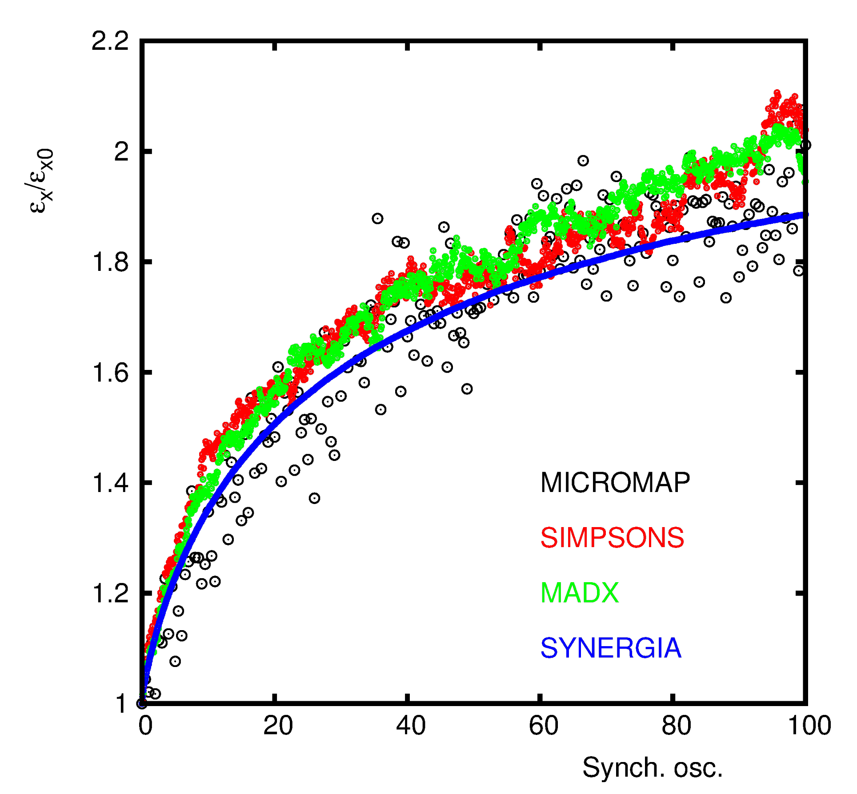
Synergia Space Charge Benchmarking
Emittance growth and long term stability
The Synergia PIC based simulation is smooth, does not become unstable over the long term.
Synergia agrees with other models within their limited range of applicability.
100K turns
4.2M macro particles, low noise!
7.1M space charge solves
29.8T particle-steps
(GSI)
(RAL)
(CERN)
(FNAL)
11
11/19/2019
Eric G. Stern | Synergia | AAC Review 2019

Slide 12
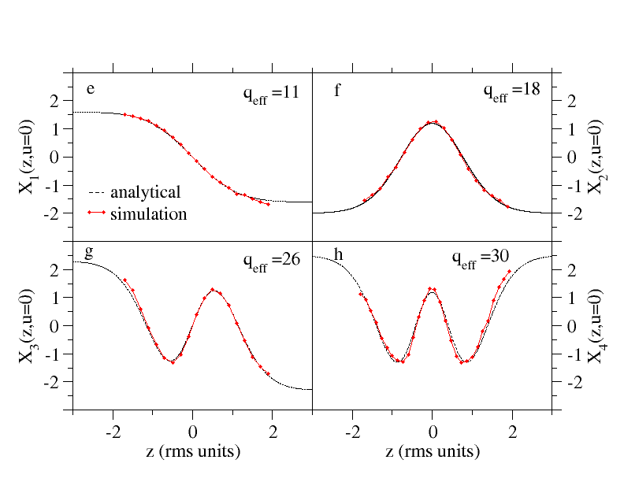
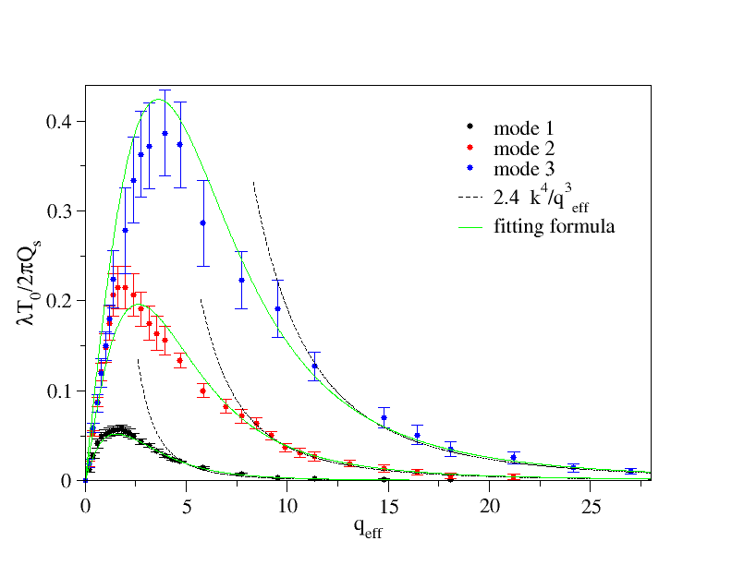
Space charge modes and Landau damping
Shape of the dipole space charge modes in the strong coupling regime
Landau damping of the space charge modes versus space charge interaction strength
mode 1
mode 2
X(z)
λ damping rate
mode 3
mode 4
space charge strength
The simulation agrees with theoretical predictions in the strong space charge regime (A. Burov, PRSTAB, 2009, V. Balbekov, PRSTAB 2009)
Unlike analytical calculations, the simulation can address weak and intermediate interaction regimes (A. Macridin, PRSTAB, 2015).
12
11/19/2019
Eric G. Stern | Synergia | AAC Review 2019

Slide 13
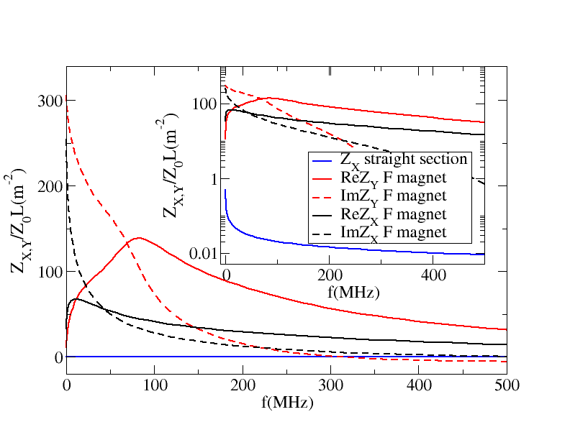
Impedance and Wake fields
Synergia has a unique capability to accommodate arbitrary wake fields with correct transverse dynamics.
  The wake fields are calculated independently and saved in a file.
We developed numerical methods to calculate wake fields for pipes with arbitrary geometry, A Macridin, et. al, PRSTAB, 2013.
We developed numerical methods to calculate wake fields in laminated chambers, A Macridin, et. al, PRSTAB, 2011.
Horizontal impedance in the Fermilab Booster focusing gradient magnet.
13
11/19/2019
Eric G. Stern | Synergia | AAC Review 2019

Slide 14
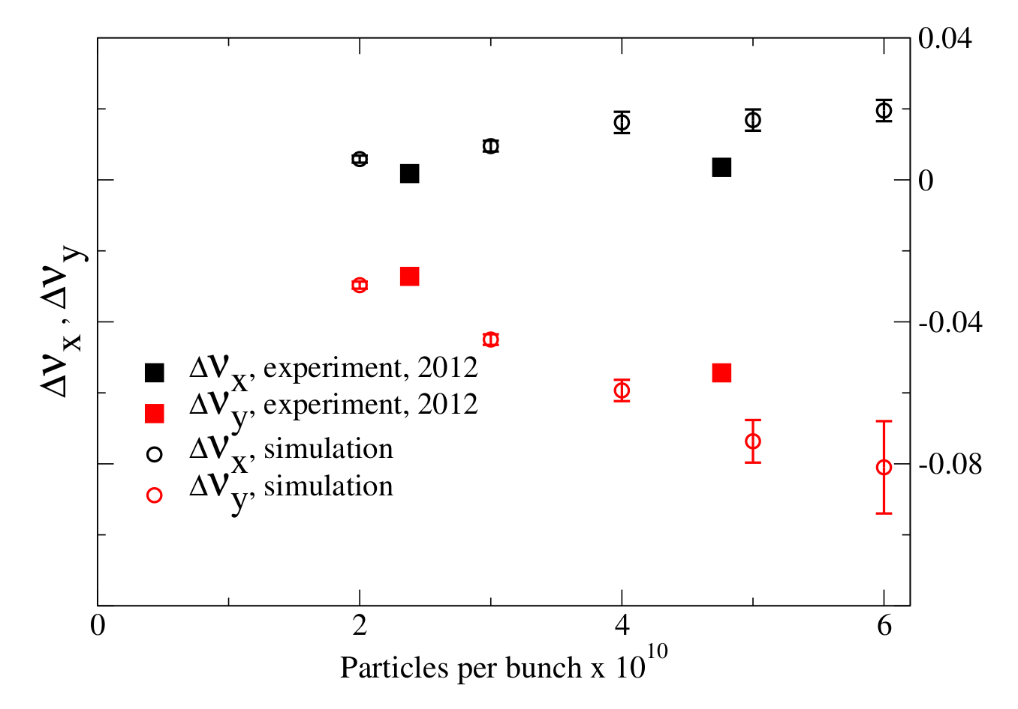
Impedance model reproduces measured detuning
The simulation shows slightly larger tune shift than the measurement but follows the data well.
The different behavior between x and y is understood due to the different impedances of the F and D magnets and the beta functions.
A. Macridin, FERMILAB-CONF-13-431-CD, Phys.Rev.ST Accel.Beams 14 (2011) 061003
14
11/19/2019
Eric G. Stern | Synergia | AAC Review 2019

Slide 15
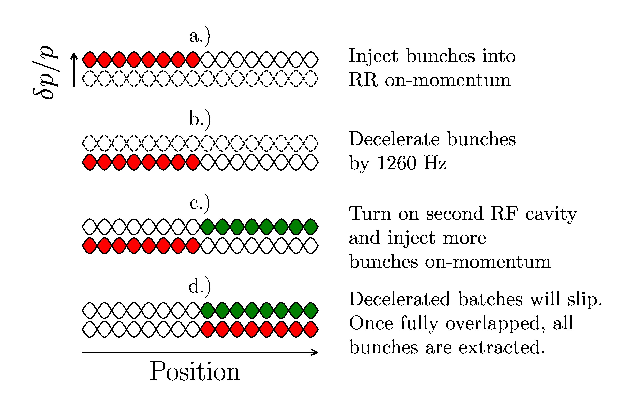
Multiple Bunch Slip-Stacking
Slip-stacking is a clever technique for increasing intensity.
  Pioneered at Fermilab, now used at CERN as well.
  Used in Recycler to double the number of protons per pulse.
  By the end of the cycle two bunches are added in the same bucket.
  Crucial for reaching 700 kW beam power.
Understanding slip-stacking is crucial for future high intensity machines.
Synergia has the unique capability to simulate slip-stacking with space charge interactions
15
11/19/2019
Eric G. Stern | Synergia | AAC Review 2019

Slide 16
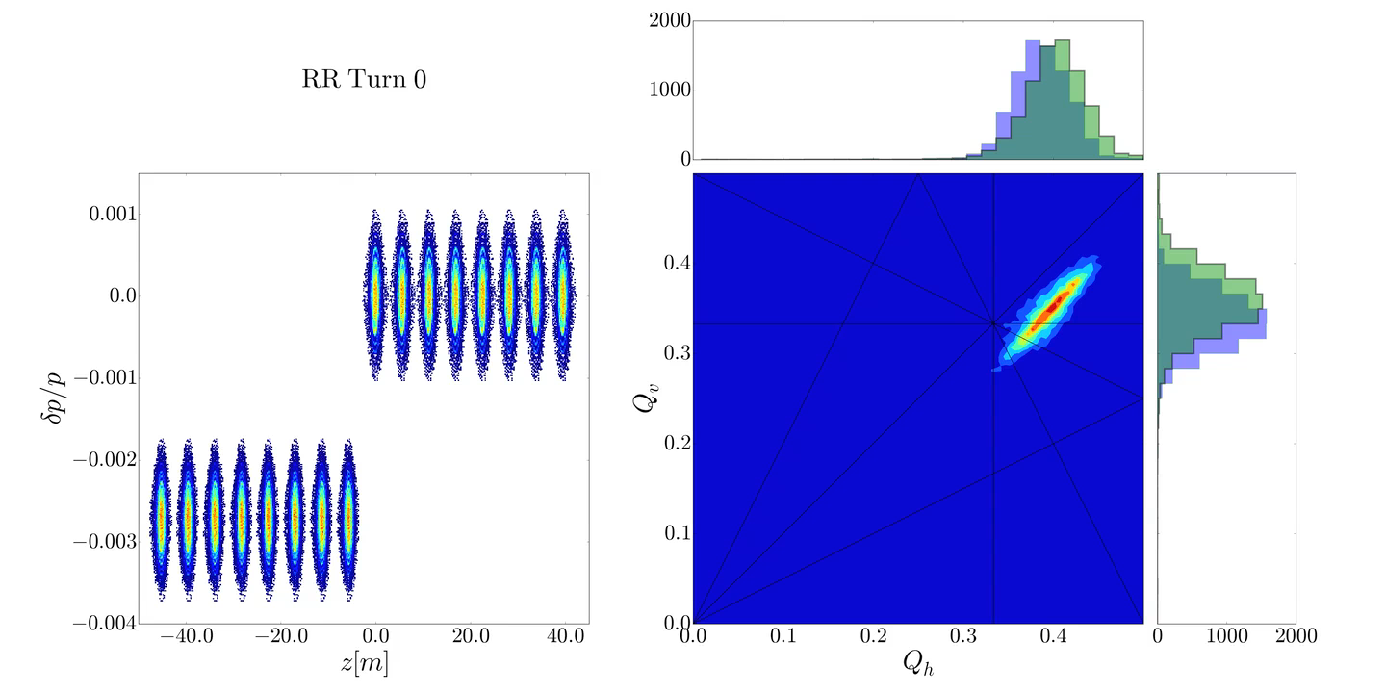
Tune footprints during slip stacking in Fermilab Recycler
R. Ainsworth, et al., Phys.Rev.Accel.Beams 22 (2019) no.2, 020404 .
16
11/19/2019
Eric G. Stern | Synergia | AAC Review 2019

Slide 17
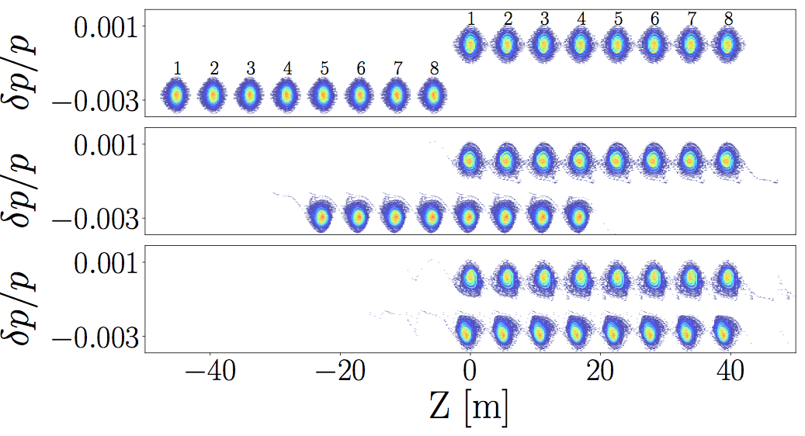
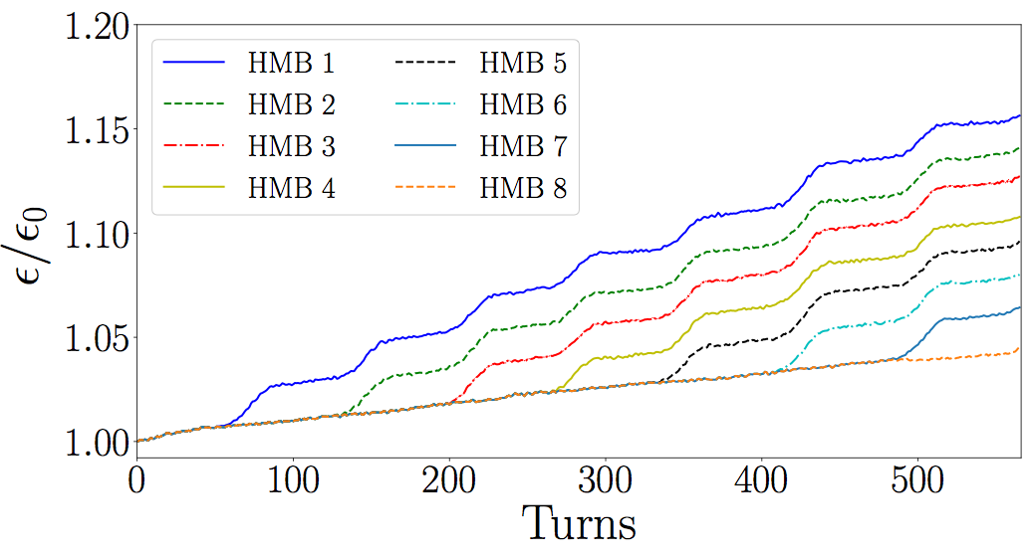
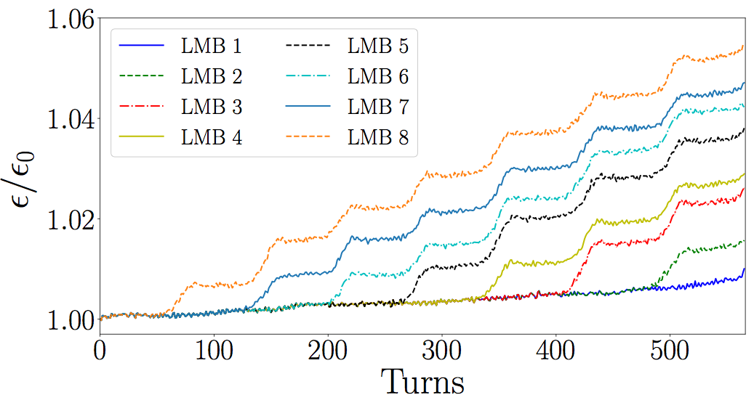
Synergia: Two-beam simulation of slip stacking
Transverse emittance growth
17
11/19/2019
Eric G. Stern | Synergia | AAC Review 2019

Slide 18
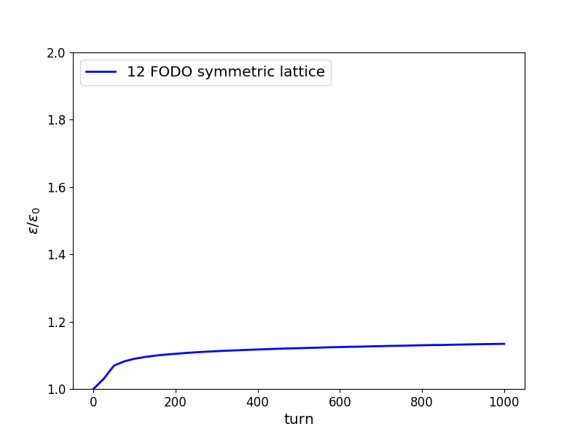
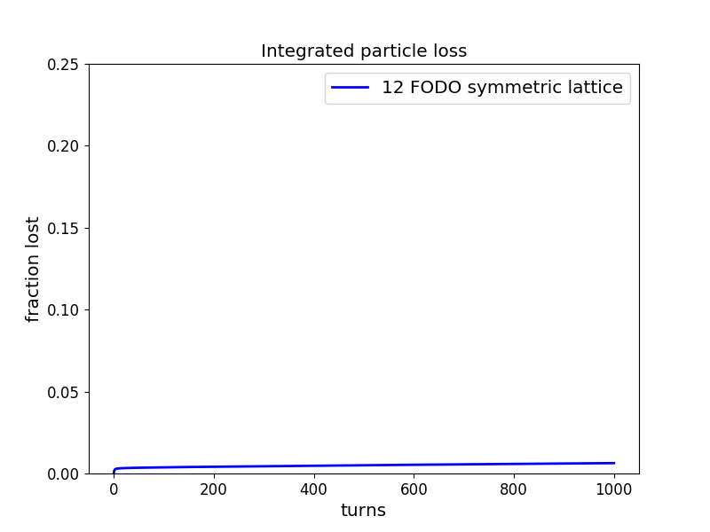
Extreme space charge- ideal lattice
Focusing
1000 turns
dQ_{SC} = -0.9
Defocusing
RMS x emittance growth
4 sigma aperture loss
13% emittance growth
0.6% particle loss
18
11/19/2019
Eric G. Stern | Synergia | AAC Review 2019

Slide 19
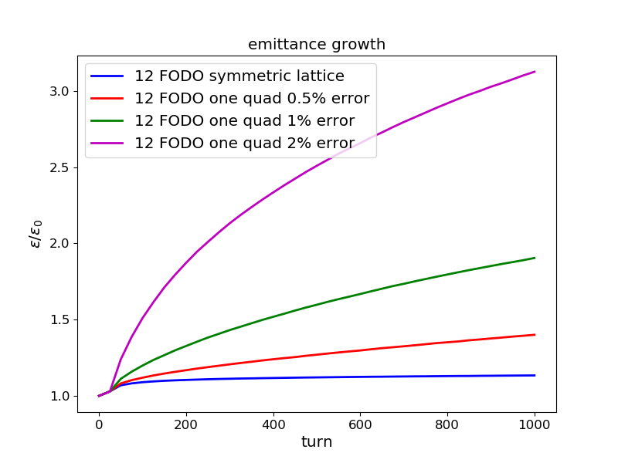
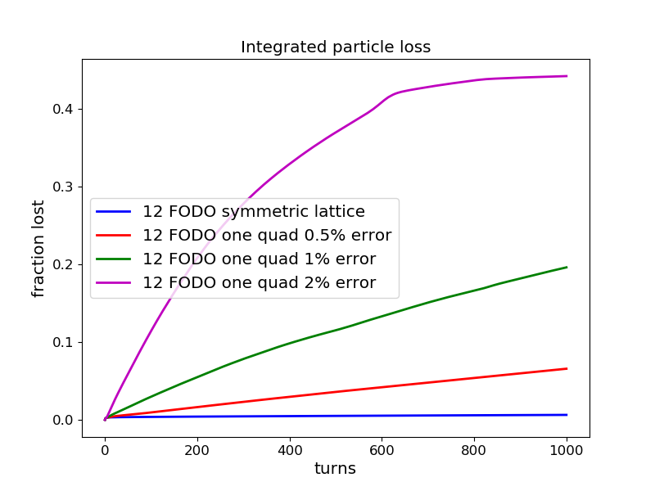
Extreme space charge – lattice error
Focusing
1000 turns
dQ_{SC} = -0.9
Lattice error in one element
Defocusing
1% error
RMS x emittance growth
4 sigma aperture loss
19
11/19/2019
Eric G. Stern | Synergia | AAC Review 2019

Slide 20
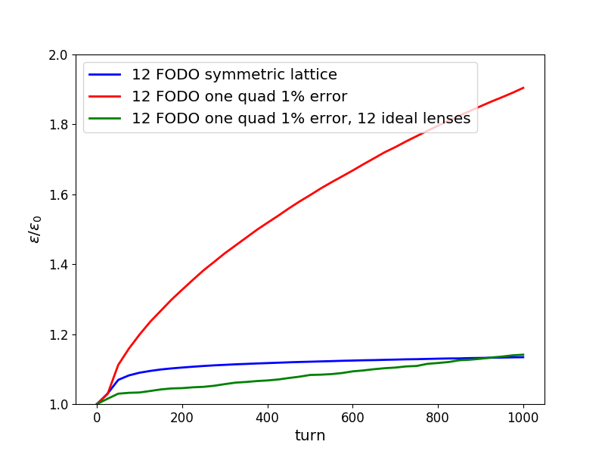
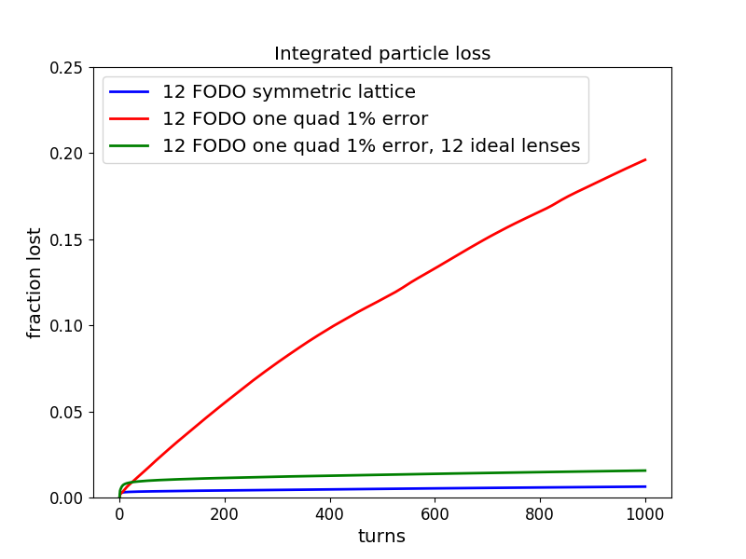
Extreme space charge with compensation
Electron lens
1000 turns
dQ_{SC} = -0.9
Lattice error in one element
Focusing
Defocusing
1% error
RMS x emittance growth
4 sigma aperture loss
20
11/19/2019
Eric G. Stern | Synergia | AAC Review 2019

Slide 21
Conclusions
Synergia is a fully complete package for simulating the variety of accelerators and operating scenarios in the Fermilab complex.
Synergia’s space charge and impedance models have been validated by benchmarks and experimental measurements.
21
11/19/2019
Eric G. Stern | Synergia | AAC Review 2019

Slide 22
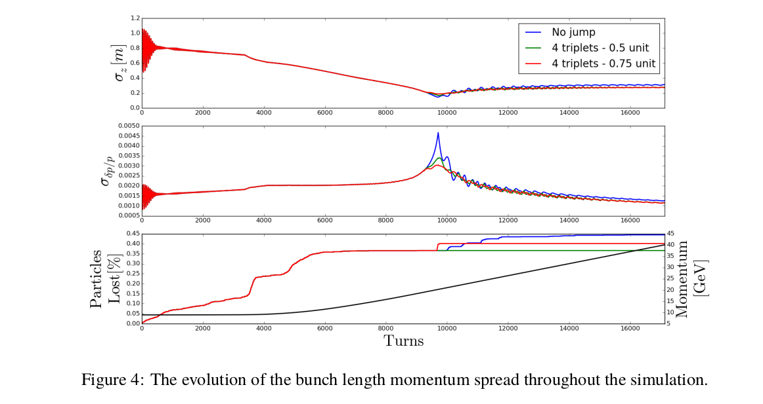
Main Injector Transition Crossing
Synergia simulates detailed transverse dynamics as well as longitudinal dynamics to catch transverse losses in an otherwise advantageous gamma-t scheme.
22
11/19/2019
Eric G. Stern | Synergia | AAC Review 2019

Slide 23
Parametric Landau damping
A. Macridin, et al, PRAB, 2018.
Landau damping is due to the resonant energy transfer between the collective mode and the individual particles.
  In the conventional mechanism the tune of the particles which participate to Landau damping match the mode tune.
The enhancement of the damping in our simulations is due to a new mechanism, parametric Landau damping (PLD).
  A necessary condition for PLD is that the mode-particle coupling has a frequency spectrum.
  The resonant energy exchange results from the interplay of both particles and mode-particle coupling spectra.
  In PLD the tune of the particles participating to the damping mechanism do not match the mode tune.
Scientific discovery through advanced computing simulations.
23
11/19/2019
Eric G. Stern | Synergia | AAC Review 2019

Slide 24
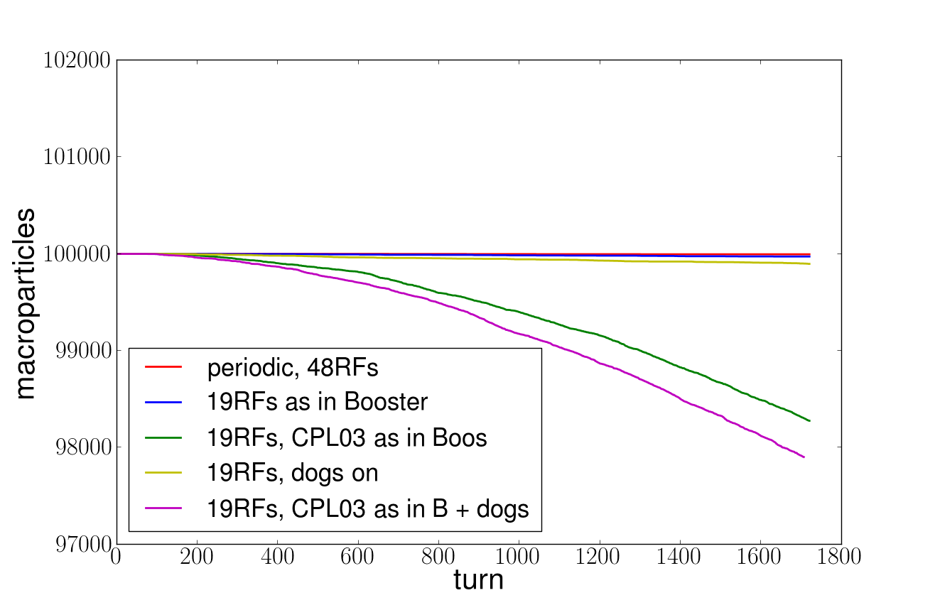
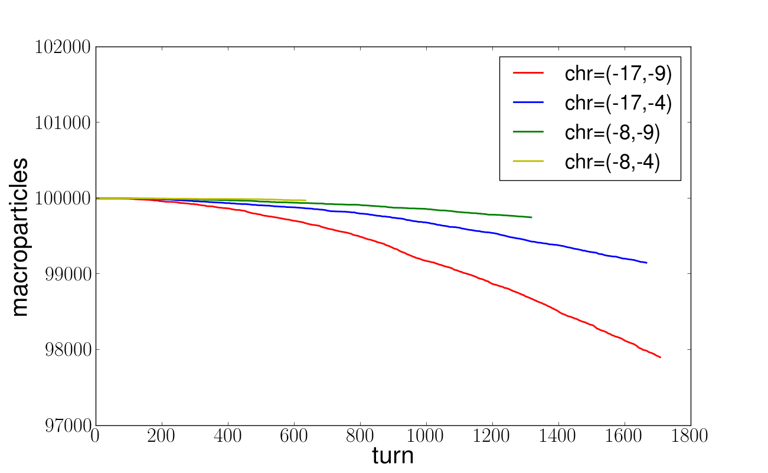
Beam Loss in the Presence of Symmetry Breaking in the Fermilab Booster lattice
Large Space Charge, Q_{sc}=0.34
Q_{0x}=0.734, Q_{0y}=0.824
Chromaticity=(-17,-9)
Position of the CPL03 corrector package is the main culprit for beam loss
The horizontal chromaticity has a large influence on loss
Beam loss investigation requires very good beam matching. Normal forms up to the 7th order were necessary for Booster simulations.
Synergia has advanced beam loss diagnostic tools.
24
11/19/2019
Eric G. Stern | Synergia | AAC Review 2019

Slide 25
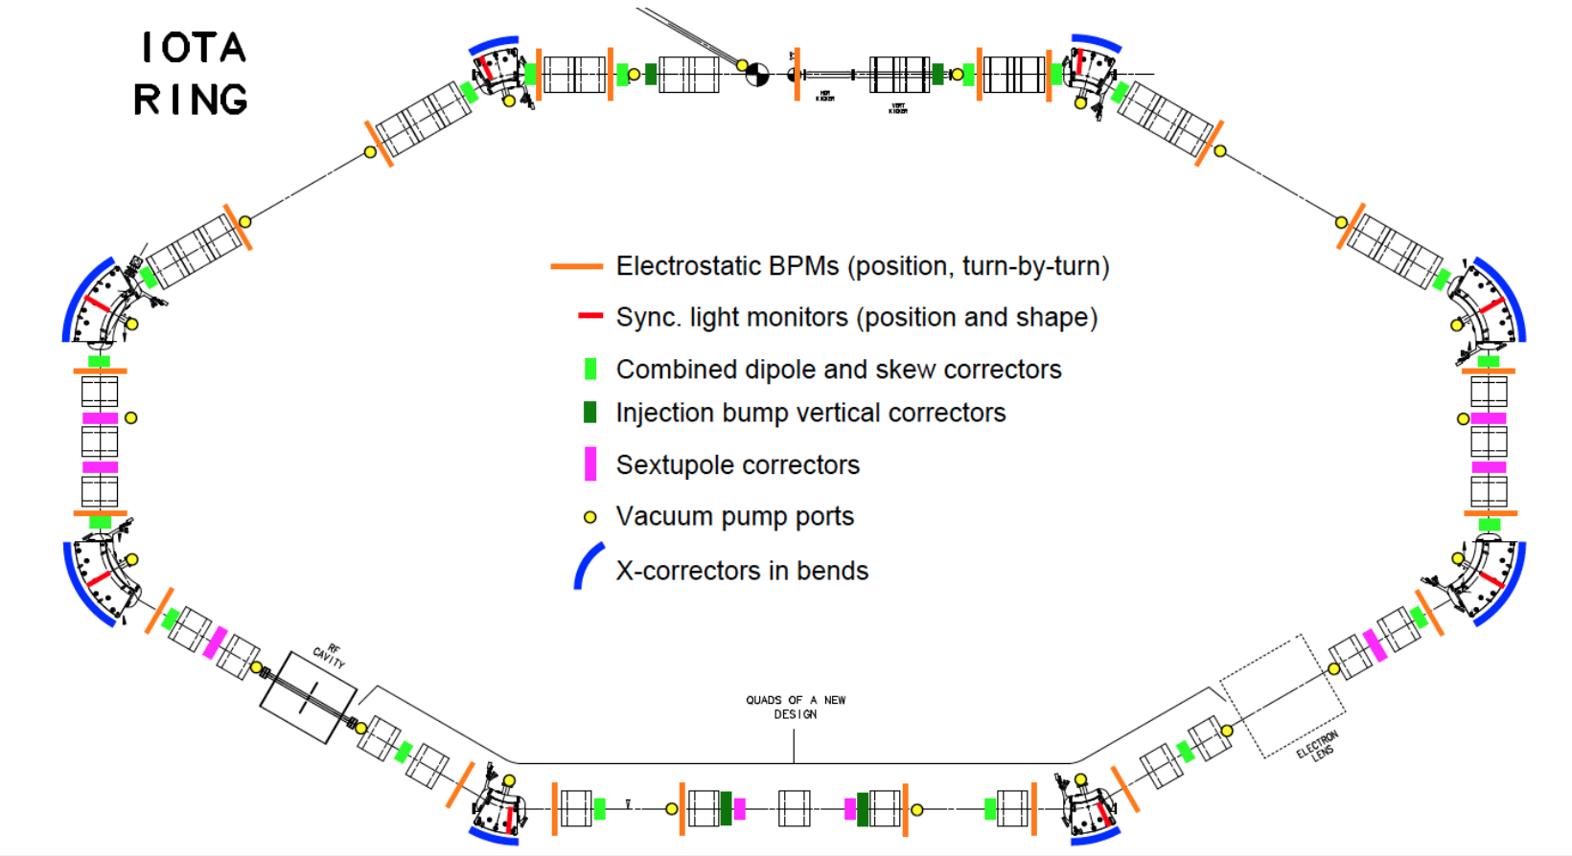
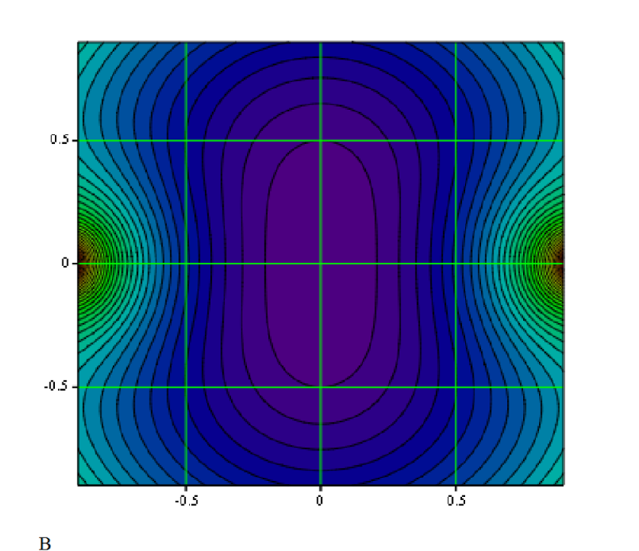
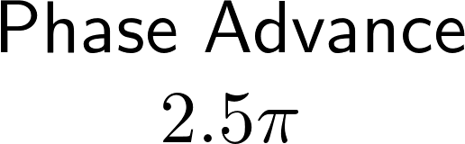
IOTA with damper
Nonlinear lens
kicker
pickup
25
11/19/2019
Eric G. Stern | Synergia | AAC Review 2019
damper
pickup
damper
kicker
nonlinear
element

Slide 26
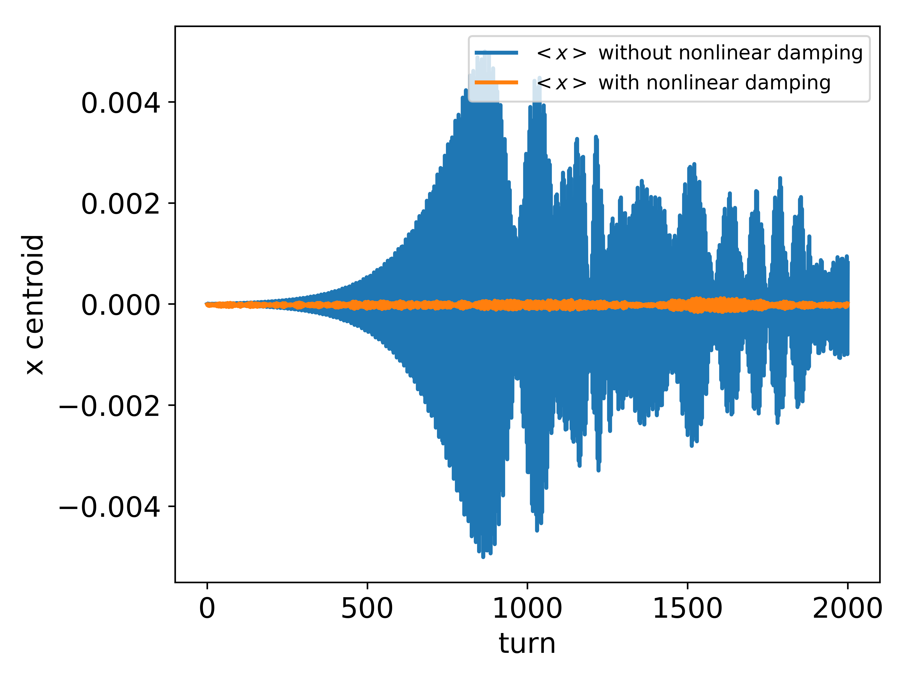
IOTA Experiment
Simulations in support of an IOTA experiment of enhanced Landau damping.
An anti-damper is present in both cases.
When the nonlinear lens is absent the beam is unstable (blue).
The nonlinear lens stabilizes the beam (orange).
Eric Stern, IPAC, 2018
26
11/19/2019
Eric G. Stern | Synergia | AAC Review 2019

Slide 27
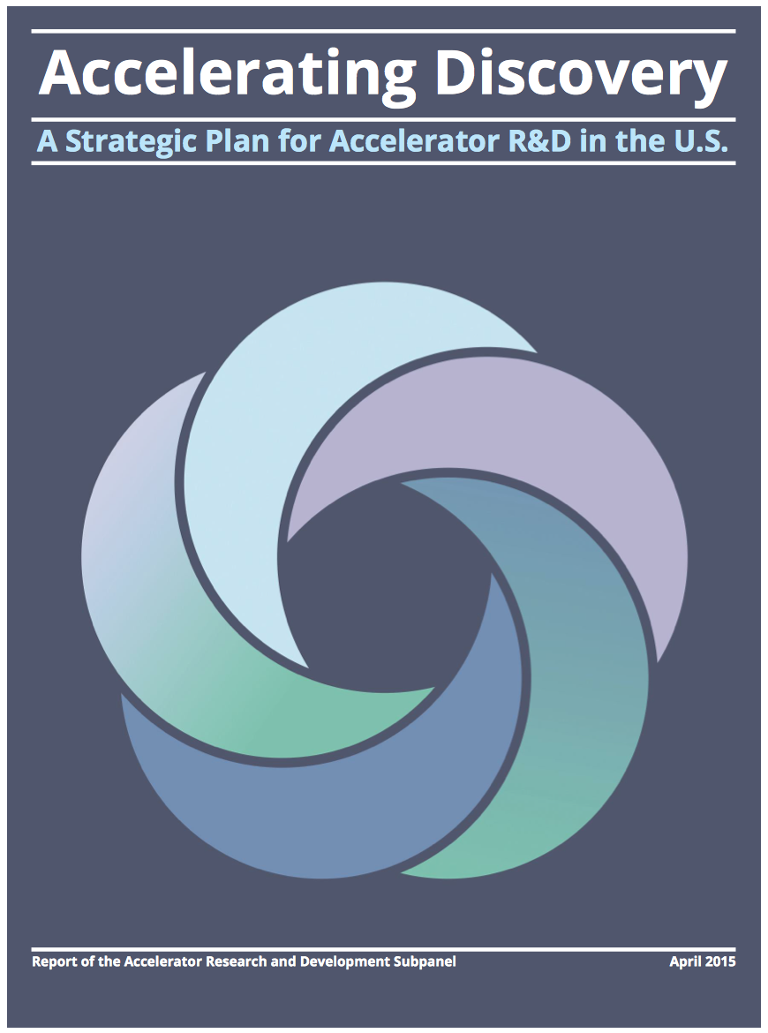
2015 Accelerator R&D Subpanel Recommendations
- maintain accelerator science core competence and support high intensity proton beam physics R&D:
[R2] Construct the IOTA ring, and conduct experimental studies of high-current beam dynamics in integrable non-linear focusing systems.
[R3] Support a collaborative framework among laboratories and universities that assures sufficient support in beam simulations and in beam instrumentation to address beam and particle stability including strong space charge forces.
[R14] Continue ABP R&D aimed at developing the accelerators defined in the Next Steps and the Further Future Goals.
[R15] Ensure a healthy, broad program in accelerator research, allocate a fraction of the budget of the ABP thrust to pursue fundamental accelerator research outside of the specific goals.
27
V.Shiltsev | 2018 DOE Fermilab GARD review
07/31/2018
Notes:
27

