Slide 1
PIP-II SRF Update

Slide 2
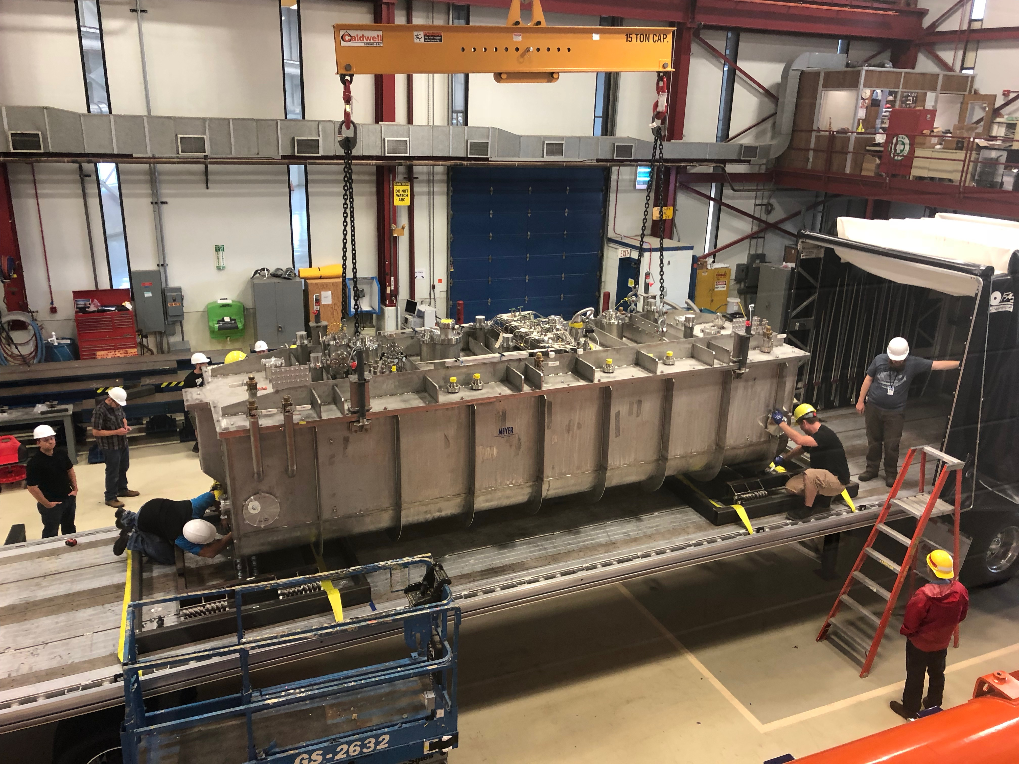
Status
HWR CM was delivered to FNAL early AM August 16th.
No apparent issues form transport
Visually OK, BL vacuum unchanged, accelerometers show < 0.2G
Final integrated leak check before transport found a leak in the 50K thermal shield circuit
~1e-4 mBar-l/sec, sensitivity ~1e-7 mBar-l/sec
Leak check is performed by evacuating insulating vacuum, and pressurizing (~1 atm) individual He ckts
Given the upcoming lack of resources for HWR activity at ANL (loss of key personnel) it was decided to transport to FNAL for repair
Repair to thermal shield will be added to the already planned/understood CM completion of HWR expected at FNAL (due to transport considerations)

Slide 3
Thermal Shield

Slide 4
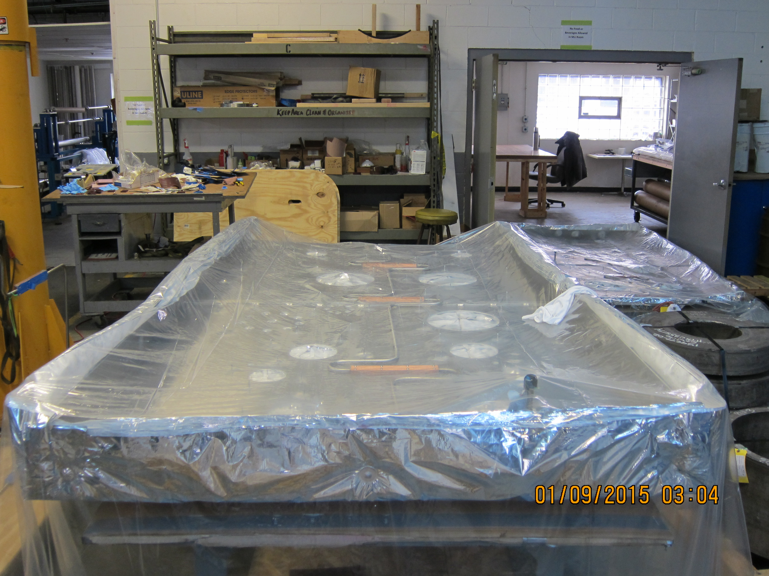
Thermal Shield

Slide 5
Thermal Shield
Thermal shield assembly being lifted at Meyer Tool.
The vacuum vessel, magnetic shielding, and thermal shield (with inner/outer covering of MLI) was delivered to ANL as a completed unit/assembly.

Slide 6
Thermal Shield – Leak Check History
leak checked at Meyer Tool at the end of fabrication (5/19/2015),
leak check at ANL upon receipt of the cryomodule from Meyer Tool (8/6/2015),
leak check at ANL prior to transport from BLDG 366 to 203 for the engineering cool-down (1/19/2016),
leak check at ANL after transport from BLDG 366 to 203 for the engineering cool-down (2/2016),
leak check at ANL during the engineering cool-down with the 50 K circuit at 77K (2/20/2016),
leak check at ANL after transport from BLDG 203 back to 366 after engineering cool-down (4/6/2016),
8/14/2019 leak check at ANL which found a 1.4 e -7 mbar-l/s leak in the cryomodule lower vacuum vessel 50 K circuit.

Slide 7
HWR Repair and Completion Plan
We were already planning on performing a number of activities related to completion of the HWR CM, as a result of removing or postponing installation of components for transport.
We add to this repair (identification/localization then repair) of the thermal shield process piping.
Work activities structured in 5 Phases (some in parallel)
Phase I – Post transport checks
Phase II – Prepare for thermal shield repair
Phase IIIa/b – Thermal shield repair (offsite/onsite options)
Phase IV – Post-repair assembly & transport
Phase V – Final assembly at PIP2IT
Phase VI – ORC preparations

Slide 8
Tentative HWR Repair and Completion Schedule
Phase I – Post transport checks
8/19/19 – 8/28/19
Phase II – Prepare for thermal shield repair
8/21/2019 – 9/5/2019
Phase IIIa/b – Thermal shield repair (offsite/onsite options)
IIIa : 9/5/2019 – 10/8/2019
IIIb : 8/26/19 – 10/11/19
Phase IV – Post-repair assembly & transport
10/11/2019 – 10/23/2019
Phase V – Final assembly at PIP2IT
10/1/2019 – 11/19/2019
Phase VI – ORC preparations
3/11/2019 – 11/18/2019

Slide 9
HWR Repair and Completion Schedule
Original Schedule : Cooldown 10/9/19 (delivery 8/20/19)
7 weeks after receipt
New Schedule : Cooldown 11/19/19 (“delivery” 10/12/19)
5 weeks after “receipt”
some Phase V work on top plate occurs in parallel with repair activities (if resources available)
Examples
Solenoid lead soldering.
WEKA valve welding/installation
Jumper cables between FTs/patch panels
Wiring
Final tuner piping

Slide 10
HWR Repair and Completion - Next Steps
Push forward on Phase I activities
Refine schedule, add resources
Input to BCR for repair activities
Input for “buy/make” decision for offsite/onsite repair
Begin discussion with MTM re: budgetary estimate
Critical issues:
Development of procedures, JHAs, other safety documentation, especially for new scope of work
Examples : safety analyses for CM stands, CM lid stands, lid lifting (ANL procedure exists), thermal shield removal (never done at ANL), thermal shield repair (never done), other mundane tasks
This can/will be the critical path, need engineering resources
Offsite repair of TS eliminates some of this burden

Slide 11
HWR Cryomodule Lessons Learned for Partner Labs (Preliminary)
Fermilab leads and oversee the design of cryomodules with prototyping
Fermilab oversight
Experienced partner lab: Fermilab provides specification
Other partner lab: Fermilab provides specification, procedure and QA/QC guidance
All governed by project planning documents
Priority and commitment of partner labs are essential

Slide 12
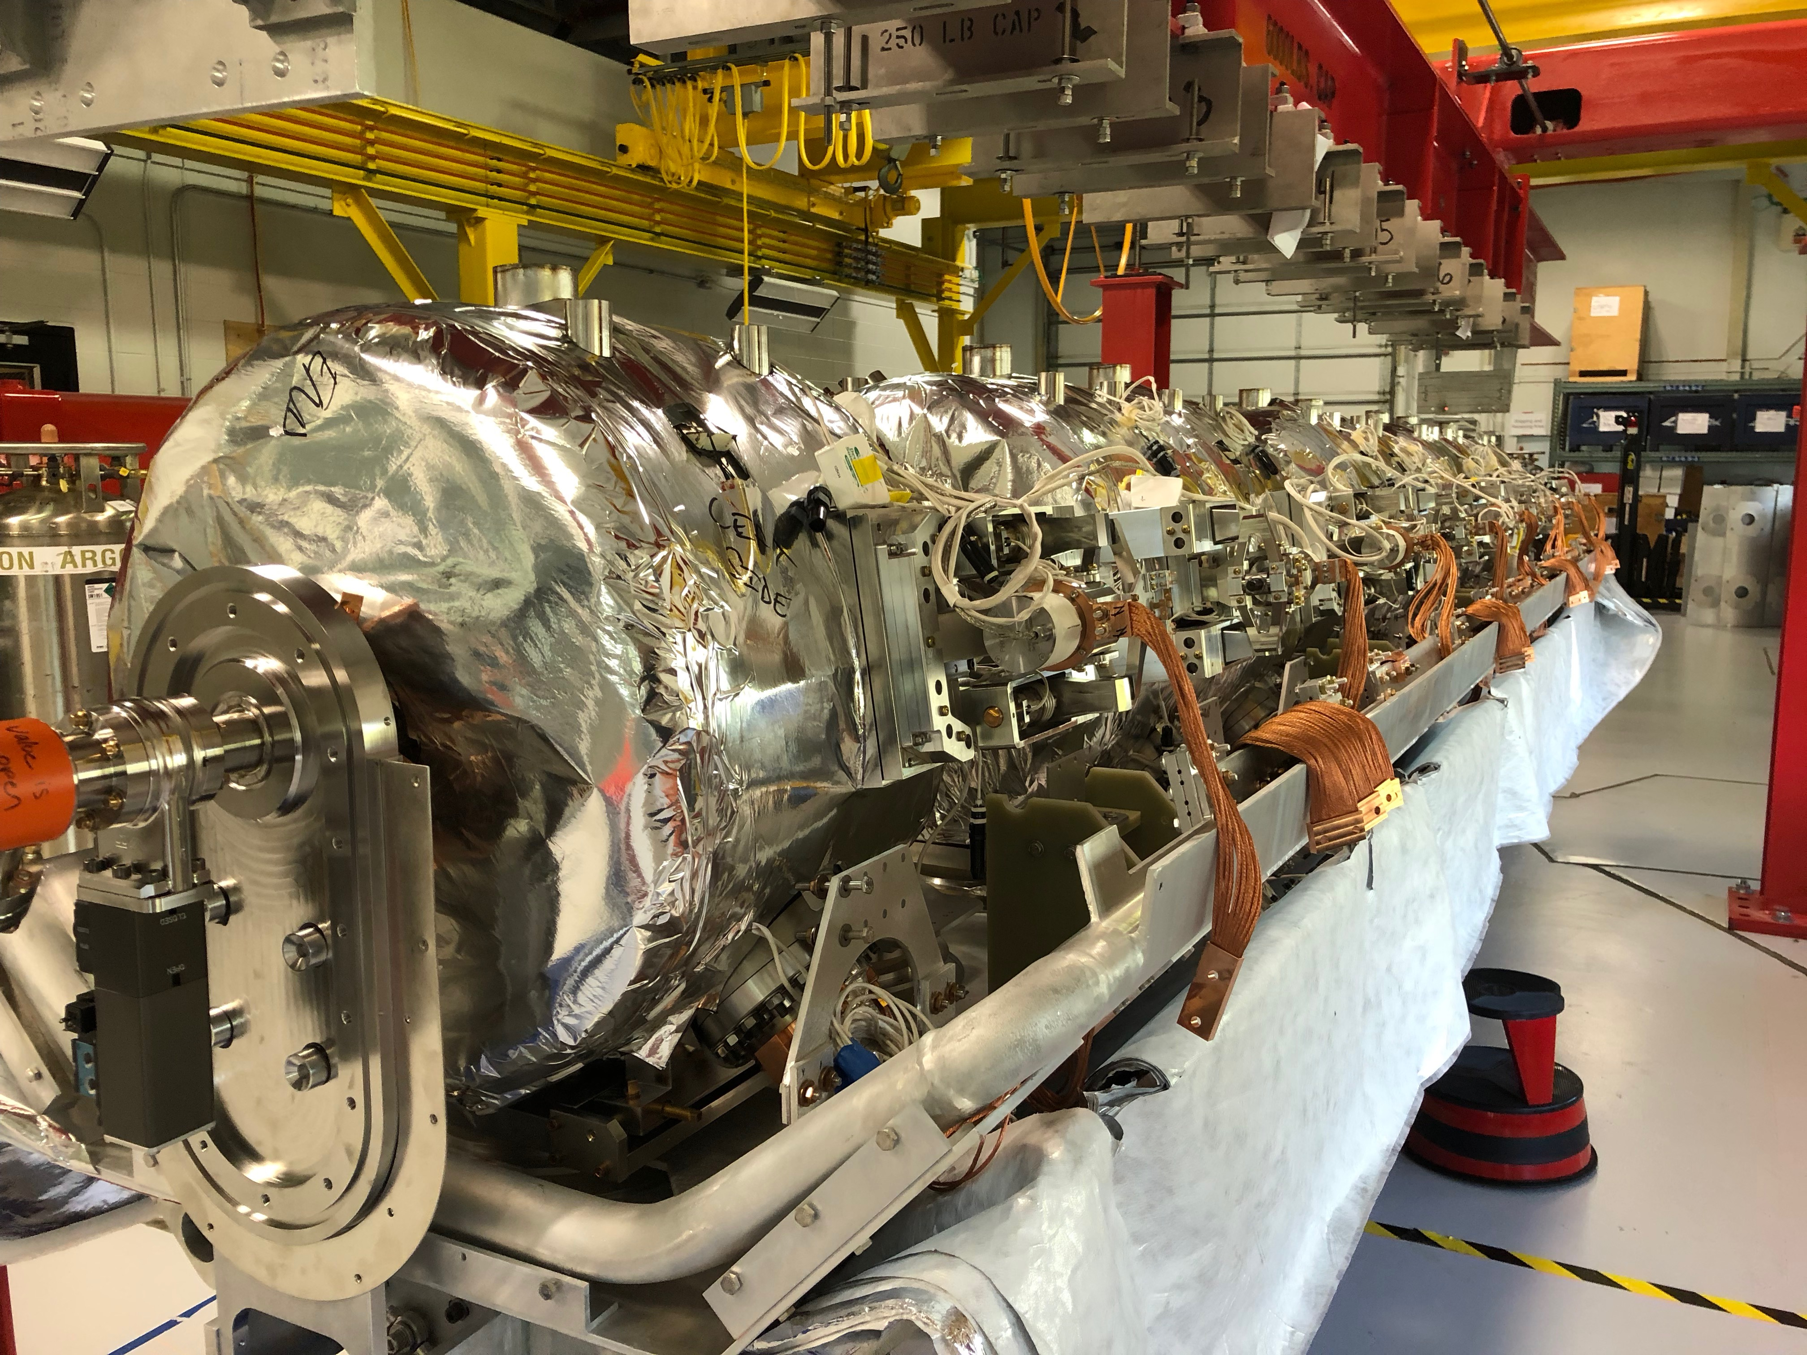
WBS 121.2 SRF Updates – SSR Cryomodules
SSR1: cold mass assembly is in progress.
SSR1: cryomodule assembly is expected to complete in October.
SSR2: prototype cavity niobium bids received, evaluation is in progress.
Issues: SSR1 experienced difficulty to get alignment support due to accelerator shutdown work load.

Slide 13
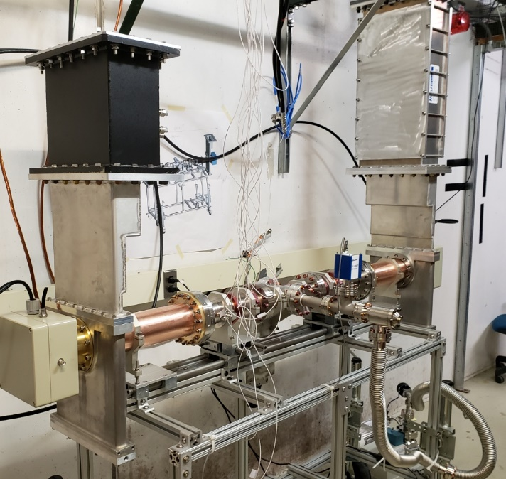
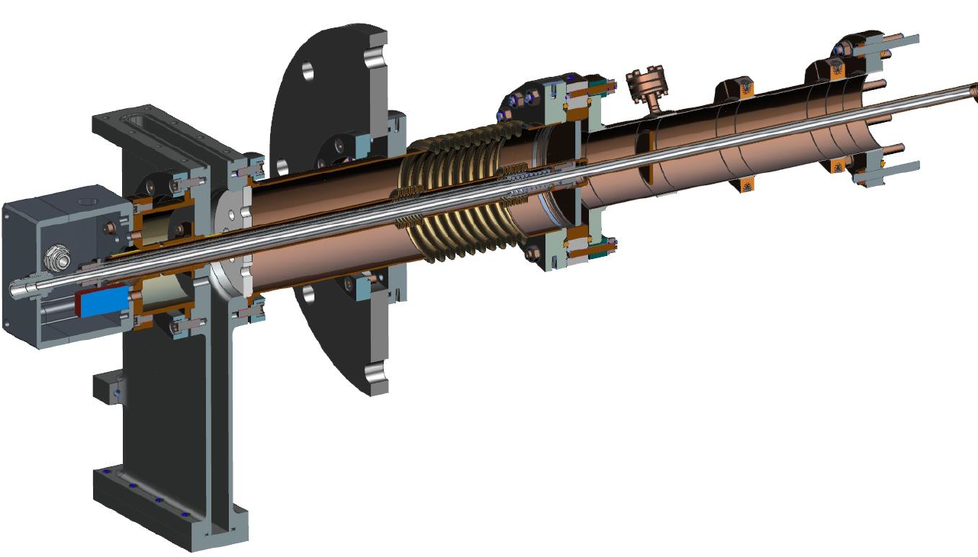
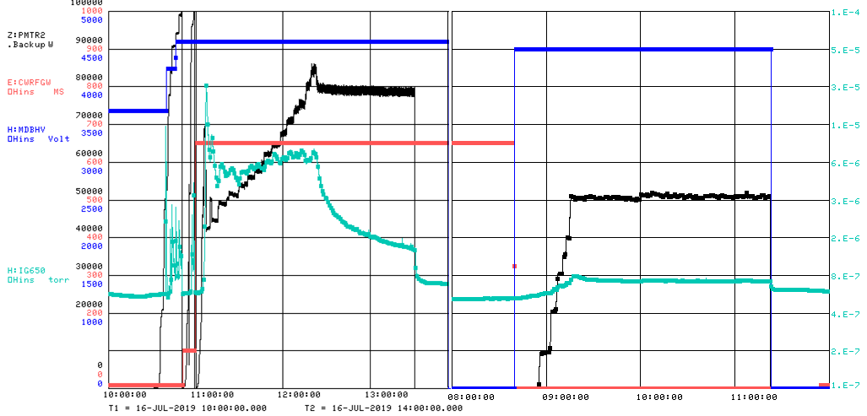
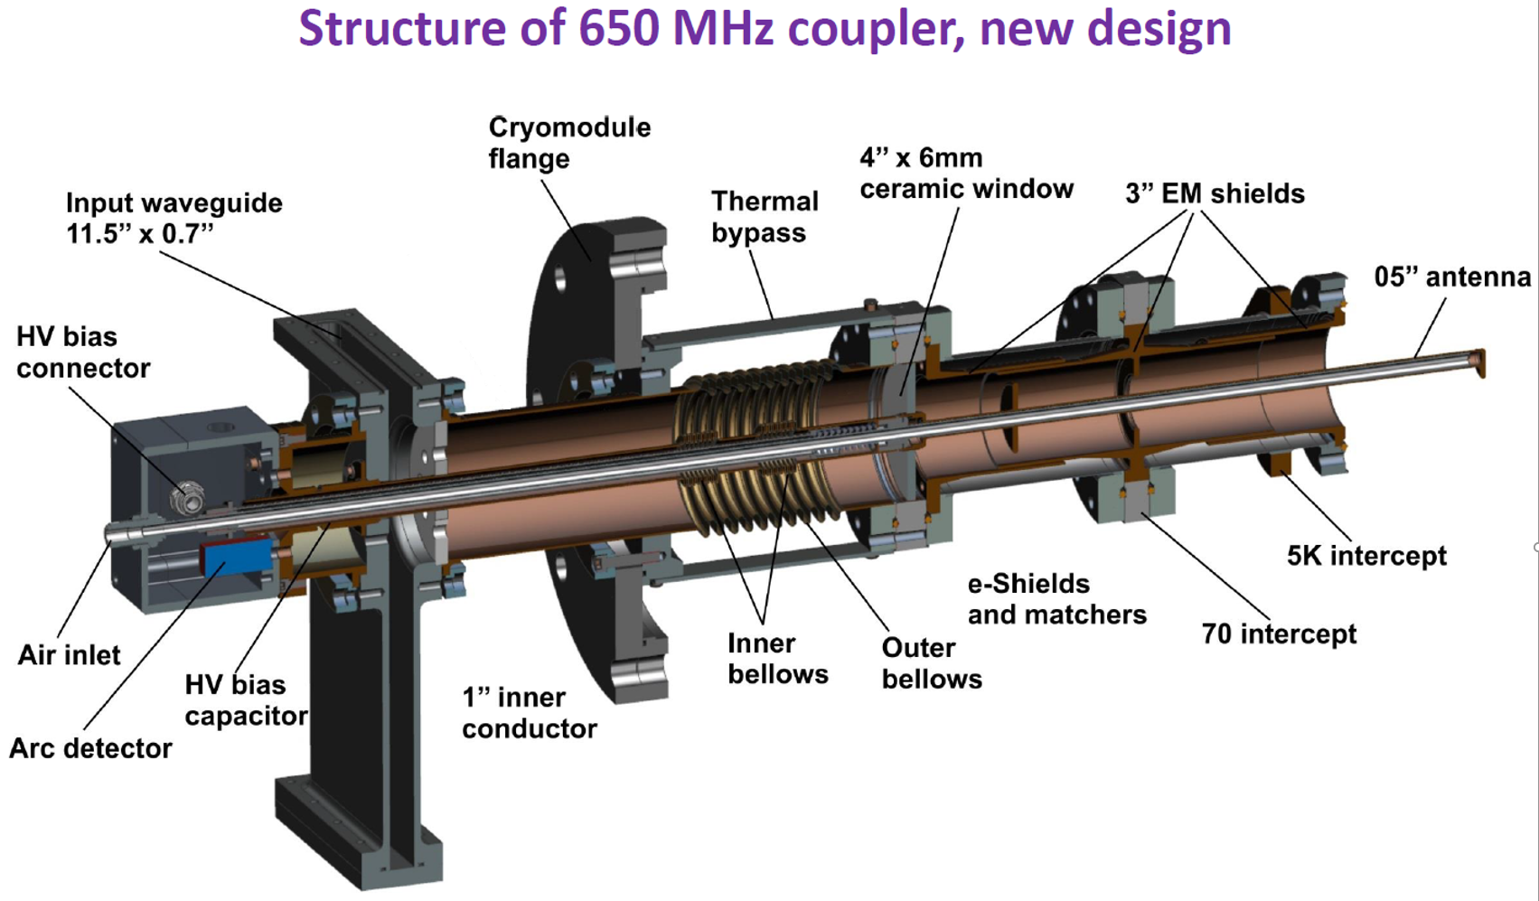
WBS 121.2 SRF Updates – 650 Cryomodules
All four prototype couplers qualified at room temperature conditioning stand.
A pair of EM shield design and traditional design
50kW CW full reflection

Slide 14
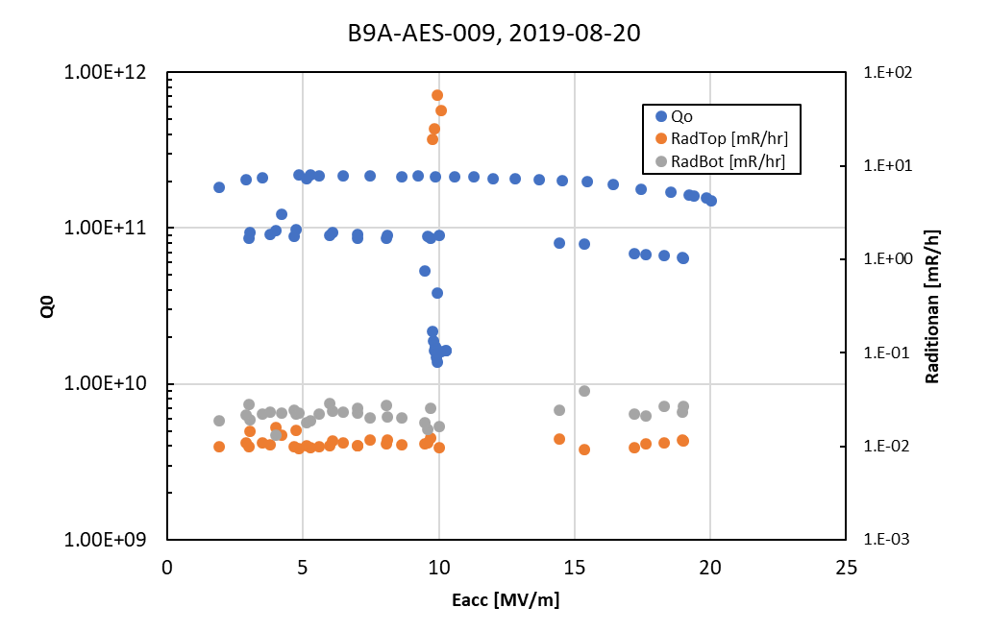
WBS 121.2 SRF Updates – 650 Cavities
HB650 5-cell tested, cavity performance limited by quench.
Second cavity in a row has no field emission.
Second cavity in a row that quenched at 20 MV/m with high Q.
Cold EP improvement is on the way for the next several cavities

