Slide 1
Jefferson Lab’s Ganni Helium Refrigeration Process Cycle
Dana Arenius
Engineering Division Cryogenic Systems Department
JLab’s Collins Cryogenic R&D Institute
Project X Collaboration Meeting
Nov 21-22 2008
This work is supported by the United States Department of Energy (DOE) contract #DE-AC05-060R-23177

Slide 2
Outline
Standard Helium Process Cycle Example
Refrigerator Recycle Flow
Compressor Efficiency vs. Pressure Ratios
One solution..Ganni Cycle
Cycle Features
What the Cycle Does and Does Not Do
Supportive Equations which indicate it works
Practical Applications already in use
Examples of Results
Recognitions of the work
Summary

Slide 3
Simplified Standard Helium Cycle
Majority of flow is recycled, 60-90%
Please Note
Standard
Ratios

Slide 4
Items to Remember for Existing Systems
Most of the gas compressed by the compressors is recycled through expansion engines (ex: turbines) to generate the refrigeration of the gas which actually is supplied to the load, Note: Standard Pressure Ratios ~5-7
To lower the amount of refrigeration delivered many plants regulate the inlet valves to the turbines to reduce the mass flow through the turbines …however
System pressures and pressure ratios remain the same
Excess gas is bypassed around the compressor stages
Input power remains the same regardless of refrigeration

Slide 5
NOW…..
LET’S TAKE A LOOK AT A PROBLEM WITH THESE PRESSURE RATIOS….

Slide 6
Compressor Characteristics Efficiency vs. Pressure Ratio
FIGURE 1.3 BRV=2.2 1st Stage
FIGURE 1.4 BRV=2.6 2nd Stage
Compressor has peak efficiency at fixed pressure ratio regardless of discharge pressure, Pr ~3 to 3.5

Slide 7
Question???
So why does the largest compressor (2nd stage compressor) with the most flow (recycle flow) have pressure ratios other than the ideal fixed value?
Ans: Good Question….suggest the following reasons
Dismissed because plant sizes were small (300W) when screw compressors were introduced to replace reciprocating units
Solving oil carry over and improving reliability took center stage
Forgot a new process would be needed as loads increased
Compressor R&D is not a market focus due to small market, compressors is not a product of the large system suppliers

Slide 8
A Solution
JLAB developed a new helium process…”GANNI CYCLE”
Patented by US Gov and Jefferson Science Associates
Licensing of technology was offered to industry
Sole license granted to Linde for commercial applications
US Gov and JSA reserved right to acquire systems built to the technology from any vendor for their applications
A version of the cycle is easily adaptable to existing systems (usually requires control loop changes)

Slide 9
Ganni Cycle Example

Slide 10
Ganni Cycle Features
Recycle Flow is “broken out” separately from the load return flow (C1 & C2)
A compressor is provided to handle the much smaller load return flow (C0)
Recycle compressors are allowed to “float” in pressure which naturally develops optimal pressure ratio (~3-3.5)
Recycle compressors are generally fewer in number or size
Requires less installed electrical and cooling water utility
Instead of regulating the turbine inlet valves to adjust refrigeration generation, the recycle compressor circuit pressures is allowed to float naturally (i.e. Pr = constant)

Slide 11
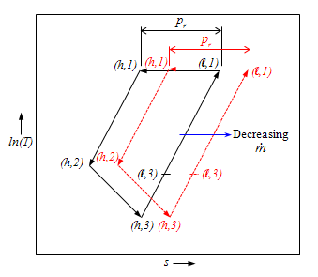
Floating Pressure T-S Diagram
In the floating pressure process, the compressor suction and discharge vary, but at a constant pressure ratio (p_{r}). This is opposed to traditional cycles that attempt to force the controls to the design T-s condition by adding heat, bypassing expander flow, bypassing compressor flow or the throttle expander inlet valve.

Slide 12
Another Way of Looking at it…..
Changes the standard helium cycle from a constant mass flow and input power at constant pressure system with a fixed “T-s”
To
A helium cycle with constant compressor pressure ratios coupled with constant volumetric flow with variable system pressure, floating “T-s”, and input power which varies automatically with load

Slide 13
What Does Not Change
There are no new equipment components to develop
Compressor oil removal performance is not affected
Size of heat exchangers not affected
What Does Change
Operational efficiency is extended to a large operating domain for loads less than 100% refrigeration
Opportunity for smaller and/or less compressors & turbines
Allows the system to automatically operate at peak efficiency if the design goals of the refrigerator or load are not as expected or is variable

Slide 14
A constant pressure ratio system that maintains a constant efficiency and constant volume flow for a variable load
A Floating Pressure System is……….

Slide 15
Where Is It Being Used So Far (Industry may already have more)
Existing Plant Conversions
Jefferson Lab...all six refrigerators, 2K/4K, 200 to 4.6 kW
Brookhaven RHIC ….Central Helium Liquefier
Spallation Neutron Source (SNS)…Central Helium Liquefier 2.3 kW @ 2.1K
Michigan State University….Cyclotron Test Facility
NASA Johnson Space Center, Environmental Test Chamber A, twin 3.5 kW 20K refrigerators
Planned New Facilities
Jefferson Lab 12 GeV Upgrade, 4.6 kW @ 2.1K (Bids Received)
NASA JSC Houston, James Webb Telescope Test Facility, 12.5 kW @ 20K, (On Order)

Slide 16
Results So Far
General Results of All Users
Lower required electrical and cooling water requirement
Smaller equipment foot print
Greater system temperature stability
Reduction in required emergency repair and planned maintenance
At Jefferson Laboratory
20% reduction in CHL electrical and cooling requirement Example: 6.5 MW to 5.2 MW reduction
Lower maintenance requirements Example: screw compressor maintenance, 35 K to 74 K hrs

Slide 17
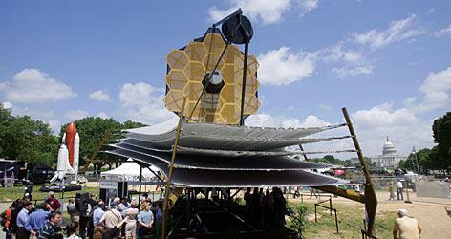
NASA-JSC/JLab Collaboration
James Webb Telescope
Space Telescope
Replaces Hubble
~1 million miles out
Telescope Mockup at the National Mall, D.C.
NASA-JSC/JLab Cryogenic Collaboration (NASA Funded)
Help NASA engineers modify Current Environmental Space Simulation Chamber cryogenic system to JLab’s Floating Pressure Technology
Help develop specification of additional new 20K, 12.5 KW refrigerator using the Ganni Helium Process Cycle

Slide 18
NASA Test Results and Plan

Slide 19
Brookhaven RHIC Conversion Results
Brookhaven Reports Its Very Successful Energy Conservation Improvement Program Results After One Year of Operation
Brookhaven TODAY, Feb 11, 2008 http://www.bnl.gov/today/story.asp?ITEM_NO=544
“Jefferson Lab technology saving BNL $1.5M in electricity alone for typical 30 week experiment”
Brookhaven RHIC Cryogenic Staff
“ Seen increased reliability, stability, and efficiency”

Slide 20
Recent JLab Cryogenic Technology Recognitions Relating to the Cycle

Slide 21
JLab Cryogenic Recognitions
2007 President’s White House Closing the Circle Award
2006 DOE Office of Science Pollution Prevention and Environmental Stewardship P2
“Best in Class Award”
The award recognizes the JLab cryogenic team’s efforts at making a considerable energy savings to the running of accelerator cryogenics plants and reducing its impact on the environment
Recognizing outstanding achievements of Federal employees and their facilities for efforts which resulted in significant contributions to, or have made a significant impact on, promoting environmental stewardship (reducing electrical, cooling water, etc.)

Slide 22
2007 White House Closing the Circle Award

Slide 23
Summary
A new helium refrigerator process cycle referred to as the “Ganni Cycle” has been developed for all temperatures
The cycle is patented and licensed to industry
It realigns the process so that high efficiencies are realized for both the refrigerator cold box and compressors over a wide operating domain
Has positive effect on repair, maintenance, operation, and capital equipment cost
Many of the US laboratories have converted to the process for existing plants with very positive results
Multiple new plants is being built using the technology

Slide 24
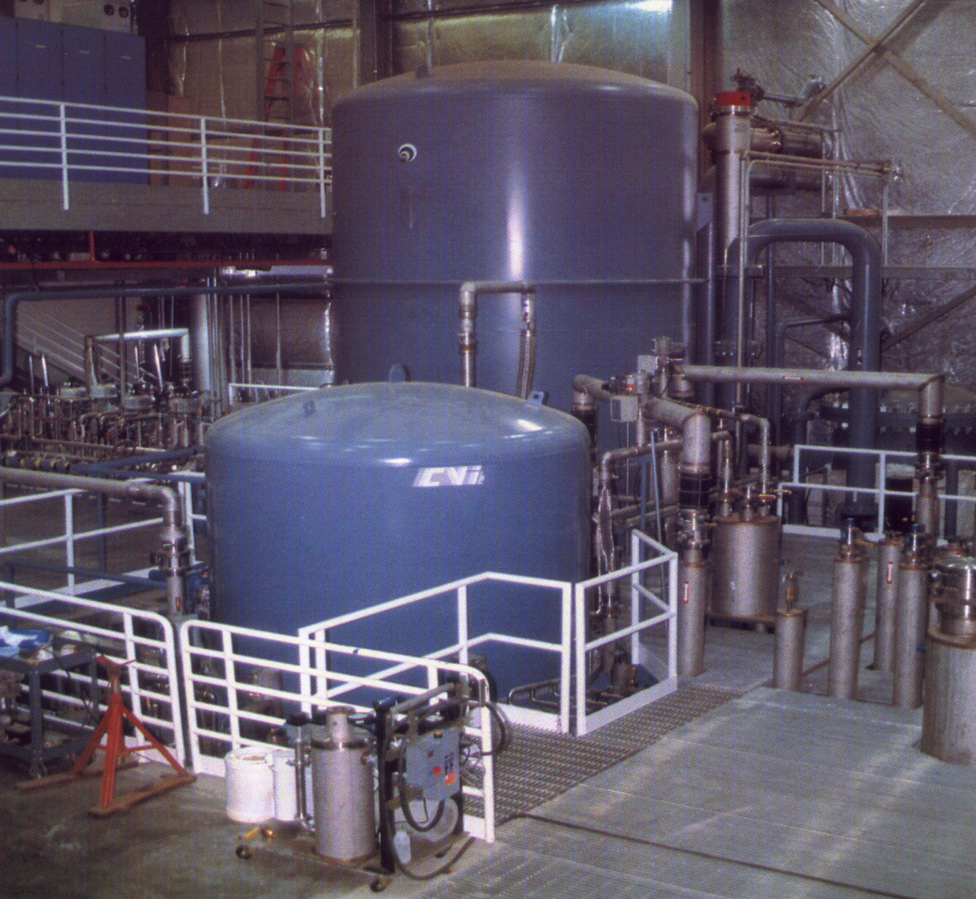
Thank You for Your Kind Attention May We Answer Your Questions ?

