Slide 1
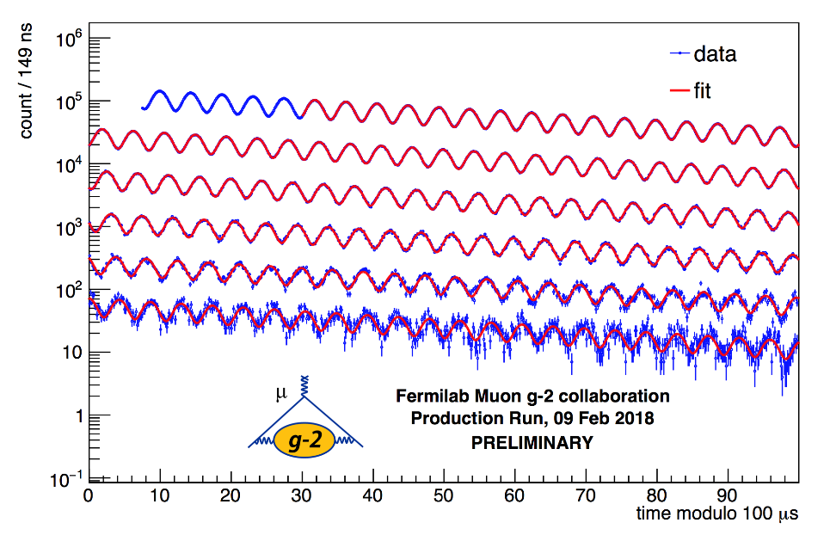
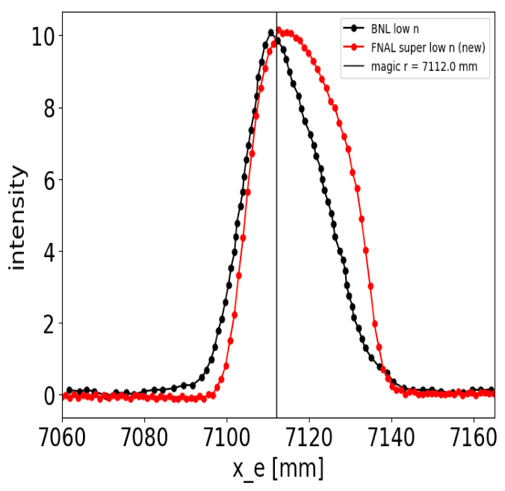
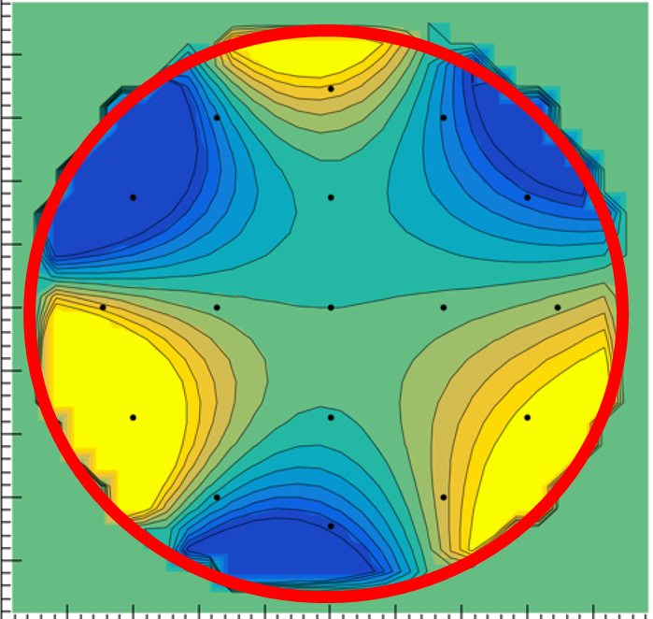


1993
ω_{p}
ω_{a}
BD
Status of the muon g-2 experiment at Fermilab
David Hertzog
University of Washington
Sept 9, 2019
INT Workshop on g-2 Hadronic Contributions

Slide 2
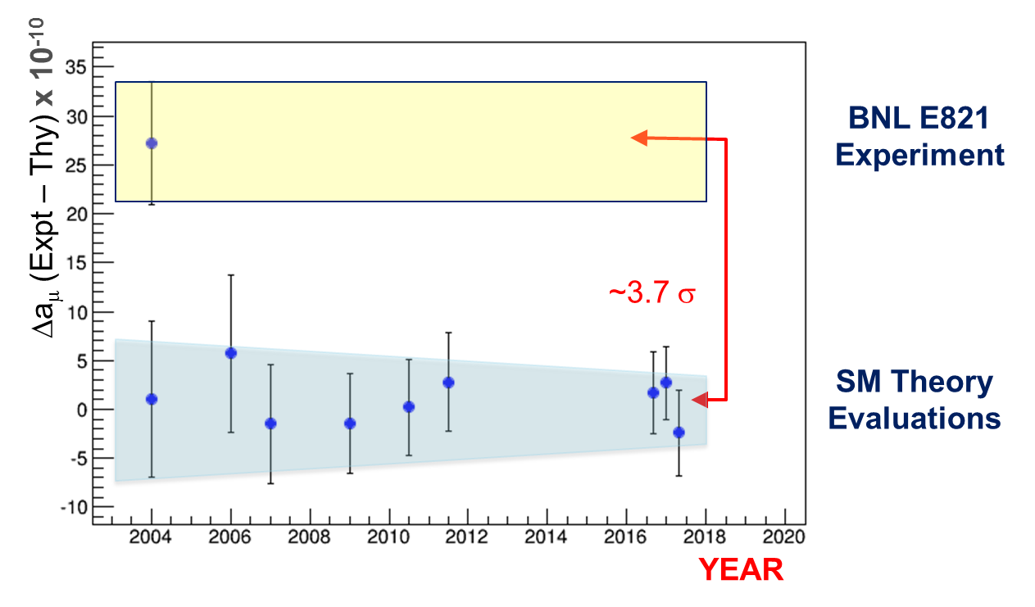
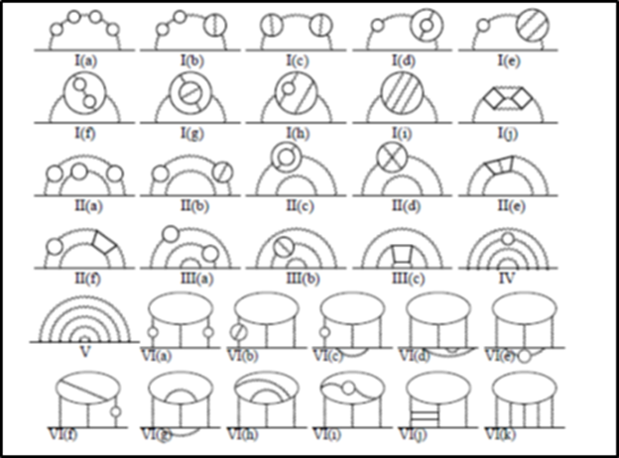
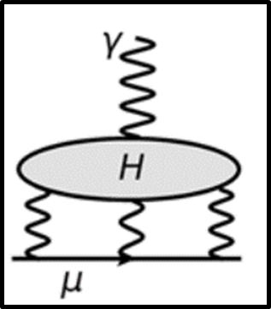
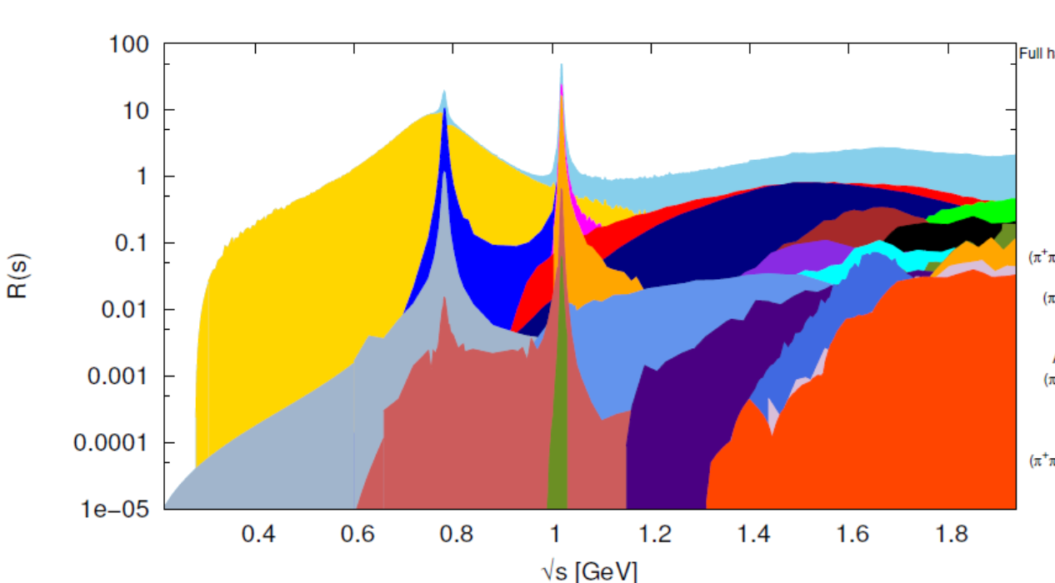
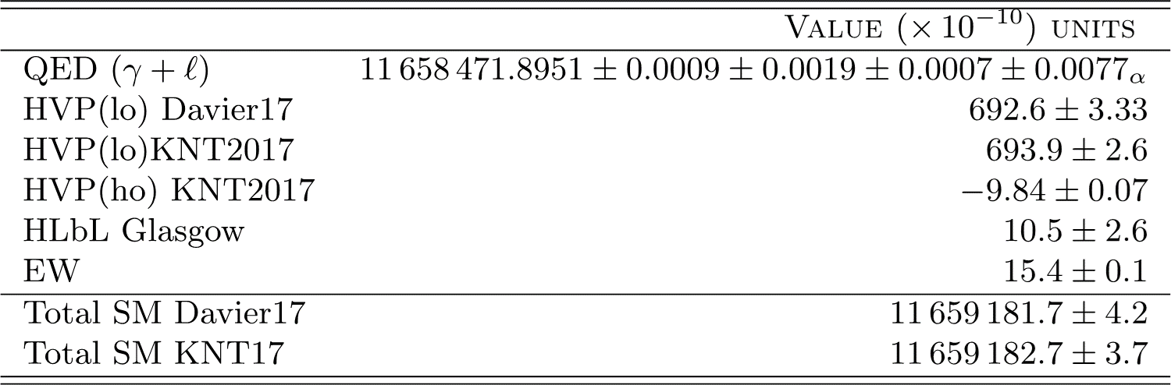
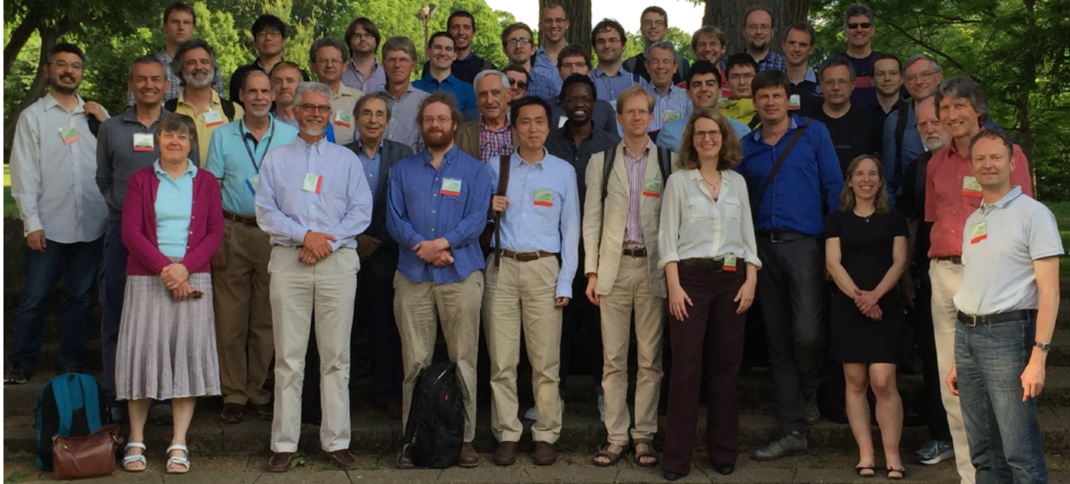
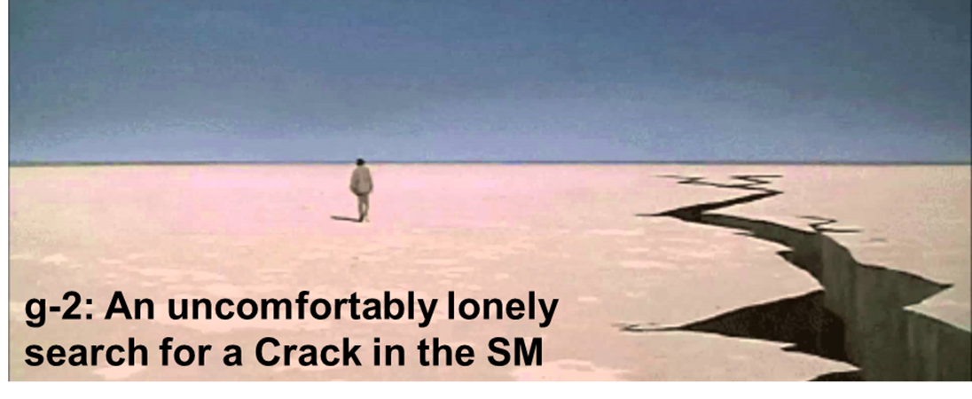
Introductory comments …
Motivation to measure muon g-2
Status of the Standard Model
  QED and Weak contributions
  Hadronic Vacuum Polarization
  Hadronic Light-by-Light
What might it mean if g-2 = SM theory at 5 σ?
History of measurements
Motivation to measure muon g-2
Status of the Standard Model
  QED and Weak contributions
  Hadronic Vacuum Polarization
  Hadronic Light-by-Light
What might it mean if g-2 = SM theory at 5 σ?
History of measurements
Well, that’s going to save a lot of time …

Slide 3
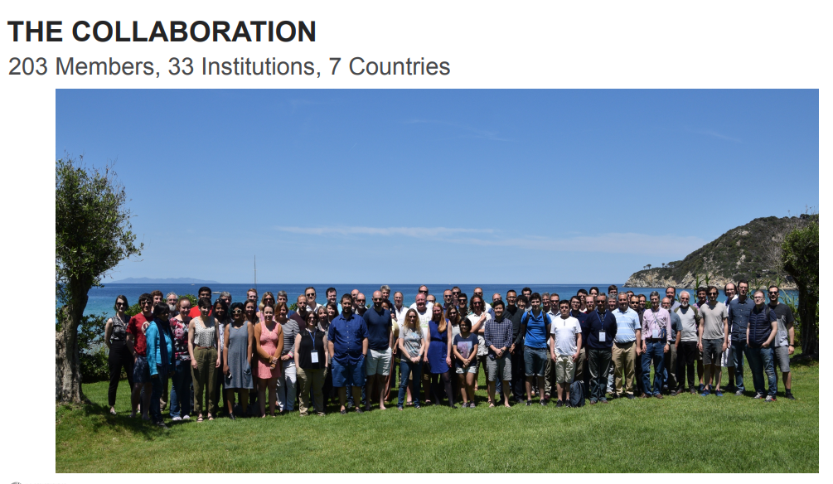
First, on behalf of E989, we offer warm greetings and a collective thanks for the hard work you are doing on the theory
We are also working hard to understand the data …
Elba, Italy
May 2019

Slide 4
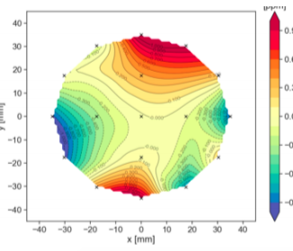
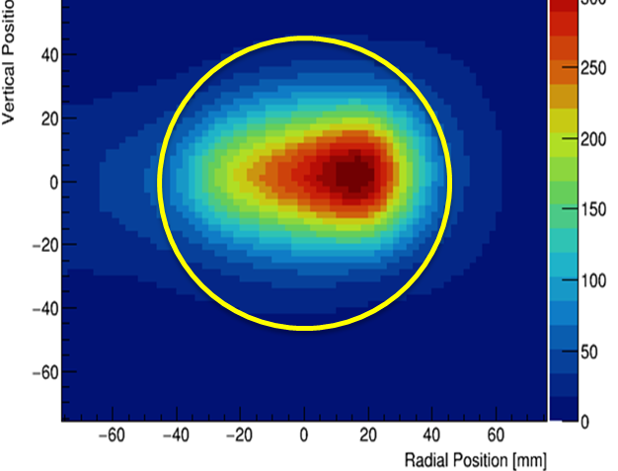
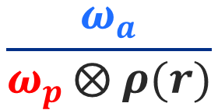
In principle, extracting a_{μ} requires measurement of 3 things by us, plus external constants
-0.001 519 270 380(5) [3 ppb] Hydrogen Maser
206.768 2826(46) [22 ppb] Muonium Hyperfine
2017 CODATA
-2.002 319 304 361 82(52) [0.26 ppt] Electron g-2/QED
E989
(US)
$$\frac{ω_{a}}{ω_{p }⨂ ρ(r)}$$
⊗

Slide 5
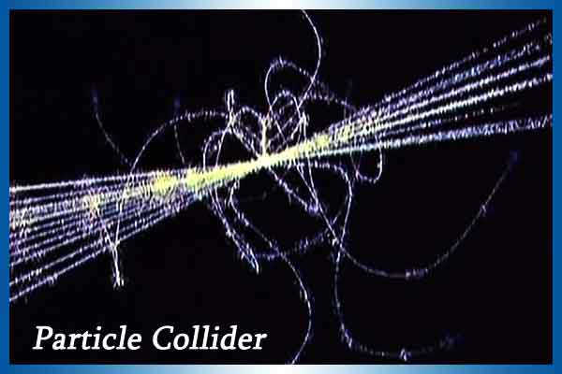
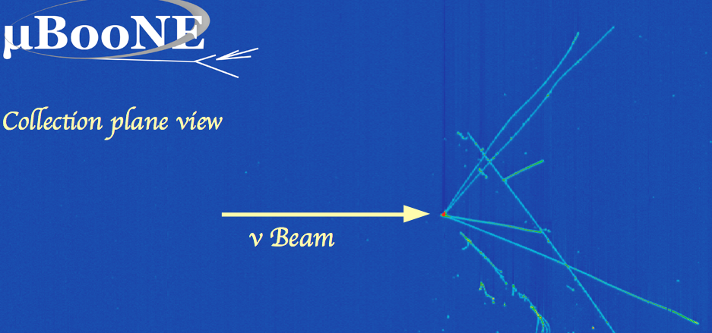
What is unusual in this particle physics experiment?
The muons do not collide with another beam
And they do not strike a target
Observe them “from a distance” to infer their spin orientation and their path around the magnet
  Decays reveal spin from self-analyzing PV
  Betatron motions are manifest in acceptance variations of the detectors
  Trackers can image muon spatial distribution

Slide 6
Our plan for a better measurement
Store More Muons
  20 x BNL in statistics … (100 ppb)
  Eliminate the hadronic pion “flash” at injection
Prepare A More Uniform Magnetic Field
  Goal → 3 x better and more carefully measured (70 ppb)
Improve the Precession Frequency Measurement
  New instrumentation; high-fidelity recording of muon decays (70 ppb)
Understand the Beam Dynamics (motions) fully
  Model End to End to whole system
  Internal tomography of storage by indirect Tracker reconstruction of e⁺ decays

Slide 7
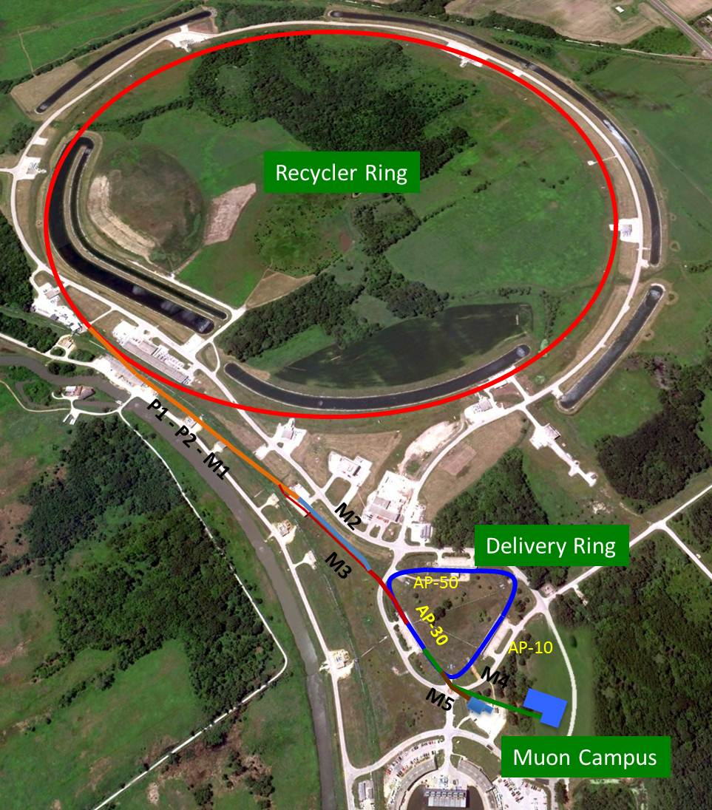
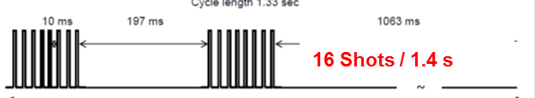
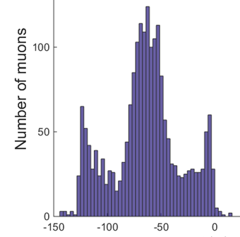
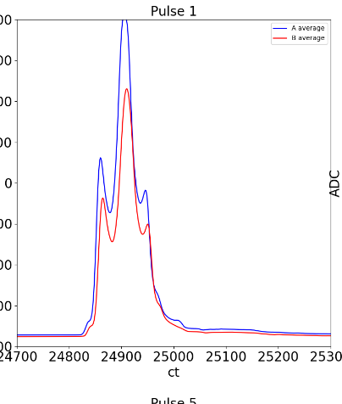
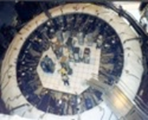
Creating the Muon Beam for g-2
8 GeV protons
Divide in 4 bunches
Extract each to strike target
Magnetic lenses collect π ◊ μν
p/π/μ beam enters Delivery ring -protons get kicked out; pions decay away
And only muons enter storage ring
Intensity profile is 120 ns wide with “W” shape

Slide 8
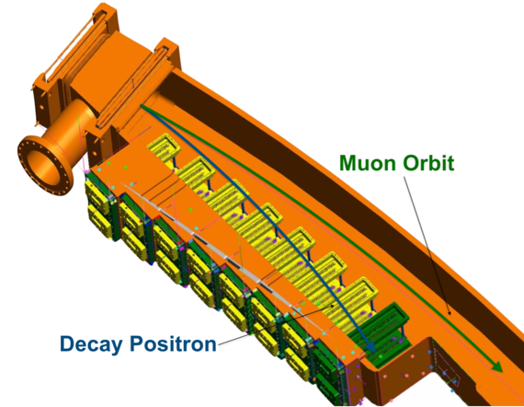
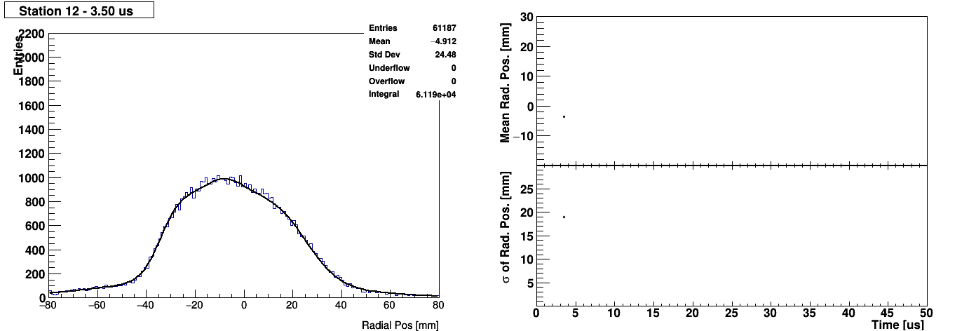
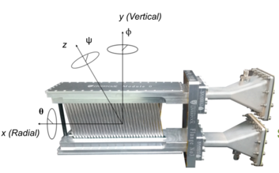
Trackers determine the complex breathing of the stored beam radially and vertically
Here, you see the radial coherent betatron oscillations:
The oscillation amplitude, frequency, and damping time enter the analysis of the precession frequency

Slide 9
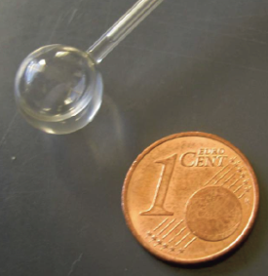
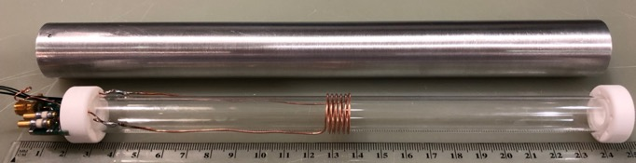
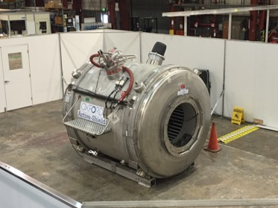
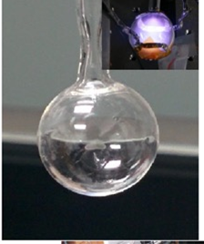
Absolute field calibration in great shape
Same BNL H₂O probe, also used in LANL muonium hyperfine compared to our new probes
We developed a new cylindrical plunging probe (smaller shape corrections)
We developed a new He-3 standard probe (smaller corrections)
We built a dedicate cross-calibration facility at ANL to make all tests under highly controlled conditions
TDR
ANL Test Facility
Cylindrical plunging probe
Developed He-3 as a new standard

Slide 10
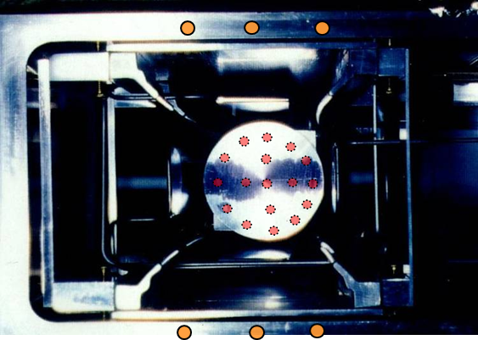
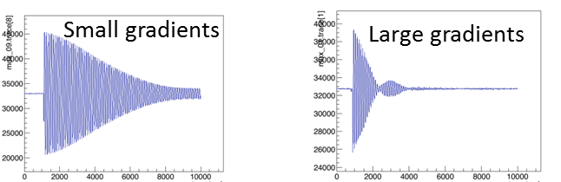
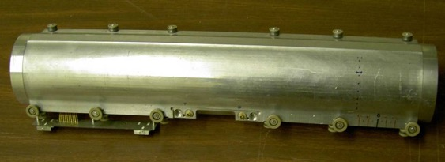
Monitoring the magnetic field with new fixed and Trolley probes
Fixed probes track field at top/bottom of vacuum chamber & monitor field 24/7
NMR trolley maps field where muons live every 2-3 days
All signals digitized and analyzed to precisely extract Field from free induction decay
TDR

Slide 11
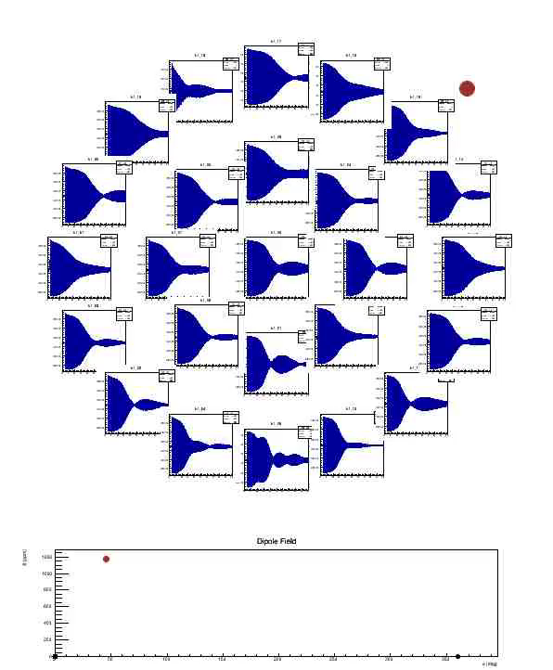
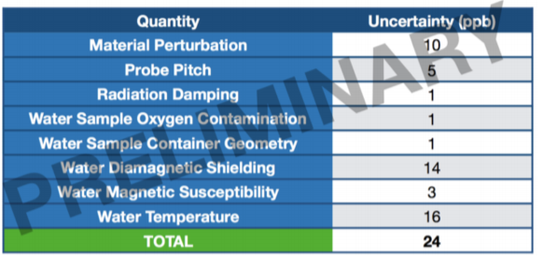
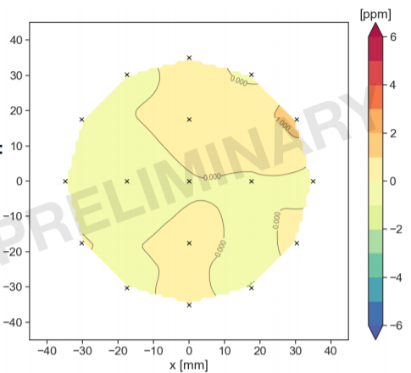
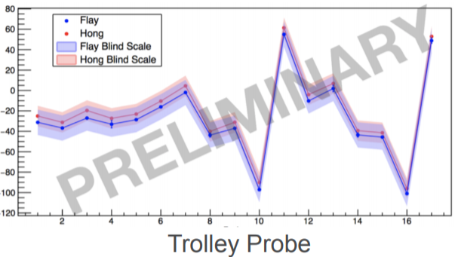
The Magnetic Field is measured using proton NMR
Free Induction Decay (FID) Waveforms, give typical precision of ~10 ppb per FID shot
The animation here is from an early stage, when a “shimming” trolley* was pulled around the ring with 25 probes on its nose. You can see the file gradients in the FID displays, and the average dipole below it.
Probe Matrix
Very uniform azimuthal average ~1 ppm in storage volume
*The in-vacuum Trolley maps the final field where the muons live. I just don’t have a movie of it!

Slide 12
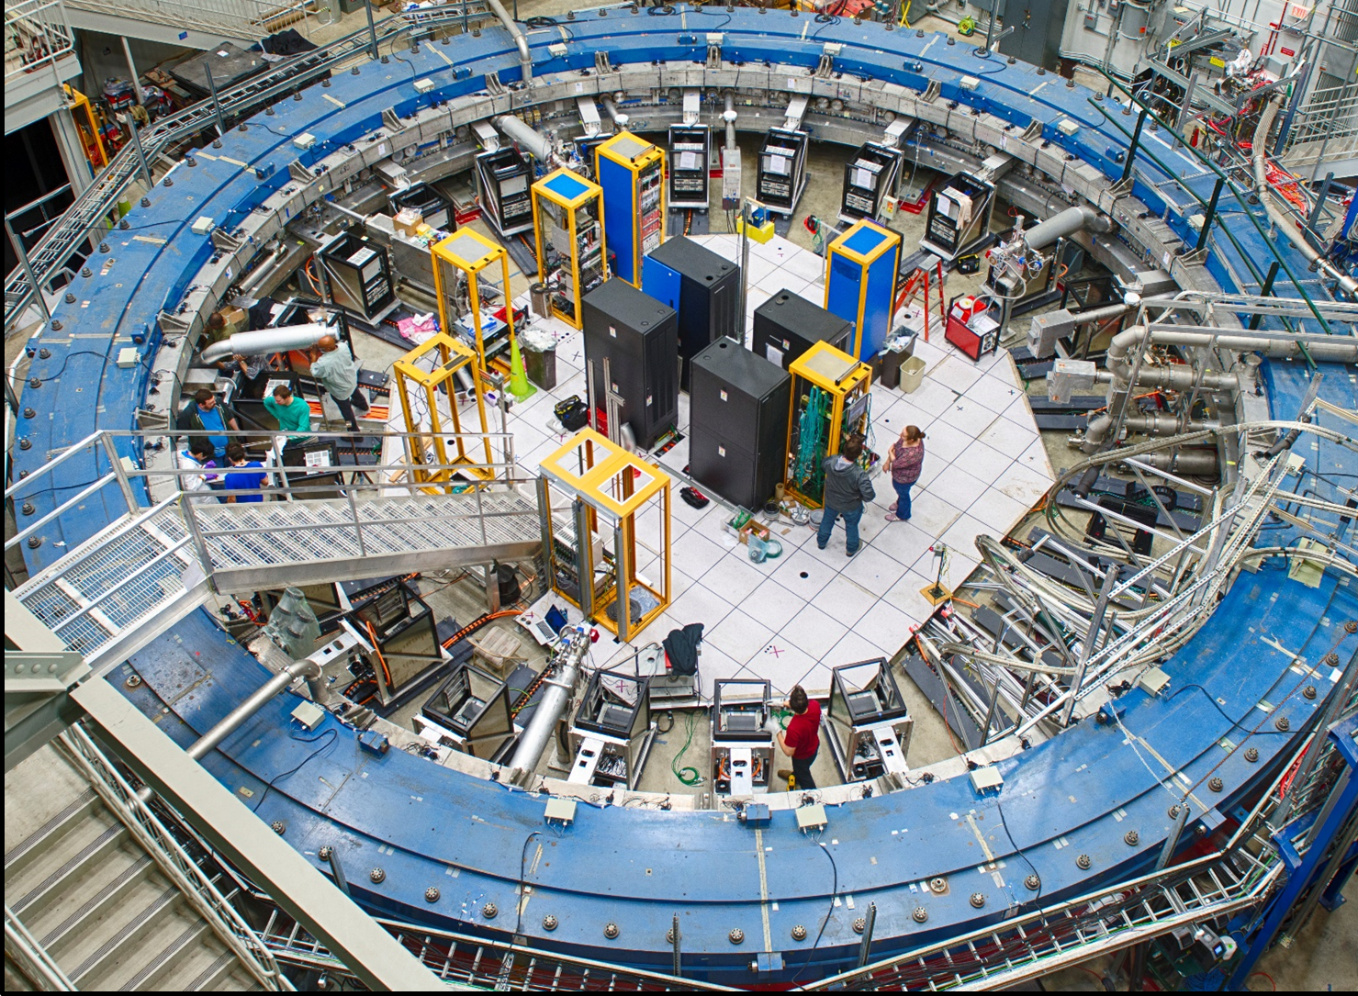
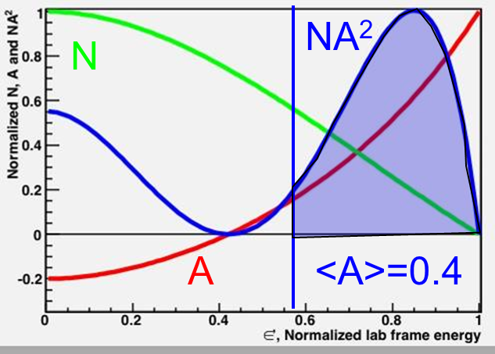
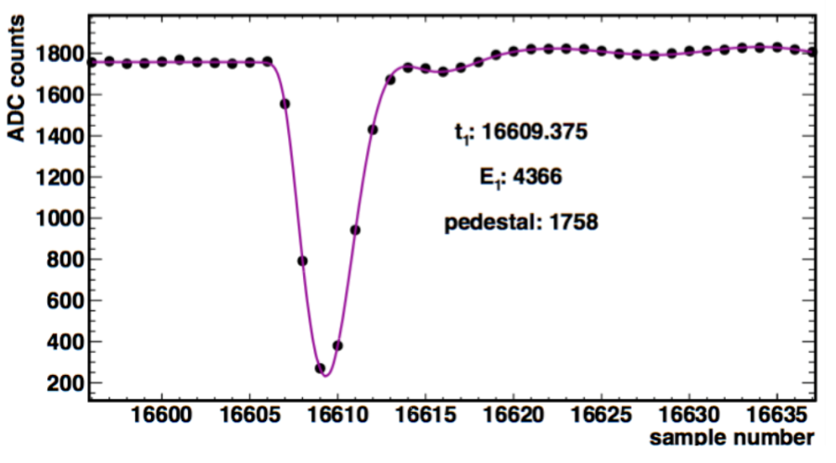
The precession frequency, ω_{a} is derived from a time histogram of high-energy e⁺ decay events
PbF₂ xtals
e⁺
Events above threshold
Software threshold
Systematic error total ω_{a} budget: [ 210 ppb → 70 ppb ]

Slide 13
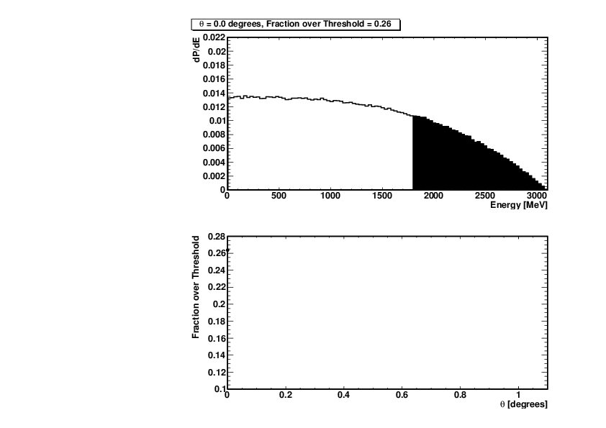
The precession frequency is the difference between the spin and cyclotron frequencies, encoded as an oscillation in the positron energy spectrum as seen by the calorimeters
Threshold Energy Cut
Energy in Calorimeters
Phase of Muon Spin

Slide 14
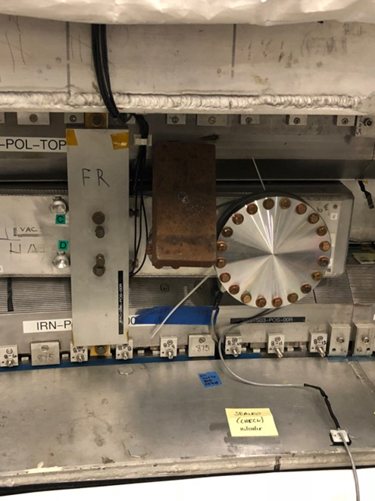
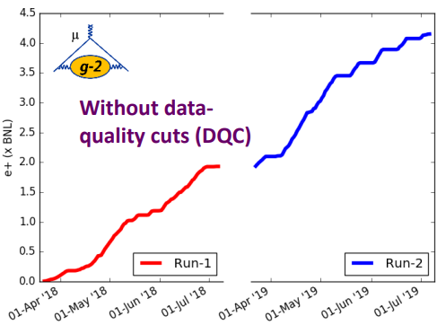
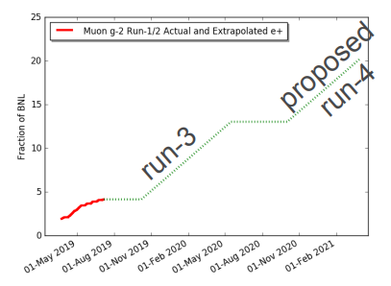
Run-1 and Run-2 data accumulation in BNL “units”
General remarks
Run 1 had a number of changing conditions as we optimized the data taking
  Some real challenges owing to that plus some hardware issues discovered after the run ended
Run 2 was stable, but started late (because of us). Greatly reduced running at end because of lab budget
Run 3 is planned to be a direct continuation of Run 2; no major changes
Run 4 is still far away …
Compared to BNL totals
“the brick”

Slide 15

We pushed hard toward Unblinding in Elba, but …

Slide 16

“All human plans [are] subject to ruthless revision by Nature …”
(We are entering a realm “beyond BNL E821” and carefully moving forward)
From our Elba Meeting
*Arthur C. Clarke, 2010: Odyssey Two

Slide 17


We are confident we will get it right because …
1) We built incredible Instrumentation that works
To measure the incoming and stored muon distribution
T0
IBMS 1,2,3
Fiber Harps
Straw Trackers
To measure the magnetic field
Absolute water and He-3 probes
Absolute Plunging probe
Trolley probes
Fixed probes
Flux-gate monitors
To measure the muon precession frequency
Electromagnetic calorimeters
Waveform digitizers
Clock and Control system
Laser calibration system
Fast DAQ

Slide 18
2) We developed a multi-team, analysis structure to build in independent checks
2018/19 Data
a_{μ}(Expt)
~
Q Data (integrated method)
Q Fit (UKy)
Fit method
(team name)
TDR
ω_{a}
T,A,E (UW)
Recon West
T,E (Cornell)
T (STFC)
ω_{p}
⊗
Muon
Dist
Recon East
T,A (Europa)
R (BU)
Team B
Tracker
+ Dedicated systematic teams for Muon Loss, Pitch, E-Field, and other beam dynamics
Team P
Fast Rotation
Calib

Slide 19
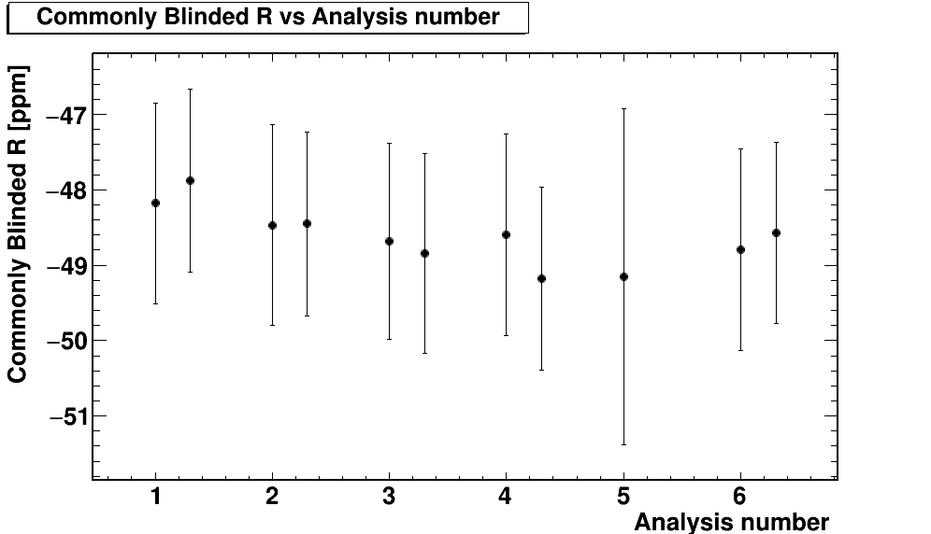
Examples of many positives intermediate results.
(no chance for me to do this list justice… I would need hours)
Relative unblinding of 60 H data set confirmed 6 precession analyses consistent
  3 Reconstruction methods
  New Pileup techniques
  CBO function accounts for beam motions
  Gain Corrections on Long-term (days), Mid-term (in a fill), and Short-term (2 close pulses) time scales
  Muon loss vs time cleanly extracted*
Absolute magnetic field calibration accurate
Relative unblinding of Field Tracking of 60+ H sample finds good agreement and led to better understanding of field tracking between Trolley runs
Muon momentum distribution – while not ideally centered – is very well determined by several independent methods.
  This leads to accurate and precise E-field corrections.
  Significant systematic error checking on this correction has taken place so in very good shape
6 different precession analyzers
*but we will return to this subject

Slide 20

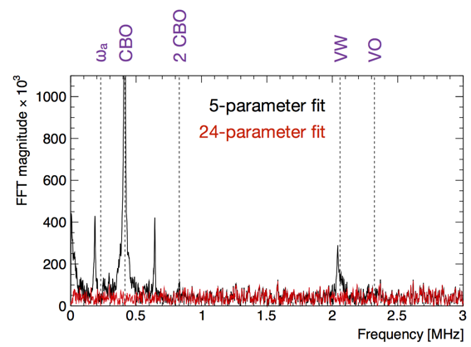
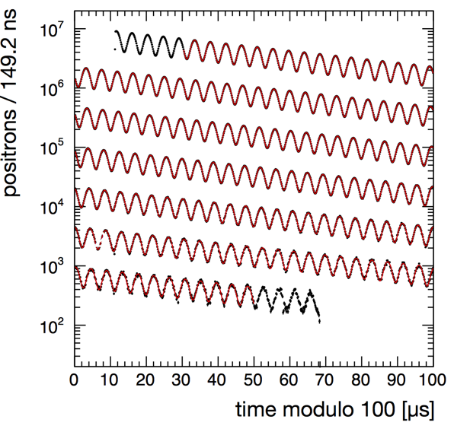
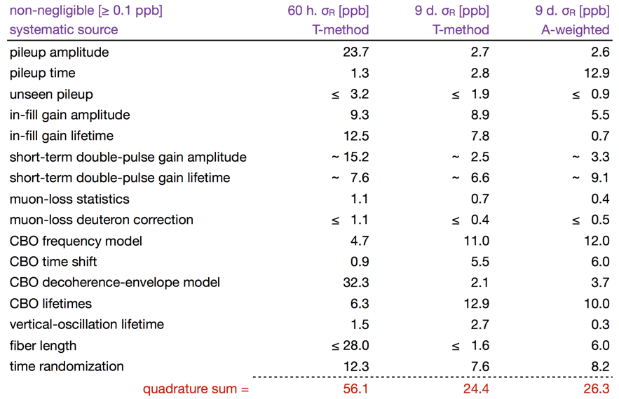
An example of just one of the Precession Analyses intermediate reports
TDR
Preliminary
Preliminary
“Wiggle” Plot + Fit
With correct function, the residuals are flat (as they must be) and theχ² is good and fit results are stable
An insane amount of checking of any biases is taking place.. This is just showing; net ~25-35x lower than statistical here! (but not all listed)

Slide 21
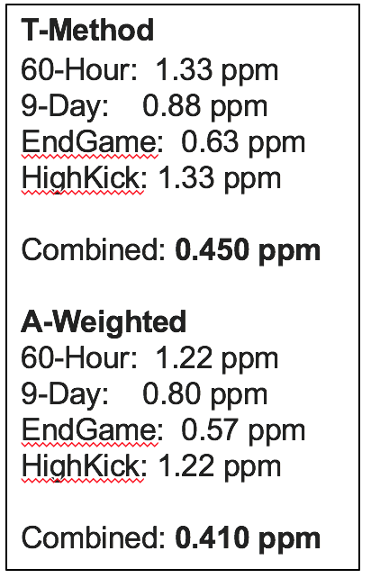
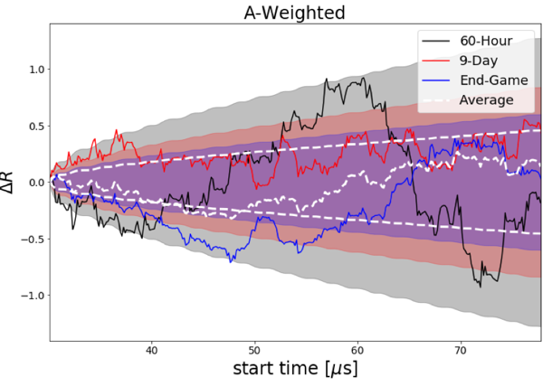
And, one example of a typical consistency test
The result (in blinded ppm) vs time of fit start for 3 data sets
Preliminary
410 ppb is probably the best we can achieve out of the Run-1 Statistical data set (does not include systematics)
Bands show 1σ
allowed difference (set-subset)

Slide 22
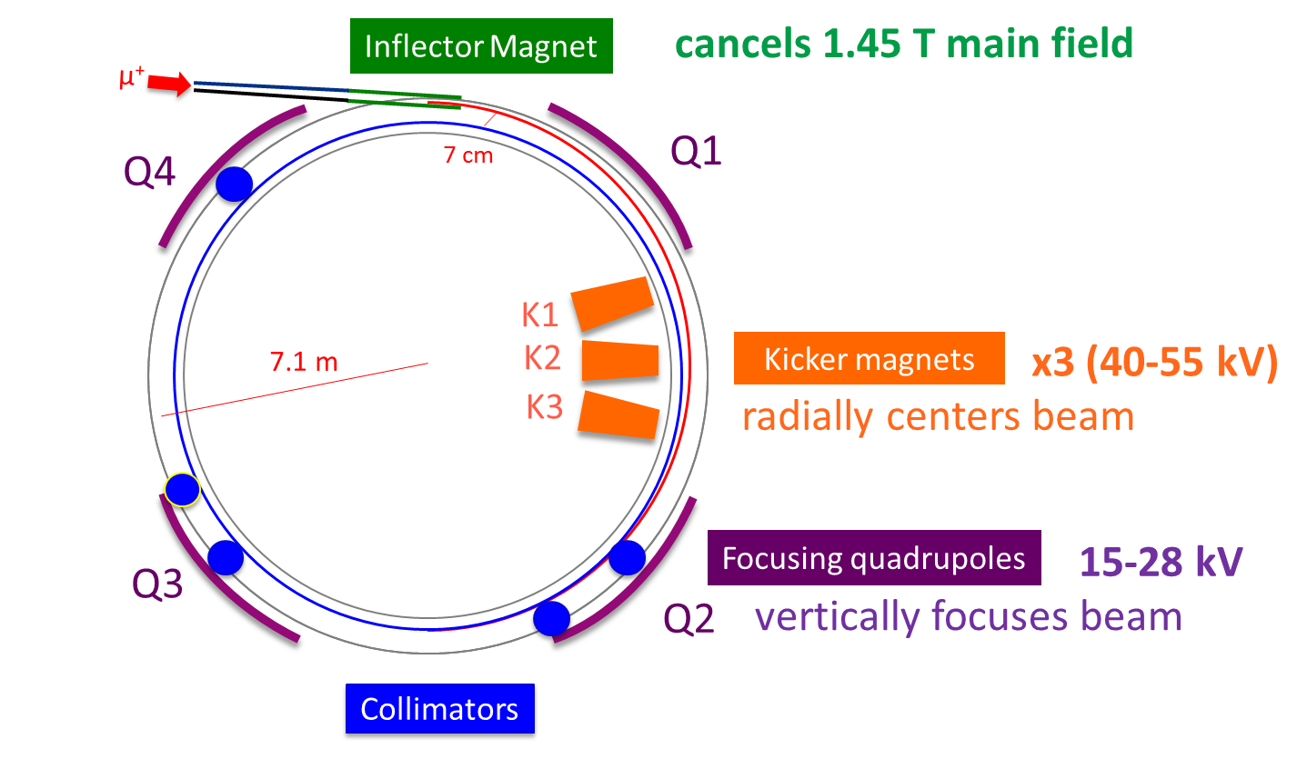
3) There are also challenges:
Reminder of Injection and storage components because that’s where we are not yet optimized
We would like to put in new Open Ended next summer to increase the Rate by 30%
We continue to improve this challenging system to increase Kick
Working on increasing max Voltages and adding Novel RF system for scraping and CBO reduction

Slide 23
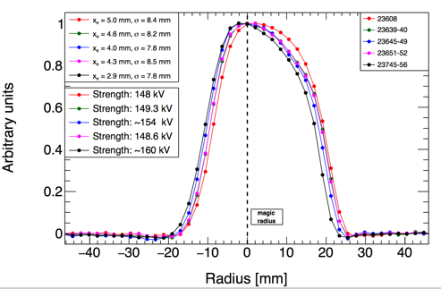

The (magnetic) Kicker needs to create a ~11 mrad deflection of the incoming beam on the first turn, and then “get out of the way” before the beam returns. This is an engineering challenge that was never fully realized for BNL … and not yet for us.
If the kicker voltage is set too high, current-carrying cables can burn so we had to back off a bit to avoid that.
These are distributions of the beam in the ±45 mm radial coordinate. It’s well contained, but not quite centered. The colors represent different kick strengths
Important takeaway for now. We can live with this. We just don’t like it

Slide 24

During Run-1, 2 of 32 HV resistors on the Quad plates were flawed.
This meant they did not stabilize prior to “fit start time” and thus …
Vertical Muon distribution mean moves down by 0.6 mm
  We are investigating its impact on ω_{a} extraction
Muon Loss fraction ~10x greater than Run 2
  This can cause a “phase shift” if the lost muons have a different average phase compared to the non-lost muons.
Start of Fit
EXAMPLE of how we approach determining the Muon Loss impact
Determined Momentum-Phase correlation in Stored Muon distribution from Simulation AND directly by a special measurement where we exaggerated the effect significantly. This is known well.
Determined Muon Loss Fraction in context of Precession fits. This is known well.
Determining correlation between Lost muons and their momentum. In progress.
  We made a special systematic run to bias the momentum distributions high and low to test ML rate
  Multiple beam storage simulation programs being tuned to study lost muon event momenta
In the end, we take the most conservative information to estimate the systematic.
Red and blue Quad plates charged up too slowly …
(Remember, this was a Run-1 problem only. These resistors were replaced before Run-2

Slide 25

So, where are we now …
Run-1
  Completing production of last ω_{a} data set
  Finishing Field analyses
  Several Beam Dynamics Task Forces working on the selected systematics.
  Making a few magnetic field measurements that can only be done without beam (eddy currents, etc)
Run-2
  Production and analysis to begin very soon.
  Teams assembled
Next Collaboration meeting is mid November
MEANWHILE: RUN-3 Starts in October !!!

Slide 26

Conclusions
E989 is in the thick of simultaneous Analysis / Hardware Tweaking / Running.
  We are busy!!!
People are working hard to get out a much-anticipated result, still in 2019.
  BUT !!! We cannot afford to rush it so we are making lots and lots of checks.
As we go “beyond BNL” we are learning a lot.
Thanks
ω_{a}
BD
ω_{p}

Slide 27








USA
  Boston
  Cornell
  Illinois
  James Madison
  Kentucky
  Massachusetts
  Michigan
  Michigan State
  Mississippi
  North Central
  Northern Illinois
  Regis
  Virginia
  Washington
USA National Labs
  Argonne
  Brookhaven
  Fermilab
China
  Shanghai Jiao Tong
Germany
  Dresden
Italy
  Frascati
  Molise
  Naples
  Pisa
  Roma Tor Vergata
  Trieste
  Udine
Korea
  CAPP/ISB
  KAIST
Russia
  Budker/Novosibirsk
  JINR Dubna
United Kingdom
  Lancaster/Cockcroft
  Liverpool
  Manchester
  University College London

Slide 28
Extras

Slide 29

The off-momentum muon spins are slightly affected by the radial E field
β x E and “γ” terms signs both flip depending on momentum
No cancellation
All off-momentum muons reduce effective a_{μ}
Low Momentum
γ < γ_{m}
High Momentum
γ > γ_{m}
Magic Momentum
γ ≡ γ_{m}
~0.5 ppm effect, net

Slide 30
The “pitch” correction owing to vertical betatron oscillations
(great exaggeration)
Pitch effect reduces the magnitude of ω_{a}
~0.25 ppm effect, net

Slide 31
Overview of ω_{p} Measurement
Pole Piece
ω_{s}
B
ω_{p}
ω_{p’}
B
B
Protons in
Trolley Probes
μ_{muon}
μ_{proton}
μ_{proton in} _{H2O}
Fixed Probes
Pole Piece
Want to measure B field in terms of free proton precession frequency ω_{p} while muons stored
Dave Kawall

