Slide 1
RFD crab cavity multipoles study
Carrasco Álvarez Álvaro Adrián
Paolo Berrutti
Final Presentation
29/08/2019

Slide 2
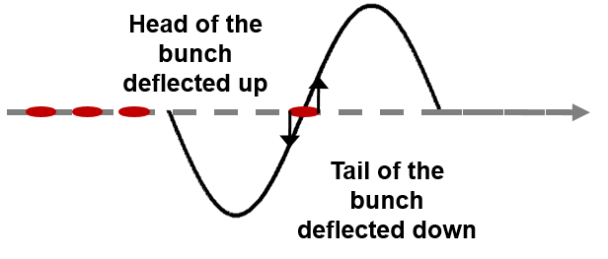
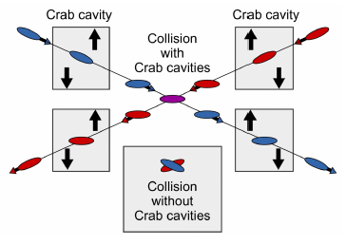
Crab Cavities
Non accelerating cavities
Rotate the bunch of particles
Purpose
Maximize the cross section at the interaction point
Increase the luminosity of the accelerator
Number of collisions constant in time

Slide 3
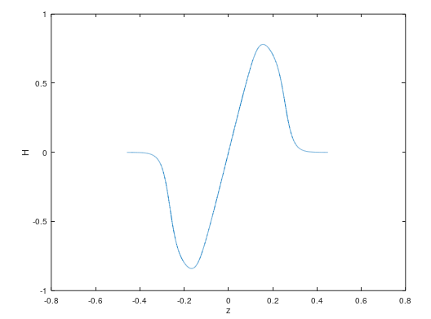
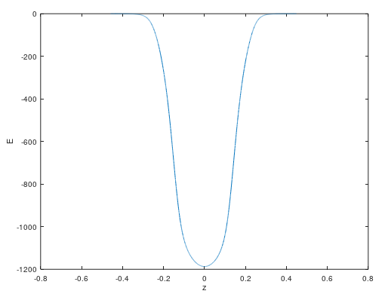
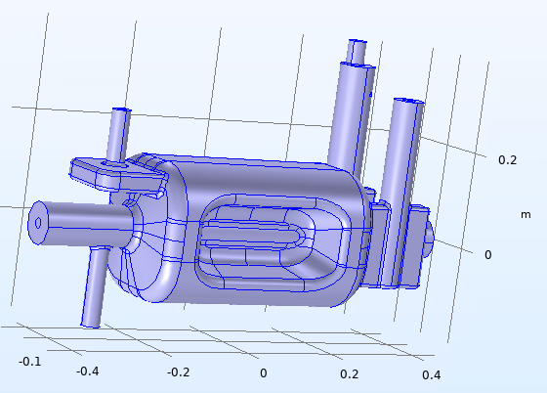
Crab Cavities
Magnetic Field
Electric Field
Simulate different quantities
Electric field
Magnetic field
Calculations with simulated fields
Momentum gain
Accelerating Voltage
Optimum Beta (particle velocity)
Bead-pull Field

Slide 4
Bead-Pulling
Slaters Small perturbation theorem
Sphere or Needle as the perturbing object
Bead

Slide 5
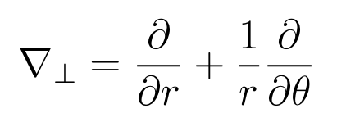
Simulations: Radial Kick
Methods
Lorentz force integration
Panofsky Wenzel theorem

Slide 6
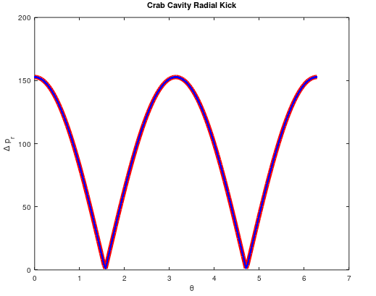
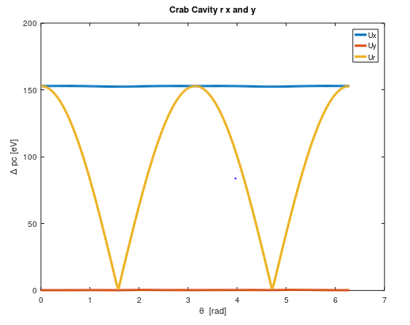
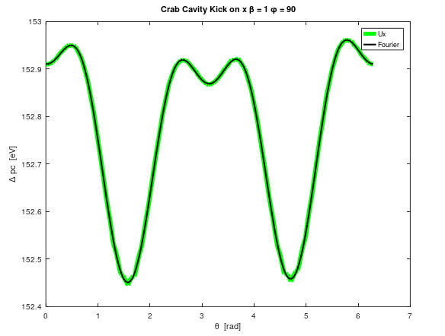
Simulations: Radial Kick
Equivalent methods to calculate the radial kick
The main contribution is the x component
8/28/2019

Slide 7
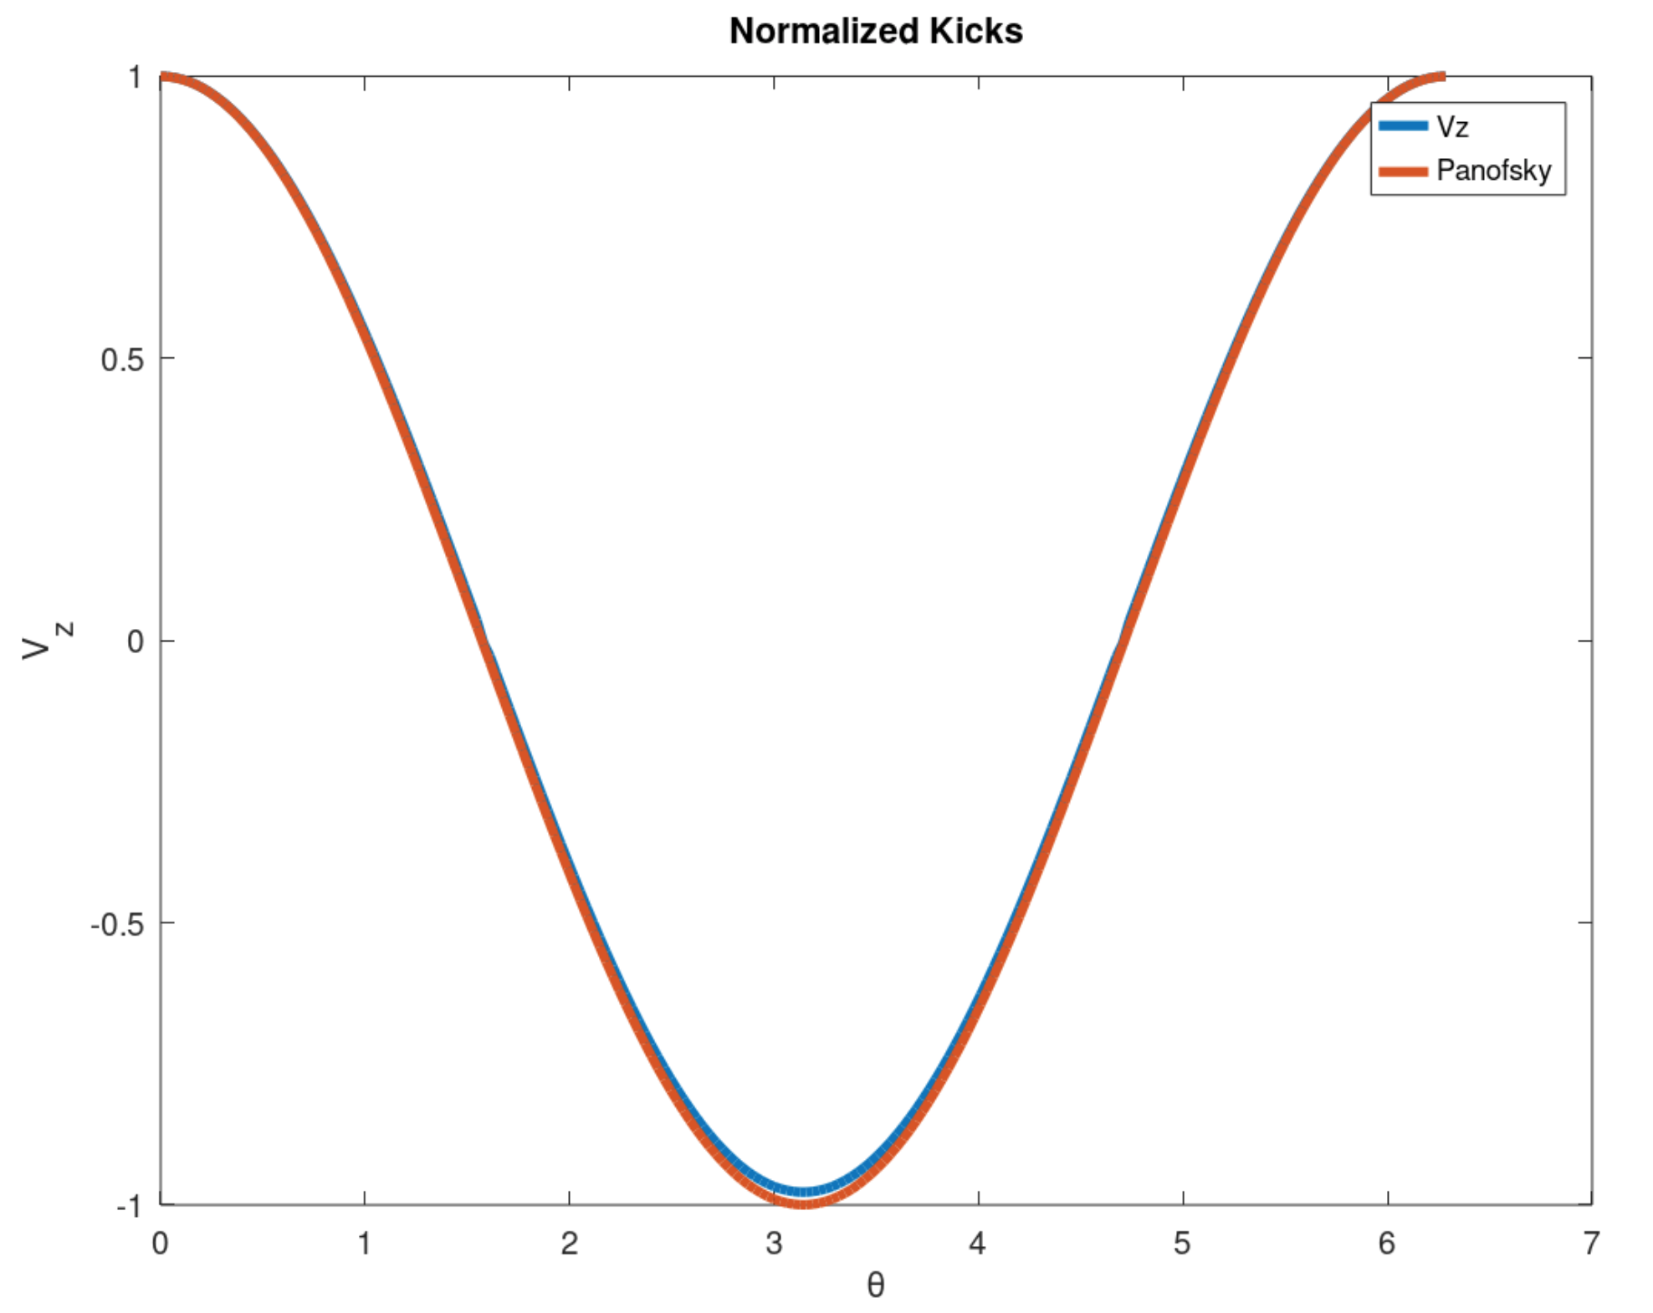
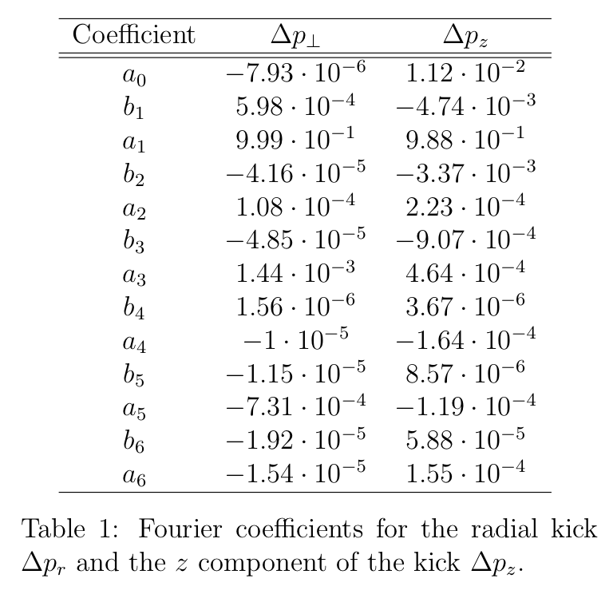
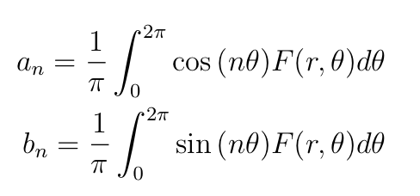
Simulations: Radial Kick
Different approach
Radial and z components have similar behavior
Similar multipole components
Related by an scaling factor

Slide 8
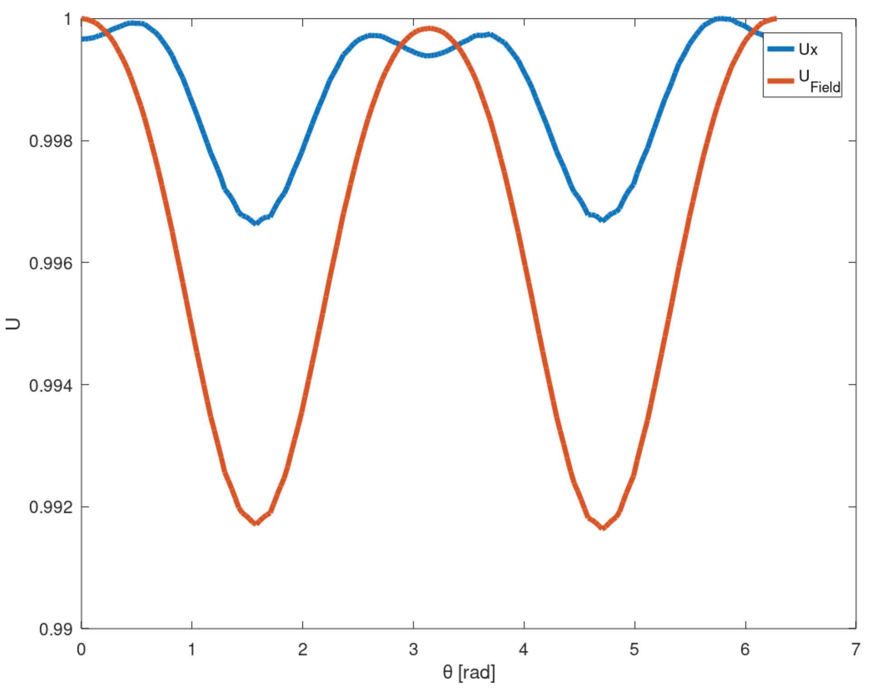
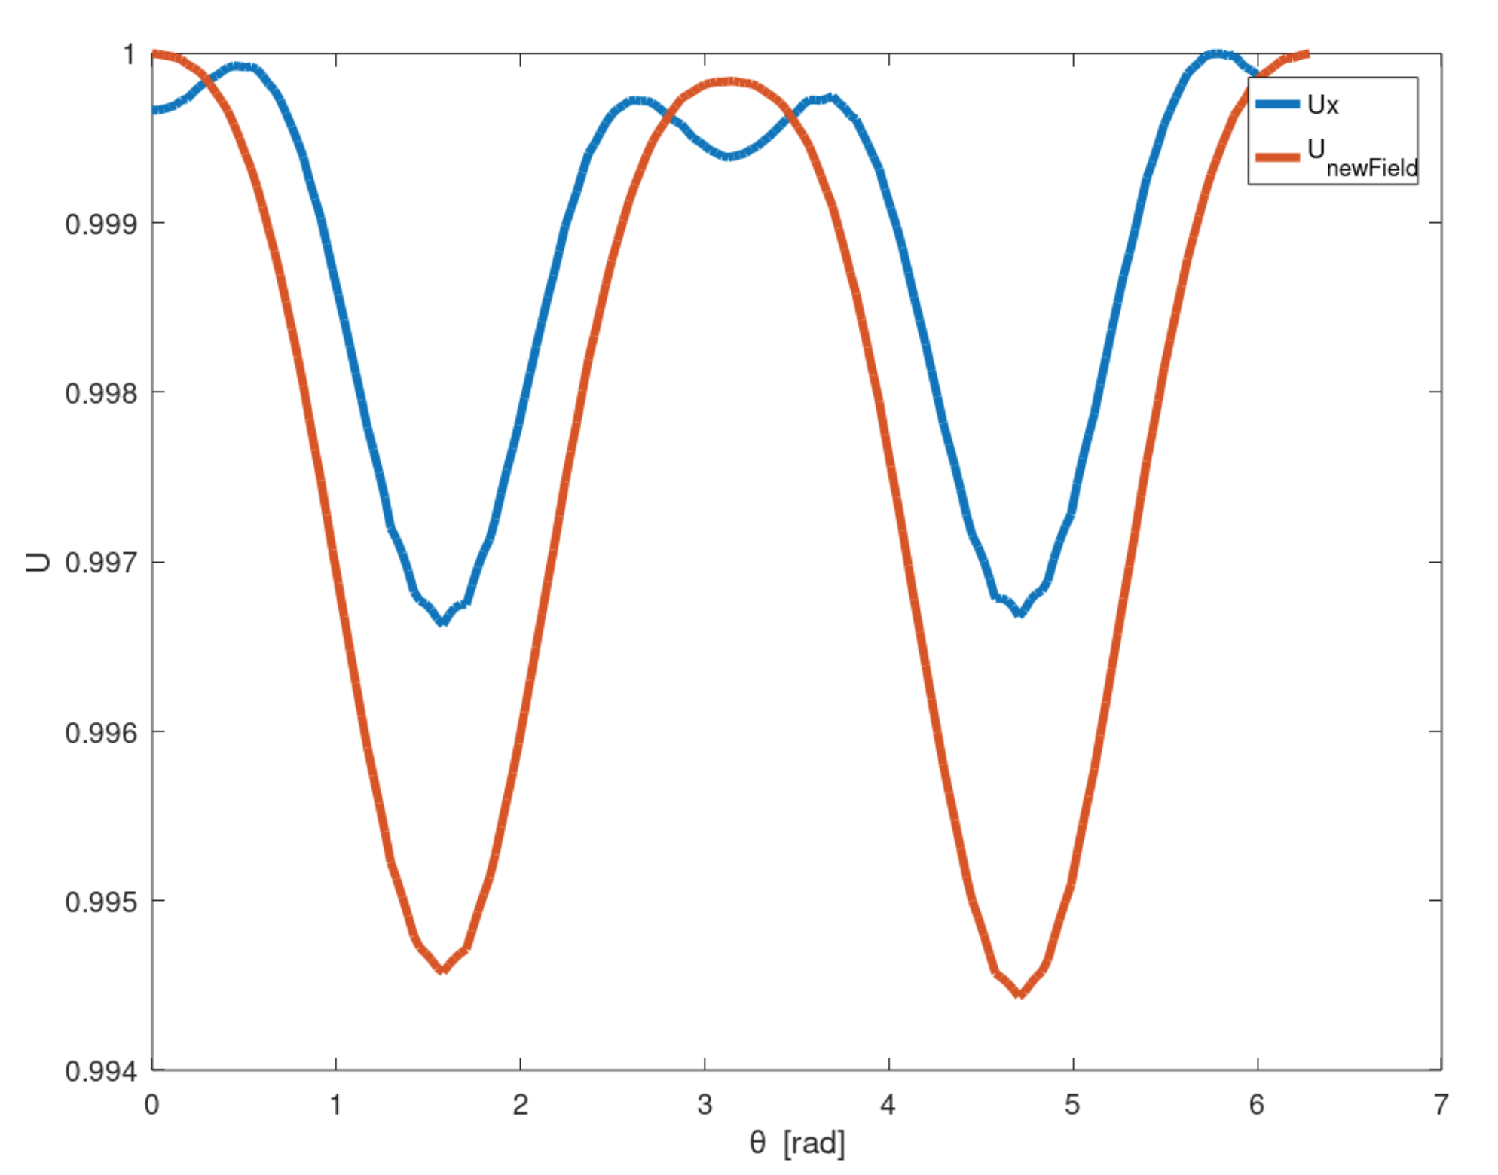
Simulations: Sphere or Needle for Measurements?
Sphere
Approximated energy and ‘kick’
Approximated energy with no magnetic interaction
Overestimates the energy

Slide 9
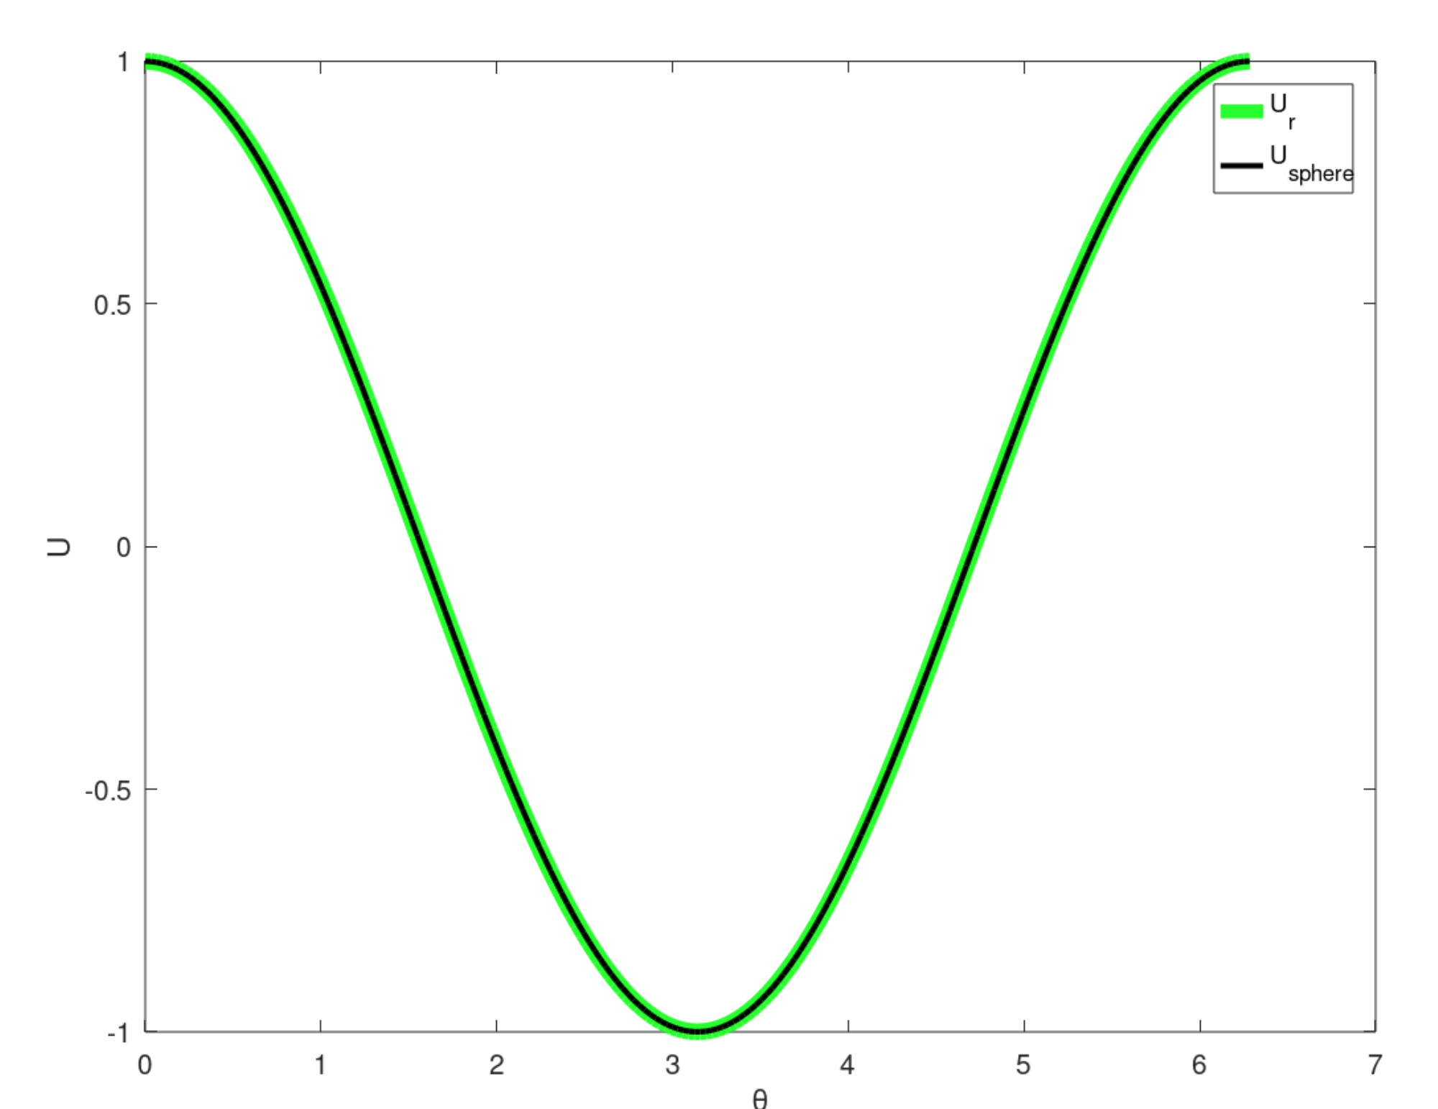
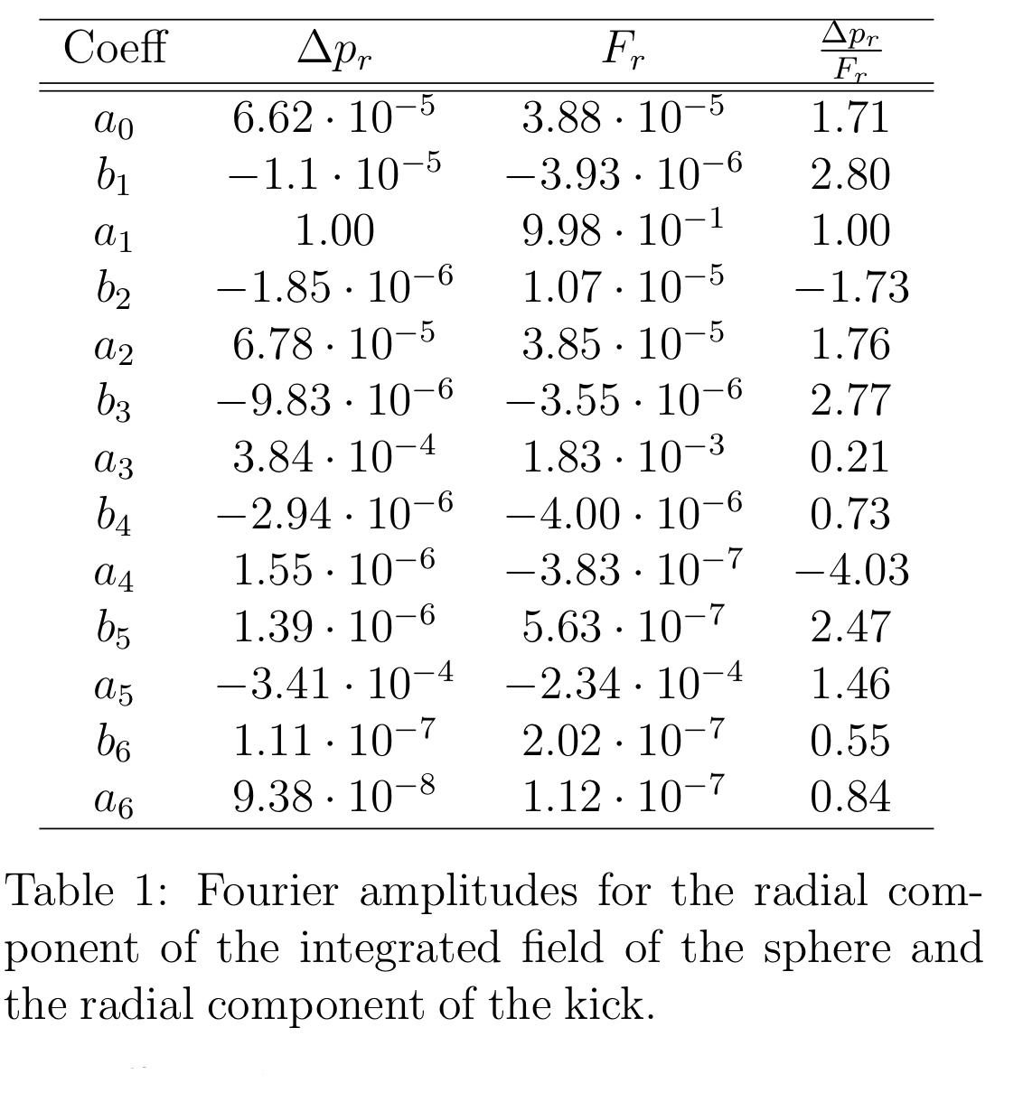
Simulations: Sphere or Needle for Measurements?
Compare radial components
They look very similar
But there are some diferences
Compare radial components
They look very similar
But there are some diferences
Coefficient ratio close but not equal to one. For the dipole it is.

Slide 10
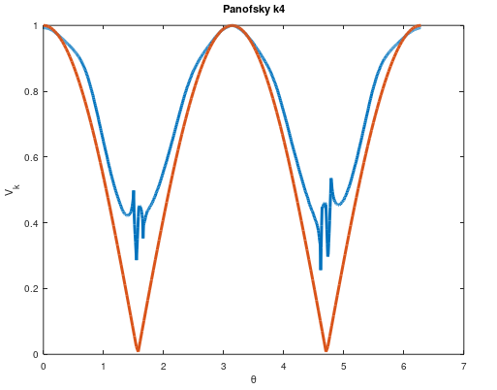
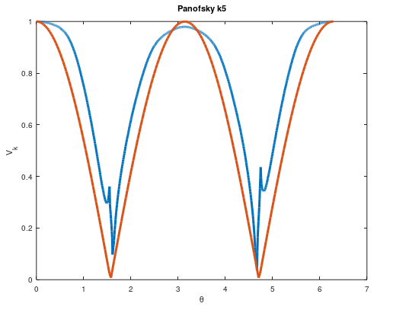
Simulations: Sphere or Needle for Measurements?
Needle
Approximated energy and ‘kick’
K parameter takes into account a small interaction with Ex
K= 0.01
K= 0.001

Slide 11
Conclusions
It is possible to measure the dipole Kick,radial kick and multipole components without Lorentz or Panofsky integrals, but not with a high precision
The main component of the Kick is the X one, it varies a little bit with the angle but it shows an almost constant behavior.
Bead-pulling the RFD cavity with a sphere would give the x component of the field which is almost constant→ good way to calculate the dipole kick higher multipoles amplitudes are complicated to assess.
If we measure with the needle we measure mainly the z component of the electric field→ integrating E_{z} is a simple way of getting the dipole amplitude, higher multipoles still difficult to assess.

Slide 12
Thank you for your time
Ask questions if any

Slide 13
Radial and z Kick

Slide 14
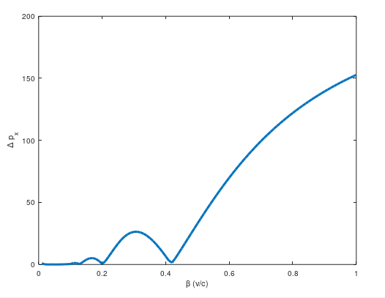
Optimum Beta
Maximize:

Slide 15
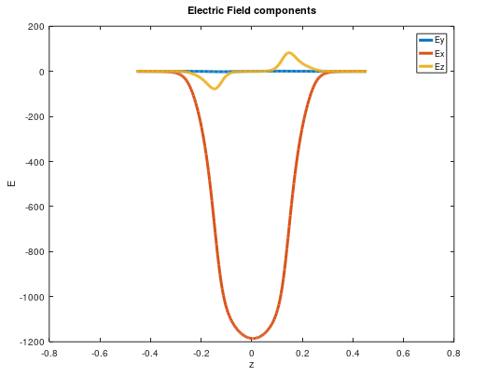
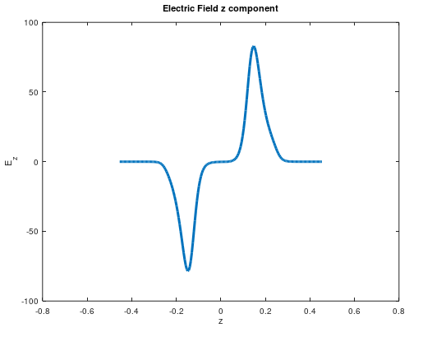
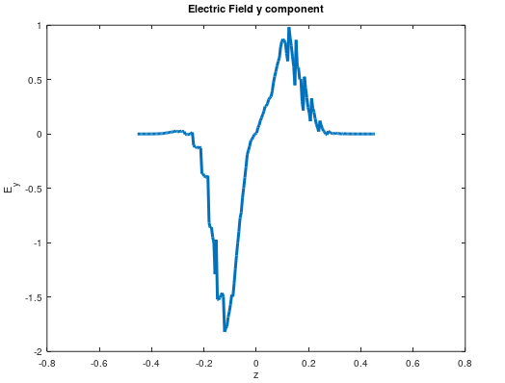
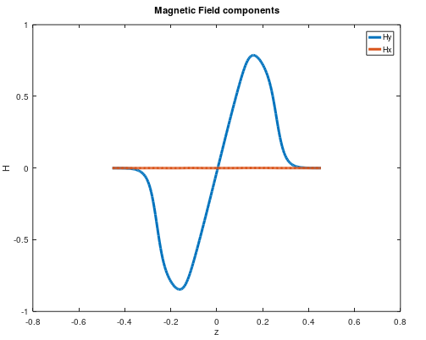
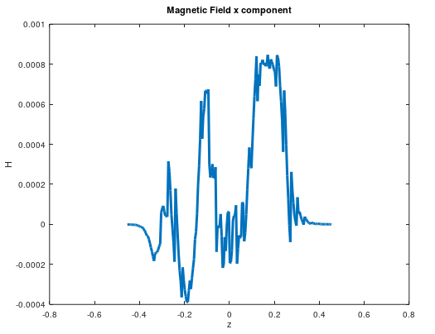
Electric and Magnetic Fields

Slide 16
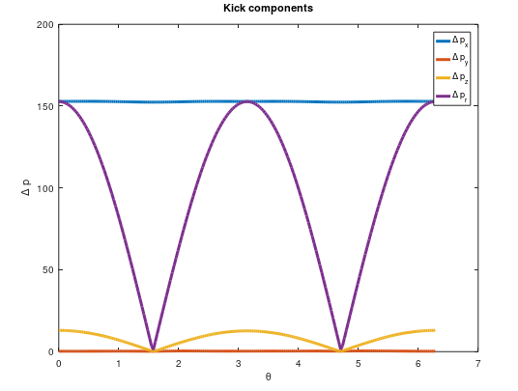
Kick components

