Slide 1
Improving Beam Tomography With Deep Neural Networks and Machine Learning
Waltteri Leinonen Supervisor: Kyle Hazelwood
Helen Edwards Final Presentation
29.8.2019
Notes:
My talk today will cover the learning aspects of my project:
I’ll describe what problem I’m trying to solve
How we intend to improve upon this technology with machine learning
Finally, I’ll give a view of what we’ve achieved so far, and what challenges still lay ahead.
Overview:
Introduction of the problem (and the problem with TaRDIS, the current tool)
The proposed solution (convolutional neural networks – show some history)
The research process (explain how BLonD made training data, and design of network)
Hurdles
The C3PO architecture (show some GIFs and network architecture, explain the features)
Future research (new training data, new architectures, new techniques - ”transfer learning”)

Slide 2
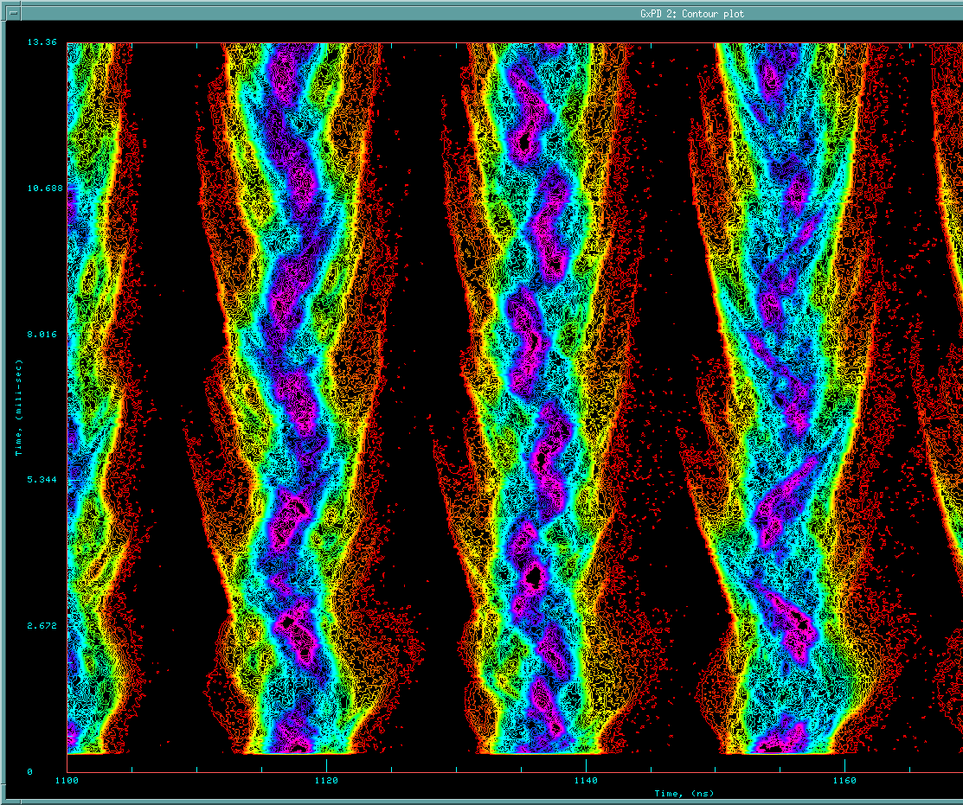
TaRDIS
Longitudinal charge profiles after RR injection
Tomography and Related Diagnostics In Synchrotrons
Tool made in 2014 by Duncan Scott
An application that uses tomography to reconstruct longitudinal phase space distributions from longitudinal charge profiles, provided by RWCM (resistive wall current monitors)
Works slowly, and requires input from the user.
Essential task is to map RWCM data to a phase-space interpretation.
TaRDIS phase space reconstruction
Notes:
Talk about TARDIS
It was made to use the RWCM data and reconstruct phase-space from tomography algorithm
Slow
Not general
Not proven
This image is a longitudinal charge profile taken by the RWCM. It measures the charge profile after an offset interval of some tens of nanoseconds after a TCLOCK event, capturing the bunches as they pass the same location.
Both axes are in units of time, but you can multiply the bottom axis with the beam velocity to get a displacement in space. Each row of pixels going upward represents a snapshot of the beam charge profile after many many rotations around the Recycler ring.
TARDIS is a tool written by Duncan Scott in 2014. It works by taking the same data that this image captures, preprocessing it, and performing tomography to recreate a phase-space reconstruction.
This problem with TARDIS is that:
It works very slowly, as it is very methodical and programmatic
The algorithm doesn’t work in all cases, and is sometimes inaccurate
The algorithm was made by someone who had an intuition with how Booster/MI/RR worked, and isn’t a generalizable methodology that can easily port over to other accelerators.

Slide 3
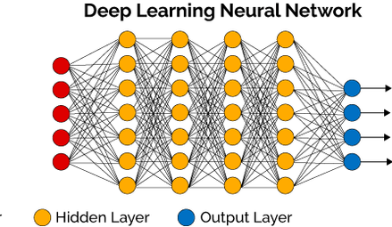
The Problem & Progress
Above: TaRDIS reconstruction of longitudinal charge profiles
Left: charge profile data of two bunches
Below: matching bunch
Above: BLonD phase-space reconstruction
Below: Predicted output from one of our promising network designs
Notes:
TARDIS works by taking the data, zooming in on one bunch and analyzing a half of a synchrotron oscillation.
We can do that same thing with the same data, and try another method of constructing the phase-space diagram. Deep Learning Neural Networks.
My supervisor recognized that a neural network would be invaluable in this context, and created a working prototype using a basic NN that he trained using simulated and experimental data. Even with a basic Perceptron, he was able to reconstruct a somewhat blocky phase-space diagram in Java.
I’ll be mainly using Python with Tensorflow, Keras, and perhaps in conjunction with Scikit-Learn to train a NN with at least 1 or 2 hidden layers, as we need the added nonlinearity to work with this problem

Slide 4
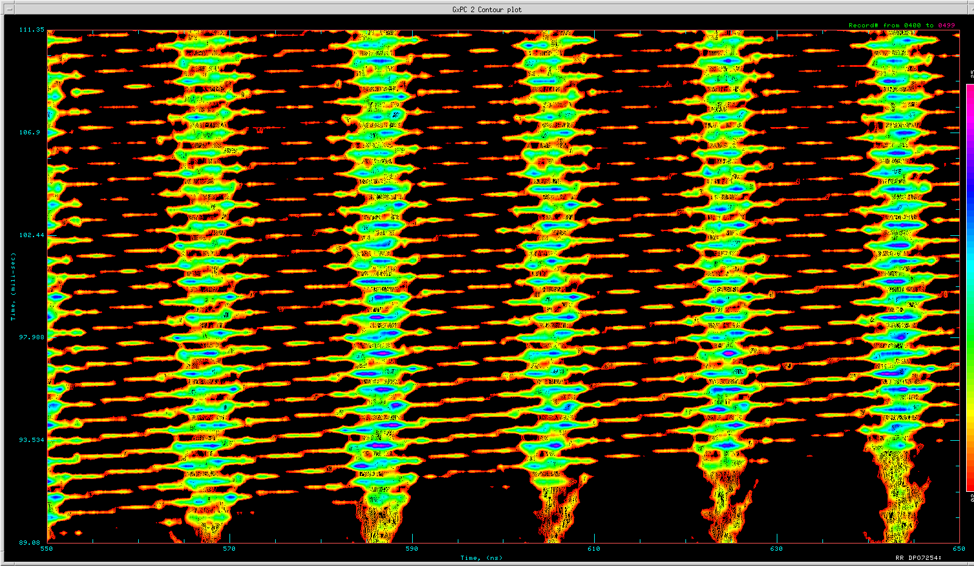
Deep Neural Network Goals
The end goal is to create a generalized neural network model (unique to Recycler) that is:
Accurate enough to diagnose Recycler issues
Fast enough to do this in almost real-time
Capable of more than simple cases
Need More Training Data!!
NN
Pssst… Your bunch rotation is off…
Slip stacking in Recycler
Notes:
The end goal is to create a generalized NN, which means that we will train a model that can be plugged into any other program that will be able to accurately predict the phase-space representation of any number scenarios.
Some challenges that still lay ahead:
Creating enough training data to train our NN
Implementing the NN such that it is generalizable
Making a model that can recognize multiple bunches or singular bunches
Making a model that can work in cases with slip-stacking (TARDIS is not able to do this!!!)
We already took multiple GB of test data from Recycler before they powered off last weekend, and are working now to create many different scenarios with BLonD simulation code. Once the training data is in the proper format, the implementation of the NN and training thereof will come next. Finally testing will use the data we collected to test whether it works or not!
No matter what the accuracy, this is an accurate short-cut to the same end result that TARDIS take us to, but potentially generalizable to multiple different scenarios!

Slide 5
Convolutional Neural Networks
Commonly used on image data for image classification or object recognition tasks
Translationally invariant pattern learning
Locally connected pattern learning
Orders of magnitude decrease in number of nodes/weights
Simple to implement and test in Tensorflow and Keras
https://towardsdatascience.com/a-comprehensive-guide-to-convolutional-neural-networks-the-eli5-way-3bd2b1164a53

Slide 6
Convolutional Neural Networks
CNNs are neural networks containing at least 1 convolutional layer.
They apply a discrete convolution matrix multiplication of multiple small filters across all channels of an image, producing 1 feature map per filter.
The network trains (improves) the weights of the filters.
Above: A cartoon convolutional layer, showing one filter’s receptive field on the left, and the corresponding point in the filter’s corresponding feature map.

Slide 7
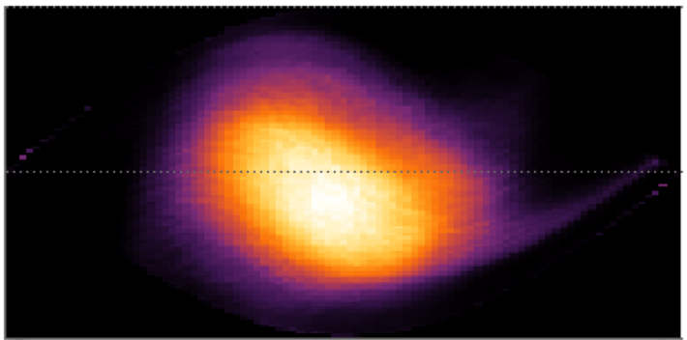
C3PO (Conv3 Predicted Output)

Slide 8
C4PO (Conv4 Predicted Output) (Unfortunately better)

Slide 9
Research Process
Good training data
Bad data can cause training confusion
We want data that would be common to see
Network Design
Architecture that has large enough representational capacity
Otherwise it would never be able to make the correct output
But small enough so it doesn’t immediately overfit
Manifests itself in a Fully Convolution Network as negligibly different output
Training to a sufficient accuracy (low MSE)
Validation and Testing
Remains to be done, requires further research before it is possible.

Slide 10
Research Process: Acquiring Training Data
VS.
A crucial step was in collecting good, clearly labeled, training data. This was done using the CERN package BLonD.

Slide 11
Research Process: Network Design
Next, many architectures were designed and tested.
Diagnosing the problems of each model led to honing in on an architecture that had sufficient representational capacity for the data set.

Slide 12
Research Process: Loss Curves
The training procedure lasts until the validation loss stops improving.
While designing, Early Stopping was used to stop training after 2 epochs of no improvement.
In practice, 10+ patience is used.
The Mean-Squared Error (MSE) loss function was the natural choice for the data.
Left: A loss curve showing the training and validation loss history for an early network architecture we trained.

Slide 13
Hurdles
The amount of training data requires batch training. Too big for memory.
Training networks with 10⁸+ trainable parameters crashed my computer.
Training 10⁸+ parameters on CPU takes 8-9 hours on average (finishing early was a sign that something was broken)
A working GPU only became available yesterday.
Unconventional network design requires further research of its own.

Slide 14
Challenges & Future Work
Create proper Booster output
New training data, including bunch rotation and tails
Test new techniques
Transfer Learning
Recurrent Neural Networks
Produce proper validation scores.
Test generality of networks on new simulations and on measured data.
This method directly outputs an image that corresponds to a predicted phase-space diagram – this has a probabilistic interpretation, but is difficult presently to show how well it performs given new data.

Slide 15
Thanks for everything
This internship was a great experience, and all of you helped make that experience great.

