Slide 1


Studying Qubit Interactions with Multimode Cavities Using QuTiP
Soumya Shreeram
Helen Edwards Summer Intern, Final presentation
29th August, 2019
Supervised by Yu-Chiu Chao with support from Eric Holland
Reporting to Alexander Romanenko

Slide 2
Project overview and goals achieved:
Introduction
Theory
I. Resonance Studies
II. Crossing and Stark Shift
Conclusions
Using QuTiP to simulate a 2 qubit and multiple cavity system
Spectroscopy of cavity-cavity and qubit-cavity interaction
Studying resonance in cavities
Dynamics of adiabatic traversing of a qubit-cavity system
Simulating the Stark Shift in a system

Slide 3
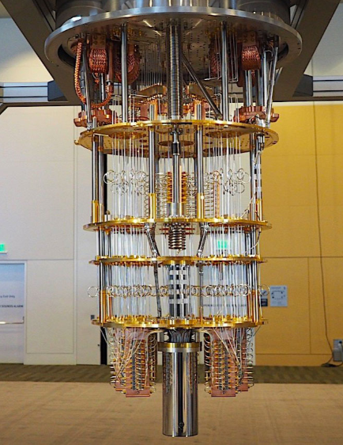
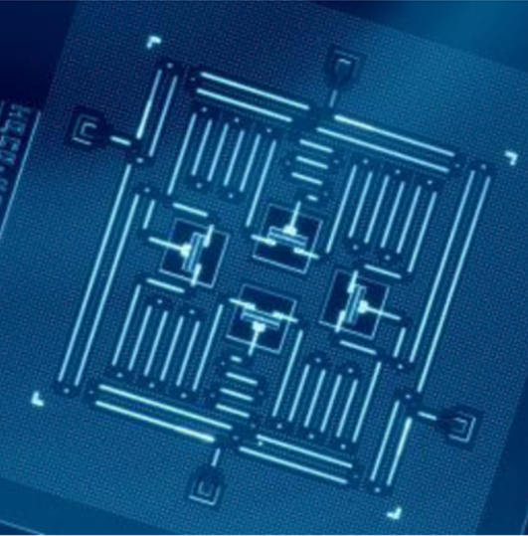
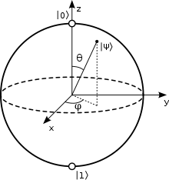
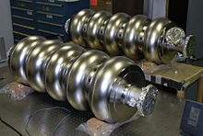

Quantum Computing
Introduction
Theory
I. Resonance Studies
II. Crossing and Stark Shift
Conclusions
Quantum computer: A machine that functions according to quantum mechanical laws
Motivation: tiny transistors used produce too much heat and tunnel (corrupts signal!)
N Qubits $→2^{N}$
Superconducting circuits
Limitations: coherence times due to spontaneous emissions, dephasing
Need for precise electronics (resonators) for controlling qubits: 3D microwave cavities
Notes:
Questions to address:
Joshepen Junction – transmon (a physical qubit can also be built from Atoms, Electrons and photons)
Observation tools depend on qubit: Ion trap, spin measurement, polarizing filters etc
Why build Quantum gates? Deterministic, reversible, can always find the output based on the input

Slide 4
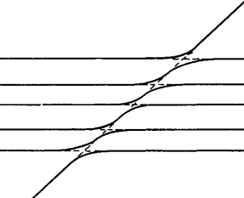

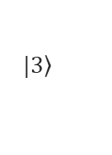



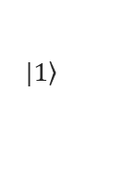

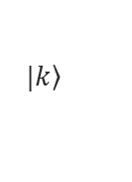
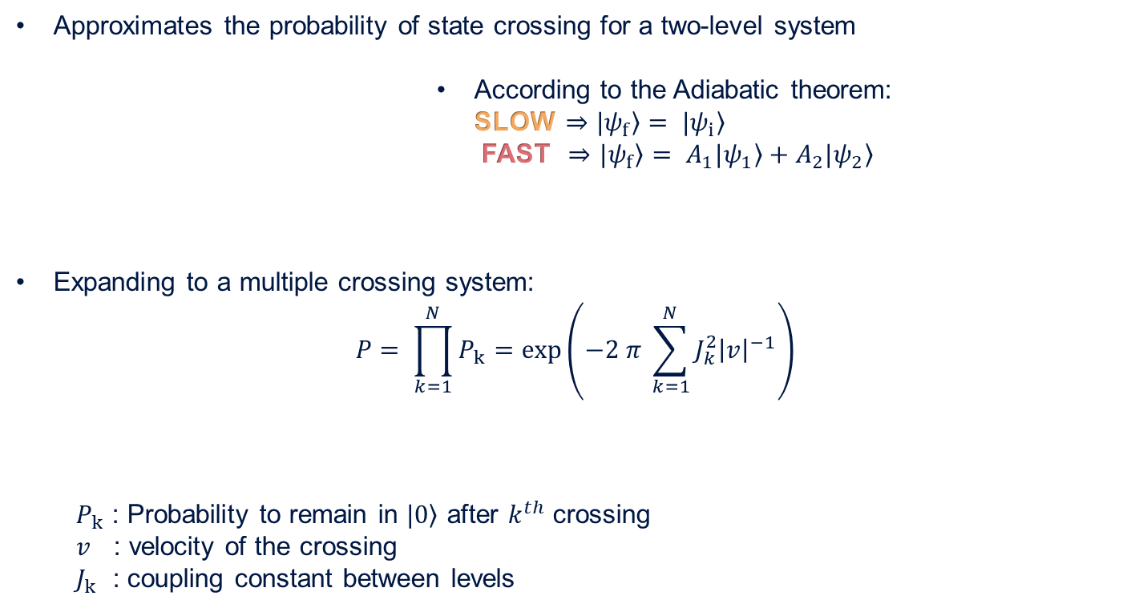

The Landau-Zener tunneling model
Introduction
Theory
I. Resonance Studies
II. Crossing and Stark Shift
Conclusions
Approximates the probability of state crossing for a two-level system
              According to the Adiabatic theorem:
              SLOW $⇒$ $\left.|ψ_{f}\right\rangle = \left.|ψ_{i}\right\rangle$
              FAST $⇒$ $\left.|ψ_{f}\right\rangle =$ $\left.A_{1}|ψ_{1}\right\rangle +A_{2}\left.|ψ_{2}\right\rangle$
Expanding to a multiple crossing system:
$$P= \prod_{k=1}^{N}{P_{k}=exp⁡\left(−2 π \sum_{k=1}^{N}{J_{k}^{2}{\left|v\right|}^{−1}}\right)}$$
$P_{k}$ : Probability to remain in $\left.|0\right\rangle$ after $k^{th}$ crossing
$v$ : velocity of the crossing
$J_{k}$ : coupling constant between levels
$$?$$
$$ψ_{2}, E_{2}$$
$$?$$
Adiabatic path
Diabatic path
$$ψ_{1}, E_{1}$$
$$\left.|k\right\rangle$$
….
$$\left.|3\right\rangle$$
Energy
$$\left.|2\right\rangle$$
$$\left.|1\right\rangle$$
$$\left.|0\right\rangle$$

Slide 5
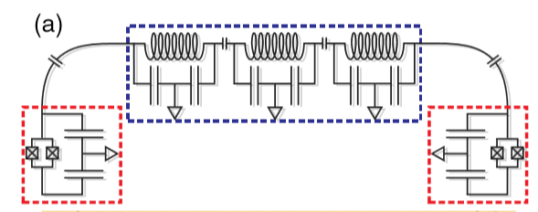
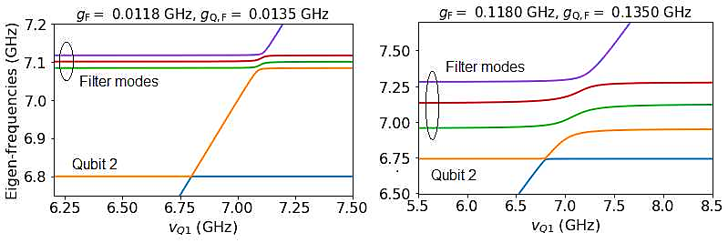



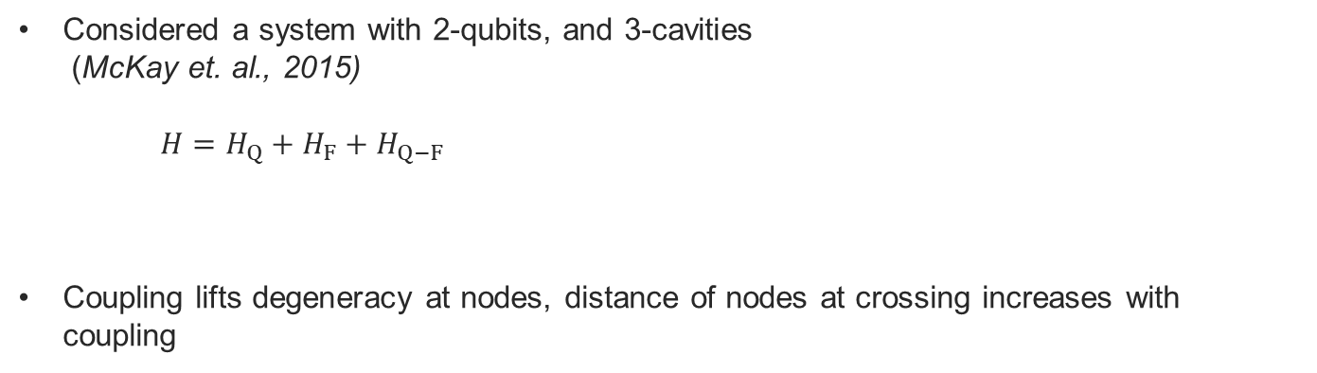
Energy splitting due to coupling
Introduction
Theory
I. Resonance Studies
II. Crossing and Stark Shift
Conclusions
Considered a system with 2-qubits, and 3-cavities
(McKay et. al., 2015)
$H=H_{Q}+H_{F}+H_{Q−F}$
Coupling lifts degeneracy at nodes, distance of nodes at crossing increases with coupling
$$∝g_{F}$$
$$∝g_{Q−F}$$
$←$ (Qubit 1 frequency) $→$

Slide 6
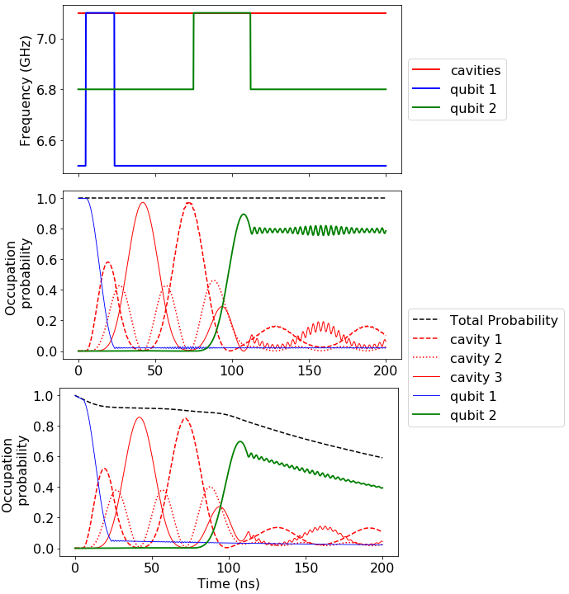
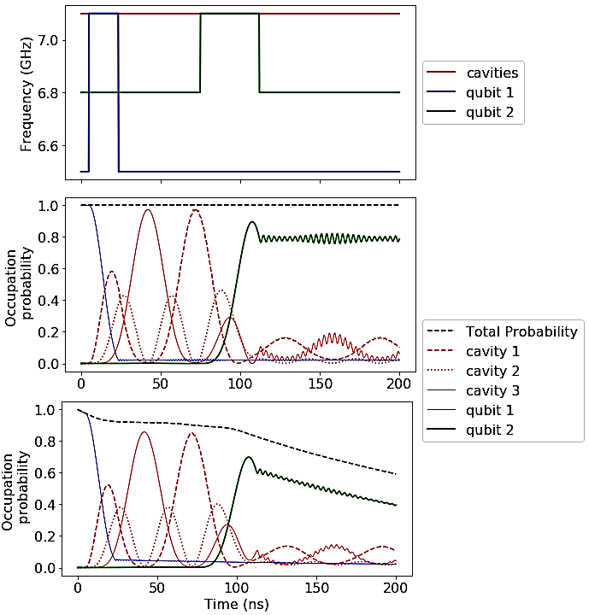
Introduction
Theory
I. Resonance Studies
II. Crossing and Stark Shift
Conclusions
Applying the iSWAP gate
Universal gate: self-sufficient to perform any computation (NAND, NOR, etc)
Ideal iSWAP gate: switches the probability of the qubits
Reversible quantum gate: avoids unwanted loss (energy lost only when information erased)
Setting up the time-dependent Hamiltonian
Solving the Lindblad Master Equation
Calculating the expectation value of all components as the system evolves
SWAP gate
Notes:
Classical Boolean gates: start with an assumption -> get out a valid conclusion (mathematical framework)
Any computation can be decomposed into sequence of logic gates
Energy dissipated when info lost == even with all other mechanisms of energy loss eliminated, we would yet loose energy (irreversible logic gates)
NOT is reversible (if you know output, you know input)
Toffoli, fredkin are all reversible gates

Slide 7
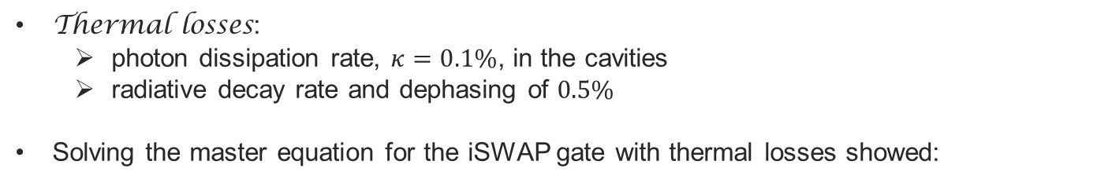
Introduction
Theory
I. Resonance Studies
II. Crossing and Stark Shift
Conclusions
Applying the iSWAP gate, understanding the thermal effect
Thermal losses:
  photon dissipation rate, $κ=0.1\%$, in the cavities
  radiative decay rate and dephasing of $0.5\%$
Solving the master equation for the iSWAP gate with thermal losses showed:
Also developed functionality to send in an RF pulse (work in progress)

Slide 8
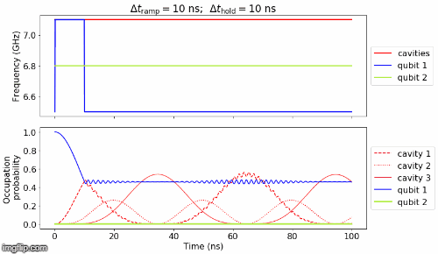
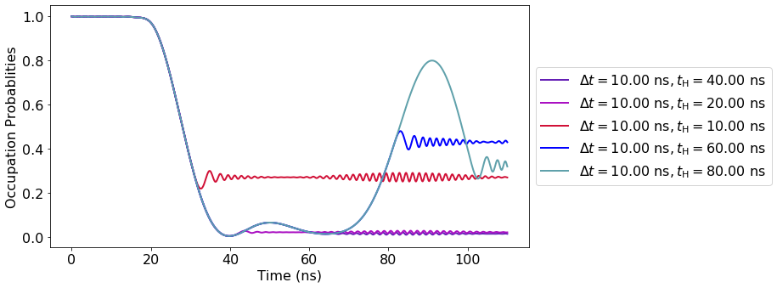
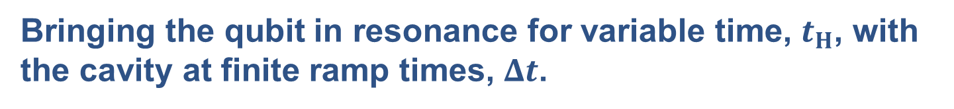
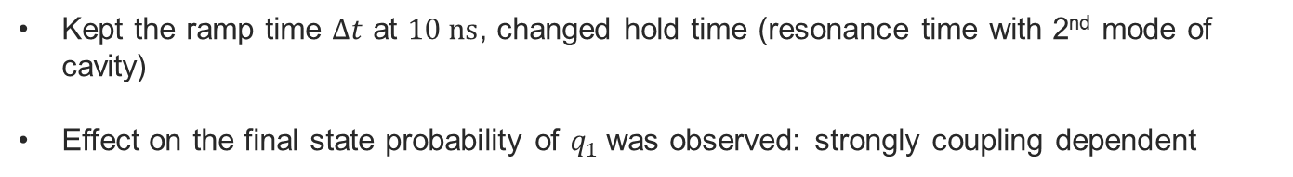
Introduction
Theory
I. Resonance Studies
II. Crossing and Stark Shift
Conclusions
Bringing the qubit in resonance for variable time, $t_{H}$, with the cavity at finite ramp times, $Δt$.
Kept the ramp time $Δt$ at $10 ns$, changed hold time (resonance time with 2nd mode of cavity)
Effect on the final state probability of $q_{1}$was observed: strongly coupling dependent

Slide 9
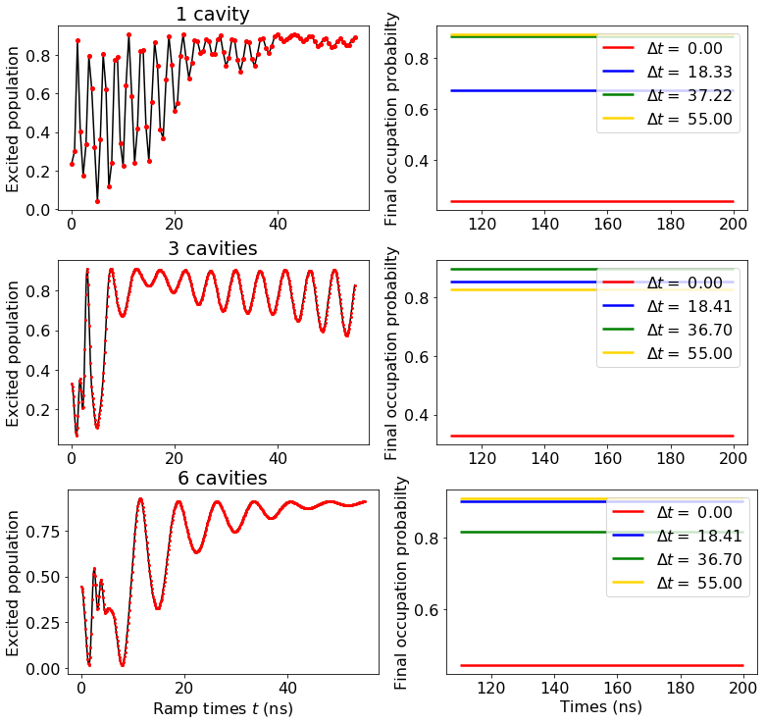
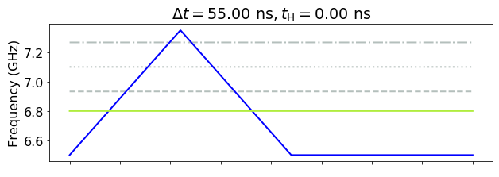
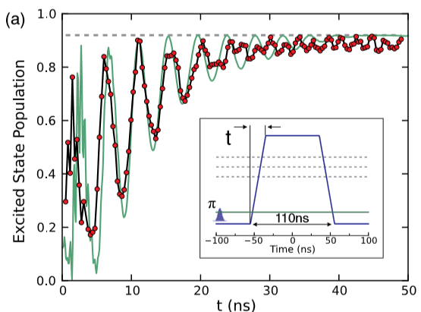
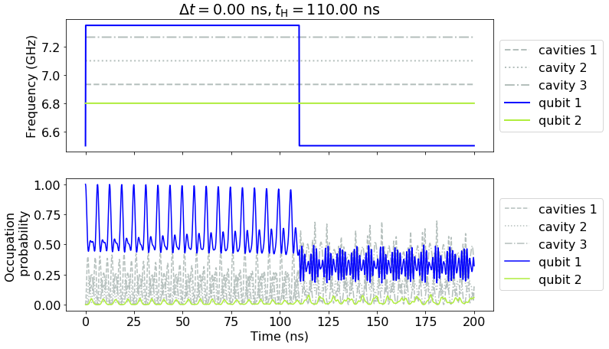
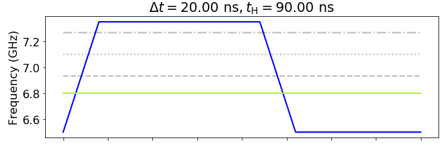
Introduction
Theory
I. Resonance Studies
II. Crossing and Stark Shift
Conclusions
Studying the dynamics due to adiabatically traversing the qubit-filter avoided crossing
Crossing the eigen-states of the filters using variable ramp times
Is the multi-mode nature advantageous? i.e. can we transfer energy for a multiple cavity system in shorted ramp times?
Adiabatic
Completely Adiabatic
McKay et. Al.

Slide 10
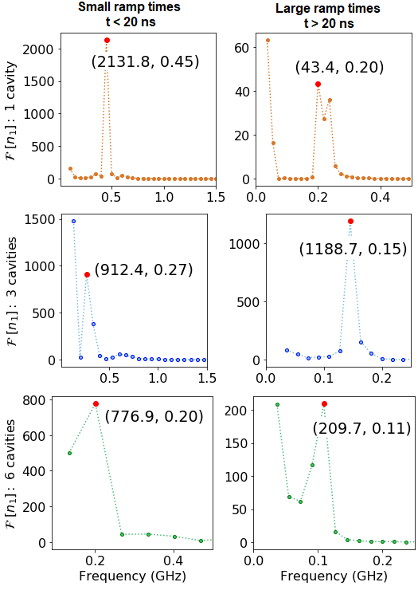
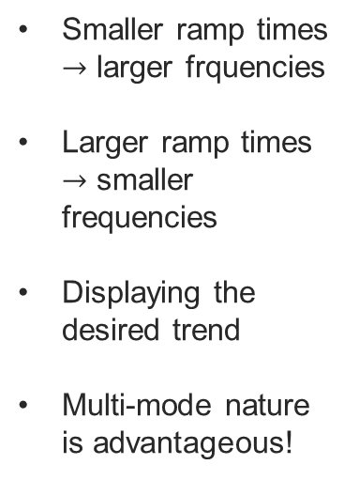
Introduction
Theory
I. Resonance Studies
II. Crossing and Stark Shift
Conclusions
Slow vs Fast traversing:
Smaller ramp times $→$ larger frquencies
Larger ramp times $→$ smaller frequencies
Displaying the desired trend
Multi-mode nature is advantageous!

Slide 11
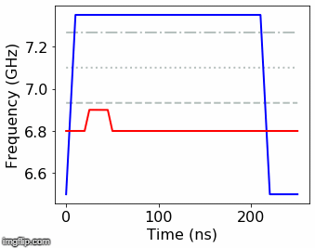
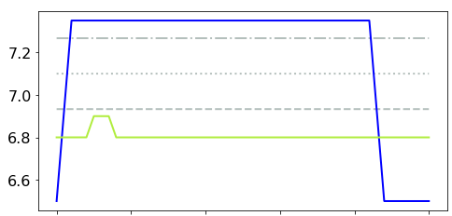
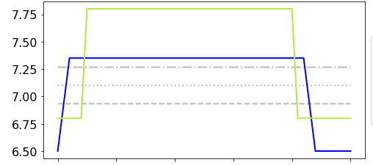
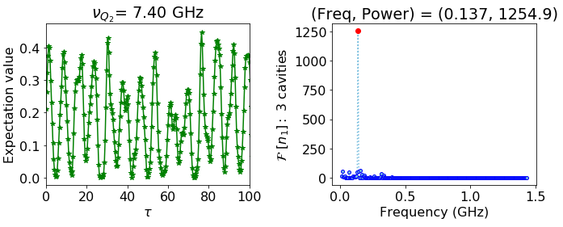
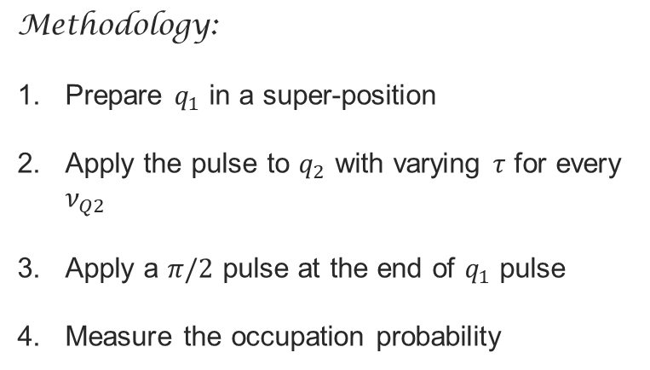


Introduction
Theory
I. Resonance Studies
II. Crossing and Stark Shift
Conclusions
Observing the Stark Shift by simulating Ramsey fringes
$$ν_{Q2}(ns)↑$$
$$↓$$
Frequency (GHz)
$$←τ (ns)→$$
Evolution time (ns)
Evolution time (ns)
Methodology:
Prepare $q_{1}$ in a super-position
Apply the pulse to $q_{2}$ with varying $τ$ for every $ν_{Q2}$
Apply a $π/2$ pulse at the end of $q_{1}$ pulse
Measure the occupation probability

Slide 12
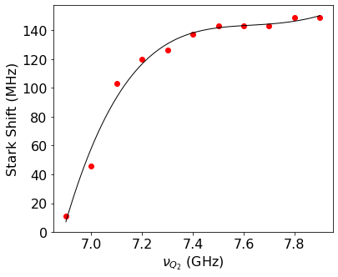
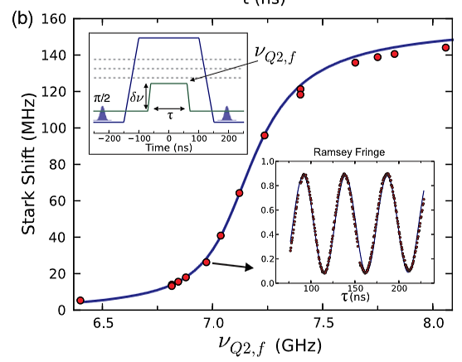

Introduction
Theory
I. Resonance Studies
II. Crossing and Stark Shift
Conclusions
Observing the Stark Shift by simulating Ramsey fringes
FFT of the Ramsey fringe $→$ Stark Shift
Left: Red points are simulated on QuTiP | Right: Experimentally measured data points by McKay et. al. with a theoretical curve.

Slide 13
Introduction
Theory
I. Resonance Studies
II. Crossing and Stark Shift
Conclusions
Goals achieved, conclusions, and future work
Using QuTiP to simulate a 2 qubit and multiple cavity system:
Spectroscopy of cavity-cavity and qubit-cavity interaction:
Studying resonance in cavities
Dynamics of adiabatic traversing of a qubit-cavity system
Simulating the Stark Shift in a system
Solving the master equation with the time-dependent Hamiltonian (mesolve), setting up operators, using ptrace, etc.
Studying the effect of coupling on the Eigen-states showed that distance between nodes increases with coupling
Implemented the iSWAP gate on the 2-qubit, 3-cavity system with and without thermal losses
Multimode nature is advantageous from the study of 6 cavity, 3 cavity and 1 cavity system comparison
Understanding the shift induced by changing $v_{Q2}$: simulated date closely resemble experimentally calculated points

Slide 14
Introduction
Theory
I. Resonance Studies
II. Crossing and Stark Shift
Conclusions
Accessing all the work:
GitHub repository with all 11 notebooks:
  https://github.com/SoumyaShreeram/Qubit
Website with guide to set up QuTiP (work in progress)
  https://soumyashreeram.github.io/Qubit/
Will also submit a report with all the results summarized (work in progress)
Thank you for listening!
Any questions?

Slide 15
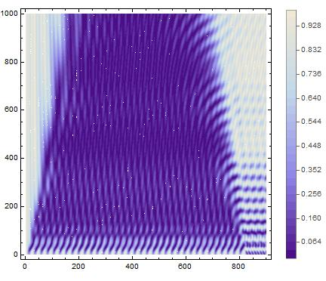
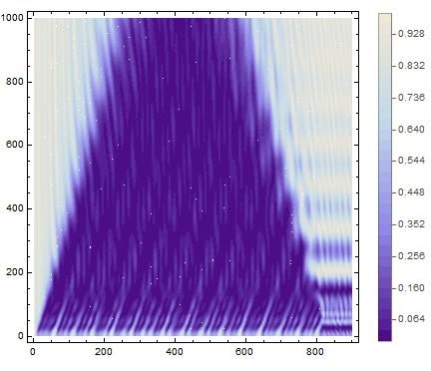



Back-Up
Contours for avoided crossing:
1 cavity
6 cavity
Ramp times (ns) $→$
Evolution times (ns) $→$
Evolution times (ns) $→$

Slide 16
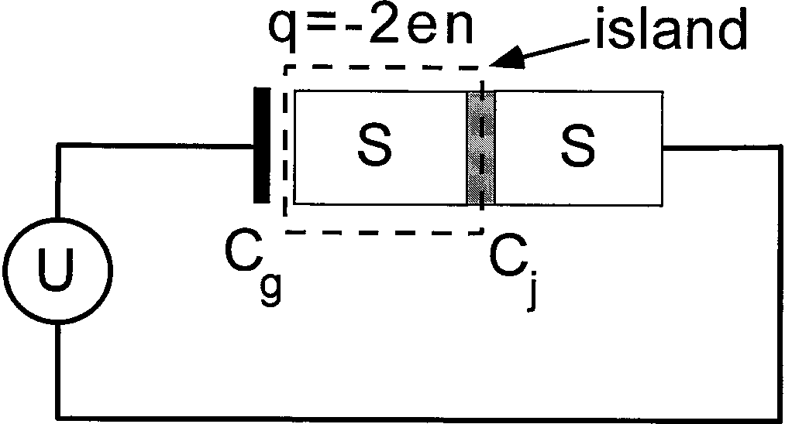
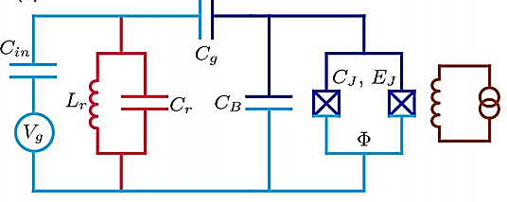
Back-Up
Transmon

