Slide 1
Simulations of beam dynamics with strong space-charge
Arturo Prieto Tirado, University of Cantabria, Santander, Spain
Supervisors: Yuri Alexahin, Eric Stern
Helen Edwards Final Presentation 08/29/2019

Slide 2
Introduction
Beam dynamics affected by:
    Lattice elements (dipoles, quadrupoles…)
    Space Charge repulsion (SC)
Goals:
  Study SC effect in beam sizes, emittances
  Find initial condition/distribution for self consistent solution
  Important to avoid initial mismatch and control emittance growth
Tools:
  MADX
  Mathematica
  Synergia (Python)

Slide 3
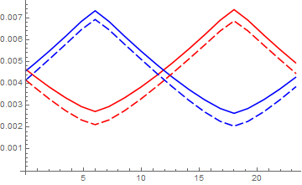
Example of SC in beam sises (dashed)
Beamsizes
Length

Slide 4
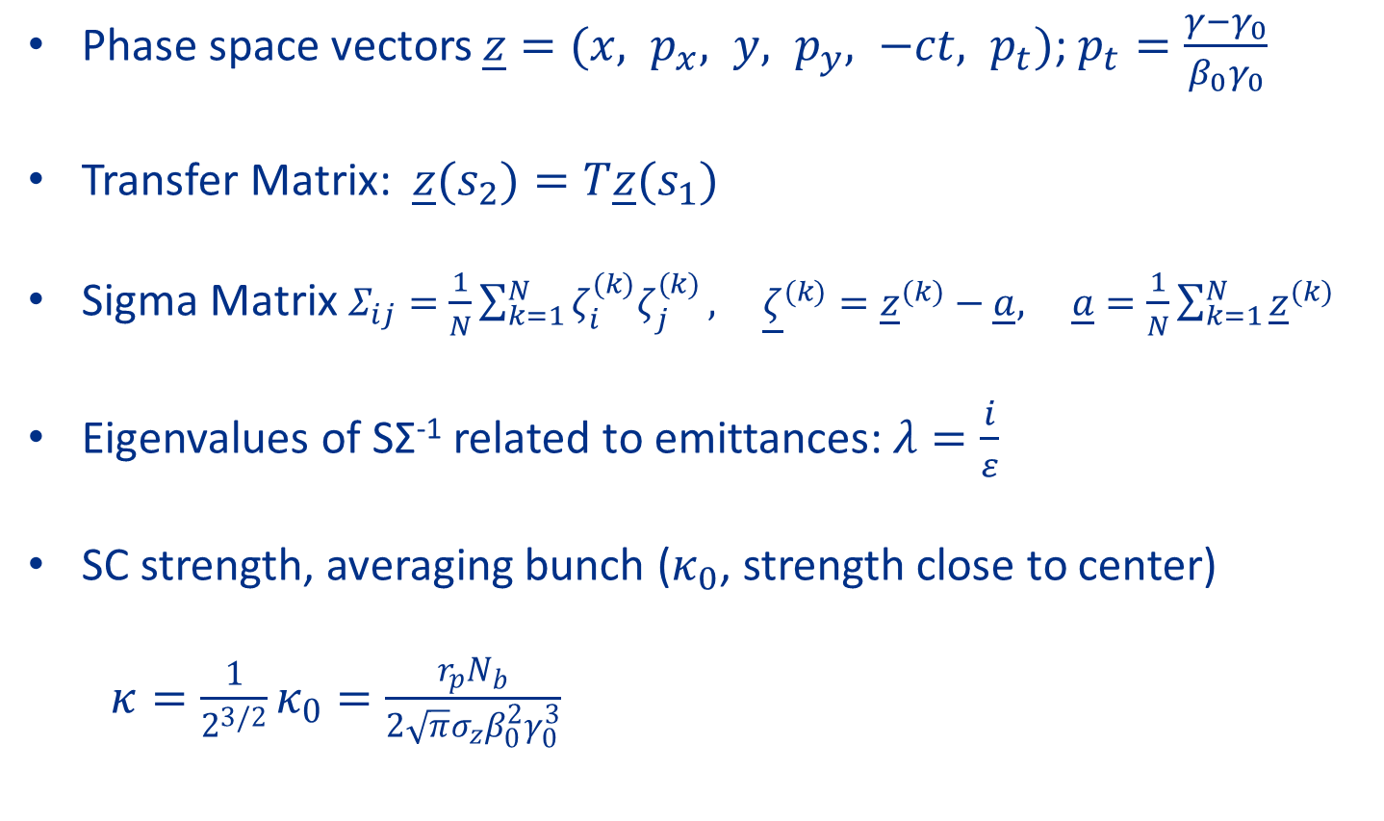
Theory
Phase space vectors $\underline{z}=(x, p_{x}, y, p_{y}, −ct, p_{t})$; $p_{t}=\frac{γ−γ_{0}}{β_{0}γ_{0}}$
Transfer Matrix: $\underline{z}(s_{2})=T\underline{z}(s_{1})$
Sigma Matrix $Σ_{ij}=\frac{1}{N}\sum_{k=1}^{N}{ζ_{i}^{(k)}ζ_{j}^{(k)}}, {\underline{ζ}}^{(k)}={\underline{z}}^{(k)}−\underline{a}, \underline{a}=\frac{1}{N}\sum_{k=1}^{N}{{\underline{z}}^{(k)}}$
Eigenvalues of SΣ⁻¹ related to emittances: $λ=\frac{i}{ε}$
SC strength, averaging bunch ($κ_{0}$, strength close to center)
$κ=\frac{1}{2^{3/2}}κ_{0}=\frac{r_{p}N_{b}}{2\sqrt{π}σ_{z}β_{0}^{2}γ_{0}^{3}}$

Slide 5
MADX: Lattice and first analysis
Definition of general elements: Dipoles, quadrupoles…
SC modeled as SC discrete elements, 240 in total (12cellsx20)
Results:
  Lattice files: Periodic and perturbed
  Transfer Matrix and parameters for initial aproximation
SC elements

Slide 6
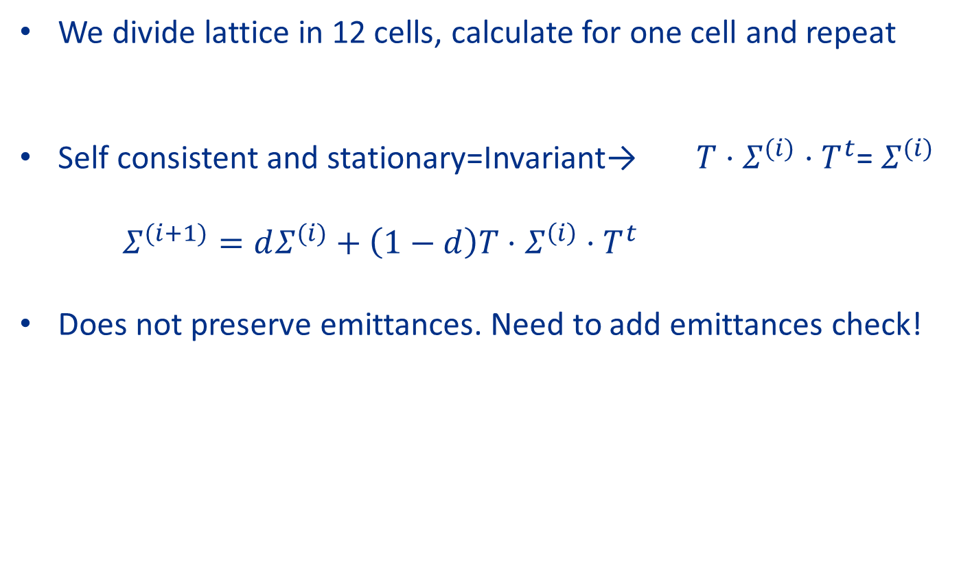
Mathematica: Periodic lattice
We divide lattice in 12 cells, calculate for one cell and repeat
Self consistent and stationary=Invariant→ $T⋅Σ^{(i)}⋅T^{t}$= $Σ^{(i)}$
$Σ^{(i+1)}=dΣ^{(i)}+\left(1−d\right)T⋅Σ^{\left(i\right)}⋅T^{t}$
Does not preserve emittances. Need to add emittances check!

Slide 7
Mathematica Results: Periodic lattice
SC not important for periodic lattice
Always possible to find periodic solution by repeating result for one cell to twelve cells
Found other solutions by changing initial conditions a bit

Slide 8
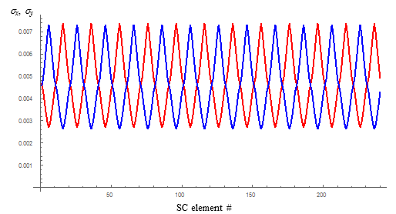
Periodic solution for periodic lattice

Slide 9
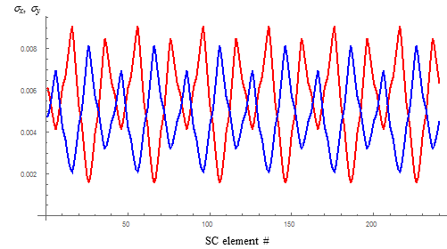
Periodicity 6 solution for periodic lattice
Not lattice periodic because of initial condition

Slide 10
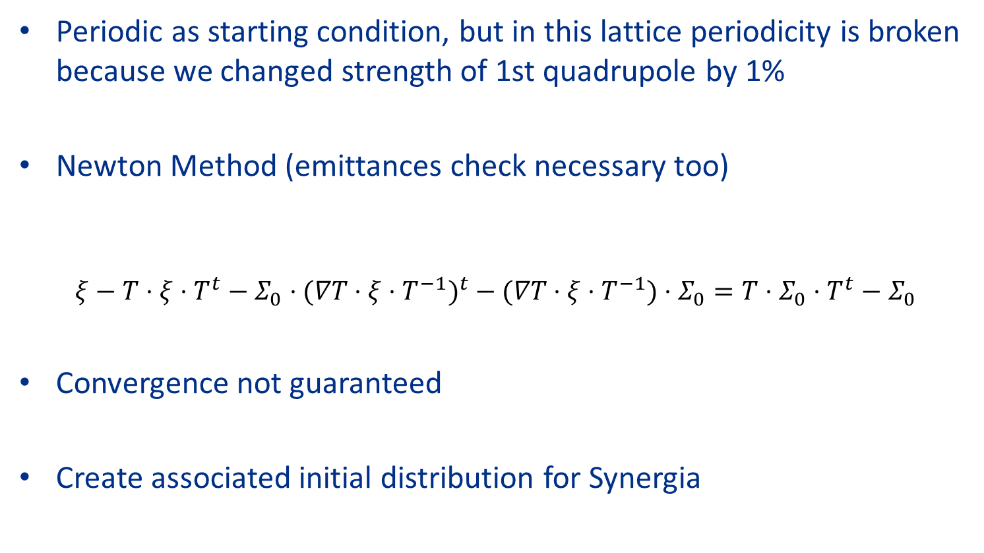
Mathematica: General solution, perturbed lattice
.
Periodic as starting condition, but in this lattice periodicity is broken because we changed strength of 1st quadrupole by 1%
Newton Method (emittances check necessary too)
$ξ−T⋅ξ⋅T^{t}−Σ_{0}⋅(∇T⋅ξ⋅T^{−1})^{t}−(∇T⋅ξ⋅T^{−1})⋅Σ_{0}=T⋅Σ_{0}⋅T^{t}−Σ_{0}$
Convergence not guaranteed
Create associated initial distribution for Synergia

Slide 11
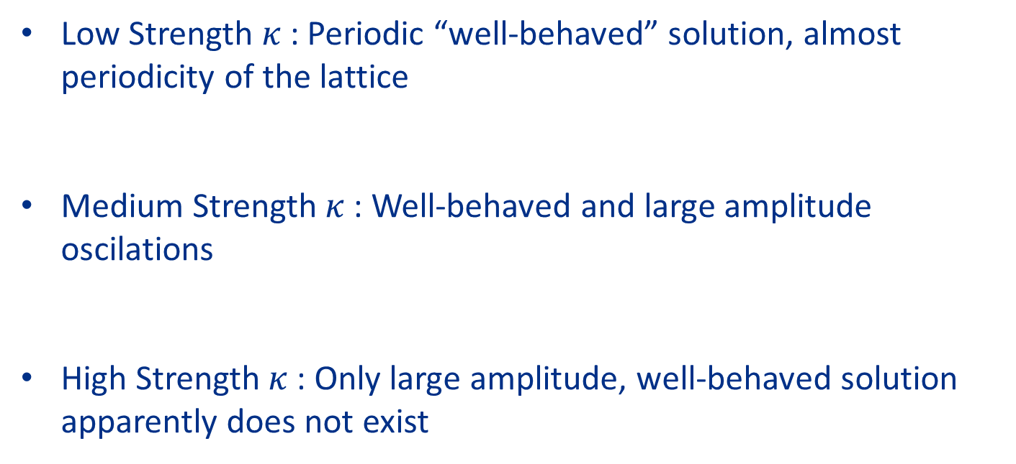
Mathematica Results: Perturbed lattice
Low Strength $κ$ : Periodic “well-behaved” solution, almost periodicity of the lattice
Medium Strength $κ$: Well-behaved and large amplitude oscilations
High Strength $κ$: Only large amplitude, well-behaved solution apparently does not exist

Slide 12
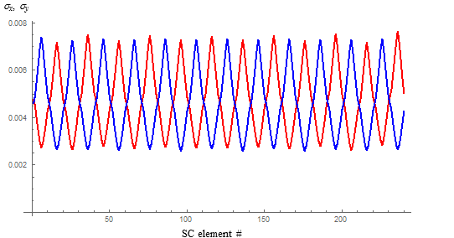
Well-behaved solution for perturbed lattice

Slide 13
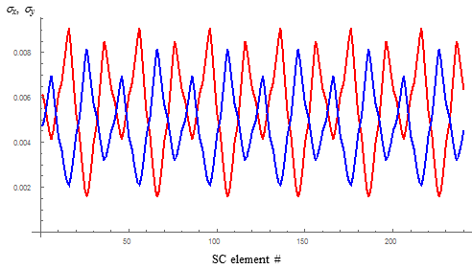
Large amplitude solution for perturbed lattice
Periodic, but not with lattice periodicity because of SC

Slide 14
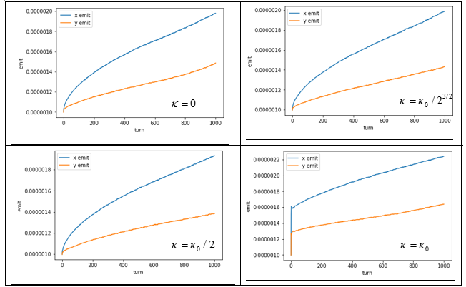
Synergia: Emittances of perturbed lattice

Slide 15
Conclusions
Developed a self consistent algorithm in Mathematica
Found multiple solutions to perturbed and periodic problem, including well-behaved for low space-charge values
Developed a tracking algorithm for Synergia
Analysed importance of SC strength factor in emittances growth

