Slide 1
Development of DAPHNE at Fermilab
Manuel Arroyave-Escuela de Ingeniería de Antioquia EIA
Javier Castaño-Universidad Antonio Nariño UAN
DUNE PDS
September 4, 2019

Slide 2
ACTIVITIES
Development of the stay-Javier Castano (August 19-November 15)
Software installed: Altium Nexus, Xilinx ISE, Xilinx Vivado
Definition of the basic architecture: work with Sten Hansen and Miguel Marchan (Fermilab)
Starting the firmware development: Manuel Arroyave, Javier C.

Slide 3
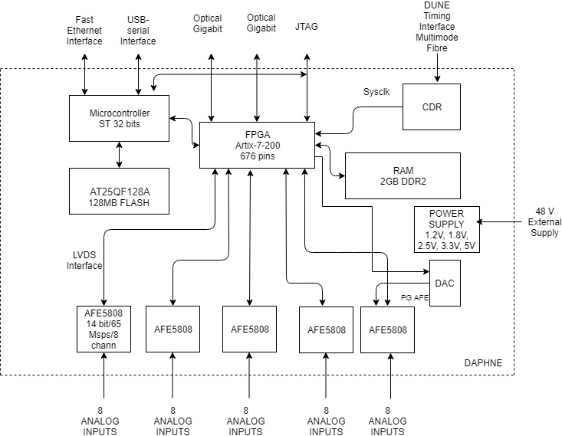
DAPHNE ARCHITECTURE
FPGA pincount is OK
FPGA SERDES pins availability
Altium footprints available
Flash memory 128 MB is OK
AFE5808 65 Msps, 14 bits

Slide 4
To do…
Definition of some devices (memories, etc)
Calculation of USD/channel (in principle we are under USD 50/channel)
CDR (we have the UoB Timing Interface Schematics)
Data format
Pile up (algorithm, etc)

