Slide 1

DUNE Project Status
Janet Bishop
DUNE PMG Meeting
September 2019

Slide 2
Outline
ES&H Update
QA Update
PM Update
Schedule & Budget Status
DUNE Update
  FD Engineering
  FD Installation
  FD APA
  FD TPC Electronics
  Near Detector
Upcoming Events

Slide 3
ES&H Update
Review documentation for the upcoming Ash River workshop
Continue to support the development of the DUNE TDR
DUNE ESH Coordinator integrating with the SP Technical Leads
Reviewed response to the Ash River APA Assembly Tower Assessment

Slide 4
Quality Assurance
QA Input
  Review/update QA/QC Sections of the Technical Coordination TDR.
  Updated DUNE Part Numbering System Presentation after review meetings.
  Review Documentation in Preparation for Ash River APA Trial Assembly Work Shop.
Participated in the following DUNE Meetings/Reviews
  Far Detector Technical Board.
  DUNE Technical Coordination.
  DUNE Installation Coordination.
  DUNE Technical Integration: Interface Drawings.
  APA Engineering.

Slide 5

Project Management Highlights
Preparation for IPR October 29 – November 1
  Successfully updated DUNE-US schedule and resources in P6 by the end of August.
  Defined on-project and operational costs & implemented changes.
  Refining definition of KPPs.
  Preparing presentations, BOEs, updating risks.

Slide 6
Project Management Highlights
Technical Design Report “pen-ultimate draft” in final revisions
  Four of the five volumes (including the Single Phase volume) were submitted; Dual Phase volume will be submitted on Nov 1 to allow data collection from ProtoDUNE-DP.
  LBNC review teams making one further round of comments on the TDR – some received on September 16.
  Responses being prepared.
  DUNE anticipates this is the final round of comments/revisions and expects LBNC to recommend for approval the Executive Summary TDR Volume, The Physics Volume, the Far Detector Single Phase Volume and the Technical Coordination Volume.

Slide 7
Project Management Highlights
DUNE Technical Board Meeting – August 29
  Planning for testing APA #7 in the CERN cold box.
  Discussed proposal to remove APA grid plane. Discussion at the DUNE Executive Board on September 5 – currently under consideration.
DUNE Technical Board Meeting – September 12
  Main technical topic was the inclusion of electron diverters on the edges of the APA frames. The task force presented their evaluation and discussions will continue at next meeting.
Staffing Update
  Ongoing search for Lead Mechanical Engineer for Far Detector.

Slide 8
DUNE Milestones
T2: Federal Project Director
T3: Fermilab Directorate
T4: Project Director
T5: L2 Manager
T6: CAM
 | July 2019 P6 Update | August 2019 P6 Update | Variance | Comments
Completed In August 2019
T4 MS - Stakeholders Written Approval of 100% FSCF Final Design Documents | 8/1/2019 | 8/1/2019
T4 MS - Interface Agreement with all Detector Subgroups Complete | 8/20/2019 | 8/20/2019 |  | Released Interface Documents in conjunction with TDR release
Planned for Completion September – November 2019
T4 MS - High Voltage System Preliminary design review Complete | - | 9/3/2019 |  | Complete
T4 MS - Ash River test results (phase 1) | 10/16/2019 | 10/16/2019 |  | On target

Slide 9
DUNE Stop Light Report – August 2019
Overall, the performance for August is within acceptable range
Most of overspend due to catching up accruals on APA task
Underspend due to vacations and unfilled role – work is getting done by drawing upon other resources.

Slide 10
DUNE Stop Light Report – last 6 periods
Variances are due to:
Overspend and schedule delay on TPC Electronics during this period – recovery.
Still have underspend in several areas due to vacations and unfilled role – work is getting done by drawing upon other resources.

Slide 11
Far Detector Engineering
DUNE General
  Procedures for DUNE safety analysis (structural and electrical) have been uploaded to EDMS 195593; additional support information in EDMS 199222.
  Initial structural analysis of the APA and HV have taken place at prior reviews – EDMS 195184. The electrical safety analysis of the APA is currently being planned.
DUNE Detector component integration
  Continue to develop drawings for Consortia-to-Consortia mechanical interfaces; Kyle Zeug (PSL) is helping to lead this effort along Manhong Zhao (BNL) and others.
  Electrical interfaces are being identified and plans to produce or verify documentation are being generated.
DUNE Detector Electrical/Electronics
  Continue series of meetings with the DAQ Consortia leaders on issues relating to the Surface Computer Room, Underground DAQ Room and main fiber trunk runs.
  SLEDs (Single-Line-Electrical-Drawings) generated for the AC power distribution with UPS backup the DAQ equipment has been produced. Physical footprint required has been identified; working with CF on equipment location.
  Completed draft budget for temporary power distribution, optical fibers and rack infrastructure.

Slide 12
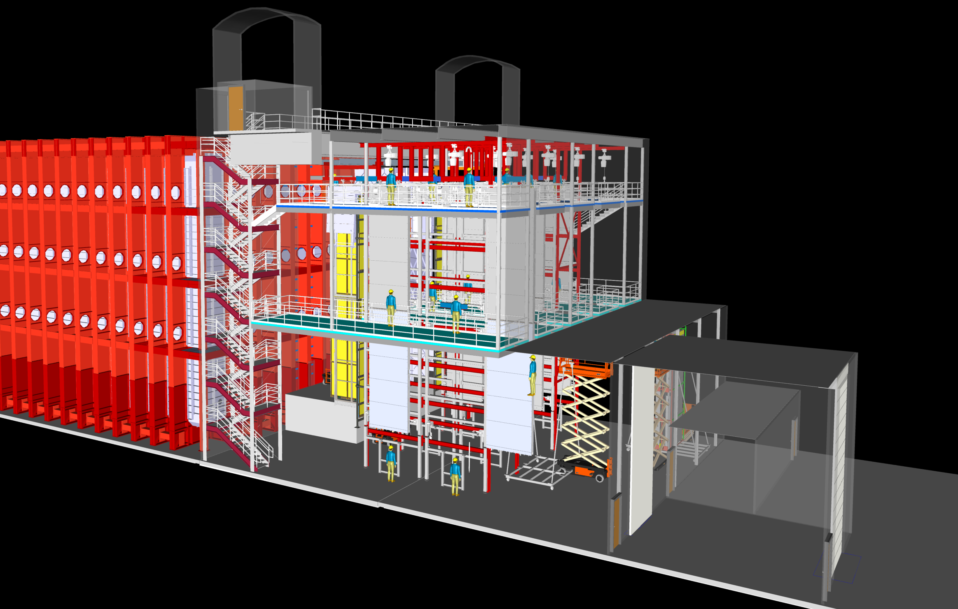
FD Installation
Work continues on the cleanroom design
  Defining the mechanical requirements so engineering work can begin.
Detail work on the interfaces to the cold boxes began
  Interfaces between the APA, TPC electronics, photon, cryogenics system and the cleanroom to the cold box need to be clarified.
Proposals for lighting and power in the cleanroom and cryostat were drafted

Slide 13
DUNE Trial Assembly at Ash River
Preparation for Workshop – Sep 30 - Oct 3
  Motorized cable reel has been installed and tested. Modifications to both the sheave wheel and cable reel were required to minimize movement during the installation of the cable.
  Installed I-beam to hold sheave wheel in proper position.
  A 1-1/2” diameter cable mesh was used on the old bundle. It easily went in the slotted conduit but was stiffer on the spool and likely would not “breath” as well as the looser bundle.
  Need to confirm cable lengths and number of cables so we can make up a second new long bundle plus 2 short ones if time allows.
  Completed installation of new encoder, repaired dead LED, switched up and down buttons on pendant.
  Constructed “stand” to better hold the APAs against the catwalk when they are not in the APA Assembly frame.

Slide 14
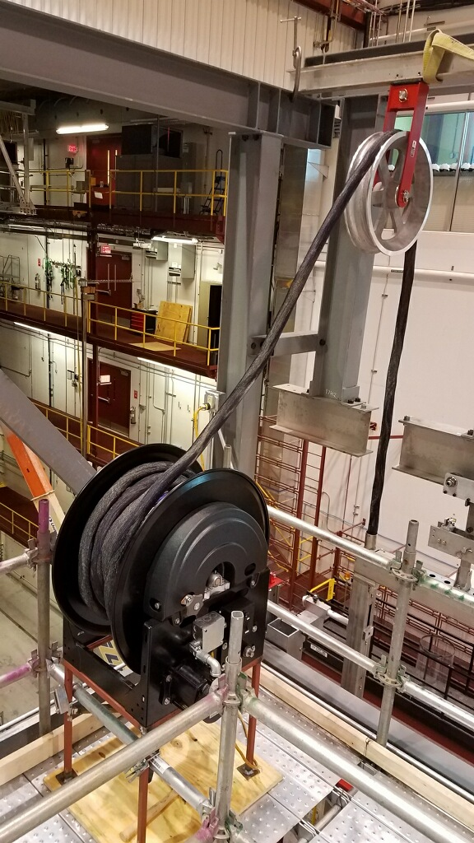
DUNE Trial Assembly at Ash River
Work on Phase 2 documentation
  Continue to work with PSL to define the requirements document for Barr Engineering for the Phase 2 structural.
Response to Ash River Assessment in July
  A response was submitted to the majority of the “opportunities for improvement” including:
    Better signage and yellow tape for low head clearance.
    Signage for emergency evacuation area.
    OSHA Competent scaffolding training.
    Sign off by the University of Minnesota on Ash River training program to validate consistency during an 8-hour train-the-trainer session.
    Put personnel limit on APA Assembly Tower until it is tied into Phase 2 design.
Motorized Cable Reel

Slide 15
FD APA
Preparation for the DOE IPR Review
  APA production activities are now part of a proposal submitted to NSF and have been removed from the DOE project.
  Remaining DOE APA activities: support for final R&D and prototyping in FY20 and installation activities.
Workshop at Ash River, Sept. 30 – Oct. 3
  APA doublet process with PDS cables connection and CE cabling test.
Progress at PSL, U. Wisconsin
  Working on procurement of material and machining for the next set of APA frames.
  Board pre-production: ongoing modifications of jigs for gluing tooth strips (boards width modified from 3” to 4”).
  Winder modifications: proposal for adding a clutch to the new rotating interface arm, agreed by colleagues at Daresbury Lab.
  Preparation of cost estimates for FY20 activities and installation (specific APA installation hardware and installation fixtures).

Slide 16
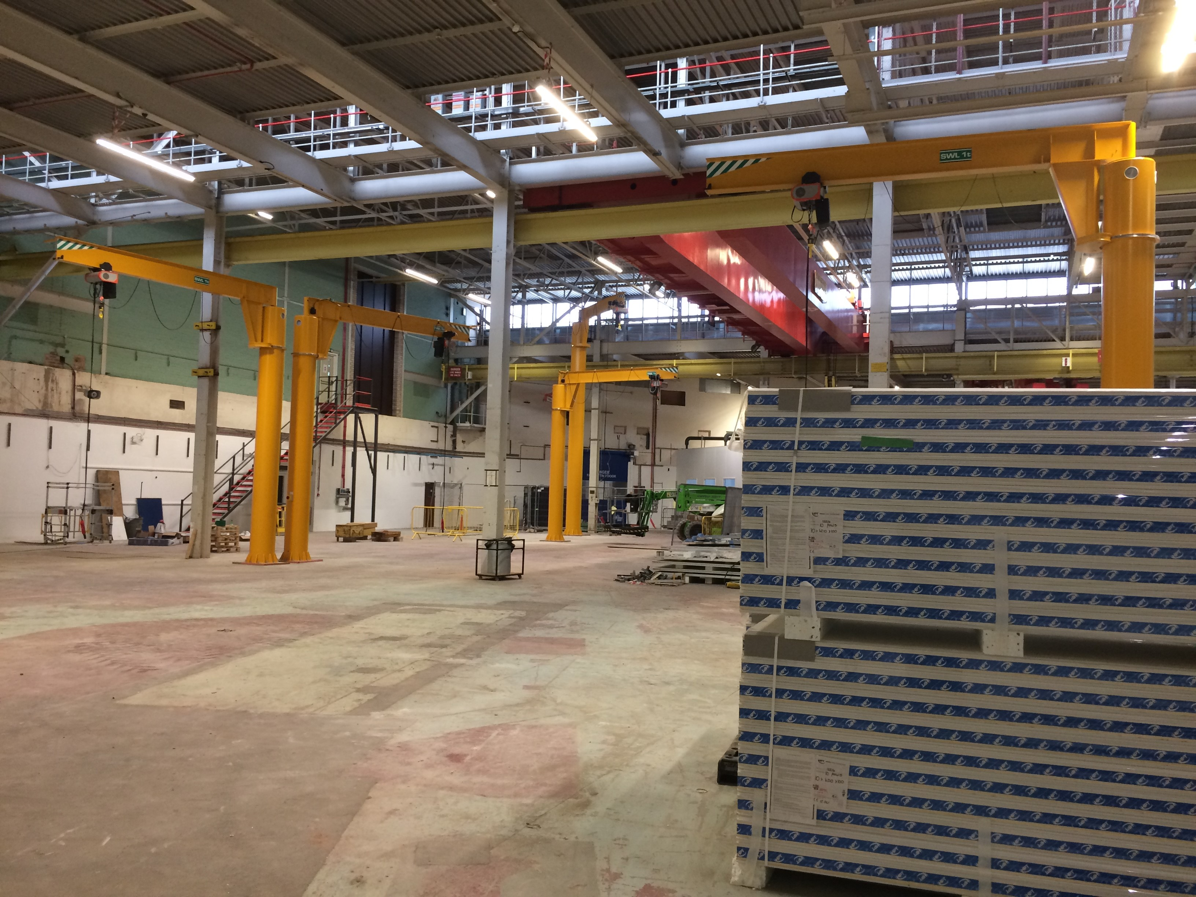
FD APA
Progress at Daresbury Lab.
  Winder modifications: continuing tests on the new winding head with DC motor drive. Smoother operation on a test bench, it seems promising.
  Progress on the APA transport frame: two different, but similar designs to hold the APA inside the transport frame, from Daresbury and PSL.
  Setup of production site: all jib cranes installed, erection of walls to start on Sept. 23 and expected to continue for 6 weeks, followed by winders assembly.

Slide 17
ICEBERG Test Stand at PAB
Ready to operate the cryostat in the way it was designed (with purifier, with appropriate pressure regulation)
  Going cold this week, commission condenser.
  Should be able to observe tracks in the TPC next week.
  Still using ProtoDUNE FEMB, ready to operate with SBND FEMBs in next LAr fill.
  Planning for simultaneous running of TPC electronics and photon detector with new readout.
  Conclusion of ~5 months commissioning period.
Could switch to testing SBND FEMBs in early October and FEMBs with ColdADC in November
  Will keep on using same Warm Interface Board and same firmware as for ProtoDUNE (need only minor SW changes, already done for SBND FEMBs).

Slide 18
Status of ASICs (i)
LArASIC
  Continue understanding of “ledge effect” with detailed simulation of FE response.
  Problem arises in 2nd stage of preamplifier, where programmable gain is implemented.
  No design fix yet.
ColdADC
  Test board with socket being assembled
    To be used for characterization of ~140 chips to be mounted on FEMBs.
    Software test suite almost ready.
    Will have all ADCs characterized at the beginning of October.
First version of FEMB (LArASIC + ColdADC + FPGA)
  Prototypes being assembled.

Slide 19
Status of ASICs (ii)
COLDATA
  Almost all digital logic has been verified to work (at room temperature so far).
  Only one minor problem observed in I2C communication
    The first time an I2C command is relayed to another chip COLDATA does not rebroadcast the reply from the chip.
    From the second command on everything works properly.
  Power-on reset works properly.
  PLL locks properly and transmits data at 1.28 Gbps.
  Data from ADCs is captured correctly and all four defined COLDATA output formats are formed correctly.
  Data from multiple sources is merged correctly.
  Started checking 8b10b encoder.
  Still to be done
    Repeat tests at LN₂ temperature.
    Demonstrate synchronization with fast commands.
    Characterize high speed data links.
  Additional help from SMU for testing expected at Fermilab this week.

Slide 20
Status of ASICs (iii)
COLDATA
  Design of FEMB mezzanine for COLDATA can start.
  Will use same number of warm/cold connections as for ProtoDUNE
    Cannot implement (yet) reduction in number of connections due to I2C issues (to be addressed in 2nd version of ColdADC/COLDATA).
  FEMB for COLDATA requires new WIB.
  New WIB design available (from BNL).
  U Penn group is working on modifying ProtoDUNE firmware (porting from Altera to Xilinx).

Slide 21
Cold Box at CERN and 7th ProtoDUNE APA
Recommissioning of Cold Box at CERN was given lower priority compared to completion of Dual Phase detector
Cold Box at CERN should be available this week
7th ProtoDUNE APA has been at CERN since Spring
ProtoDUNE electronics also available
We have made plans for using 2nd-4th week of October for installing ProtoDUNE FEMBs on 7th APA, tests in Cold Box
  Agreed dates with SBND, small reshuffling of their installation plans, avoided conflicts.
After initial commissioning with ProtoDUNE FEMBs will test SBND FEMBs and later FEMBs with ColdADC

Slide 22
Near Detector
Recent Activities:
  ND LArTPC:
    Estimated ND resources entered into P6 in preparation for Oct. IPR
    Developing BOEs in support of IPR estimates, with target of end of Sep.
    In parallel, refining ND resources:
      Exploring areas where LArTPC resources can be trimmed.
        T. Bolton @ SLAC/LBNL Sep. 12-13.
      Goal: Freed resources hopefully enable temporary μ-spectrometer in US scope.
    ND Installation and Integration resource estimate proceeding in parallel (M. Leitner).
    ArgonCube 2x2 Demonstrator:
      Full-scale cryostat, cryogenic cycle test: Aug. 26-Sep. 6 @ Bern.
      2x2 sessions at DUNE Collab Meeting: Thur. Sep. 26, 9am-12:30pm.
      LBNL Engineers (J. Joseph, A. Karcher) now assisting with charge readout design.
  MPD and Beam Monitor:
    Magnet workshop, for both MPD and KLOE: Sep. 3-6 @ FNAL: https://indico.fnal.gov/event/21272/
    Significant progress in MPD magnet design, alternative concepts.
    Substantial interest from international partners (Italy, India) in MPD, KLOE systems.
  Next ND Workshop:
    Week of Oct. 21 @ DESY (Hamburg): https://indico.fnal.gov/event/21340/
Next steps:
  Complete BOEs for US ND scope. Establish path for temporary μ-spectrometer.

Slide 23
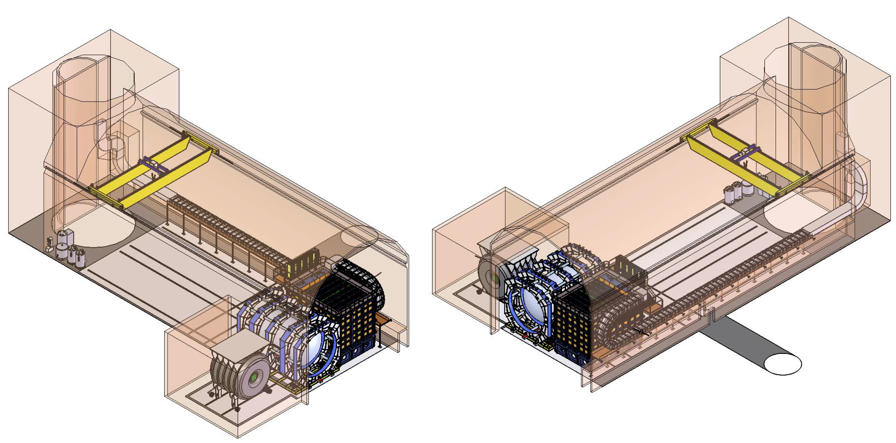
Near Detector:
'Reference Design’
M. Leitner
MPD Detector
Superconducting Magnet (0.5-0.7 T)
200 t Calorimeter
Pressurized Argon Gas TPC
LAr Detector
200 t High Purity Liquid Argon
Pixelated Readout Electronics
KLOE-3DST Detector
Superconducting Magnet (xx T)
Calorimeter
TPC or 3DST

Slide 24
Upcoming Events
RRB Meeting at FNAL – September 19 - 20
DUNE Collaboration Meeting – September 23 – 27
Installation Prototyping Phase 1 Workshop @ Ash River – September 30 – October 3
Near Detector Workshop at DESY – October 21 - 23
LBNF/DUNE IPR at FNAL – October 29 – November 1
LBNC Meeting at FNAL – December 2 - 4
Collaboration Meeting at CERN – January 27 - 31
RRB Meeting at FNAL – April 2 - 3
DOE CD-2/3b Review at FNAL – April (TBD)

