Slide 1
SBN Program Status
Peter Wilson – SBN Program Coordinator
Oversight Board
13 September 2019

Slide 2
Outline
ICARUS technical progress
SBND technical progress
Transition to Operations Planning
Booster Neutrino Beam in 2020-21
Upcoming Reviews

Slide 3
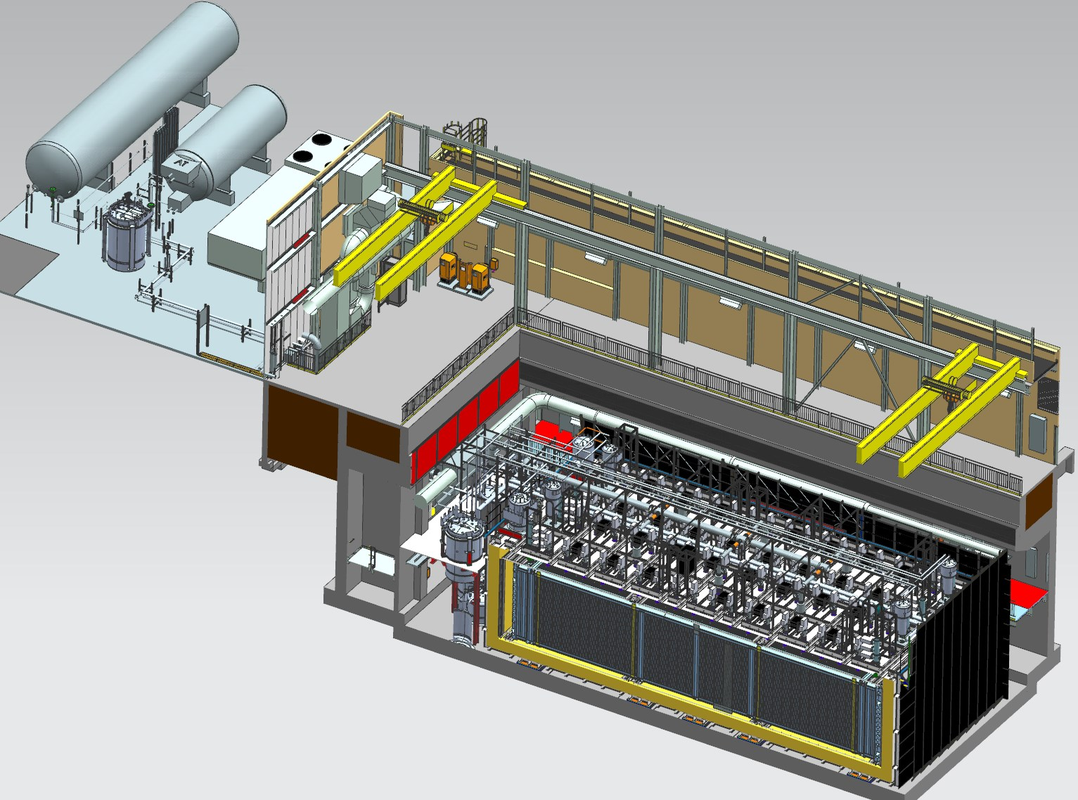
Far Detector - ICARUS
Cryogenic Dewars
TPC Electronics
Top CRT and Overburden
(not shown)
Exterior LAr Filters
Two 33 ton cranes
Proximity Cryogenics
Not shown in alcoves (mezzanine and pit):
DAQ racks
Controls racks
Cold Vessels (TPCs and PMTs inside)
Bottom CRT
Side CRT

Slide 4
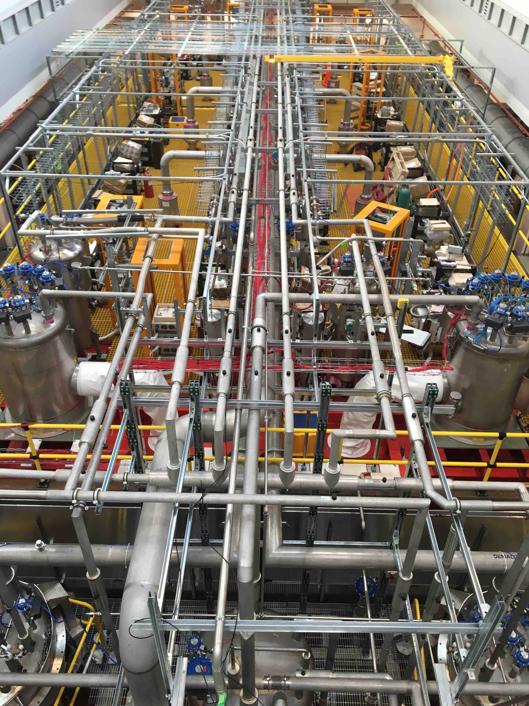
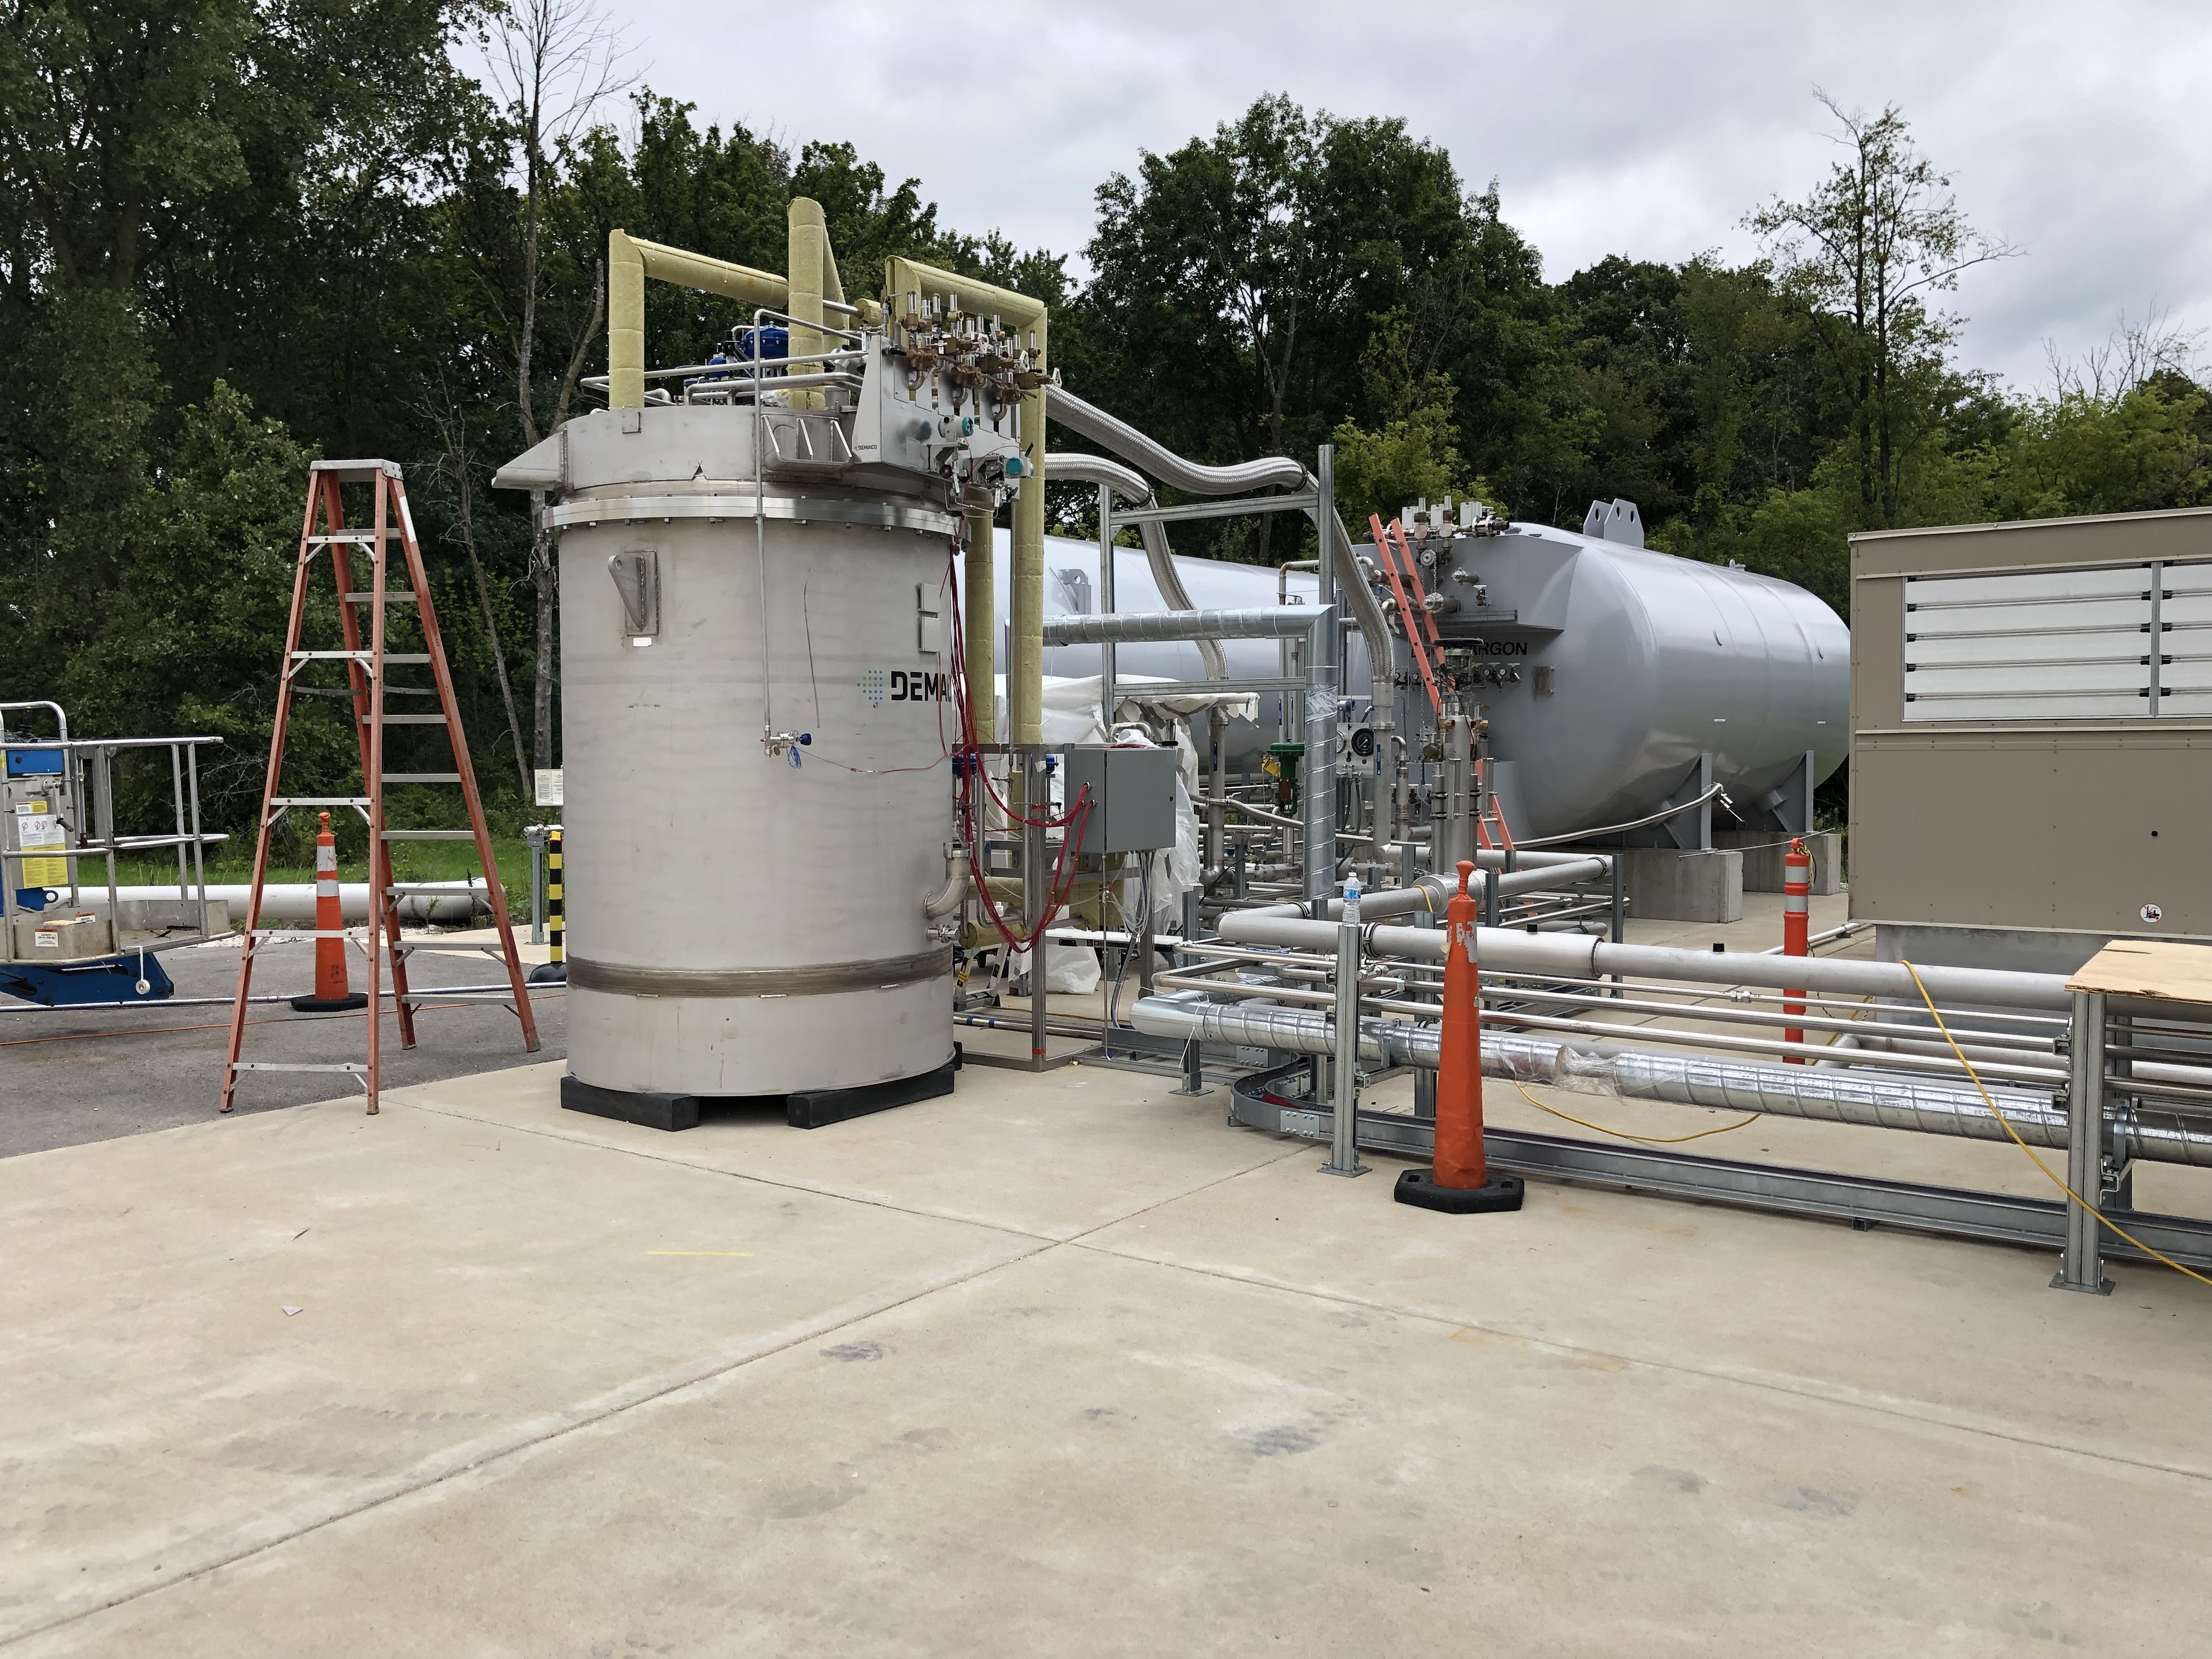
Far Detector Progress
Cryogenics
Final few items to complete hardware installation
Controls and ODH wiring near complete
Controls programming in progress
Infrastructure - electricians
Outlets on vessel top completed
Outlets for west mezzanine DAQ racks in progress
Outlets for east mezzanine PMT racks starting
Electrical work continues on critical path
Readout and DAQ Electronics infrastructure
Main cable tray installation on top of the detector complete
PMT readout racks setup
DAQ racks in place
First EVB/DAQ servers onsite remaining severs due in early October
Networking:
Cable tray (yellow in photo) components on order, also used for DAQ and PMT fibers
Network switches in hand
Completion in October on critical path

Slide 5
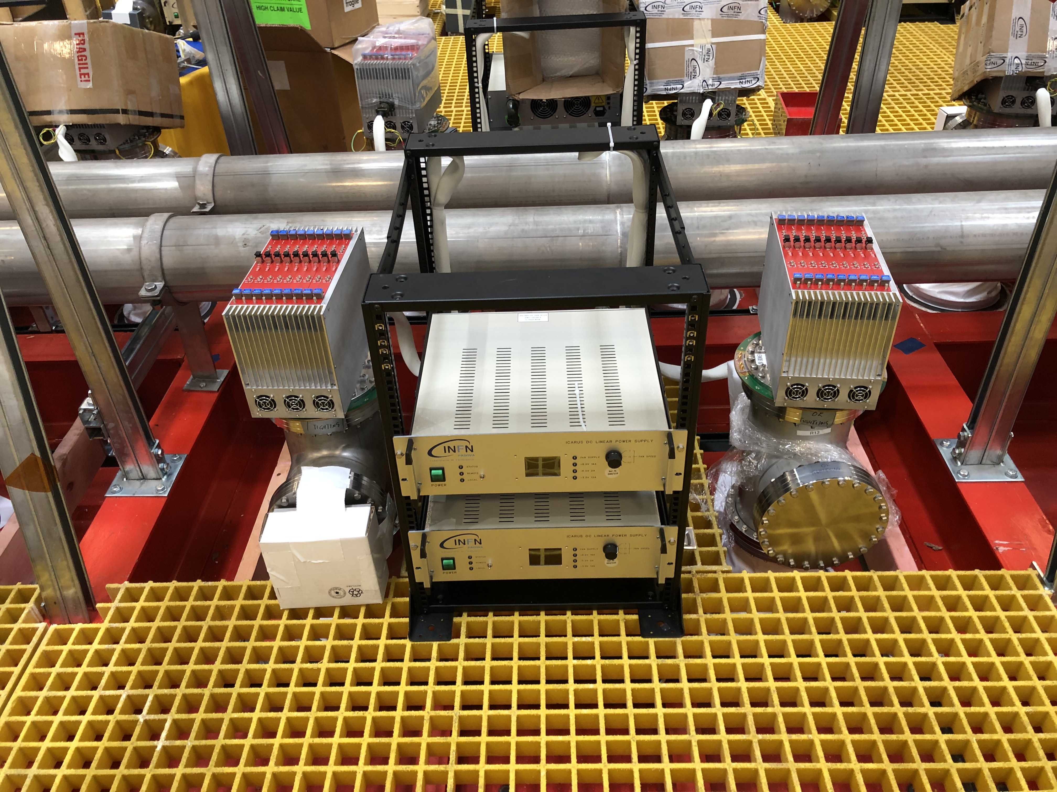
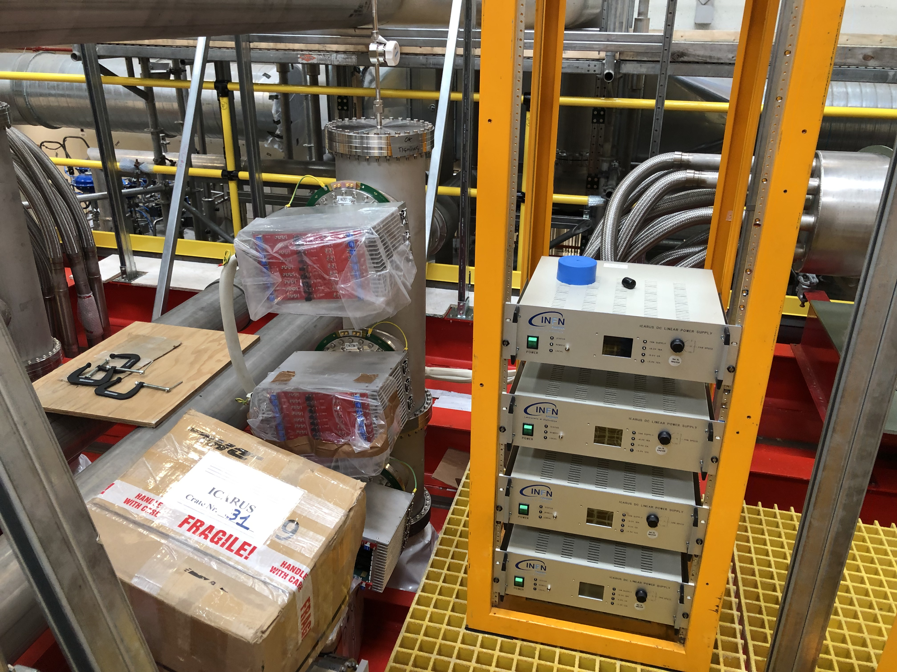
Far Detector Progress
TPC Front end electronics
All electronics installed and tested
Noise characterization studies completed
Measured effect of building systems on electronic noise (negligible)
Some noisy channels in a few corner chimneys
Proposal to make a two day intervention the week of Sept 23
Cables for wire bias and timing distribution near completion, installation in one to two weeks
PMT system
Installation of cabling to digitizers and calibration fibers started. Remaining cables in transit from CERN with DAQ servers (early Oct).
Preparing for installation of calibration laser
CRT system
North wall dedicated to Simone Marcocci (FNAL postdoc) on Sept 11
Mounting system for east and west wall CRTs being installed. Main CRT installation after fill.
Production progress well at Frascatti for top CRT – ship at end of the calendar year.

Slide 6
Cryogenics Commissioning Activities
Vacuum operation started 10th June
Continue pumping until the start of cool-down
Cool-down and liquid argon filling
Liquid Argon contract in place – requires >21 day notice to start daily delivery
LN2 dewar operation approved, certified and filled in July
LAr dewar operation approved, cetification and fill in next week
Scheduling of final steps to start LAr fill in progress
Controls hardware checkout ~ end of September
Controls programming checkout ~ end of September
ODH system active - early October
Final system checkout by CERN and FNAL engineering – early October
Approval (pORC) to start LN2 cooldown – early October
Start LN2 cooldown – late October
Start LAr fill – early November
CERN engineering participates, in person, starting from final checkout through the fill process.
Includes monitoring of cold vessel strain gauges
CERN has a safety documentation & review process similar to Fermilab’s, and the participation satisfies their sign-off procedure

Slide 7
ICARUS Milestones to I-1 Ready to Fill
(after July statusing)
Intermediate Milestone | Owner | Baseline Date | Forecast Date |  | Actual Date
Vessels rigged into building | P. Wilson | 16-Aug-2018 |  | ✓ | 16-Aug-2018
Manholes welded and vacuum test successful | C. Montanari | 10-Oct-2018 |  | ✓ | 11-Oct-2018
Warm Vessel roof complete | C. James | 15-Nov-2018 |  | ✓ | 31-Oct-2018
Cryo Platform complete | C. James | 15-Dec-2018 |  | ✓ | 04-Oct-2018
Proximity cryogenics installation begins | B. Norris | 15-Jan-2019 |  | ✓ | 28-Jan-2019
DBB & flanges installation complete and tested | A. Fava | 15-Feb-2019 |  | ✓ | 15-Mar-2019
Cold proximity cryogenics installation complete | B. Norris | 15-Apr-2019 |  | ✓ | 21-June-2019
1st T300 readout installation complete | A. Fava | 15-Mar-2019 |  | ✓ | 11-Apr-2019
All detector readout installed | A. Fava | 1-May-2019 |  | ✓ | 17-May-2019
Begin vacuum pumping | C. Montanari | 15-Jul-2019 |  | ✓ | 10-June-2019
Cryogenic operation approved | B. Norris | 15-Jul-2019 | 20-Sept-2019
I1: ICARUS detectors ready to fill with LAr | P. Wilson | 30-May-2019 | 20-Sept-2019 | f

Slide 8
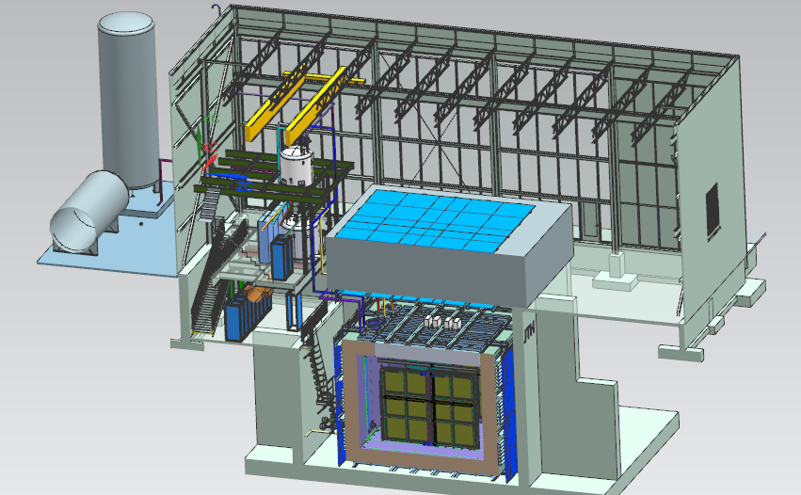
Near Detector - SBND
20 ton crane
Top CRT and Overburden
Cryogenic Dewars
Proximity Cryogenics
Readout racks
Top CRT
TPC
Cryostat
Side CRT

Slide 9
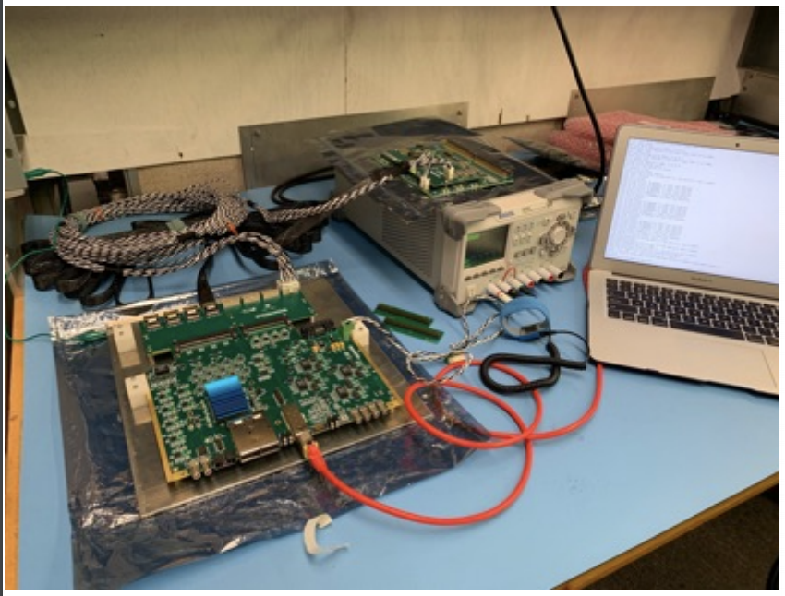
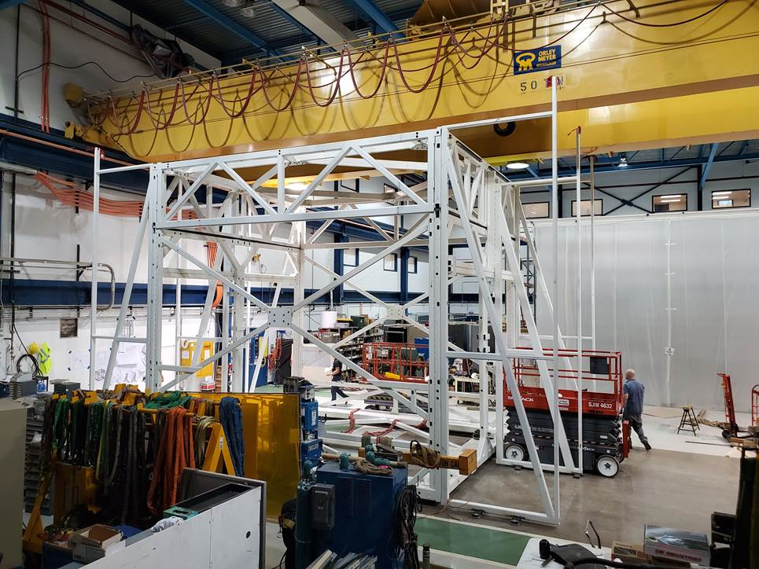
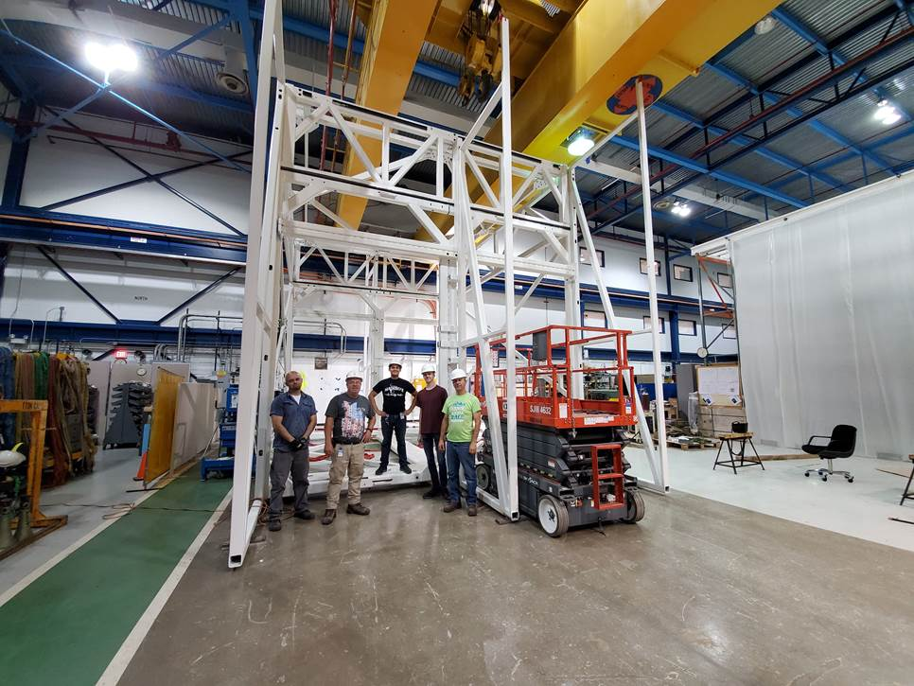
Near Detector Progress
Cold electronics reception test at Fermilab
TPC Electronics
Production nearing completion – remaining part is
All Front-End Mother Boards delivered to Fermilab and ready to install
Photon detection systems
PMTs under test at LANL
Adopted plan to shift R&D photon system from light guide bars + ARAPUCA to ARAPUCA + X-ARAPUCA. X-ARAPUCAs will use electronics developed for light guide bars (based on Mu2e CRT electronics). Aligning with current DUNE development diraction
TPC assembly (at Dzero):
First Anode Plane pair (of two pairs) complete and ready to install
Cathode Plane Assembly is ready to install
Field cage components are ready to install
assembly and transport fixture (atf) complete
Need to assemble tenting etc
Completing support beams and mounting components
Technical review of detailed assembly procedures Sept 18-19
Includes all TPC components and light detection systems
Assembly and transport fixture

Slide 10
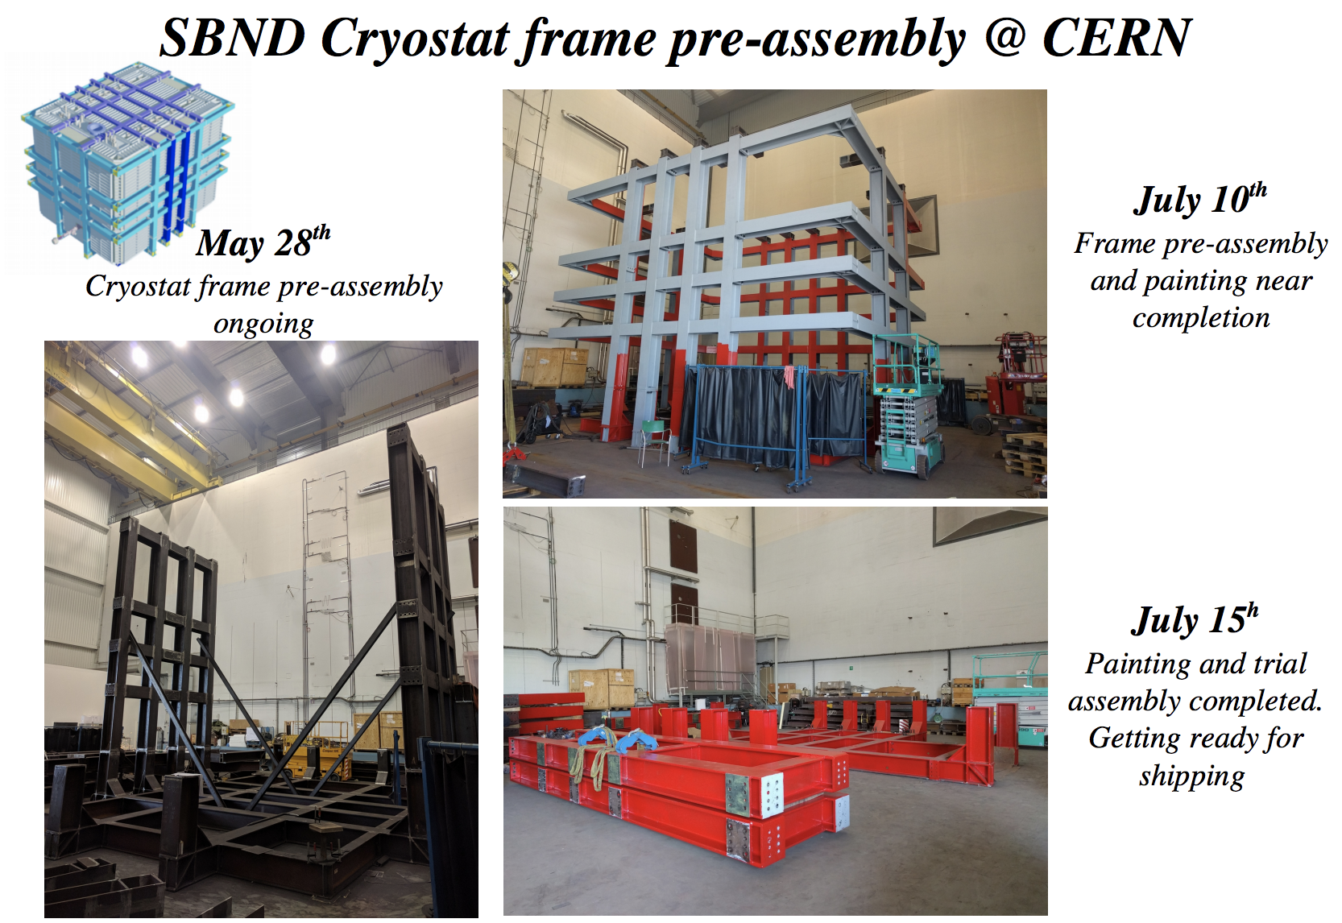
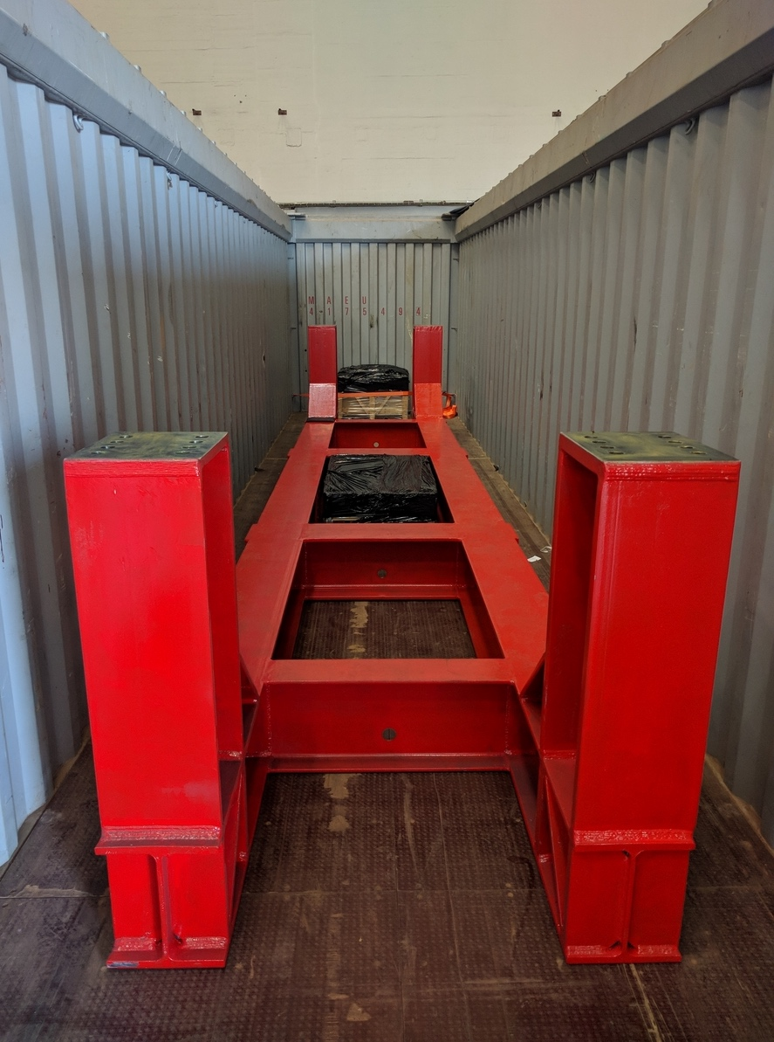
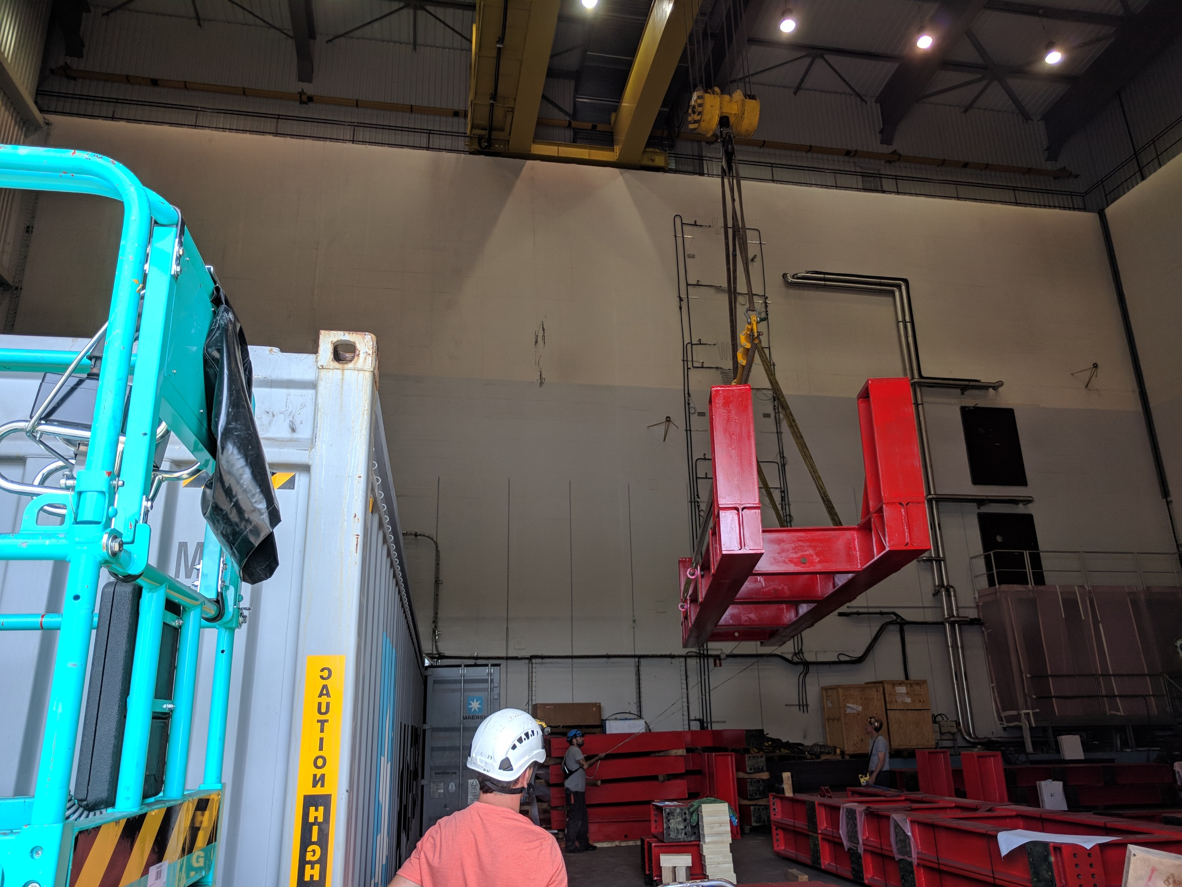
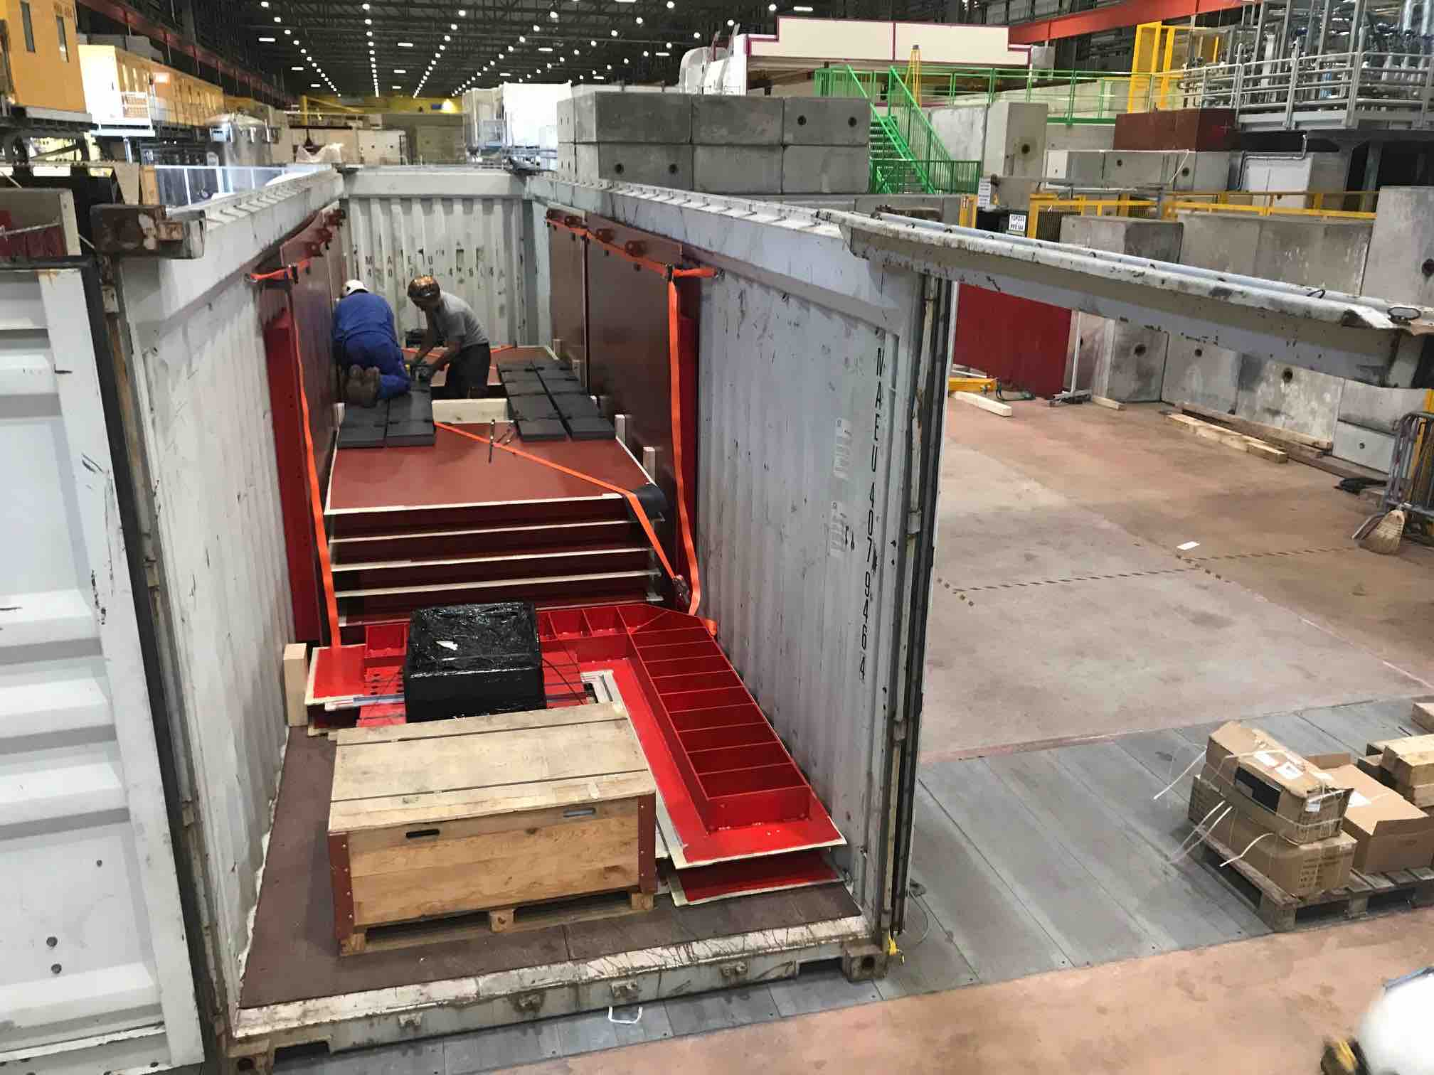
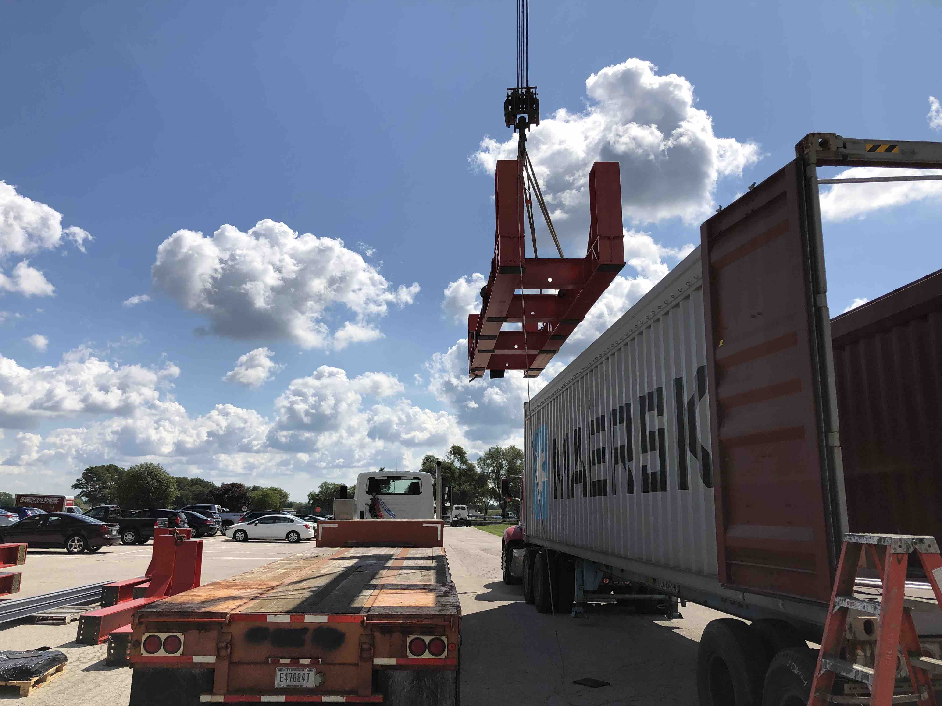
Near Detector Cryostat
Warm vessel frame preassembly completed at CERN and components delivered to Fermilab in late August
Side plate fabrication at CERN completed and shipped at the end of August. Delivery expected around Oct 1
Shimming and bottom CRT installation start next week
Warm vessel installation starts Sept 30 with team from CERN, INFN and FNAL
Design of membrane completed by GTT. CERN is working with CERN on pricing and delivery schedule.
Installation of the membrane is on critical path for SBND completion
(credit: Roberto Acciarri)
Loading of shipping containers at CERN
Unloading of shipping containers at FNAL

Slide 11
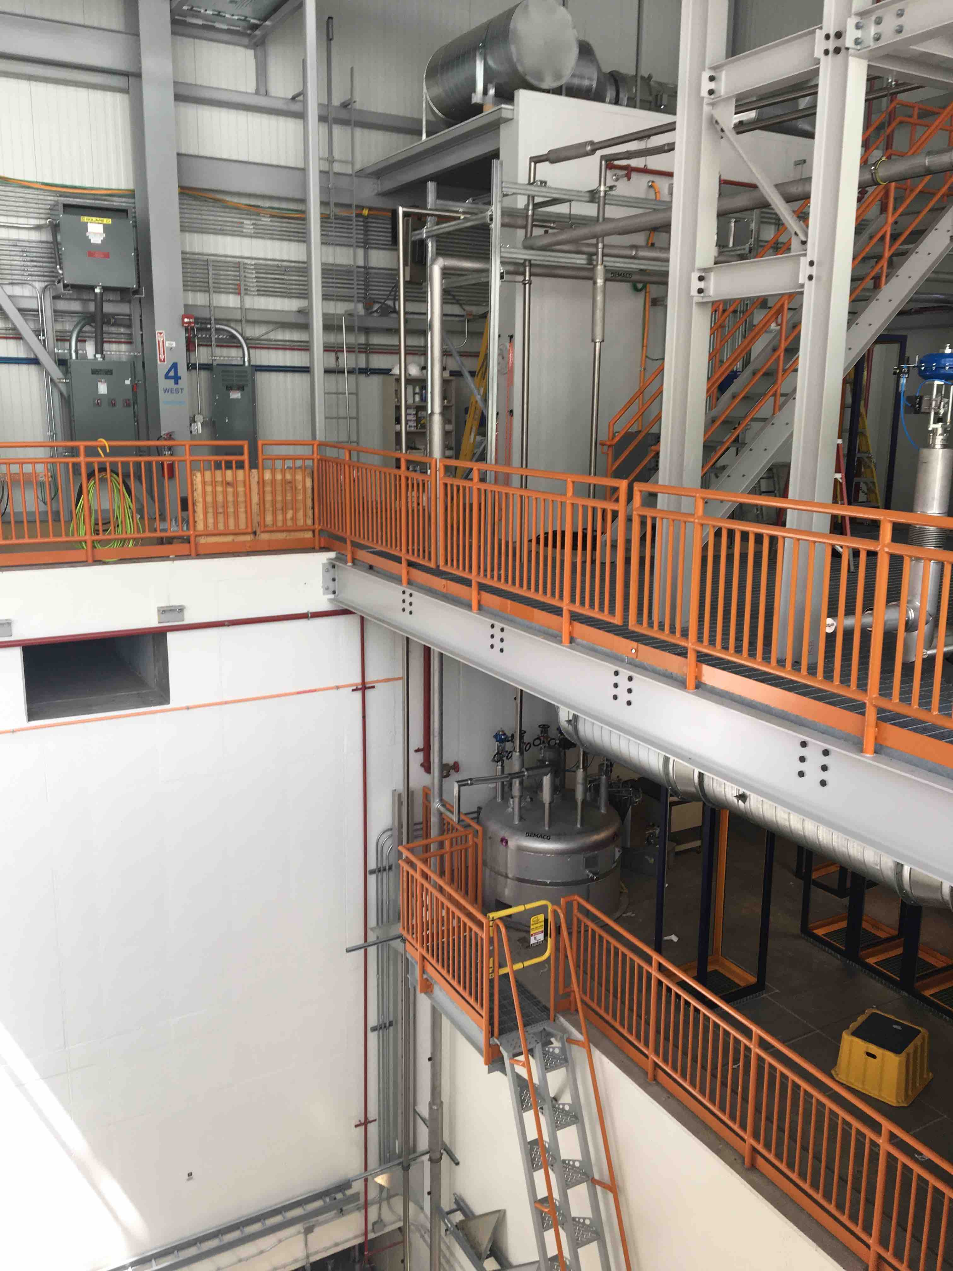
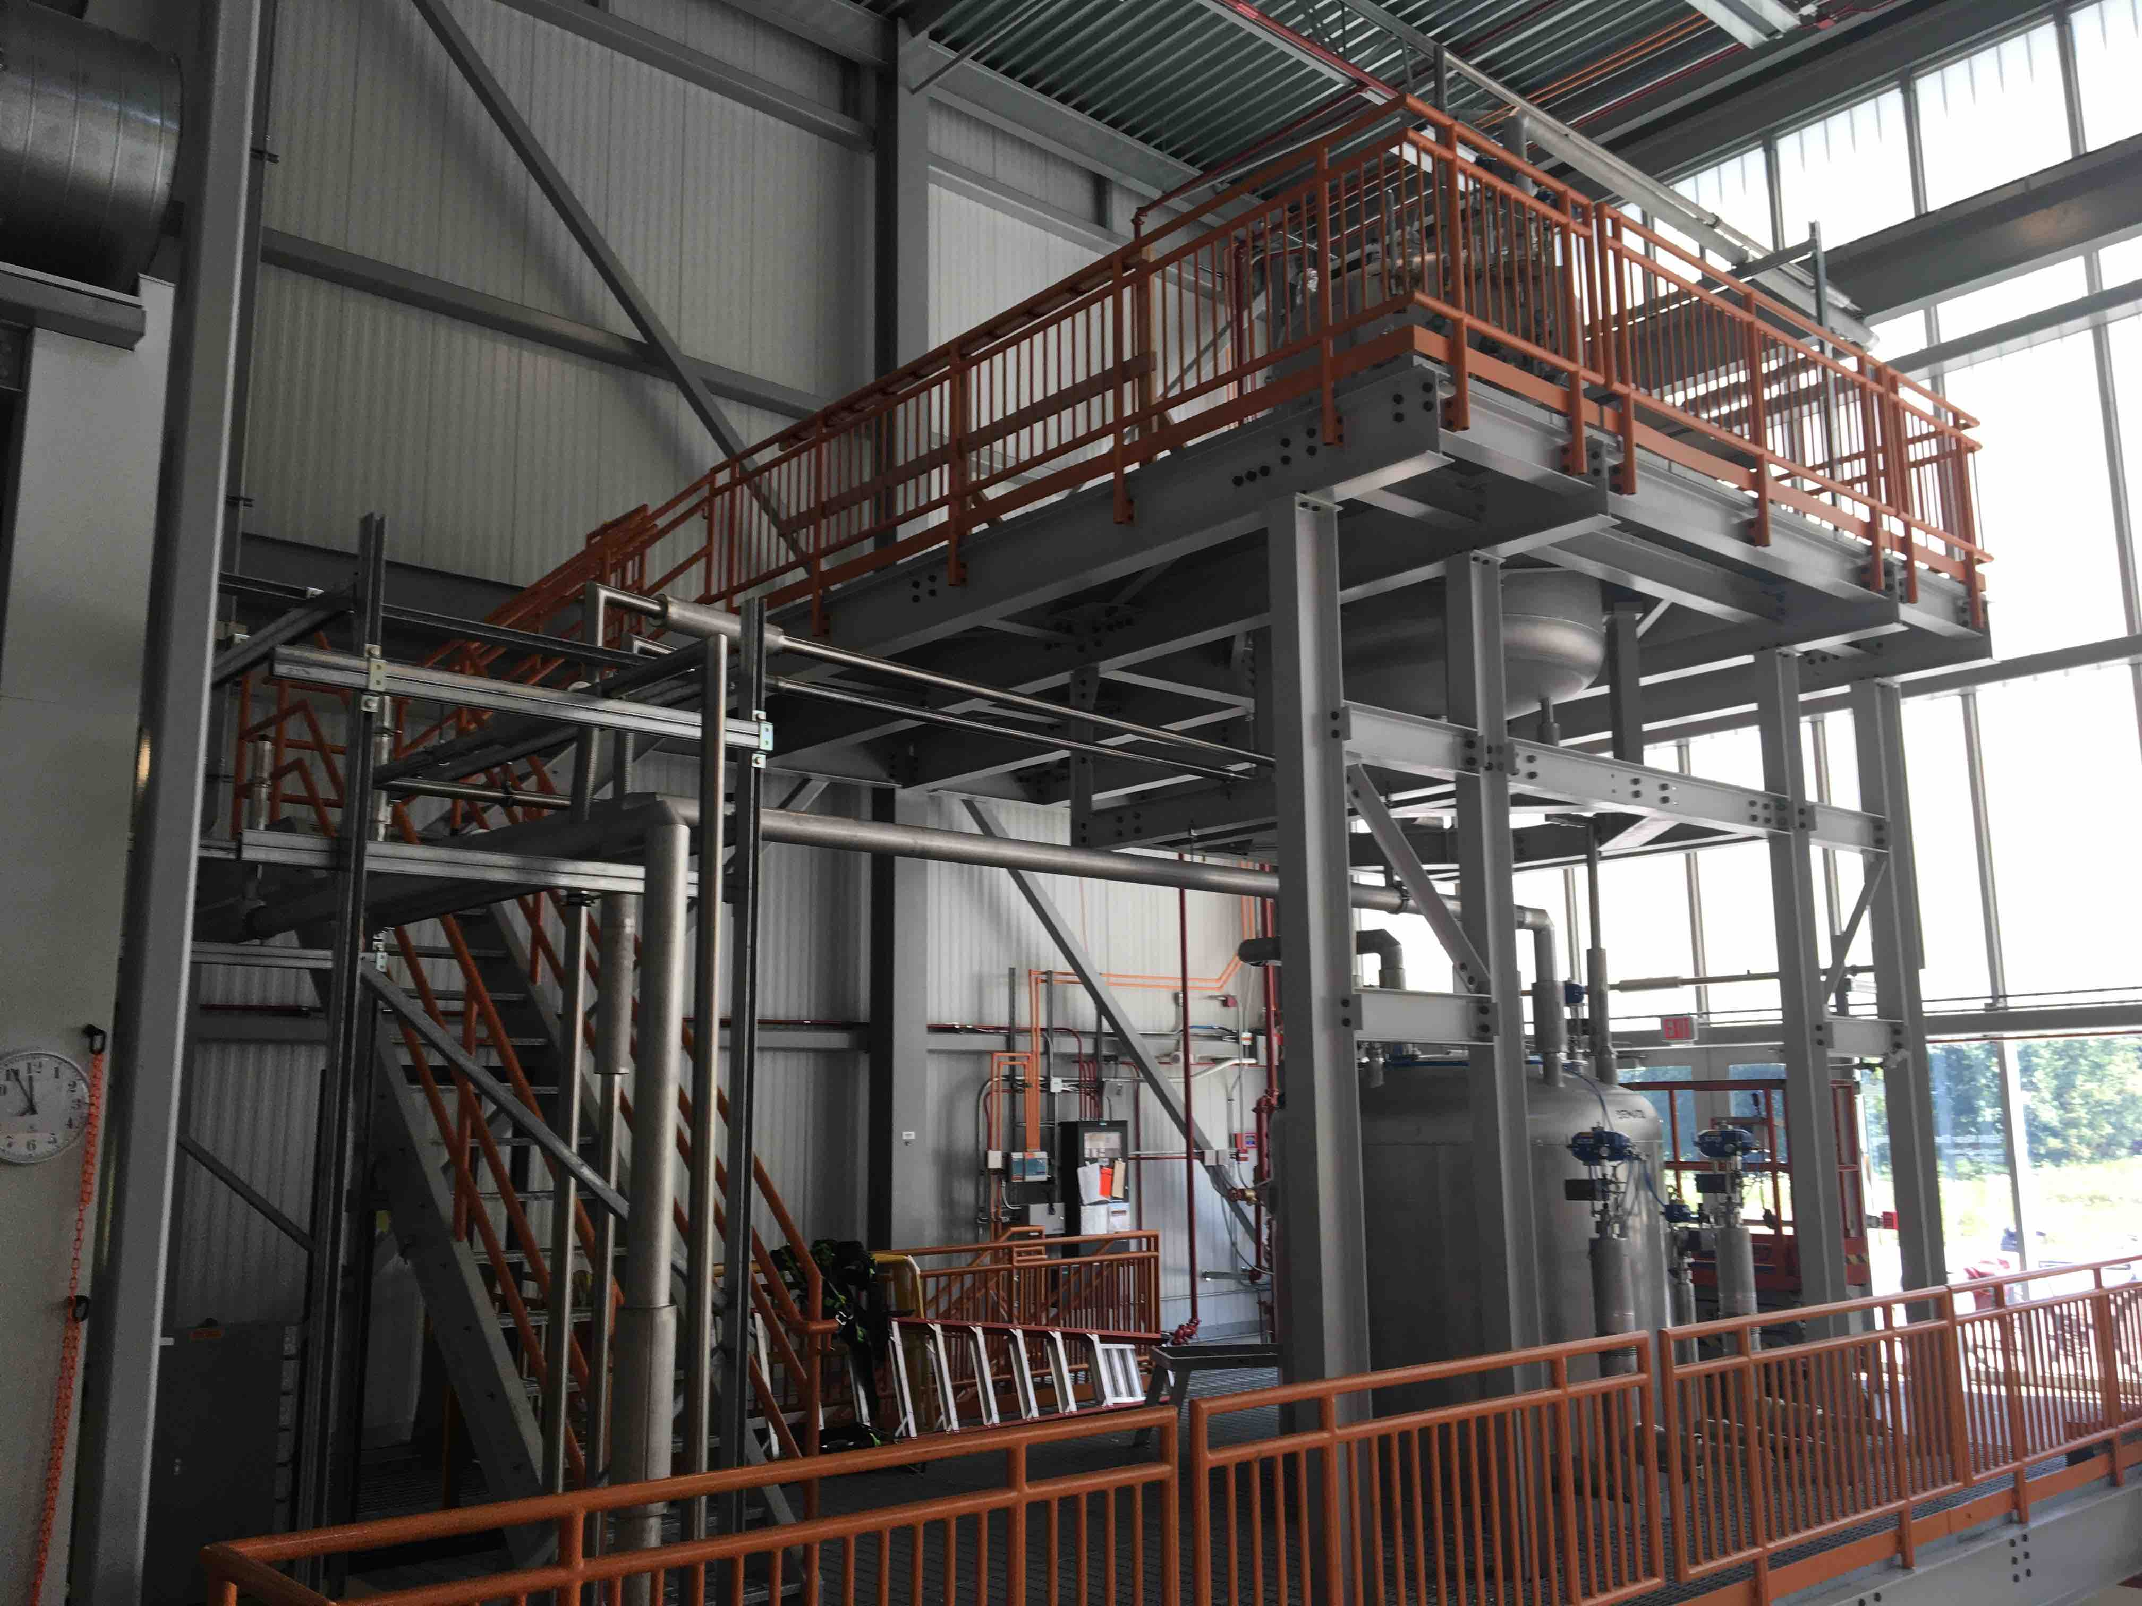
Near Detector Cryogenics
Demaco completed install of proximity cryogenics July 23.
Completed work with ~2 week effort in July (estimate was 3-4 weeks)
Ends a 6 month installation campaign at far and near detector buildings
Remaining FNAL deliverables about to enter final design before procurement: incorporating lessons learned from protoDUNEs and ICARUS
ND Proximity Cryogenics

Slide 12
SBND Milestones to S-1 SBND ready to move
(after July statusing)
Intermediate Milestone | Owner | Baseline Date | Forecast Date (Schedule) |  | Actual Date
First set of APAs shipped to Fermilab | K. Mavrokoridis | 24-Sept 2018 |  | ✓ | 4-Mar-2019
PO for COTS ADCs placed | H. Chen | 10-Oct-2018 |  | ✓ | 30-Oct-2018
All TPC Components at Fermilab | K. Mavrokoridis | 1-Mar-2019 |  | ✓ | 27-Mar-2019
Complete atf assembly at DAB | J. Zennamo | 1-May-2019 | 14-Aug-2019 | a
50% of motherboards delivered to Fermilab | H. Chen | 15-May-2019 |  | ✓ | 22-May-19
APAs and CPAs installed in atf | J. Zennamo | 15-Jun-2019 | 31-Oct-2019 | b
Field cage assembly complete | J. Zennamo | 15-Jul-2019 | 11-Dec-2019 | b
Cold electronics installed and tested | H. Chen | 23-Aug-2019 | 23-Jan-2020 | b
S1: TPC ready to move to SBN ND | A. Schukraft | 30-Aug-2019 | 28-Jan-2020 | b
The atf fabrication delay propagates through the rest of the schedule leading to S1.
Planning to accelerate the schedule by parallelizing some of these tasks. Expect S1 before end of CY 2019.

Slide 13
SBND Milestones to S-2 Ready to Fill
(after July statusing)
Intermediate Milestone | Owner | Baseline Date | Forecast Date |  | Actual Date
GTT Design Study Begins | M. Nessi | 1-Feb-2019 |  | ✓ | 26-Apr-2019
Delivery of warm box steel | M. Nessi | 15-Jun-2019 | 16-Sept-2019
Warm vessel installation complete | M. Nessi | 15-Jul-2019 | 15-Nov-2019
TPC Transport to ND building complete | J. Zennamo | 15-Sept-2019 | 5-Feb-2020
Cryostat material arrives at Fermilab | M. Nessi | 1-Oct-2019 | 12-Nov-2019 | c
Cryostat top plug is ready to attach to atf | M. Nessi | 1-Nov-2019 | 25-Mar-2020 | c
Membrane Cryostat Completed | M. Kim | 1-Mar-2020 | 22-Jan-2020 | c
Plug welded to cryostat | M. Kim, J. Zennamo | 15-Apr-2020 | 9-Jul-2020 | c
Cryogenic operation approved | M. Geynisman | 1-Jul-2020 | 30-Sept-2020 | c
S2: SBND detector is ready to fill with liquid Argon | A. Schukraft | 15-Jul-2020 | 30-Sept-2020 | c
c) Membrane cryostat and top cap schedule are not updated and subject to change

Slide 14
Transition to Operation Planning
Address commissioning and operations plans for both detectors and associated support (e.g. cryogenics, online computing, data storage)
Transition to Operations Team
Angela Aparicio – Neutrino Division (ND) Safety Officer
Steve Brice – ND Representative
Angela Fava – Far Detector Deputy Technical Coordinator and Commissioning Coordinator
Claudio Montanari – Far Detector Technical Coordinator
Barry Norris – SBN Program Engineer and Head of ND Technical Support Dept
Dave Schmitz – SBND collaboration representative
Michelle Stancari – Near Detector Commissioning Coordinator
Peter Wilson – Program Coordinator, chair of TOT
Bob Wilson – ICARUS collaboration representative
Wes Ketchum - Scientific Computing Division representative
Meetings since February to define organizations and prepare Experiment Operations Plan (EOP)
Outline of EOP discussed at last meeting.
EOP is the primary document to be reviewed in the Operations Readiness Review
ND Technical Support Dept finishing Cryogenics Operations Support plan
Extension of existing support plan for MicroBooNE to support all LAr detectors detectors
Takes effect as cryo commissioning completes

Slide 15
BNB Beam – Start of 2019-2020 beam period
Slide from Cons Gattuso of AD Operations
Note: standard FNAL beam schedule is based on US Fiscal year with beam operation typically starting in October (beginning of FY) and ending with a maintenance shutdown of several months at the end of the summer

Slide 16
Beam schedule in Fiscal Year 2020 (FY20)
Slides from Mary Convery (Deputy Head of Accelerator Division)

Slide 17
Beam Delivery Goals in 2020
Slides from Mary Convery (Deputy Head of Accelerator Division)
Red = Design
Blue = Base

Slide 18
Beam in 2021
Expect FY 2021 beam startup to be similar to FY 2020 or slightly later accommodating the 5 month FY2020 shutdown
BNB startup between Oct 1 and Nov 1
Expect FY 2021 shutdown to be normal duration of about 3 months probably starting in July
Performance curves for BNB delivery of protons/month to BNB should be similar to 2019 and 2020

Slide 19
Upcoming Reviews
There will be a Operations Readiness Review held by the laboratory in February 2020 covering: SBN Operations Phase 1: Far Detector Only
Preparation for this review is the responsibility of the collaboration
A follow-up review will occur when the Near Detector makes the transition to operations
Exact review date still to be set. Should occur with sufficient time to have established functionality of major detector sytems
The next SBN Director’s Review is scheduled for the week of Feb 17, 2020. The review will be focused on completing the SBND installation and transition of SBND to operations

Slide 20
Backup

Slide 21
Safety and Work Planning
Safety of people must remain the top priority for the SBN program. This is the responsibility of everyone involved.
A work planning process was created by Aria Soha (Far Detector Installation Coordinator) which has been used for installation activities by Fermilab, CERN, Demaco, and the collaboration.
The goal is safe and efficient planning of work
Flexibility to allow for unknowns is essential
If the conditions change: stop and discuss the plan before continuing
This process has been adopted for SBND activities
As ICARUS transitions from installation to commissioning Aria’s role as Installation Coordinator is coming to an end, Primary responsibility moves to Commissioning organization
Need to maintain discipline of planning work through these transitions
Written work plans for major activities
Work plans will now be presented and reviewed in the Wednesday morning ICARUS meeting
Hazard Analyses for activities with significant hazards per Fermilab Environment Safety and Health Manual (FESHM) chapter
Discuss all work of the day at daily Toolbox Meeting (currently at 8am at SBN FD)

Slide 22
ODH and Work Planning
Before the LN2 is introduced into the cold shields the area below grade in the SBN FD Building will become an Oxygen Deficiency Hazard (ODH) Class 1 area
Work below grade will only be permitted for ODH Qualified personnel: ODH training and medical exam by Fermilab
This will remain in effect for the duration of the experiment
Details of implementation will be communicated in the coming weeks
During cryogenics commissioning (LN2 cooldown and Lar fill) additional restrictions will be in place that will severely limit access below grade
Will require permission and escort by Cryo team
These will remain in place until cryogenics have been stabilized after the fill
Need to get as much installation completed as possible before cooldown
These restrictions encourage us all to plan work on the detector and mezzanines even more carefully to perform remaining installations efficiently and minimize future access

