Slide 1
LCLS-II LLRF Design, Production & Ongoing Tests
Andy Benwell on behalf of LCLS-II LLRF Collaboration
LLRF 2019
10/3/2019

Slide 2
Outline
LLRF overview
Recent development and testing
3.9 GHz preparation
Hardware status
Summary

Slide 3
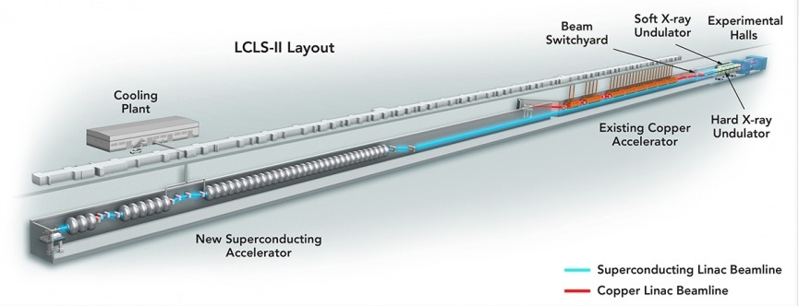
LCLS – II
The Linac Coherent Light Source (LCLS-II), in Menlo Park, CA is designed produce a 4 GeV electron beam at high repetition rate (up to 1 MHz) for Soft X-ray (SXU) and Hard X-ray (HXU) Undulators
In order to accomplish this, SLAC will install 280 1.3 GHz SRF cavities and 16 3.9 GHz SRF cavities in the first third of the 2-mile accelerator housing
Superconducting RF is new for SLAC – we have benefitted greatly from the LLRF collaboration

Slide 4
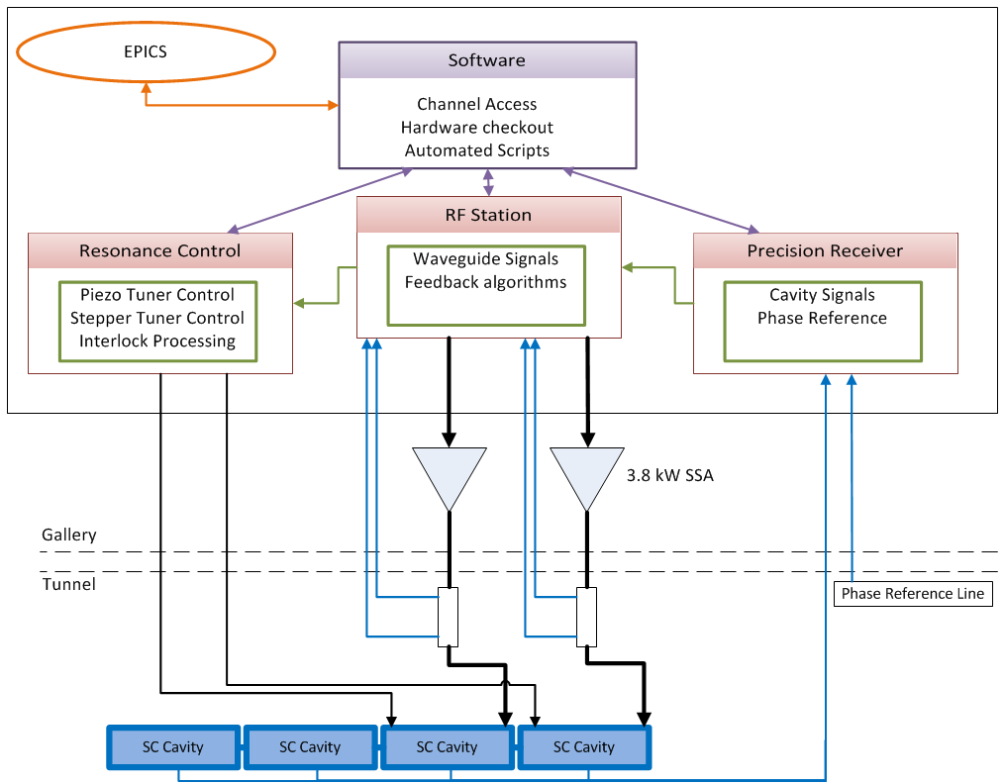
LCLS–II LLRF System Overview
Hardware/Firmware
Precision Receiver Chassis (PRC)
Exclusively for cavity signals
Fiber communication for high Isolation necessary for 0.01º/0.01%
RF Station (RFS)
Generates independent RF signal for 2 cavities
Forward, Reverse and SSA Drive signals
Detune calculation, PI loop control
Resonance Control
Piezo Control, Stepper Motor Control
Temperature Monitoring
Interlock processing
Software
Automated Scripting
Cavity and SSA characterization
Channel Access
EPICS
All control displays and waveform readouts

Slide 5
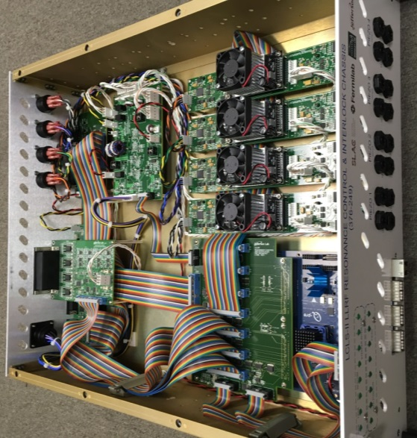
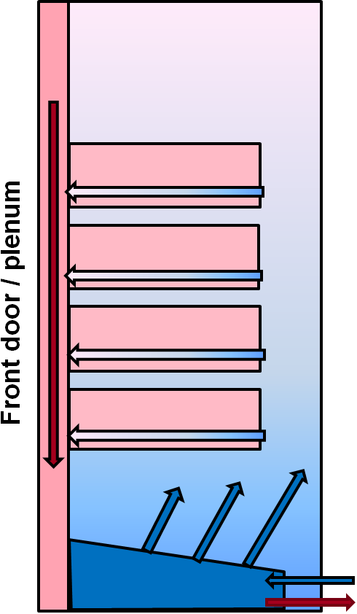
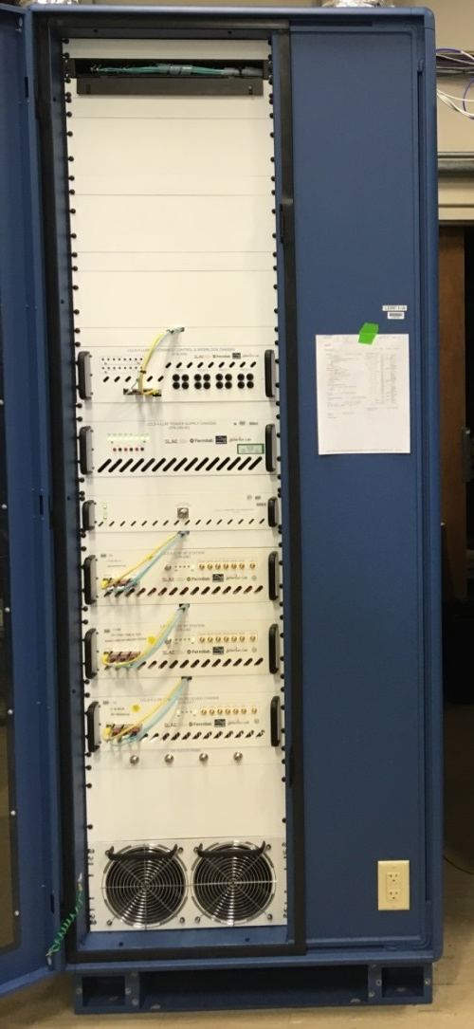
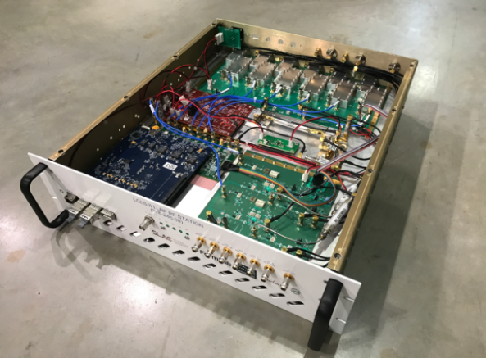
LLRF Rack System
Resonance Control
Coupler/Stepper
Temperature
Interlock
digital I/O
Stepper tuner
driver
PS Board
FMC Breakout
QF2-pre Digital Carrier
Piezo tuner
drivers (x4)
RF Station
PS Board
Down
Converter
Digitizer
QF2-pre
Digital Carrier
Up
Converter

Slide 6
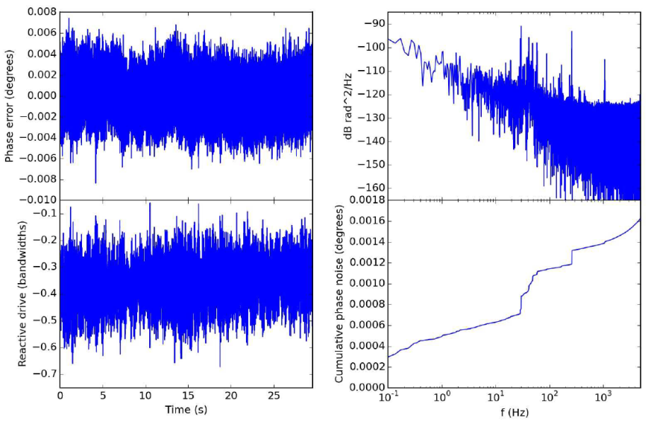
2 years ago
Prototype testing at FNAL
Controlled multiple cavities simultaneously in SEL and GDR mode on a cold cryomodule
Semi-automated cavity turn-on scripts find phase in SEL and ramp amplitude, even with significant low field detuning
Out-of-loop phase error < 2x10⁻³ deg rms
In the last year, efforts have been made toward
preparing the system functionality for commissioning
improving user experience
supporting cryomodule testing with custom applications
Notes:
This slide demonstrates that the LLRF system can control a cryomodule with outstanding performance.
Phase noise of the LLRF system is exceptionally low.
The LLRF system can control gradient with a PI loop with high precision.
PI coefficients can be even further optimized, these were set manually to demonstrate the system performance
A step change was introduced at the same resolution of the amplitude regulation spec. The over shoot is tiny for this step change on the order of 100 us
Make a point to mention Larry’s (the architect) talk who is the expert on this system, and its tests, Larry will discuss these tests and more in detail

Slide 7
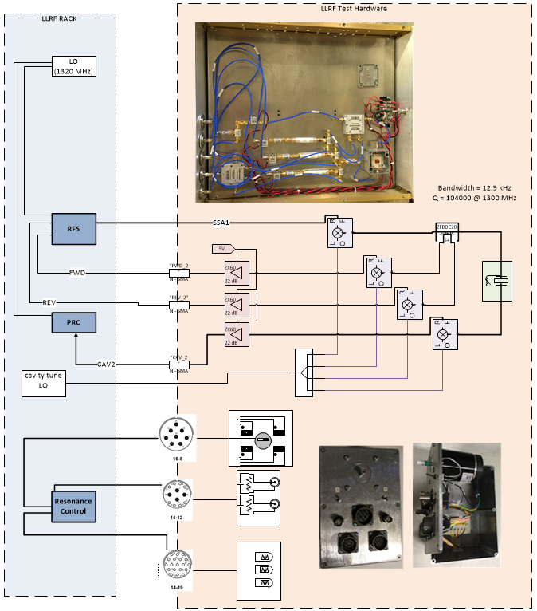
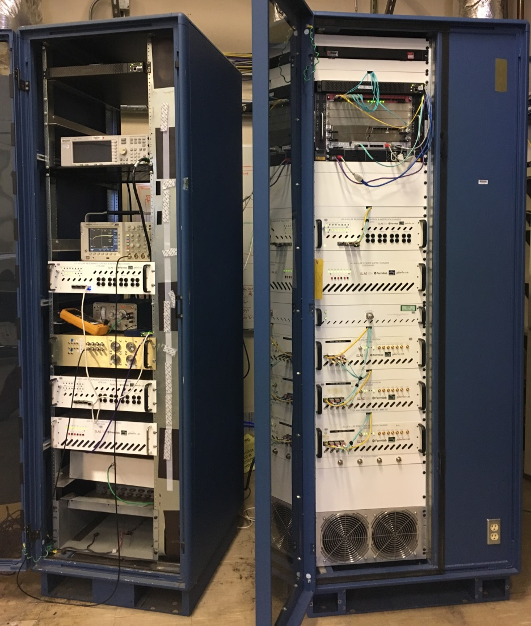
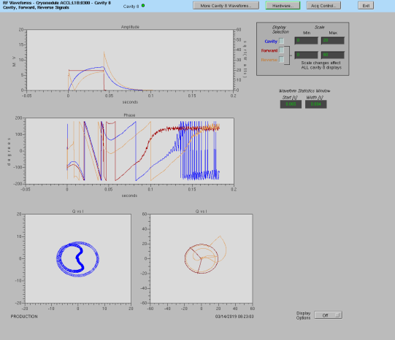
Recent Test History - SLAC
SLAC LLRF rack system used for production hardware testing and rapid software prototyping
Full set of LLRF hardware
Test loads to simulate cryomodule
Narrowband low power cavity
Stepper motors, piezo tuner loads
Linux RT computer
Timing crate
Great for hardware testing and software prototyping but cannot support testing unique issues of SRF cavities

Slide 8
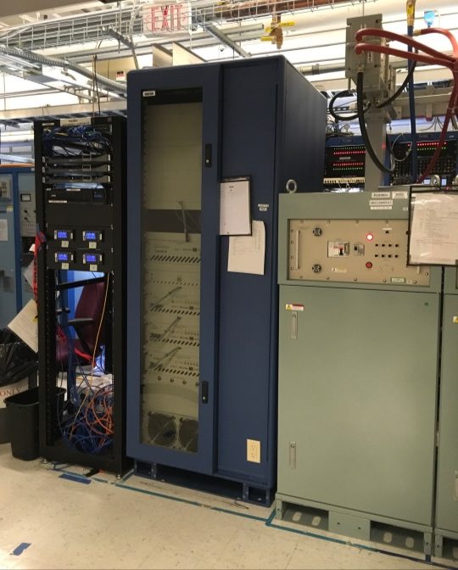
Recent Test History – JLab LERF
JLab LERF facility
RF supported exclusively by LCLS 2 design
All production equipment must work!
Mandate for system to be as close to production as possible
All modes of operation (SEL, SELAP, Pulsed)
SSA and LLRF control
User interfaces
Calibration routines
Production IOC
PV naming conventions
Tuning scripts
Operator and expert interfaces
Cryomodules controlled by physicists and operators
All difficulties and issues immediately communicated
Tools as requested and deemed necessary for SRF cavity evaluation

Slide 9
Control improvements
Characterization
Calibration
Steady state operation (optimization)
Interlocks
Resonance Control

Slide 10
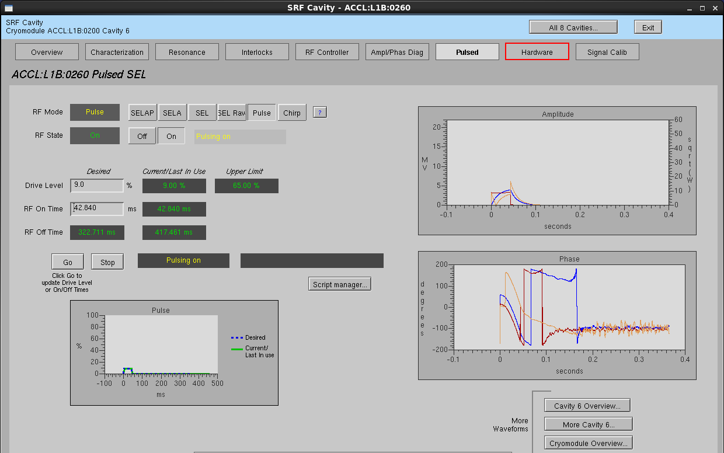
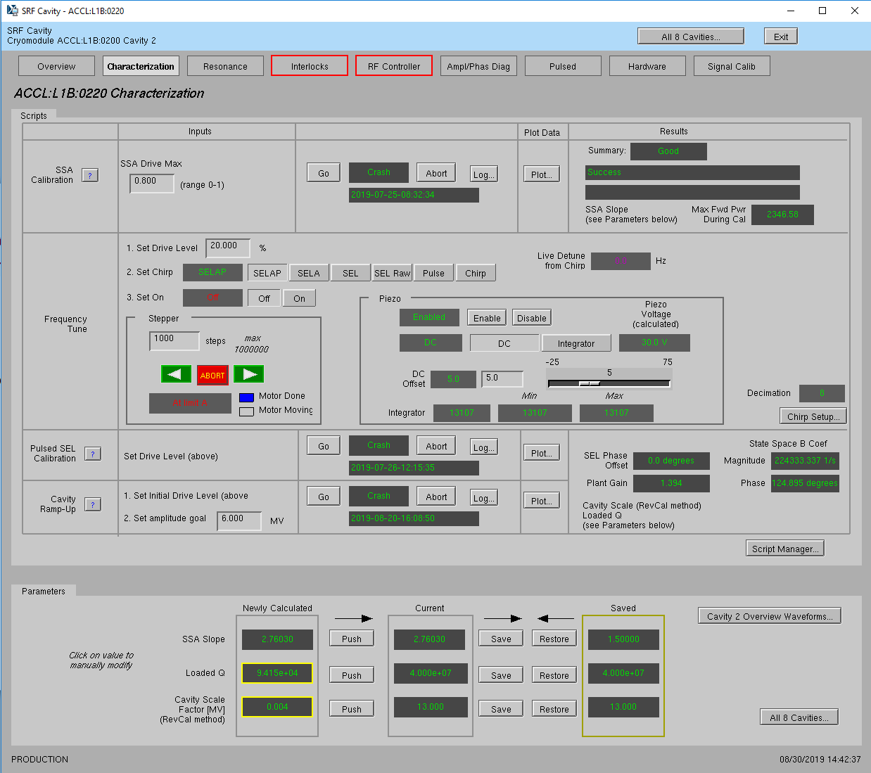
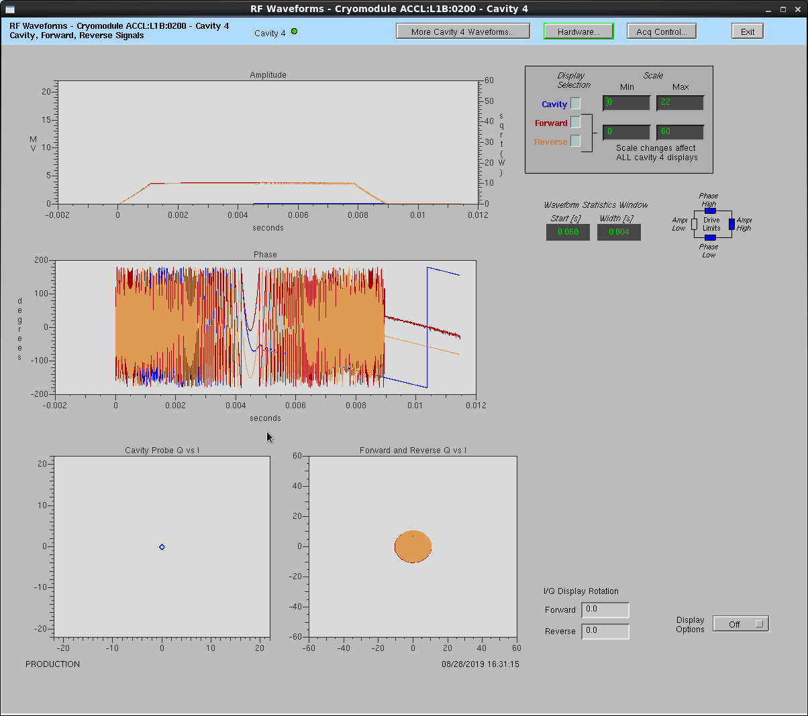
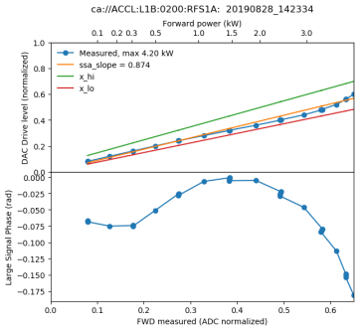
Characterize System and Go
4 “easy” steps
SSA calibration
Chirp detune scan
Immediately “find” cavity and enter SEL
Enable faster tuner response to center cavity at nominal frequency
Pulsed SEL calibration
Measures loaded Q
Calculates cavity scale factor, based on energy integration
Set up to target field in SELAP mode
Cavity Forward Reverse

Slide 11
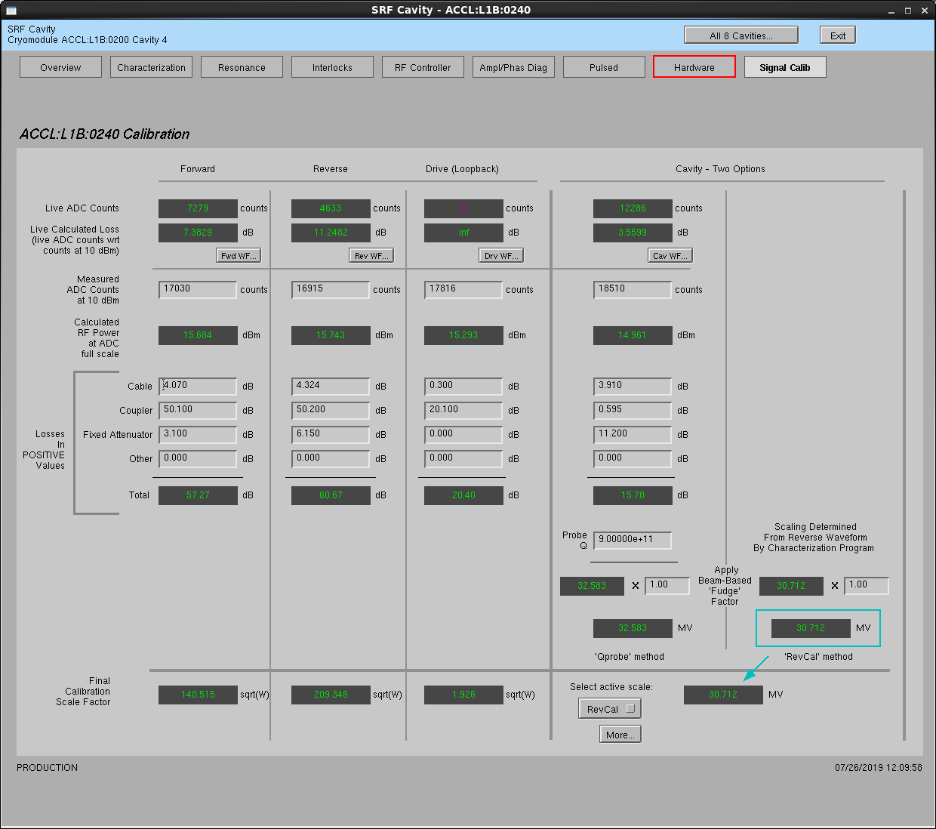
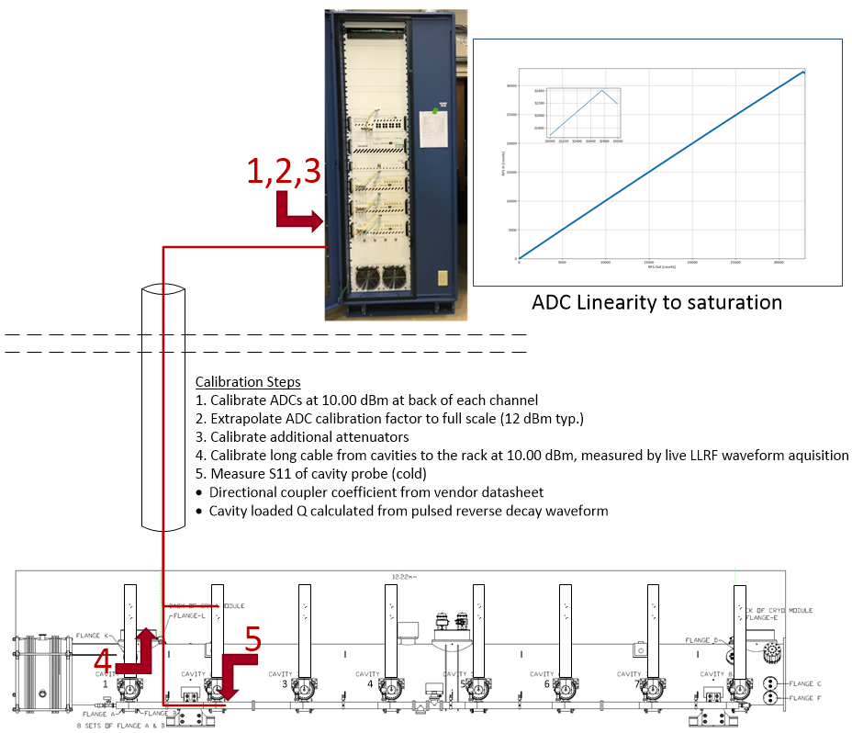
RF system calibration

Slide 12
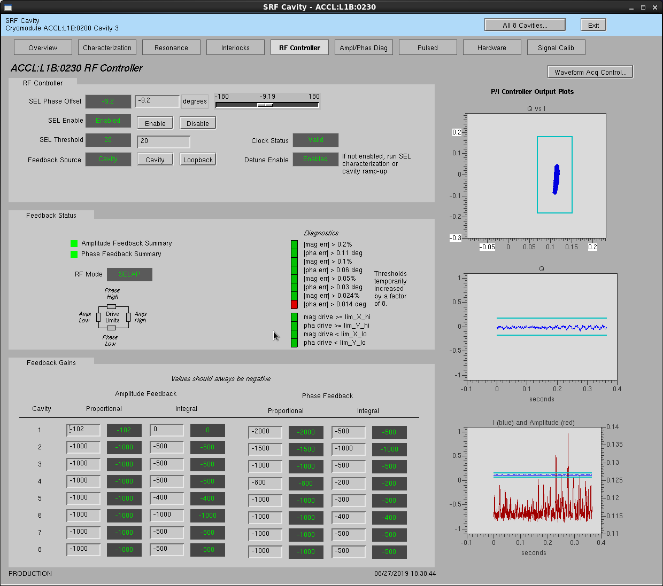
RF control and optimization
Expert level controller
Phase and amplitude P & I coefficients
Target stability summary
Reactive and real power status and clip limits
If a cavity frequently clips into SEL mode, envelope settings can be adjusted
Real microphonics not suppressed here

Slide 13
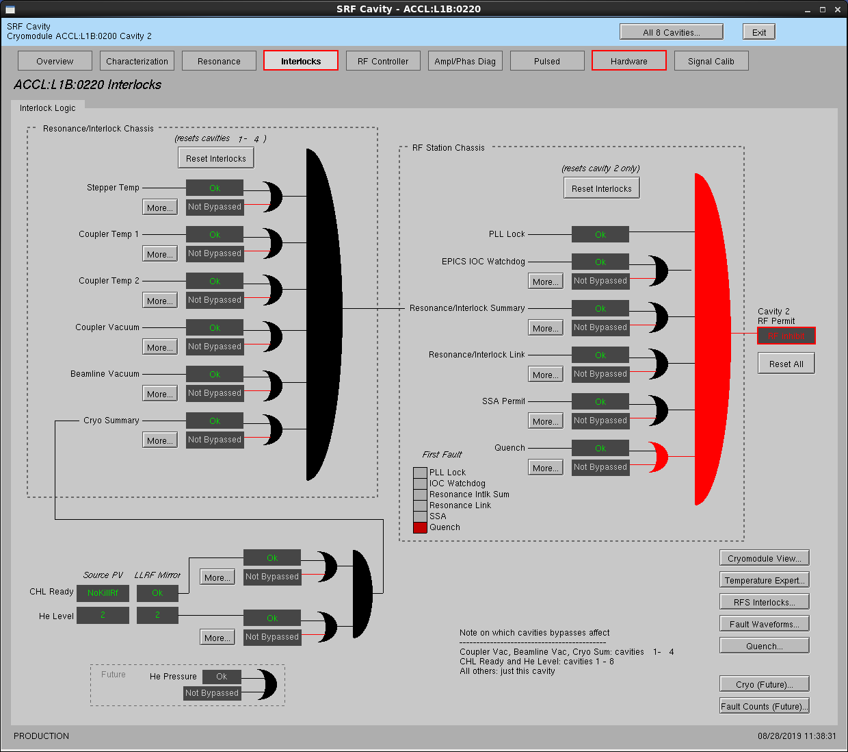
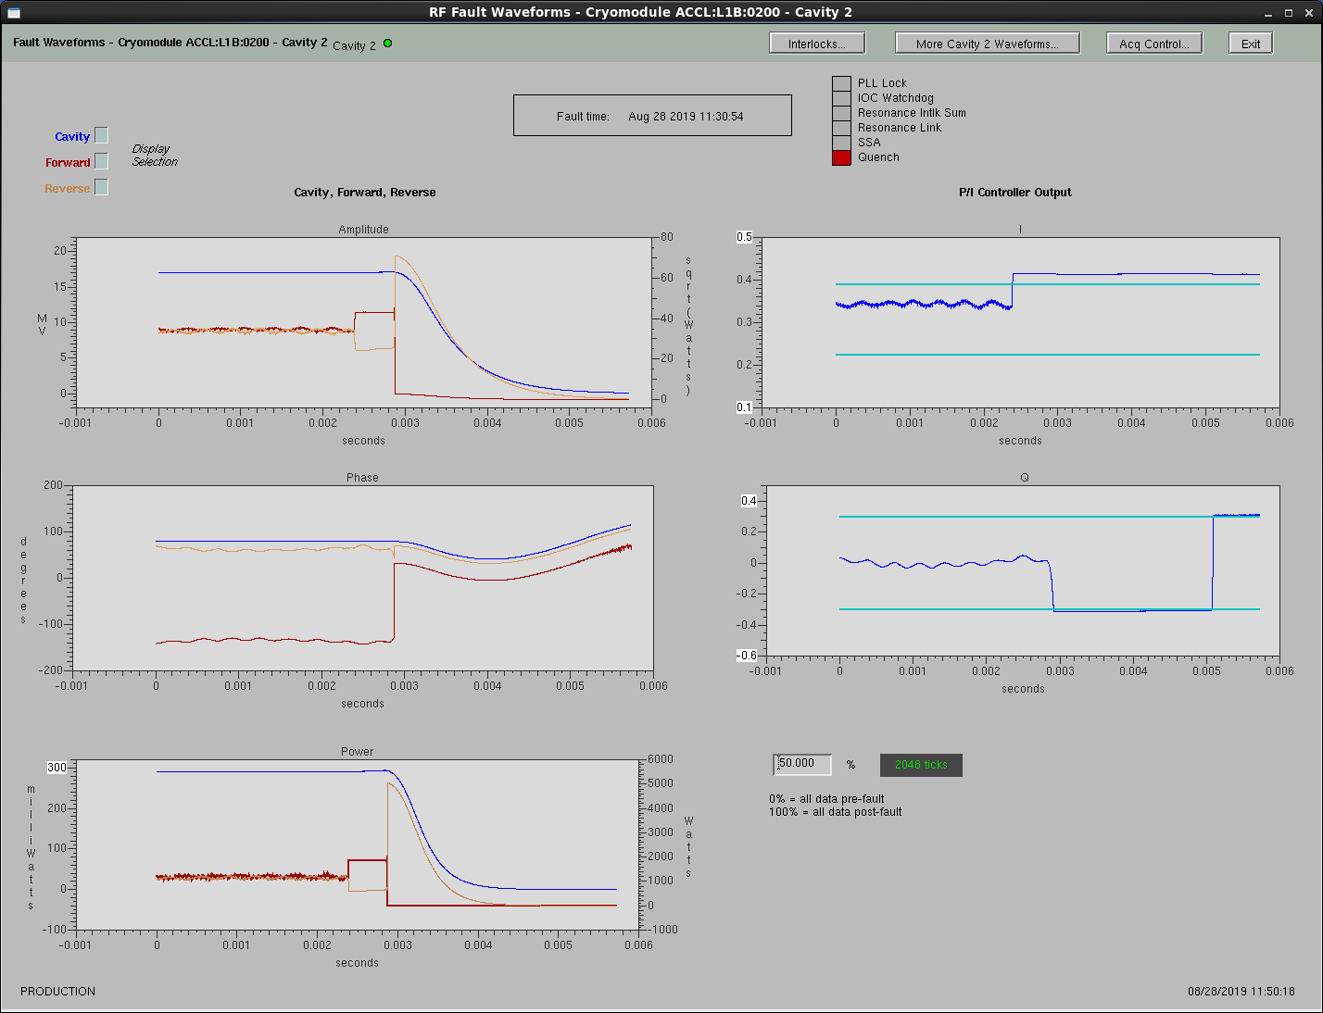
Firmware Based Interlocks
All fault information embedded into firmware
SSA permits
IOC watchdogs
Stepper tuner temperatures
Limit switch status
Coupler temperatures
Vacuum status
Cryo-system summary
Quench detection
Enables fast response and fault waveform capture
FPGA detected quench fault
Waveform acquisition halted and displayed (with appropriate time scaling)

Slide 14
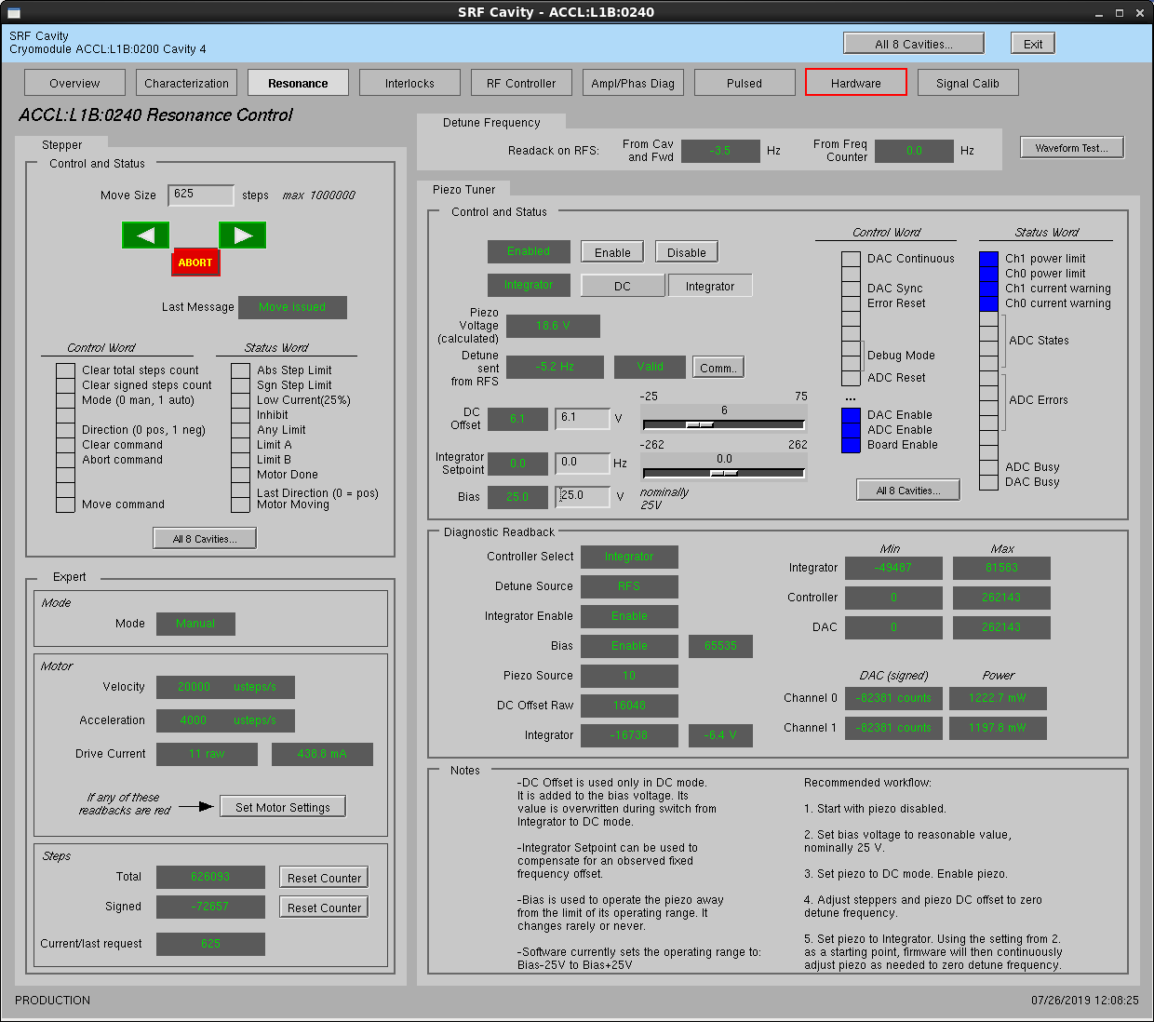
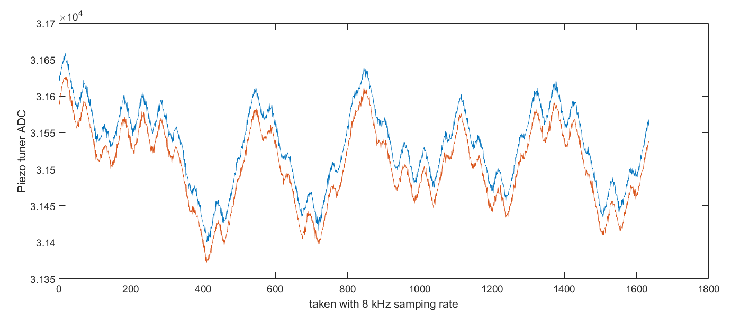
Resonance Control
Piezo tuner feedback loop keeps cavity tuned for long periods of time
Stepper motor can be used to re-center the piezo tuner as needed
Piezo tuner DAC waveforms on acoustic time frames

Slide 15
Detune waveforms
Resonance Control waveforms exported
Cavity detune information displayed
FWD power to maintain gradient

Slide 16
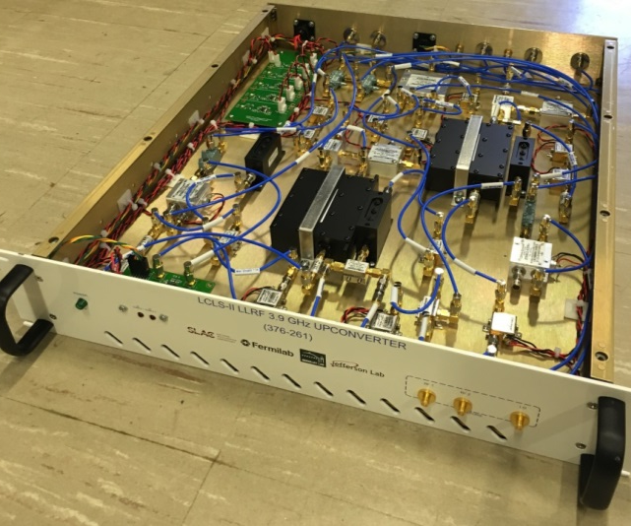
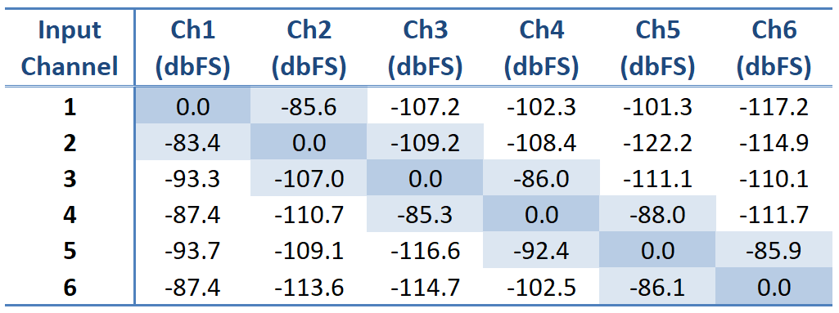
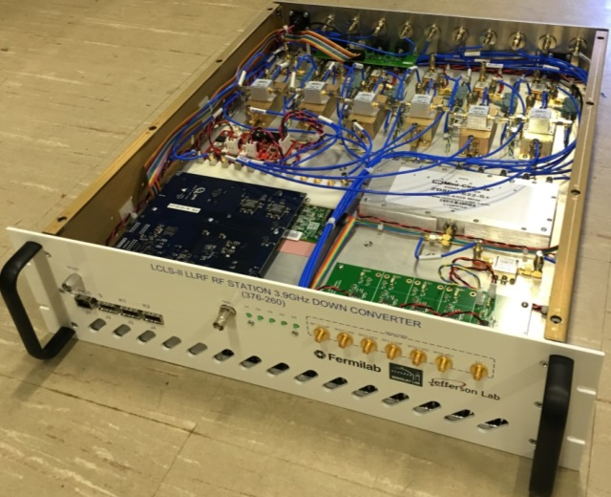
3.9 GHz Preparation
A 3.9 GHz version of the LCLS 2 LLRF system is expected at Fermilab this fall
Hardware architecture similar to 1.3 GHz chassis
Up and down conversion separated into two chassis due to size of connectorized components and reduced total quantity
Resonance Control is identical to 1.3 GHz
Chassis performance must be similar to 1.3 GHz system
This is the only LLRF system being built for 3.9GHz Harmonic Linearizer CM testing
LERF development has enabled this system to be ready for 3.9 GHz cryomodule testing

Slide 17
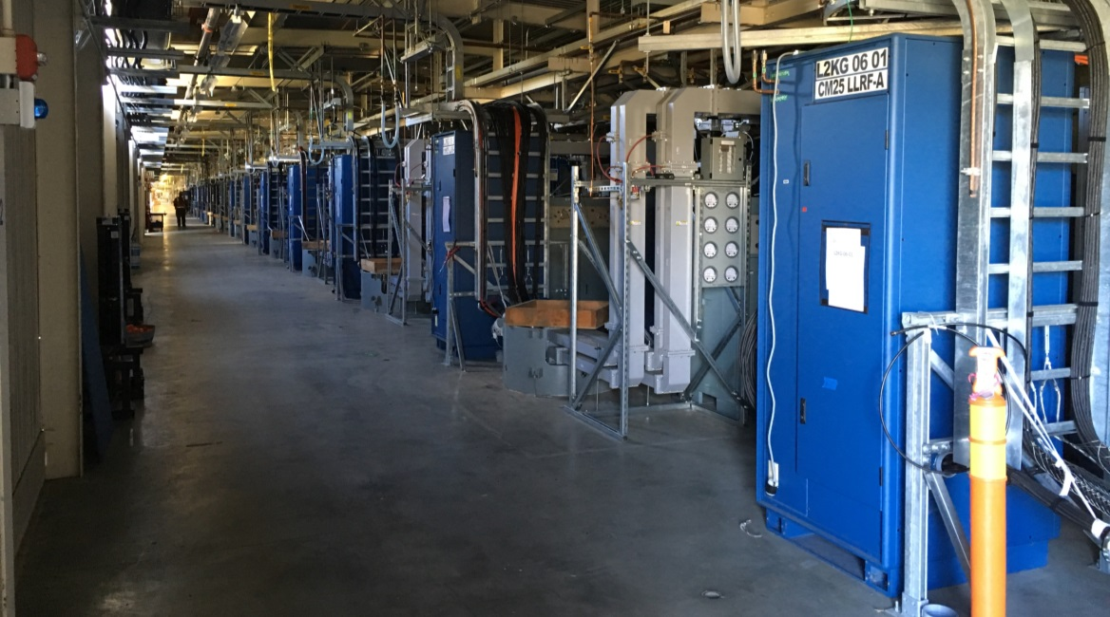
Production Hardware Status
LCLS – II is composed of 37 superconducting cryomodules
296 SCRF cavities
Single Source Single Cavity for precision field control with high Q
SSSC dramatically increases RF system component count
76 total LLRF racks
236 RF chassis (RFS or PRC)
74 resonance control chassis
78 power distribution chassis
84 LO timing distribution chassis

Slide 18
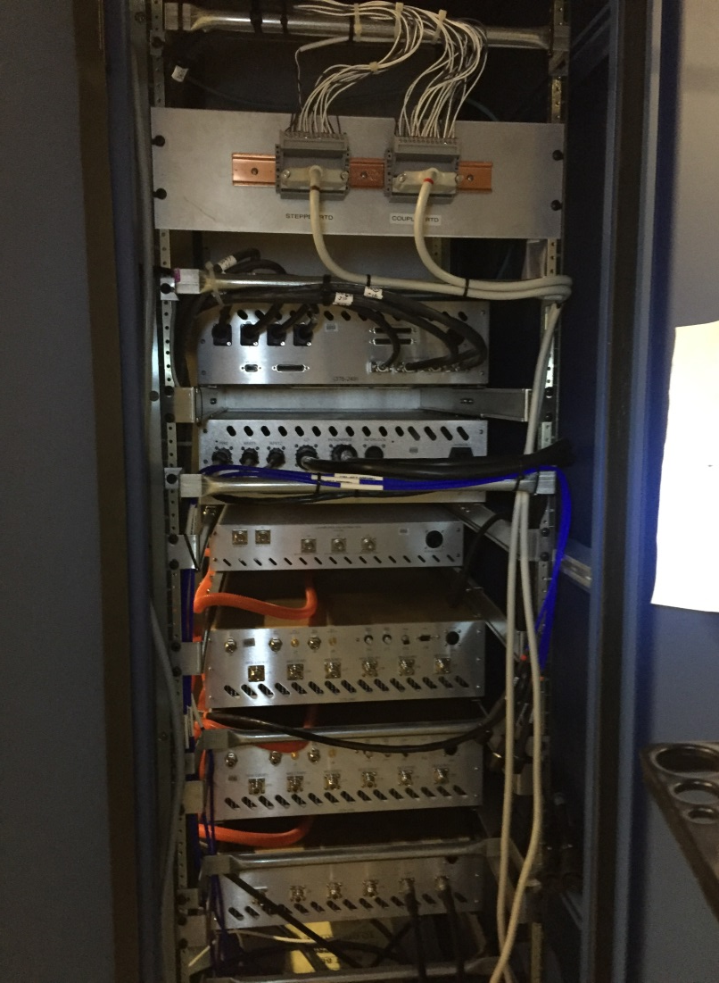
Production Hardware Status
All 1.3 GHz racks have been built, loaded, and installed in LCLS2 gallery
Fiber optic cabling
Internal RF cabling
Power Distribution
Internal plumbing
Mechanical infrastructure (rails, panels, strain relief)
Racks will undergo full LLRF checkout and calibration in field as soon as AC power is available

Slide 19
Summary
LCLS 2 LLRF system has demonstrated its ability to meet design specifications
The control system and user interface have undergone tremendous progress towards commissioning readiness
Over 20 people (SLAC and experts from other labs) have run cryomodules at LERF
Their pokes, prods, and comments and been incredibly valuable
3.9 GHz system has been built, and partially tested
It is the next system to be commissioned as part of cryomodule testing at FNAL
Gun and Buncher LLRF have already transitioned to operations successfully
Heading toward commissioning at SLAC, hardware installation is progressing well
There is still plenty of work to do!

Slide 20
Lots of ongoing development
Kintex Ethernet over fiber (high speed data transfer)
LCLS 2 timing system integration
Beam Synchronous Acquisition
Machine Protection System protocol integration and testing
Phase averaging Reference Line
Improved diagnostics on existing waveforms
Buffer freeze during non-trip events (e.g. RF clipping)
Improve/automate feedback gain
Improve clip limit interface
And if the project becomes interested
Active Resonance Control Implementation
Previously demonstrated at Fermilab, but no automation

Slide 21
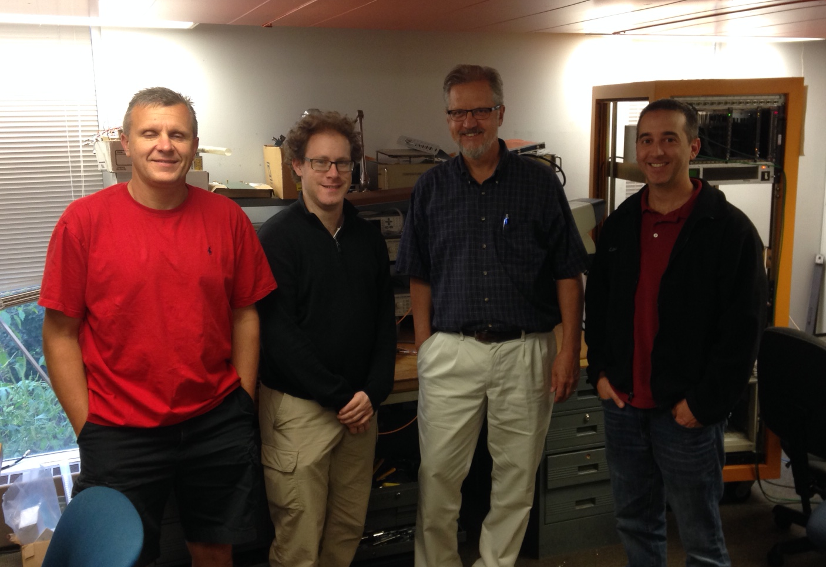
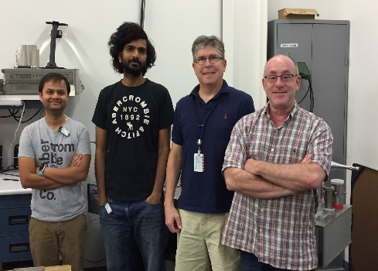
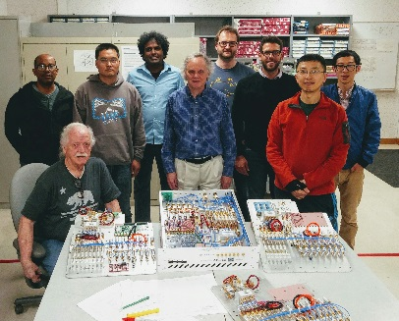
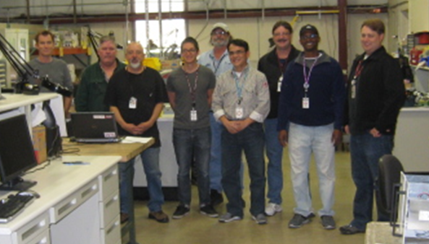
Questions?
SLAC
A. Benwell
M. Boyes
G. Brown*
J. Diaz
B. Hong*
S. Hoobler*
A. Johnson
J. Jones*
R. Kelly
A. McCollough
P. Nguyen
M. Petree
A. Ratti*
D. Steele
J. Sikora*
LBNL
K. Campbell
Q. Du
M. Davidsaver*
L. Doolittle
J. Greer
G. Huang
C. Serrano
V. Vytla
Y. Xu
FNAL
B. Chase
E. Cullerton
J. Einstein
Dan Klepec
JLAB
R. Bachimanchi
C. Hovater
O. Kumar
D. Seidman
Thank you!!!
*not in photo

