Slide 1

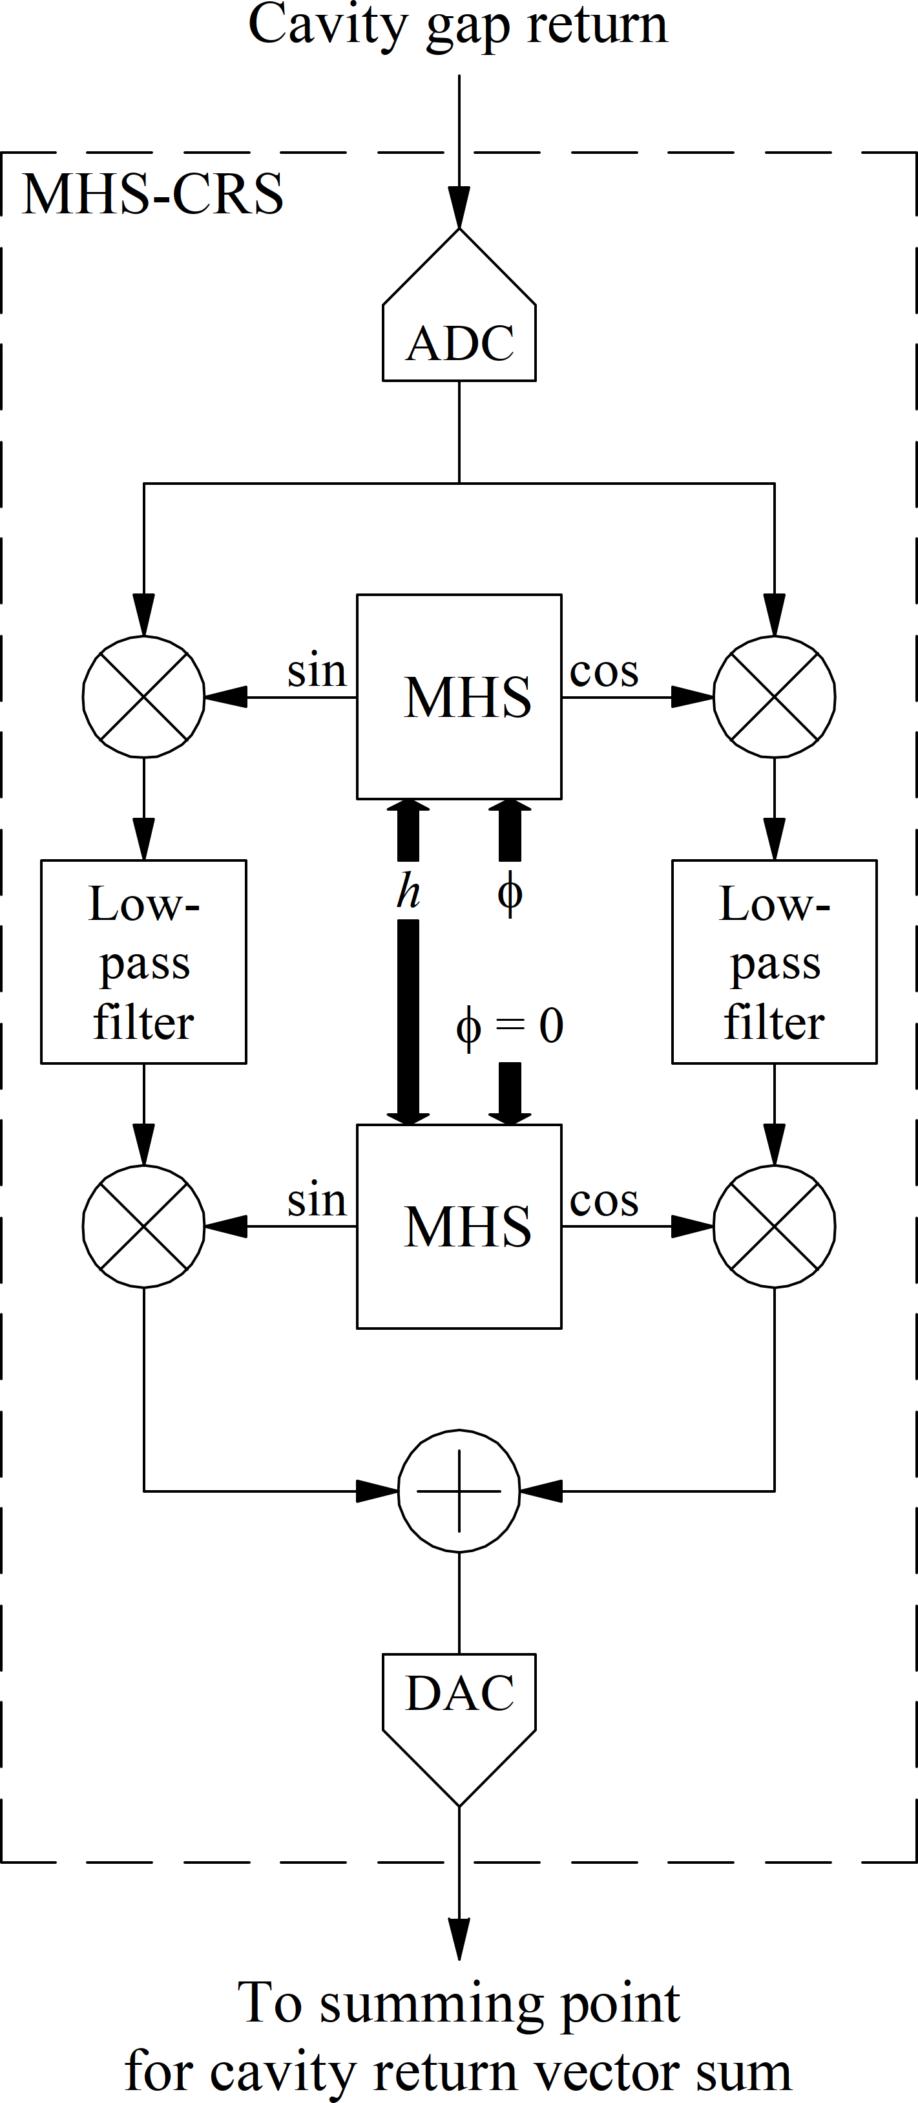
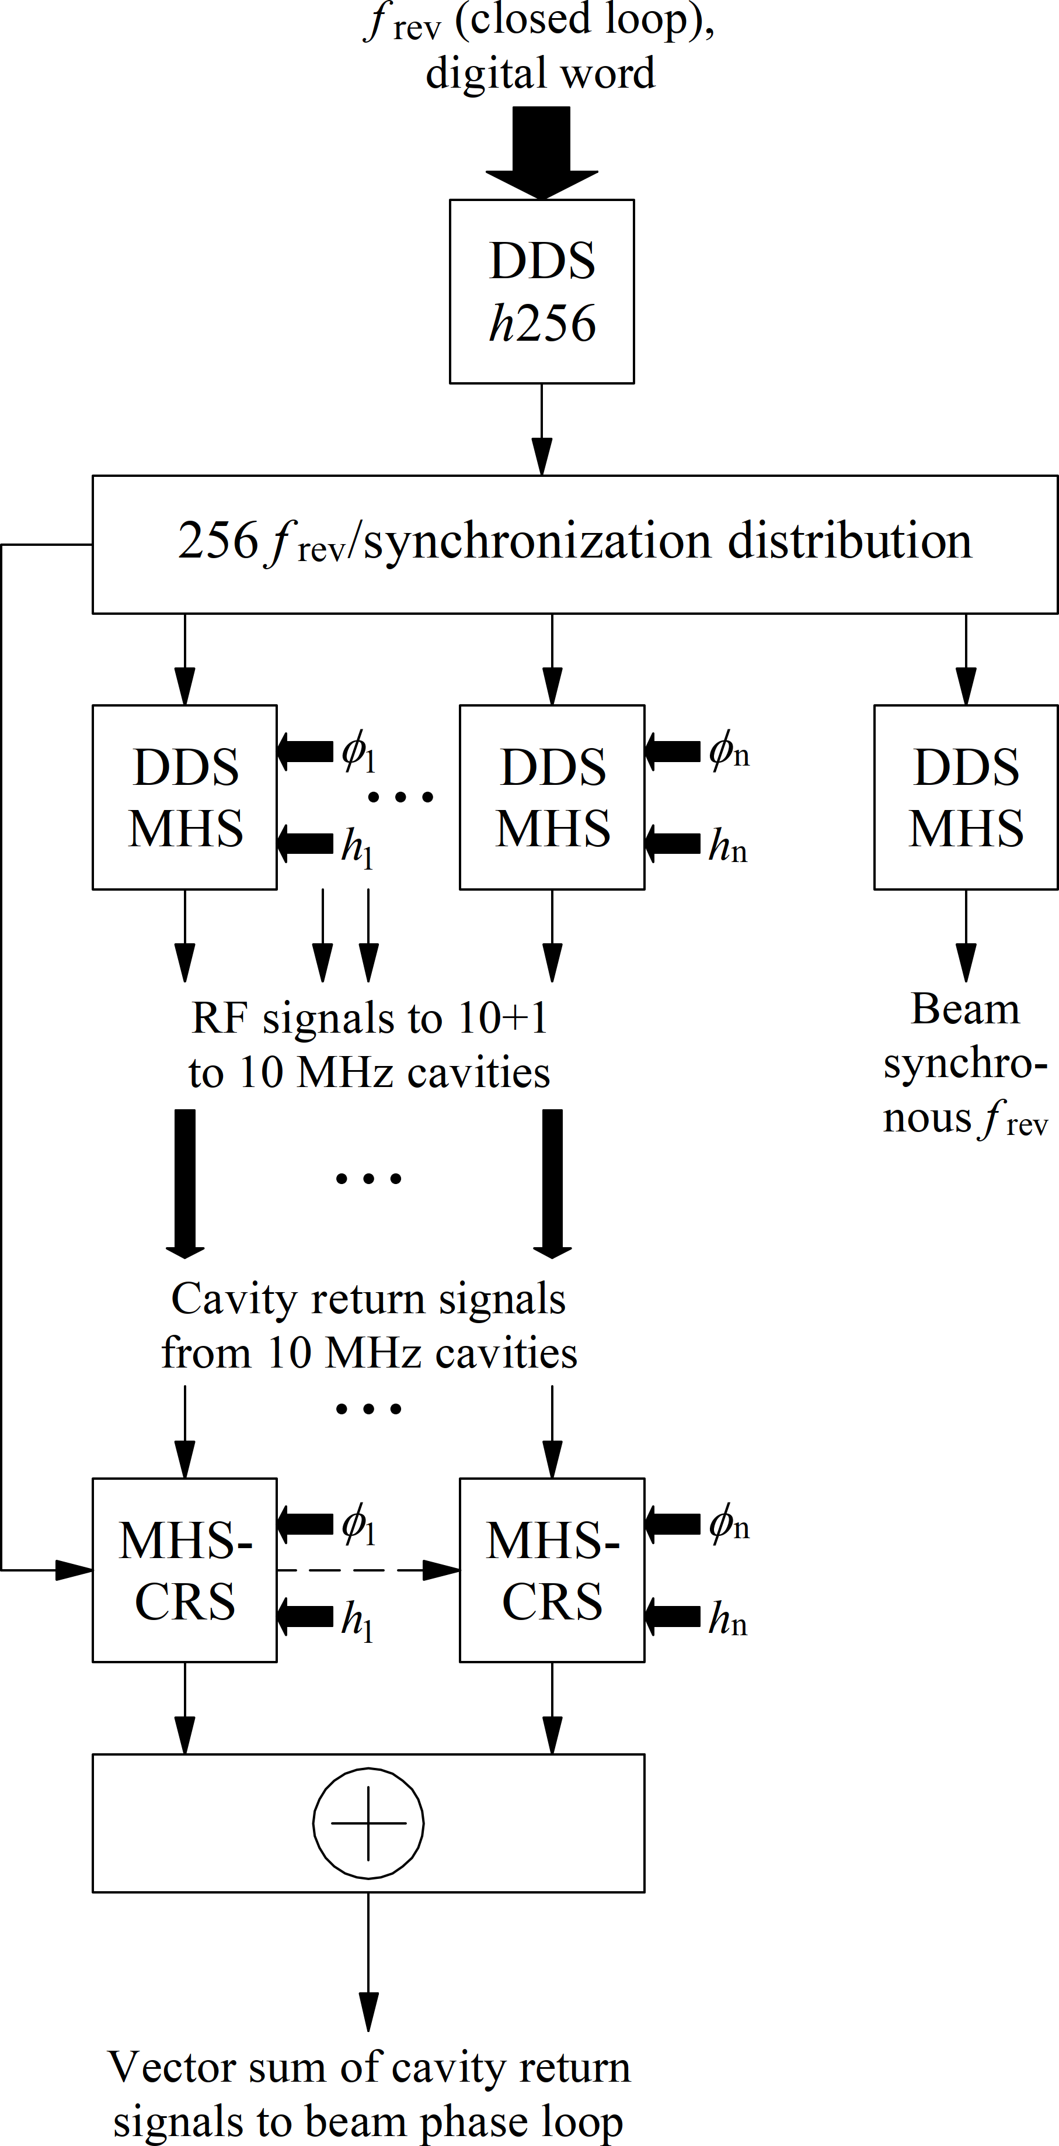
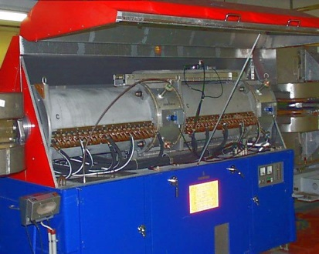
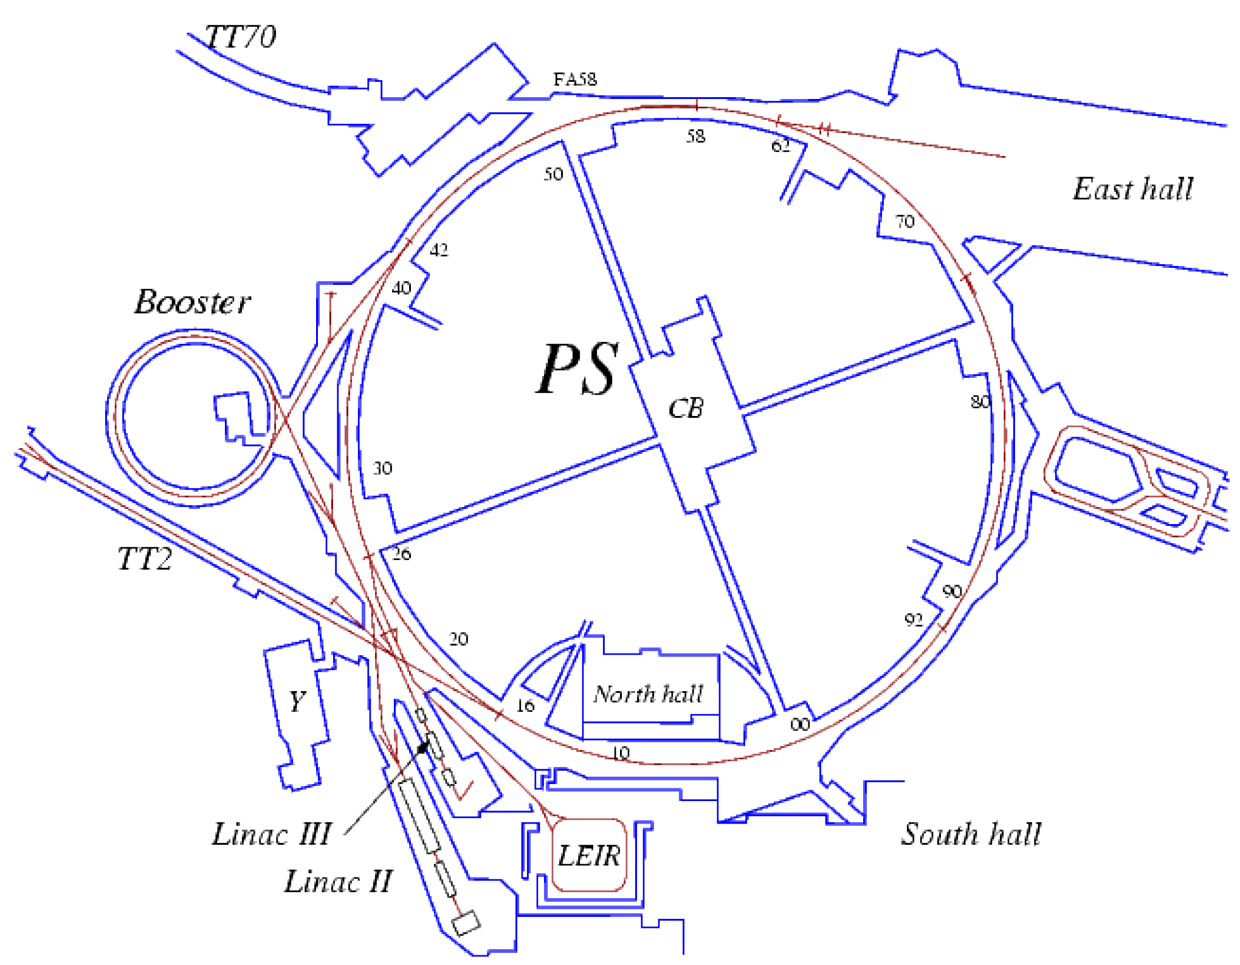
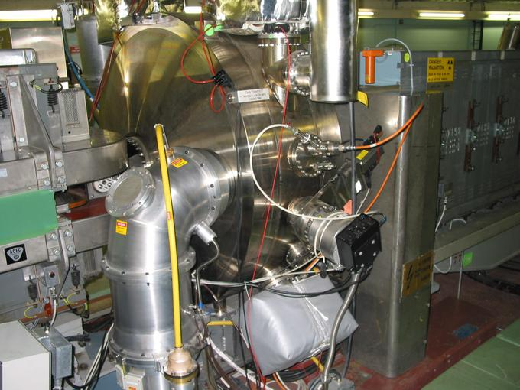
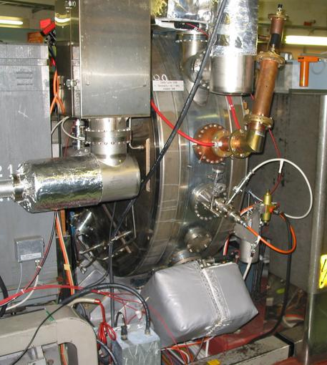
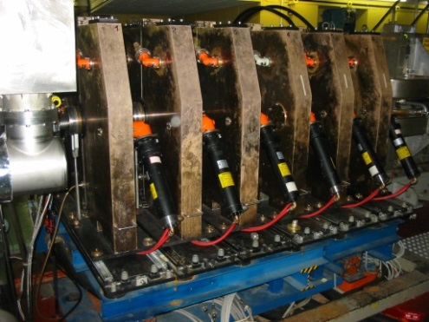
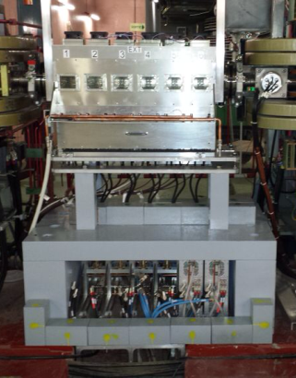
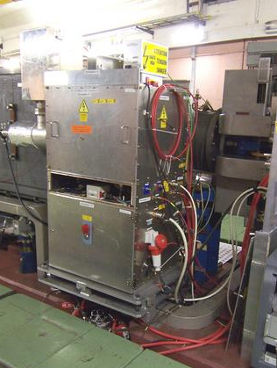
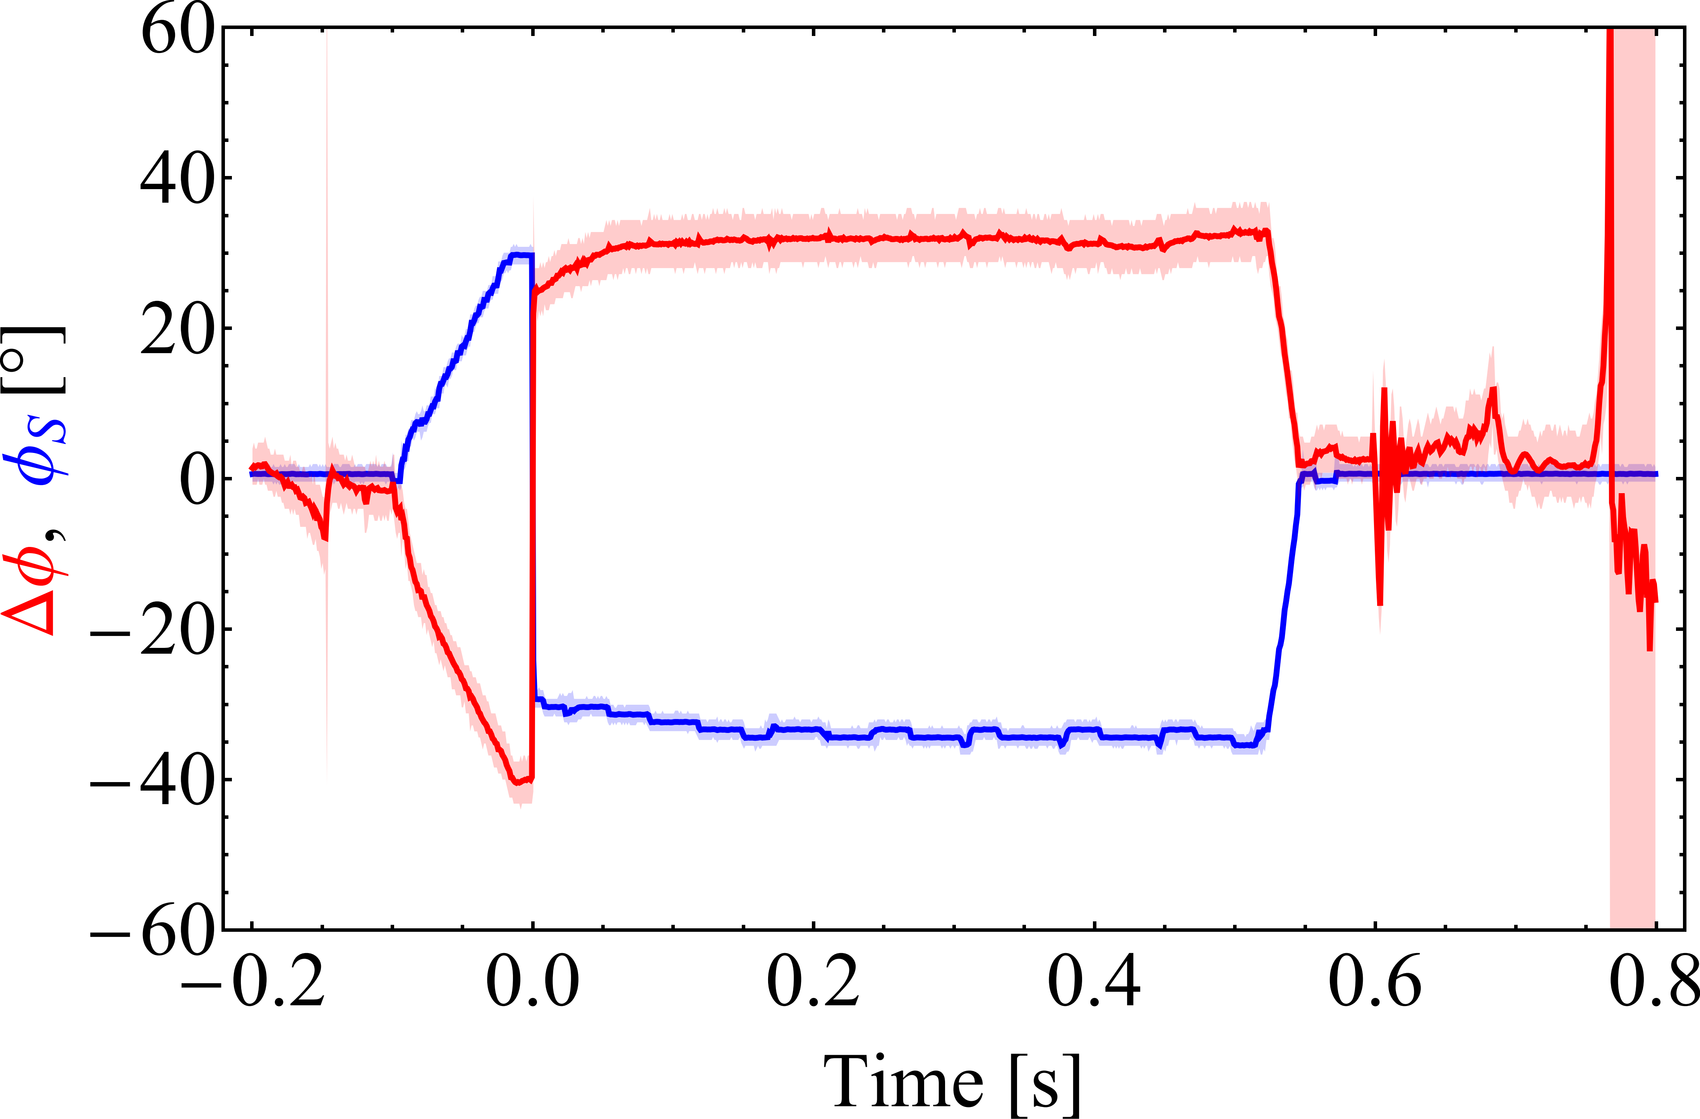
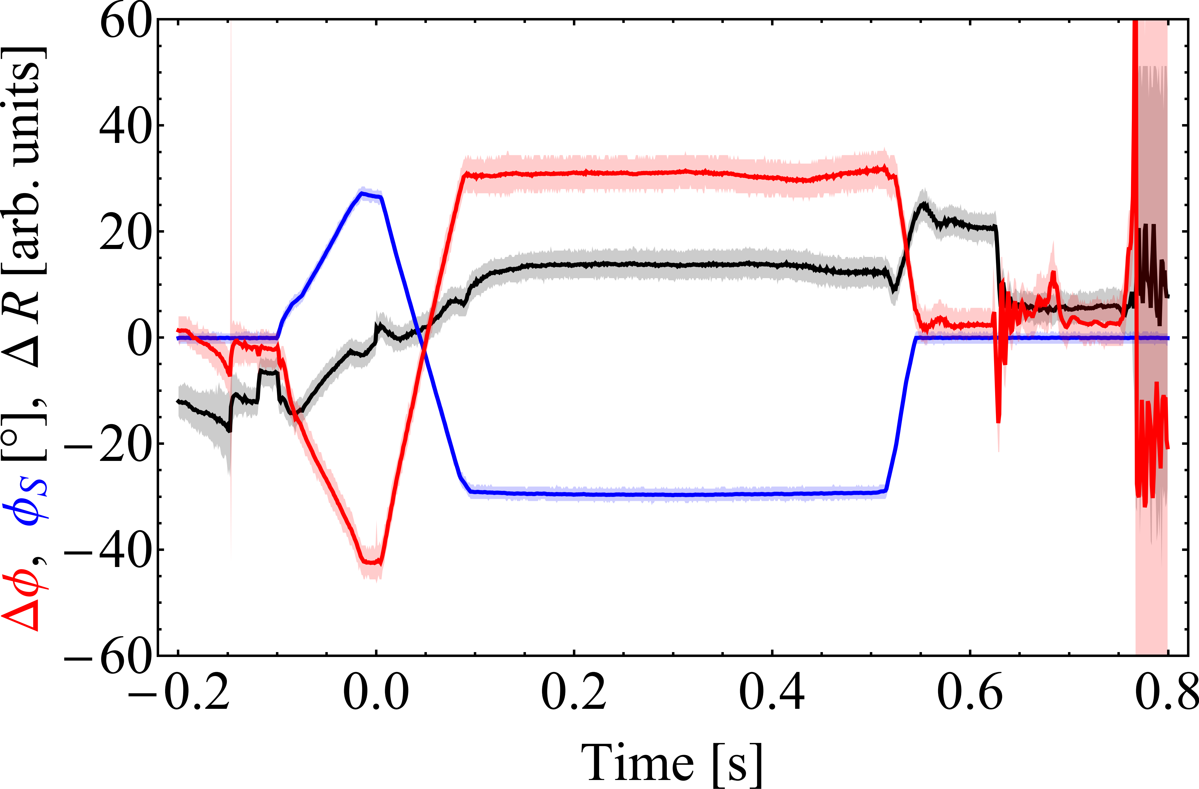
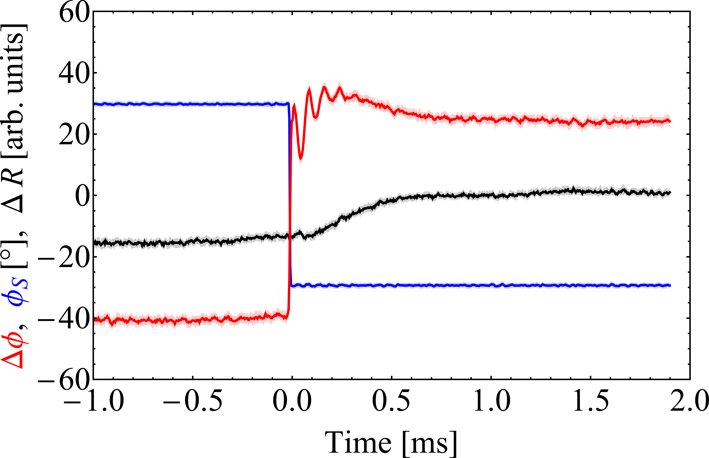
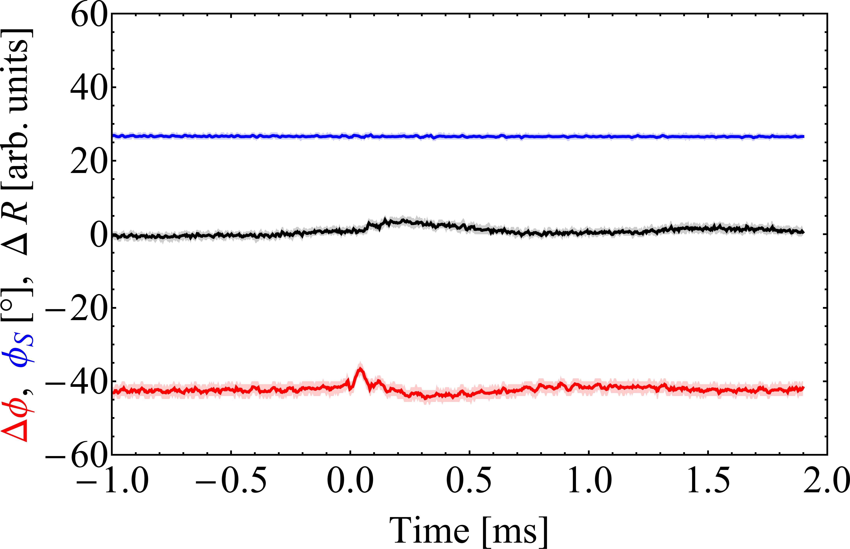

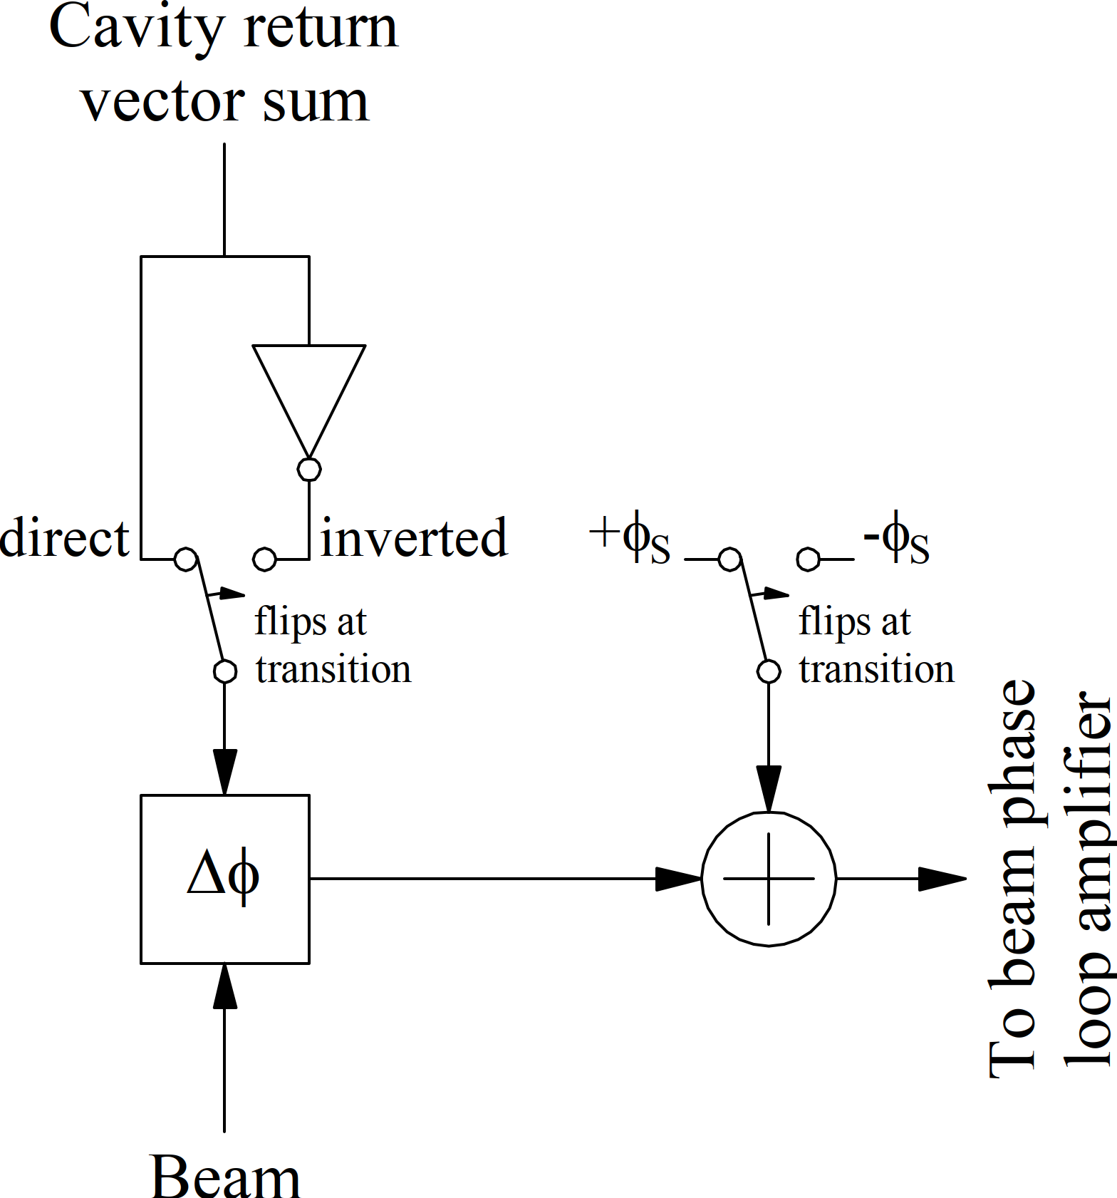
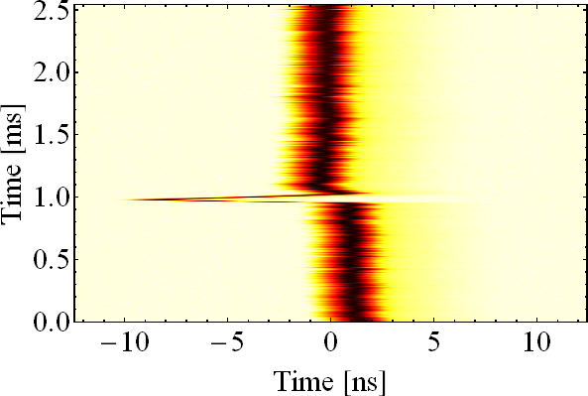
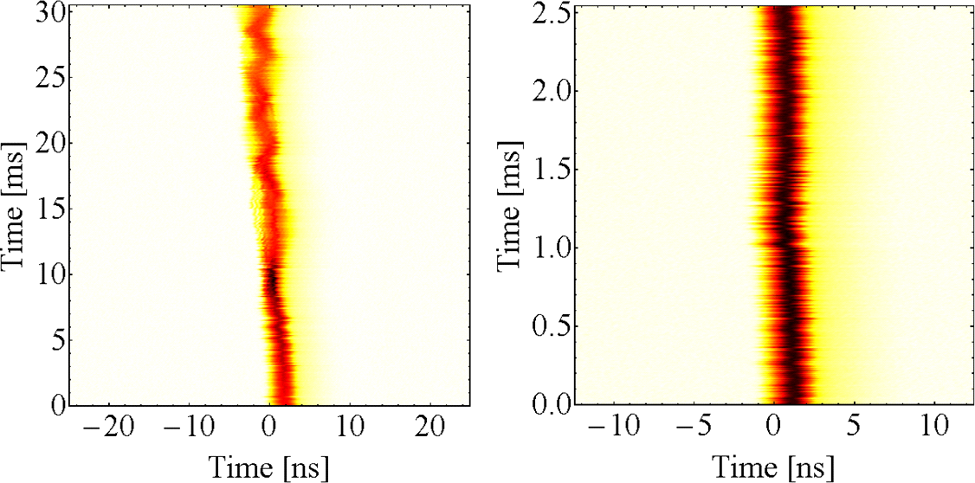
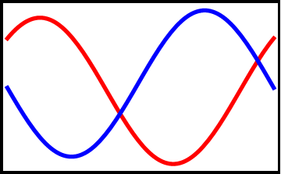
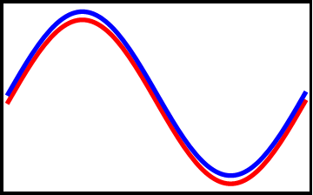

Compensated Phase Jump at Transition Crossing
in the CERN PS
H. Damerau
CERN, Geneva, Switzerland
LLRF2019
Chicago
Abstract
Compensated transition crossing scheme
For acceleration and RF manipulations the CERN Proton Synchrotron is equipped with in total 26 RF cavities in the frequency range of 0.4 MHz to 200 MHz. Eleven ferrite-loaded RF cavities cover a frequency range large enough to accelerate beams at harmonic numbers from 6 to 24. To drive the cavities and to distribute signals like the beam synchronous revolution frequency from the low-level RF system, a new master-slave RF source system has been developed and commissioned. The slave multi-harmonic sources are clocked at the 256th harmonic of the revolution frequency and are fully configurable in harmonic, azimuth and phase. Their phase accumulator always runs at the revolution frequency and is resynchronized once at fixed frequency before injection. This guarantees a well-defined phase relationship at any harmonic number for all sources, even at different physical locations. The flexible sweeping clock and synchronization scheme allows operating parts of the beam control system at different clock frequencies such that future extensions like additional feedbacks can be easily integrated.
Inject phase jump of 180° - 2φ_{S} directly into cavity drive and return
Change phase of cavity drive → - (180° - 2φ_{S}
Undo phase change on cavity return signals → - (180° - 2φ_{S})
Relative phase of beam and RF voltage → - (180° - 2φ_{S}
Phase change of cavity return vector sum → - (Zero (ideally)
Transition crossing compensated for beam phase loop
Processing of gap return
Drive and return phase control
Introduction
Longitudinal manipulations at transition crossing
RF phase jump of bunch with respect to RF phase by 180° - 2φ_{S}
Change of sign of radial loop
11×
10 (+1) tuneable ferrite-
loaded for acceleration
through transition
crossing
RF systems as 20 MHz,
40 MHz, 80 MHz and
200 MHz for
RF manipulations
Fast quadrupoles to
rapidly change γ_{tr} at
transition: γ_{tr} jump
scheme
2.8 – 10 MHz
RF manipulations
Acceleration
46
51
56
66
76
77
40 MHz
to SPS
36
CERN PS
78
80
81
86
88
11
8
6
96
91
92
89
80 MHz
2
200 MHz
Results with beam
Longitudinal blow-up
0.4 – 5 MHz
20 MHz
Transition crossing transparent to
beam phase loop
Glitch at transition removed
Slow compensation after transition to
move measured beam phase back to
zero at flat-top
Conventional
Compensated
Proton multi-bunch for LHC
Proton multi-bunch for LHC
Beam phase with respect to RF (beam phase loop)
Conventional transition crossing scheme
Radial position offset
Stable phase program
Phase jump of 180° - 2 φ_{S} distributed over two separate actions
Change sign of cavity return sum signal → 180°
Change of sign of stable phase program → 2φ_{S}
→ 180° - 2φ_{S}
Glitch!
LLRF set-up
Mountain range triggered with f_{rev} clock
Compensated transition crossing, ²⁰⁸Pb⁵⁴⁺
Glitch!
Difficult to
synchronize
Conclusions
Generation of cavity drive and return signals
A compensated transition crossing scheme has been implemented in the PS low-level RF system and commissioned with beam. It removes the glitch of the beam phase loop at transition by changing the phase of cavity drive and return signals simultaneously such that the phase jump becomes transparent to the beam control loops. Despite from being essentially glitch free, the new scheme offers several advantages compared to the conventional scheme used at CERN before. Since the generation and vector summation of the cavity signals has been upgraded anyway to MHS-based systems, no additional hardware is required for the compensated transition crossing. The controlled, programmable phase jumps of the MHS allow optimizing the jump duration to facilitate the phase flip for the RF power systems. Furthermore, no fast change of the stable phase programme is required with the compensated crossing scheme, which significantly simplifies its generation. The new transition crossing scheme has been fully validated with all relevant proton and ion beams in the PS during the 2018 run. It will be the default configuration for the restart after LS2.
Universal cavity return sum to generate $\sum{\vec{V}}$ at any possible RF harmonic
MHS-based cavity return sum operational since 2018
De-phasing of cavity return signals shifts them back in phase
Automatic phase compensation according to cavity azimuth, Φ
Simple cavity return vector sum (MHS-CRS)
Programmable phase jumps at the level of the MHS phase accumulator
Master DDS h=2^{n}
MHS: Multi Harmonic Source
h, φ, Φ, τ
RF to cavity 11
h, Φ
…
MHS
…
MHS-CRS
MHS
RF to cavity 96
MHS-CRS
REFERENCES
[1] A. Sørenssen, Crossing the Phase Transition in Strong-
focussing Proton Synchrotrons, Part. Acc., Vol. 6, 1975.
[2] H. Damerau, A. Findlay, S. S. Gilardoni, S. Hancock, RF Manipulations for Higher Brightness LHC-type Beams, IPAC2013, Shanghai, China, 2013.
[3] H. Damerau, S. Hancock, A. Lasheen, D. Perrelet, RF Manipulations for Special LHC-type Beams in the CERN PS, IPAC2018, Vancouver, British Columbia, Canada, 2018. [4] H. Damerau, D. Perrelet, Upgrade of the Beam- synchronous RF Source System in the CERN PS, LLRF2017, Barcelona, Spain, 2017.

