Slide 1
PIP-II Project Manager’s Report
Marc Kaducak
Project Management Group
18-Sep-2019

Slide 2
PIP-II Division and Staff Updates
Project Controls Manager
  Richie Walker, current PIP-II Project Controls Manager, is leaving Fermilab. Last day is 27-Sep-2019.
    Thanks and best of luck to Richie! We will miss him.
  David Leeb, currently Mu2e Project Controls Lead, will be the new PIP-II Project Controls Manager and is beginning the transition.
    Welcome David!
    Thank you to Doug Glenzinski, Rich Marcum, Ron Ray and Mu2e!
      Open to suggestions for gift ideas for Ron
Climate Survey
  Four action teams developing recommendations
    Communication – Lead: Allan Rowe
    Employee empowerment/ team members feeling important – Lead: Elvin Harms
    Career development / recognition – Lead: Fernanda G. Garcia
    Trust – Lead: Jim Steimel
  Teams include both members of PIP-II division and matrixed personnel
  Teams welcome feedback from anyone

Slide 3
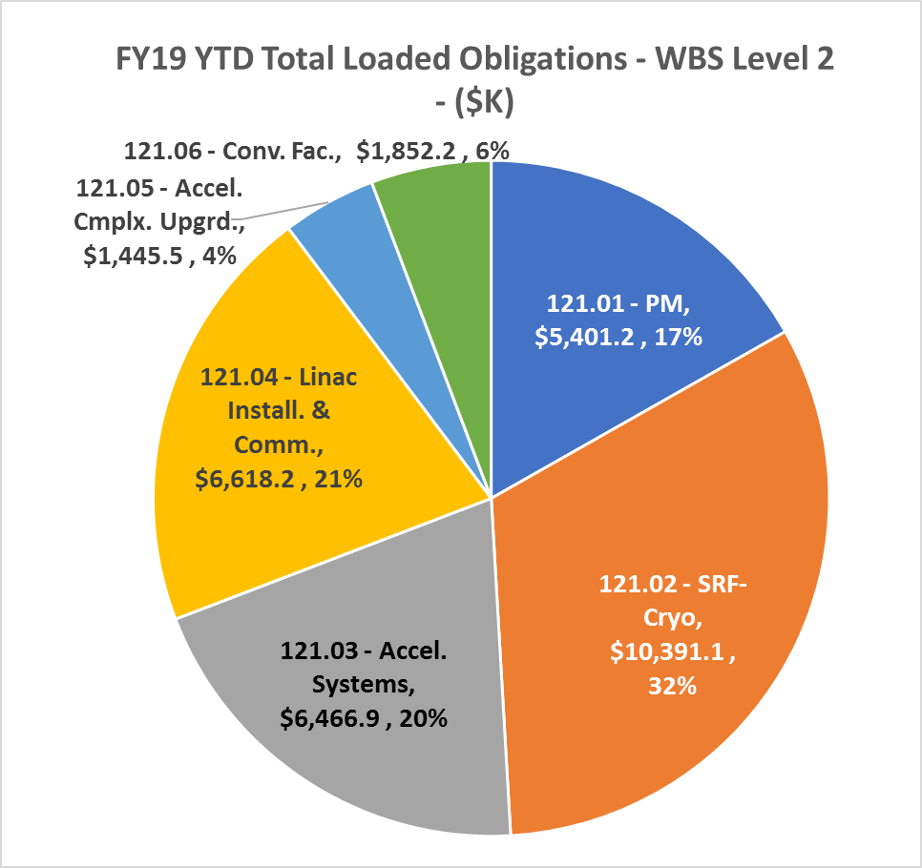
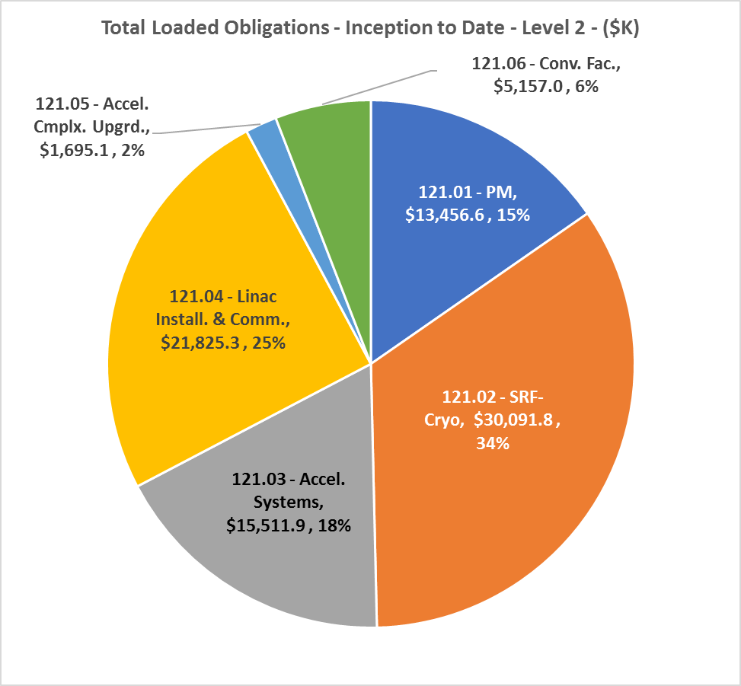
Financials Thru August 2019
YTD FY19 | Inception to Date

Slide 4
Current Funding vs. Plan at $35M level
Funding at prorated $35M | Oct | Nov | Dec | Total Q1FY20
TEC (prorated $20M) | 1.67 | 1.67 | 1.67 | 5.00
OPC (to make up prorated $35M) | 1.25 | 1.25 | 1.25 | 3.75
Total Funding at prorated $35M | 2.92 | 2.92 | 2.92 | 8.75
Monthly Planned Expenditures | Oct | Nov | Dec | Total Q1FY20
Labor Forecast | 2.70 | 2.40 | 2.40 | 7.50
Planned M&S | 1.14 | 1.09 | 0.79 | 3.02
Planned Expenditures | 3.84 | 3.49 | 3.19 | 10.52
Total plan including Contingency (20%) | 4.61 | 4.18 | 3.83 | 12.62
Funding needed to support plan | Oct | Nov | Dec | Total Q1FY20
TEC | 1.67 | 1.67 | 1.67 | 5.00
OPC | 2.94 | 2.52 | 2.17 | 7.62
Total | 4.61 | 4.18 | 3.83 | 12.62
Note: FY19 carryover forecast ~$700k not included above

Slide 5


International Partners activities since PIP-II DR
Aug 11 – 16: Visit DAE to discuss Construction phase dates, PPD dev’t
Sept 15: Identified major MS for DAE construction phase. Work in Progress to develop partner schedule.
Sept 30 – Oct 4: QA team visits STFC/DL, CEA, IPNO
Oct 10:
  CEA & CNRS present DUNE/PIP-II Plans to Ministry
  IPNO visit to validate PPD for CD-2 review
Oct 11: P2PEB#3 meeting @ IPNO
Nov 8 - 11: CEA visit to validate PPD for CD-2 review
Nov 12-14: IFJ PAN/Poland visit Fermilab for technical mtgs
Nov 14: 5th INC Session
Nov 18-24 InPAC Conference, Delhi – PIP-II to be represented
Dec 1: Freeze PPDs for CD-2 review, incl. RLS alignment
STFC and INFN PPDs internal revision for final validation ongoing

Slide 6
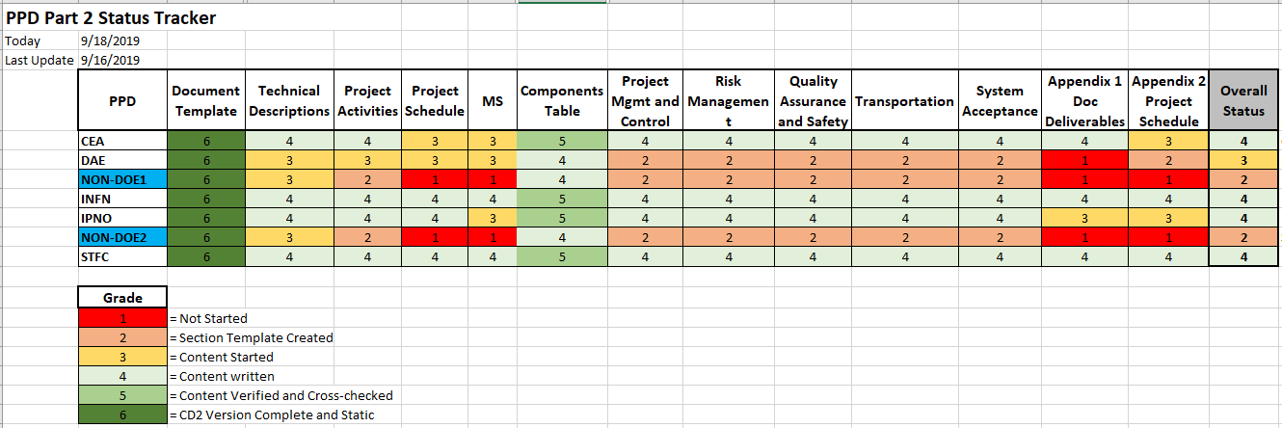
PPD Part 2 Status
Oct-Dec: Finalize Monthly Report Template

Slide 7
ESH Update
Responding to Director’s “Improving Safety Initiative” memo.
The PIP-II IESH Management Plan was updated to incorporate recommendations from the Director’s review. Plan is out for PIP-II Management review.
The PIP2IT Shielding Assessment is being reviewed by the Shielding Assessment Review Panel.
Work continues on the draft PIP-II Accelerator Readiness Review (ARR) Plan.

Slide 8
WBS 121.3 Accelerator Systems Updates
Controls
- EPICS training was held in August, 15 people attended each of the operator and developer sessions. It was well received by all.
- Bob Dalesio of Osprey DCS visited. We discussed strategies for integrating EPICS and ACNET as well as other possible EPICS tools we might evaluate for use here. A final report is in preparation (and due next week).
Vacuum
- Investigating the merit of NEG vs (or in addition to) Ion Pumps for the beam line vacuum in response to concerns raised about possible excessive particulate generation from ion pumps. Two major thrusts recently:
  a. Discussion with Jefferson lab on their motivation and scheme for implementing NEG pumping
  b. Procuring materials to conduct tests to examine relative particle generation
- Beginning assembly of the SSR-1 pumping station and pre-assembly of the HEBT thanks to recent staff availability opening up.
Magnets/PS
- Design work for the PIP2IT solenoid cap bank/dump circuit is moving ahead
- Vendor quotes for 4-quadrant switcher supplies and the circuit described above are being evaluated for potential cost savings and favorable delivery compared to in-house versions. Vendors are also offering evaluation units.

Slide 9
WBS 121.3 Accelerator Systems Updates
RF
- PIP2IT RF distribution hardware installation is advancing. There has been a delay in procuring the last pieces.
- A SOW for LLRF collaboration with JLab is under preparation.
- Forming a focused group to look at Booster Injection from a beam physics standpoint.
Instrumentation & MPS
- Meetings with AD/Energy Distribution group have begun in concert with Accelerator Physics to outline the scope of work needed to identify optimum location of loss monitors along the Linac and estimate beam-induced energy deposition onto the Half Wave Resonator. The latter issue is important in understanding if there could be a quench limit due to beam loss at the entrance to the cold part of the PIP-II linac.
- Candidates to be the long-term L3 manager for Machine Protection System are being identified. Additional names are welcomed.

Slide 10
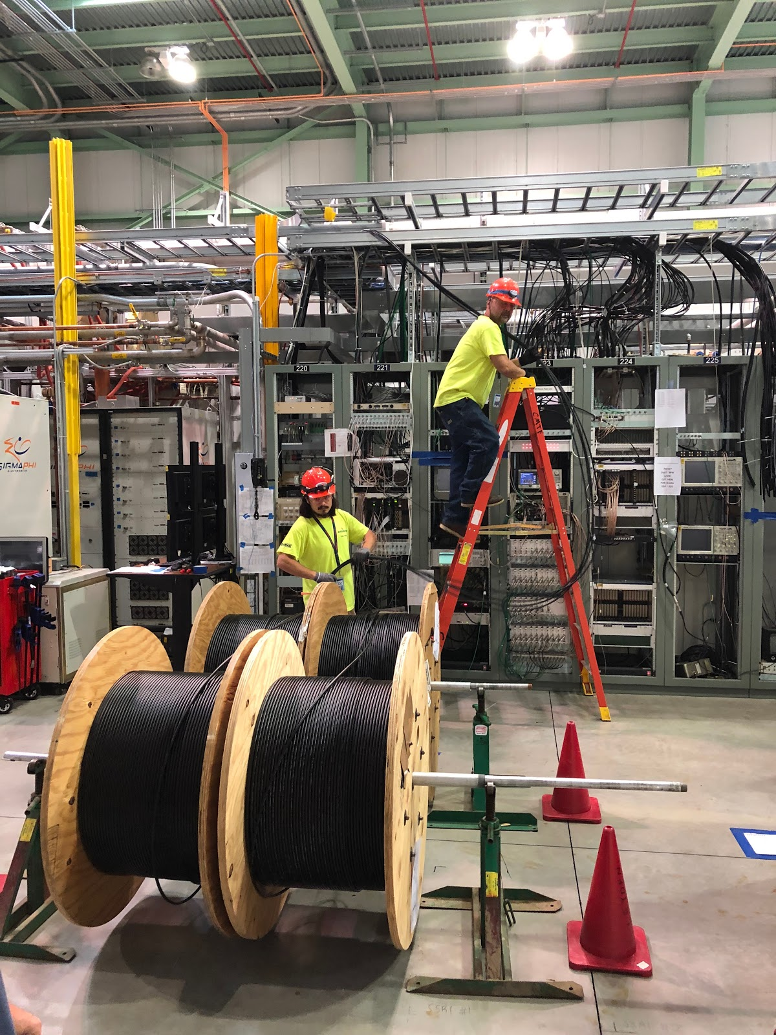
Updates - WBS 121.4 Linac Installation and Commissioning
Test Infrastructure – PIP2IT
      Electrical work continues (cable pulls, power panels, cable tray and outlet installation, ODH fan wiring)
      ~ 75% complete
      Cryo TransferLine (CTL) mechanical tie-in to plant complete
        Cryoplant turn on this week followed by CTL commissioning
Building Infrastructure
  Compressed Air design for Utility Plant is complete
    Completing documentation follow up with sign-offs.
Installation
Lots of collaboration with AP lattice design team to drive beam transfer line (BTL) lattice to conclusion
Received comments regarding the PIP-II Davis Bacon Exception submittal from DOE legal review.
  Started incorporating comments in the document
Beam Commissioning and Accelerator Physics
Team focused on optimizing the BTL lattice design
Linac lattice has been extended to include the straight-ahead diagnostics

Slide 11
Conventional Facilities
Cryogenics Plant Building
  100% Design Completed: July 12, 2019
  Procurement documents being developed/reviewed
  Anticipate proposals in hand prior to DOE Independent Project Review
Linac Complex
  Update to design documents began in late April 2019
  Completion moved up to October 2019
  Detailed/Final Design expected to start in January 2020
Cost/Schedule Update
  Request for Proposal to Gensler for cost/schedule update based on revised design.
  Includes independent cost/schedule update from outside source.
  Scheduled completion in December 2019

Slide 12
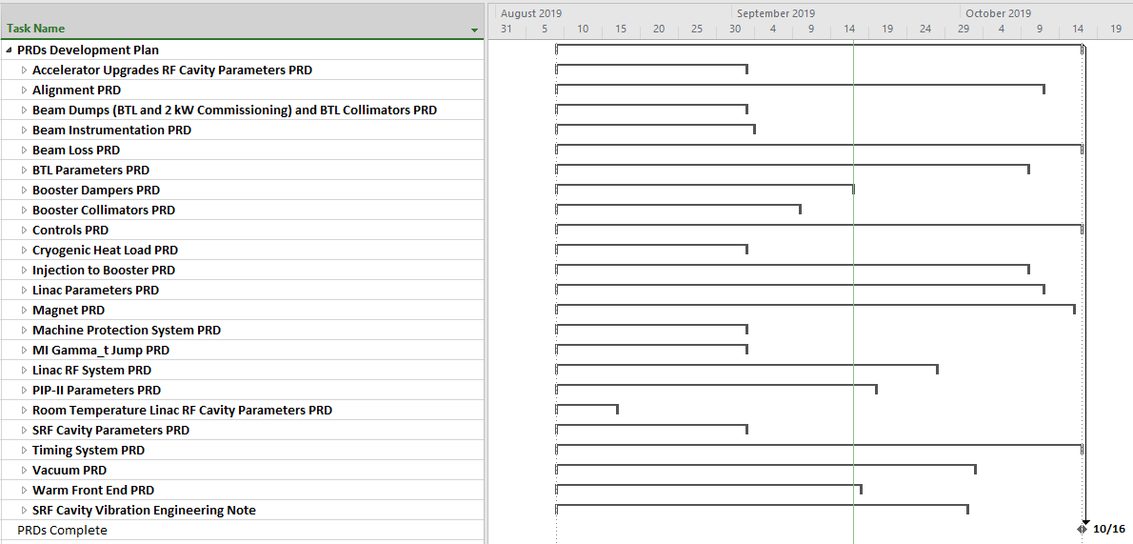
Physics Requirements Documents (PRD) Status
Total of 23 PRD’s
Initial drafts have been created for all, several are in the final review stage
Weekly meetings with authors to track progress, provide guidance, etc.
All are scheduled to be completed by mid-October

Slide 13
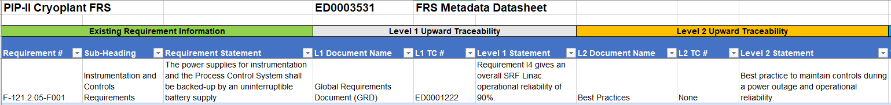
Requirements Flowdown Scheme Status
Each L3 FRS has a corresponding Metadata sheet
Metadata sheets document the traceability (GRD, PRD, TRS, etc.) for each individual functional requirement
Integration Team is in process of completing first draft metadata sheets for all L3 FRS’s
  Work is being done in tandem with PRD development
  Will follow up with L3’s to complete
  Not all requirements flow up to PRD’s such as:
    Best Practice Requirement
    Self-Derived Requirement
    PIP-II Design Choice
  Flowdown verification to be completed in November 2019

Slide 14
RLS/EVMS
Schedule workshops held this month to look at major schedule building blocks. Focus was on:
  Cryoplant building, plant, distribution system schedule
  CF schedule
  SRF schedule
  DAE milestone updates
Extensive P6 updates underway:
  Improving CAM ownership
  Updating procurement cycles
  Reviewing logic checking, float paths, coding
  “True Up” baseline dates to align with working schedule
  Simplifying IKC structure
All the above will likely result in an overall delay in project completion

Slide 15
August Performance – WBS L2
Notes:
121.02 -SVcum – Primarily delays in 650MHz - HB - 1st Prototype CryoModule. The preliminary design of BCAVs / cavity processing optimization for B.90 and B.92 single cell has slipped six months, delaying material purchase. Also delays experienced in design of DCAV RF couplers and tuners. Current period, more DCAV work effort has fallen behind. In addition, there are delays in SSRs - R1 - 1st Prototype CryoModule, with coldmass components and assembly continuing behind. -CVcum is primarily labor overruns in these same areas, with lagging material costs on pre-Jan CTCs contributing about 45%.
121.03 -SVcum – Primarily delays in materials for HPRF-RFDist - PIP2IT RF Power, LLRF, and Vacuum Systems. Also delays in Beam Instrumentation for PIP2IT; specifically, HEBT Laser System. -CVcum is spread across multiple CAs; primary contributors are lagging material cost on pre-Jan CTCs (30%); L3 Management and Coordination (27%); LLRF HWR Integration & Test (16%); LLRF PIP-II Design (14%).
121.06 +Cvcum – Under-runs in CryoBuilding Design (45%) and Management and Coordination (37%).

Slide 16
Summary
International Partners increasingly engaged. PPDs rapidly advancing.
Concerned about FY20 CR, even if short. FY21 CR scenario planning underway.
Continuing good progress on PIP2IT
Challenges remain in RLS/EVMS but we are on a good path
IPR scheduled Jan.28, 2020. ICE visit Jan.13, 2020.

