Slide 1

DUNE Project Status
Janet Bishop
DUNE PMG Meeting
October 2019

Slide 2
Outline
ES&H Update
QA Update
PM Update
Schedule & Budget Status
DUNE Update
  FD Engineering
  FD Installation
  FD APA
  FD TPC Electronics
  FD HV
  FD Photon Detector
Upcoming Events

Slide 3
ES&H Update
Reviewed documentation prior to the Ash River workshop
  Workshop complete.
  Base documentation is sound. Process for assembling the doublet is understood and repeatable. Process Details continue to evolve.
  Generated good discussion and ideas for some technical aspects of the frame connections, and PDR connections
Continue to support the development of the DUNE TDR
DUNE ESH Coordinator integrating with the SP Technical Leads
Reviewed response to the Ash River APA Assembly Tower Assessment

Slide 4
Quality Assurance
  QA Input
  Update EDMS 2254563 LBNF DUNE Control of Nonconforming Material, Parts or Components Procedure
  Update Proposal for a DUNE Part Numbering System presentation to version 9Oct2019
  Technical Design Reports (TDRs)
  Provide feedback on the QA Management Assessments section 9.9.1.
  Participated in the Ash River APA Assembly Tower Work Shop
  APA Doublet Assembly Installation, Rail System, Routing of cable bundles
  Capture detailed pictures throughout the assembly process and lab to provide DUNE personnel documentation for procedures and to illustrate problems requiring revisions to assemblies

Slide 5
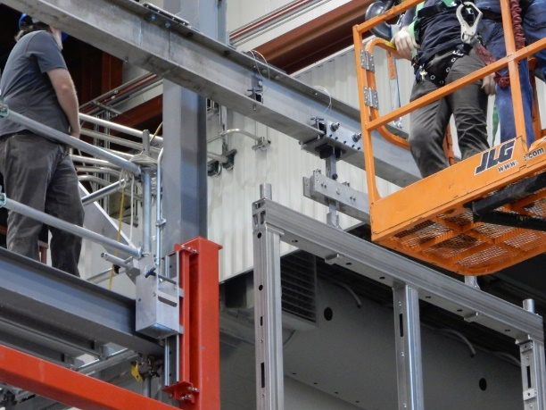
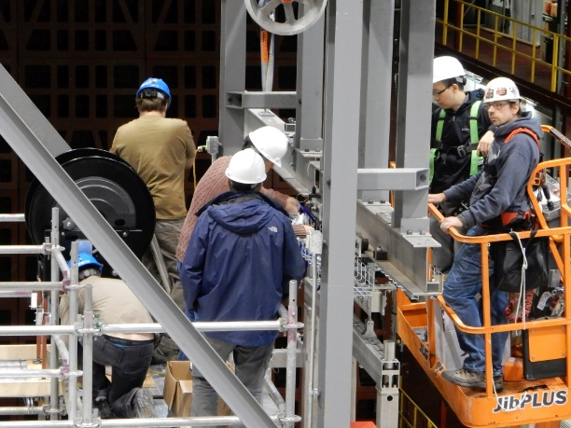
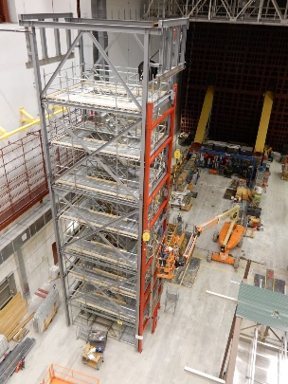
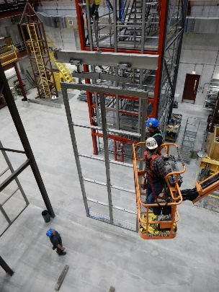
Quality Assurance
APA Assembly Tower
Addition of 2nd APA
to Create a Doublet
Mounting of 2nd APA
to the Rail System
Routing of Photon Detector
Cable into APA Frame

Slide 6

Project Management Highlights
DUNE Collaboration Week – September 23 – 27
  Significant progress on Near Detector design.
Preparation for IPR October 29 – November 1
  Refined definition of KPPs.
  Prepared presentations and practiced management, far detector, and near detector talks.
Technical Design Report “penultimate draft” in final revisions
  Responses being prepared for final round of comments received on September 16.
  DUNE anticipates this is the final round of comments/revisions and expects LBNC to recommend for approval the Executive Summary TDR Volume, The Physics Volume, the Far Detector Single Phase Volume and the Technical Coordination Volume.
Staffing Update
  Ongoing search for Lead Mechanical Engineer for Far Detector.

Slide 7
DUNE Milestones
T2: Federal Project Director
T3: Fermilab Directorate
T4: Project Director
T5: L2 Manager
T6: CAM
 | August 2019 P6 Update | September 2019 P6 Update | Variance | Comments
Completed in September 2019
None
Planned for Completion October – December 2019
T4 MS - High Voltage System Preliminary design review Complete | 9/3/2019 | 10/1/2019 |  | Complete. The review report is in Docdb #12403
T4 MS - Ash River test results (phase 1) | 10/16/2019 | 10/16/2019 |  | Complete – major tests completed
T4 MS – Define US SP-FS CD-2/3 Scope | 12/16/2019 | 12/16/2019 |  | On target

Slide 8
DUNE Stop Light Report – September 2019
Overall, the performance for September is within acceptable range
Underspend due to labor resources originally planned to be on-project not charging time. Transition period until end of FY20 Q1 as plan is updated and TC transitions off-project.

Slide 9
DUNE Stop Light Report – last 7 periods
Variances are due to:
Slow recovery from past overspend and schedule delay on TPC Electronics.
Underspend due to labor resources originally planned to be on-project not charging time. Transition period until end of FY20 Q1 as plan is updated and TC transitions off-project.

Slide 10
Far Detector Engineering
DUNE General
  Worked on the final version of the DUNE Far Detector Technical Coordination volume of the Technical Design Report.
DUNE Detector component integration
  Bi-weekly meetings are in process of being scheduled to discuss detector interfaces which include lead engineers and applicable consortia technical leads.
DUNE Detector Electrical/Electronics
  Continued a series of meetings with the DAQ Consortia leaders on issues relating to the Surface Computer Room, Underground DAQ Room and main fiber trunk runs. We are studying the possibility of moving DAQ racks to the top of the cryo mezzanine for each of the four detectors. Grounding, power and heat loads are all being evaluated.
  Worked with LBNF (Jack Fowler) to clarify expected performance and allowable optical power loss in the fiber runs from surface to underground.
  SLEDs (Single-Line-Electrical-Drawings) generated for the AC power distribution with UPS backup for the DAQ Racks has been produced for BOTH baseline design in the CUC and for racks on the cryo mezzanine. Physical footprint required has been identified; will continue to work with CF on equipment location.

Slide 11
Installation Prototyping Phase I Workshop: Sep 30 – Oct 3
Successful workshop with 15 visitors at Ash River and completed the following tasks:
Constructed an APA Doublet several times
Added protection panels and practiced removal and joining the two APAs – determined some re-design of protection panels needed
Performed multiple cable tests with slotted conduits, cable spool and mechanical reel
Tried new alignment pins
Evaluated PD connections
Connecting and removed the APA Linkage
Installed cable trays on top APA and built some additional cables sets to lay in the tray
Performed complete APA doublet installation for University ES&H, they will provide documentation for an ORC. This took just over an hour which is considerably less than what is currently in installation schedule.

Slide 12
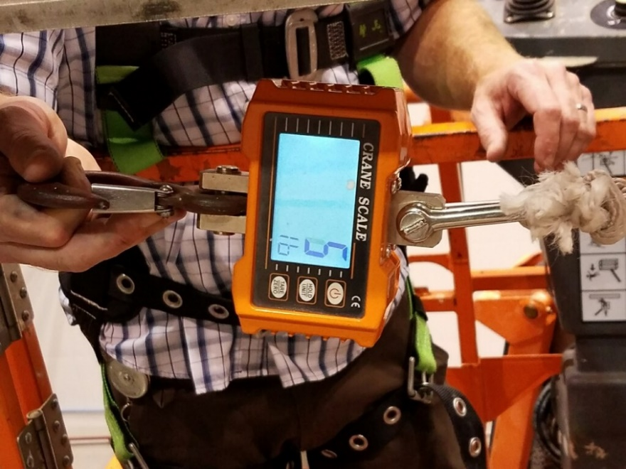
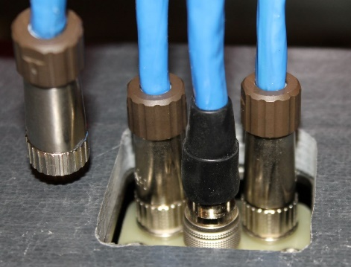
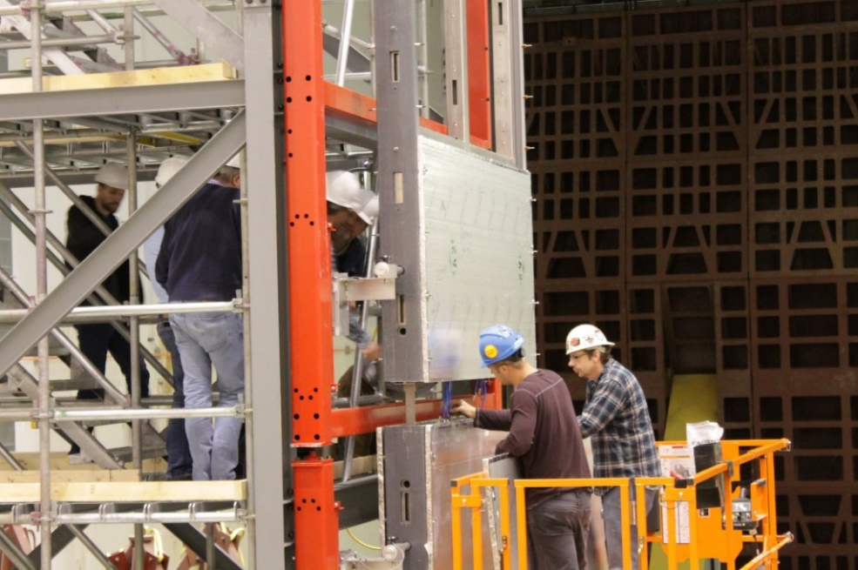
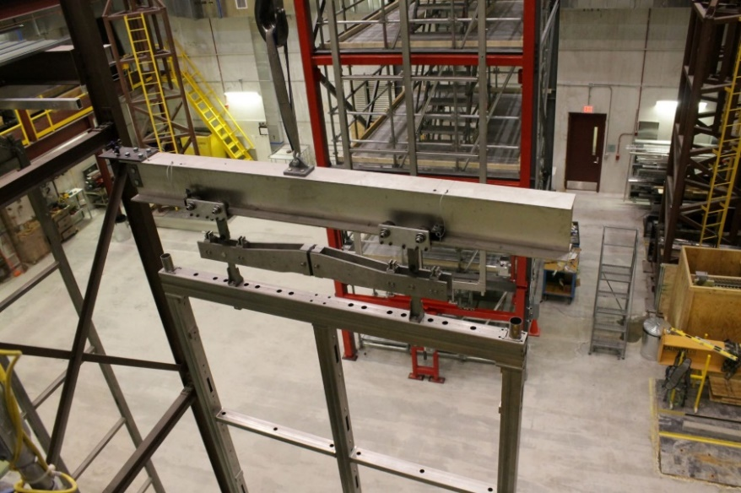
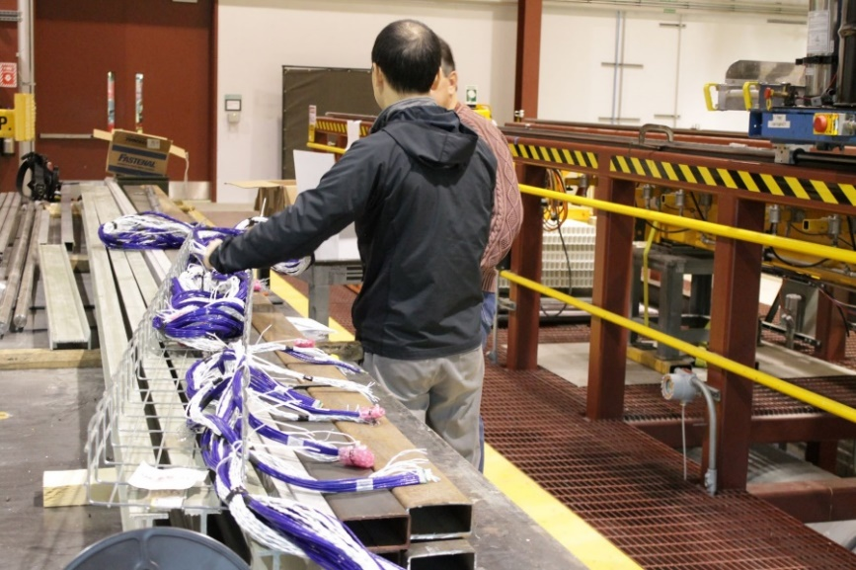
Pictures from Ash River Trail Assembly Work Shop
Pull test with APA Doublet
Connecting PD cables with Protection panels in the way
Moving top APA into position
Testing cable positioning in tray

Slide 13
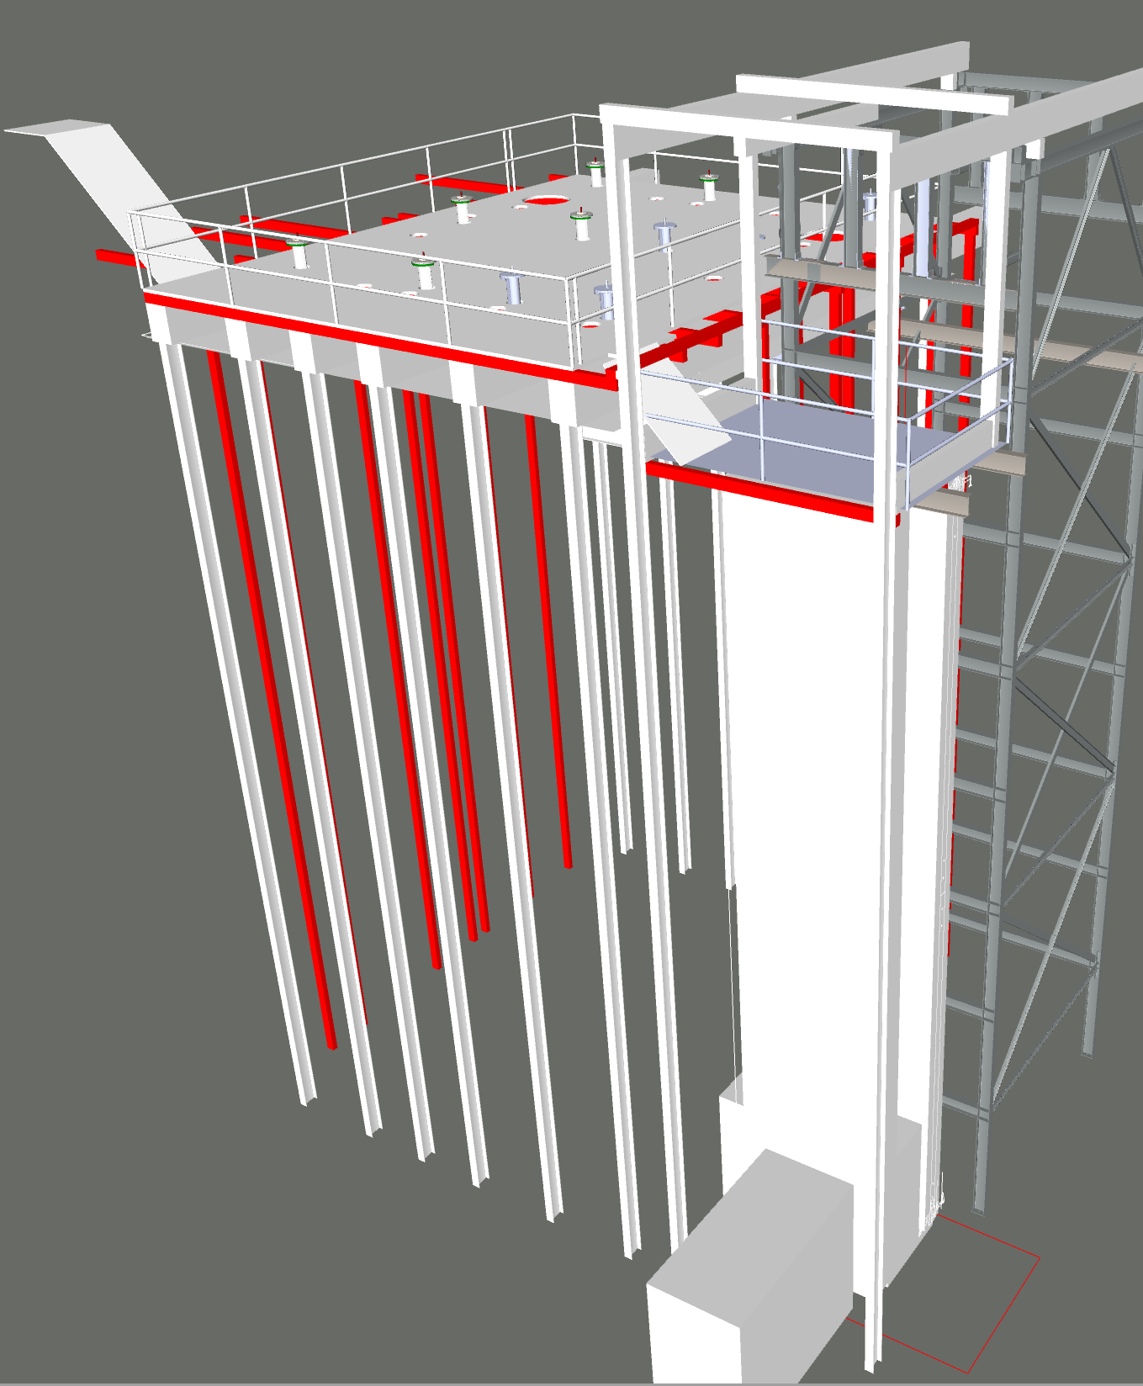
Trial Assembly Phase 2 at Ash River
Progress on requirements documentation to allow Barr Engineering to start the structural design for Phase 2:
Added work platform for APA
Added full TCO and TCO DSS beams
Added changes to shuttle rails and shuttle beams to the smaller 6” stainless beams
Completed list of load cases for Row 1 and Row 25
Redesign of the CPA Assembly tower completed, currently in review before going out for bids

Slide 14
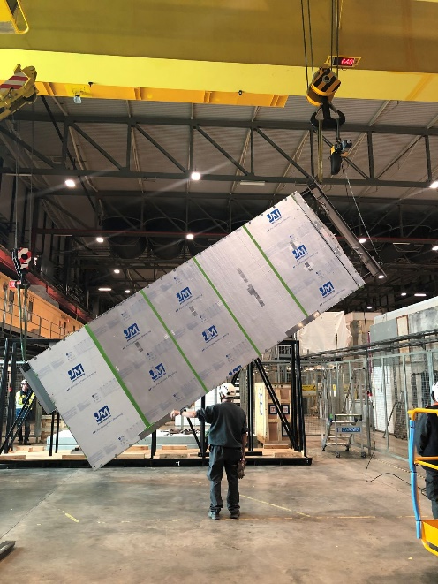
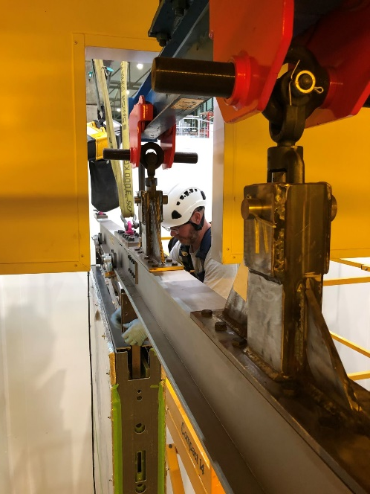
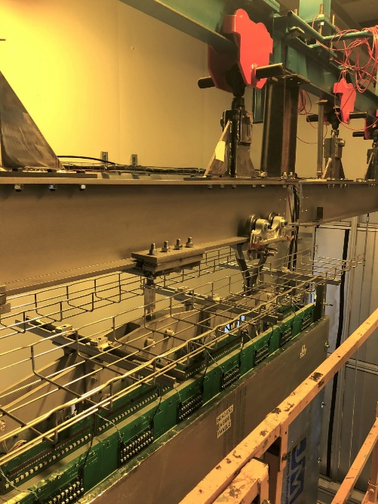
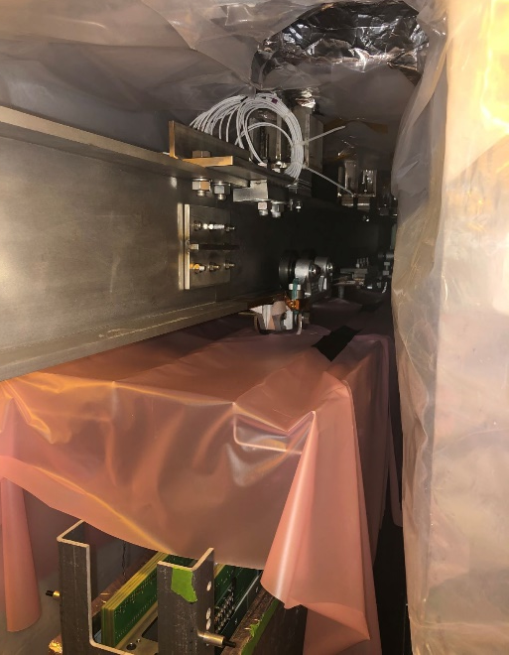
APA#7 at CERN
Very successful 2 weeks at CERN getting APA#7 in front of the cold box ready for CE
The steps used for moving the APA on the fixture are identical to what we plan to will use in DUNE
APA lifting fixtures installed and the APA was rotated into a vertical position (this procedure will be done while still in the APA shipping frame for DUNE)
Careful visual inspection of APA after removing protection panels
Installed Cable trays and tested how it fit in the cold box and had electrical isolation
APA #7 Rotation
Moving APA into Cleanroom
Cable trays installed
APA #7 in Cold Box

Slide 15
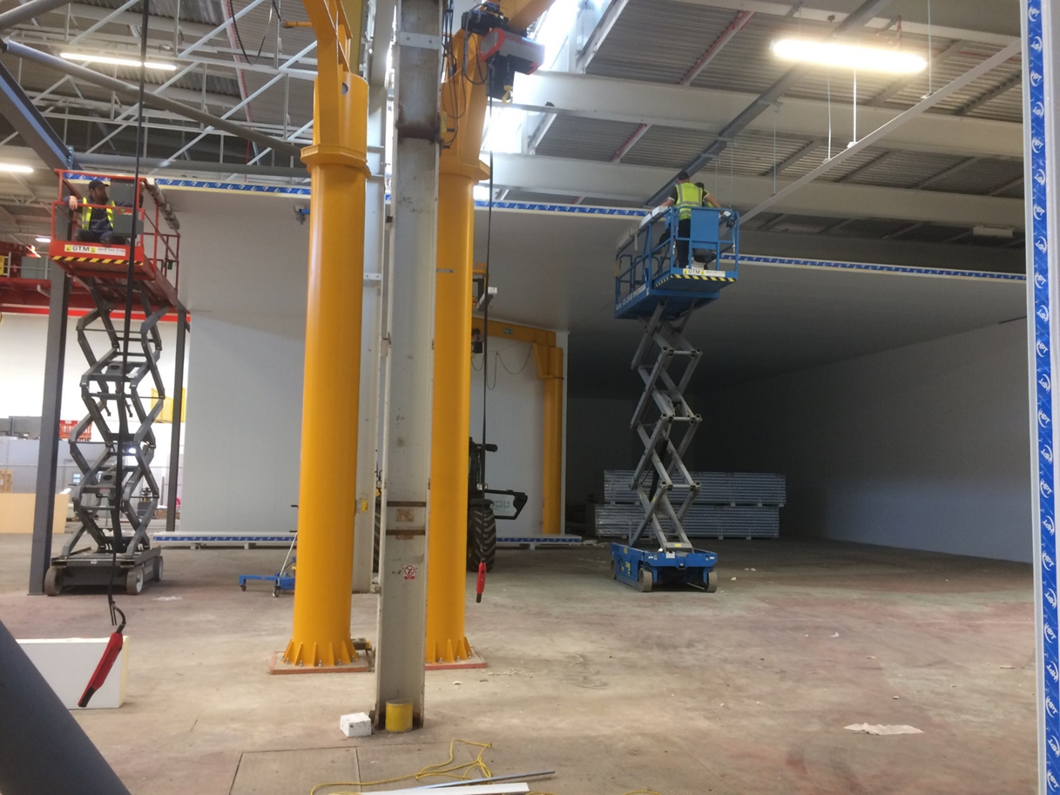
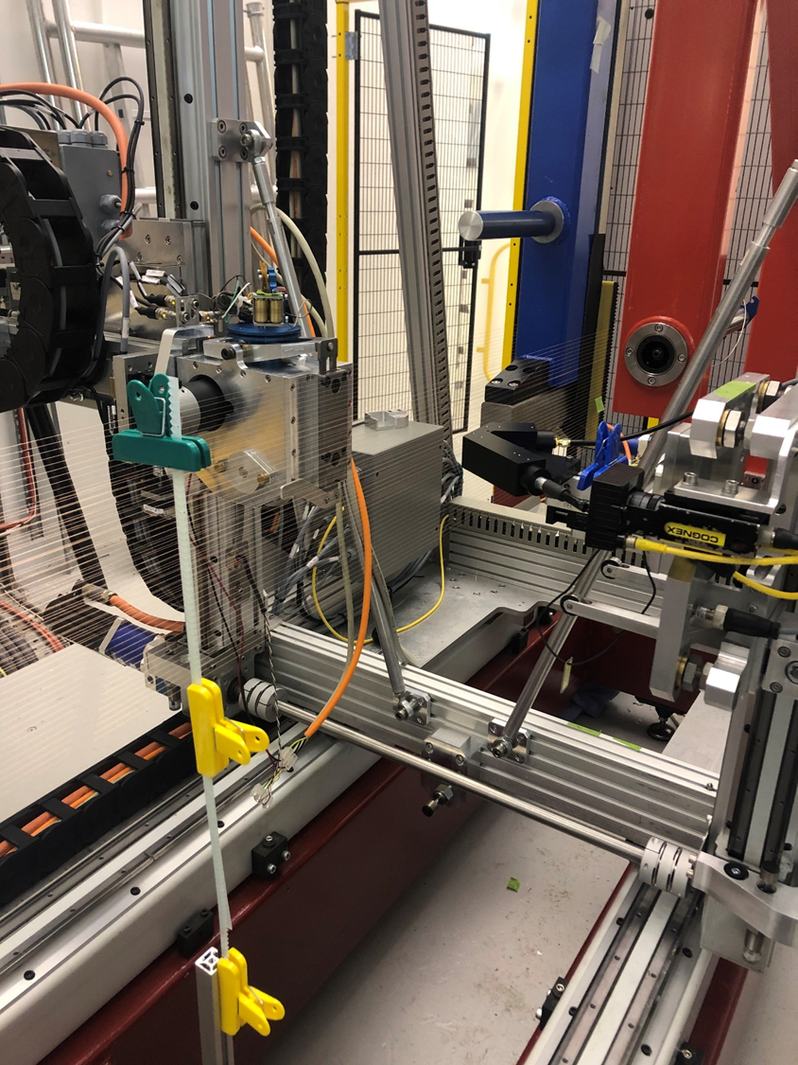
FD APA
Progress at Daresbury Lab
  Proceeding with assembly of production factory (plan to be completed by early November.
  Progressing on tests of winder head
  with active tension control
    achieved 6 ± 0.5 N for horizontal wires
    APA frame needed for diagonal wires

Slide 16
Status of ASICs and FEMBs
LArASIC
  Significant progress in identifying source of “ledge effect” observed in ProtoDUNE: 2nd stage of preamp, added after microBooNE version to allow for different gains, working on redesign
ColdADC
  Now characterizing ~140 ADCs for installation on prototype FEMBs
  At the same time investigating in detail some of the features observed in initial testing: discovered that SHA receives kickback from pipeline ADC, which contributes to the non-linearity (will help develop the fix in the design)
COLDATA
  Extensive testing performed at Fermilab both at room and LN₂ temperature
  Only two minor flaws observed in testing
CRYO
  Working on the noise issue inside CRYO (observe a line at 160 KHz)
FEMBs
  Fabricated prototypes of FEMBs with LArASIC+ColdADC+FPGA
  Working on design of FEMB with CRYO and with COLDATA

Slide 17
Setups for system tests (i)
Small TPC in ICEBERG cryostat at PAB, setback of 2-3 months
  Significant work done in July/August to complete the cryostat
    Add condenser to better control the pressure / level of LAr
    Add purifier
  Filled cryostat, operated TPC in LAr in September
  Not yet working in the optimal way
    Can reach 56” level, need 60-62” (FEMBs fully immersed in LAr)
    Cryogenic engineers working on small design changes to condenser to address the first problem
    This probably solves also the 2nd one
  Unfortunately we had (again) damage to the FEMBs (and to the WIBs)
    In a previous run, this was caused by discharges (bubbles in the LAr, problems with field cage)
    This time the damage occurred when the TPC electronics was not powered on, during tests of the photon detector
    Problem not understood, being investigated

Slide 18
Setups for system tests (ii)
7th ProtoDUNE APA in the Cold Box at CERN
  Full scale APA
  Direct comparison with ProtoDUNE, but not a TPC
  Commissioning delay due to prioritization of Dual Phase detector
  Setup of Cold Box and assembly area completed in the 1st week of October
  APA removed from box (it’s been stored at CERN since end March)
    Inspections and wire tension measurements last week
  TPC electronics personnel at CERN since last Thursday (all parts at CERN since Spring)
    Completed all safety training yesterday
    Installation of FEMBs on APA started this morning
    Expect to perform tests in cold box next week
  Will perform test with SBND FEMBs next (either in December or early January)
New Warm Interface Board (WIB) required for COLDATA/CRYO
  Design of first prototype out for fabrication
  Working on translating firmware from Altera to Xilinx

Slide 19
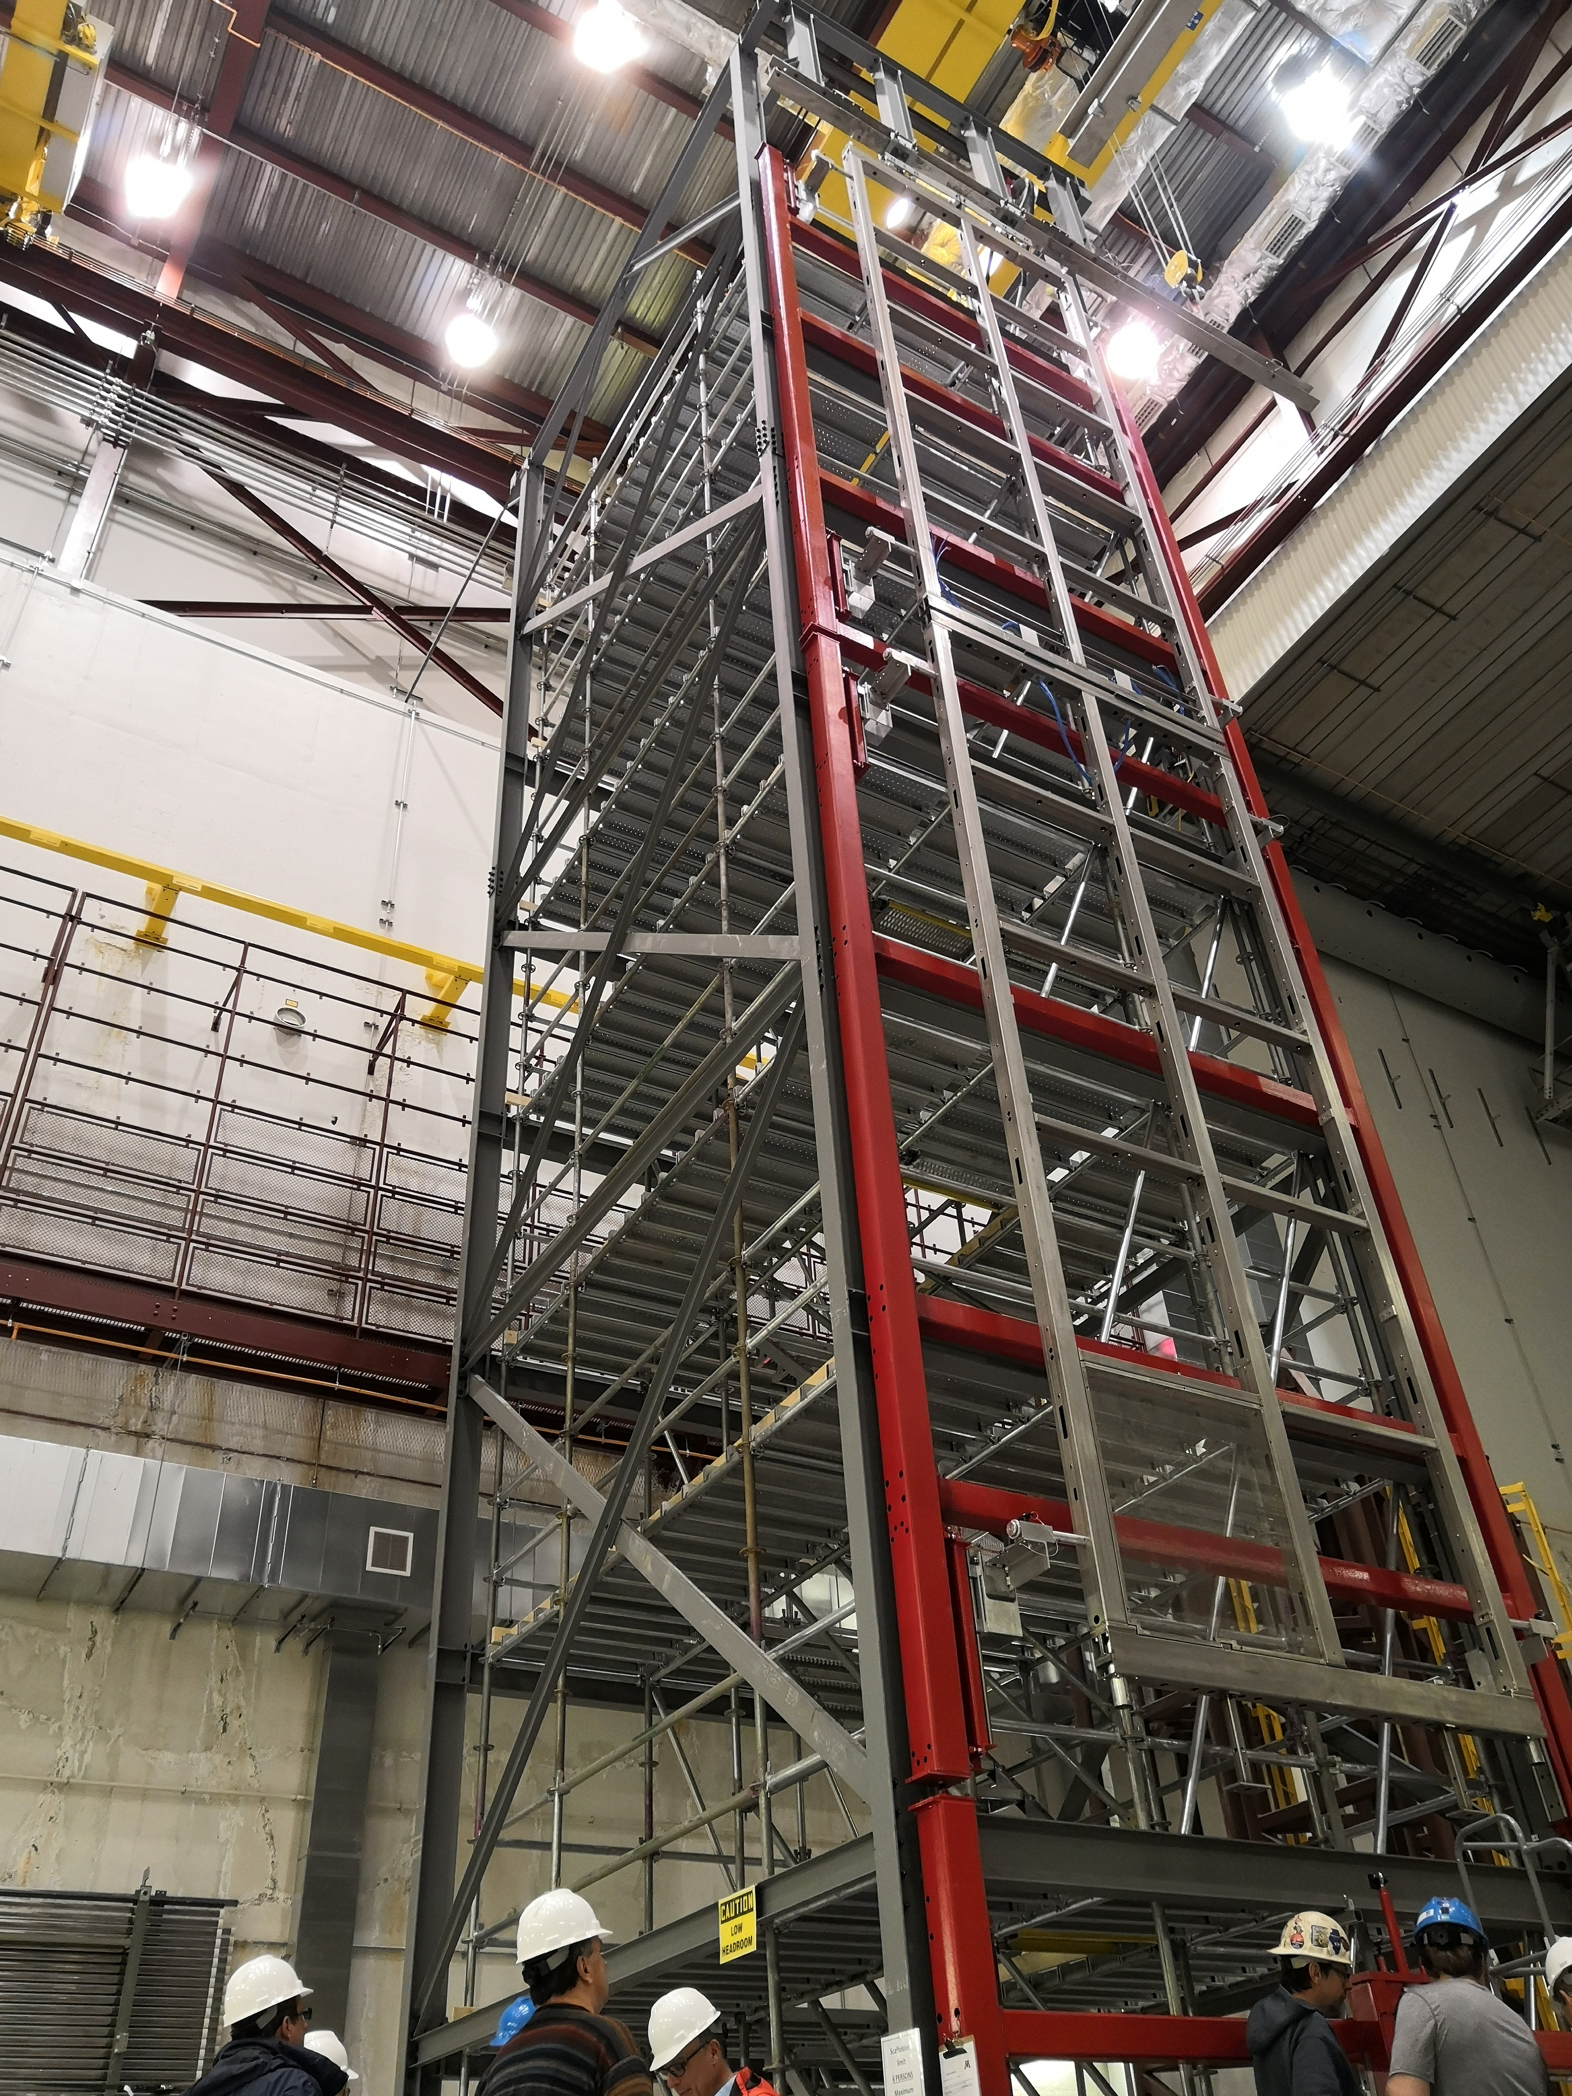
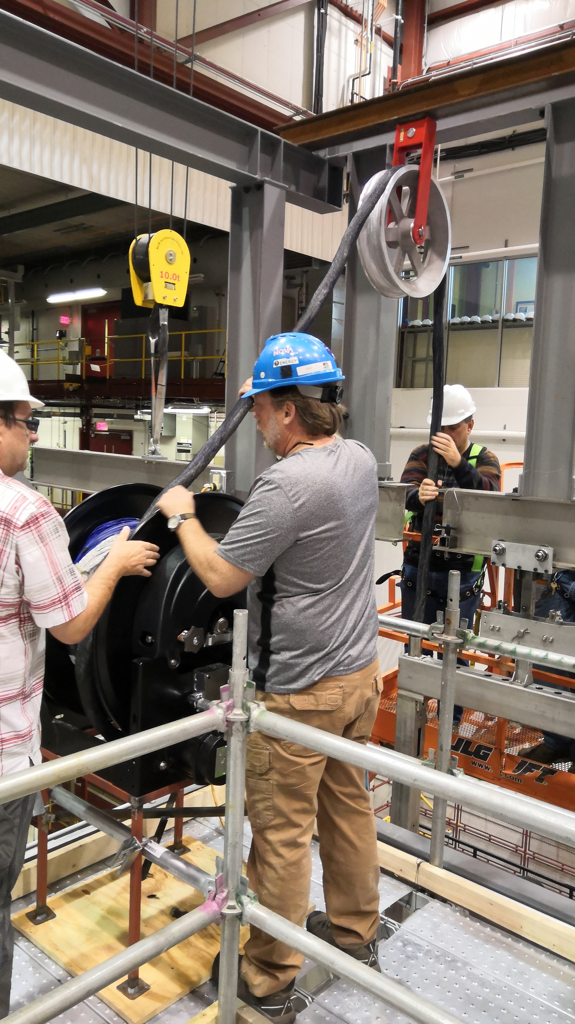
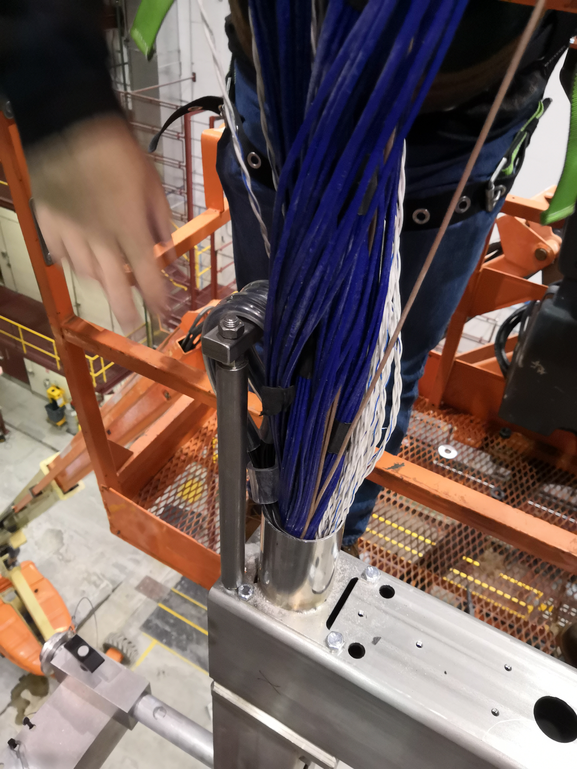
Integration Tests at Ash River
Cable insertion tests performed at Ash River (beginning of October)
Many lessons learned, will need some small design changes on supports for cables and FEMBs

Slide 20
Other
Boiling in LAr ?
  Tests done at BNL demonstrate that we do not expect any boiling in LAr from the electronics for the lower APA (would have to route gas outside of sensitive volume)
TDR
  Implemented small corrections to address comments from LBNC on July version
Interface Documents
  Making steady progress on fully defined mechanical interfaces with APAs and photon detectors,
  Need to finish writing interface document with APA and develop interface document with facility (drawings exist)
Preparation for IPR
  Two most complex BoEs are complete, three more to be completed in the next 10 days
Preparation for SP-FS CD-2/3 (and director’s review)
  A lot of work to be done, update all quotes / BoEs
  Very tight timeline

Slide 21
FD High Voltage System
TDR
  Both single phase and dual phase HVS chapters for the TDR have been submitted on schedule. Final update to the SP version with the editors.
HVS Design Status
  The updated field cage, ground plane, and CPA designs are progressing well. First version of the 3D models and drawings have been made available for review. Key structural changes have been evaluated at Ash River.
  Initial on-site transportation, assembly and installation plans have been developed in close collaboration with TC.
  All relevant interface documents have been generated as part of the TDR submission.
Cost and Schedule
  All activities (US and non-US) have been entered into a unified P6 schedule.
  Risks for US project have been updated.
  BOEs are being updated in preparation of the October IPR.

Slide 22
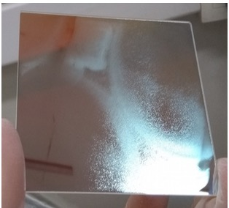
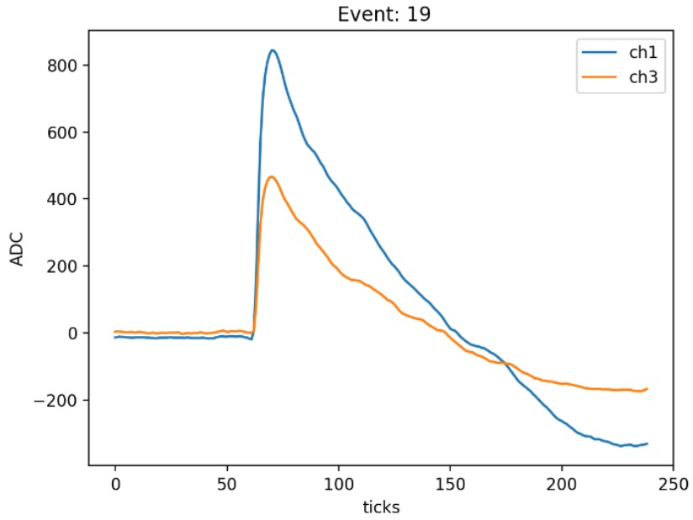
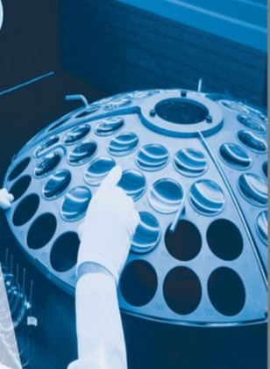
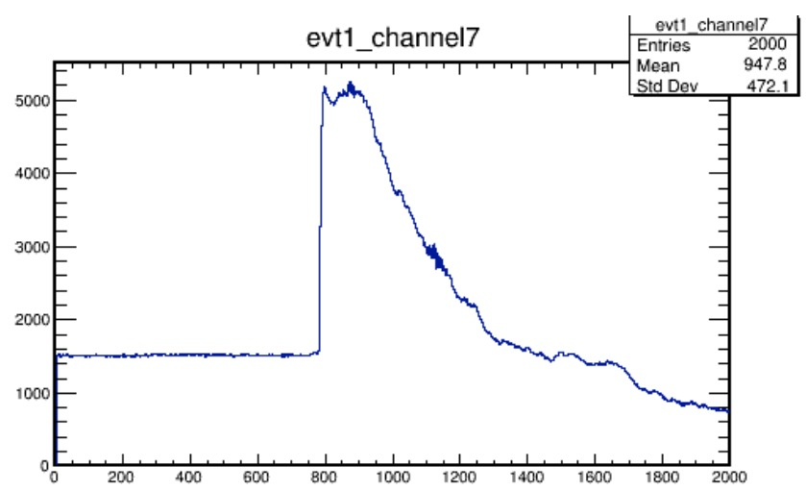
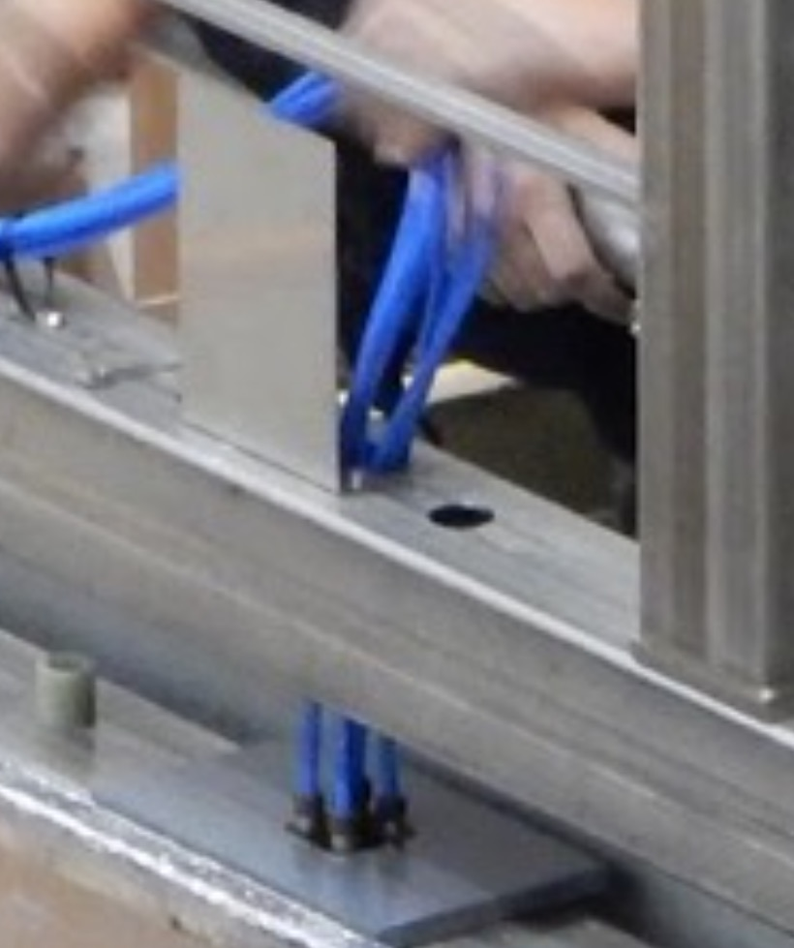
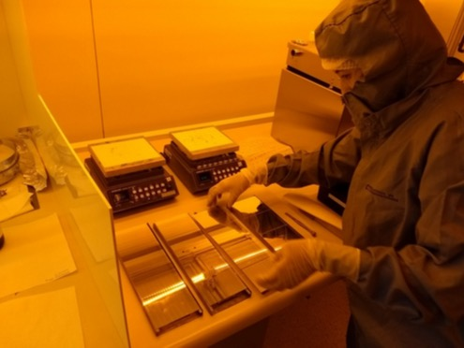
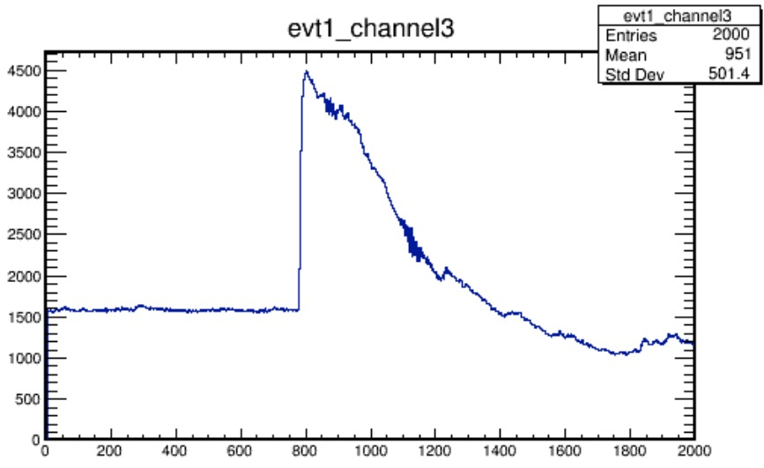
Photon Detector
Tested upper-lower APA junction at Ash River
Resolved Brazilian filter “Halo” problem
  Caused by design of filter deposition oven
  Resolved with new solid backing plate
Operated SSP and Daphne in ICEBERG
DAPHNE
Ash River Test
SSP X-ARPUCA
SSP X-ARPUCA

Slide 23
Upcoming Events
Near Detector Workshop at DESY – October 21 - 23
LBNF/DUNE IPR at FNAL – October 29 – November 1
LBNC Meeting at FNAL – December 2 - 4
Collaboration Meeting at CERN – January 27 - 31
RRB Meeting at FNAL – April 2 - 3
DOE CD-2/3b Review at FNAL – April/May (TBD)

Slide 24
Backup

Slide 25
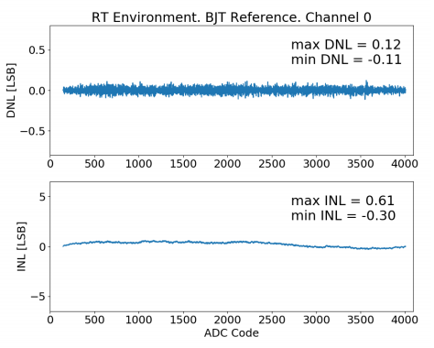
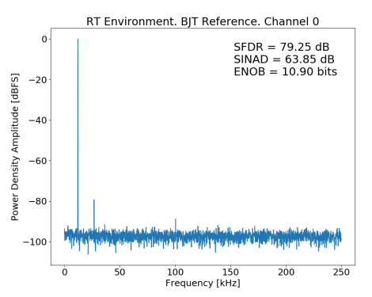
Status of ASIC development / testing (i)
LArASIC
  Significant progress in identifying source of “ledge effect” observed in ProtoDUNE: 2nd stage of preamp, added after microBooNE version to allow for different gains
  Now working on redesign
  Will then work on adding differential output (already prototyped in ColdADC)
ColdADC
  Now characterizing ~140 ADCs for installation on prototype FEMBs
  At the same time investigating in detail some of the features observed in initial testing: discovered that SHA receives kickback from pipeline ADC, which contributes to the non-linearity (will help develop the fix in the design)
  This is an excellent ADC sampling at 2 µs (we need to sample at 500 ns)

Slide 26
Status of ASIC development / testing (ii)
COLDATA
  Extensive testing performed at Fermilab both at room and LN₂ temperature
  Only two minor flaws observed in testing
    PLL requires 1.2 V to lock at room temperature (designed for 1.1V, for reliability). At LN2 temperature the PLL locks at 1.05V
    The relay of I2C commands between different chips does not work perfectly. This requires that some commands are re-issued (problem already identified in Verilog)
  Need to measure bit error rates with 2 lengths of cable (waiting for delivery of components
  Expect to complete characterization by early November, packaging chips
  Started design of FEMB with ColdADC and COLDATA
CRYO
  SLAC has used nEXO funds to advance design (address issues observed in the first version for DUNE), will submit version of chip with nEXO front-end soon (expect better ADC performance, with ENOB at the level of ColdADC)
  Now reverting to understand the noise issue inside CRYO (observe a line at 160 KHz)

Slide 27
FEMBs
System Tests
  We are planning to perform system tests with the small TPC in the ICEBERG cryostat at PAB and with a ProtoDUNE APA in the cold box at CERN
  Three versions of FEMBs (in addition to ProtoDUNE FEMBs used to commission the setups and SBND FEMBs) with different ASICs
    LArASIC+ColdADC+FPGA on mezzanine
      Being assembled, waiting for ColdADC chip testing, can be tested with same WIBs used for ProtoDUNE/SBND FEMBs, minor software changes required
    CRYO
      Design being done at U Hawaii (delayed by putting contract in place), will use nEXO version of chip, available in Spring, requires new WIB
    LArASIC+ColdADC+COLDATA on mezzanine
      Design starting at BNL, expect to have prototypes at the beginning of 2020, requires new WIB

Slide 28
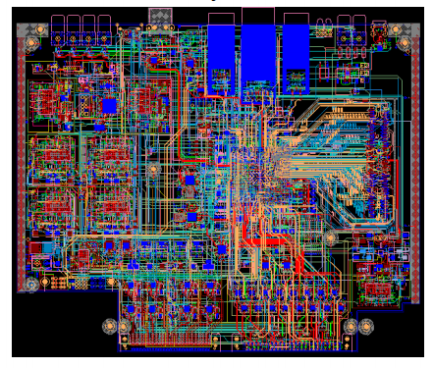
Warm Interface Board
System tests with new ASICs require new WIB
  Different power distribution scheme
  New WIB designed at BNL
    Uses newer/cheaper FPGA compared to ProtoDUNE
    More flexibility/monitoring in power distribution
    Prototypes in hand
  New firmware required
    Moved from Altera to Xylinx
    Two version of old firmware (BNL and BU)
    New groups involved in firmware design (Penn, Pittsburgh, BNL, possibly UCDavis, Florida if needed to meet the deadlines)
    Identified different blocks that need to be translated
  Expected to be ready for system tests with FEMBs with new ASICs in January/February

