Slide 1
Beamline Requirements to NSCF
N. Dhanaraj
Beamline/NSCF Integration Meeting
October 2, 2019

Slide 2
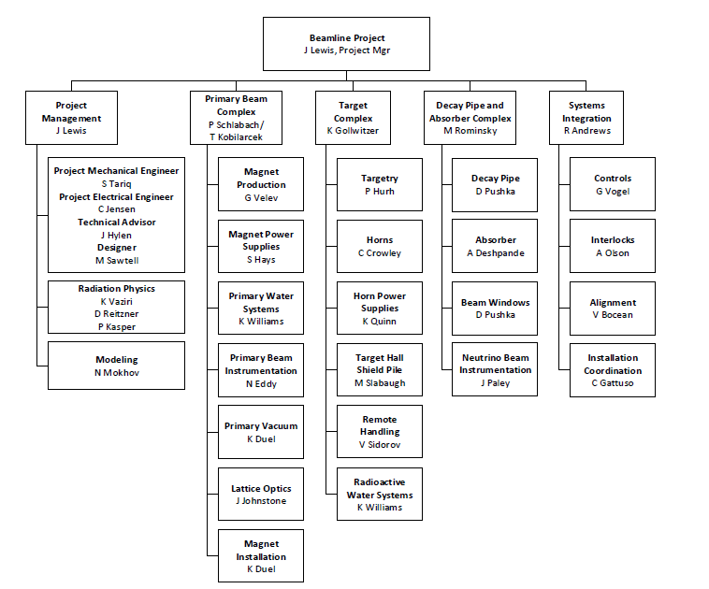
Status of Power and Cooling Requirements

Slide 3
Purpose of this meeting
Need to turn in all NSCF L4 schematic and NSCF L5 Functional requirements from DOORS to LBNF/DUNE management on 04OCT2019, then to be sent to NSCF A/E to develop the preliminary NSCF design
However, need to confirm at today’s meeting some of these requirements
For Example: DOORS ID 1606: L5 PBE Electrical Requirement: For both surface facilities and underground enclosures, NSCF shall provide conventional power distribution system, including lighting, HVAC, welding receptacles, power receptacles, and utility outlets.

Slide 4
Additional Requirements Needing Clarification
Standby and emergency power for what systems and what locations? What kind of power source – generator, UPS, etc.?
DOORS ID 2019, L6 NSCF: NSCF shall provide standby and emergency power to the power supply room, quad room, pump room and controls room in the PBSB, via a generator (?)
No other requirement found in DOORS for any other location
There are multiple air and gas systems that have cfm ratings that need to be verified and posted to DOORS, so A/E can design the facilities with the correct HVAC capacities
DOORS ID 1956, L6 NSCF: NSCF shall provide the ability to supply 3500 CFM of Nitrogen at 25 degree C for each of the three horn striplines independently, with the duct running between the gas handling equipment to the bunker termination occurring at the top of the modules
Need to confirm what other cfm values for other gas-air handling systems that the A/E will have to build (i.e. 25,000 cfm for what system?)

Slide 5
Additional Requirements Needing Clarification (contd.)
Floor flatness
Sealant for dust control
Type of fire protection
Codes and standards (FESHM, etc.)
Communication lines (ACNET, Metasys, etc.)

