Slide 1
Component Qualification
Andrew Laundrie
UW Physical Sciences Lab
DUNE Electronics Review
2019 November 18

Slide 2
Cold-Test Methodology
Select components having a good chance of surviving temperature extremes
Mount components on a test vehicle
Measure characteristics at room temperature and at Liquid Nitrogen temperature
Repeat temperature cycles

Slide 3
Cold-Tested Components
Multi-Layer SMT Ceramic Capacitors
Thick-Film SMT Resistors
Bias Connectors
Mill-Max Receptacles

Slide 4
Component Selection
Research options having necessary specs
Only evaluate components rated for -55C
Study component structure and materials
Read manufacturer’s process guidelines

Slide 5
Capacitor Choice
Kemet part number C2225X392JGGACTU
3.9 nF +/- 5% C0G (NP0) 2 kV Surface Mount
Usable for all coupling and filter functions
High immunity to flex cracks
Pliable silver epoxy between the base metal and nickel barrier layers of the termination system.
Inhibits the transfer of board flex stress to the rigid ceramic body

Slide 6
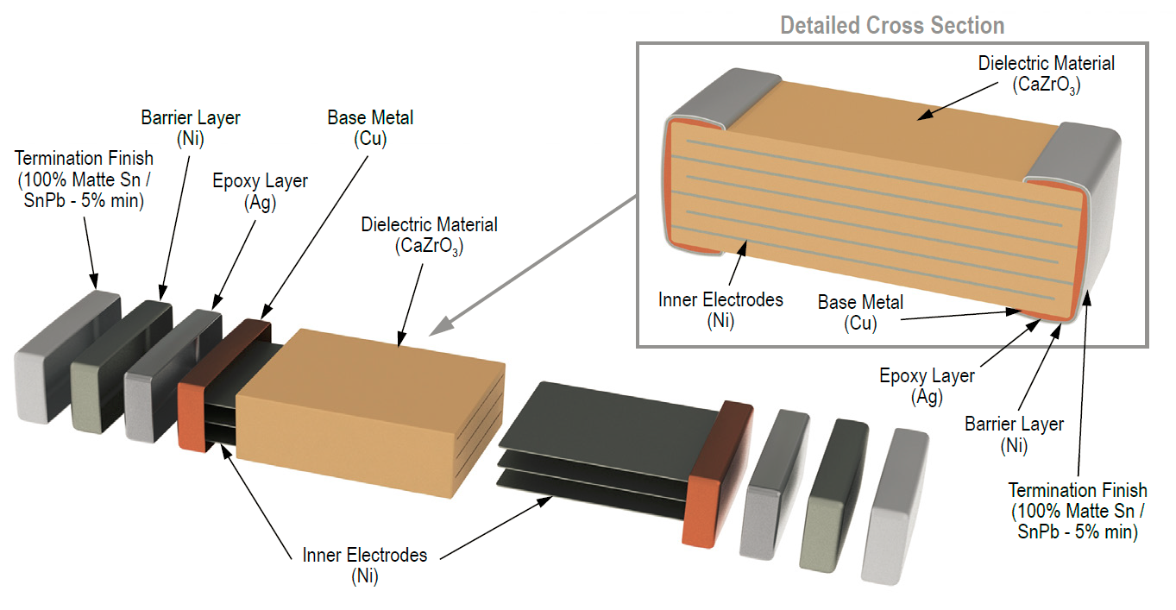
Capacitor Construction

Slide 7
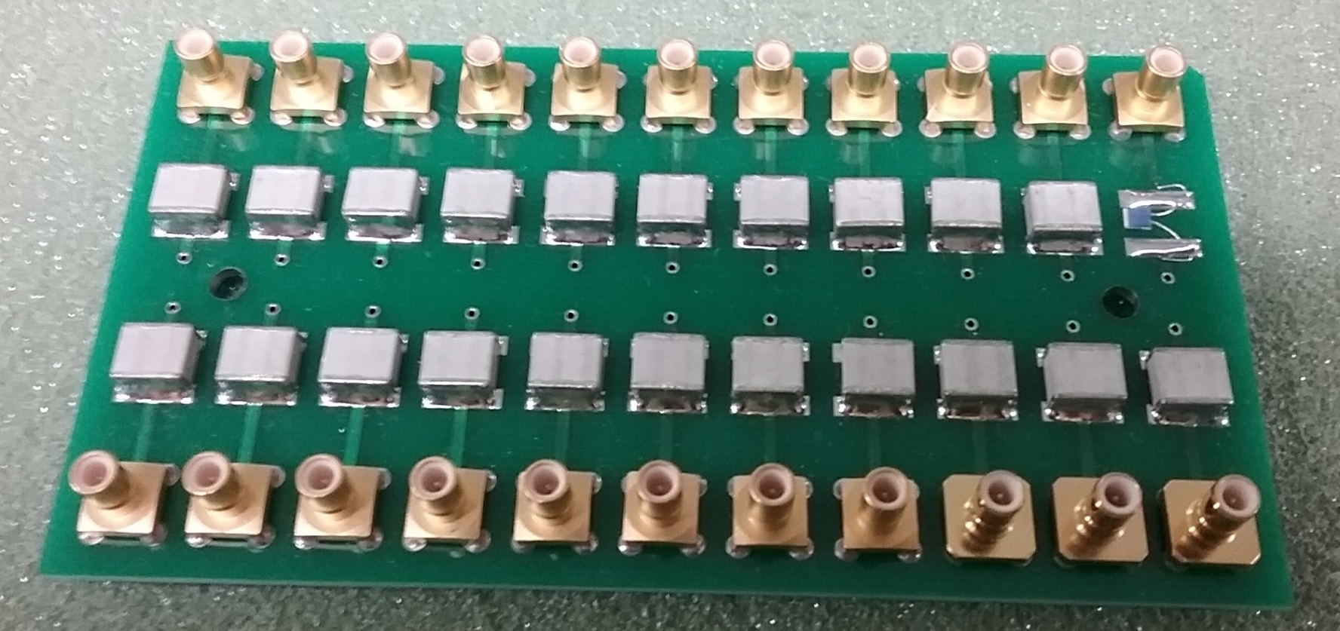
Capacitor Cold Test Fixture

Slide 8
Capacitor Cold Test Results
42 Samples tested hot and cold, five cycle
Room temperature: 3.79 to 4.02 nF (+/- 0.5%)
In liquid nitrogen: All increased ~0.02 nF
No changes over five temperature cycles
No leakage currents exceeded 0.1 nA at 1 kV

Slide 9
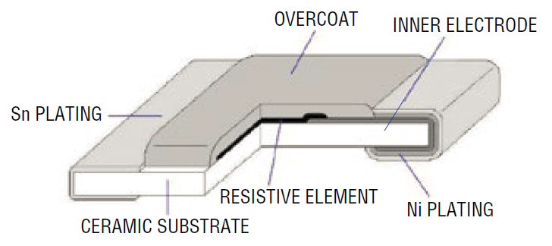
Resistor Choice
Bourns CHV Series Thick Film High Voltage Chip Resistors (rated for -55C)
CHV2010 Package: 2000 Volts
Reliable for UL/IEC safety certifications
Tolerance +/- 1% for 5 or 10M, +/- 5% for 51M

Slide 10
Resistor Cold Test Results
21 Samples of 51M tested hot and cold (x5)
Room temperature: 48.8 to 52.0 (+/- 2%)
In liquid nitrogen: Increased by 1.5 to 1.9
21 Samples of 4.7M tested hot and cold (x5)
Room temperature: 4.69 to 4.71 (+/- 0.2%)
In liquid nitrogen: Increased by 0.15 to 0.16
No changes seen over five temp. cycles

Slide 11
Bias Connector Choices
Phoenix Contact 1808190 SMT receptacle
Phoenix Contact 1778832 plug
No temperature range given, only hot derating
Body material is a Liquid Crystal Polymer
Same class of material used in Samtec parts
Contact resistance measured warm and cold
Mating forces measured warm and cold

Slide 12
Bias Connector Cold Test Results
Room-temperature mating and removal forces: 1 to 2 pounds
Liquid Nitrogen mating and removal forces: 1.5 to 2.5 pounds
Change in contact resistance: none seen

Slide 13
Mill-Max Board-to-Board Connectors
ProtoDUNE components were off-the-shelf
Mechanical stability problems were not recognized early enough to explore options for customized components
Mechanical stability was enhanced using 3M 2216 Clear epoxy
Components were tested warm and cold to ensure good electrical performance

Slide 14
M-M Connector Cold Test Results
200 mated components were mounted in a head board stack and connected in series
Most of the combined resistance was contributed by jumper wires and on-board wire traces
A four-wire Ohm-meter measured combined resistance repeatable to +/-0.002 Ohms
After 10 temperature cycles, no change in combined resistance value

Slide 15
Mill-Max Board-to-Board Connectors
DUNE uses custom designs
Mechanical stability was thoroughly tested at room temperature
Mechanical stability is assured for an acceptable range of through-hole diameters
Components were tested warm and cold to ensure good electrical performance

Slide 16
M-M Connector Cold Test Results
160 mated components were mounted in a head board stack and connected in series
After 10 temperature cycles, no change in combined resistance value was noted
Total resistance was continually monitored during temperature transitions to detect any intermittent contact (same as for ProtoDUNE)
More testing using larger arrays is planned

Slide 17
Backup Slides

