Slide 1
Geometry Board Design
Andrew Laundrie
UW Physical Sciences Lab
DUNE Electronics Review
2019 November 18

Slide 2
ProtoDUNE PCB Design Metrics
Head board thickness: 0.1875 in. (4.76 mm)
Side and foot boards: 0.125 in. (3.18 mm)
Dune was developed expecting 2% tolerance
The prevailing industry standard is +/- 10%
ProtoDUNE boards were closer to +/- 5%
Low-cost quick-turn suppliers are inconsistent
Quality suppliers cost more and take longer

Slide 3
ProtoDUNE PCB Design Metrics
Minimum wire trace width: 0.012 in. (0.3 mm)
ProtoDUNE used 0.012 traces in most places
Short segments near wire solder pads: 0.030
Geometry board designs for DUNE: all trace widths increased to 0.030 in. (0.8 mm)
Spacing was kept as wide as possible to minimize crosstalk
IPC guidelines followed for APA bias voltages

Slide 4
IPC-2221B guidelines for Long-Term PCB Reliability
Based on many years of failure analysis performed at Sandia National Lab
Defense against early dielectric breakdown
Not a substitute for Physics of Failure analysis
May help to avoid PoF to pass certification
Violations are not bad in all cases
Generally accepted: more spacing not better
Spacing vs Voltage guidelines are a goal

Slide 5
Spacing recommended for various voltage differentials encountered in DUNE
 |  | Uncoated | Coated | Embedded
∆V Volts | Locations | mm / in. | mm / in. | mm / in.
400 | U to Gnd | 2.5 / 0.10 | 0.8 / 0.032 | 0.25 / 0.010
500 | Tension Test | 2.5 / 0.10 | 0.8 / 0.032 | 0.25 / 0.010
700 | G to Gnd | 3.5 / 0.14 | 1.4 / 0.056 | 0.75 / 0.030
900 | X to Gnd | 4.5 / 0.18 | 2.0 / 0.080 | 1.25 / 0.050
1000 | Tension Test | 5.0 / 0.20 | 2.3 / 0.092 | 1.50 / 0.059
1300 | X to U | 6.5 / 0.26 | 3.2 / 0.130 | 2.25 / 0.090

Slide 6
X Head Board (Top Side Metal)
Solder Pads for Wires
DVM
Probe
Pads
Plated-through holes for Mill-Max receptacles
VSS
VSS
V
U

Slide 7
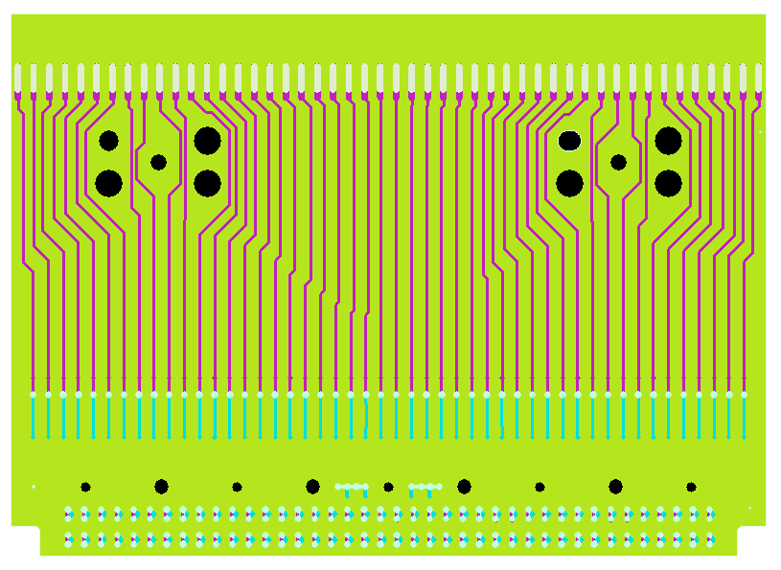
X Head Board (Top and Bottom)
Pads
for
probe
card
V
U

Slide 8
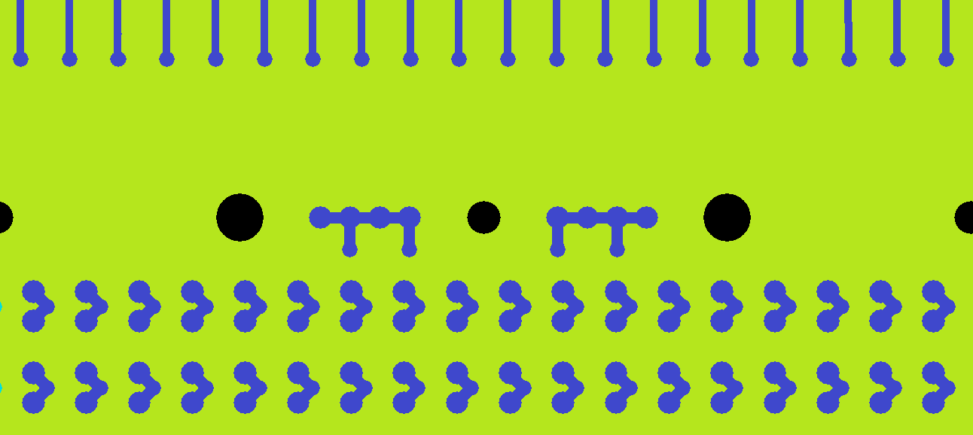
X Head Board (Bottom)
Bottom-side pads are for a probe card mounted in place of a CR board. The probe card uses spring-loaded contacts and is held in place with 5 fasteners.
X
VSS
VSS
V
U
Circles show 1-mm diameter pads where probe cards make contact

Slide 9
X Head Board Design Check
Features | Minimum Separation (S) mm | Possible ∆V Volts | Meets IPC? | Safety Limit¹ = S * 1kV/mm Volts
U and V traces (long-term) | 2.5 uncoated | 400 | Yes | 2500
∆U and ∆V (wire tension) | 2.1 uncoated | 500 | No | 2100
∆X (wire tension) | 2.2 uncoated | 500 | No | 2200
∆X (wire tension) | 0.81 coated | 500 | Yes | N/A
1. Dielectric breakdown in air requires more than this voltage (for uncoated traces only)

Slide 10
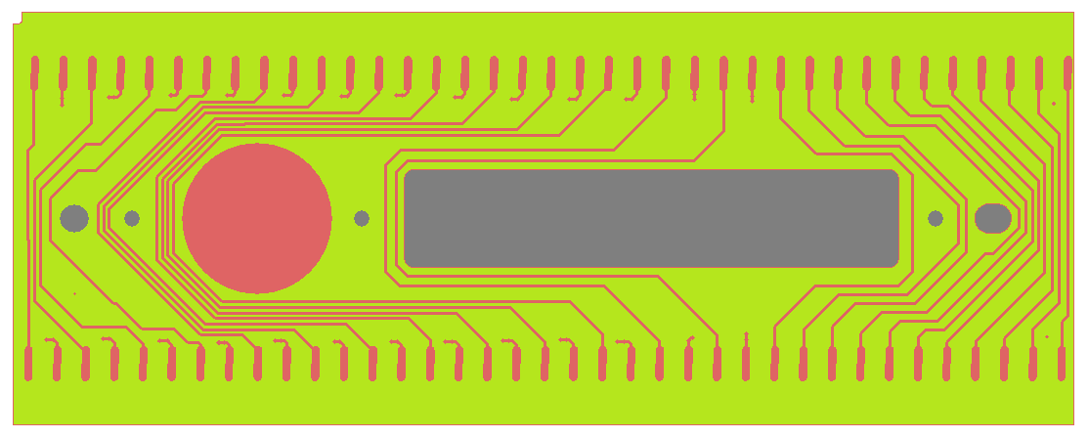
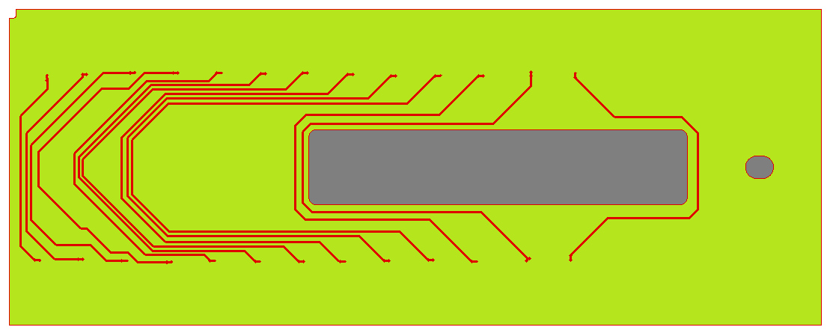
V Side Board With Slot
Top Layer
Internal Layer

Slide 11
V Side Board Design Check
Features | Minimum Separation (S) mm | Possible ∆V Volts | Meets IPC? | Safety Limit¹ = S * 1kV/mm Volts
∆V (wire tension) | 5.8 uncoated | 500 | Yes
∆V (wire tension) | 0.80 coated | 1000 | No | N/A
∆V (wire tension) | 0.80 internal | 1000 | No | N/A
1. Dielectric breakdown in air requires more than this voltage (for uncoated traces only)

Slide 12
V Side Board Design Check
A sample board had 2000 Volts applied between all adjacent traces on the top and internal layers for 15 minutes with no breakdown (Hi-Pot test threshold 100 nA)
This board will be re-designed to reduce or eliminate occurrences where adjacent wire traces are biased more than 500 Volts during electronic wire tension testing

Slide 13
Backup Slides

