Slide 1
ProtoDUNE and DUNE APA Wire Mapping Update
Andrew Laundrie
UW Physical Sciences Lab
DUNE Electronics Review
2019 November 18

Slide 2
Signal paths from Head Boards to CE channels are Unchanged
Head board ID (wire plane and stack position)
Solder pad (1 thru 48 for X, 1 thru 40 for U & V)
CR board input pin (one of 128)
CR Board output connector & pin
Adapter board: input and output pins
CE board input connector and pin
CE channel

Slide 3
PSL has completed a spreadsheet linking APA wire segments to CE channels
Wire Segment names, embedded therein:
  Head Board Stack number (1 through 20)
  Wire layer (U, V, or X)
  Solder Pad number (1 thru 40 or 1 thru 48)
  Which of up to three segments (A, B, or C)
X-Y-Z Coordinates of wire endpoints

Slide 4
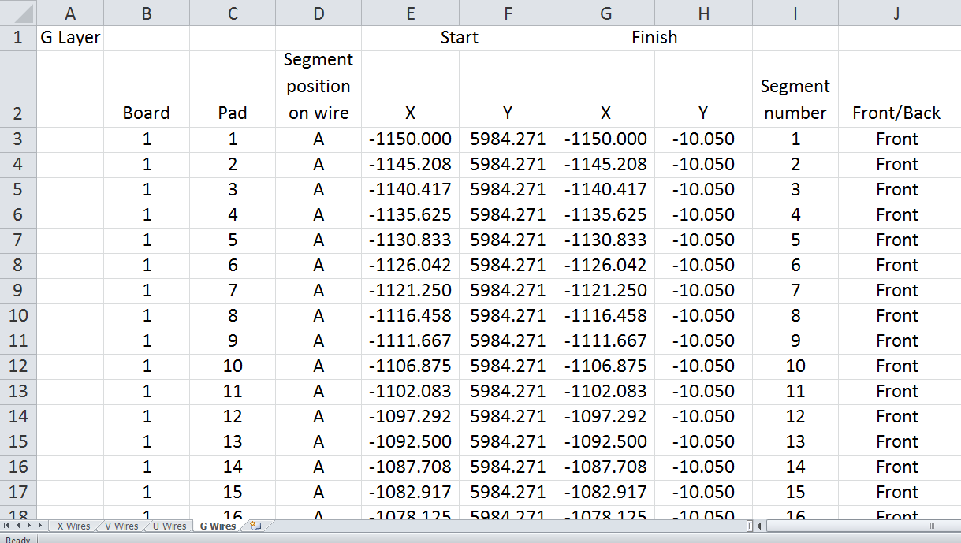
Spreadsheet for wire segment mapping

Slide 5
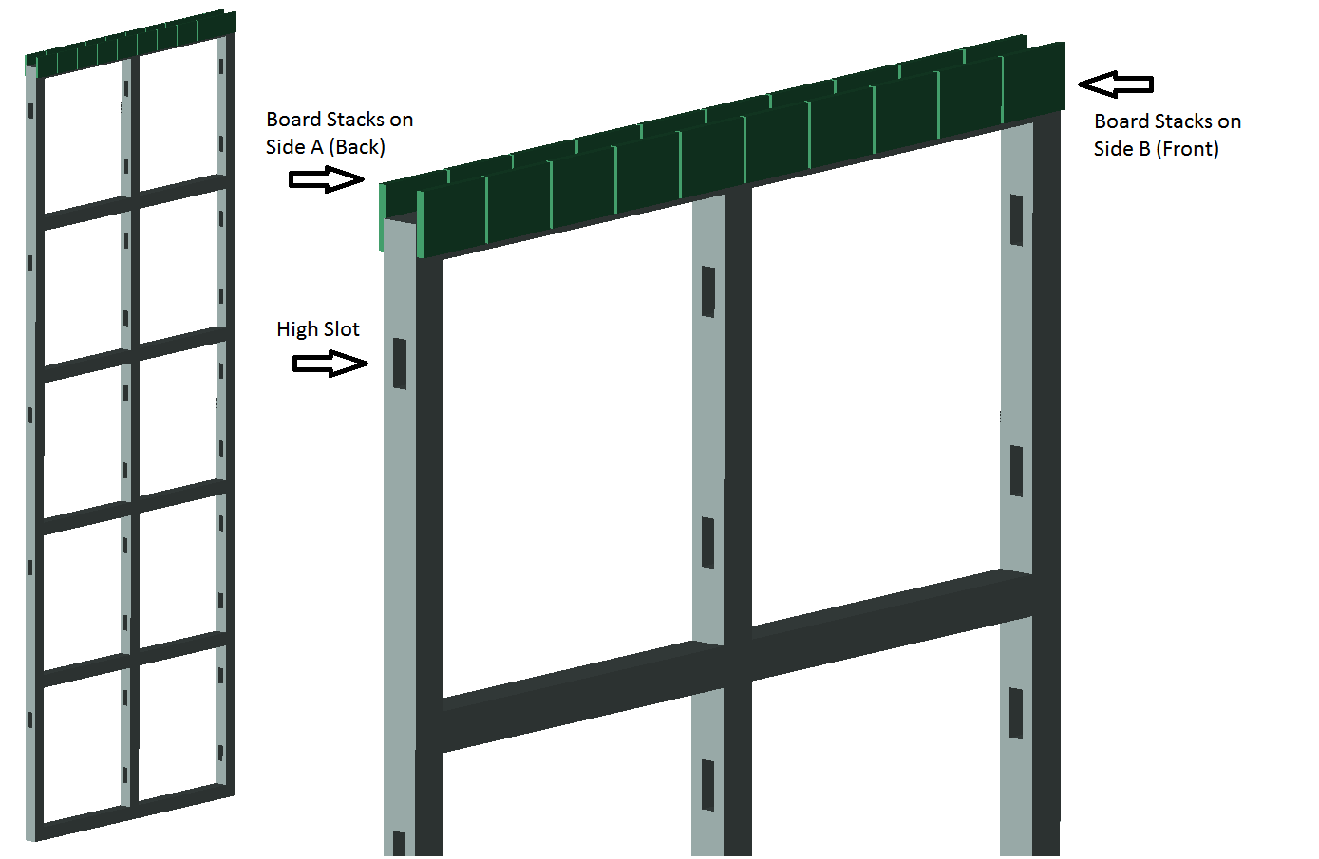
Board Stack identification

Slide 6
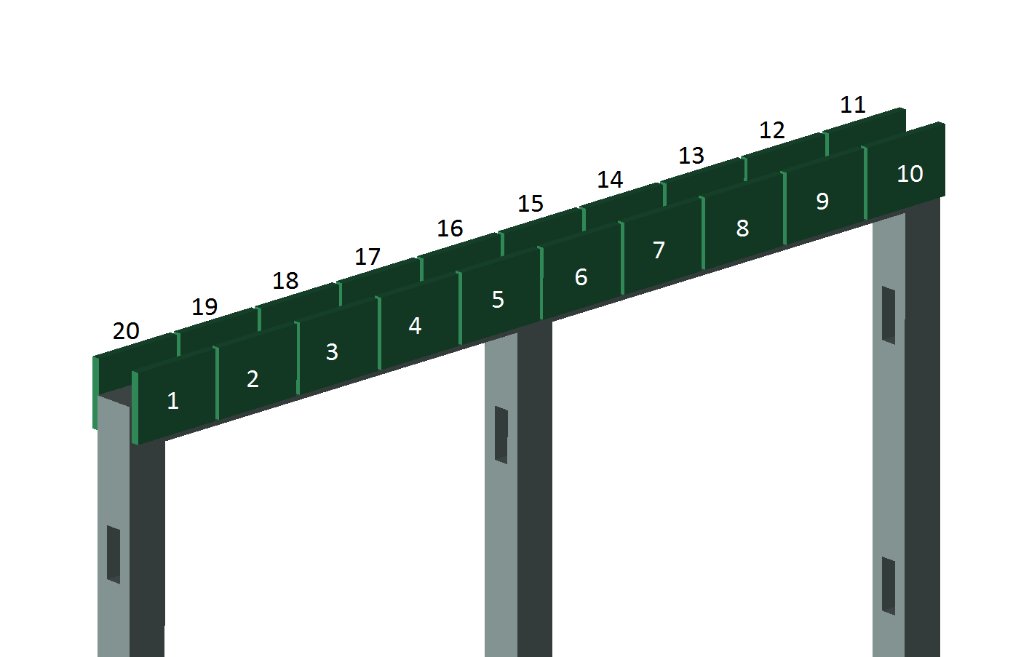
Board Stack numbering
(Front view = Side B view)

Slide 7
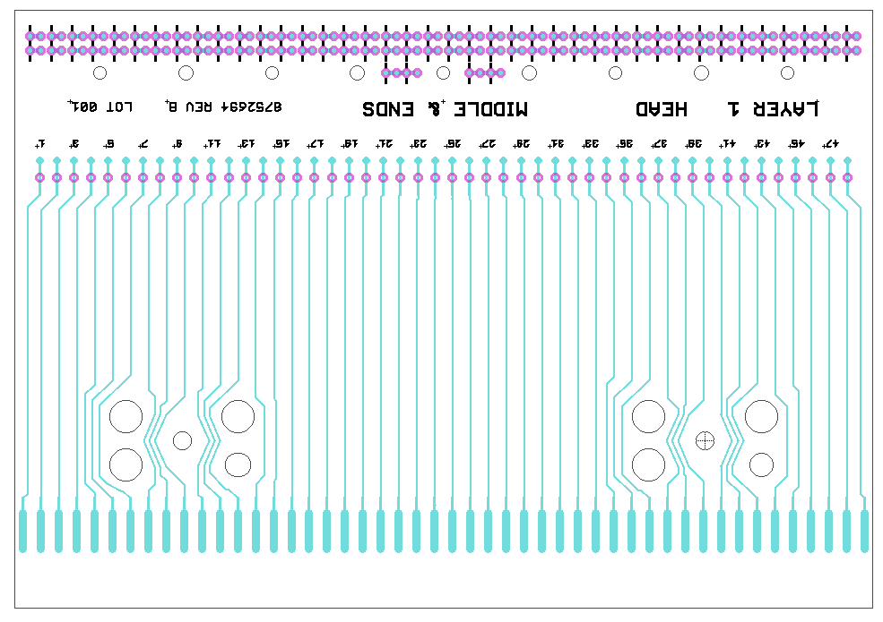
Wires are traceable to pins on the CR board
Pad 1
Pad 48

Slide 8
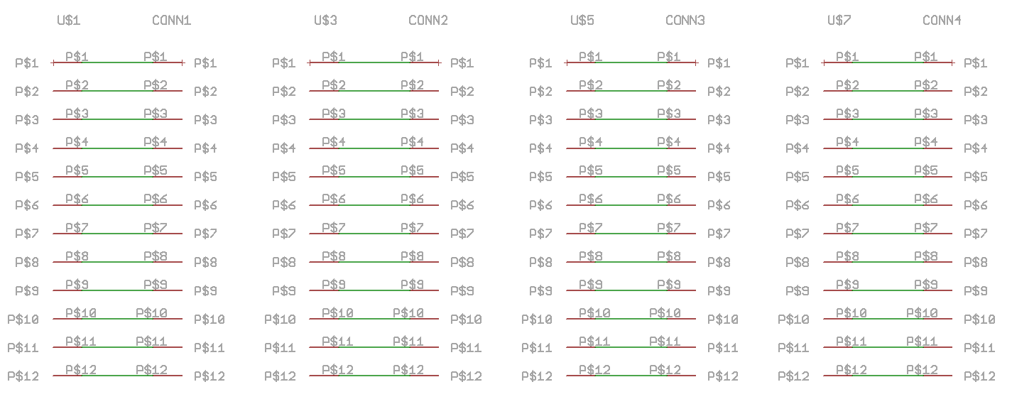
Head board schematic shows connections from pads to pins

Slide 9
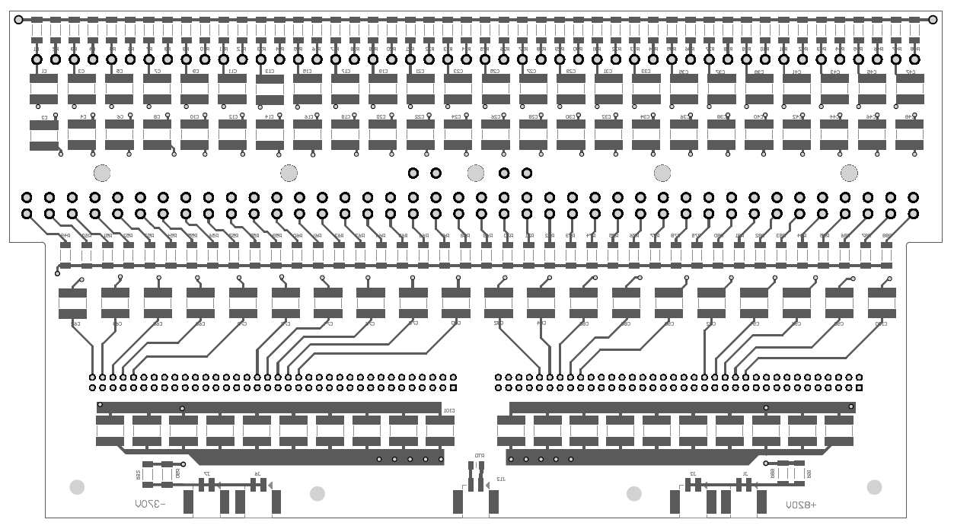
CR boards: connecting Head Boards to Adapter Boards

Slide 10
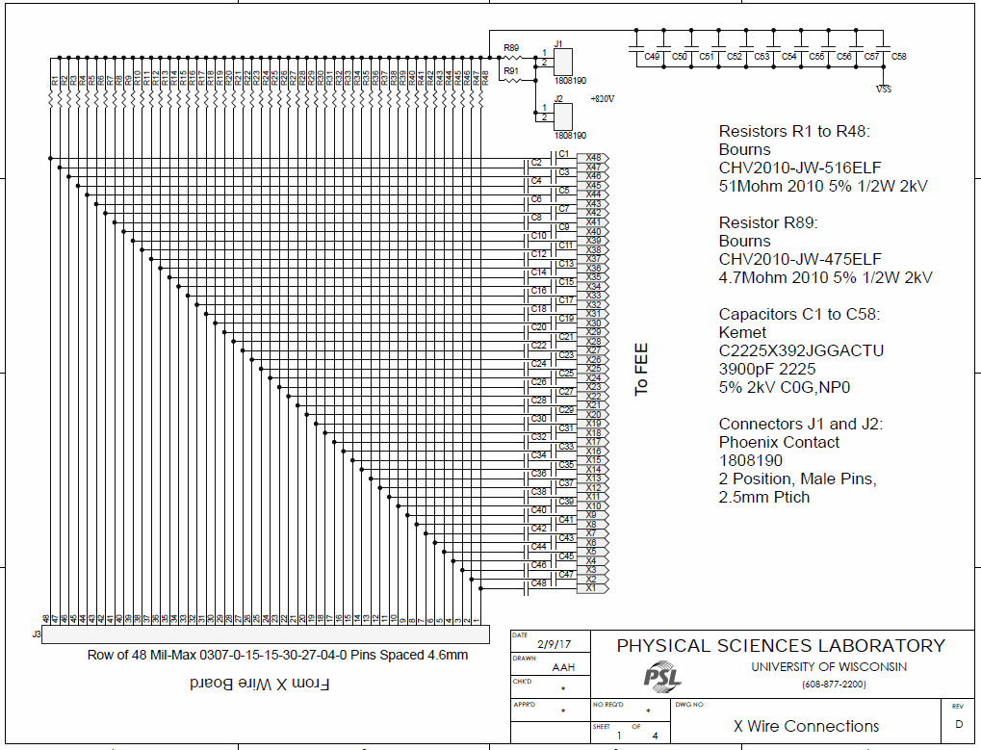
CR board schematic indicates signal paths
from Wire Boards to Adapter Boards

Slide 11
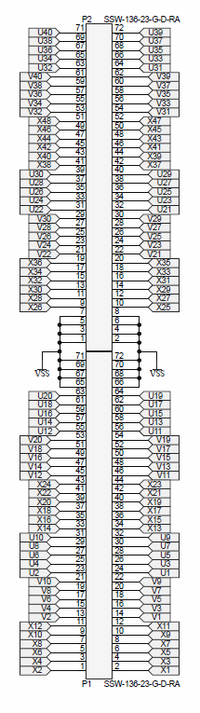
CR board schematic (continued)
Pins on connectors that mate with the Adapter board
are identified with APA wire names

Slide 12
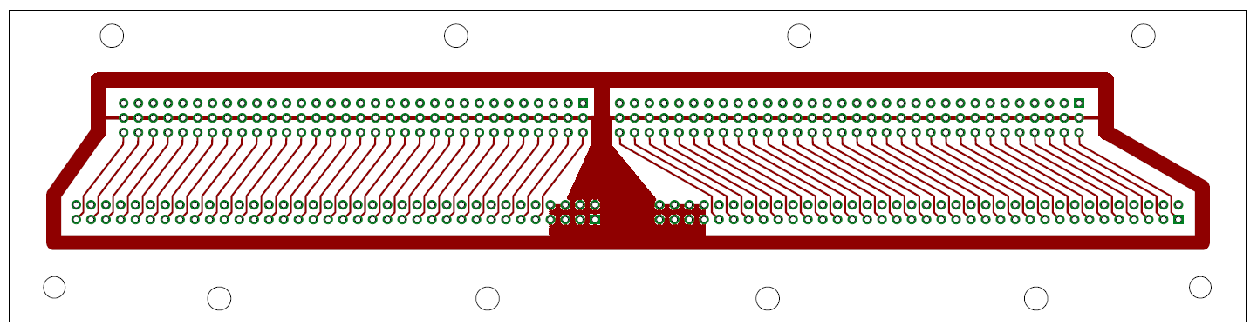
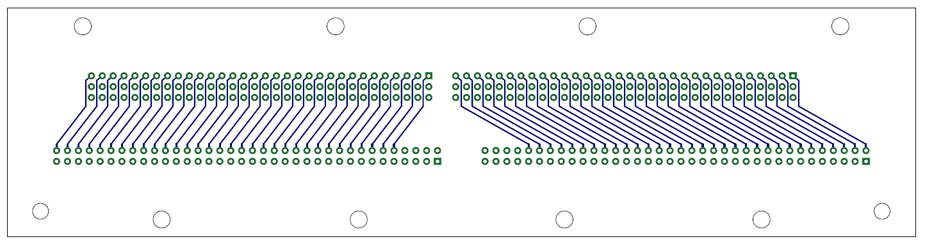
Adapter boards connect CR Boards to CE Boards

Slide 13
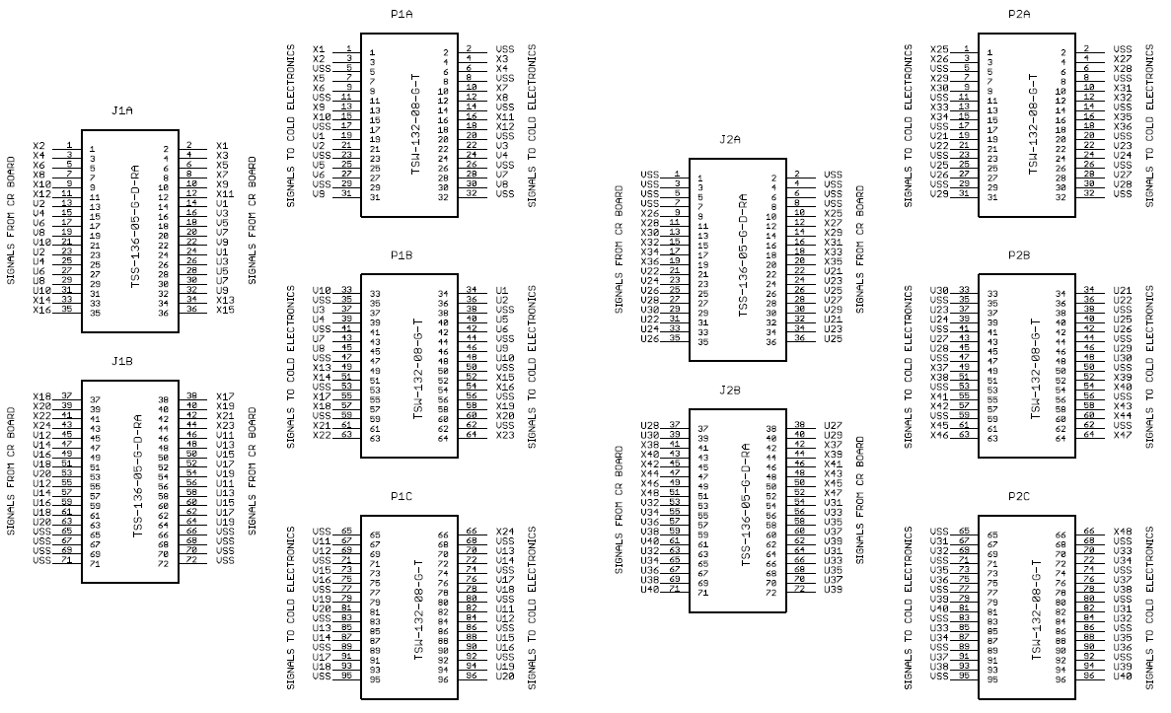
Pins on connectors that mate with the CE board
are identified using APA wire names

Slide 14
Connections between CR board
and CE board are tabulated
along with APA wire assignments

Slide 15
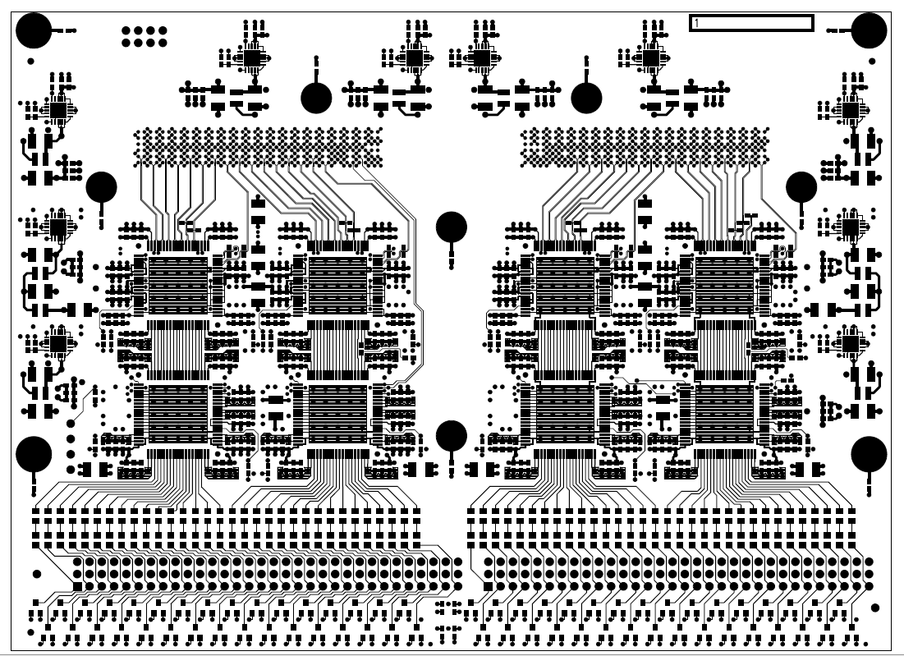
CE boards connect Adapter Boards to Digitizer ASICS

Slide 16
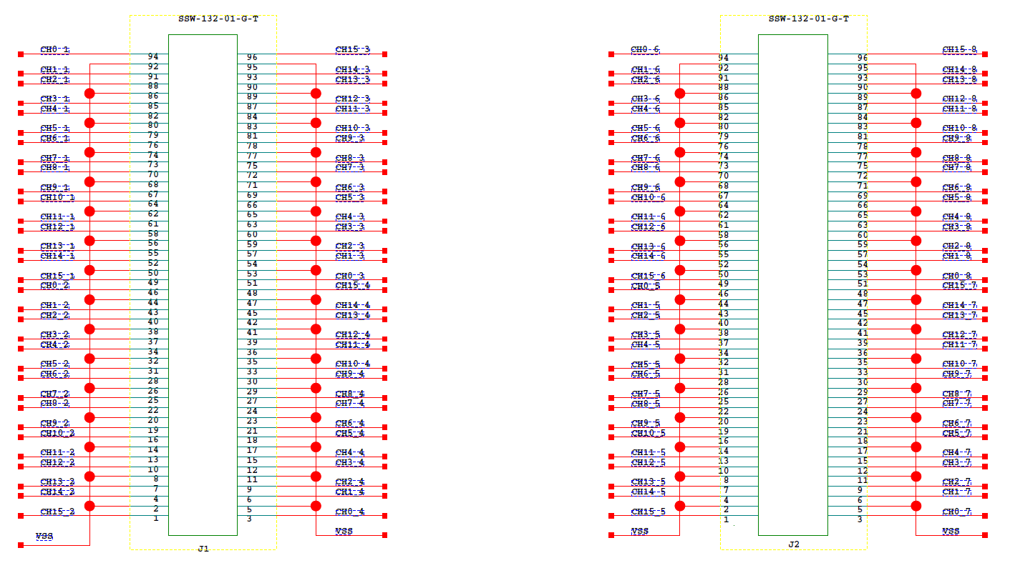
CE schematic from BNL indicates paths from
input connectors to digitizer channels

Slide 17
Summary of Wire Tracing
Documentation exists to support tracing active APA wires to CE channels
A spreadsheet provides endpoint coordinates for wire segments on ProtoDUNE APAs
A similar spreadsheet will be created for DUNE
A relational database would help with capturing and verifying all this data!!
It would also help link wire-tension data which uses a different wire-numbering system

