Slide 1
Bias Wire Harness Design and Construction
Andrew Laundrie
UW Physical Sciences Lab
DUNE Electronics Review
2019 November 18

Slide 2
Bias Wire Harness Features
Brings bias voltages to CR and G-bias boards
Fed from the SHV receptacles in the SHV panel
ProtoDUNE bias connectors probably should be upgraded to more secure locking method
Better connectors could justify less redundant
Pastel wire colors are difficult to differentiate
Seeking ways to label bias connectors or wires

Slide 3
Bias Harness: A Mess of Wires
Two bundles of 12 wires span the head tube
Sixty bias pigtails have to be managed
DUNE APAs ship without CR boards installed
Harnesses could be installed on-site
The wider DUNE head tube helps

Slide 4
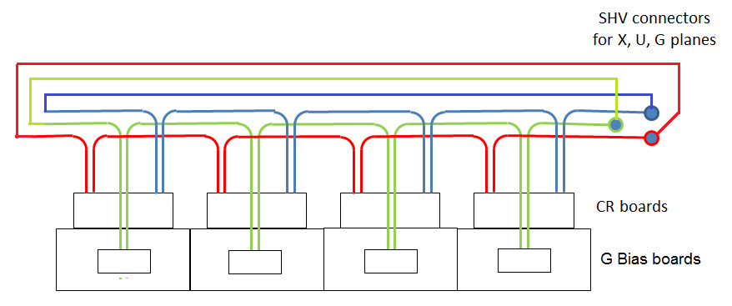
Looped Daisy-Chain (Ring) Architecture
A single disconnected bias connector drops bias voltage to only one head board
Redundant loops ensure that a single disconnected bias connector does not leave any X, U, or G wires unbiased

Slide 5
P11XA
P11XB
P12XA
P12XB
P20XA
P20XB
Bias Input X
Bias plugs are Phoenix
type 1778832 with heat-
shrink tubing applied
to improve insulation
SHV
X layer bias
CR Board 11
X layer bias
CR Board 12
X layer bias
CR Board 20
Bias wires are 20 AWG stranded
hook-up wire, color-coded, with
silicone insulation rated for 3 kV
N.C.
P10XA
P10XB
P9XA
P9XB
P1XA
P1XB
X layer bias
CR Board 10
X layer bias
CR Board 9
X layer bias
CR Board 1

Slide 6
P11UA
P11UB
P12UA
P12UB
P20UA
P20UB
Bias Input U
U layer bias
CR Board 11
U layer bias
CR Board 12
U layer bias
CR Board 20
SHV
Bias plugs are Phoenix
type 1778832 with heat-
shrink tubing applied
to improve insulation
Bias wires are 20 AWG stranded
hook-up wire, color-coded, with
silicone insulation rated for 3 kV
N.C.
P10UA
P10UB
P9UA
P9UB
P1UA
P1UB
U layer bias
CR Board 10
U layer bias
CR Board 9
U layer bias
CR Board 1

Slide 7
P11GA
P11GB
P12GA
P12GB
P20GA
P20GB
Bias Input G
G layer bias
Filter Bd 11
G layer bias
Filter Bd 12
G layer bias
Filter Bd 20
SHV
Bias plugs are Phoenix
type 1778832 with heat-
shrink tubing applied
to improve insulation
Bias wires are 20 AWG stranded
hook-up wire, color-coded, with
silicone insulation rated for 3 kV
N.C.
P10GA
P10GB
P9GA
P9GB
P1GA
P1GB
G layer bias
Filter Bd 10
G layer bias
Filter Bd 9
G layer bias
Filter Bd 1

Slide 8
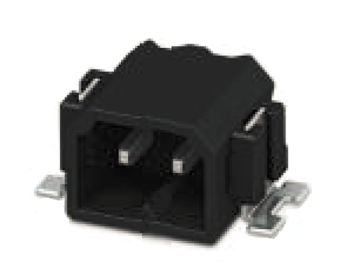
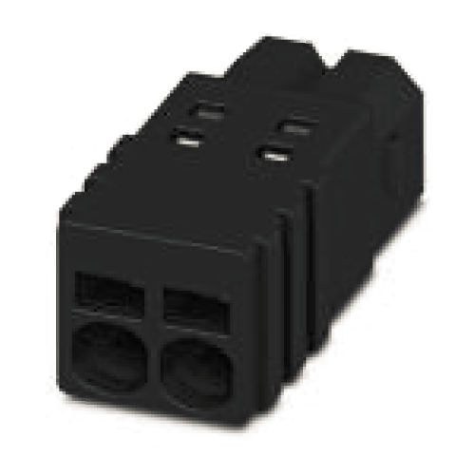
Bias Connectors
Surface-mount receptacles are compact and mount securely to circuit boards. The insulation material is a liquid-crystal polymer with high heat tolerance and good low-temperature performance.
Plugs have small wedge-shaped protrusions that expand the receptacle body slightly when inserted. The protrusions lock into cut-outs in the receptacle body.
Separation force is about 1 pound.

Slide 9
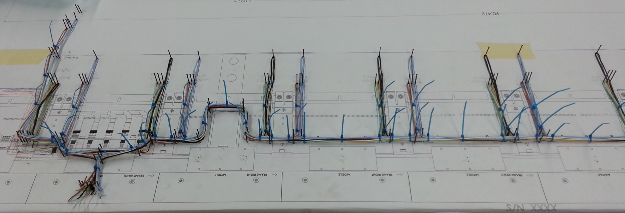
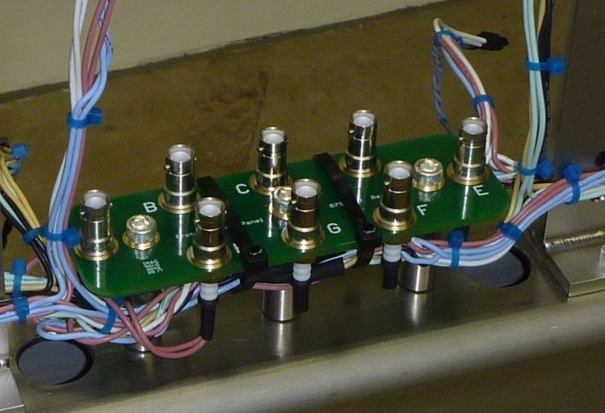
Wire harness construction
Field cage bias will bypass SHV panels in DUNE. The SHV panel will have fewer connectors and a smaller footprint.

Slide 10
Backup Slides

