Slide 1
Cost & Schedule
Alberto Marchionni, Fermilab
APA Electrical review
November 19, 2019

Slide 2
APA Electrical Components
Assumptions
  Full set of boards for 154 APAs
  Include additional 10% for board procurement
  Include setup costs and shipping to production sites
FY20 costs in k$
M&S | Eng. | Tech. | UnderG | Fringe& IDC | TOT
4,057 | 192 | 1,215 | 822 | 673 | 6,959

Slide 3
APA Electrical Components
$2M M&S for geometry boards

Slide 4
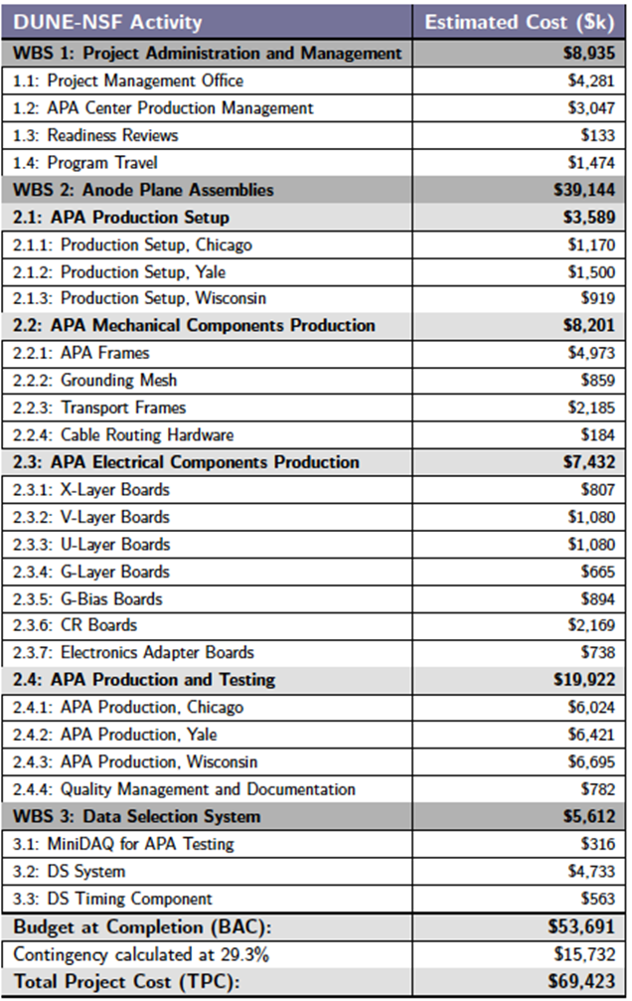
Total NSF Project Cost

Slide 5
Pre-production schedule
PC Board redesign Oct 2018 – Apr 2019
PC Board procure 3 sets Apr 2019 - 90%
PC Board assemble & test Sept 2019 - Feb 2020 50%
Support Board fabrication Dec 2019 – May 2020
for Consortium
Build pre-production APA May – July 2020

Slide 6
NSF Schedule 1st year

