Slide 1
Geometry Board Overview
Lee Greenler
UW Physical Sciences Lab
DUNE Electronics Review
2019 November 18

Slide 2
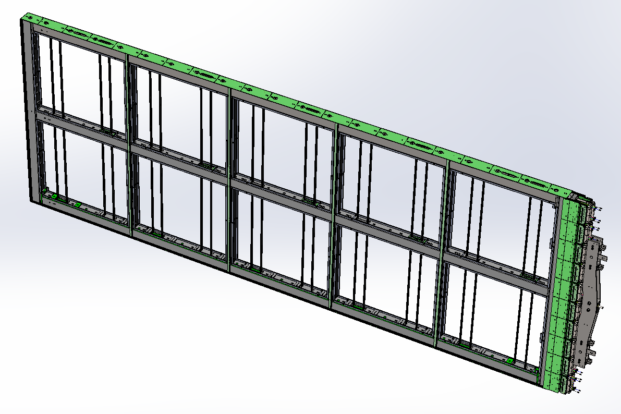
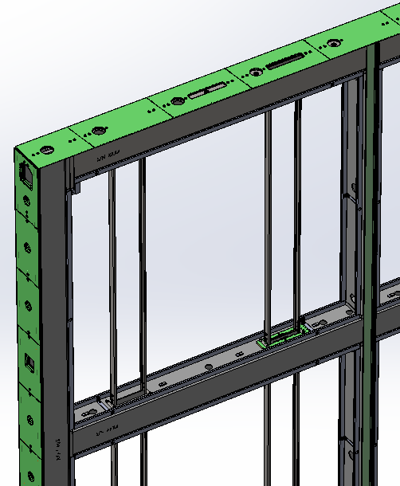
APA landmarks
Electronics is mounted on head end of APA
PD insertion slot
Side boards
Foot boards
PD rails
Head boards
Yoke
All wires have one end on a head board and the other on a foot board. Some wires go straight head to foot and some wind around the edge either one or two times.

Slide 3
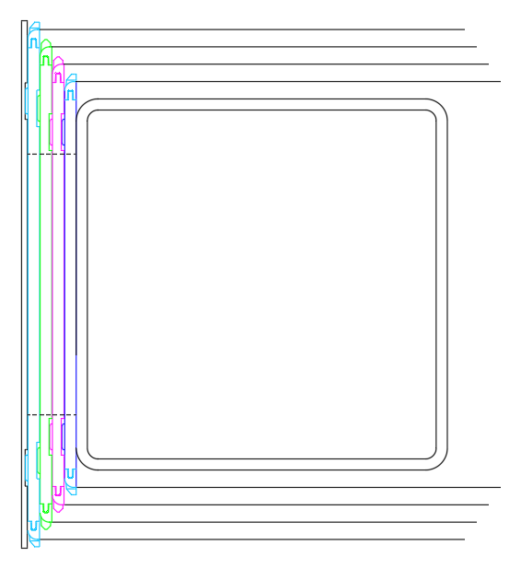
Wire layers
G Layer
The X and G layer wires run straight from head to foot. The U and V layer wires are angled and wrap around the edges.
The wires within a layer are spaced by pins along the edges of the boards.
The wire layers are spaced, at the sides and foot, by the increasing width of the side and foot boards.
U Layer
V Layer
X Layer
Foot tube
Foot boards

Slide 4
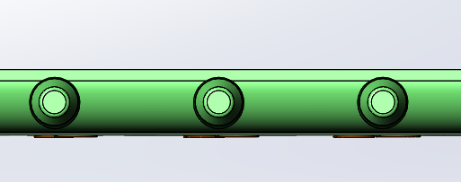
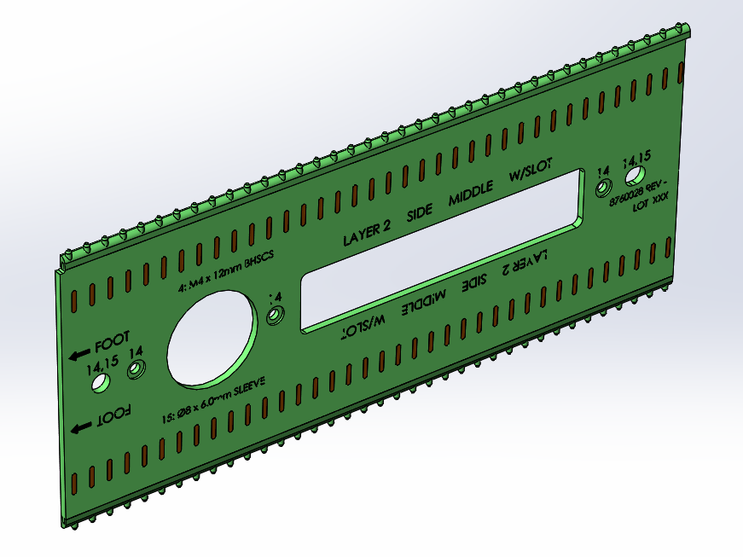
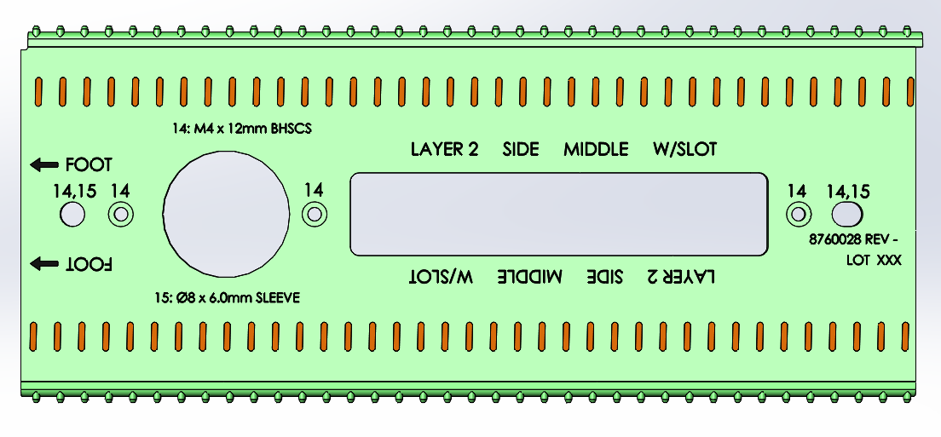
Wires wrapped around V side board
Note: Top and bottom segment of the wire “intersect” at outer surface of frame – when seen from above.
Inner surface of V board, outer surface of frame (frame not shown)
Connected by traces

Slide 5
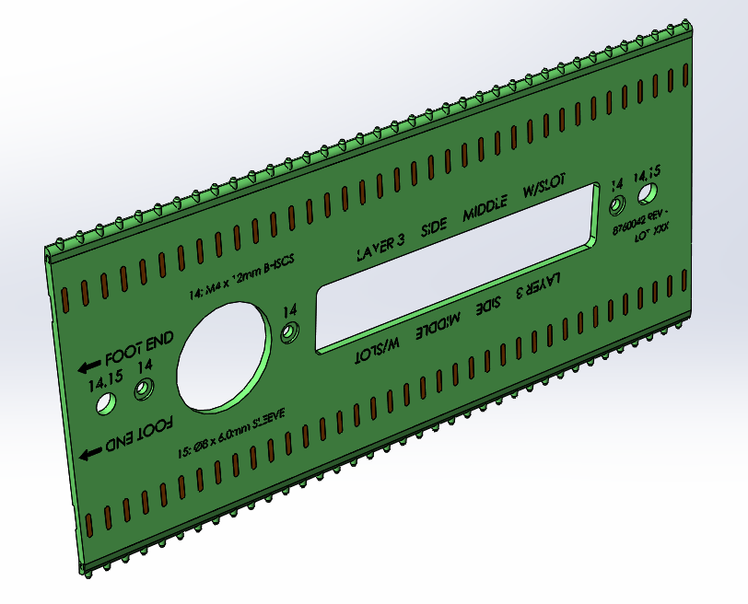
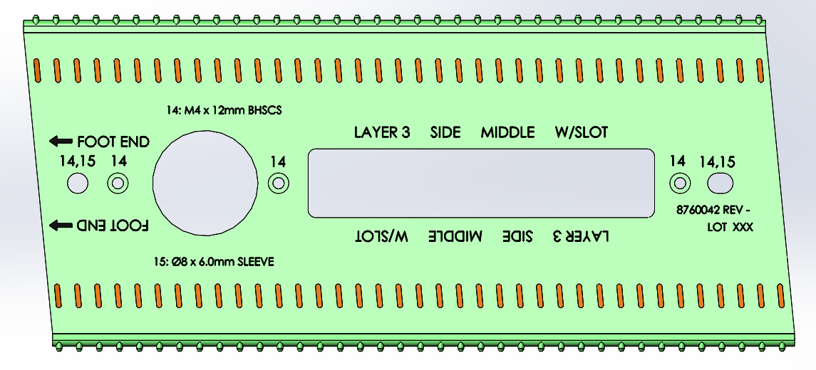
Wires wrapped around U side board
Note: Top and bottom segment of the wire still “intersect” at outer surface of frame – when seen from above.
Inner surface of V board, outer surface of frame (frame and V board not shown)
Inner surface of U board, outer surface of V board (frame & V board not shown)
Connected by traces
Ends of U boards slanted to match wire path.

Slide 6
Board types
On one APA there are:
80 head boards
84 side boards
40 foot boards
A total of 204 boards in one APA
But, there are:
Several different variations of boards in each layer
Ends
Middles
Special photon detector openings
For a total of 29 different boards

Slide 7
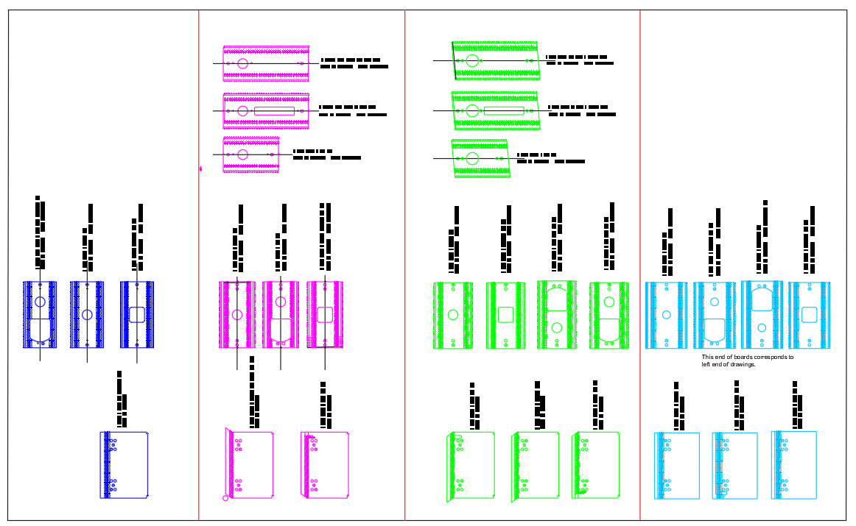
Board types
X layer
V layer
U layer
G layer
Side boards
Foot boards
Head boards

Slide 8
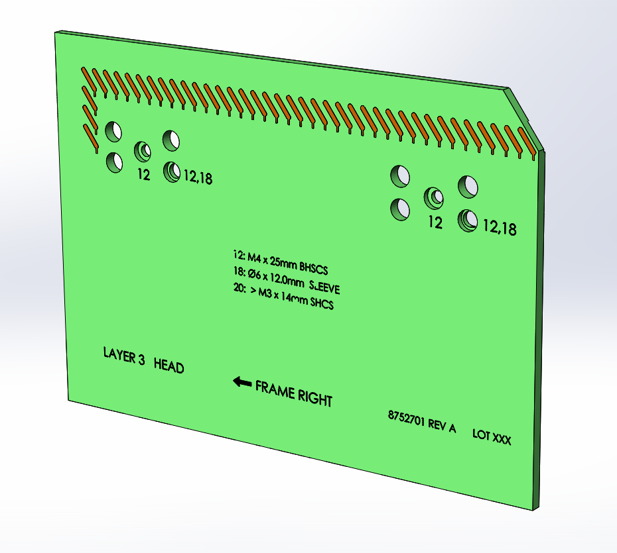
Tooth strips
The head boards, like this U head board, have no teeth on them.

Slide 9
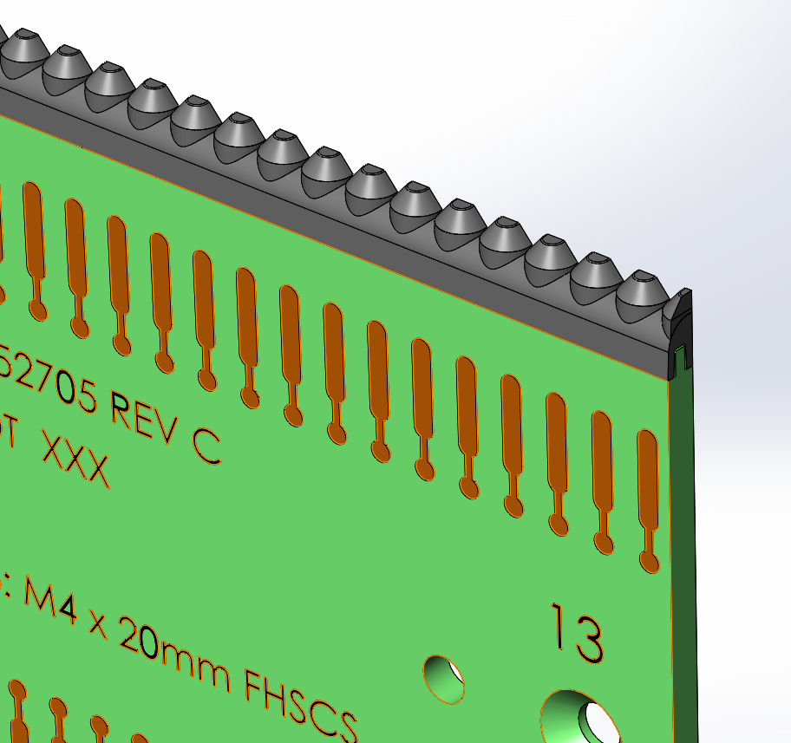
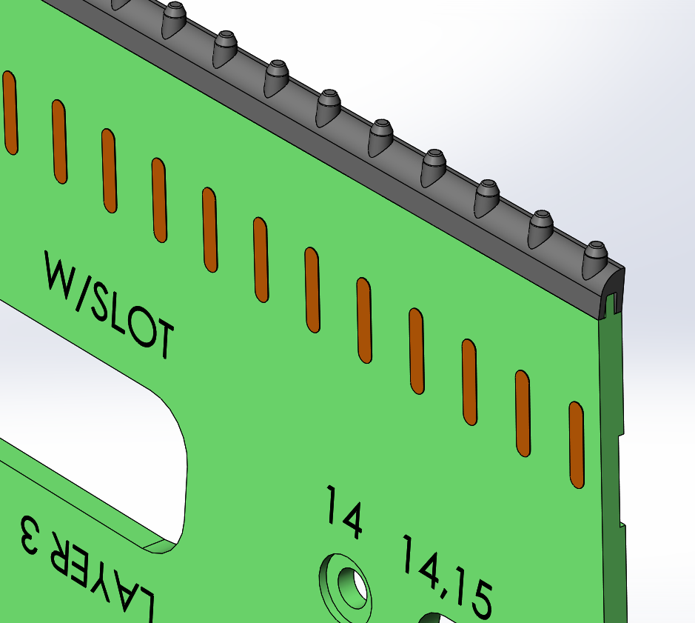
Tooth strips
The X (and G) layer foot boards have teeth with a small slot that precisely locates the wire.
The U (and V) boards have “pins”. The angled wires are pulled against the pins for accurate location.

Slide 10
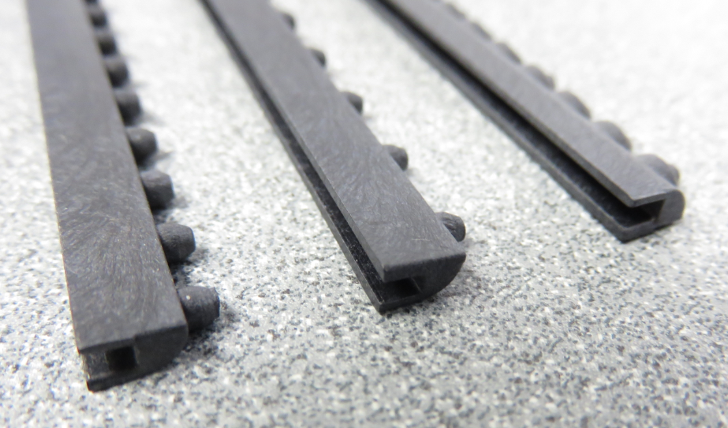
Tooth strips
The tooth strips are injection molded from 30% glass-filled LCP plastic (trade name Vectra E130i).

Slide 11
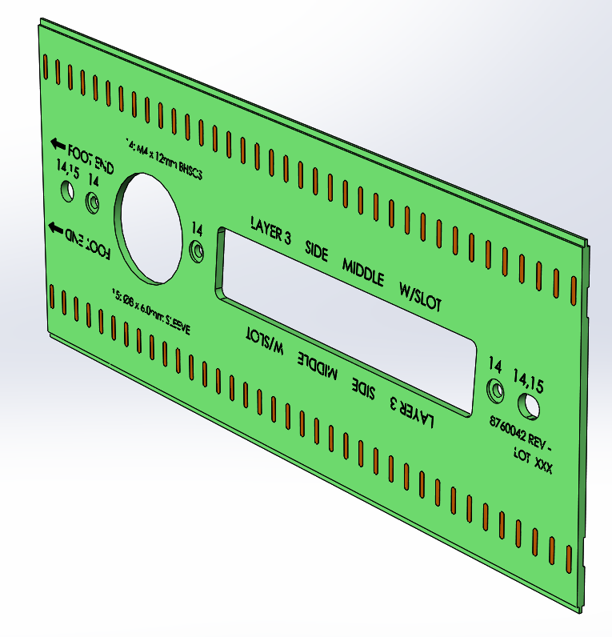
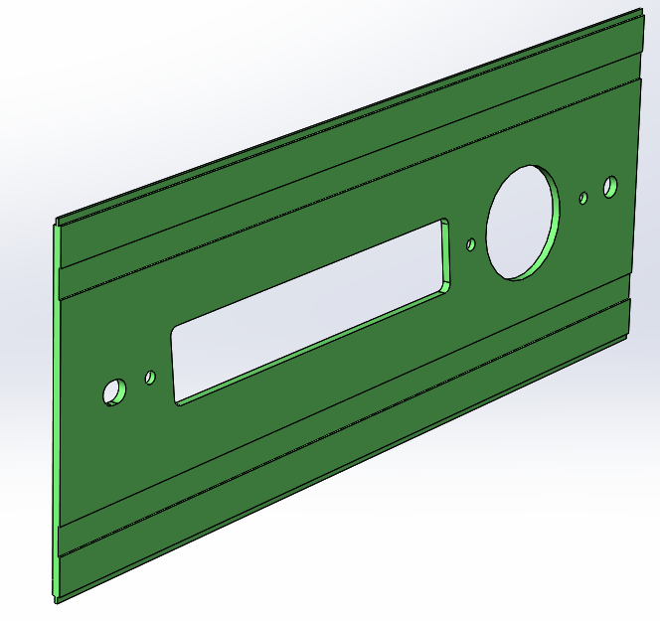
Board dimensional issues
Controlled depth milling features
Front
Back
Through milling features
The side and foot boards, as ordered from the board fabricator, have a combination of through milled features and controlled depth milled features.
Board houses are good at through milling, but not as accurate with controlled depth milling.

Slide 12
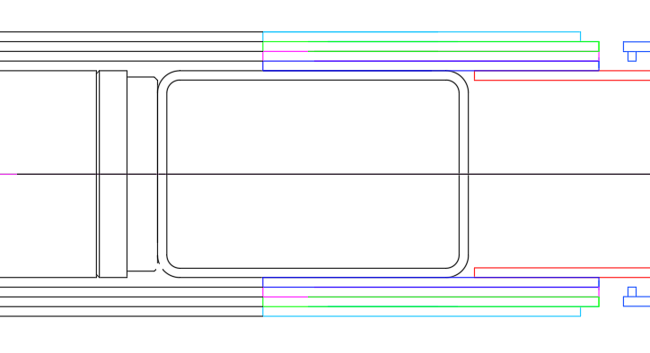
Board dimensional issues
G wire
G board
U wire
U board
V wire
V board
X wire
X board
The wires attach to the top surface of a board, and that board rests on top of the board below. This means that board thickness determines the wire spacing.
Board houses are not used to holding boards to close thickness tolerance – it’s not as critical for most applications.

Slide 13
Board dimensional issues
The electrical group at PSL is working with board fabrication companies to find those:
that can perform accurate controlled depth milling,
and
ones able to provide material of closer than usual thickness tolerance
Another option is to find machining companies willing to do post-machining to the boards. Finding a single board fabricator that can do everything is preferable.

Slide 14
Wire Segment
To
Channel Mapping

Slide 15
Wire segment to channel mapping
In a stack of boards at the head of the APA there are:
48 wires on the X board,
40 wires on the V board,
40 wires on the U, and
48 on the G
Since the G wires don’t connect to electronics there are 48+40+40=128 channels in a stack of boards.
With an additional 48 wires on each G board, there are 176 total wires coming from a board stack.
With 20 stacks of boards on an APA there are 20(128)=2560 channels.
There’s one extra G wire on each side of the APA for a total of 20(176)+2=3522 wires in an APA.
This is counting each wire that starts at a head board and ends at a foot board as a single wire. However, the diagonal wires wrap around the edges so they are broken in to either two or three segments. (All straight head to foot wires are a single segment.)
There are 6526 wire segments in an APA.

Slide 16
Wire segment to channel mapping
Wires are most easily defined by:
Layer (X, V, U, or G)
Board number (1 – 20 in an APA)
Pad number (1 – 48 in X and G, 1 – 40 in U and V)
Straight wire segments are simple: Since each wire has one segment the numbering of X and G wire segments is the same as X and G wires.

Slide 17
Wire segment to channel mapping
Diagonal wire segments are more complicated:
The wire segments are counted across the top of the APA and down one edge. Doing this on both faces of the APA numbers all the wire segments in a diagonal layer.
1
2
3
4
Head
399
400
401
402
1
APA
1150
Foot
1151
There are 1151+1151=2302 V wire segments and the same number of U wire segments in an APA.

Slide 18
Wire segment to channel mapping
The geometrical coordinates of the start and end point each wire segment, and a cross reference between channel numbering and wire segment numbering, can be found in DocDB 15787.
An explanation of nomenclature is included.
Great beach reading!

