Slide 1
System Overview and Grounding
Andrew Laundrie
UW Physical Sciences Lab
DUNE Electronics Review
2019 November 18

Slide 2
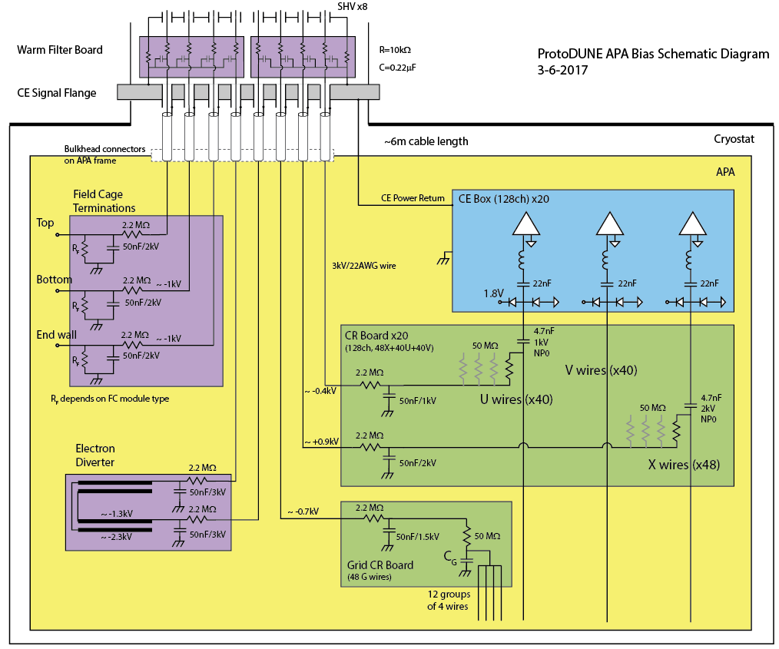
Previous APA Schematic Diagram (Bo’s)

Slide 3
ProtoDUNE Implementation Details
Single part for coupling and bias-filter caps
3.9 nF +/- 5 percent, 2 kV used throughout
Met minimum coupling capacitance requirement
Bias filters use ten capacitors in parallel for 39 nF
All bias filters were grounded through connections to VSS pins on the Cold Electronics Front-End input connectors
VSS connects to the frame via the CE box

Slide 4
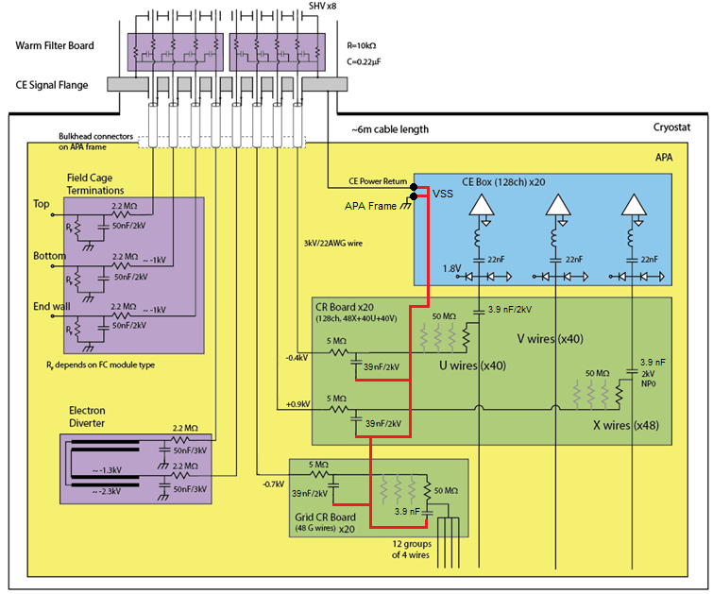
Updated APA Schematic ProtoDUNE
Ground path for
bias filters

Slide 5
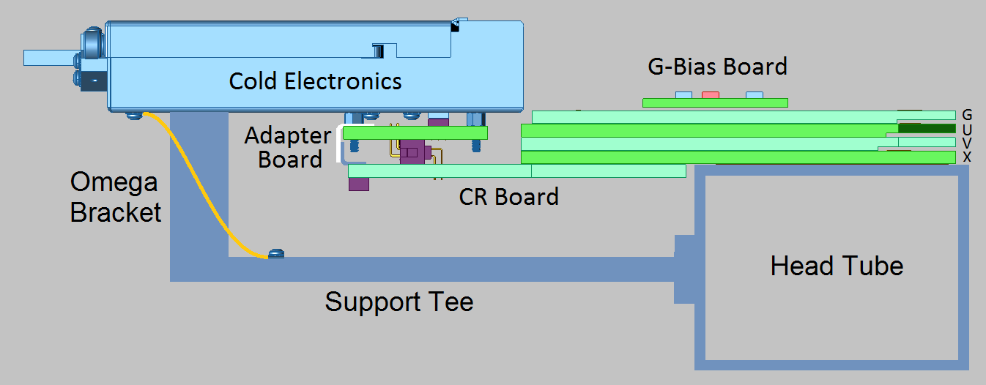
Frame Ground Paths Through Support Tees
● The power-return wire connects the CE enclosure (and VSS on circuit boards) to the cyrostat wall
● CE enclosures are electrically bonded to the APA frame through omega brackets and ground straps connected to support tees mounted on the head tube

Slide 6
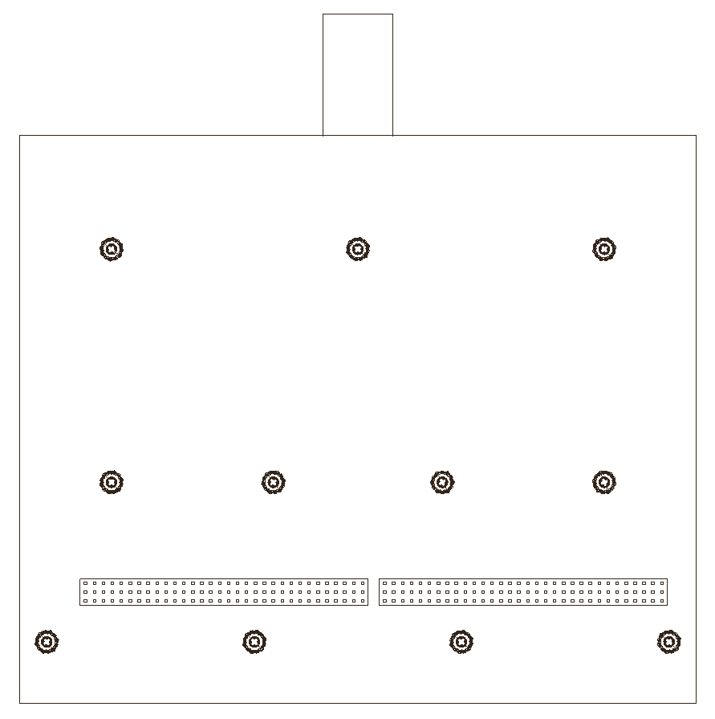
Ground Connections to CE Boxes
CE enclosure outline
(side facing CR board)
Omega bracket standoffs
The center row of pins
on the front-end
input connectors
are connected to the
VSS power plane.
VSS also connects to the
Cold Electronics enclosure.
Adapter board standoffs
Adapter board standoffs

Slide 7
Ground Path Through Adapter Boards
Connections to VSS are carried through Adapter boards
Two 2 x 36 connectors receive
plugs from the CR board
Two 3 x 32 connectors
plug into the CE box

Slide 8
Ground Path Through Adapter Boards
The center row of pins plugged into the CE input connectors
are routed to the eight inner-most pins in connectors that
mate with the CR board with a “ground pour” for low inductance

Slide 9
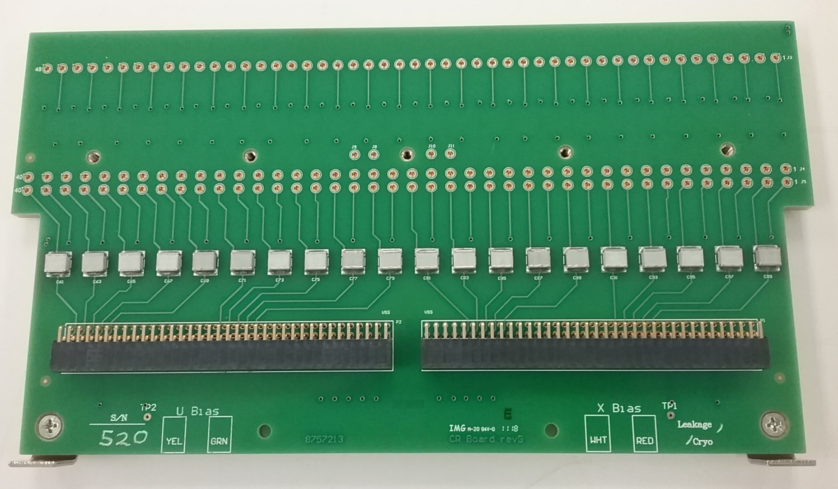
CR boards carry VSS to the board stack
VSS
VSS
VSS

Slide 10
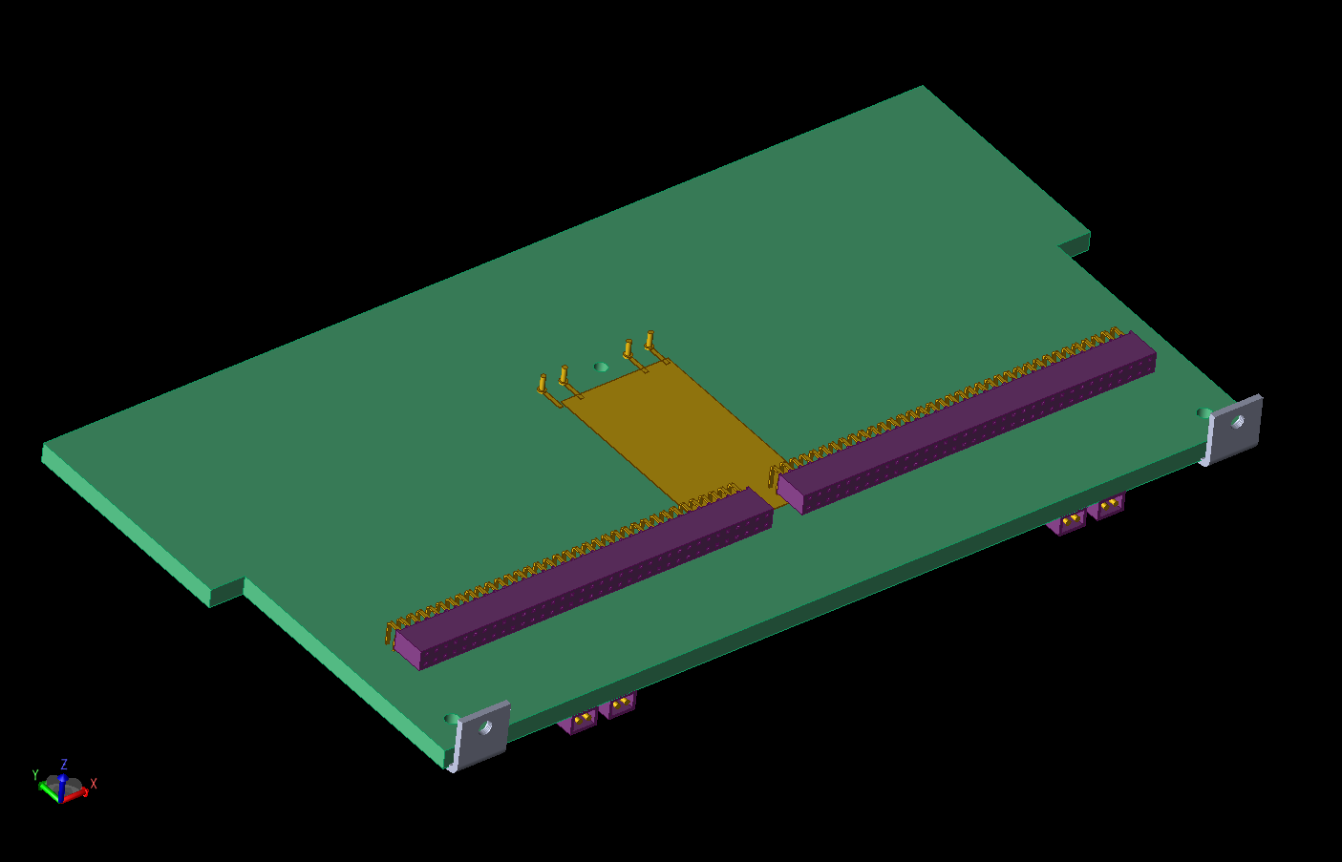
Four stacks of Mill-Max pins
and sockets carry VSS through
the board stack to the G board
CR Board
VSS reaches the CR board through
the 16 inner-most pins on the
right-angle connectors that mate
with the adapter board

Slide 11
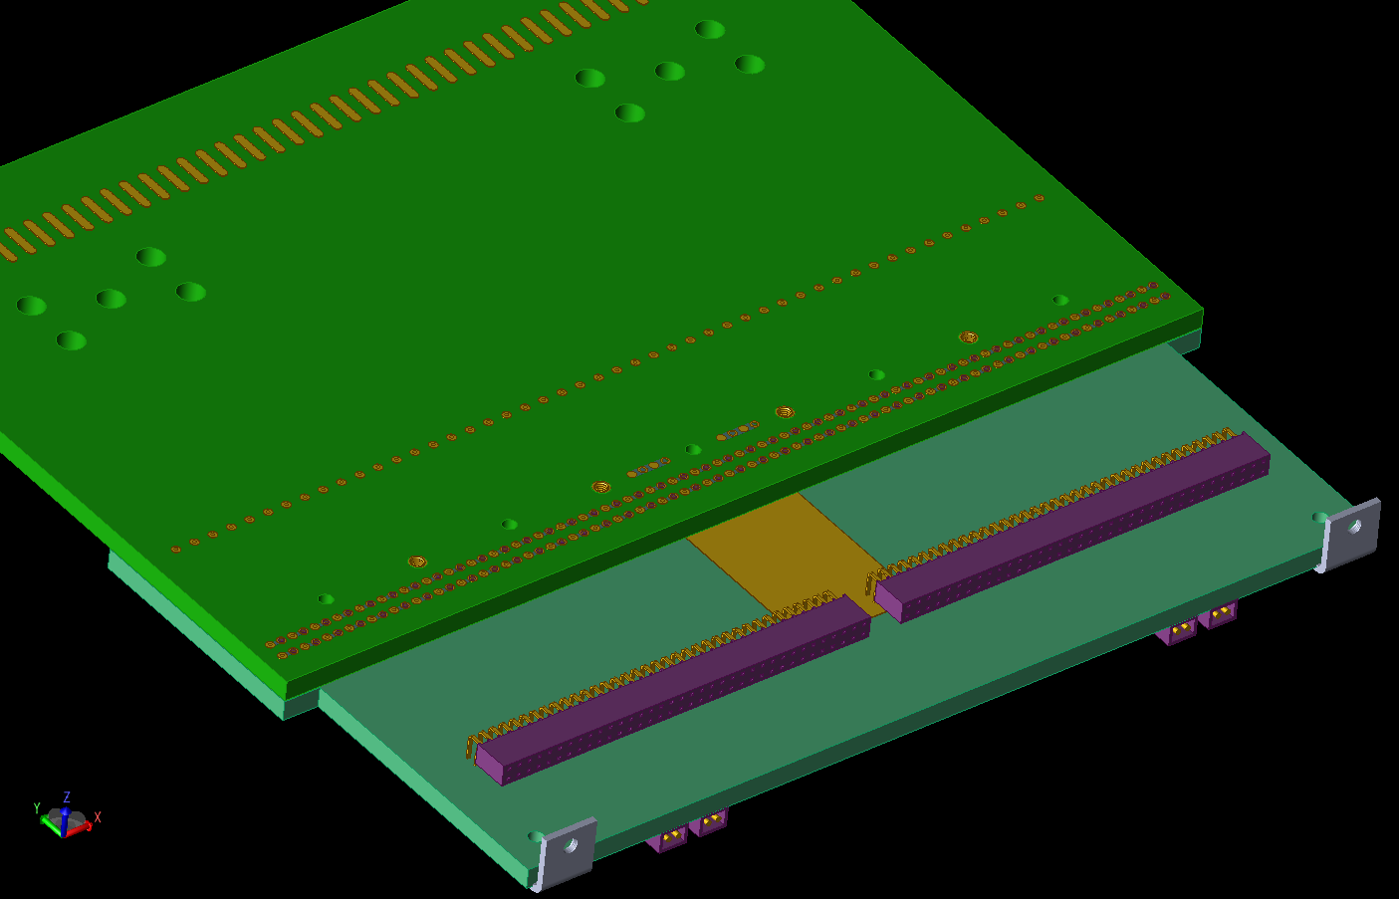
X Head Board
VSS Receptacles
Face Up and Down

Slide 12
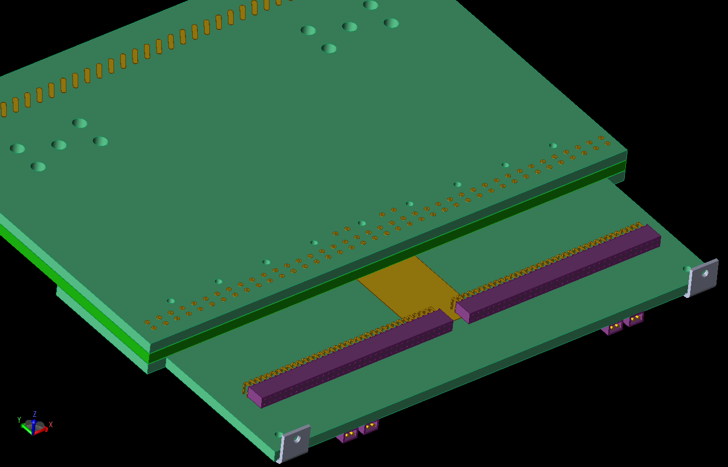
V Head Board
VSS Pins and Sockets

Slide 13
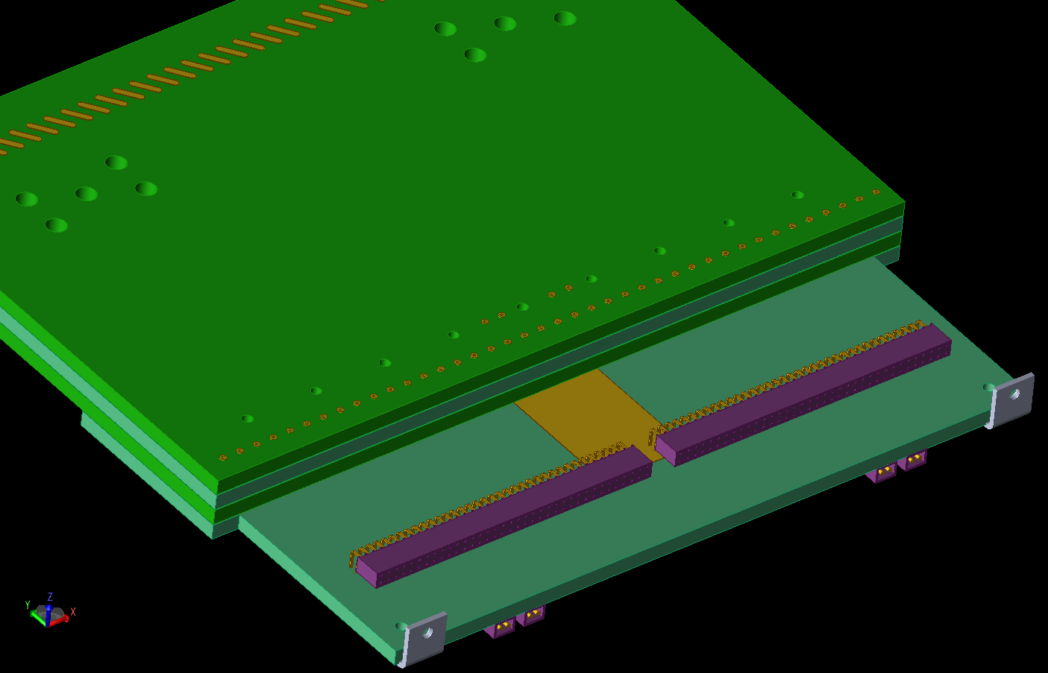
U Head Board
VSS Pins and Sockets

Slide 14
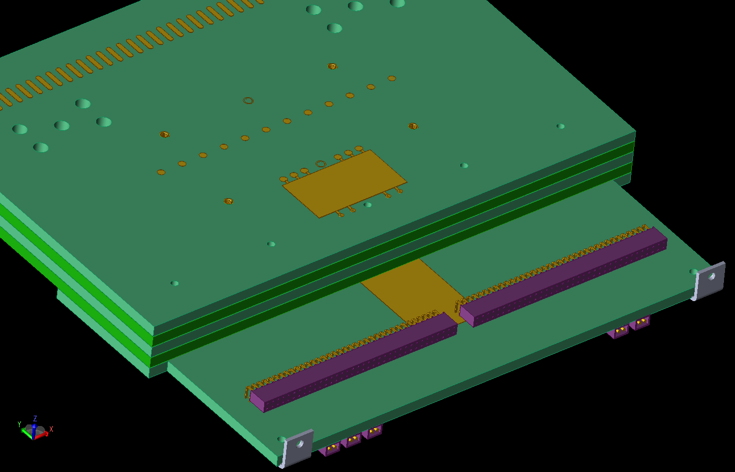
G Head Board
G-Bias Board Location

Slide 15
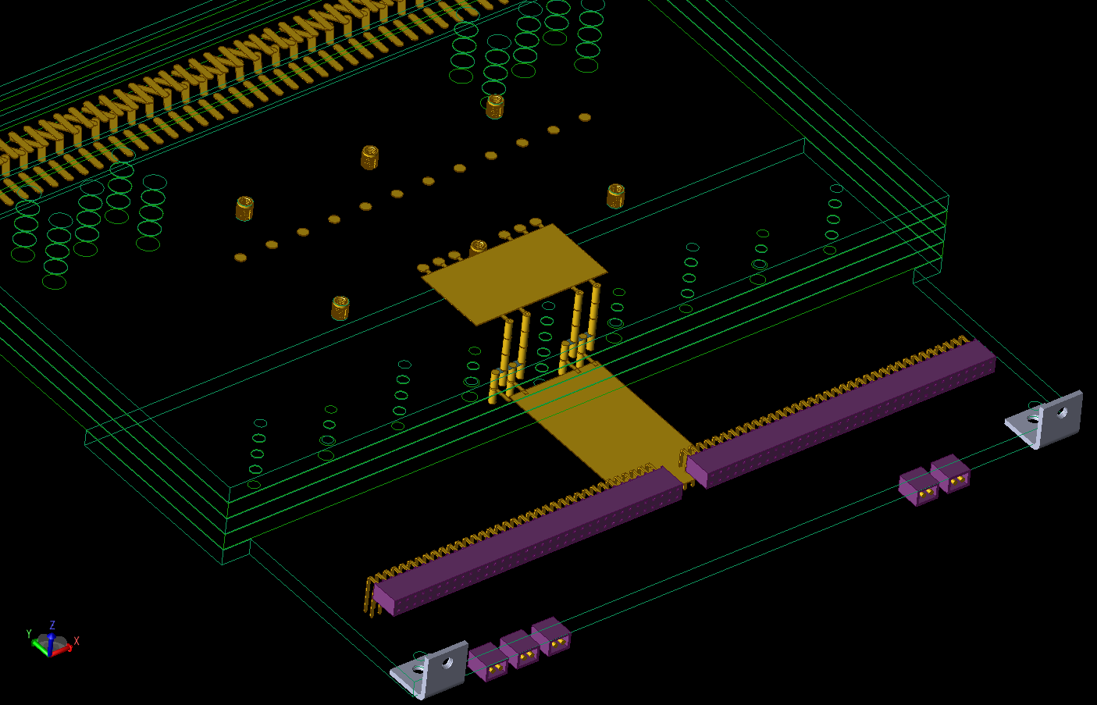

Slide 16
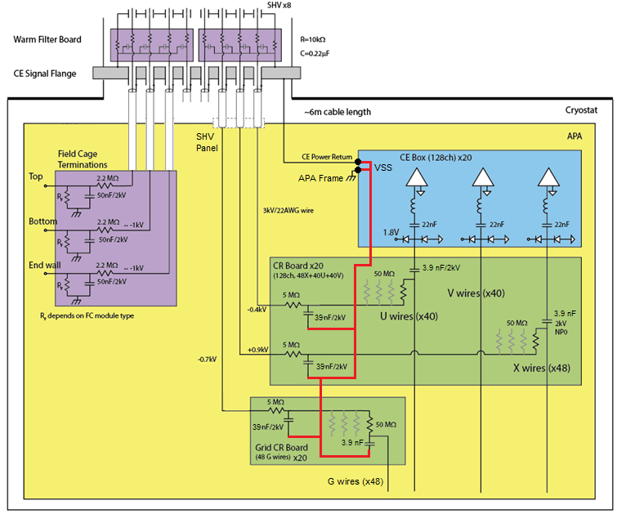
Proposed APA Schematic DUNE
Ground path for
bias filters

Slide 17
Proposed APA Schematic DUNE
Ground path for
bias filters
RECEPTACLES ON THE SHV PANEL SHALL BE
ELECTRICALLY UNCONNECTED.
CE Power Return wires are the only allowed connections between the
APA frame and the CE Signal Flange.

Slide 18
Backup Slides

