Slide 1
CR Board Design and Manufacturing
Andrew Laundrie
UW Physical Sciences Lab
DUNE Electronics Review
2019 November 18

Slide 2
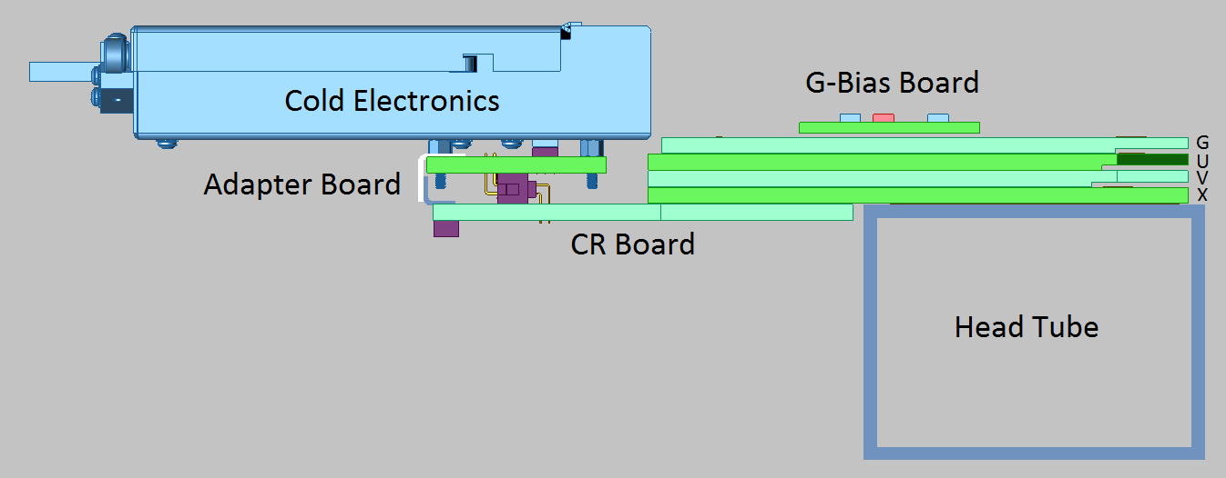
CR Boards Provide Bias to X and U Wires and Route Signal to CE

Slide 3
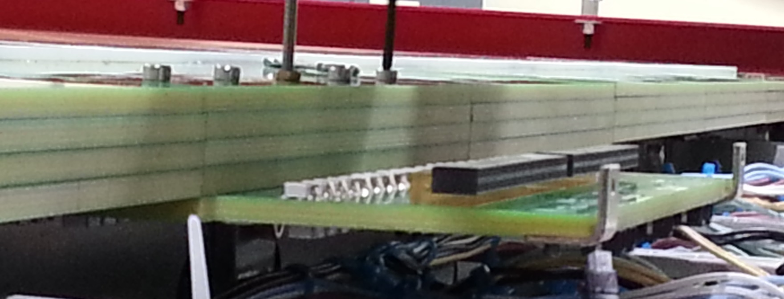
CR boards plug into X-layer head boards. Five screws are gradually tightened to mate pins with receptacles.

Slide 4
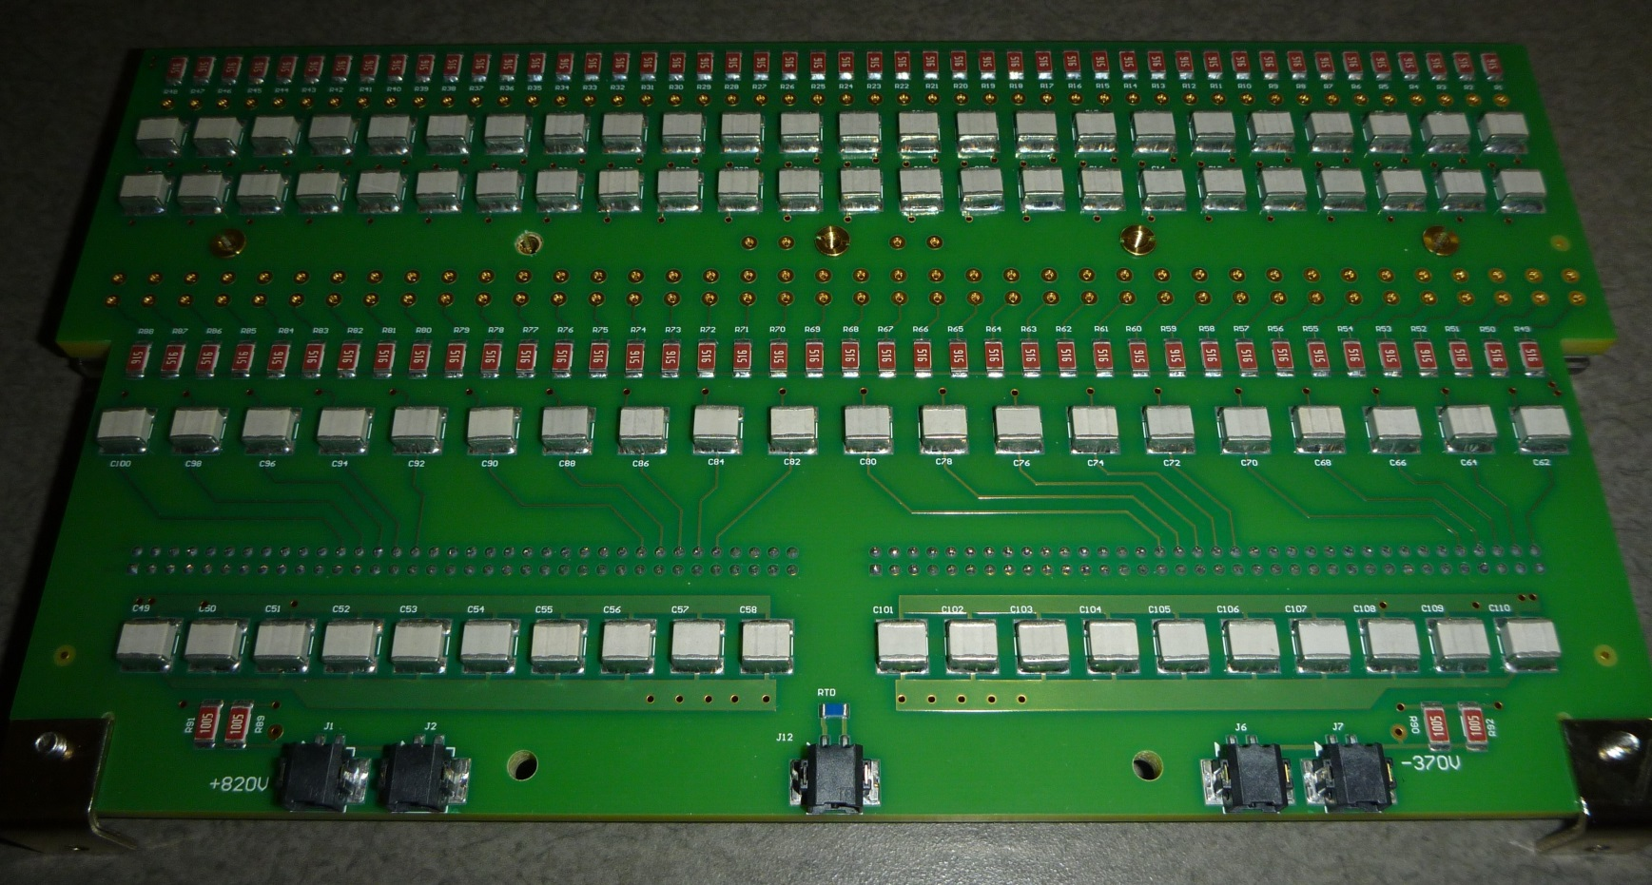
CR Board “Bottom” Side

Slide 5
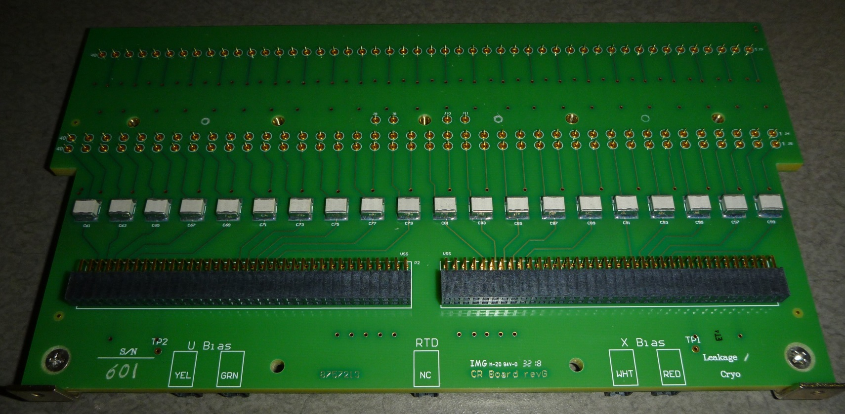
CR Board “Top” Side

Slide 6
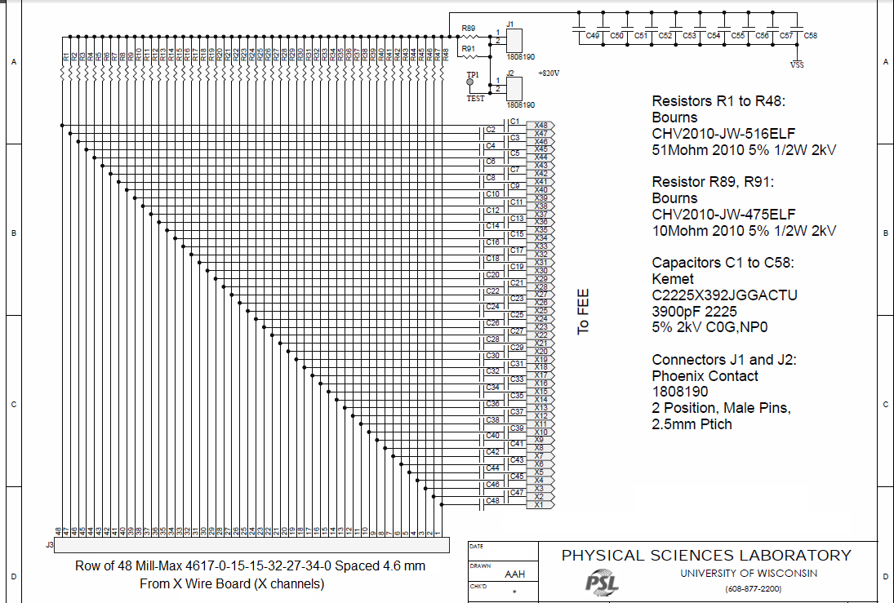
CR Board Schematic p. 1 of 4

Slide 7
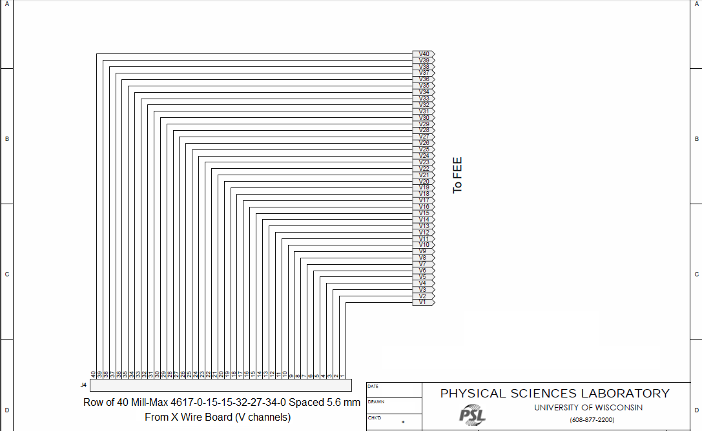
CR Board Schematic p. 2 of 4

Slide 8
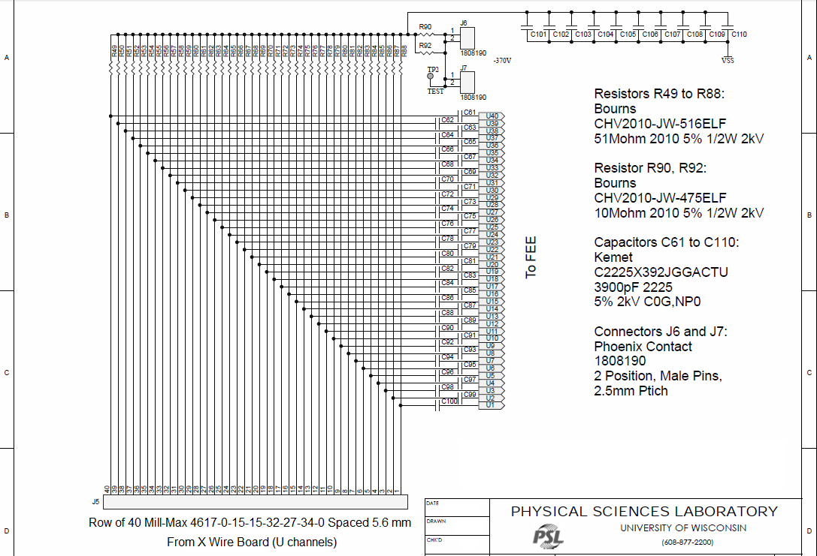
CR Board Schematic p. 3 of 4

Slide 9
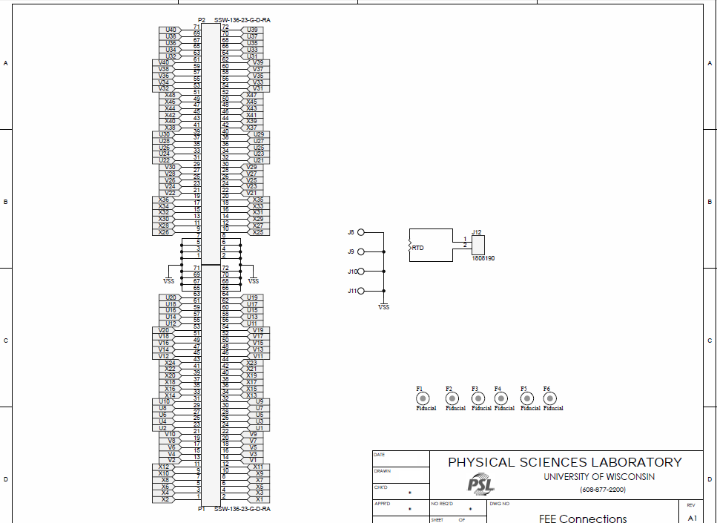
CR Board Schematic p. 4 of 4

Slide 10
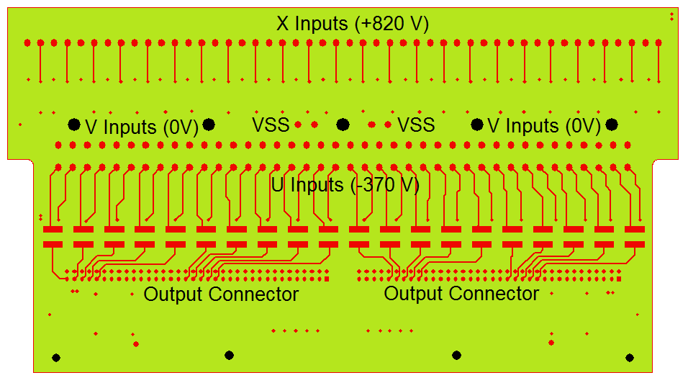
CR Board Top Metal Layer

Slide 11
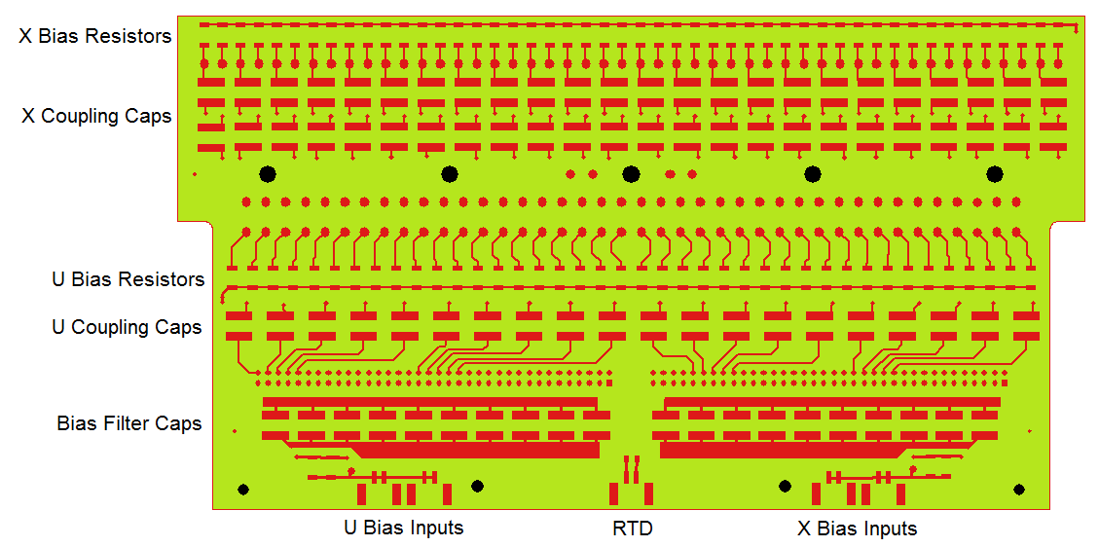
CR Board Bottom Metal Layer

Slide 12
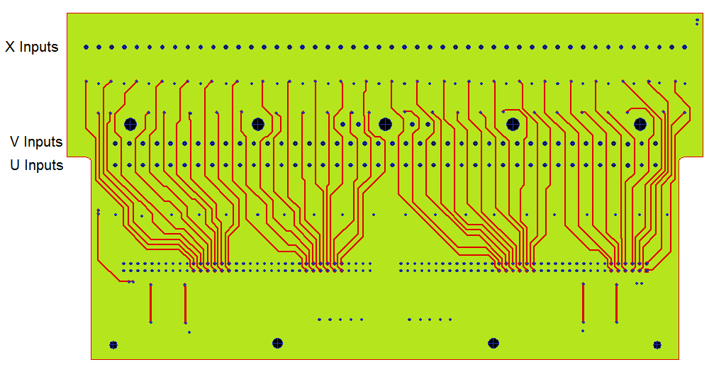
CR Board Signal Layer 1

Slide 13
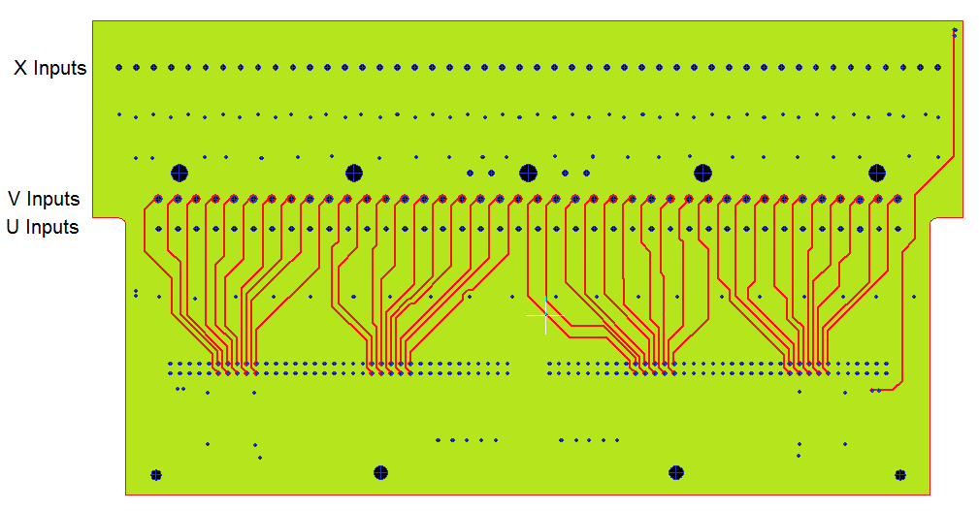
CR Board Signal Layer 2

Slide 14
ProtoDUNE CR Board Mfg. Process
Reflow bottom side in IR reflow oven
Add solder paste to caps and reflow again
Reflow 20 top-side capacitors in IR reflow oven
Add solder paste to caps and reflow again
Hand-solder through-hole output connectors
Wash boards and bake dry
Test all coupling caps for leakage at 1.0 kV
Press in Mill-Max connector pins
Test all resistors and capacitors warm, cold, warm

Slide 15
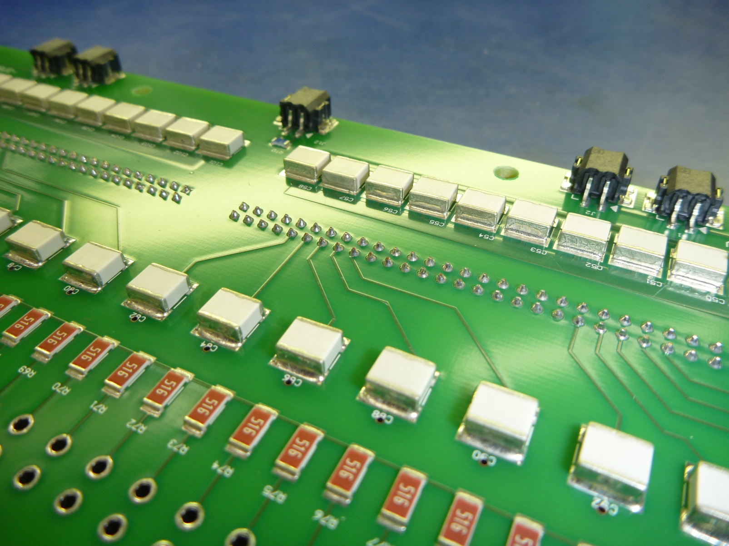
ProtoDUNE Soldering Challenges
Extra solder added
No extra solder added
Through-holes not filled

Slide 16
Proposed DUNE CR Board Manufacturing Using Vapor-Phase Reflow
Reflow 20 top-side capacitors in V-P reflow oven using lead-free solder (230C reflow temperature)
Reflow bottom side in V-P oven using tin/lead solder (215C reflow temperature)
Solder through-hole parts with Selective Solder
Wash boards and bake dry
Test all coupling caps for leakage at 1.0 kV
Press in Mill-Max connector pins
Test all resistors and capacitors warm, cold, warm

Slide 17
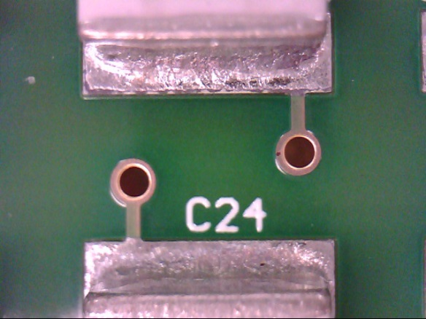
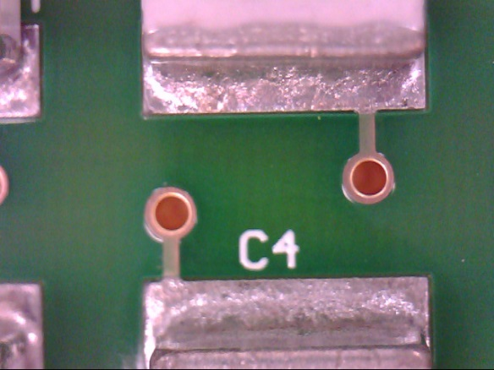
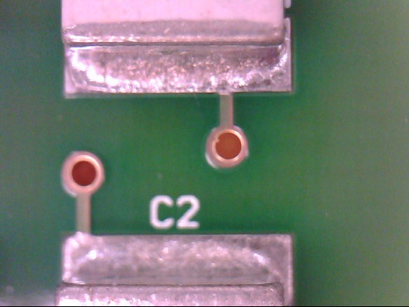
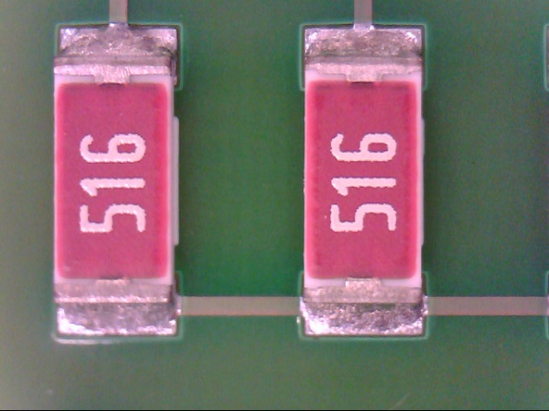
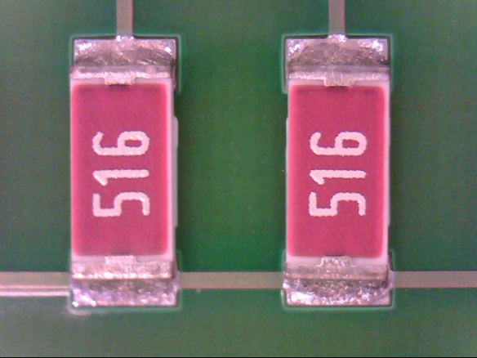
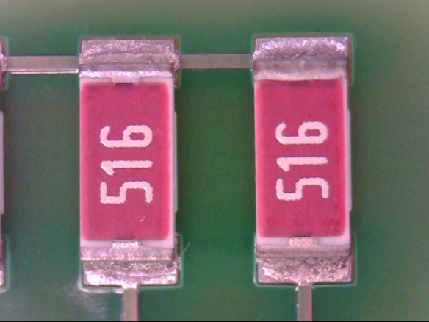
V-P Reflow With Lead-Free Solder

Slide 18
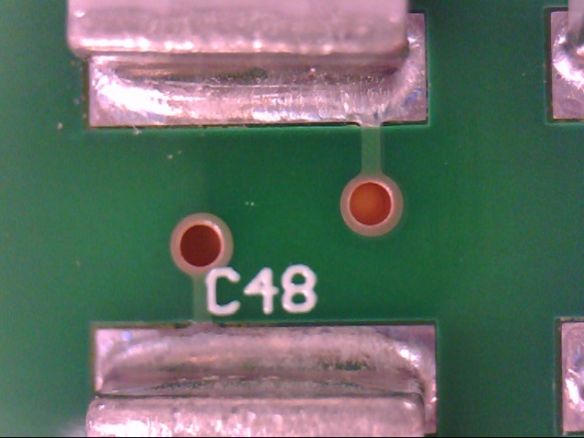
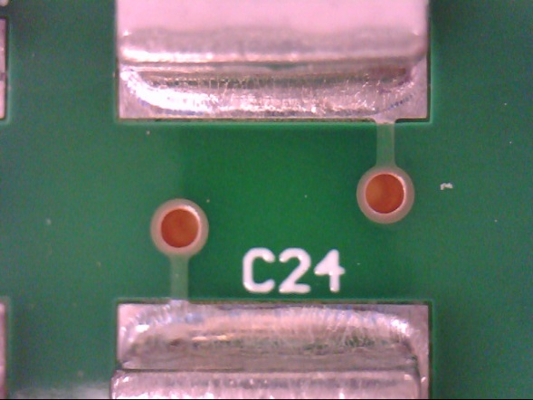
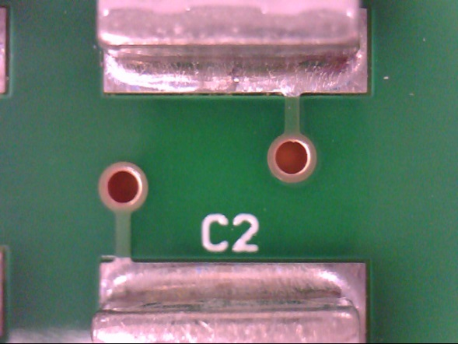
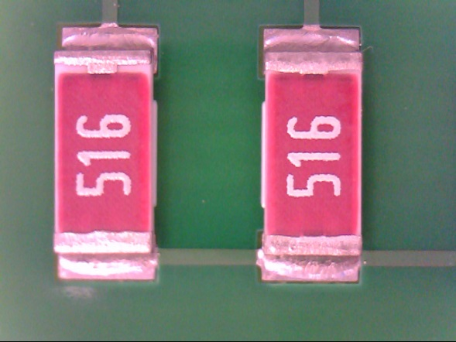
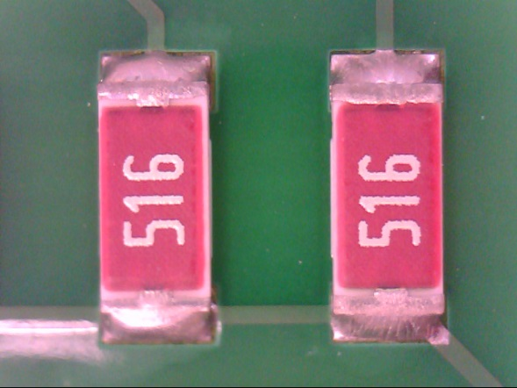
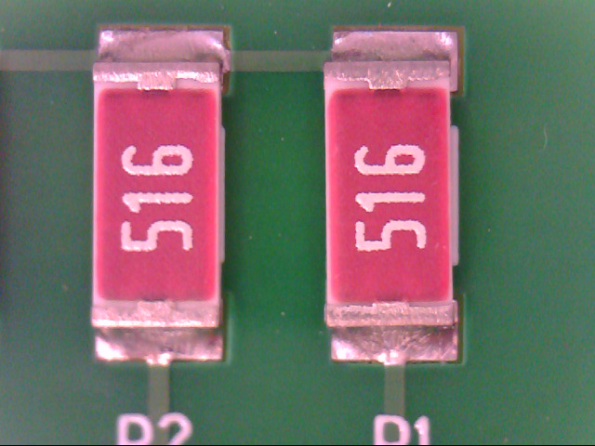
V-P Reflow With Tin/Lead Solder

Slide 19
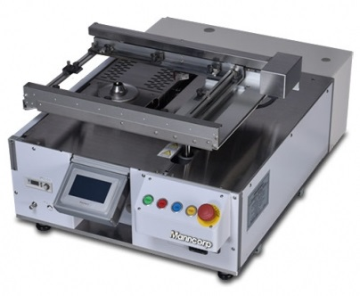
Selective Soldering Similar to wave but uses a small fountain

Slide 20
Threaded Inserts
Pressed into holes after soldering and testing
Used with five screws to mate CR boards with the head-board stack
About 200 pounds was needed to mate all Mill-Max components in ProtoDUNE boards
Improved M-M components require much less force to mate, around 50 pounds per CR board
Inserts are also used in X and G head boards

Slide 21
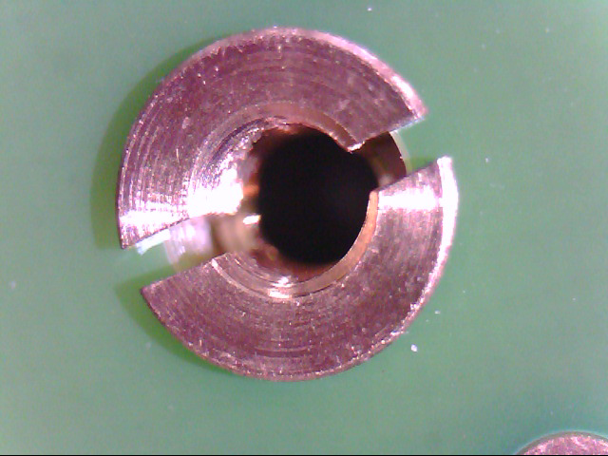
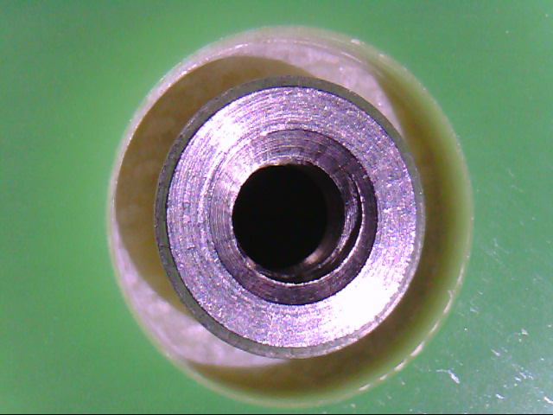
Threaded Inserts
The old style used in ProtoDUNE was supposed to expand but often didn’t adequately. They sometimes caused screws to bind, produced metal debris, and occasionally worked loose from the board. They were also too easy to break.
The new style used in DUNE is swaged into place using a press.

Slide 22
Mill-Max Receptacles (With Tails)
Pressed into holes after soldering and testing
132 locations nested in among other parts
For ProtoDUNE a hand-operated arbor press with a blade attachment could set 4 to 5 receptacles at a time when the insertion force averaged around 20 pounds
The operation required good aim and strength
New designs used in DUNE require up to 50 pounds of insertion force

Slide 23
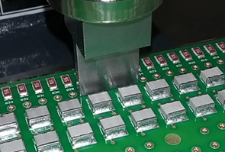
Hand-Operated Arbor Press
Probably still OK for X and G head boards
Not for CR boards (risk of damage too high)

Slide 24
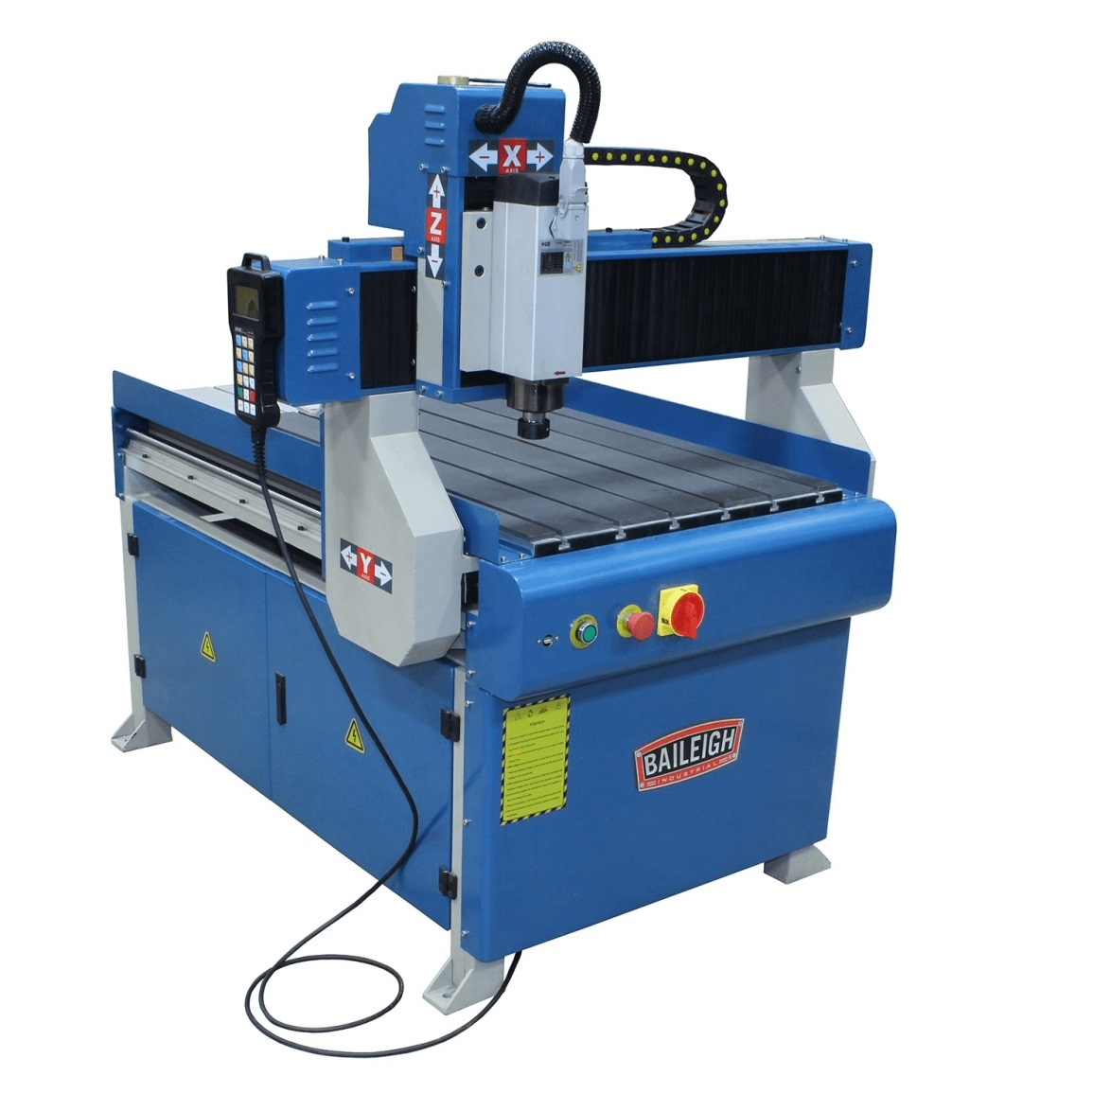
CNC Press
Quickly seats threaded inserts and Mill-Max parts without lots of operator skill and care required
Constructed by modifying a CNC router table

Slide 25
Backup Slides

