Slide 1
DUNE Electrical Interfaces
Andrew Laundrie
UW Physical Sciences Lab
DUNE Electronics Review
2019 November 18

Slide 2
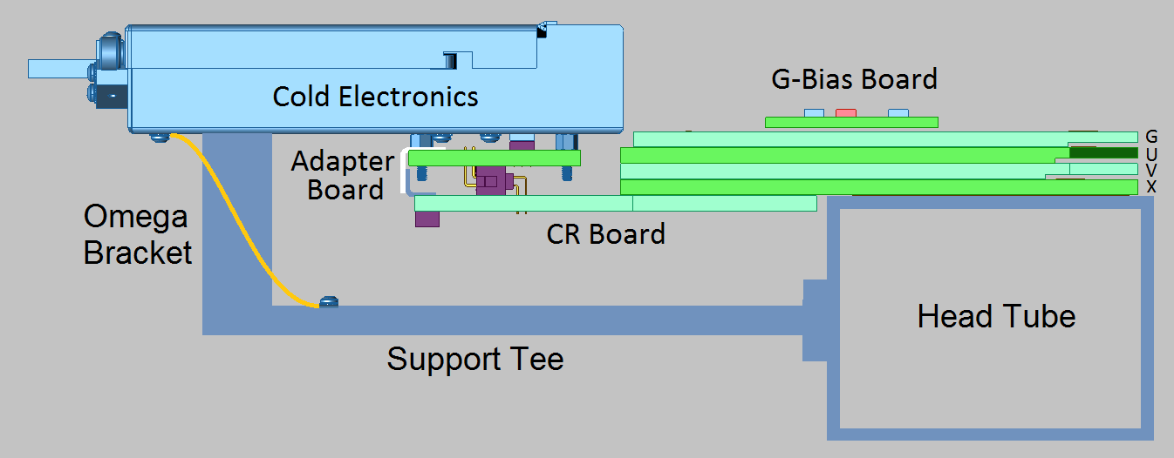
Adapter Board Connectors

Slide 3
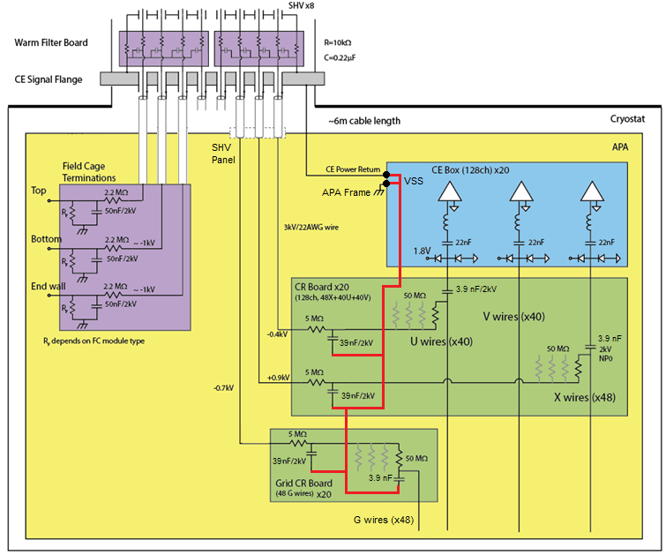
Additional Electrical Interfaces
Ground path for
bias filters

Slide 4
Additional Electrical Interfaces
SHV Panel (new design, work in progress)
Bias Wire Harness
Head Board Connections to CR and B-Bias
Head Board Connections to Probe Cards
CE Grounding Wires (any changes?)
Field Cage Wiring and Filter Grounds (WIP)

