Slide 1
Status of ICEBERG and Plan
Shekhar Mishra
On Behalf of ICEBERG (BNL, CSU, Fermilab, LSU, PSL, SLAC, UCI, UK)
Neutrino Division, Fermilab
ICEBERG Status Meeting
10/3/2019

Slide 2
Run 2B
Condenser Upgrade
Inside Cryostat Filter
SSP DAQ for Photon Detector
Cryostat was closed on 9/16
Filling of ICEBERG started on 9/19

Slide 3
CE and WIB Power
We are having problems with powering CE
  Several fuses on WIB are blown
  There appears to be damage to FEMBs
Really do not understand the reason of this failure
  We are not powering CE, not to damage it further
We need to open the cryostat to investigate the electrical issues

Slide 4
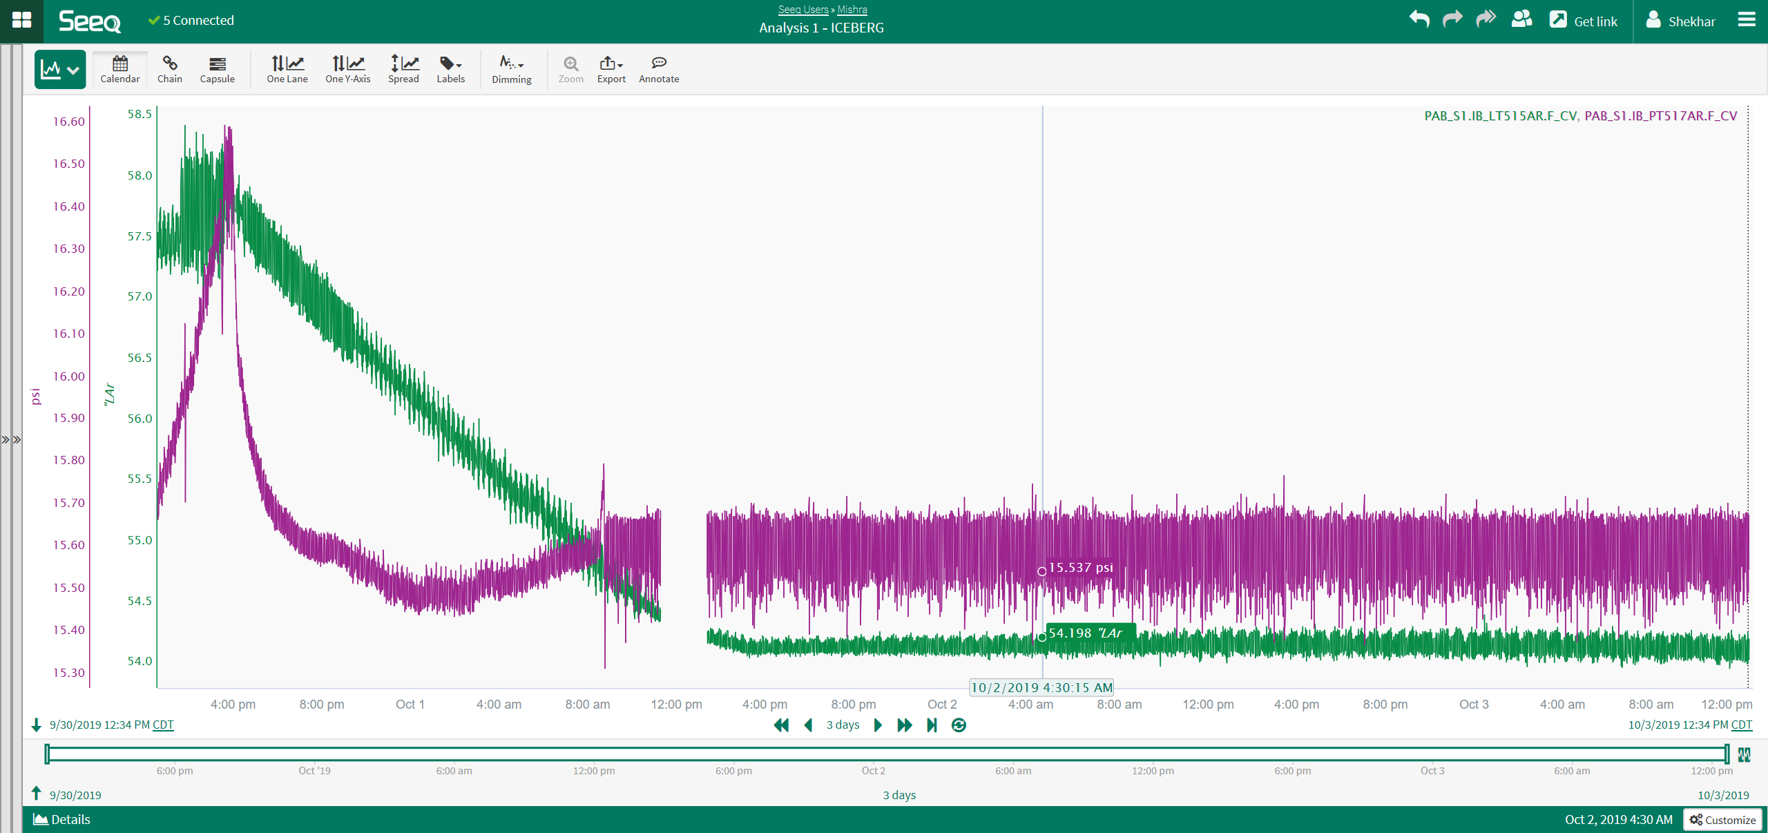
Condenser
ICEBERG Condenser works at the liquid level around 54”.
~63” of liquid is needed for CE to be in the liquid.
At liquid level above 54” cryostat pressure starts rising quickly to the maximum pressure

Slide 5
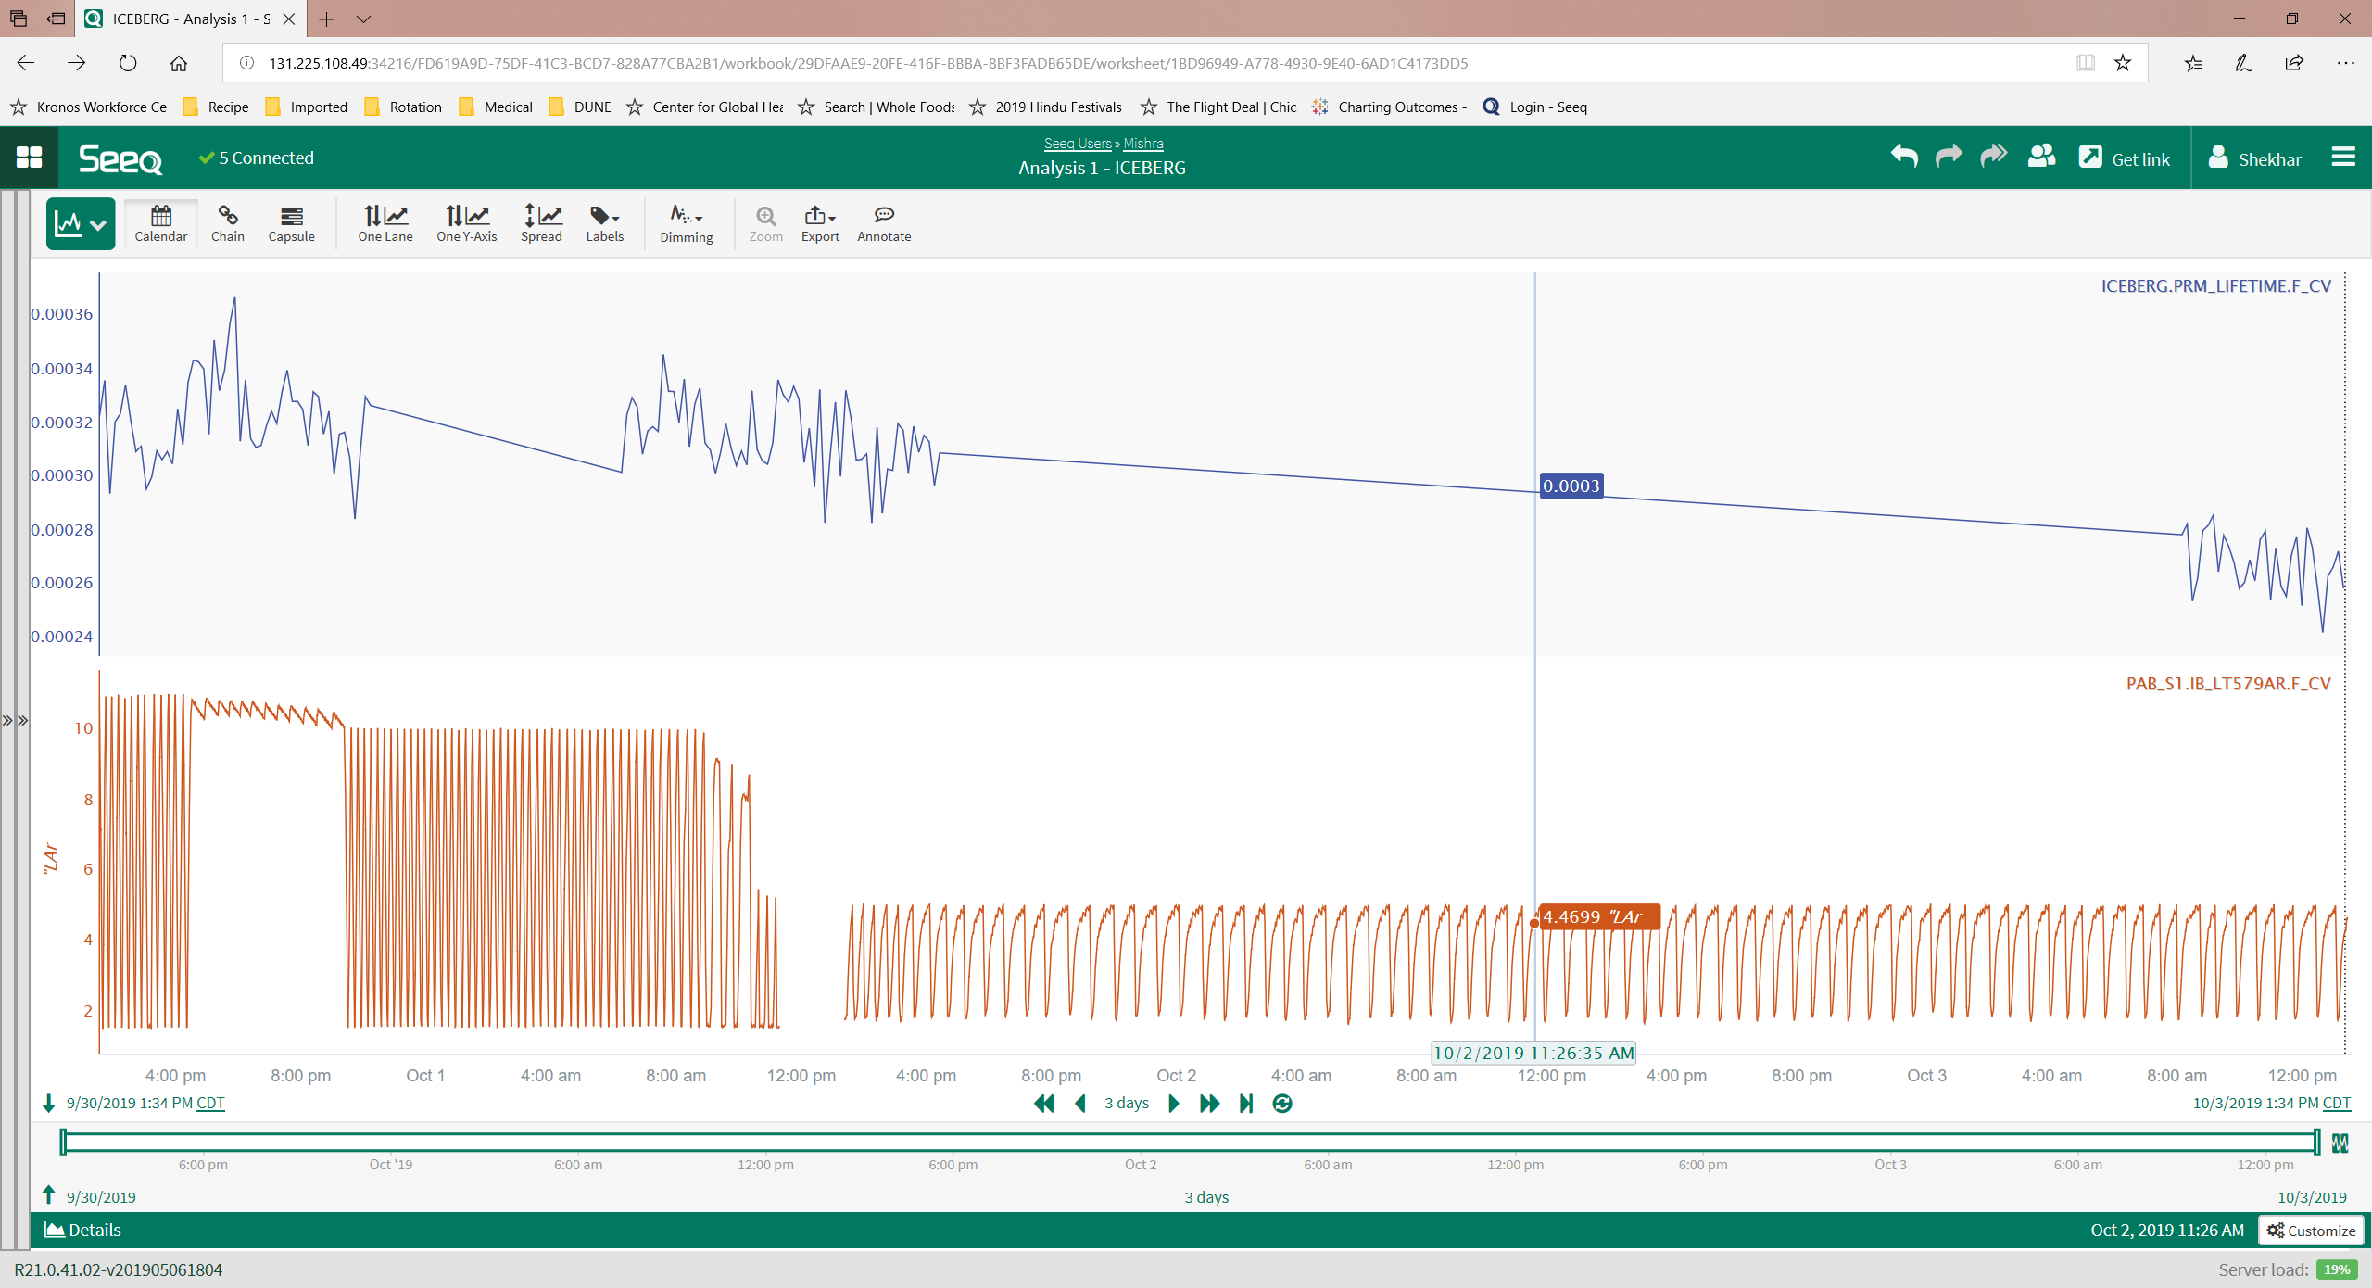
Purifier

Slide 6
Further improvements to Condenser
Replace the tee for the Argon gas inlet to condenser and LAr outlet from Condenser with a cross.
  Allowing LAr to come out if the sintered metal filter is frozen
Add a flexible tube (“snorkel”) to the condenser inlet into the condenser.
  Separate the gas and liquid in the condenser inlet pipe.
Add mole sieve material and a heater to the sintered metal filter

Slide 7
Plan
Warm up starting 10/4
Fix condenser
Understand CE issue and ….
Understand and Fix purifier
Cool down with ProtoDUNE CE late Oct.

