Slide 1
Interfaces between Main Injector Tunnel and the LBNF Extraction Enclosure
Matthew A. Sawtell
04OCT19

Slide 2
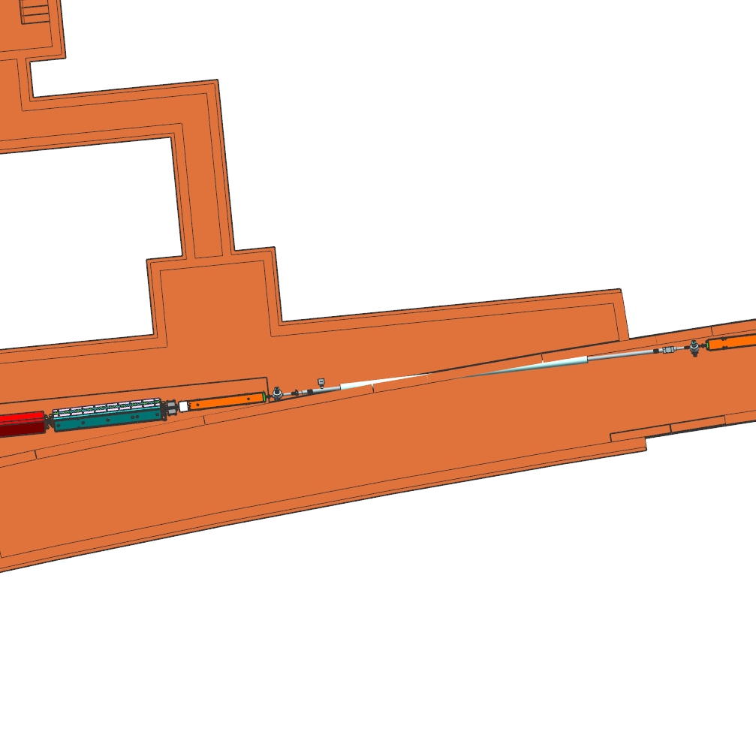
Background
There has been rudimentary understanding as to what was to interface between the walls between Main Injector and the LBNF Extractor Enclosure, other than the sleeve pipe for the vacuum line of the LBNF Beamline
With the push to the Preliminary Design of the NSCF for LBNF, there needs to be a better understanding of what is truly needed, and if can be accommodated into the NSCF Design work
Extraction Enclosure
Sleeve Pipe
for Vacuum Line
Main Injector Tunnel

Slide 3
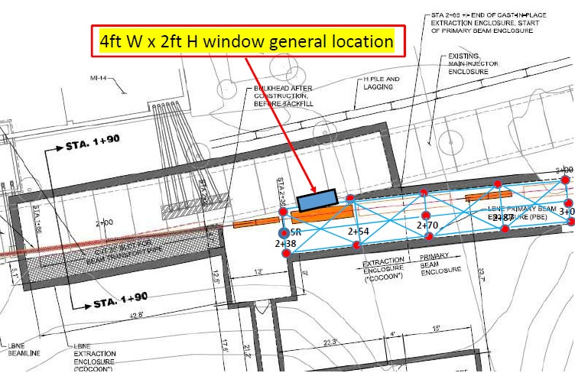
Sight Window for Beamline Alignment – located 1.5 Meters above floor of Main Injector

Slide 4
Addition Penetrations Needed?
LCW Lines?
  Supply
  Return
Communication Lines?
  ACNET
  Sensors for LBNF Primary Beamline
Power Lines?
  LBNF Primary Beamline
  Emergency / Backup

