Slide 1
SBN Program Status
Peter Wilson – SBN Program Coordinator
Oversight Board
13 December 2019

Slide 2
Outline
ICARUS technical progress
SBND technical progress
Upcoming Reviews

Slide 3
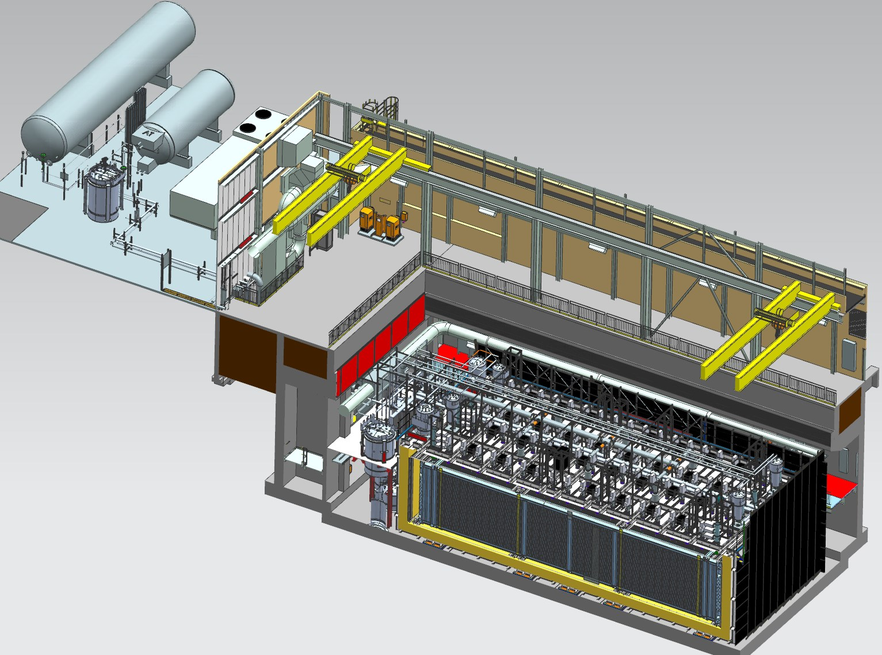
Far Detector - ICARUS
Cryogenic Dewars
TPC Electronics
Top CRT and Overburden
(not shown)
Exterior LAr Filters
Two 33 ton cranes
Proximity Cryogenics
Not shown in alcoves (mezzanine and pit):
DAQ racks
Controls racks
Cold Vessels (TPCs and PMTs inside)
Bottom CRT
Side CRT

Slide 4
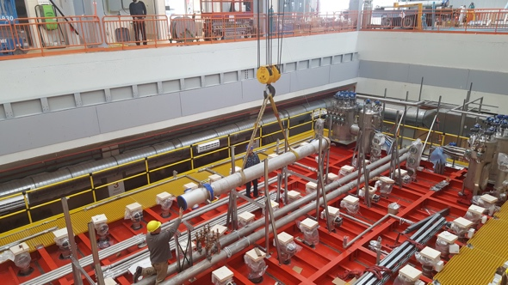
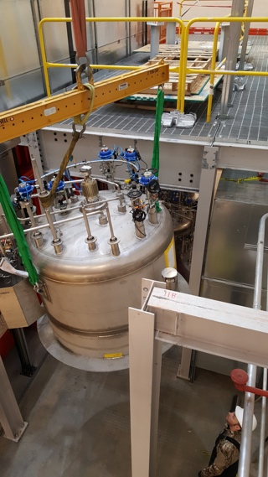
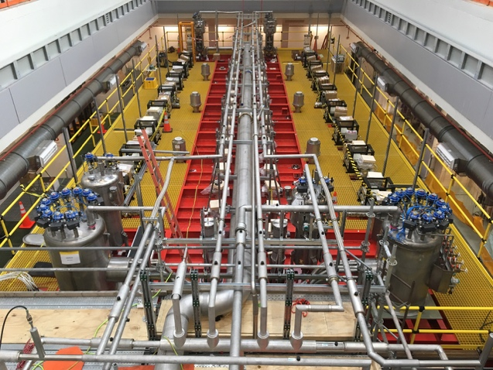
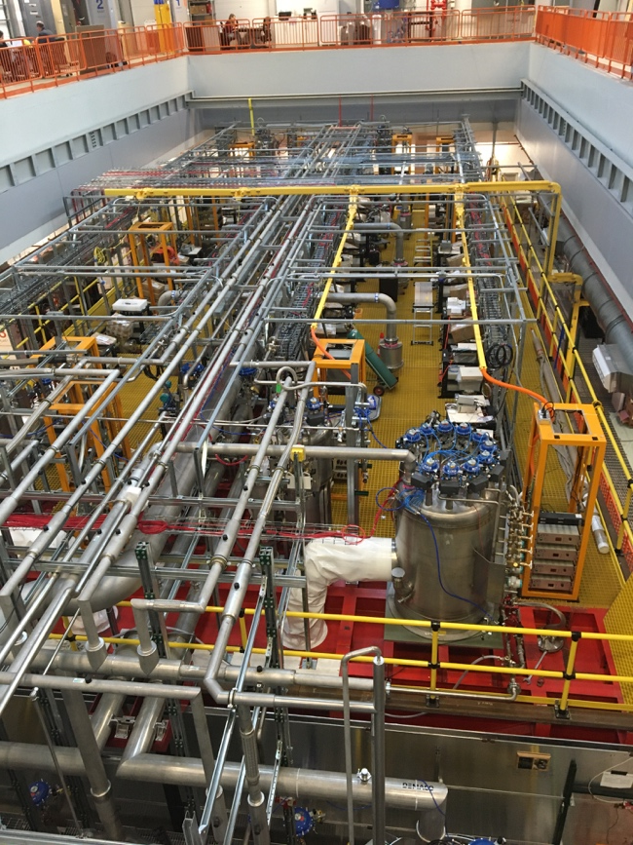
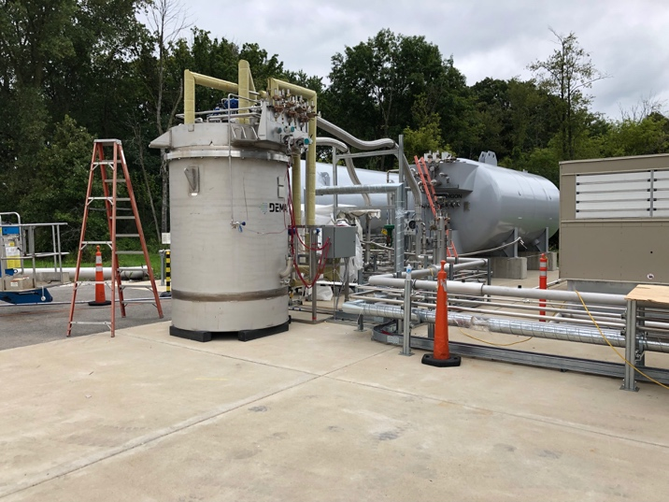
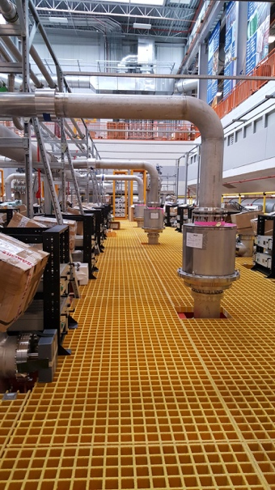
Far Detector Cryogenics
Installing Ar Vent Line
Cryogenics installation:
Proximity cryogenics installed
External cryogenics installed
Controls hardware installed
Controls software 95% complete
Rigging valve boxes
Cryogenics Installed
Piping installation

Slide 5
Cryogenics Commissioning Activities
Cold vessels under vacuum operation since June 10
Liquid Argon contract in place
Dewar filled, excellent delivered purity (O₂ < 0.5ppm)
21 calendar day notice required to start 1/day deliveries for fill
ODH system active (access restrictions not yet in place)
Final steps to start LAr fill in progress
Controls hardware checkout – 95% complete
Controls programming checkout by CERN and FNAL engineers at FNAL (December 2-10) - 50% complete
Found two fundamental differences in interpretation of controls specification between CERN/FNAL
Required code corrections understood – completion expected by December 20
Resume checkout after coding work complete
Week of Jan 6 remotely from CERN
Starting Jan 13: CERN and FNAL engineers together at FNAL
Approval (pORC) to start LN2 cooldown
Start LN2 cooldown
Start LAr fill

Slide 6
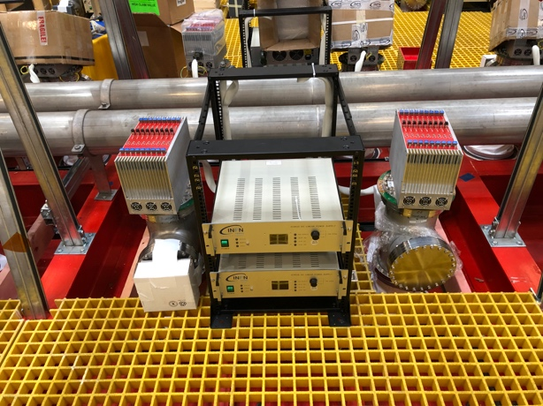
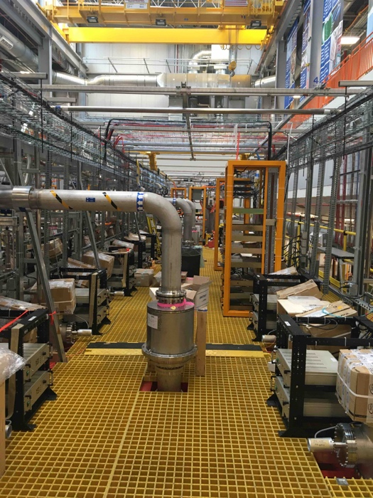
Far Detector TPC
TPC readout system installation complete
96 mini-crates and power supplies
856 readout cards
Wire bias and timing/trigger cables
6 mini-crates fully connected to DAQ for cold commissioning
TPC readout commissioning
connectivity of all channels verified using internal test-pulse distribution
tests of average noise level on all wires gave positive results, slightly in excess of measurements taken at the CERN test-facility, and possible interference with PMT readout excluded by operating simultaneously the TPC readout and powering the corresponding 30 PMTs at the nominal voltage.
TPC mini-crates and Power supplies
Detector top near completion

Slide 7
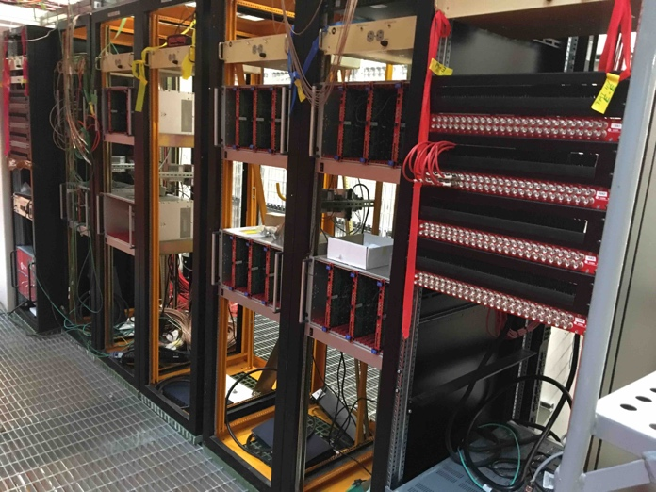
Far Detector PMT
PMT system - installation completed
HV and signal cables installed
HV distribution and readout digitizers installed
pORC approved;
PMT laser calibration system:
36 optical fibers installed
installation of laser in light-tight box in progress
Commissioning:
Connectivity checked both for PMTs and laser calibration;
all PMTs powered to nominal voltage in vacuum and tested for dark count and gain verified with LED input, with results consistent with previous measurements at CERN.
PMT readout and HV racks
Detector top near completion

Slide 8
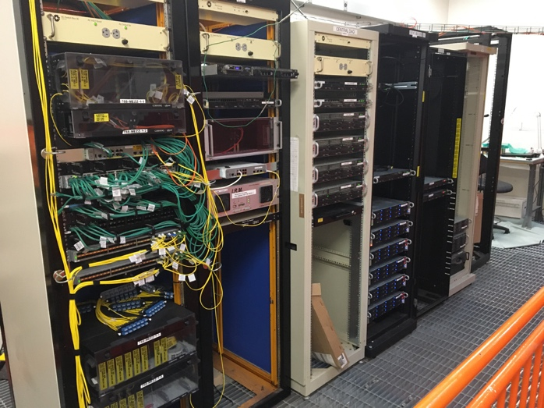
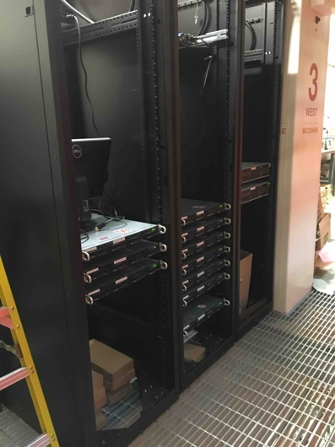
Far Detector DAQ
Central Network and Servers
Infrastructure and DAQ installation:
AC power distribution complete
Cable trays installed
Central DAQ servers installed
Network switches installed and configured
Network fiber installation to top of detector
Complete to mini-crates in January
TPC and PMT event builder servers installed (configuration in progress)
DAQ Commissioning
DAQ chain (event building, run control and online monitoring) tested at the single flange level both for TPC and PMTs
Partial chain (up to EVB) tested for 4 TPC mini-crates and 1 PMT board simultaneously at 1 Hz
extensive tests are being planned for the cold commissioning phase
Event Builder Servers

Slide 9
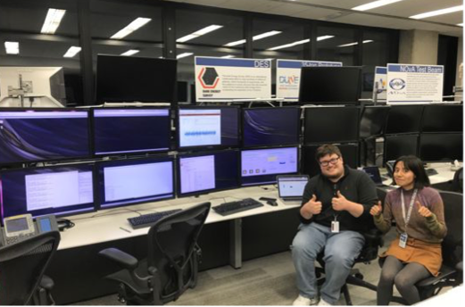
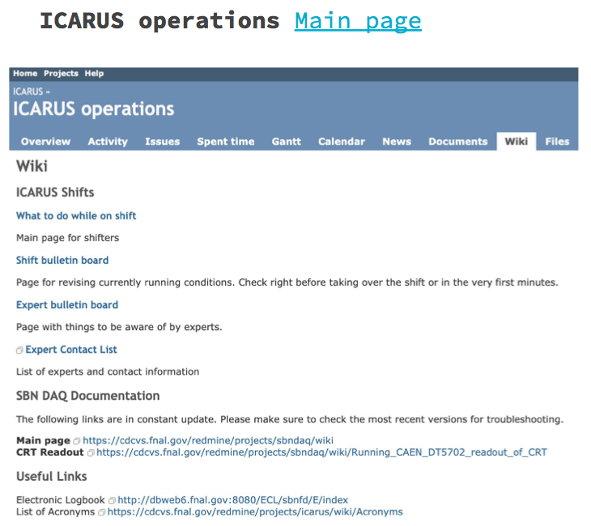
SBN Control Room
Control room for the SBN-FD is setup in ROC-West
Software for running the DAQ and network connections is in place
Have run DAQ, run control GUI, ECL and several of the monitoring tools from the control room machines since November 21
Starting to write the documentation for shifters
Starting tests with off-site Remote control room
Testing to date has been done at CSU
Diana (BNL) and Bruce (FNAL) are actively working with the control room and documentation setup

Slide 10
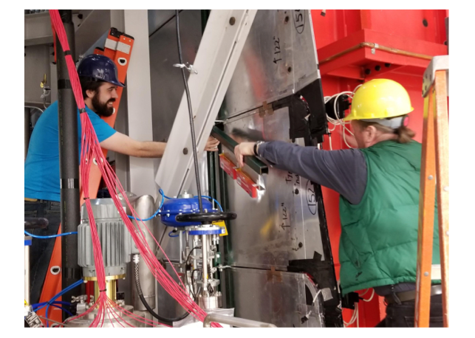
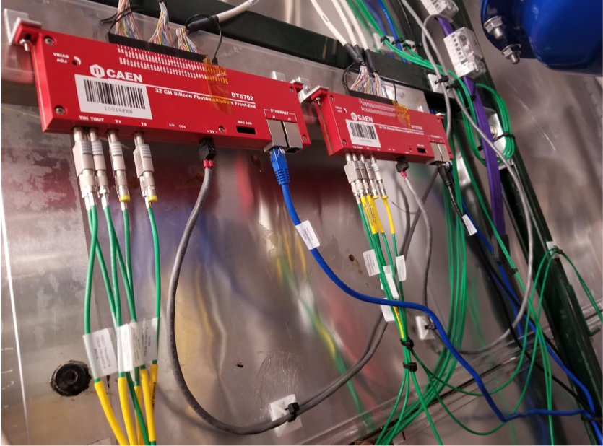
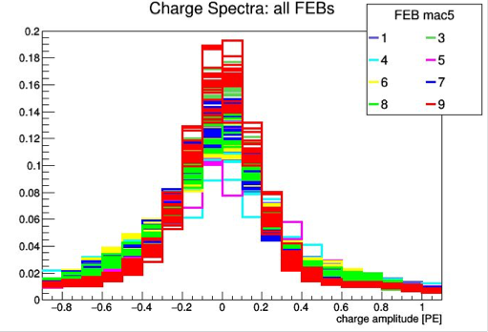
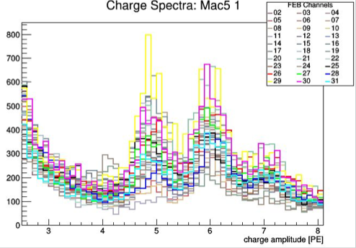
SBN-FD CRT Updates
Readout electronics have been installed at the north wall side CRT SBN-FD
Reading 240 channels (8 FEBs)
Commissioning of the north wall is ongoing
Exercising the DAQ and analyzing the data collected, setting the thresholds and working with the calibration
Preparing the bottom CRT to commission side and bottom CRT
Installing the support for the remaining side CRT installation
Pedestal for each FEB after calibration
ADC spectral overlays calibrated in PE, calibration region

Slide 11
ICARUS Milestones to I-1 Ready to Fill
Intermediate Milestone | Owner | Baseline Date | Forecast Date |  | Actual Date
Vessels rigged into building | P. Wilson | 16-Aug-2018 |  | ✓ | 16-Aug-2018
Manholes welded and vacuum test successful | C. Montanari | 10-Oct-2018 |  | ✓ | 11-Oct-2018
Warm Vessel roof complete | C. James | 15-Nov-2018 |  | ✓ | 31-Oct-2018
Cryo Platform complete | C. James | 15-Dec-2018 |  | ✓ | 04-Oct-2018
Proximity cryogenics installation begins | B. Norris | 15-Jan-2019 |  | ✓ | 28-Jan-2019
DBB & flanges installation complete and tested | A. Fava | 15-Feb-2019 |  | ✓ | 15-Mar-2019
Cold proximity cryogenics installation complete | B. Norris | 15-Apr-2019 |  | ✓ | 21-June-2019
1st T300 readout installation complete | A. Fava | 15-Mar-2019 |  | ✓ | 11-Apr-2019
All detector readout installed | A. Fava | 1-May-2019 |  | ✓ | 17-May-2019
Begin vacuum pumping | C. Montanari | 15-Jul-2019 |  | ✓ | 10-June-2019
Cryogenic operation approved | B. Norris | 15-Jul-2019 | Jan-2020
I1: ICARUS detectors ready to fill with LAr | P. Wilson | 30-May-2019 | Jan-2020 | f

Slide 12
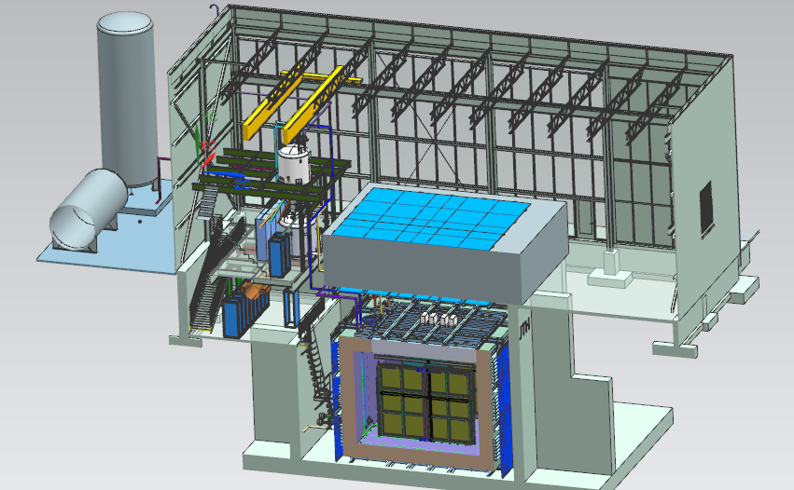
Near Detector - SBND
20 ton crane
Top CRT and Overburden
Cryogenic Dewars
Proximity Cryogenics
Readout racks
Top CRT
TPC
Cryostat
Side CRT

Slide 13
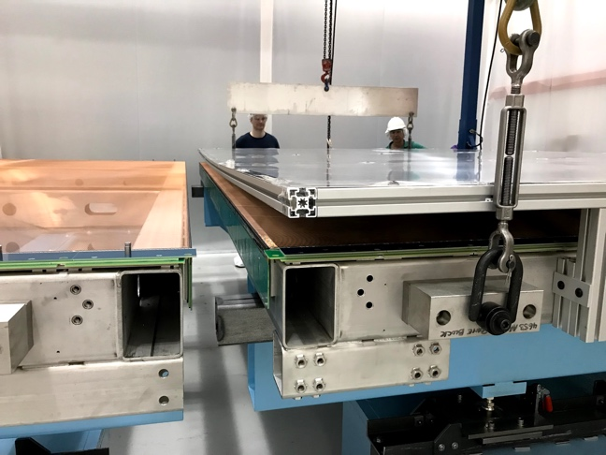
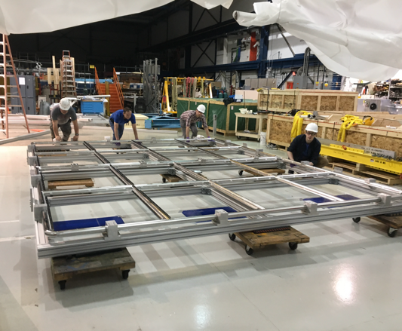
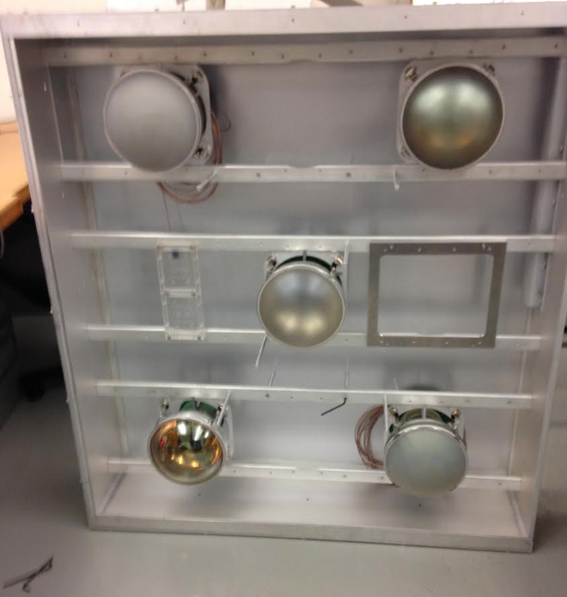
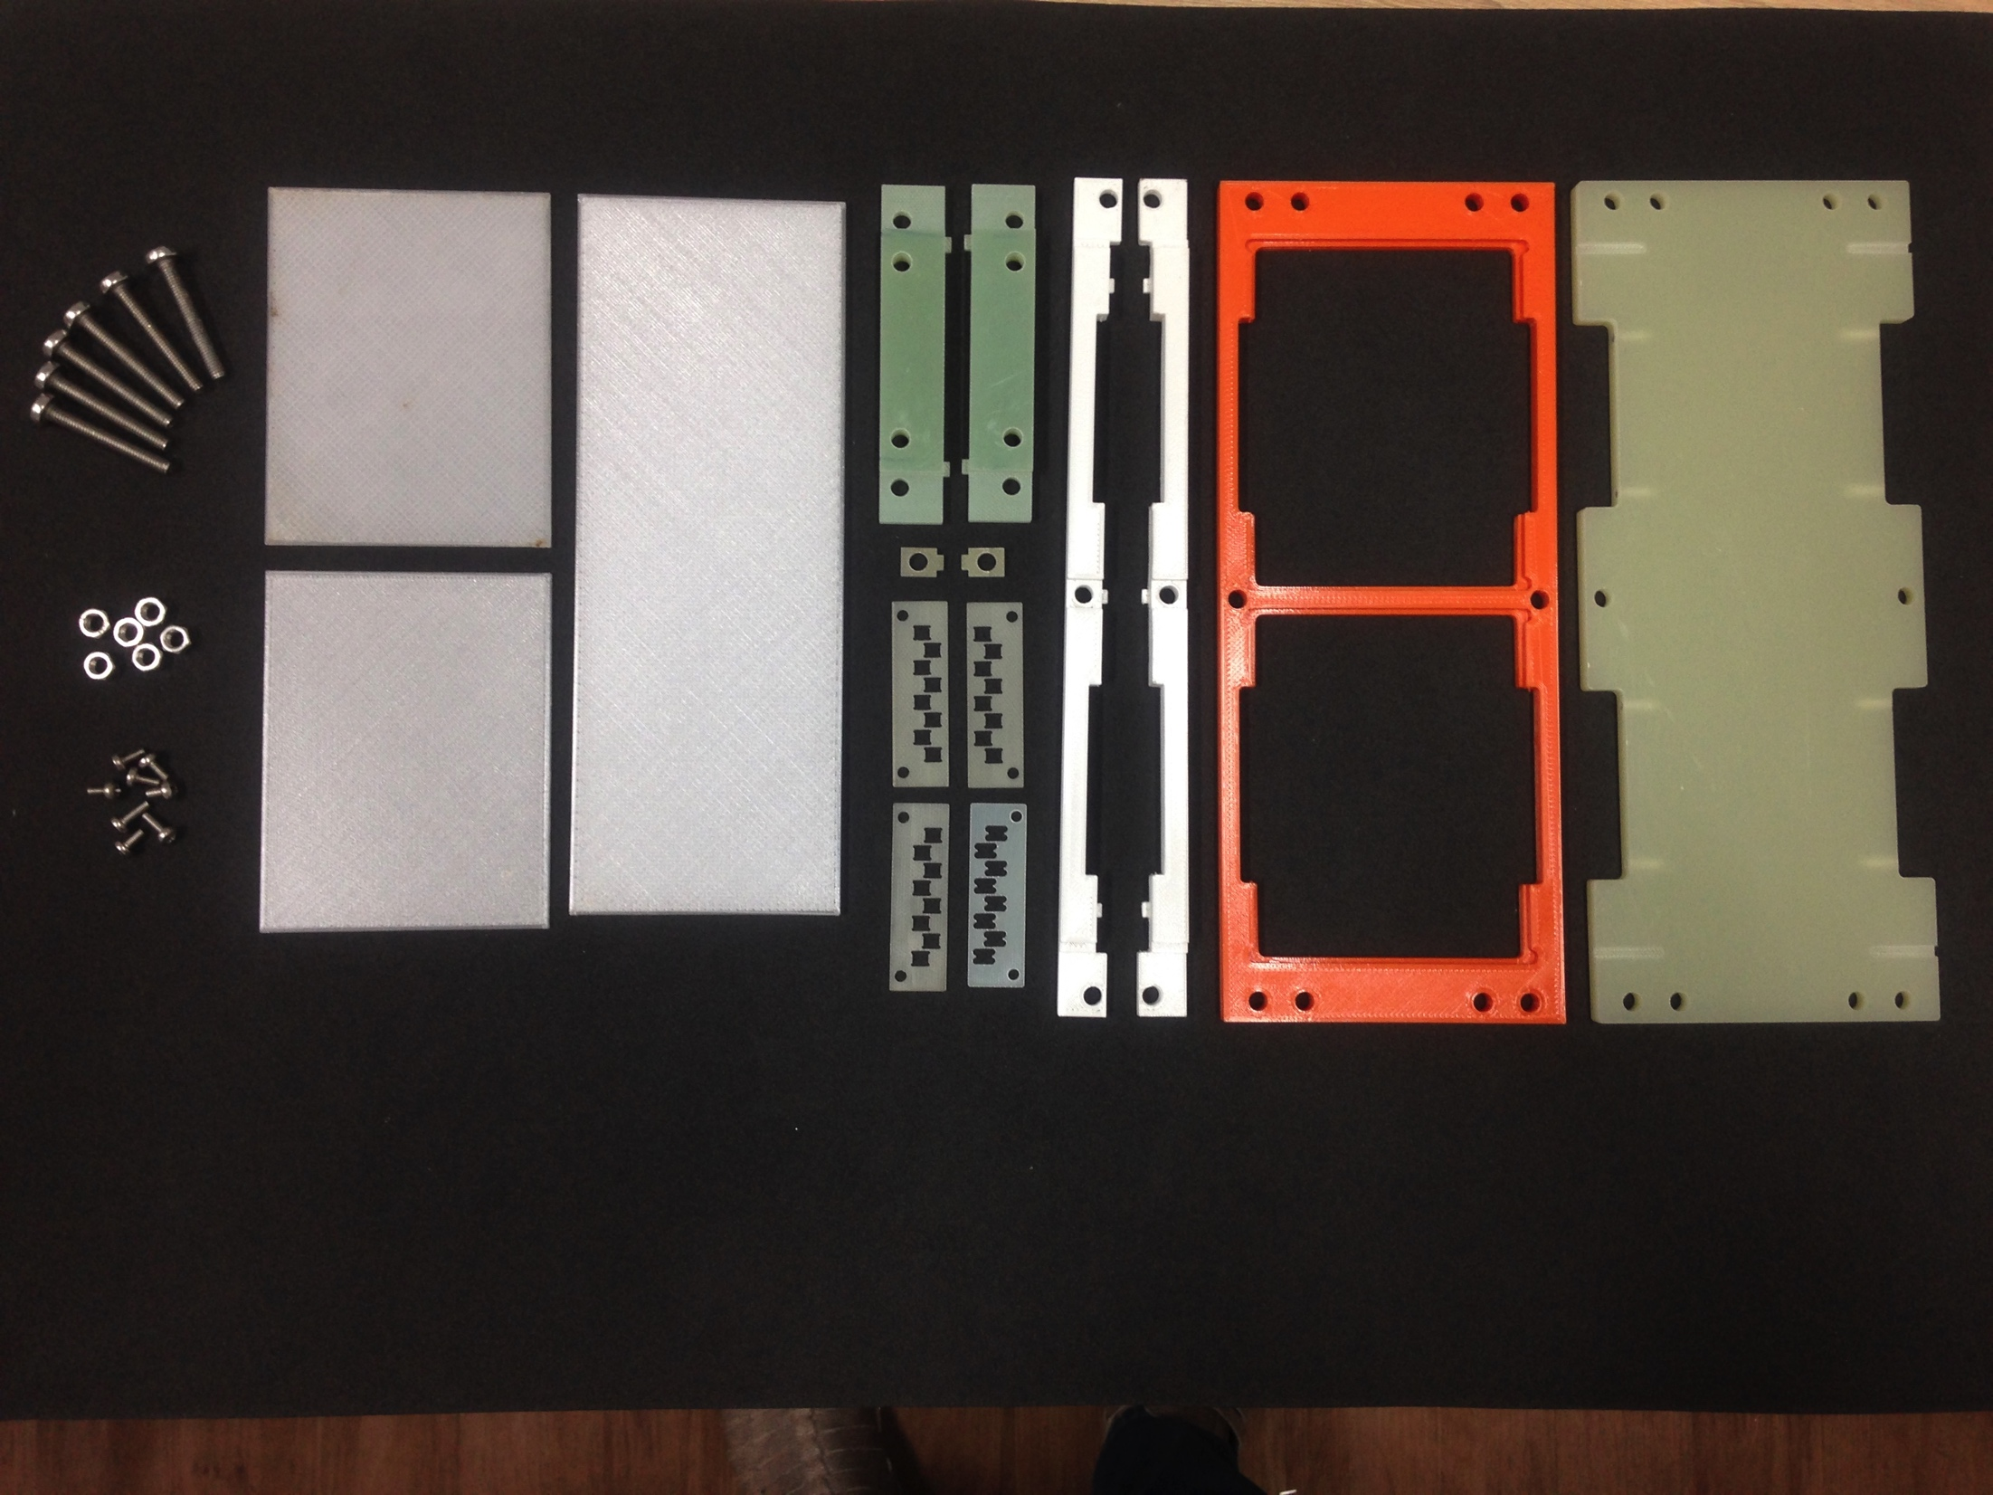
Near Detector Progress
TPC Assembly
All major TPC components delivered to FNAL
First two (of four) APAs aligned and paired
Cathode frame assembled
Assembly facility near complete
Start assembly early next year
Photon detection systems
PMT system test in Coherent Captain Mills detector completed at LANL Ship to Fermilab when ready to install
ARAPUCA system in production.
Two APAs ready for alignment
Cathode frame assembly
ARAPUCA Adapter Frame
X-ARAPUCA Adapter
for double -frame
Test fit of adapter plates in PDS box

Slide 14
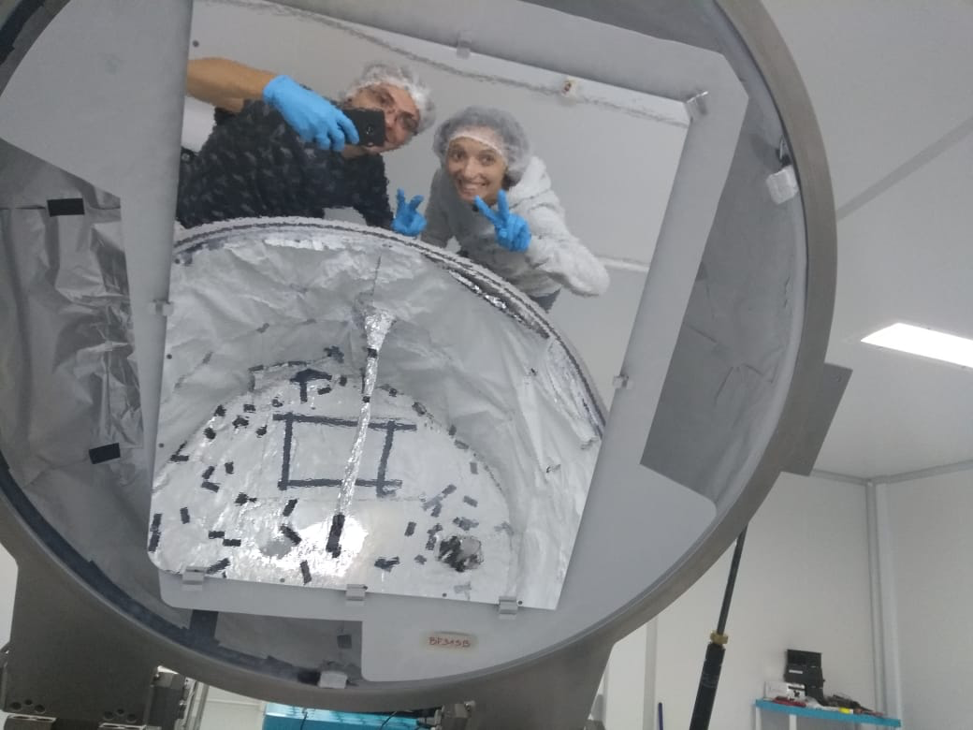
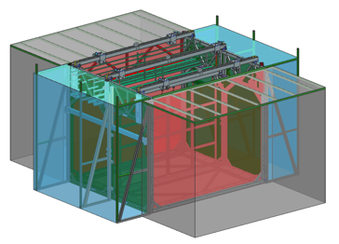
Atf construction
Need to complete the assembly transport frame (atf) before we can start TPC assembly.
Atf base frame was assembled and welded by the DAB technician team over summer/fall.
What’s next:
Complete load test
Add clean tent, roof, develop access procedures
Finish and install rest pads & support beams for Anodes and Cathode

Slide 15
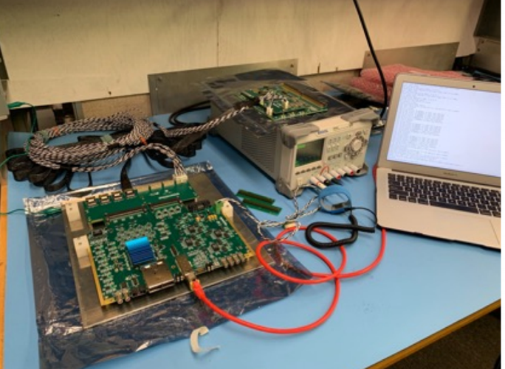
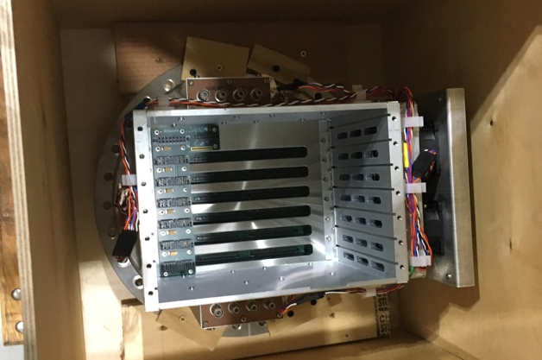
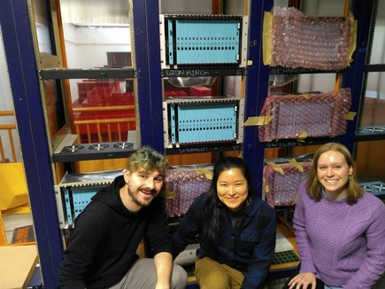
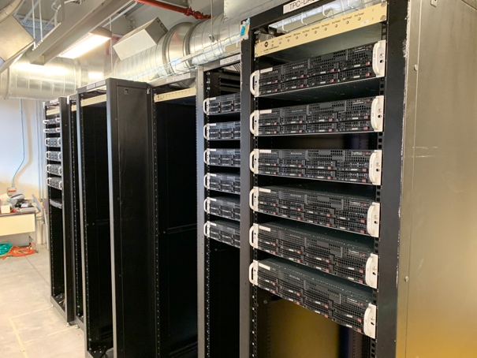
Near Detector Progress
Cold electronics reception test @ FNAL
TPC Electronics
All cold electronics delivered from BNL to FNAL
Flange crates delivered to FNAL
Back-end electronics completed at Columbia/Nevis
Back-end crate installation started at SBN-ND building
Infrastructure and DAQ
AC power to mezzanine racks
Central DAQ servers installed
Network servers ordered
Flange crate
TPC Readout crates
Server racks

Slide 16
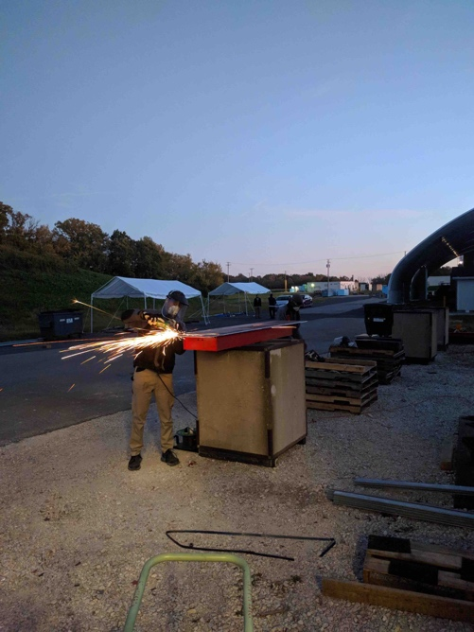
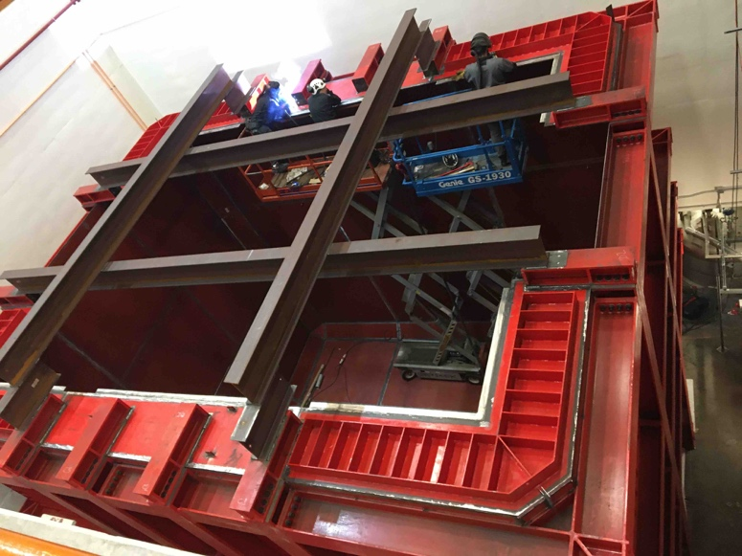
Near Detector Cryostat
Warm vessel steel structure
Preassembly at CERN
Shimming and bottom CRT installed
Assembly and welding at FNAL (CERN, INFN and FNAL)
Top cap design near complete
Cryostat membrane
Membrane design completed by GTT
Material procurement out for bids at CERN
Delivery expected Spring 2020
Rigging of 13t bottom I-beam structure
Completed I-beam structure, CRT panels underneath
Installing final top edge plates
Grinding plate edges to prep for welding

Slide 17
SBND Milestones to S-1 SBND ready to move
In the process of updating the SBND schedule to reflect expected completion of the cryostat.
Delivery of cryostat materials to Fermilab (expect spring 2020)
Installation of membrane cryostat
Install internal cryogenics
Assemble and test fit top caps
Move the detector after the cryostat is ready.
Updated schedule completed in December well in advance of Director’s review

Slide 18
Upcoming Reviews
The next SBN Director’s Review is scheduled for the week of Feb 25-26, 2020. The review will be focused on completing the SBND installation and transition of SBND to operations
There will be an Operations Readiness Review held by the laboratory: SBN Operations Phase 1: Far Detector Only
Preparation for this review is the responsibility of the collaboration
A follow-up review will occur when the Near Detector makes the transition to operations
Exact review date still to be set. Should occur with sufficient time to have established functionality of major detector systems

Slide 19
SBND Cryostat Installation
Time lapse video courtesy of Dimitar Mladenov (CERN)

Slide 20
Backup

