Slide 1
Beam Delivery to the SBN Program
T. Kobilarcik for M. Convery
SBN Oversight Board Meeting
13 December 2019

Slide 2
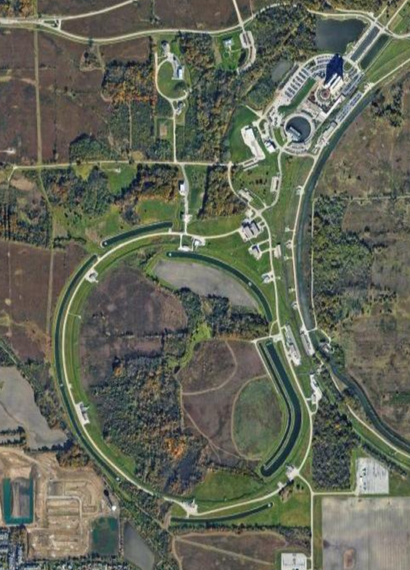
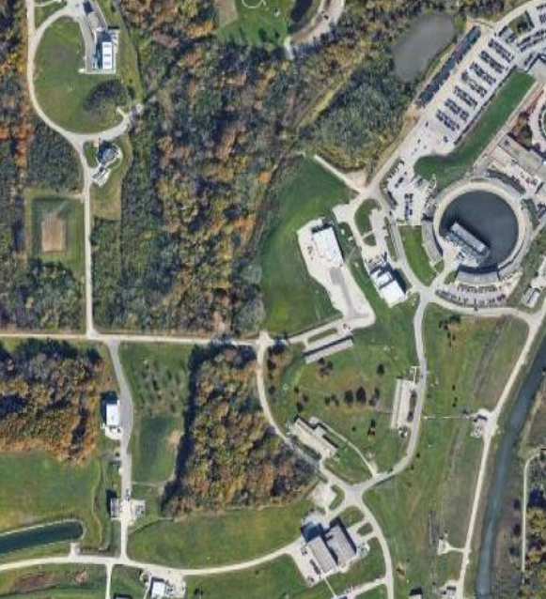
Site Overview

Slide 3
Site Overview
Booster
Short Baseline Neutrino Experiments
Booster Neutrino Beamline

Slide 4
Proton Transfers
Muon Campus
NuMI
120 GeV FT
SBN
Booster
Recycler
Main Injector
Accelerates from 400 MeV to 8 GeV
15 Hz rep rate
8 GeV storage ring
Used for RF manipulation, slip stacking and bunch rotation
Accelerates from 8 GeV to 120 GeV
Maximum 1.2 s rep rate

Slide 5
Beam to the Muon Campus affects BNB repetition rate
3.6 Hz during g-2 running (5 per 1.4s)

Slide 6
Beam to the Muon Campus affects BNB repetition rate
4.2 Hz during Mu2e 1-batch running (5 per 1.2s)
Note Mu2e planned to take 2 batches per cycle but has limited experiment shielding prior to the long 2025-27 shutdown to save money

Slide 7
Beam to the Muon Campus affects BNB repetition rate
5 Hz when Muon Campus not running (e.g. this week, also g-2 has regular 4h trolley runs)

Slide 8
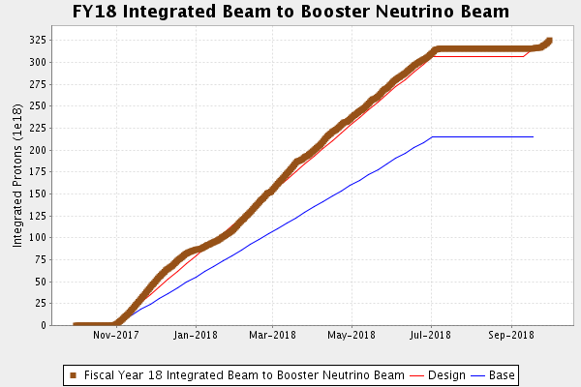
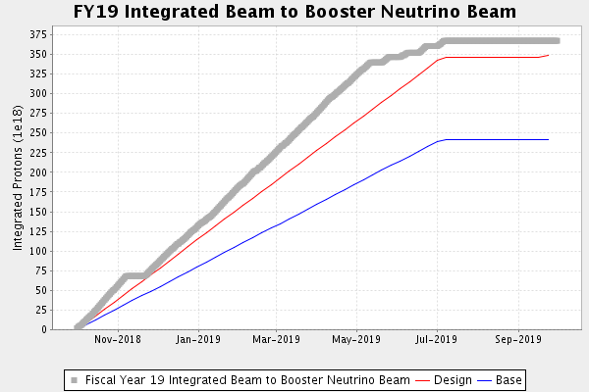
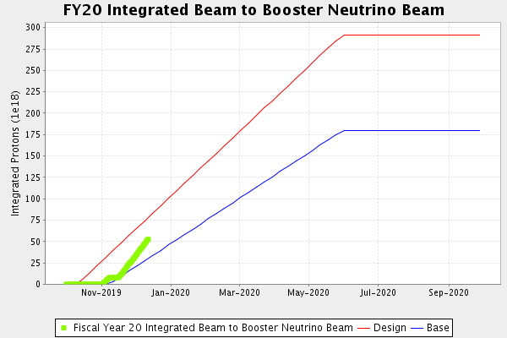
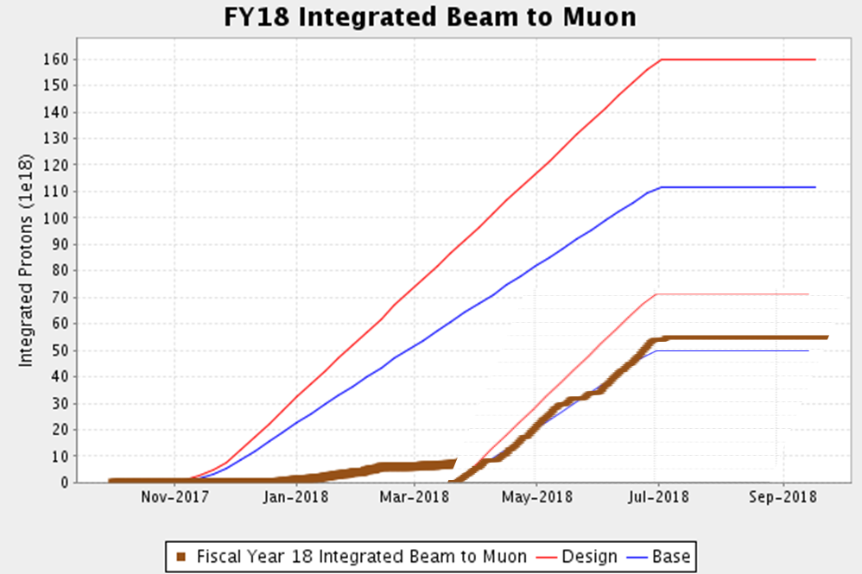
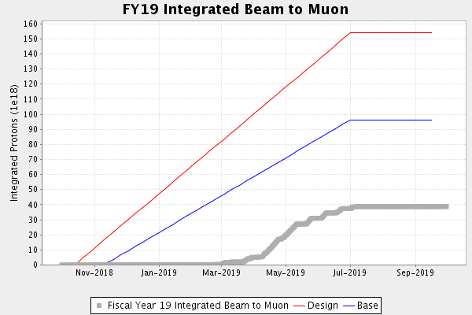
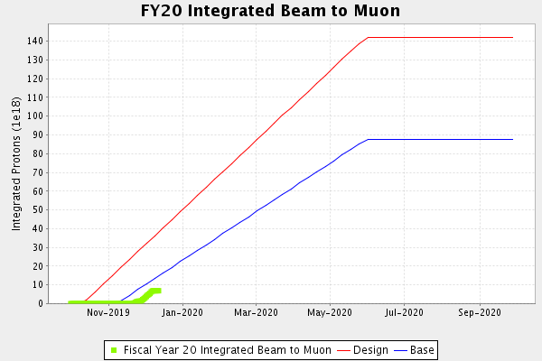
In recent years, BNB has benefitted from g-2 downtime

Slide 9
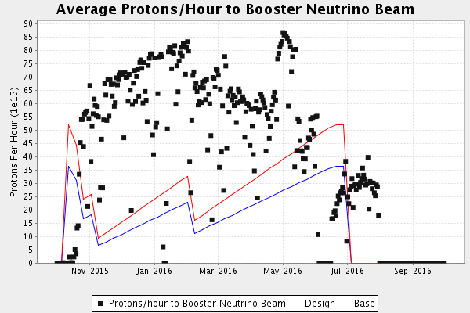
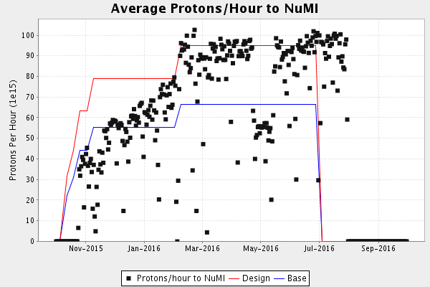
Effect of NuMI on BNB beam
NuMI is given priority on intensity per pulse when Booster losses are high
This should be a small effect except when we work on increasing from 700 to 900kW to NuMI (FY22-23)
Plots show FY16 ramp up from 400kW towards 700kW – multiple things were going on, but can see trend during ramp up once we hit the Booster loss limit

Slide 10
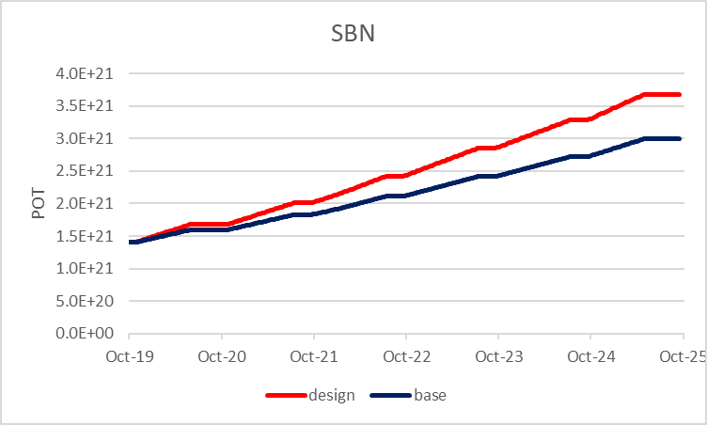
Projections for beam to BNB

Slide 11
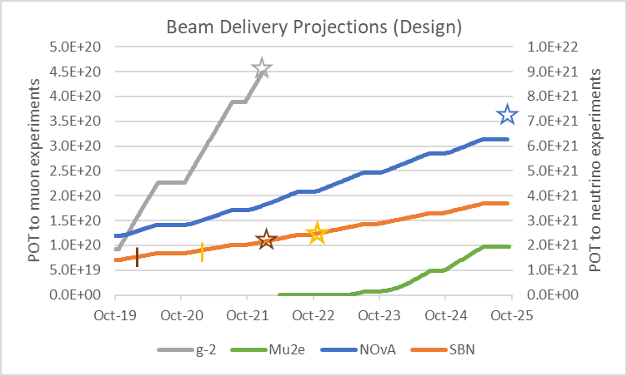
Projections assuming running at design levels for all expts
ICARUS
SBND

