Slide 1
Ab-initio alloy design for C-band accelerators
International Workshop on Breakdown Science and High Gradient Technology (HG2021) (HG2021)
Gaoxue Wang, Danny Perez
T-1, Theoretical Division
04/21/2021
LA-UR-21-23694

Slide 2
Acknowledgements
Danny Perez (T-1)
Timothy Germann (T-1)
Andrew Garmon (T-1)
Soumendu Bagchi (T-1)
Nirmal Rai (T-1)
C-band experimental team
LDRD-DR: 20200057DR, 20190079DR

Slide 3
Outline
RF breakdown
Figure of merit (FOM) for Cu alloys
Cu-Ag as an example
High-throughput screening
Summary and plan

Slide 4
RF breakdown
Breakdown probability is dependent on the material of the cavity.
Cu-Ag alloys can optimize breakdown resistance
Can we scan the whole periodic table in search of the optimal solute and concentration?
Simakov, Dolgashev, Tantawi, 2018

Slide 5
Outline
RF breakdown
Figure of merit (FOM) for Cu alloys
Cu-Ag as an example
High-throughput screening
Summary and plan

Slide 6
FOM overview
Tradeoffs:
  Good: Adding solute atoms can improve strength: limit plastic deformation under thermal loading
  Bad: Adding solute atoms can increase RF dissipation and thermal stresses: increase driving force for plastic deformation
Figure of merit (FOM):
  Critical stress to move dislocations / Thermal stress created by RF dissipation
Level of theory: Density Functional Theory (DFT)
Chemical space: Dilute binary Cu alloys

Slide 7

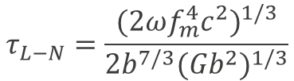


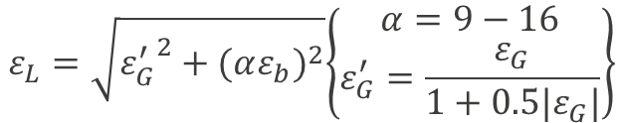
FOM #1: Critical stress to move dislocations
Labusch–Nabarro (LN) model: Critical resolved shear stress required for dislocation motion:
With:
Two key parameters:
Size misfit
Modulus misfit
$$τ_{L−N}=\frac{{(2ωf_{m}^{4}c^{2})}^{1/3}}{{2b}^{7/3}{(Gb^{2})}^{1/3}}$$
$$f_{m}=\frac{Gb^{2}}{120}ε_{L}$$
$$ε_{L}=\sqrt{{ε_{G}^{′}}^{2}+{(αε_{b})}^{2}}\left\{\begin{aligned}α=9−16 \\ ε_{G}^{′}=\frac{ε_{G}}{1+0.5|ε_{G}|}\end{aligned}\right\}$$
$$ε_{b}=\frac{db}{bdc}$$
$$ε_{G}=\frac{dG}{Gdc}$$
Johan Zander et al., Computational Materials Science 41 (2007) 86–95
M. Z. Butt, Journal of Materials Science 28 (1993) 2557-2576

Slide 8
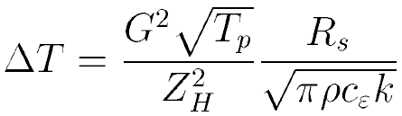

FOM #2: Thermal stress created by RF dissipation
Heating due to RF losses can be estimated from the solution of the heat equation:
Accelerator parameters
Material properties
Assuming that the surface is free to relax in z only, the corresponding in-plane thermal stress is
$$ε_{xx}≡ε_{yy}≡−\frac{EαT}{1−v}$$
Perry B. Wilson. In ITP Conference on Future High Energy Colliders.
University of California, Santa Barbara, October 1996.

Slide 9
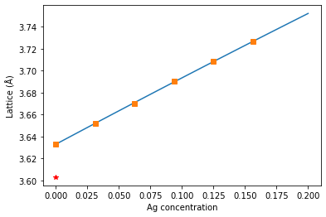
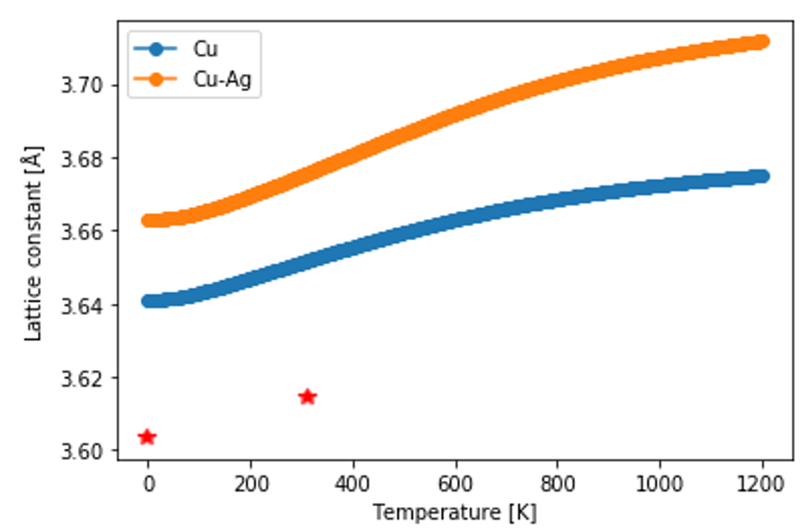
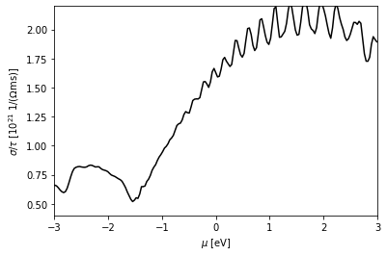
FOM = FOM #1 / FOM #2
Estimating the FOM requires:
Lattice constant: direct relaxation
Thermal conductivity: Boltzmann transport
Electrical conductivity: Boltzmann transport
Mechanical properties: finite distortion
Thermal expansion coefficient: quasi-harmonic approximation
These quantities need to be computed vs solute concentration.
This requires tens of DFT calculations per solute per concentration (!)

Slide 10
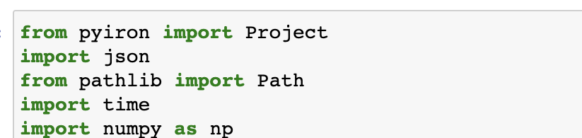
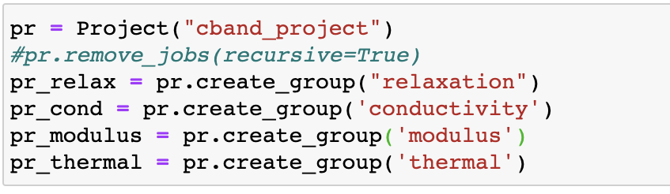
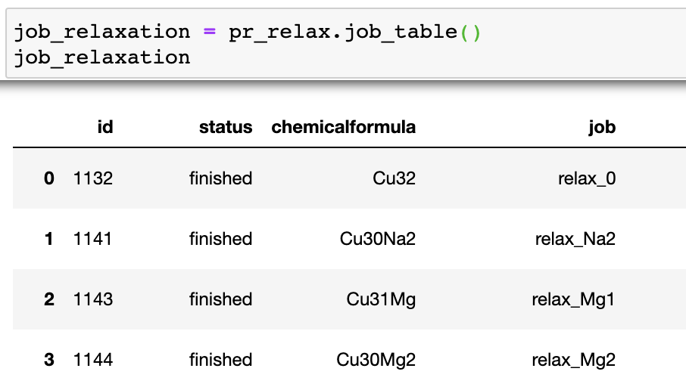

High-throughput workflow
Solution: workflow management tool called pyiron
Standardizes calculations, manages job execution, stores results in database

Slide 11
Outline
RF breakdown
Figure of merit (FOM) for Cu alloys
Cu-Ag as an example
High-throughput screening
Summary and plan

Slide 12
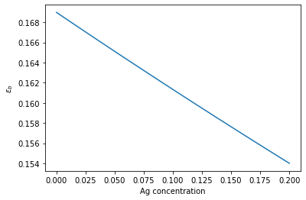
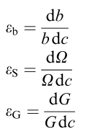
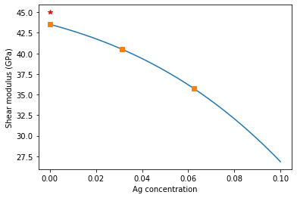
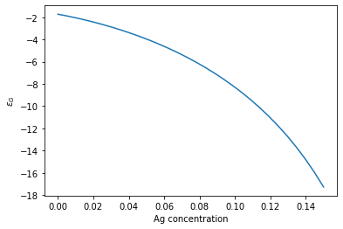
FOM #1: Critical stress to move dislocations
Cu experiments

Slide 13
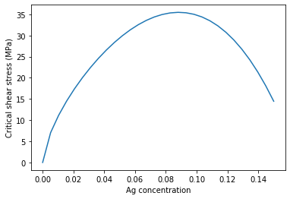
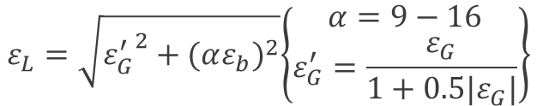





FOM #1: Critical stress to move dislocations
$$ε_{b}=\frac{db}{bdc}$$
$$τ_{L−N}=\frac{{(2ωf_{m}^{4}c^{2})}^{1/3}}{{2b}^{7/3}{(Gb^{2})}^{1/3}}$$
$$ε_{G}=\frac{dG}{Gdc}$$
Estimated from
DFT results
$$ε_{L}=\sqrt{{ε_{G}^{′}}^{2}+{(αε_{b})}^{2}}\left\{\begin{aligned}α=9−16 \\ ε_{G}^{′}=\frac{ε_{G}}{1+0.5|ε_{G}|}\end{aligned}\right\}$$
$$G$$
$$b$$

Slide 14
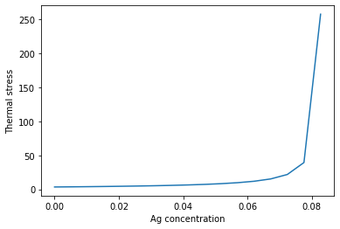



FOM #2: Thermal stress created by RF dissipation
Estimated from DFT
$$ε_{xx}≡ε_{yy}≡−\frac{EαT}{1−v}$$
Using experimental data
keep as a constant 1
wavelength

Slide 15
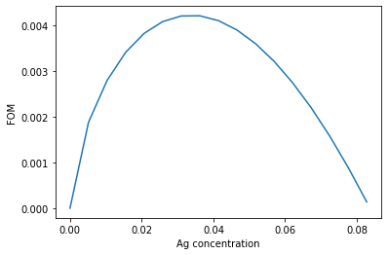
FOM = FOM #1 / FOM #2
  Critical stress to move dislocations / Thermal stress created by RF dissipation
optimal concentration

Slide 16
Outline
Introduction
Figure of merit (FOM) for Cu alloys
Cu-Ag as an example
High-throughput screening
Summary and plan

Slide 17
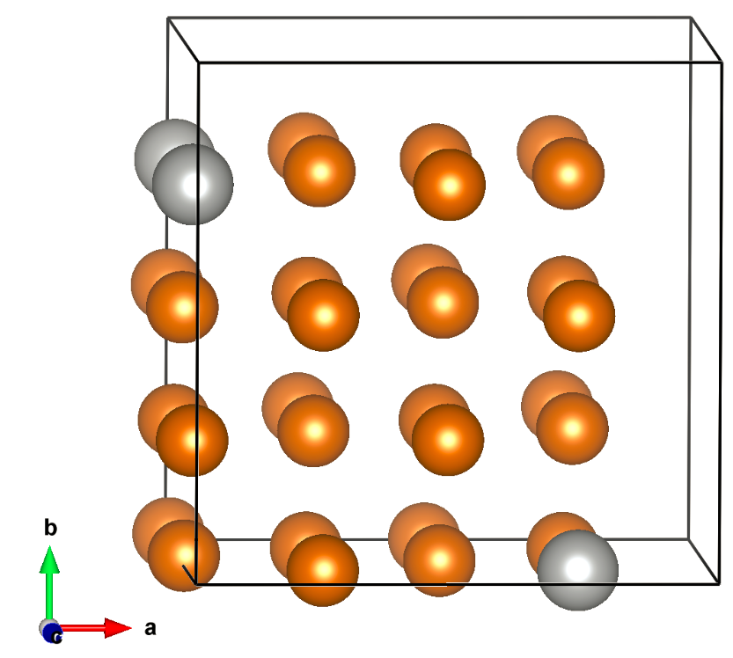
Execution plan and current status:
Solutes: atomic numbers up to 86
Concentrations: 3.1%, 6.2%, 9.4%
High-throughput workflows:
  Structure optimization
  Thermal/electrical conductivities
  Mechanical properties
  Critical resolved shear stress
  Thermal expansion coefficients
Current status:
All workflows written with pyiron. Currently sequentially executing them.
Cu
solute

Slide 18
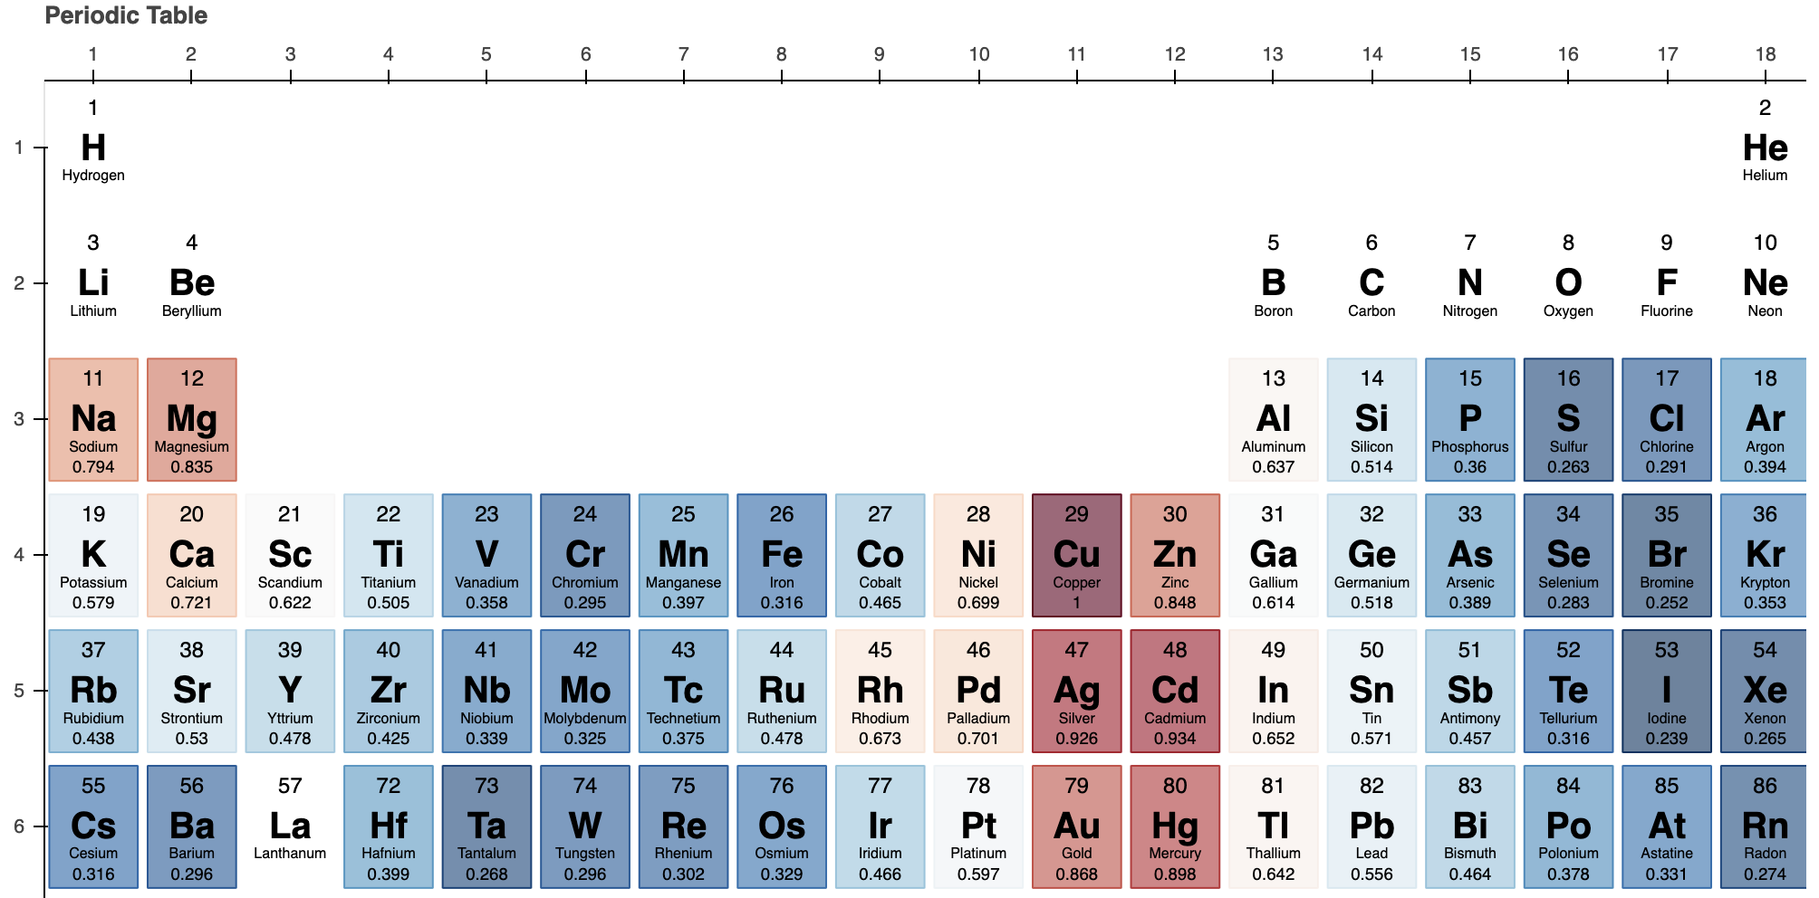
Conductivities
3.1% solute
(Normalized by conductivity of pure Cu)

Slide 19
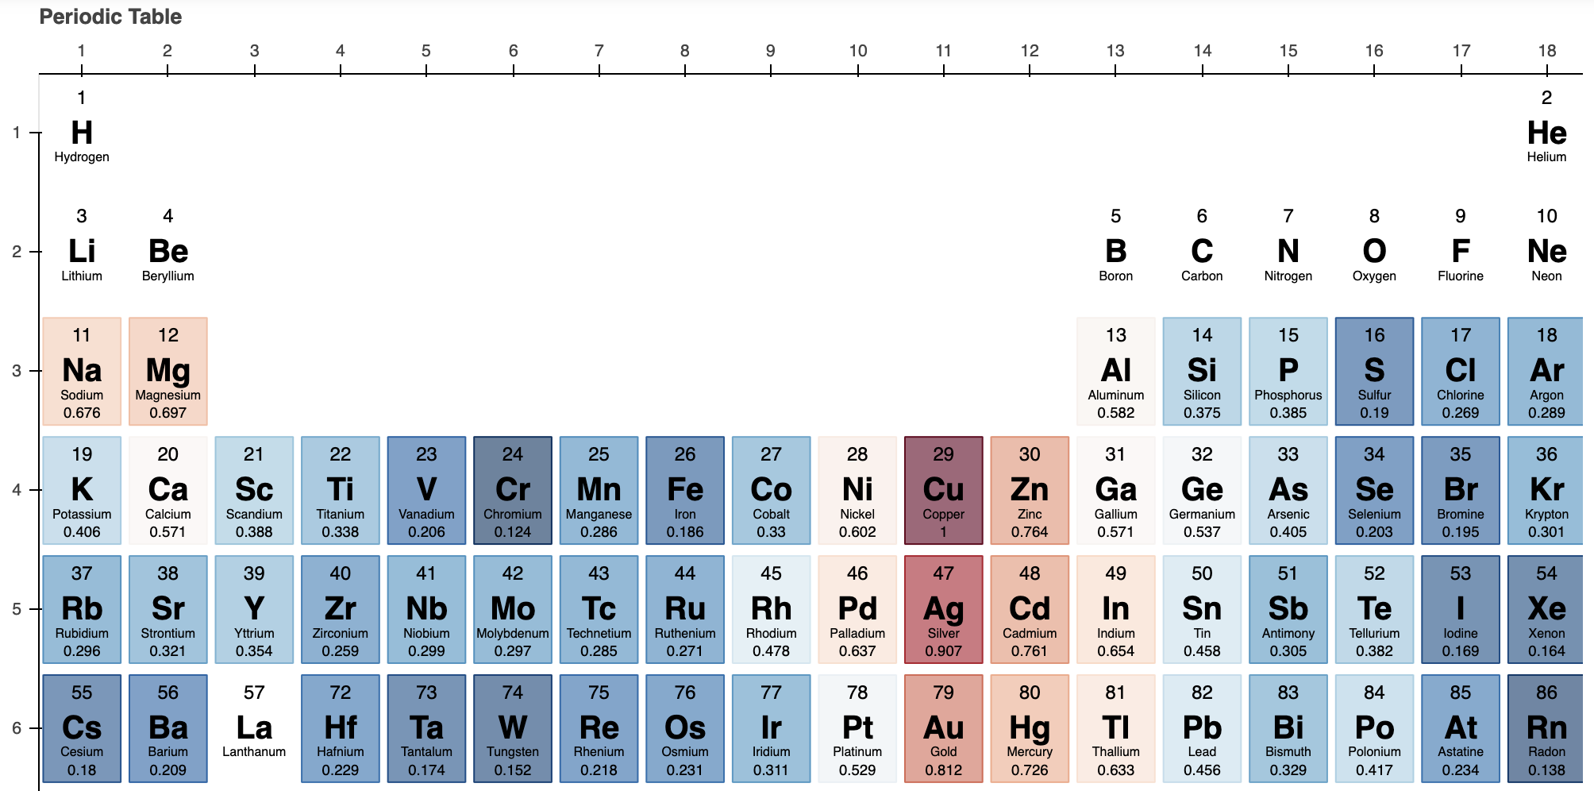
Conductivities
6.2% solute
(Normalized by conductivity of pure Cu)

Slide 20
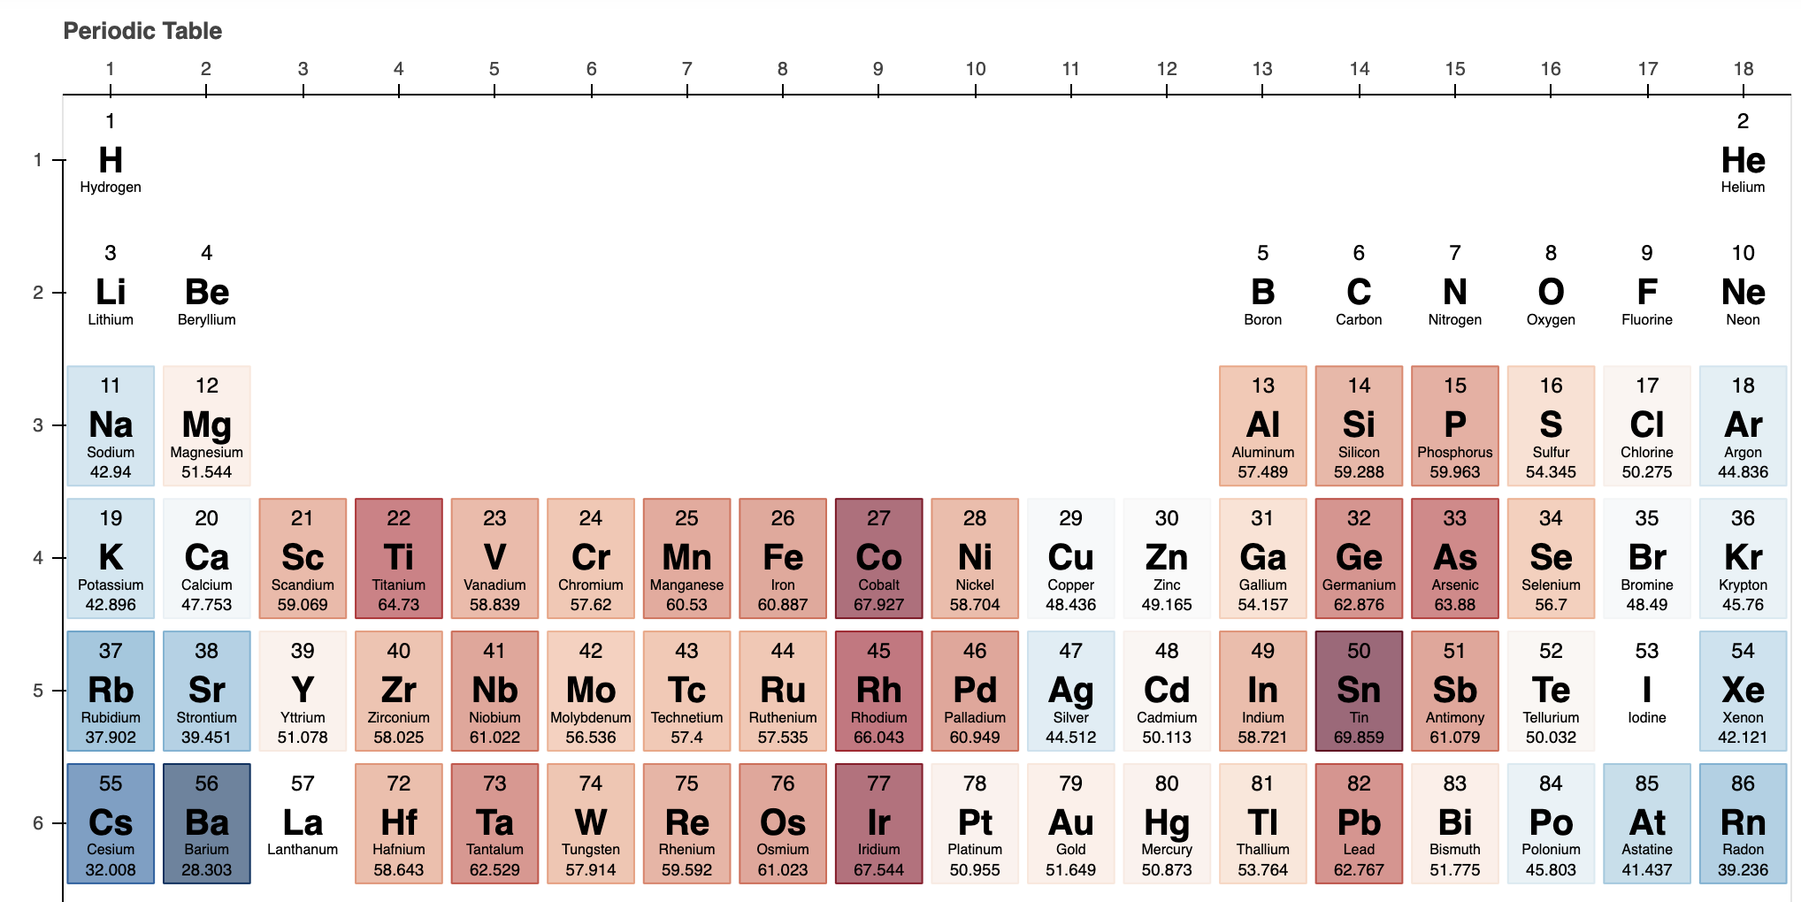
Shear modulus (GPa)
3.1% solute
(In units of GPa)

Slide 21
Summary and plan
Summary:
FOM: tradeoff between solute strengthening and RF losses
Development of a high-throughput workflow
Execution across the periodic table ongoing
Identification of solutes that are promising to maintain high conductivity of Cu and increase mechanical properties
Future plans:
Compute FOM of all binary alloys on the periodic table
Consider surface structure (e.g., solute segregation) and properties (electronic work function)
Engage with experimental efforts to assess potential candidate alloys

Slide 22
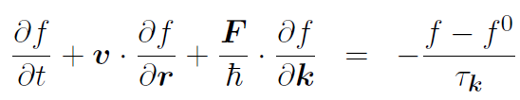

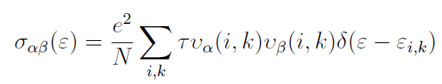
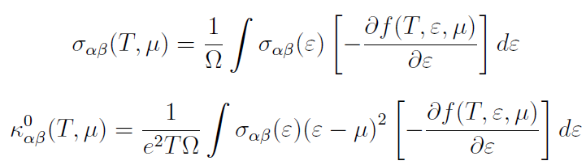
Electrical and thermal conductivity
Semiclassical Boltzmann transport equation
(Relaxation time approximation)
Electronic structure calculations
BoltzTrap2
(1)
(2)
(3)
(4)
Madsen, Georg KH, and David J. Singh., Computer Physics Communications 175, no. 1 (2006): 67-71.

Slide 23
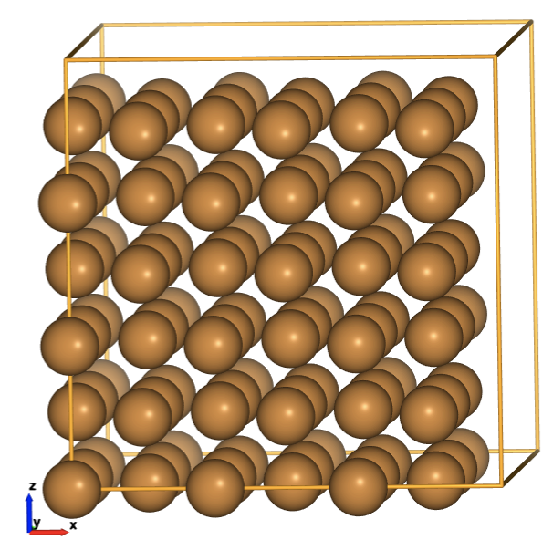
Electrical and thermal conductivity
σ/τ = 1.6*1E21 (Ωms)⁻¹
Relaxation time τ = 2.7*1E-14 s (experiments)
σ = 4.32*1E7 (Ωm)⁻¹
Resistivity ρ = 1/σ = 2.3*1E-8 Ωm
(Experiments ~1.72*1E-8 Ωm)
Pure Cu
κ/τ = 125*1E14 W(mKs)⁻¹
Relaxation time τ = 2.7*1E-14 s (experiments)
κ = 337.5 W(mK)⁻¹
(Experiments ~386 W(mK)⁻¹)

Slide 24
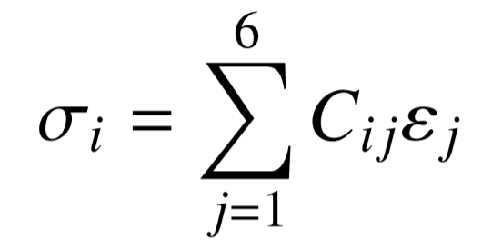
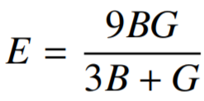
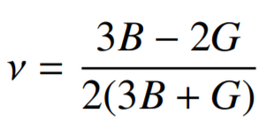
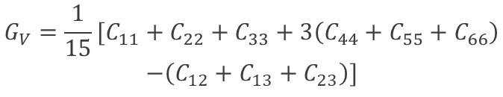


Mechanical properties
Hooke’s law
$$C_{ij}=\frac{1}{V_{0}}\frac{∂^{2}E}{∂{\text{η}}_{i}∂{\text{η}}_{j}}$$
Elastic constants C_{ij}
$$B_{V}=\frac{1}{9}[C_{11}+C_{22}+C_{33}+2(C_{12}+C_{13}+C_{23})]$$
Bulk modulus
$$G_{V}=\frac{1}{15}[C_{11}+C_{22}+C_{33}+3\left(C_{44}+C_{55}+C_{66}\right)$$
$$−\left(C_{12}+C_{13}+C_{23}\right)]$$
Shear modulus
Young’s modulus
Poisson’s ratio

Slide 25


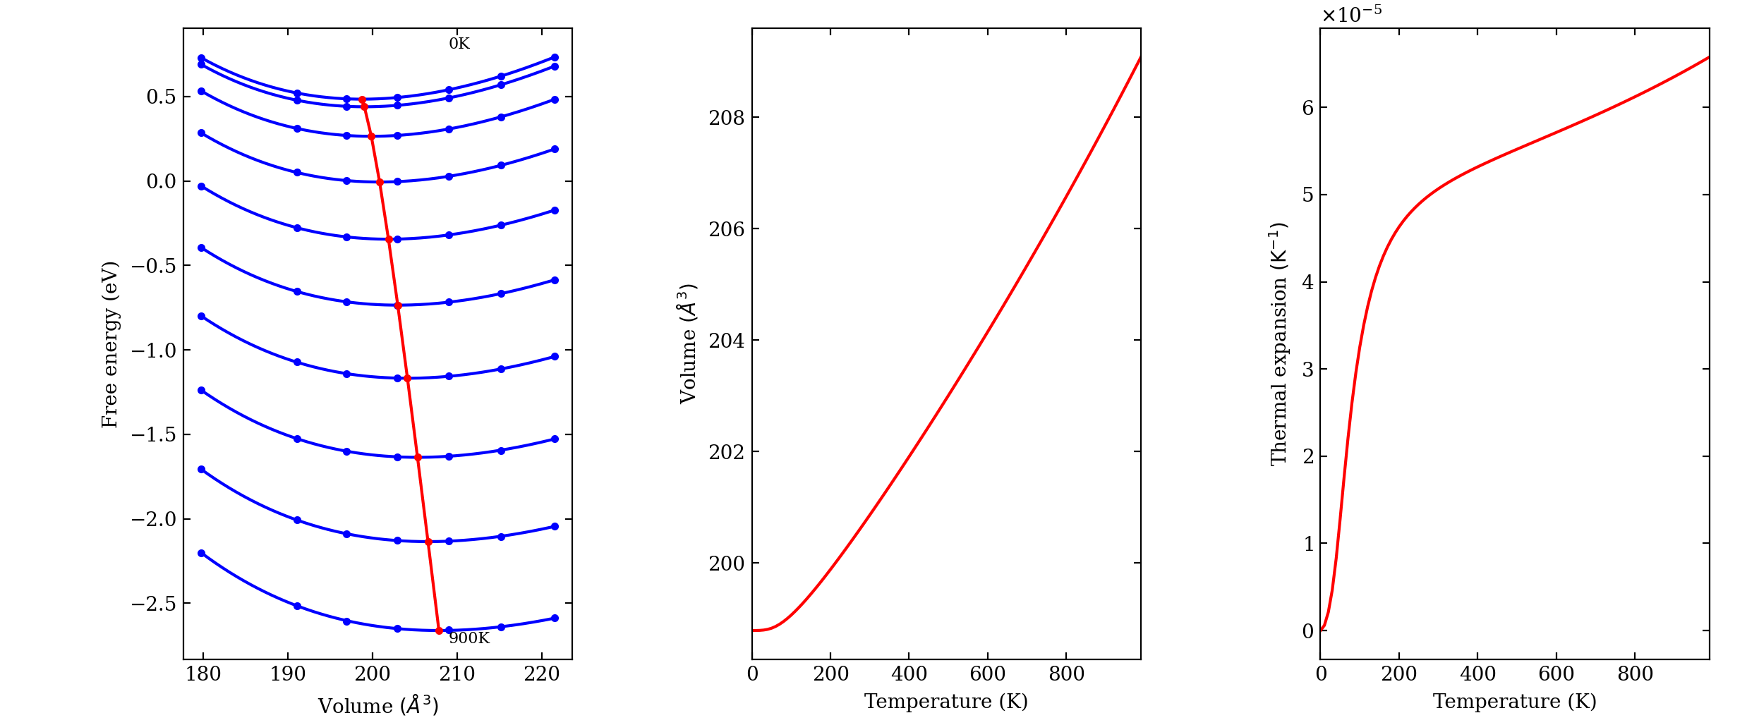
Thermal expansion coefficient
Calculated using the Quasi-harmonic approximation (QHA)

