Slide 1
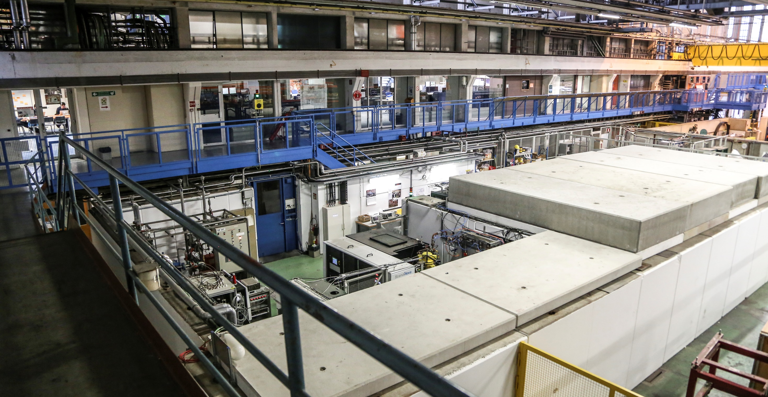
Local power coupling as a predictor of high-gradient breakdown performance
Jan Paszkiewicz, Alexej Grudiev, Walter Wuensch
High Gradient Workshop 2021
21 April 2021

Slide 2
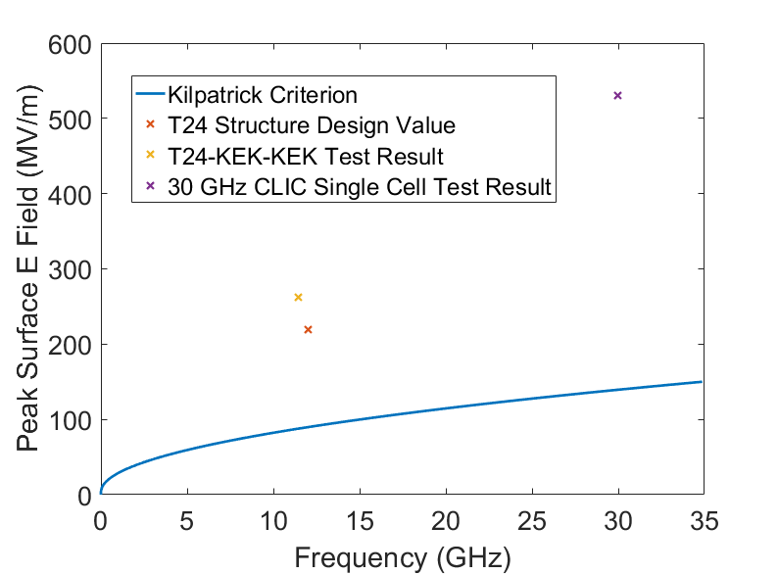
High-Gradient Limits: Electric Field
Kilpatrick’s criterion: ‘classic’ quantity defining maximum surface E field.
Different structure designs can reach different peak accelerating gradients and surface fields.
It appears that breakdown is not just a function of E field. Dependence on H field, group velocity, power flow, and total voltage have all been observed.
Dependence of peak E field with group velocity (C. Adolphsen)

Slide 3
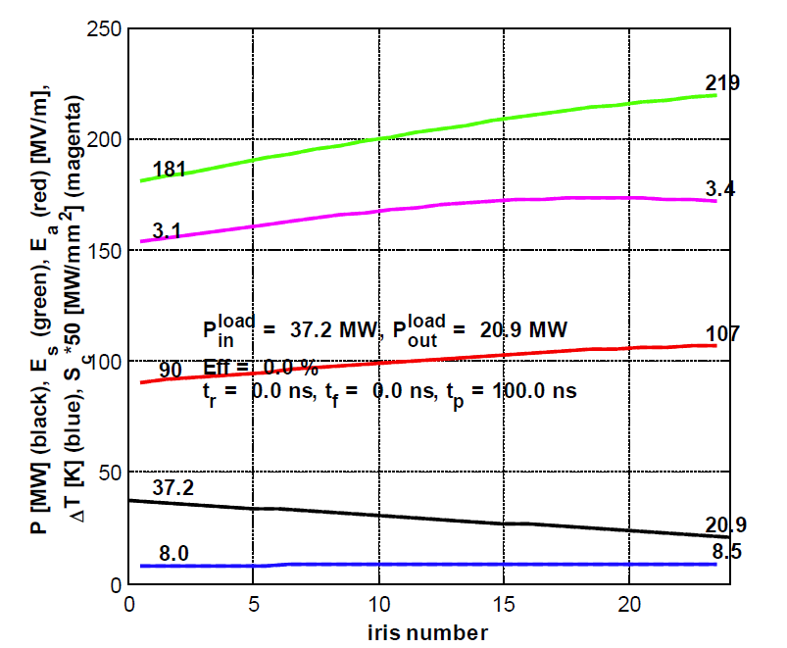
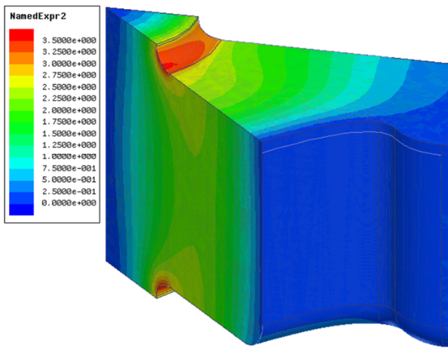
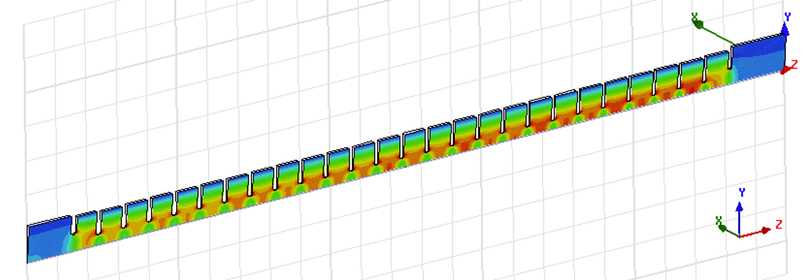
High-Gradient Limits: Power Flow
Experimental data from CERN, SLAC and KEK suggests ultimate limit depends on power flow, not E field.
Global power flow: input RF power divided by aperture circumference
Local power flow: modified Poynting vector, S_{c} – used to optimise geometries
Example of surface S_{c} calculation in 1/8th of a damped cell:
Example of structure tapering profile:
$$S_{c}=Re\left\{E×H^{∗}\right\}+\frac{1}{6}Im\left\{E×H^{∗}\right\}$$
Irises get smaller, E field gets bigger
Structure design and simulations: A. Grudiev

Slide 4
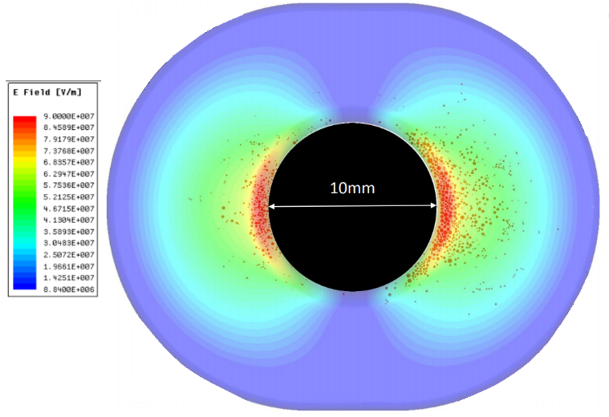
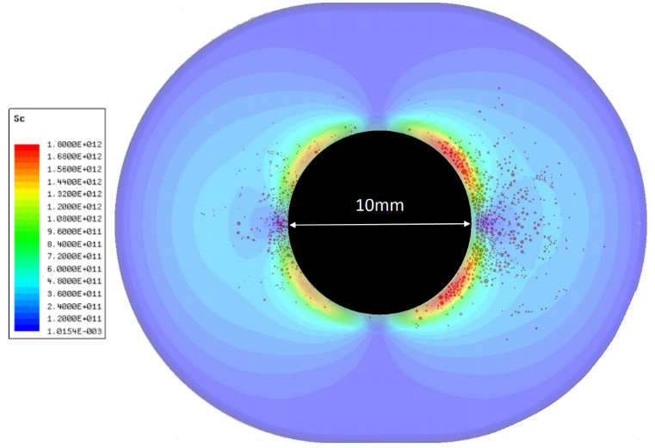
Limitations of S_{c}
Breakdown locations:
Many structures tend to have most breakdowns close to the input despite tapering.
Post-mortem results of CLIC Crab Cavity, BTW Structure do not match S_{c} prediction.
Compatibility with DC experiments:
No (real or imaginary) power flow at f = 0.
S_{c} uses unperturbed RF fields – what if we consider how local fields change during a breakdown?
Breakdown locations vs. E field
Breakdown locations vs. Sc
Structure post-mortem: E. R. Castro

Slide 5
Evolution of a Breakdown
PIC simulations and experiments show that:
Breakdown is a runaway process involving heating of an emission site and plasma formation.
Takes a short but finite time to develop.
A large number of charge particles is produced in the process – accelerating these particles requires a large influx of power.
If power flow is insufficient, the field will decrease.
Note that breakdowns are typically very small: ~10s of nm initially and ~50 um craters
H. Timko et. al., Contrib. Plasma. Phys. 4, 229 (2015).
Animation by K. Sjobaek

Slide 6
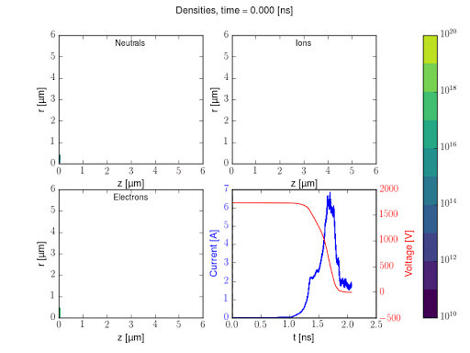
Evolution of a Breakdown
Experiments and PIC simulations show that:
Breakdown is a runaway process involving heating of an emission site and plasma formation.
Takes a short but finite time to develop.
A large number of charge particles is produced in the process – accelerating these particles requires a large influx of power.
If power flow is insufficient, the field will decrease.
Note that breakdowns are typically very small: ~10s of nm initially and ~50 um craters
H. Timko et. al., Contrib. Plasma. Phys. 4, 229 (2015).
Animation by K. Sjobaek

Slide 7
Stages of breakdown
Peak power demand during breakdown onset!
voltage
current
power
time
Field emission,
no plasma, tiny currents
Fully formed plasma
Voltage collapse
Onset of breakdown and plasma formation

Slide 8
Hypothesis
Ultimate BD limit is a function of available power, like with S_{c}.
But: consider power during BD onset, not before!
Nascent breakdown extracts power from RF by acceleration of charged particles (electrons). Interaction through E field only.
Emitted current is a function of surface E field.
Local surface E field decreases under BD loading. (In this case, we approximate the effect of complex plasma dynamics by a simple antenna on the surface.)
Higher sustained E field under loading = higher BDR.

Slide 9
Outline of Procedure
Assume that any breakdown site will emit current as this function of surface field:
(material property, to be fitted)
For every point in the structure, calculate a dependence of local field on antenna current:
Unperturbed field at I = 0, as determined by usual RF simulations.
Burning plasma
During BD onset.
We care about this one!
breakdown current I
E
Field emission
I
surface field, E
Slope R_{bd} depends on available power.

Slide 10
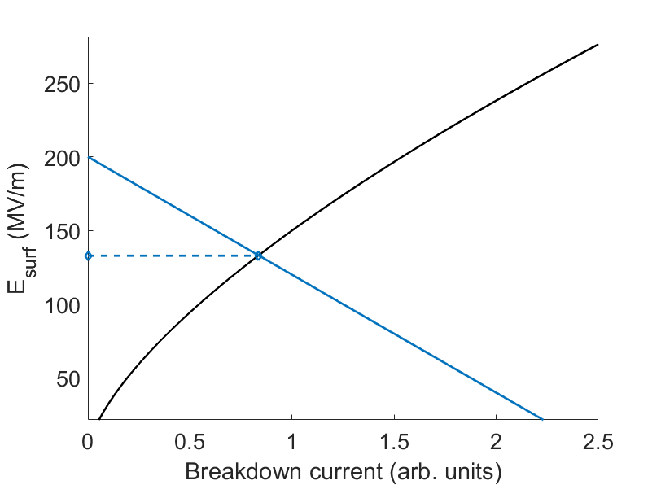
Outline of Procedure
Combine the two plots to find a quasi-equilibrium solution:
Original, unperturbed field
Field when loaded by a breakdown.
This is our new quantity.

Slide 11
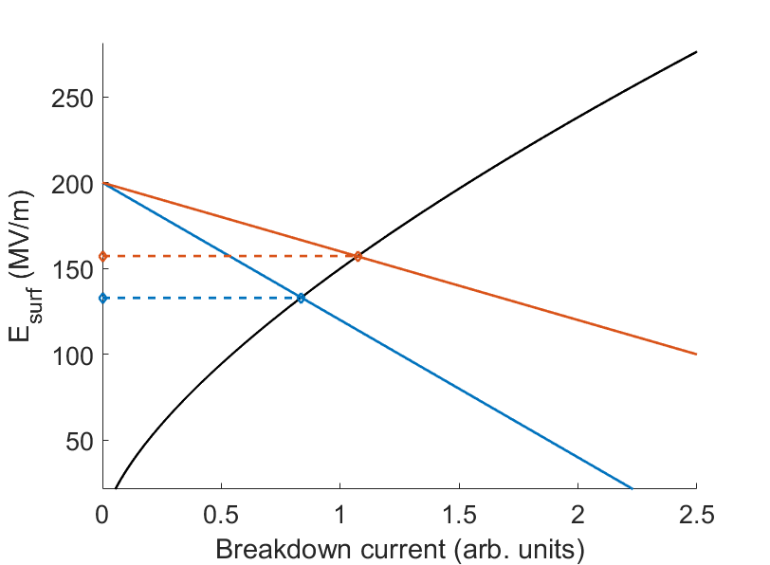
Dependence on properties
Compare with a different case:
Same unloaded field
Lower R_{bd} = more power coupling (eg. Larger aperture, better impedance match, etc.)
Higher loaded field than before: higher breakdown rate

Slide 12
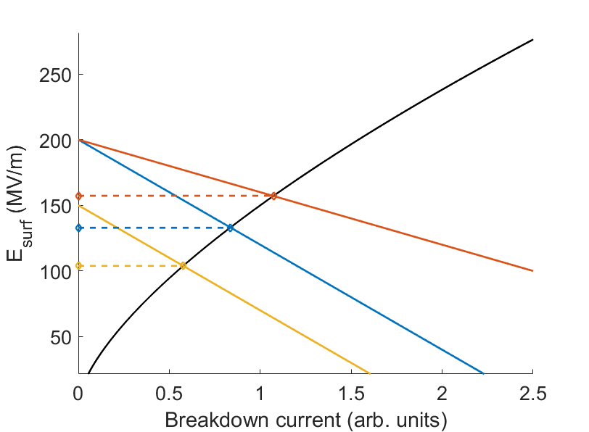
Dependence on properties
Compare with a different case:
Lower unloaded field
Same R_{bd}
Lower unloaded field
= lower loaded field
= lower breakdown rate
Implications: No BD without E field, but power flow plays an important role.
The calculation is repeated for every point in the structure.

Slide 13
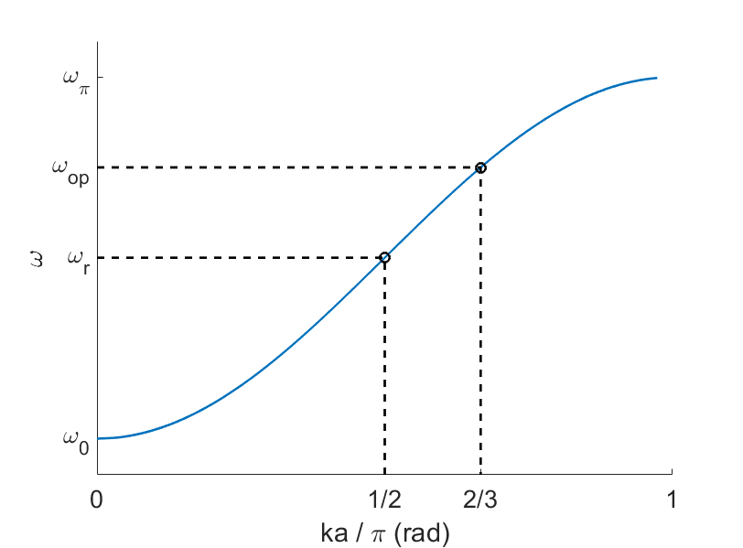
Circuit Model of an Accelerating Structure
Infinite 1D array of coupled resonant cells.
Use an eigenmode solver to get values for circuit parameters: Q & dispersion curve give enough information to solve for L, C, R and M.
Solve to get characteristic impedance Z₀, which relates power flow to cell voltage.
Dispersion curve derived from model:
$$Re\left\{Z_{0}\right\}=\frac{R}{Q}\frac{4ωω_{r}}{ω_{π}^{2}−ω_{0}^{2}}{\left(1−2\frac{ω_{r}^{2}−ω^{2}}{ω_{π}^{2}−ω_{0}^{2}}\right)}^{\frac{1}{2}}$$

Slide 14
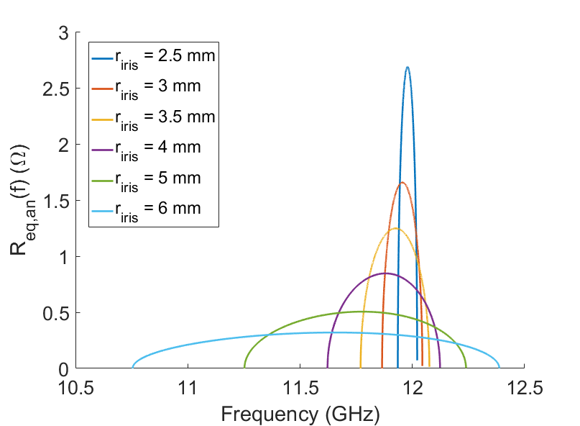
Circuit Model of an Accelerating Structure
Insert a port to represent the breakdown.
Modelled as a small antenna connected to a load.
Coupling (transformer ratio) varies with location and related to surface field at that point.
Strong dependence on group velocity and bandwidth.
Breakdown resistance vs frequency and aperture size:
Local E-field at breakdown site
$$R_{bd}=\frac{R}{Q}\frac{2ωω_{r}}{ω_{π}^{2}−ω_{0}^{2}}{\left(1−2\frac{ω_{r}^{2}−ω^{2}}{ω_{π}^{2}−ω_{0}^{2}}\right)}^{\frac{1}{2}}{\left(\frac{l_{ant}}{a}\right)}^{2}{\left(\frac{E_{0}}{E_{acc}}\right)}^{2}$$
$$∝\frac{1}{v_{g}}$$

Slide 15
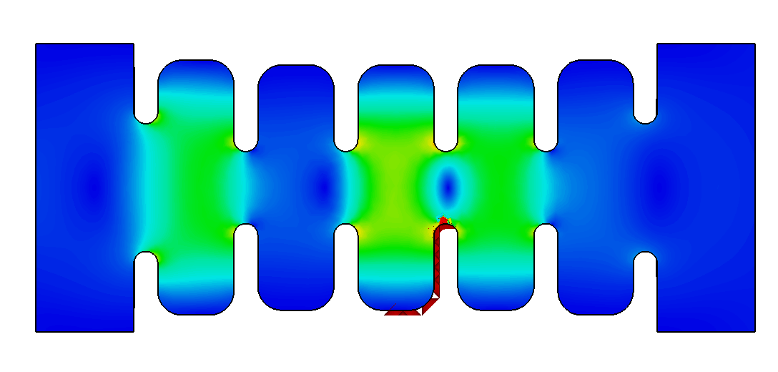
Numerical Calculation of R_{bd}
Method 1: Run a separate simulation where the antenna is the power source. Note the perturbation in E field for a given antenna current I: $R_{bd}=Re\left\{\frac{V_{antenna}}{I_{antenna}}\right\}$
Power from waveguide port (i.e. normal operation for acceleration):
Power from antenna (not physical, used for calculating R_{bd}):
Input port
Output port
Input port
Output port
Antenna
Method 2: Calculate Z-parameter matrix including the antenna as a port: $R_{bd}=Re\left\{Z_{22}−\frac{Z_{21}Z_{12}}{Z_{0}+Z_{11}}\right\}$
Better in principle but more sensitive to mesh quality.

Slide 16
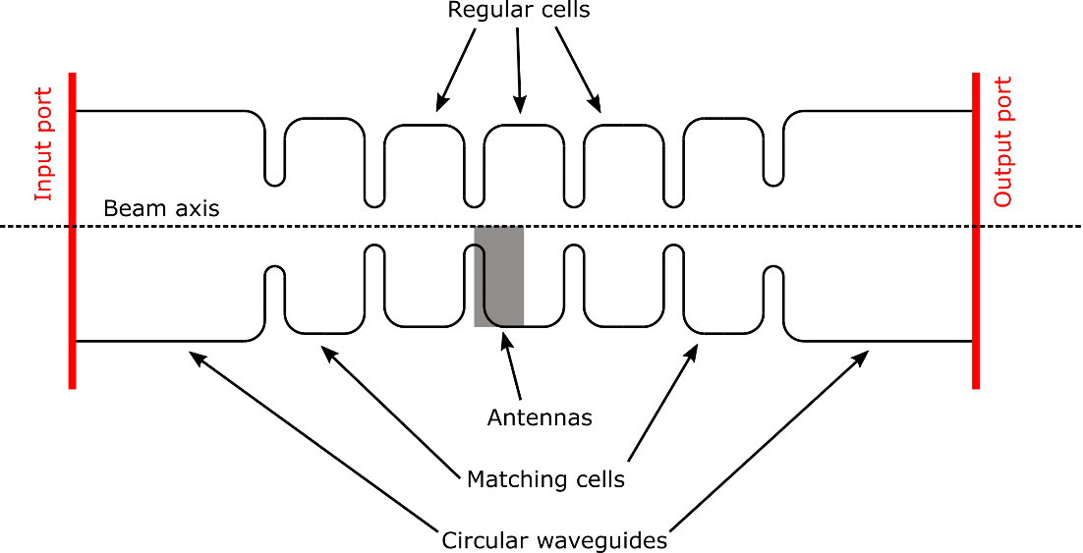
Study with Simple TM₀₁₀ Structures
Simulated a series of accelerating
cells with the following properties:
120° phase advance
2 mm iris thickness
2 mm corner rounding
8.33 mm periodicity (for β = 1)
Iris radius scanned from 2.5 mm to 6 mm
Tuned to 12 GHz by varying cell diameter
Structures of 3 regular cells + 2 matching cells fed with TM01 via circular waveguide.
Important to know details of power coupling & matching for this calculation!
E
H
S_{c}
Eigenmode field distributions

Slide 17
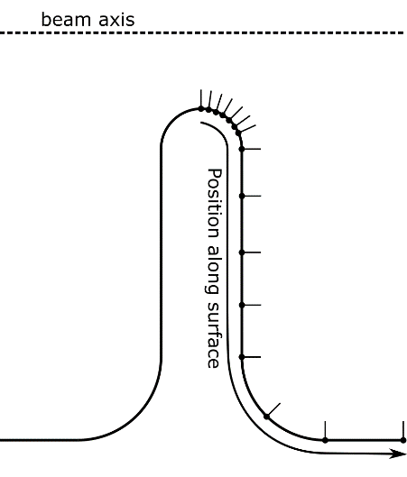
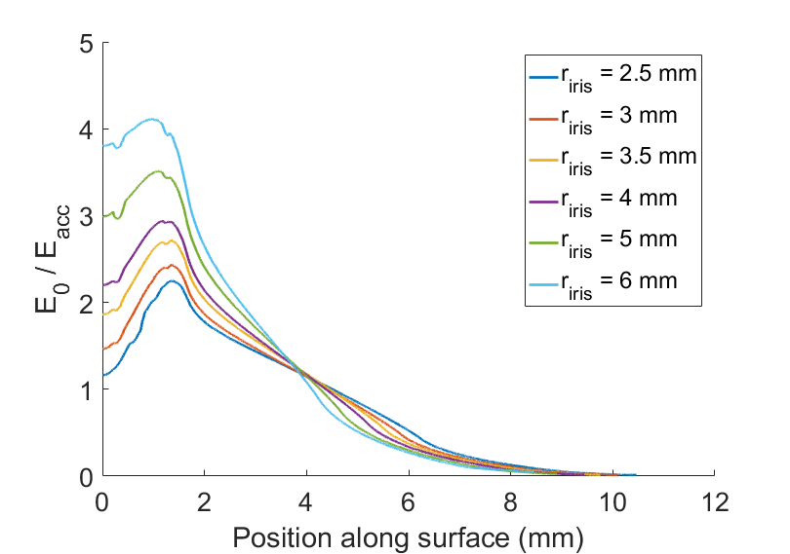
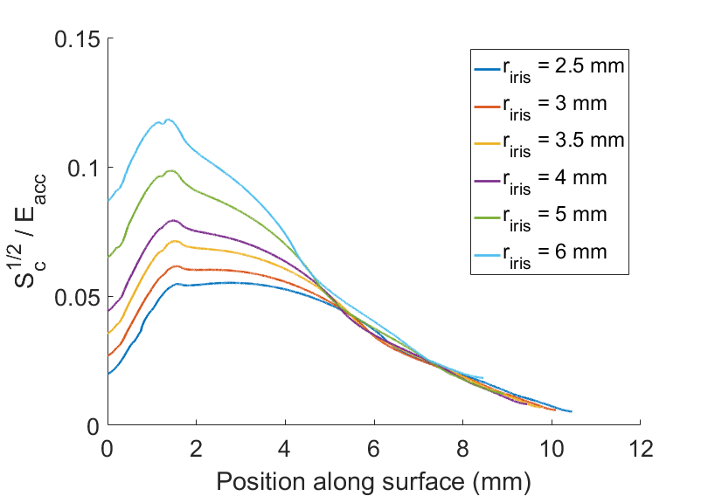
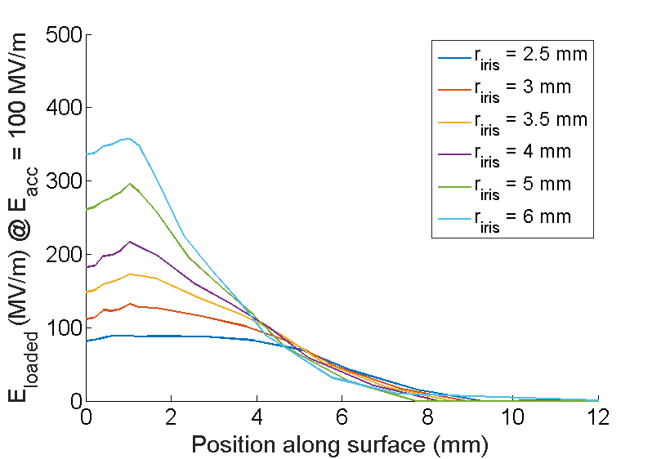
TM₀₁₀ Structures – Breakdown Locations
0 position is apex
Antennas placed along surface of centre cell:
Antennas representing possible breakdown sites.
Unloaded E-field distribution:
Sc distribution:
BD-loaded E-field distribution:
Structure post-mortem: A. P. Fontenla

Slide 18
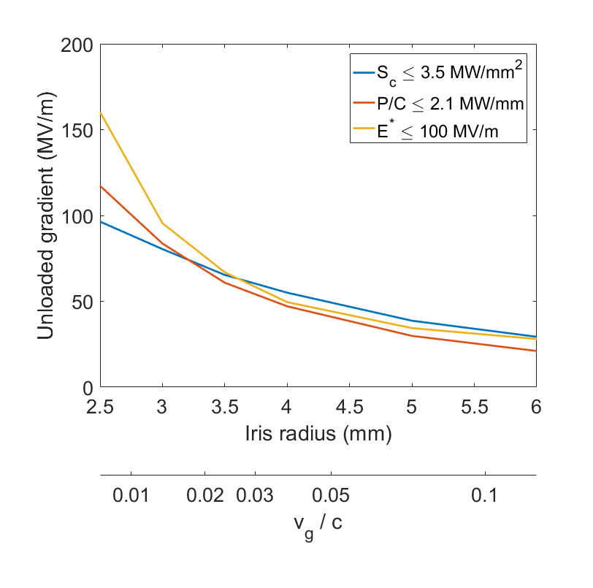
TM₀₁₀ Structures – Maximum Gradient
Calculated maximum gradient for each aperture size using different limiting quantities.
Agreement for high v_{g}, differences with regards to how low - v_{g} and standing-wave structures are treated.
P/C implies infinite gradient for v_{g} = 0.
Loaded field model (E*) implies high but finite gradient (since some power flow still exists)
P/C and S_{c} give satisfactory results for typical CLIC structures.
Good agreement for high v_{g}

Slide 19
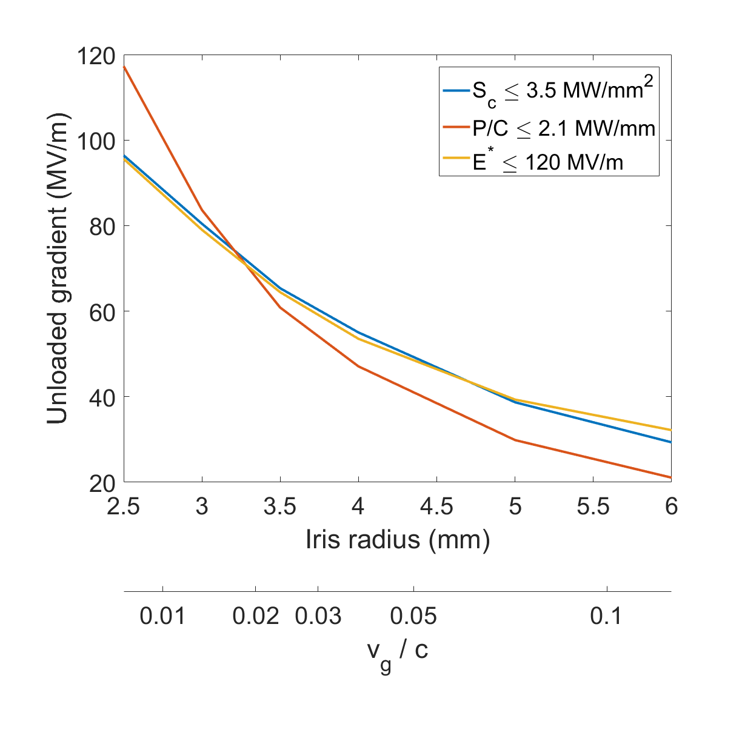
TM₀₁₀ Structures – Transient Correction
Single-frequency model implies steady state, after all stored energy discharged.
S-parameters over frequency contain information about stored energy.
Bandwidth related to transient phenomena, i.e., contribution stored energy.
Replace $R_{bd}$ with $L=\sqrt{\int_{0}^{∞}{{R_{bd}}^{2}df}}$, and rescale the emission function.
This formula assumes a short pulse of emitted current and the resulting resistive heating of the emission site.

Slide 20
Stored Energy vs. Power Flow
Large aperture, high group velocity
Small aperture, low group velocity
Less stored energy
Data points represent different locations in each structure.
More stored energy
More power flow
Less power flow

Slide 21
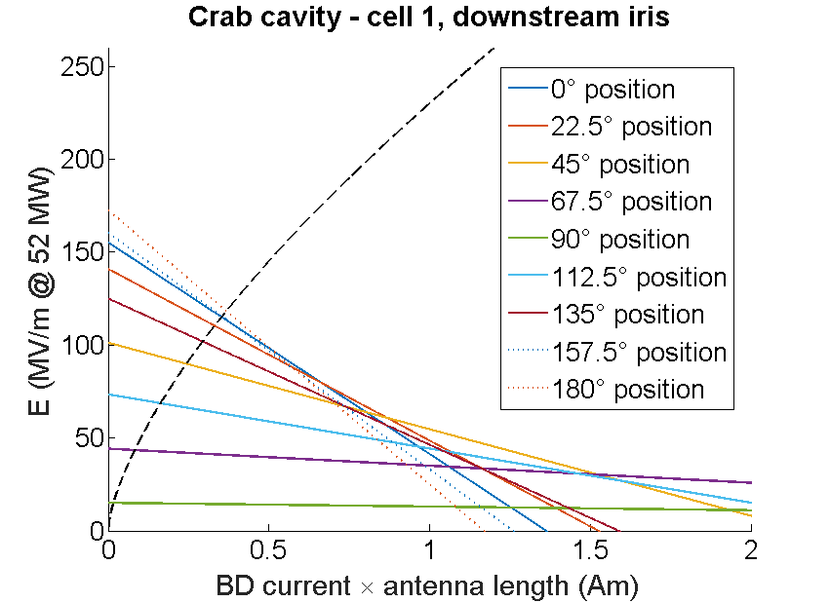
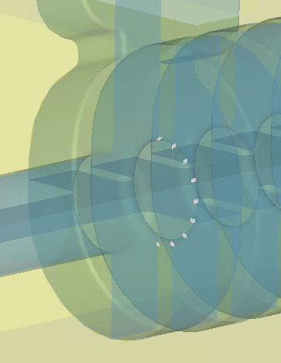
Application: X-Band Deflecting Structure
Antennas angled to capture peak E-field region:
0° position
90° position
180° position
Antennas placed in rings around each iris.

Slide 22
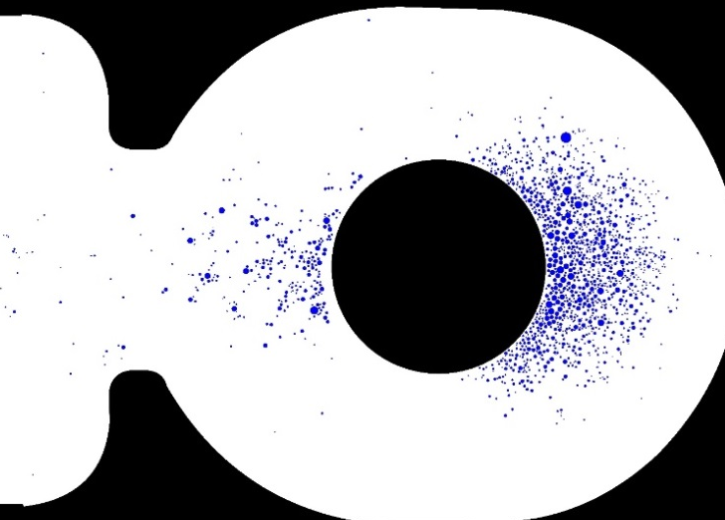
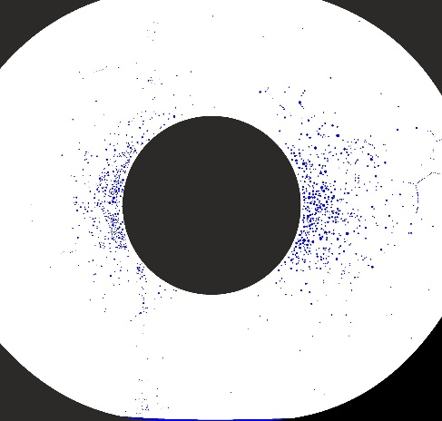
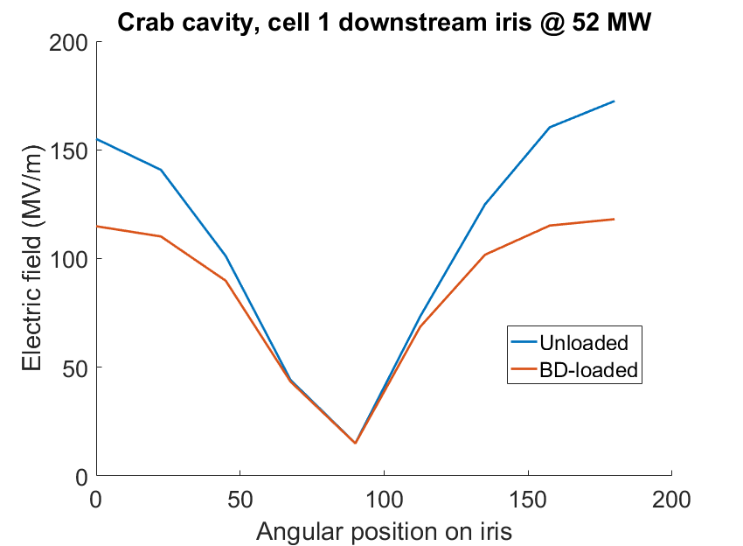
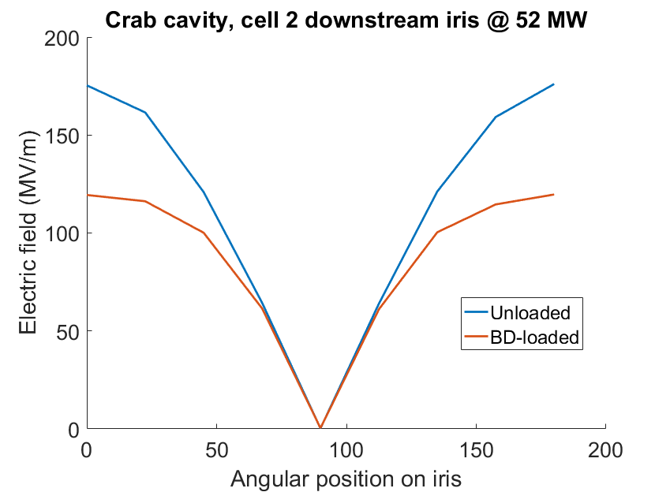
Application: X-Band Deflecting Structure
Cell 1
Cell 2
0° 180 °
0° 180 °
Breakdown locations vs. Sc:
Peak value of 118 MV/m
Structure post-mortem: E. R. Castro

Slide 23
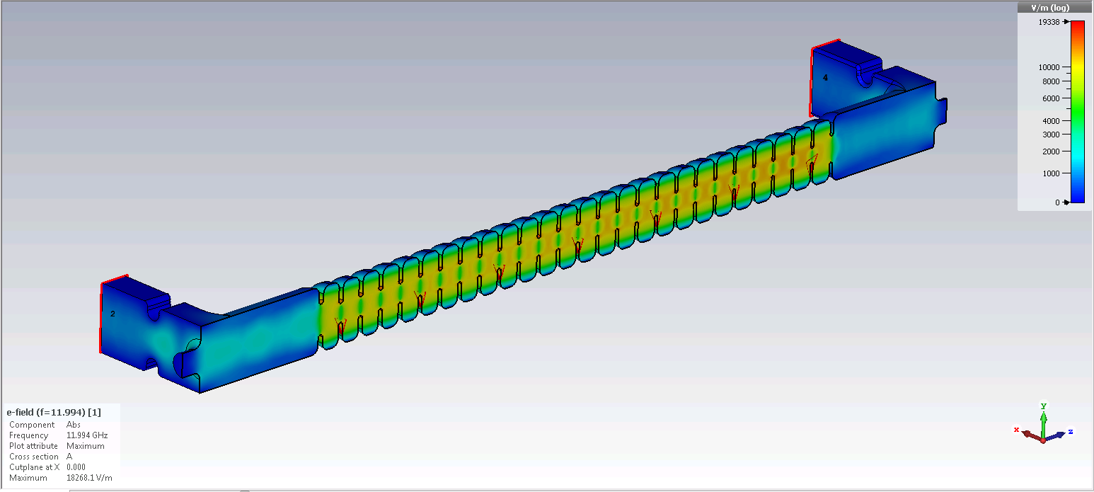
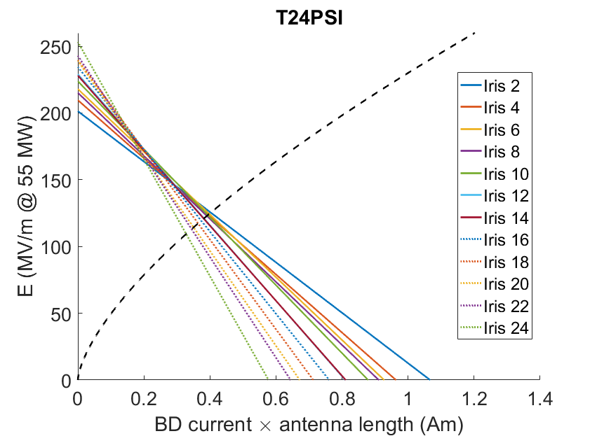
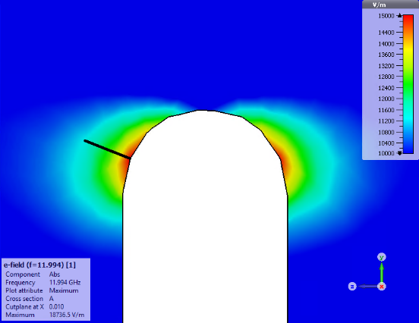
Application: T24 Accelerating Structures
T24 PSI structure, E-field complex magnitude
Loading plot for peak E-field region of each cell:
RF Output
RF Input
Iris #26
Iris #2
Antennas placed near peak E-field region of each iris.

Slide 24
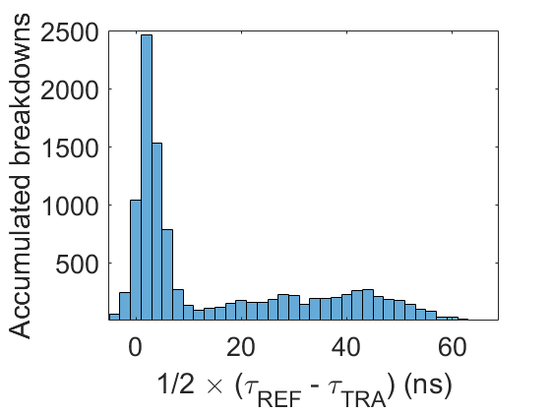
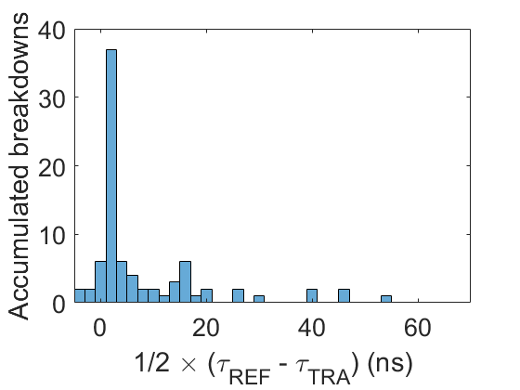
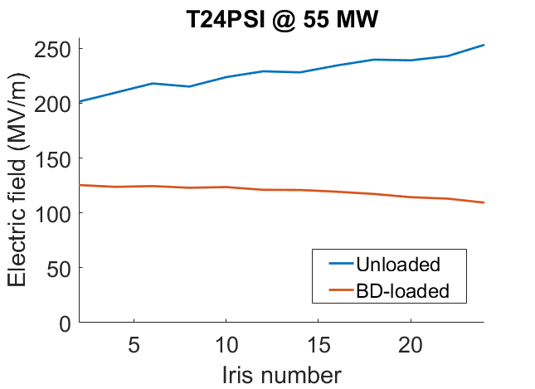
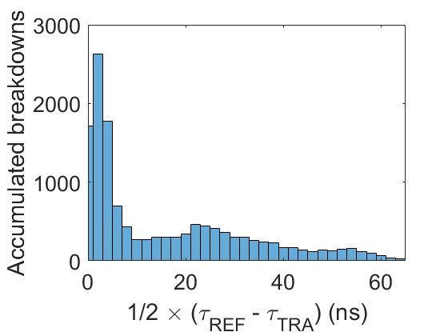
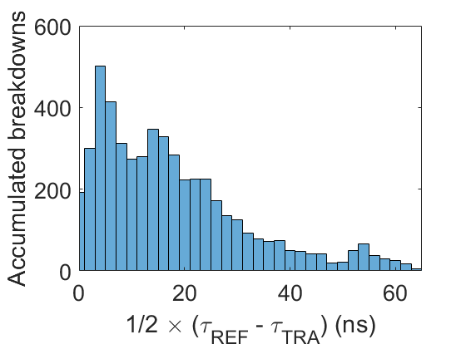
Application: T24 Accelerating Structures
Breakdown locations in T24 structures:
T24 PSI 1
full history
T24 PSI 2
112 MV/m, 200 ns flat run
Input
Output
T24N4
until 1/6/2019
T24N5
until 1/6/2019
Peak value of 125 MV/m

Slide 25
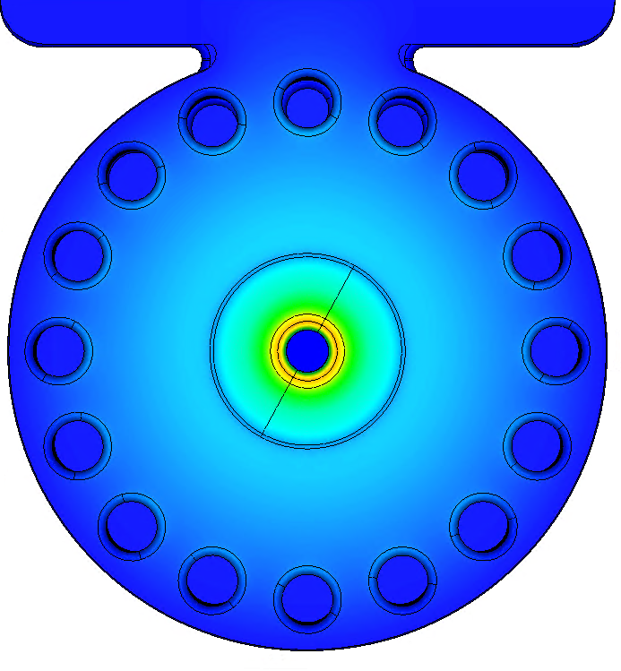
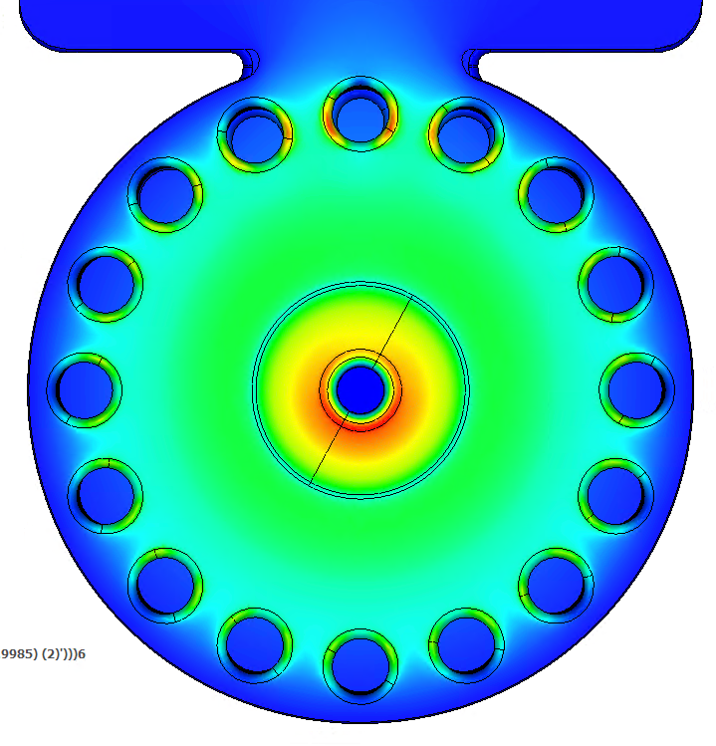
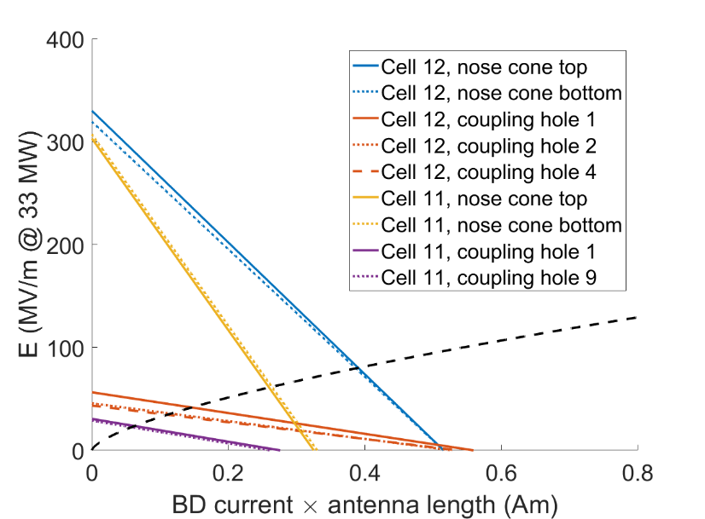
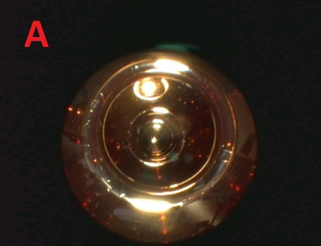
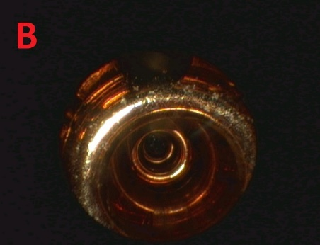
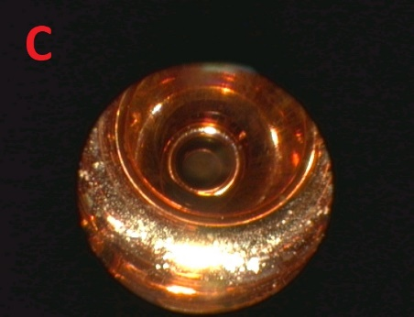
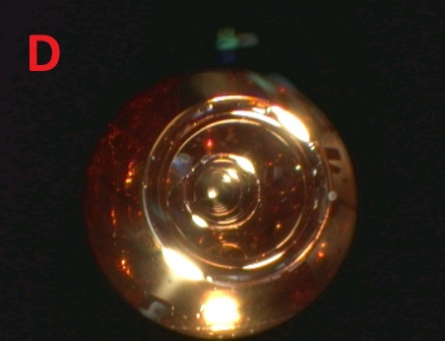
Application: BTW Proton Linac Structure
Backward-travelling-wave structure with coupling holes between cells.
Large Sc on both iris and coupling holes
Region A has very few breakdown craters even though it has a larger Sc than region B.
Breakdown locations more closely correlated to E-field distribution, consistent with E* prediction.
E-field in output cell
S_{c} in output cell @ 1W
A
63 kW/m^2
B
54 kW/m^2
C
66 kW/m^2
D
42 kW/m^2
Endoscopy photos from K. Szypula’s talk

Slide 26
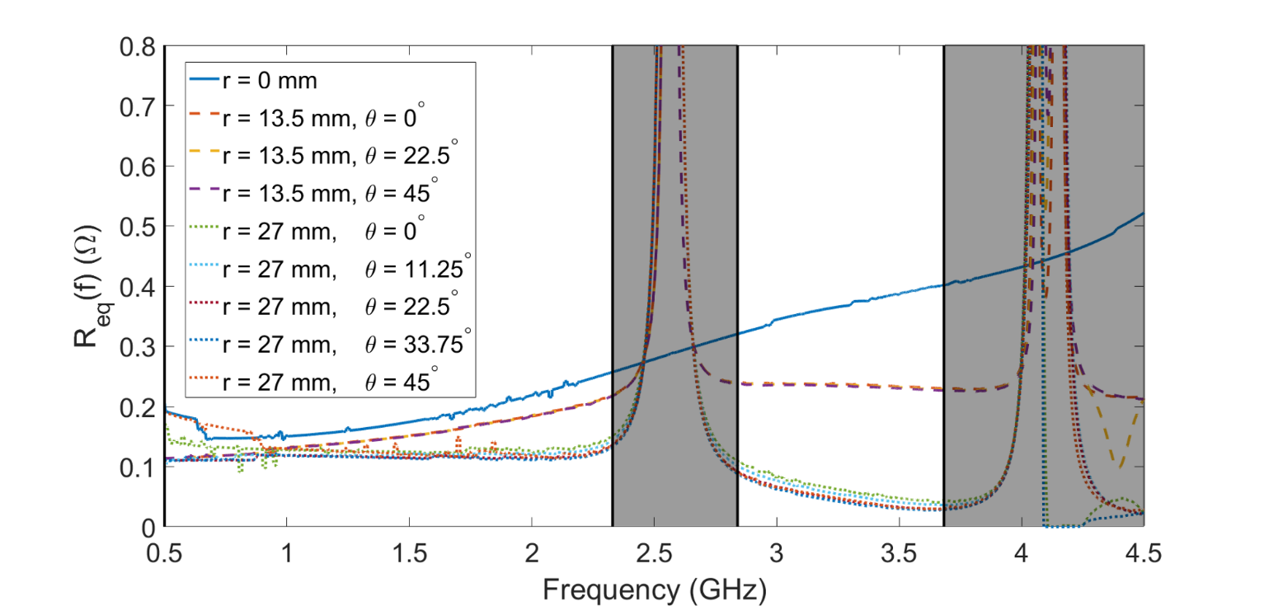
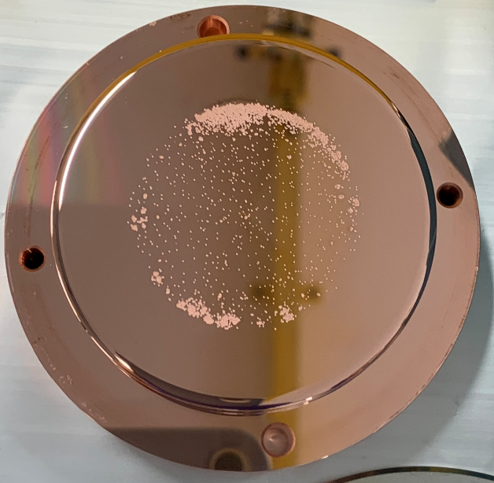
Application: DC Experiments
Electrodes tested at the DC LES at CERN regularly show breakdowns concentrated at the edge despite efforts to minimize field enhancement. (e.g. large cathode + small anode)
R_{bd} simulation shows clear distinction in power coupling between locations near the edge and at the electrode centre.
centre
intermediate
edge
Electrode photo: I. Profatilova

Slide 27
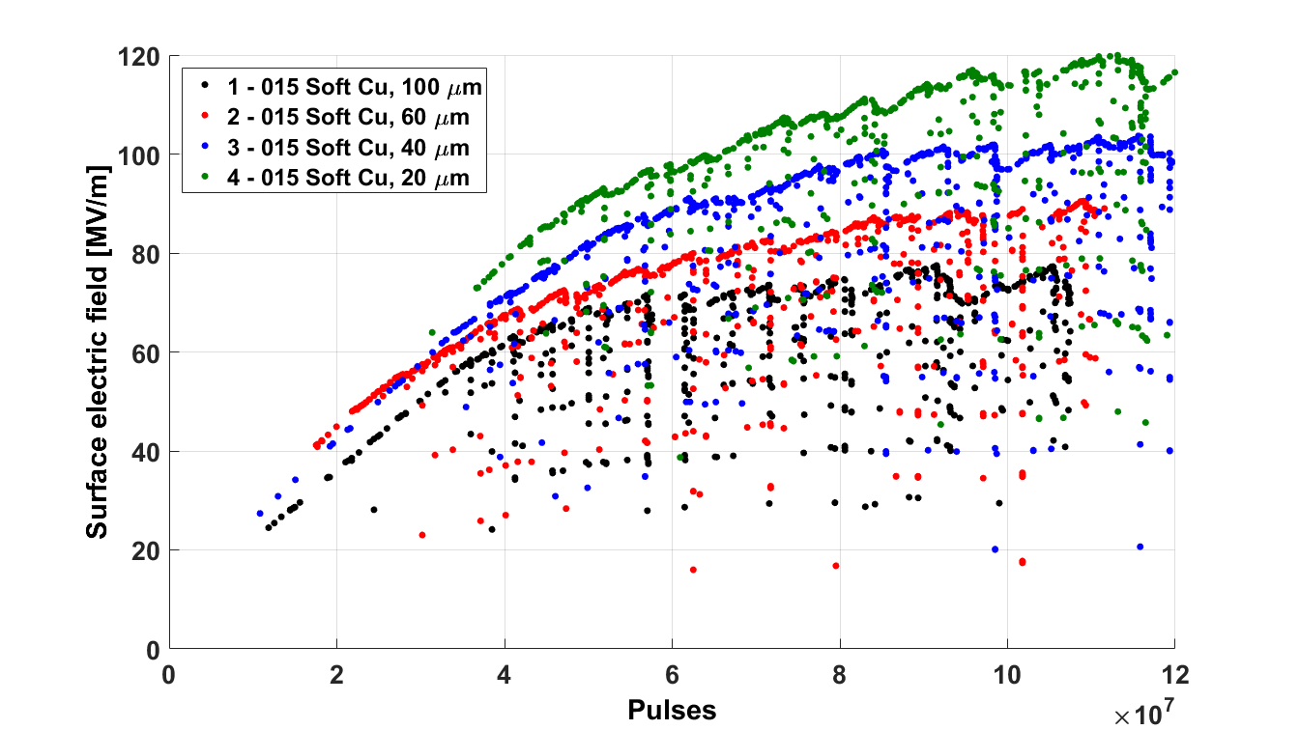
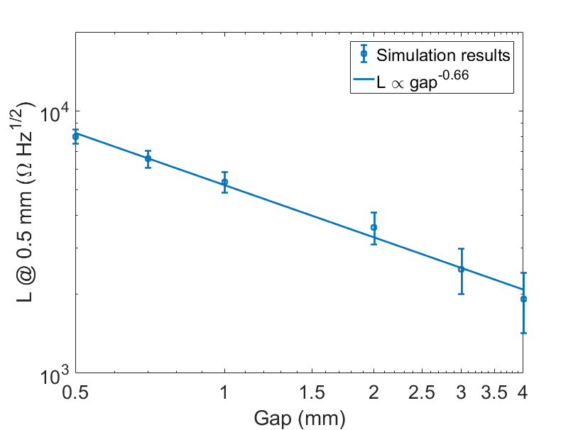
Application: DC Experiments
Some experiments show that maximum achievable E field depends on total voltage, i.e. smaller gaps can reach higher fields.
Corroborated by simulations which show L decreasing with gap size.
Intuitively: easier to couple power into a larger gap.
Conditioning curves for various gap sizes.
CERN DC system results: I. Profatilova

Slide 28
Summary
BD-loaded E field appears to be a good predictor of BD performance.
Makes distinction between unperturbed fields and fields under breakdown.
Better agreement with experimental breakdown locations.
Bottom line for high-gradient design:
Consideration of power coupling is crucial.
When optimizing a single cell, limiting peak E field is sufficient.
Structures should be optimized for a specific gradient.

Slide 29
Thank you!

