Slide 1

The EUPRAXIA@SPARC_LAB
X Band Linac
David Alesini
(National Institute of Nuclear Physics, LNF-INFN, Frascati, Italy)
With the contribution, in particular, of:
F. Cardelli, M. Diomede, S. Pioli, A. Liedl, G. Di Raddo, E. Di Pasquale, L. Pellegrino, B. Buonomo, L. Kankadze.

Slide 2
OUTLINE
EuPRAXIA@SPARC_LAB project: short introduction
Overview of the LINAC
The injector: present baseline configuration (S band) and possible upgrades
The X band LINAC:
        Basic rf module layout
        Accelerating structures design, parameters, prototyping activity
        Power distribution, pulse compressor and power stations
        Dark current studies
        Vacuum calculations
The X band test Facility @ LNF: TEX
Conclusion

Slide 3

EuPRAXIA@SPARC_LAB project: short introduction
The project EuPRAXIA@SPARC_LAB aims at constructing a FEL radiation source (λ_{FEL}=3 nm) based on RF linear accelerator combined with a plasma module;
The CDR of the overall machine has been already published few years ago and now the effort is directed towards the preparation of the TDR (expected for 2024);
The project is one of the pillar of the European Project EUPRAXIA (coord. R. Assmann, http://www.eupraxia-project.eu/) now waiting for the outcome of the ESFRI application. In any case EuPRAXIA@SPARC_LAB will be funded by INFN (independently from the EUPRAXIA-Eu developments).
A new building, now under executive design phase will host the new Facility at LNF
TDR

Slide 4
Overview of the LINAC
The RF baseline of the linac is the X-band technology (with an S band injector), and it will be used to produce high brightness electron beams up to an energy of 1 GeV;
The beam will be either injected in the FEL undulators, or used to drive a plasma cell to boost the energy further before injection in the undulators;
We will need 5-6 X band 50 MW klystron to run this facility.
undulators
X band power stations
Plasma module
S band power stations
X band modules
chicane
S band 3 m TW structures
S band RF gun and injector
E. Di Pasquale, G. Di Raddo, V. Lollo, L. Pellegrino, A. Ghigo

Slide 5
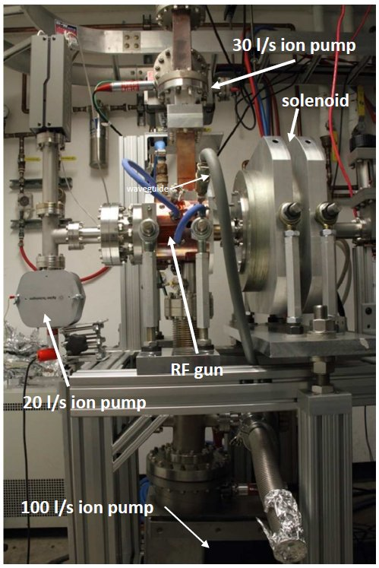
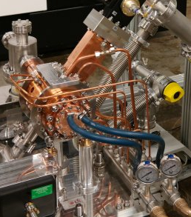
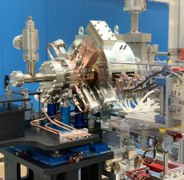
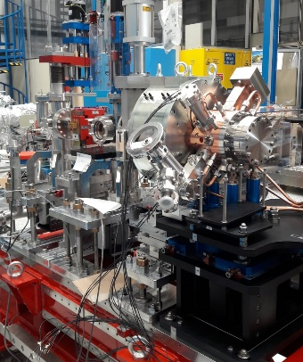
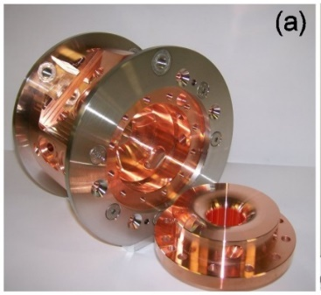
The injector: present BASELINE CONFIGURATION
Parameters | VALUE
f_{res}[GHz] | 2.856
Q₀ | 14300
Coupling β | 2
Cathode peack field [MV/m] | 120
Filling time [ns] | 515
E_{cathode}/√(P_{diss}) [MV/m/MW^{0.5}] | 37.5
Sep. 0-π modes [MHz] | 41
H_{surf_peak} [kA/m] | 377
Pulsed heating) [°C] | <35
Repetition rate [Hz] | 100
Average dissipated power [W] | 800
RF pulse length | 1
RF input power [MW] | 16
V. Lollo, G. Di Raddo, A. Battisti
SPARC (ver.1)
ELI-NP
CLEAR (CERN)
NEW SPARC_LAB
The injector is based on and S band gun followed by 2 TW 3 m long structures.
The technology for the S band gun is the brazeless one, developed @ LNF in the last 10 years and that as been used to fabricate different RF guns and injectors
D. Alesini et al., Phys. Rev. ST Accel. Beams 18, 092001 (2015)
D. Alesini et al., PHYS. REV. ACCEL. BEAMS 21, 112001 (2018)
Built and shipped @ CERN (CLEAR)
To be installed @ SPARC_LAB on May 21

Slide 6
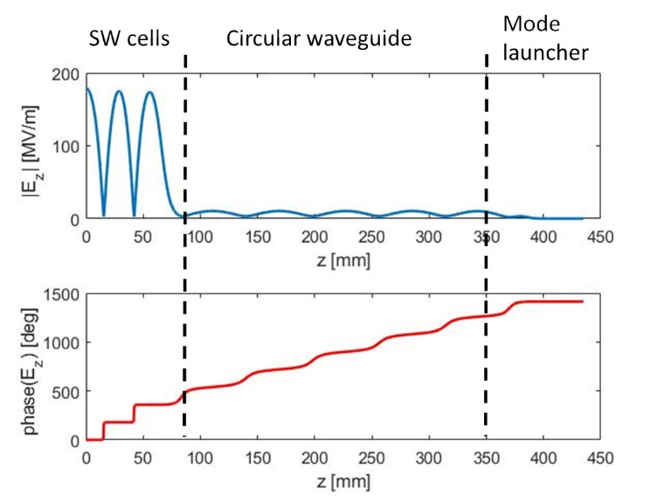
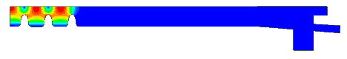
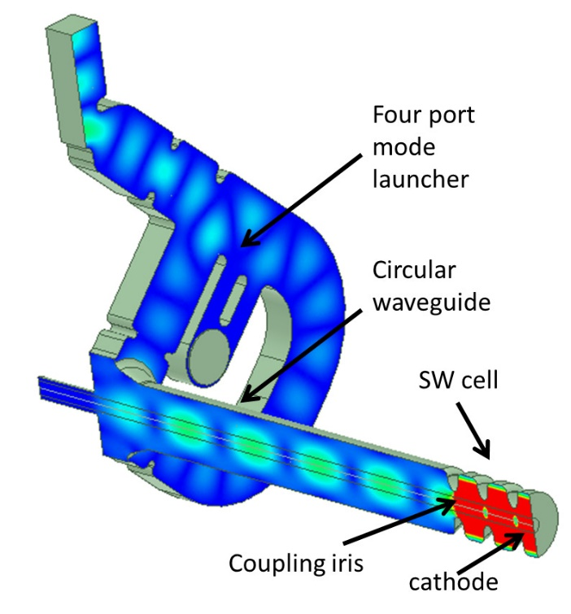
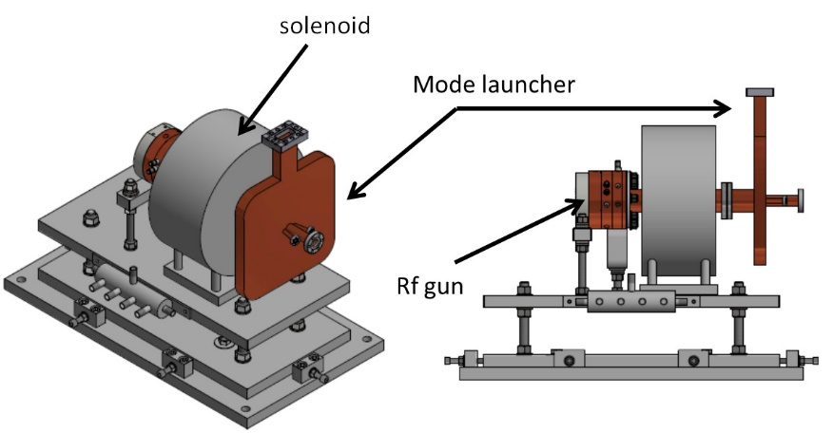
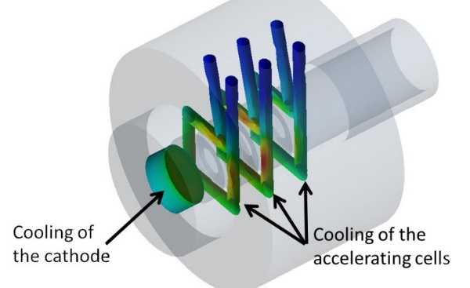
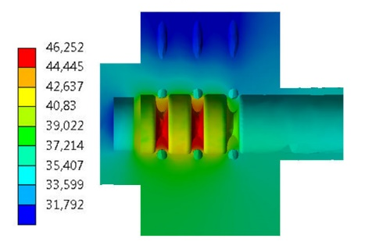
The injector: POSSIBLE UPGRADE WITH A C BAND SYSTEM
Parameter | value
Working frequency [GHz] | 5.712
E_{cath}/√P_{diss} [MV/(m⋅MW^{0.5})] | 52
RF input power [MW] | 18 | 23
Cathode peak field [MV/m] | 160 | 180
Cathode type | copper
Rep. rate [Hz] | 1000 | 100
Quality factor | 11800
Filling time [ns] | 164
Coupling coefficient | 3
RF pulse length [ns] | 300
E_{surf}/E_{cath} | 0.9
Mod. Poynting vector [W/μm²] | 2.5 | 3.1
Pulsed heating [ºC] | <20
Average diss. Power [W] | 2300 | 300
An R&D activity has been started few years ago on C band guns and full C band injectors (gun + TW C band structures);
Such as system is very promising in term of achievable beam parameters, compactness and possibility to go at very high repetition rates (up to 1 kHz)
This R&D program has been funded by the I.FAST (Horizon 2020) and TUAREG (INFN commission V) programs and is oriented to fabricate ad test a first prototype of a C band gun within four years (SW (INFN) and TW (PSI)).
This system has also been selected as the basic injector in the context of the Compact Light EU project XLS and could be studied as a future upgrade of EuPRAXIA injector.
L. Ficcadenti, G. Pedrocchi, G. Castorina, L. Pellegrino, A. Gizzi

Slide 7
The X band LINAC: rf module layout
Klystron and modulator
Baseline Layout: one klystron, one PS (BOC-type), 4 TW structures (0.9 m, 60 MV/m, 100 Hz)
Waveguide components (DC, T pumping, hybrids,…) CERN design but there are some components for which we have to fix the design (circular-rectangular waveguide mode converter, pumping unit on circular waveguide)
Pulse compressor: BOC (PSI) or INFN Design
two version of the module: Low and High Energy
flexible and “adjustable” layout
We have investigated both a symmetric and an asymmetric waveguide distribution system
Diagnostic chamber+ vacuum valve
Low attenuation circular waveguide (4,7 m)
hybrid
Circular-rectangular mode converter
X band structures
DC
Stripline integrated into the quadrupole.
BOC (PSI)
DC
Pumps with T pumping units
hybrid
G. Di Raddo, E. Di Pasquale, F. Cardelli, L. Pellegrino

Slide 8
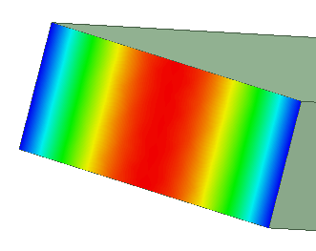
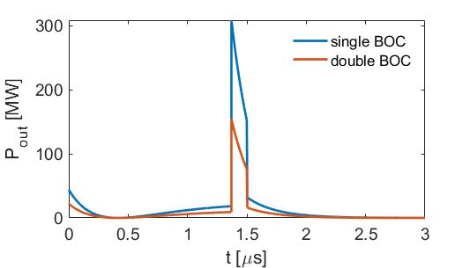
rf module DETAILS AND SINGLE/DOUBLE BOC
The 4.7 m circular waveguide need at least one pumping unit (to be designed)
To reduce the peak power after the PC the possibility to have two pulse compressors is being considered
2.5 m
∼50 MV/m
Klystron hall
1 m
Linac hall
Shielding wall
5 m
2 m
4.7 m
2.5 m
1.2 m

Slide 9
WAVEGUIDE SYSTEM: COMPONENTS AND ATTENUATION
We have considered both a symmetric than an asymmetric waveguide distribution system to optimize the rf pulse arrival wrt the beam
X-band technology requires strong R&D activity in order to evaluate and define the acceptance and quality procedures of the different components. Most of the components we have inserted in the layout have been developed by CERN but we have to perform their test at the EuPRAXIA nominal RF parameters (BOC, pumping units, circular waveguide, rf loads,…).
There are some rf components that still need to be developed or retuned (circular-rectangular mode converter, pumping system for circular waveguide)
Unfortunately the attenuation of the X band WR90 waveguide is strong (∼0.1 dB per meter) and the careful calculation of the total rf losses is important (10-15% power attenuation!).
Low Energy Asymmetric Module
Structure A, B |  | Structure C, D
WR-90 total length [mm] | 3214,82 | WR-90 total length [mm] | 5449,83
WC-50 total length [mm] | 4678,00 | WC-50 total length [mm] | 4678,00
BOC loss [dB] | -0,097 | BOC loss [dB] | -0,097
WR-90 loss [dB] | -0,315 | WR-90 loss [dB] | -0,534
WC-50 loss [dB] | -0,058 | WC-50 loss [dB] | -0,058
total loss [dB] | -0,470 | total loss [dB] | -0,689
total loss [%] | 10,25 | total loss [%] | 14,66
 | Loss dB/m
WR90 | -0,098
WC50 | -0,0124
Courtesy F. Cardelli

Slide 10
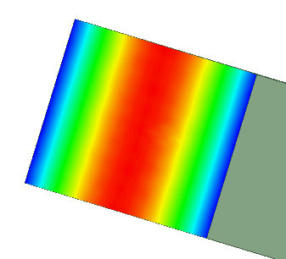
R&D ACTIVITIES ON DOUBLE HIGH WAVEGUIDES
We are strongly interested to the R&D activity proposed at CERN on double high waveguides.
A double high waveguide can reduce losses, peak field and improve the vacuum conductance.
In this framework we can support the development and test of double-high waveguide components including a new possible design of a pulse compressor (BOC)
10.16 mm
20.32 mm
22.86 mm
22.86 mm
Low Energy Asymmetric Module
WAVEGUIDE | Attenuation Structure A, B | Attenuation Structure C, D
WR90 | 10,25 | 14,66
Double high | 8,76 | 11,54
Vacuum conductance
WAVEGUIDE | C * L [cm l/s]
WR90 | ≈57
Double high | ≈166
C. Rossi,
C. Serpico
∼35 MV/m
∼50 MV/m

Slide 11
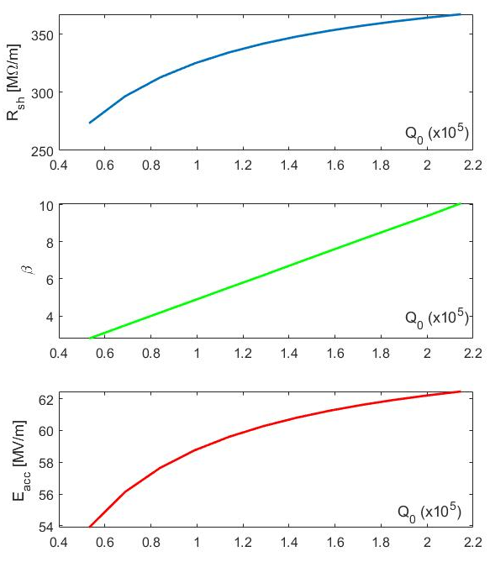
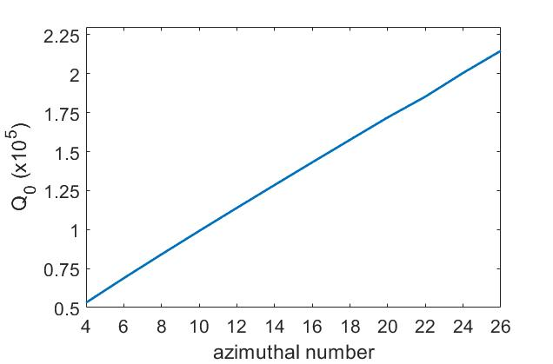
OPTIMIZATION OF THE BOC PULSE COMPRESSOR
We have developed a new design (that implement the INFN-LNF brazing-free technology) for BOC realization that can be easily adapted to implement double high waveguides geometries.
High order modes can be also considered to increase the Q-factor
45MW and 15% power attenuation

Slide 12
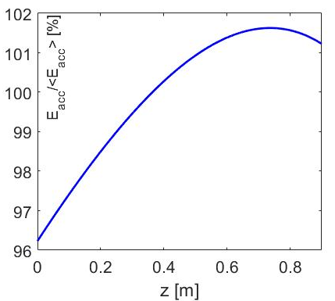
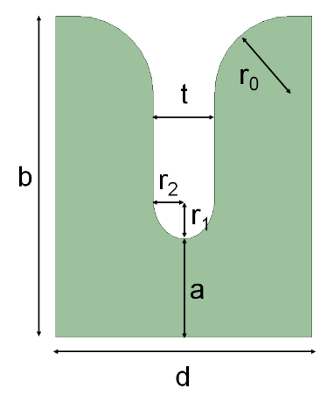
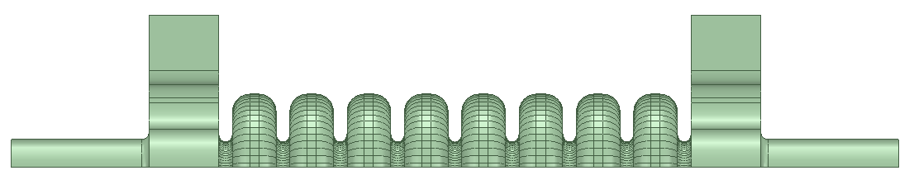
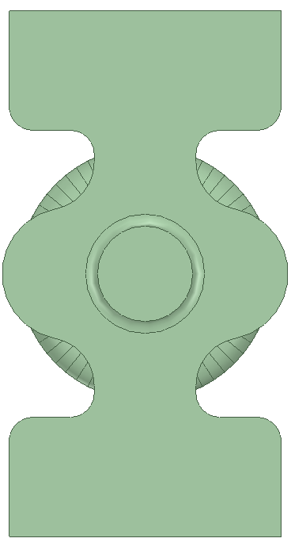
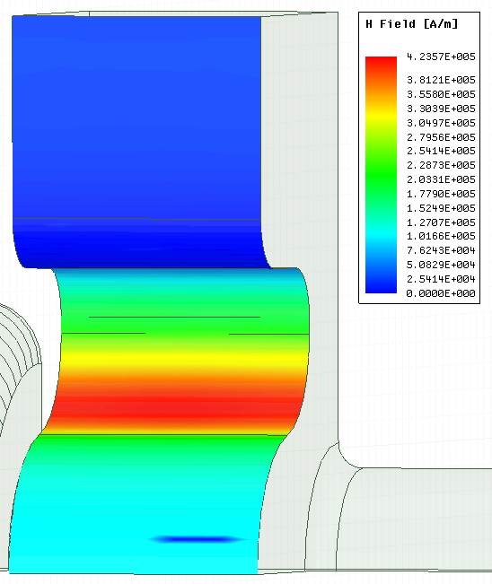
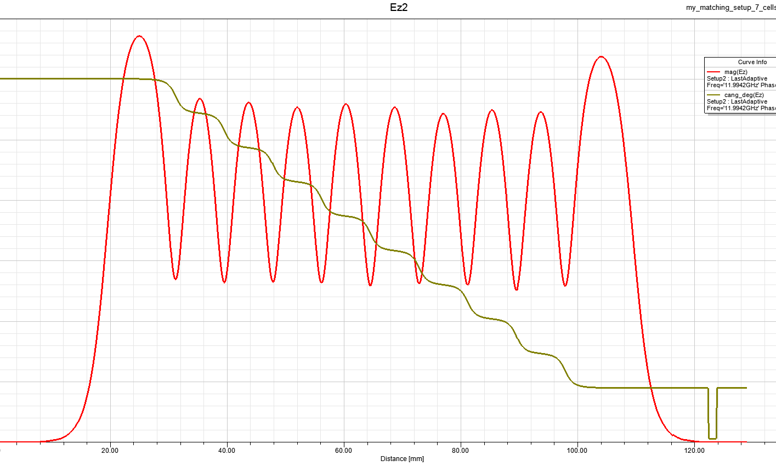
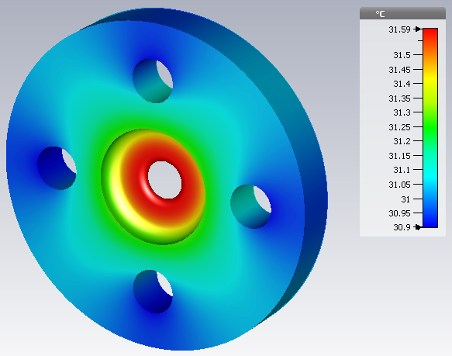
X BAND STRUCTURES: PARAMETERS
e.m. design: linear tapering of the irises, race track coupler to cancel the quadrupole field components (PhD M. Diomede in collaboration with A. Grudiev (CERN) and V. Dolgashev (SLAC));
0.9 m long structures with 3.5 mm average iris radius
Preliminary thermo-mechanical analysis done but to be checked according to the final mechanical drawing (prototyping activity in progress)
Parameter | Value
Frequency [GHz] | 11.9942
Average acc. gradient [MV/m] | 60
Structures per module | 4
Iris radius a (linear tapering) [mm] <a>=3.5 | 3.8-3.2
Tapering angle [deg] | 0.04
Structure length L_{s} [m] | 0.9
No. of cells | 109
Shunt impedance R [MΩ/m] | 94-107
Peak input power per structure [MW] | 65
Input power averaged over the pulse [MW] | 45
Average dissipated power [kW] | 1
Filling time [ns] | 126
Effective shunt Imp. R_{s} [MΩ/m] | 350
Peak Modified Poynting Vector [W/μm²] | 3.5
Unloaded SLED/BOC Q-factor Q₀ | 150000
External SLED/BOC Q-factor Q_{E} | 21000
Required Kly power per module [MW] | 37
RF pulse [µs] | 1.5
Klystron power (available) [MW] | 50 (45)
Rep. Rate [Hz] | 100
Profile of the accelerating field along the structure
G=average accelerating gradient
L=structure length
P_{kly}=klystron power (pre-sled pulse)
Courtesy M. Diomede

Slide 13
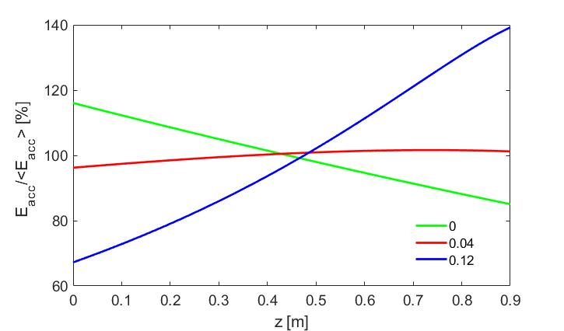
X BAND STRUCTURES: DESIGN OPTIMIZATION
The linear tapering angle has been chosen as a good compromise between high gradient performances (minimization of S_{c}), efficiency (maximization of the effective shunt impedance Rs) and beam dynamics (uniform accelerating field)
The input/output couplers racetrack geometries have been been optimized to completely cancel the quadrupole field components induced by the coupling holes
M. Diomede

Slide 14
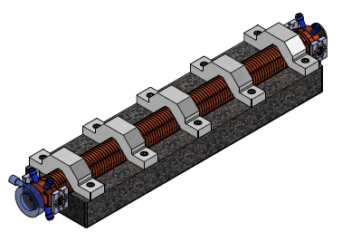
X BAND STRUCTURES: PROTOTYPING ACTIVITY
The mechanical drawing of the final X band structure is strongly related to the result of the prototyping activity: brazing test, cell to cell alignment, tuning-precision, etc...
We have identified the minimum prototype activity in three steps:
  Full scale mechanical prototype: to test the brazing process of the full structure and the cell-to-cell alignment we are able to achieve;
  Few cells-rf prototype for high power text: 10 cell prototype with input/output coupler to be tested at low and high power (tuning/no tuning,…);
  Final full scale structure.
  In the context of the I.FAST European project there is a Work Task on XLS-Compact light structure realization coordinated by G. D’Auria, to be fabricated in 2 years from May 2021. It is a structure very similar to the EuPRAXIA@SPARC_LAB one.
  Timeline: first few cells rf prototype for high power text ready by the beginning of 2022
Courtesy G. Di Raddo

Slide 15
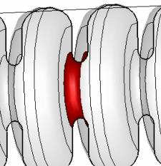
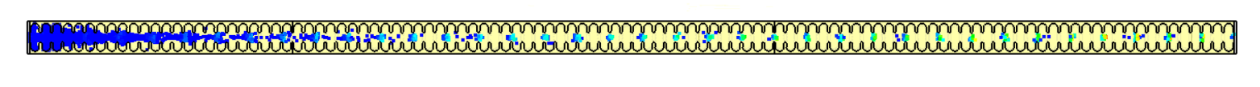
DARK CURRENT SIMULATIONS: SETUP
  The work has been done by F. Cardelli and is based on the work done at CERN by T. Lucas, D. B. Caballero and colleagues ([1],[2]).
  Dark current: field emitted electrons captured by the RF fields and transported up to the end of the structure. Its evaluation is necessary for radiation protection calculations for both EUPRAXIA@SPARC_LAB and TEX bunkers.
  General comment: the dark current strongly scales with accelerating field because to two effects:
      -decrease of the emitted current due to the lower surface field (emission effect);
      -decrease of the capture efficiency (capture process)
      Simulations have been done with CST studio (Eigenmode solver, PIC solver)
constants function of the metal work function
surface electric field
β = 30 (field enhancement factor)
Φ = 4.5 eV (work function)
CLIC style structure 24 cells
E_{acc} = 100 MV/m
EUPRAXIA@SPARC_LAB style structure 108 cells
E_{acc} = 60 MV/m
[1] T. G. Lucas, High Field Phenomenology in Linear Accelerators for the Compact Linear Collider, PhD Thesis, University of Melbourne, 2018
[2] D. B. Caballero et al., Dark current analysis at CERN, WEPRB059, Proceedings of IPAC2019, 2019

Slide 16
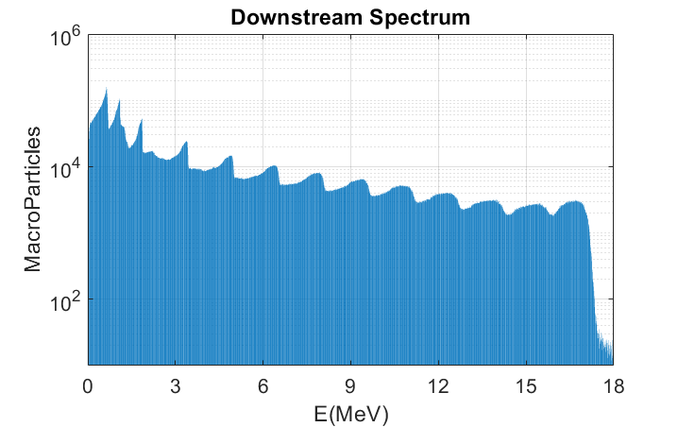
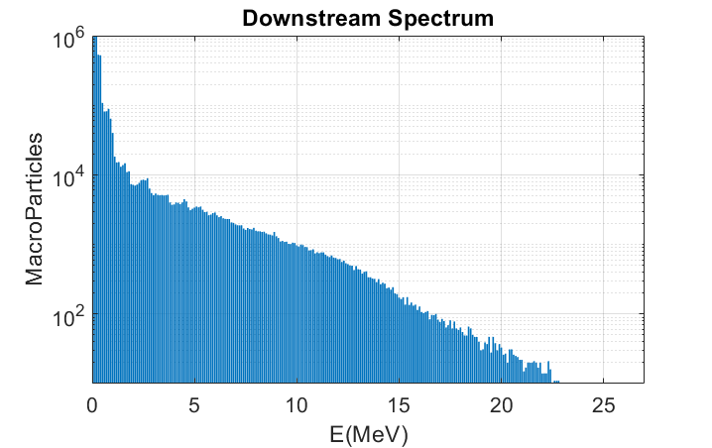

DARK CURRENT SIMULATIONS: RESULTS
CLIC Structure: 100MV/m, 24 cells (0.2m)
EUPRAXIA Structure: 60MV/m: 108 cells (0.9m)
      The CLIC case simulations have been replicated in order to found a scaling factor between CLIC and EUPRAXIA@SPARC_LAB structures thus evaluating the expected current directly scaling the current measured at the X-box test stands at CERN.
      We have considered in particular the downstream current.
F. Cardelli
$F=\frac{I_{avg}(EUPRAXIA)}{I_{avg}(CLIC)}≈1.3e^{−5}$
$$I_{meas}^{CLIC}≈1mA→I^{EUPRAXIA}≈10nA$$
The scaling factor found has been used to scale the CLIC measured dark current to the EUPRAXIA case
D. B. Caballero et al., IPAC2019, 2019

Slide 17
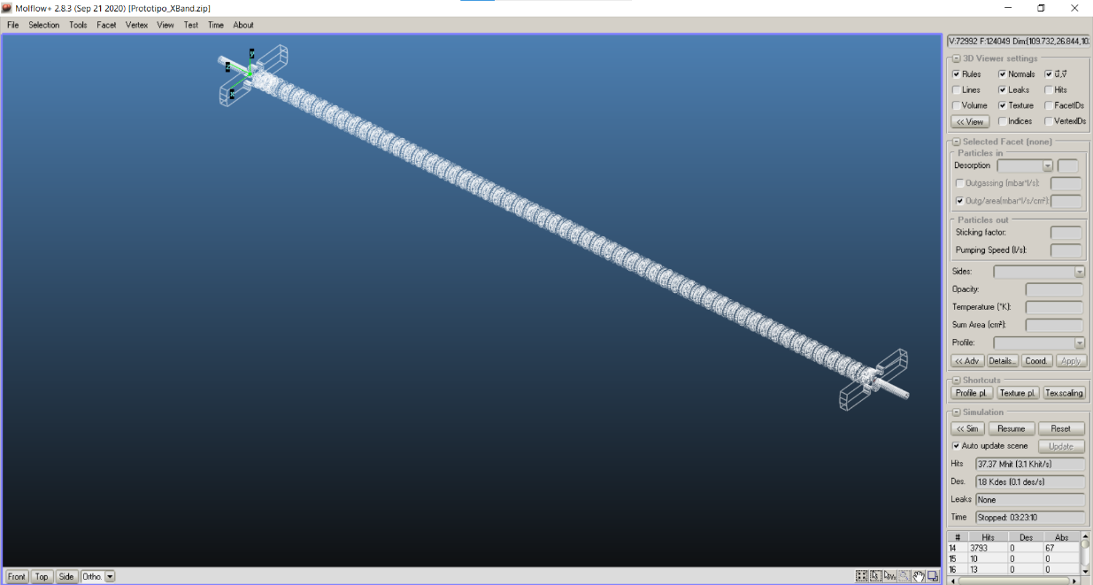

VACUUM PRESSURE CALCULATIONS
Vacuum pressure simulations have been done using Molflow (CERN).
To have a better control of the vacuum in the center of the structure, a dedicated chamber for vacuum treatment of accelerating structures after their construction/brazing is probably necessary to reduce the outgassing rate at levels below 10⁻¹² mbar l/s/cm²
$$\left[\frac{mbar∙l}{s∙ {cm}^{2}}\right]$$
A. Liedl

Slide 18
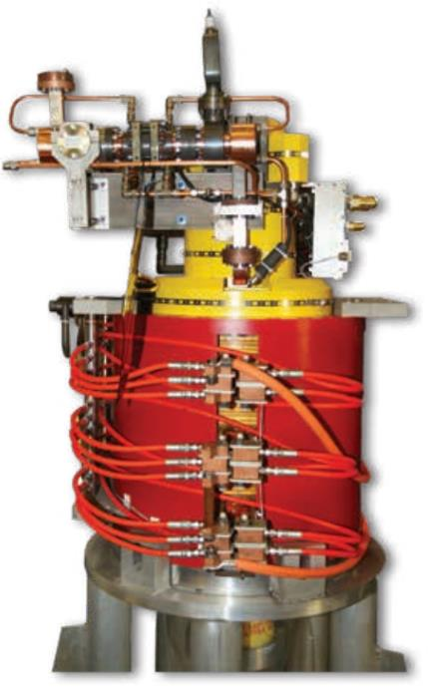
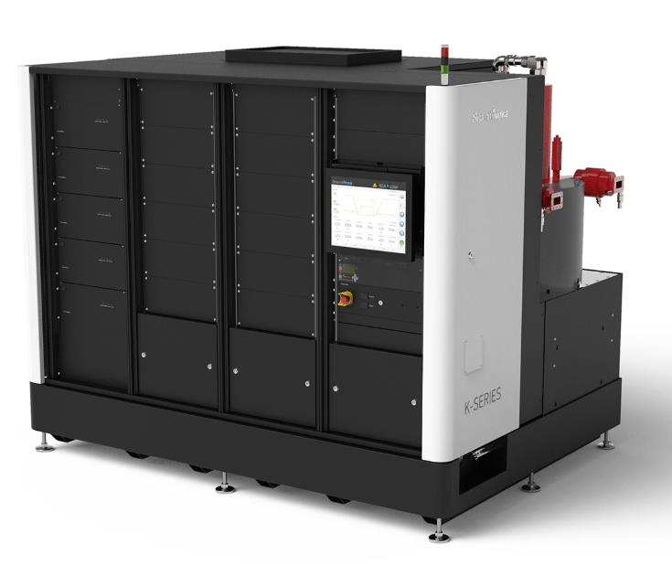
X-band RF power station
The X Band power station is based on CPI klystron and Scandinova Modulators
Reliable operation of the power source at full performances 100 Hz/50 MW needs to be verified and tested ⇒ it is necessary the acquisition of a nominal klystron+ 1 spare.
We also strongly support the R&D activity on high efficiency klystrons that has been done by CPI and CERN (we are considering the possibility to buy one high efficiency klystron instead of the “standard” one). This is important for several reasons:
    to reduce the required modulator power and HV
    To have more margin in term of peak power (>50MW)
    To increase the klystron lifetime
    To sustain the interest of the Industrial Companies (CPI,…) on this type of rf sources that are the base of our future LINAC.
Operational Parameters
RF frequency | GHz | 11.994
RF Peak Power | MW | 50
Gain | dB | 48
Modulator Peak Power | MW | 140
Operational voltage | kV | 420
Operational current | A | 320
PRF Range | Hz | 1-100
Pulse length (top) | us | 0.5 – 2
Top flatness | % | <±0.25
Pulse to pulse stability | ppm | <50
F. Cardelli, B. Buonomo
Total Number of X band klystrons: 6 (5 for the X band modules including injector and 1 for the RFD and linearizers this last waveguide system has to be still defined)
Klystron CPI VKX-8311A
Solid State Modulator Scandinova k400

Slide 19
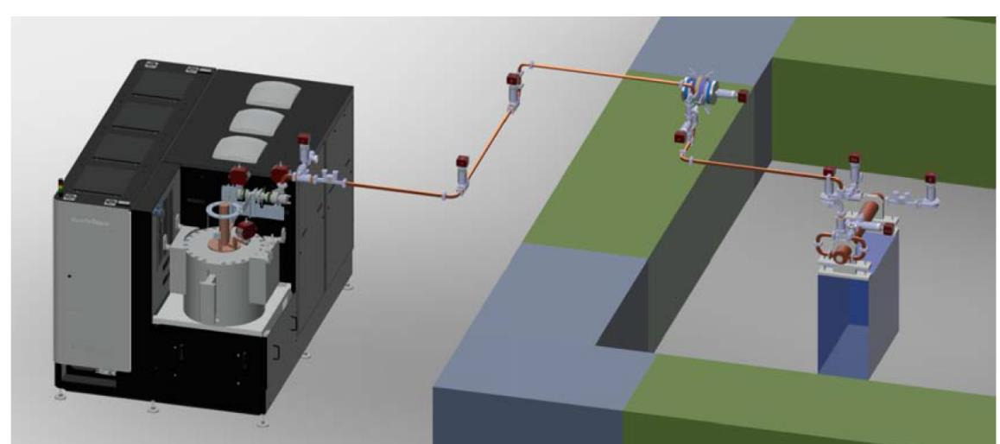
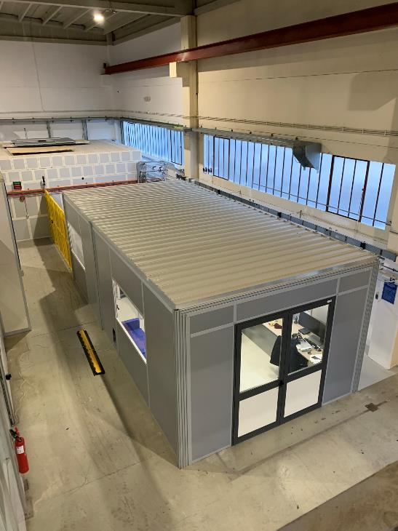
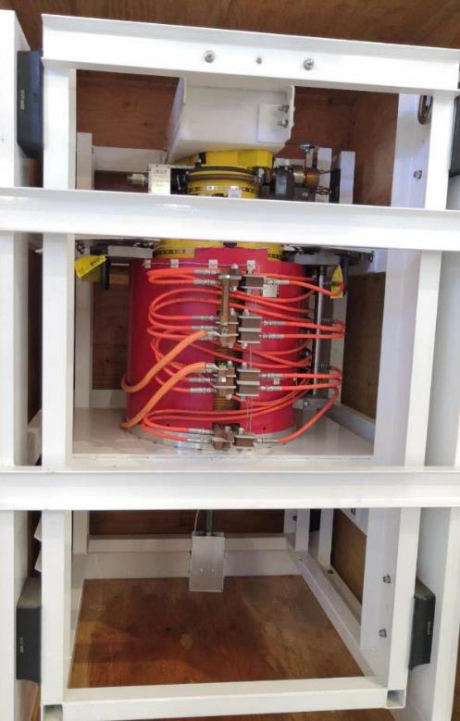
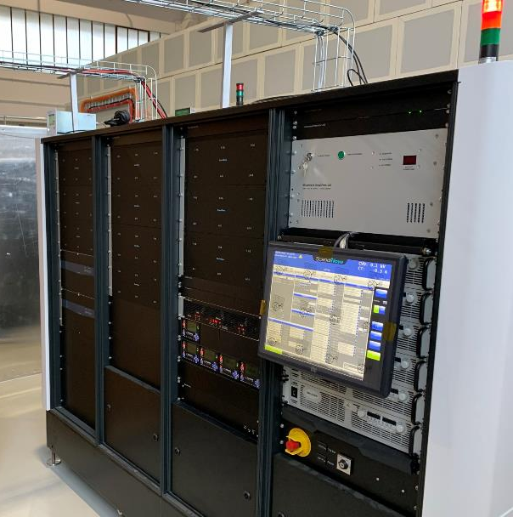
INFN-LNF X BAND TEXT FACILITY TEX ‐ TEst‐stand for X‐band
The TEX test stand (currently under implementation at LNF) has been conceived to test all the RF components and structures necessary for EuPRAXIA (including LLRF system, Vacuum, Control System,…);
It has been co-funded by the Regione Lazio in the framework of the LATINO project and, for this reason, will be also opened also to Enterprises that want to test at high power RF components
The setup of the test stand has been done in collaboration with CERN that provided the first CPI klystron and some waveguide component and will be also used to test CLIC structures.
klystron
Bunker
Courtesy S. Pioli, F. Cardelli, E. Di Pasquale
Modulator
TEX Control Room

Slide 20
CONCLUSIONS
EuPRAXIA@SPARC_LAB is the next INFN-LNF project: FEL radiation source based on RF linear accelerator (X band) combined with a plasma module. It is one pillar of the Eu project EUPRAXIA.
Injector: S band INFN-LNF based technology w/o brazing, possible interesting upgrades in C band in the framework of international collaborations (I.FAST, Compact Light, PSI activity)
X band module: has a flexible design, there are still several X band components to be tested at nominal power;
X band structures: e.m. design defined (including vacuum, dark current), the prototyping activity is in progress to arrive to the final design. Several synergies with international projects I.FAST and collaboration with CERN. There are, in principle, other possible technologies that can be used as the two halves (SLAC) and/or brazing free systems but this will go in parallel to a “standard” brazing design;
X band INFN-LNF TEX: extremely important facility to test all RF components and X band prototypes at the nominal power/gradient, there is the necessity to acquire a CPI klystron with the nominal parameters in term of power and rep. rate (preferably high efficiency klystron);

Slide 21
acknowledgementS
INFN: F. Cardelli, M. Diomede, L. Piersanti, M. Bellaveglia, S. Pioli, A. Gallo, A. Liedl, G. Di Raddo, V. Lollo, E. Di Pasquale, L. Pellegrino, B. Buonomo, C. Di Giulio, G. Castorina, A. Giribono, J. Scifo, C. Vaccarezza, A. Falone, M. Ferrario, A. Ghigo, A Cianchi, A. Stella, A. Vannozzi, L. Kankadze, A. Cianchi, A. Stella, B. Spataro, S. Incremona, U. Rotundo, A. Battisti, L. Sabbatini, A. Gizzi.
CERN: A. Grudiev, W. Wuensch, N. Catalan Lasheras, G. Mcmonagle, I. Syratchev, S. Stapnes, C. Rossi, T. Lucas, D. B. Caballero
SLAC: V. Dolgashev
TRIESTE: G. D’Auria
INFN ROMA: L. Ficcadenti, G. Pedrocchi
Regione Lazio: LATINO funding program
INFN COMMISSION V
THANK YOU!

