Slide 1
RFQ development at CERN field limit considerations and material study
Alexej Grudiev
20/04/2021

Slide 2
Outline
Introduction
Breakdowns and beam loss in RFQs: is there any connection?
Material Study for better high gradient performance in the presence of beam loss

Slide 3
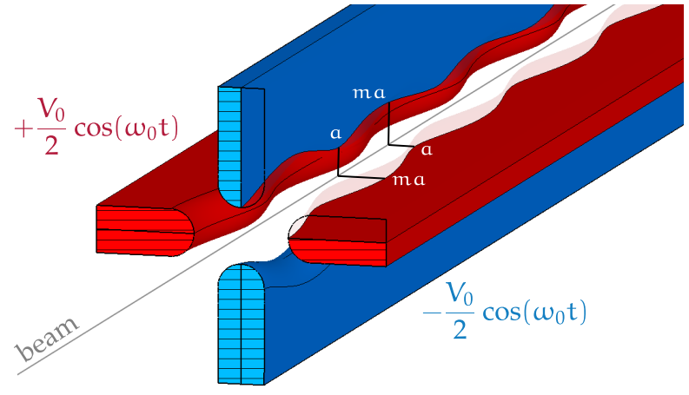
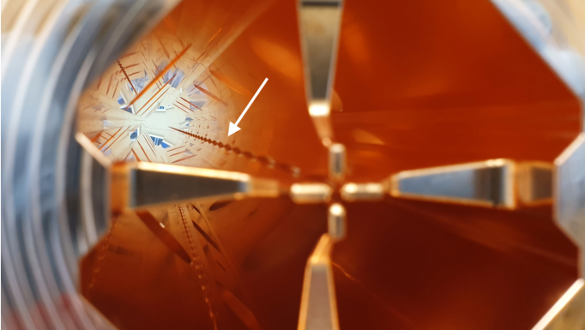
Very briefly: what is an RFQ?
accelerator of choice for low-energy hadrons up to few MeV/u
strong electric quadrupole focusing field
modulation on quadrupole electrodes produces Ez field
accepts continuous input beam from LEBT, performs adiabatic bunching
Hermann Pommerenke

Slide 4
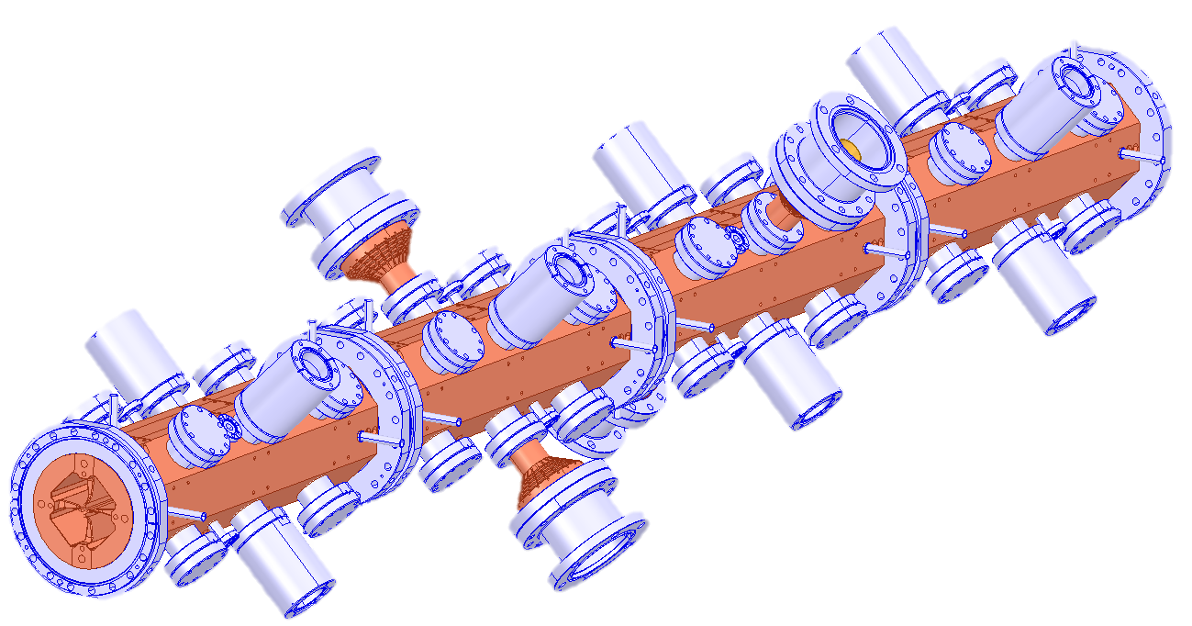
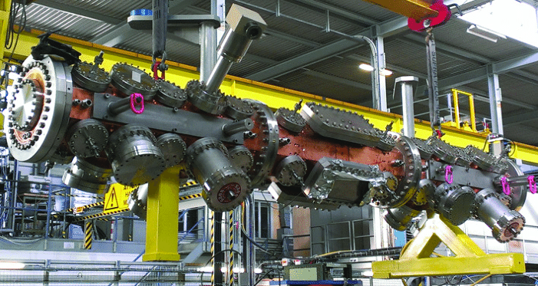
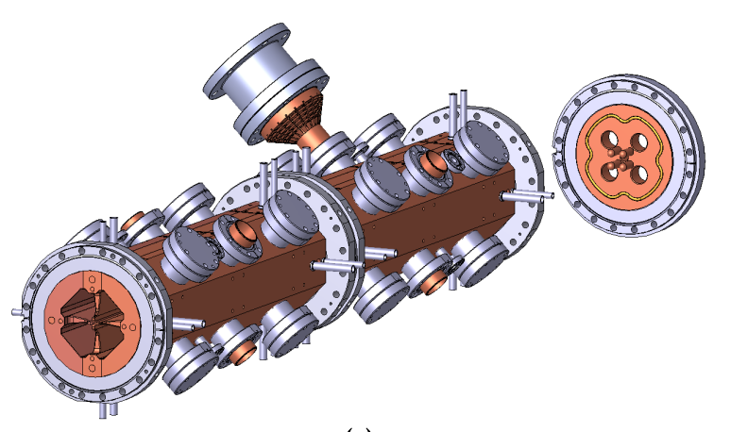
Recent RFQs developed at CERN
Hermann Pommerenke
older RFQs…
Linac4-RFQ 352 MHz 3 m
HF-RFQ 750 MHz 2 m
PIXE-RFQ 750 MHz 1 m
Carbon-RFQ 750MHz 4.8 m
C. Rossi et al., „Commissioning and operational experience gained with the Linac4-RFQ at CERN”, Proc. Linac14, 2014
operational, 2014
V = 78 kV
Es,max = 34 MV/m
= 1.8 Kilpatrick
commissioned 2018
V = 68 kV
Es,max = 51 MV/m
= 2 Kilpatrick
Beam dynamics & RF design completed early 2020, now mechanical design by CIEMAT
RF tuning complete 2020

Slide 5
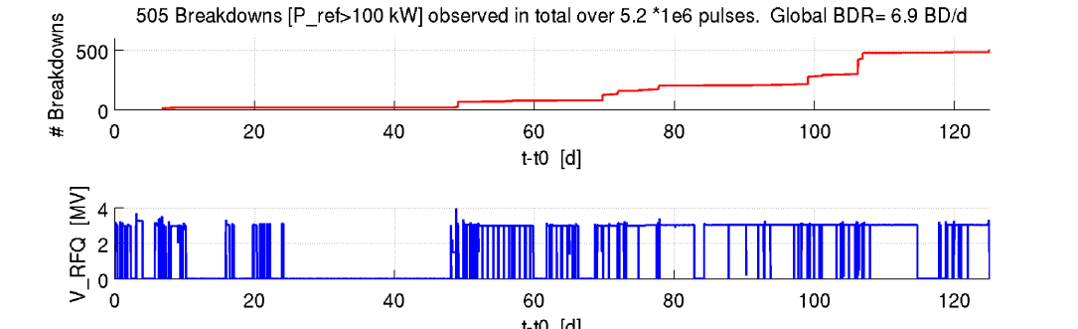
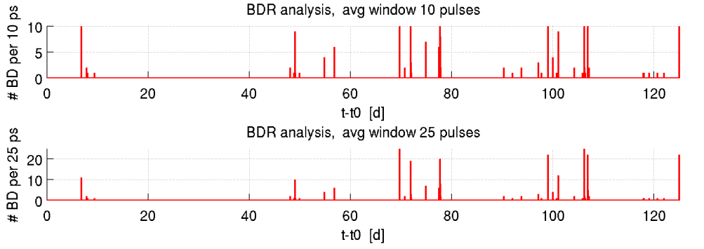
Breakdown rate (BDR) in RFQ
BDR: ~10⁻⁴
Surface field: ~35 MV/m
RF pulse 1 ms
Rep rate 1 Hz
Rolf Wegner

Slide 6
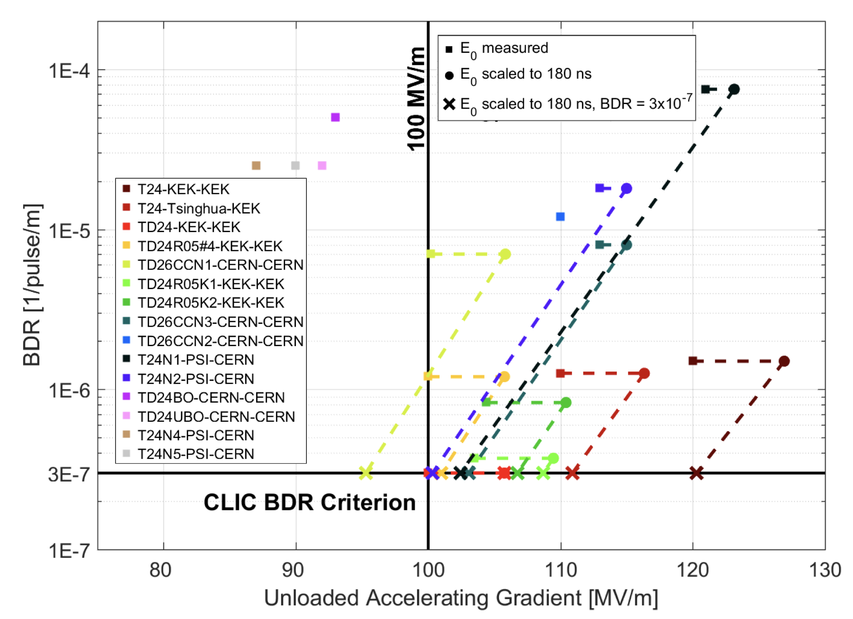
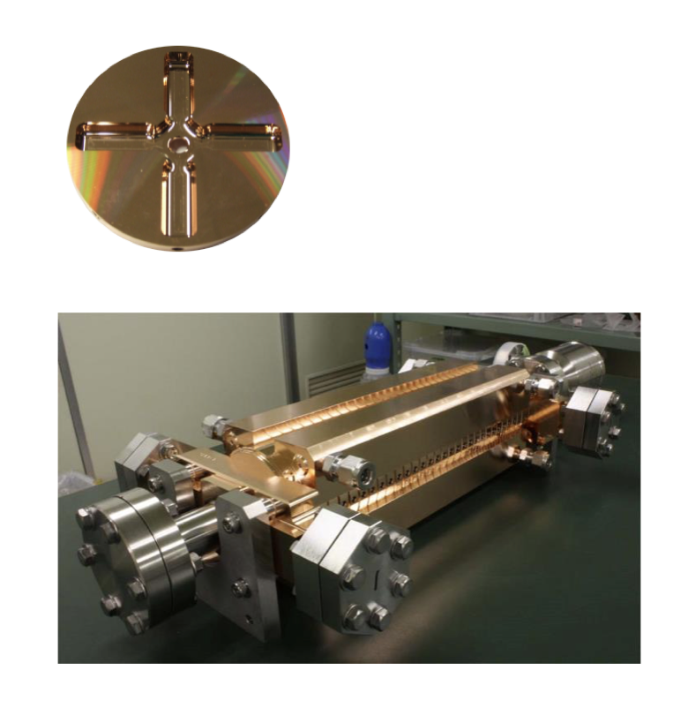
BDR in CLIC accelerating structures, a comparison
RF pulse 230 ns
Rep rate 50 Hz
W. Wuensch, S. Stapnes

Slide 7
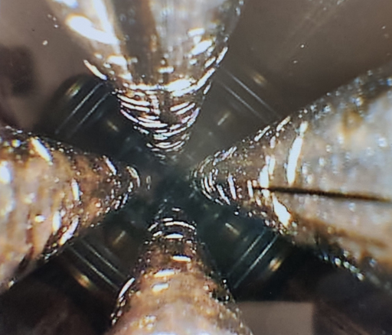
Damage from breakdowns
A replacement RFQ is being manufactured
Need to understand origin of enhanced breakdown rate, and find a mitigation
Could breakdowns be correlated with beam losses ?

Slide 8
Working Hypothesis
Possible chain of events for current L4-RFQ (maybe too pessimistic):
Few years consumable
L4-RFQ is designed for smaller beams from the source and Emax limit for no beam loss
RFQ is conditioned very fast to nominal voltage
RFQ operated with larger beams and suffered significant 25% beam loss
Beam loss -> blistering
Blistering, degrade high gradient performance --> more breakdowns
More breakdowns, more blisters, -> more surface erosion
L4-RFQ is dead => ‘long live’ L4-RFQ2
To break this chain two directions are proposed to be followed up within this WP:
Design an RFQ with 0% losses in high E-field area for given beam parameters using standard material and assembly: brazed OFE-Cu
Find alternative material which resists to blistering and is OK for RFQ fabrication. => Design RFQ with acceptable beam loss based on this material

Slide 9
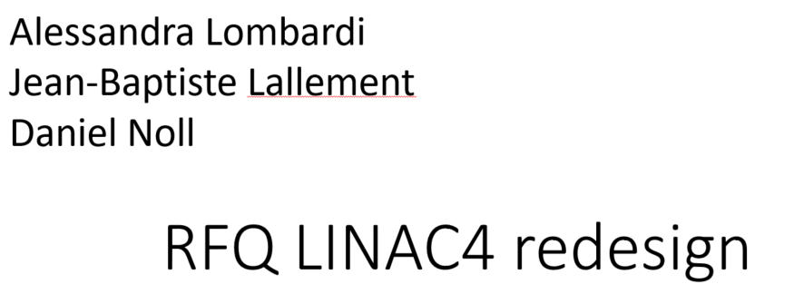
Link 1
https://indico.cern.ch/event/754020/
The design transmission is 95%
L4-RFQ is designed for smaller beams from the source and Emax limit for no beam loss

Slide 10
Link 2
Carlo Rossi
https://indico.cern.ch/event/754020/
RFQ is conditioned very fast to nominal voltage
410 kW => 78.3 kV => 34 MV/m
RFQ went up to 480 kW in 2 weeks!

Slide 11
Link 3
Alessandra Lombardi Jean-Baptiste Lallement and Magdalena Kaja
10 march 2020
https://indico.cern.ch/event/895036/
RFQ operated with larger beams and suffered significant beam loss of 25%

Slide 12
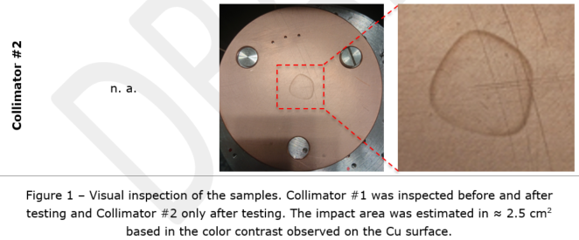
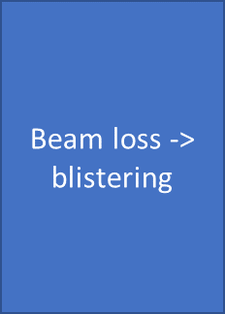
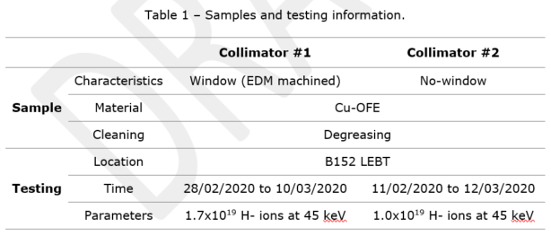
Link 4
1e19 H-
/ 2.5cm^2
= 4e18 H-/cm^2

Slide 13
Links 5, 6
In order to characterize and understand the impact of the beam induced damage on the high gradient performance of the L4-RFQ it has been proposed to used high voltage DC breakdown test setup at CERN in combination with irradiation in the H- source test stand
This needs to be verified
Blistering, degrade high gradient performance --> more breakdowns
More breakdowns, more blisters, -> more surface erosion

Slide 14
Connection between L4-RFQ and DC setup
Electric field distribution for V=1V
DC pulses, 500 ns to 100 µs, voltages up to 10 kV with gap range of 20 to 100 µm and repetition rate of up to 3 kHz.
78.3 kV => 34 MV/m

Slide 15
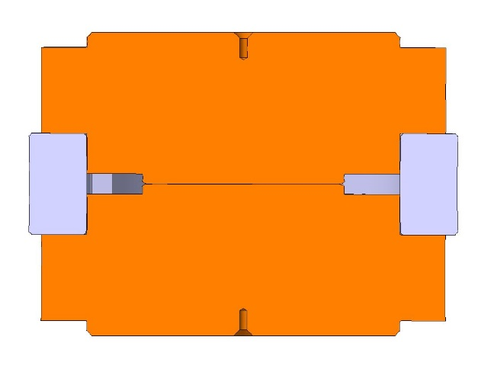
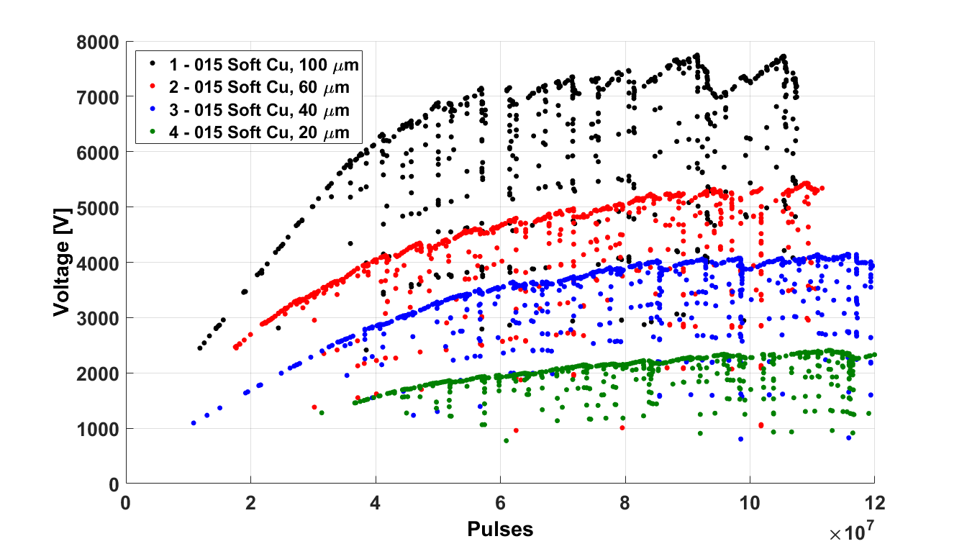
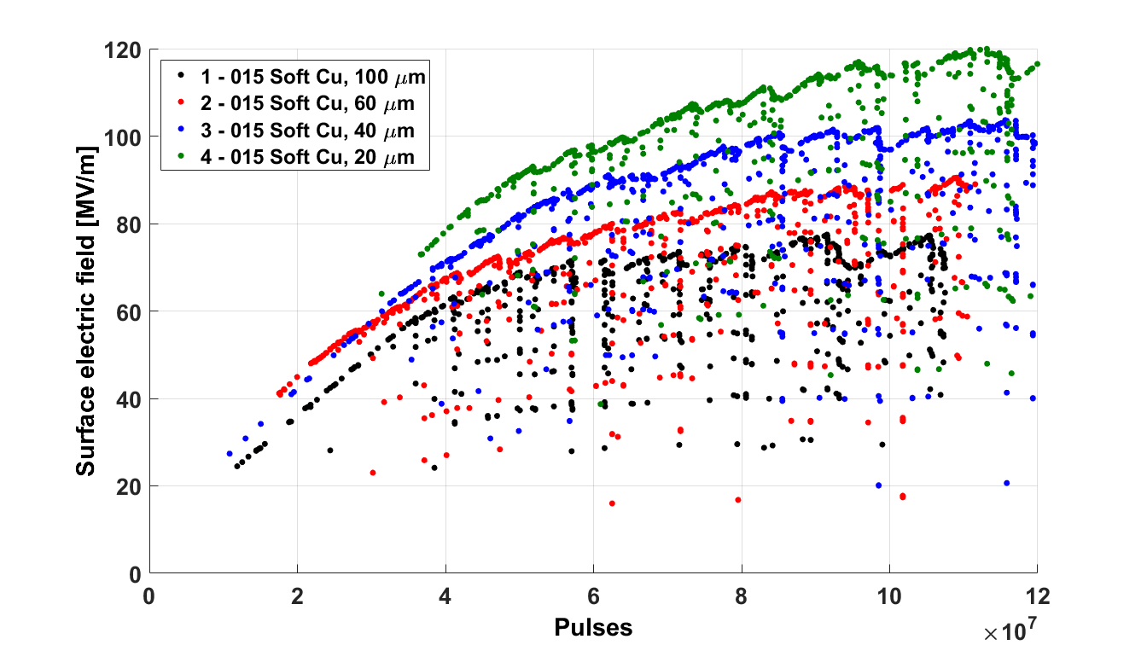
Gap dependency
$$E=\frac{V}{d}$$
I. Profatilova

Slide 16
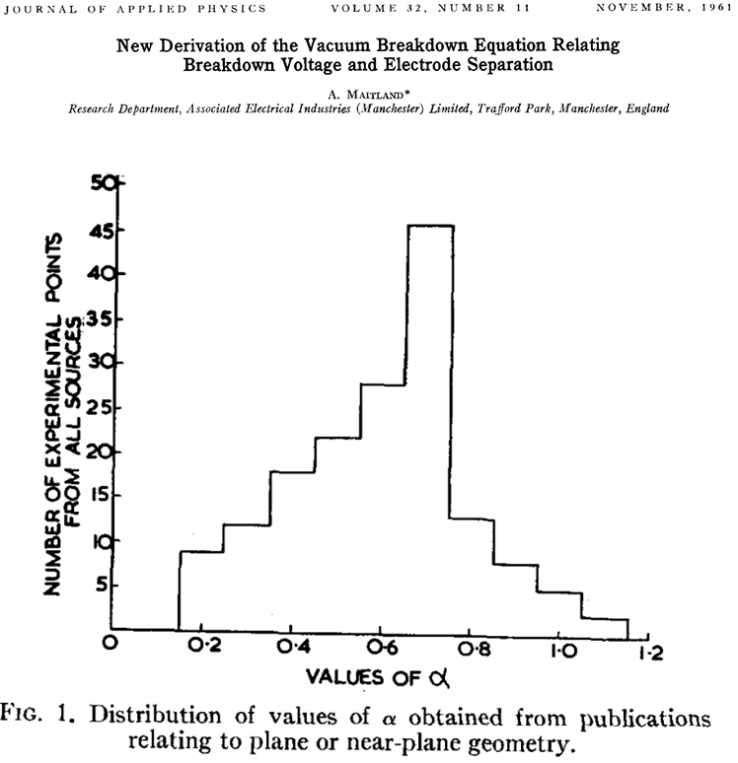
Voltage vs surface E-field scaling law in DC gaps
$$E_{norm}=\left(\frac{V}{V_{max}}\right)×{\left(\frac{d_{max}}{d}\right)}^{0.72}$$
$$V_{max}=7747 V$$
$$d_{max}=100 μm$$
In, https://indico.cern.ch/event/774570/
Walter suggested that this scaling might be relevant not only for DC gap systems abut also for RFQs

Slide 17
Making one step further gives the connection: L4-RFQ <-> DC setup
$$E_{norm}=\left(\frac{V}{V_{max}}\right)×{\left(\frac{d_{max}}{d}\right)}^{0.72}$$
$$V_{max}=7747 V$$
$$d_{max}=100 μm$$
V = 78.3 kV;
Es = 34 MV/m
d = V/Es
=>
Enorm = 1.05

Slide 18
„Gap scaling“ for RFQs
Hermann Pommerenke
$E_{norm}=\frac{V}{V_{DC}}⋅{\left(\frac{d_{DC}}{d}\right)}^{0.7}$
d = V/E_{max}
where
V = max. measured inter-vane voltage E_{max} = max. measured surface field
V_{DC} = 7747 V, d_{DC} = 100 µm from DC experiment
Kilpatrick limit: A CRITERION FOR VACUUM SPARKING DESIGNED TO INCLUDE BOTH R.F. AND D.C (escholarship.org)

Slide 19
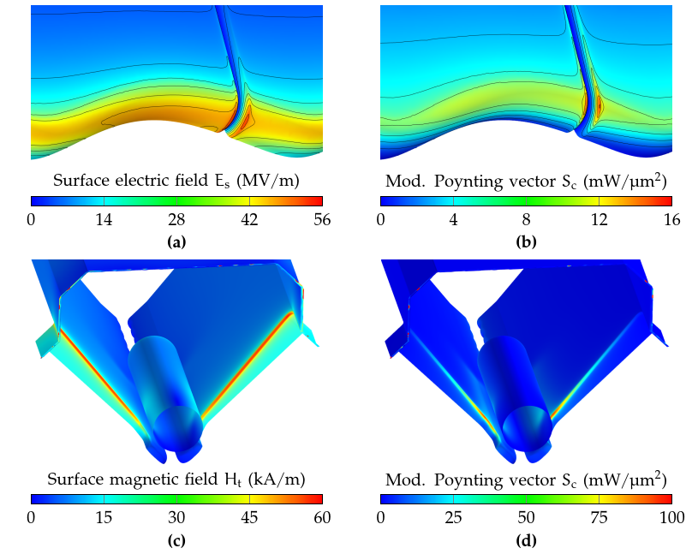
What about Sc and RF pulsed heating? (HF-RFQ)
Emax on vane tip (2.0 Kilpatrick)
small hotspot on inter-module gap
(2.2 Kilpatrick)
Es,max = 50 MV/m
Sc maximum is not on vane, i.e. not in location of breakdowns
E & H are well-separated in RFQ
Sc maximum is located on undercut edge next to dipole rod
not critical either, scaled threshold at 20 us: 860 mW/um²
Hmax on vane undercut edge resulting pulsed heating:
ΔT = 1.8 K (critical: 40K)
Hermann Pommerenke

Slide 20
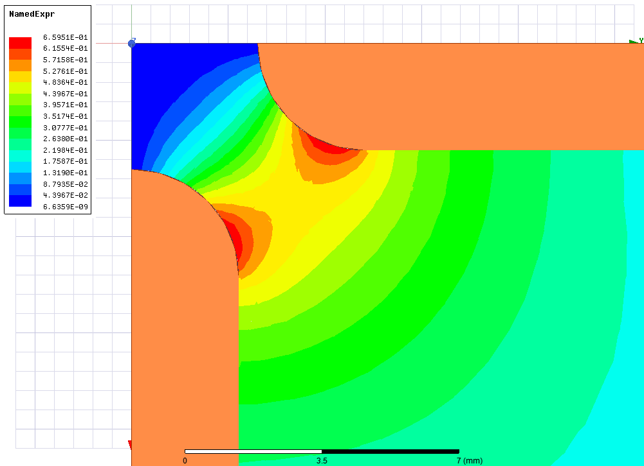
L4-RFQ: E-field and Sc (2D)
E-field [MV/m] for V=1V
Sc [W/m^2] for V=1V
V | 1 V | 78.27 kV
E-field | 394 V/m | 30.8 MV/m
Sc | 0.66 W/m² | 0.004 MW/mm²
Sc limit scaled to 200us: 4(200ns/200us)^1/3 = 0.4 MW/mm²

Slide 21
Summary on the high-power RF constraints for CLIC X-band RF structure design (2013)
RF breakdown and pulsed surface heating constraints used for CLIC_G design (2007):
E_{s}^{max} < 250 MV/m
P_{in}/C_{in}·(t_{p}^{P})^{1/3} = 18 MW·ns^{1/3}/mm
dT^{max}(H_{s}^{max}, t_{p}) < 56 K
The high gradient X-band limits do not apply to RFQs
Optimistic RF breakdown and pulsed surface heating constraints for BDR=10⁻⁶ bpp/m:
E_{s}^{max} ·(t_{p}^{P})^{1/6} < 250 MV/m · (200ns)^{1/6}
P_{in}/C_{in}·(t_{p}^{P})^{1/3} < 2.8 MW/mm · (200ns)^{1/3} = 17 [Wu]
S_{c}^{max} ·(t_{p}^{P})^{1/3} < 5 MW/mm² · (200ns)^{1/3}
and
dT^{max}(H_{s}^{max}, t_{p}) < 50 K
200 MV/m
4 MW/mm²
40 K
20% margin
Update on the analysis of the high-power test results (cern.ch)

Slide 22
Material study

Slide 23
How to limit hydrogen bubble formation
Criteria for material choice I:
Material strength larger than copper
Reduced dislocation movement
Presence of trapping centers for hydrogen to prevent coalescence
Criteria for material choice II:
Hydrogen solution must be energetically favorable
Hydrogen must have high diffusivity at room temperature
Hydrogen solubility limit must be high
Selected material candidates:
Cu-OFE (reference), CuCr₁Zr, CuBe, Nb, β-Ti-6Al-4V, Ta
(electrical conductivity is not a primary concern for RFQ vanes)

Slide 24
Irradiation
Anite Perez Fontenla

Slide 25
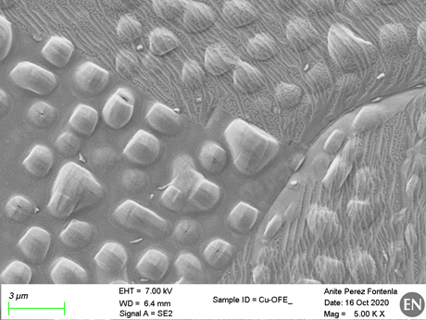
Cu-OFE: H- source
Anite Perez Fontenla

Slide 26
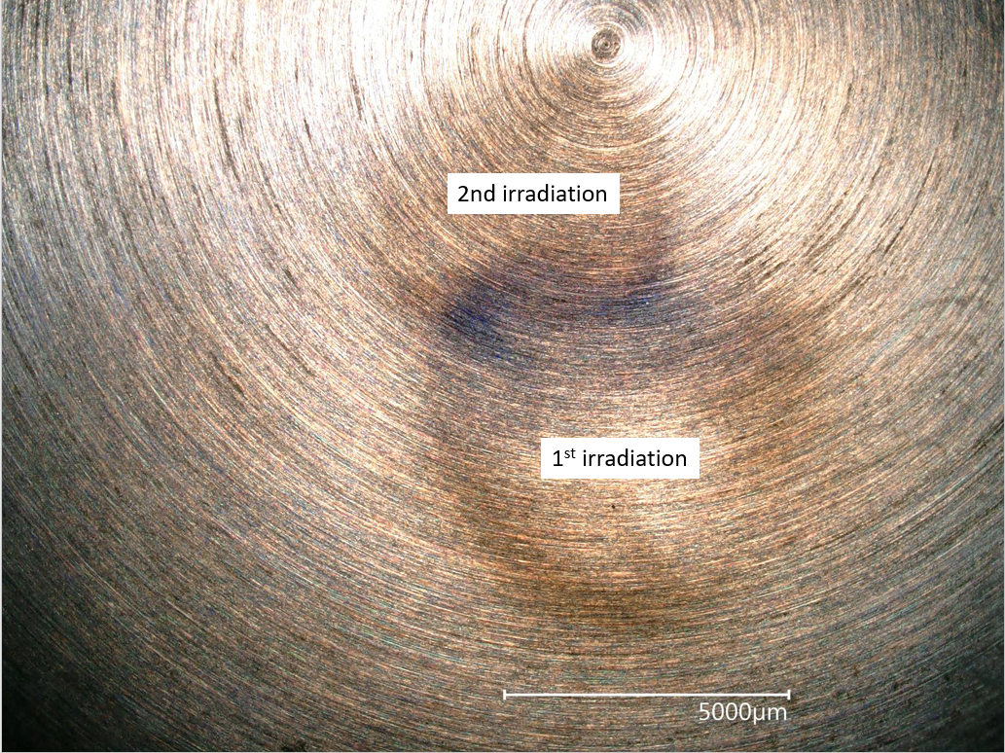
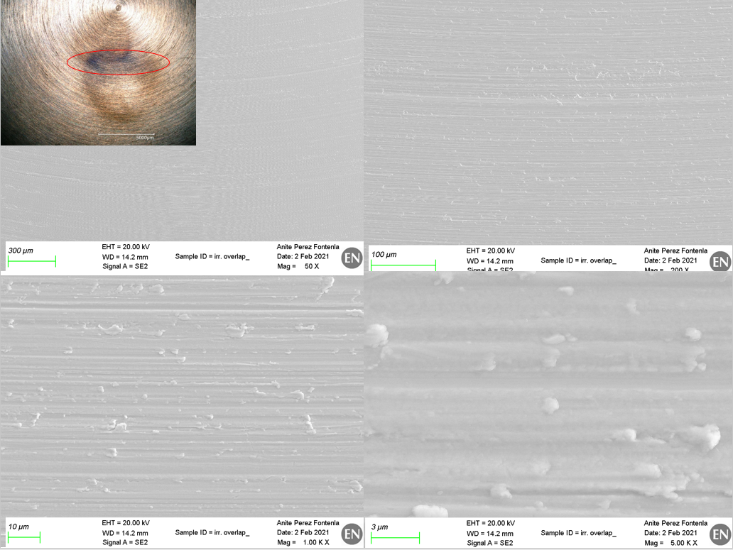
Nb: H- source
Anite Perez Fontenla

Slide 27
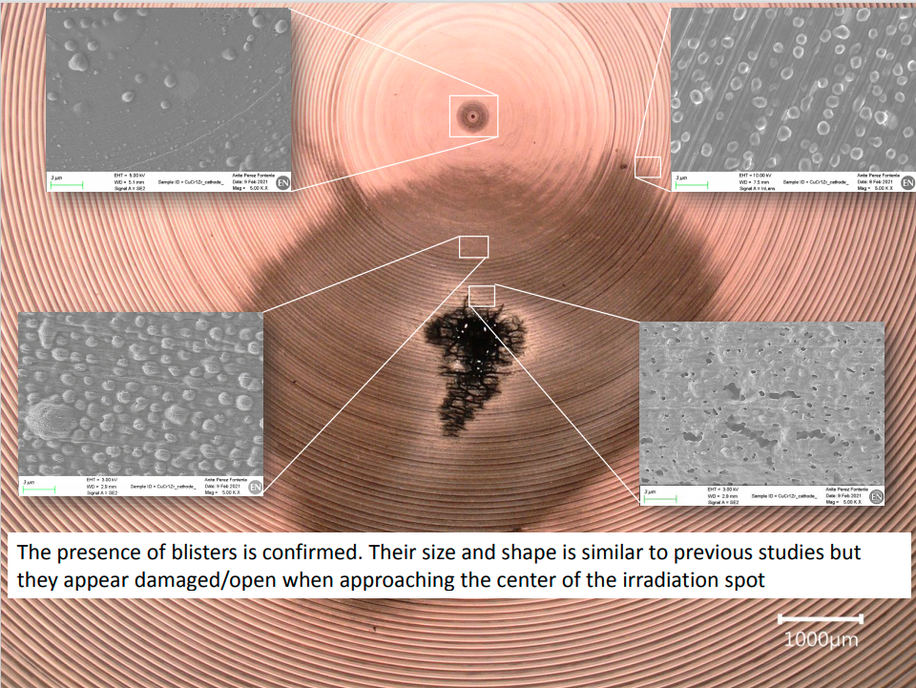
CuCrZr: H- source
Anite Perez Fontenla

Slide 28
Irradiation summary table
 | Materials | Dose [1E18p/cm^2] | Energy [keV/H] | Particle type | Angle of incidence [deg] | Blisters
Collimator test | OFE-Cu | 4 | 45 | H- | 90 | YES
L4-RFQ operation | Annealed OFE-Cu | 200 | 45 - 500 | H- | 10 - 90
Electrode irradiation | Annealed OFE-Cu | 12 - 24 | 45 | H- | 90 | YES
Helsinki samples Batch #1 | OFE-Cu; CuCrZr; Nb; Ti6Al4V | 1, 4 | 45 | H2+ | 90 | YES: OFE-Cu; CuCrZr; NO: Nb; Ti6Al4V
Electrode irradiation | Nb | ~20 = 4.9p / 0.24cm^2 | 45 | H- | 90 | NO (no SEM yet)
Electrode irradiation | CuCrZr1 | ~20 = 9.8p / 0.44cm^2 ~40 = 9.8p / 0.22cm^2 (only central dark spot) | 45 | H- | 90 | YES

Slide 29
Ruth Peacock

Slide 30
Cu-OFE
Ruth Peacock

Slide 31
Cu-OFE
Ruth Peacock

Slide 32
Ruth Peacock

Slide 33
Ruth Peacock

Slide 34
Acknowledgements to people whose materials have been used
Sergio Calatroni
Anite Perez Fontenla
Alessandra Lombardi
Ruth Peacock
Hermann Pommerenke
Carlo Rossi
Walter Wuensch
Thank you !

Slide 35
Spare slides

Slide 36
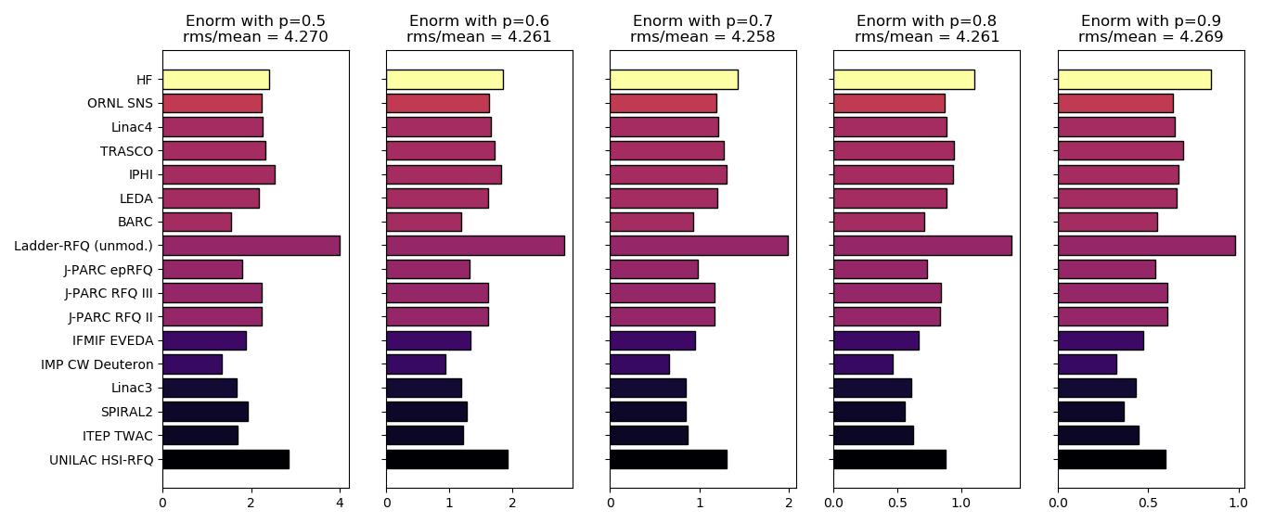
Different exponents for gap term
$E_{norm}=\frac{V}{V_{DC}}⋅{\left(\frac{d_{DC}}{d}\right)}^{p}$

Slide 37
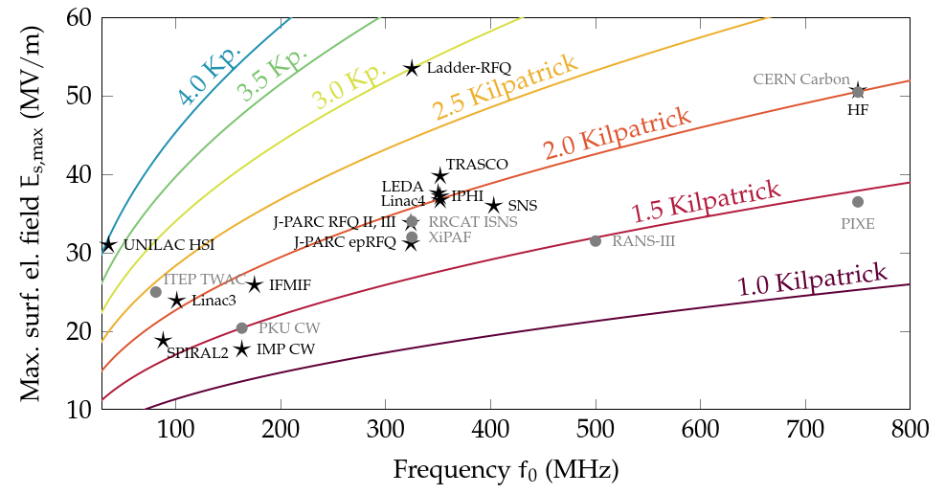
RFQs worldwide – Kilpatrick criterion
Kilpatrick criterion is used for most RFQ developments (common design choices CW-RFQ: <=1.8 Kp, pulsed RFQ: <=2.0 Kp)
but: during commissioning: more can often be achieved:
experiment
design
Hermann Pommerenke

Slide 38
Cu-OFE: Helsinki

Slide 39
Nb and Ti6Al4V: Helsinki

Slide 40
CuCrZr: Helsinki

